Slide 1
1
EDELWEISS HACKATHON 2023
OPTIONS CHAIN TOOL
Group Members
Leader - Siddhesh Sanghavi (16010420064)
Mayank Pujara (16010420057)
Dev Mehta (16010420046)
Hardik Singh (16010420050)
Hardik Jain (16010420053)

Slide 2
2
2
PROBLEM STATEMENT
Develop a real-time options chain screen that analyzes market data stream over TCP/IP packets and calculates various metrics, including implied volatility (IV), for various options contracts and update the option chain web-page data in real time without the need to refresh.
The option chain will be displayed as a webpage, much as platforms like the option chain for NSE India. On the selection of underlying and different expiries, the webpage updates accordingly

Slide 3
REQUIREMENTS
3
System Requirement:
Quad core machine
8 GB RAM
100 GB free disk space.
Windows(Windows10/11)/Linux(Ubuntu 22.04/23.04)
General Requirements:
Basic knowledge about Options: Calls and Puts.
Conceptual understanding about Implied Volatility and methods to calculate it.
General idea of the market data and its data structure.

Slide 4
TECHNOLOGIES USED
4
Frontend:
Backend:
Core packages used:
SQLalchemy
Flask
Flaskrestful
Flask_sqlalchemy
Celery
Supporting Packages Used:
Flask_cors
Os
Re
Numpy
subprocess
ReactJS
React-bootstrap
React-redux
HTML
CSS
Database Used:
SQLite3

Slide 5
APPROACH FOLLOWED
5
Frontend:
The system was first designed in Figma keeping in mind the User Experience . The aim was to keep the UI of our system clean and as clear as possible for the users.
We have used the ReactJS framework for the frontend of our system. We have chosen ReactJS for our system as it has a vast ecosystem of libraries which extends the capabilities of our system.
React- bootstrap was used as the CSS framework for the UI. It combines the power of React.js and the Bootstrap framework. It leverages the flexibility and modularity of ReactJS to create components that seamlessly integrate with the React ecosystem.
React Hooks were used mainly for fetching the data from database using API. When fetching data from a database, we typically need to handle the state of the fetched data. With React Hooks, this process becomes more streamlined and real-time.

Slide 6
APPROACH FOLLOWED
6
Backend:
The first step is to retrieve the data which is being generated. We have determined the APIs from which we will be able to fetch the options data. Once this data is retrieved, we have parsed it and extracted the necessary information from the response. After this, we have established a connection to the database where the options data will be stored. We have used SQLite as our database.
The second step is to create the API for frontend usage. We have identified the needs of the frontend system and identified the operations that frontend requires from the backend. This includes fetching the data, performing calculations and other functionalities required by the frontend.
The third step is the Creation of asynchronous tasks which removes the expired options and future entries from the database in the background of the ongoing tasks without the need of any manual starting process.

Slide 7
SYSTEM DESIGN
7
A program runs on one of the servers which takes the input data of the updated stock option and futures. It the reshapes and segregates this data in the right format to be added or updated into the database.
Another program runs on a different server to cater the requests of the front-end made through it's API. It catches the API call which is made, executes the function corresponding to that API and returns that data to the frontend.
If no options are changed on the front-end for the data the users wants to view the last relevant API request is sent every second from the front-end to get the real-time for the web-page.
A asynchronous process is initiated at 15:16:00 everyday on the redis-server in the background which looks out for the entries whose expiry is set to that day on 15.15 and then it eliminates it. Hence removing the redundant data from the database.

Slide 8
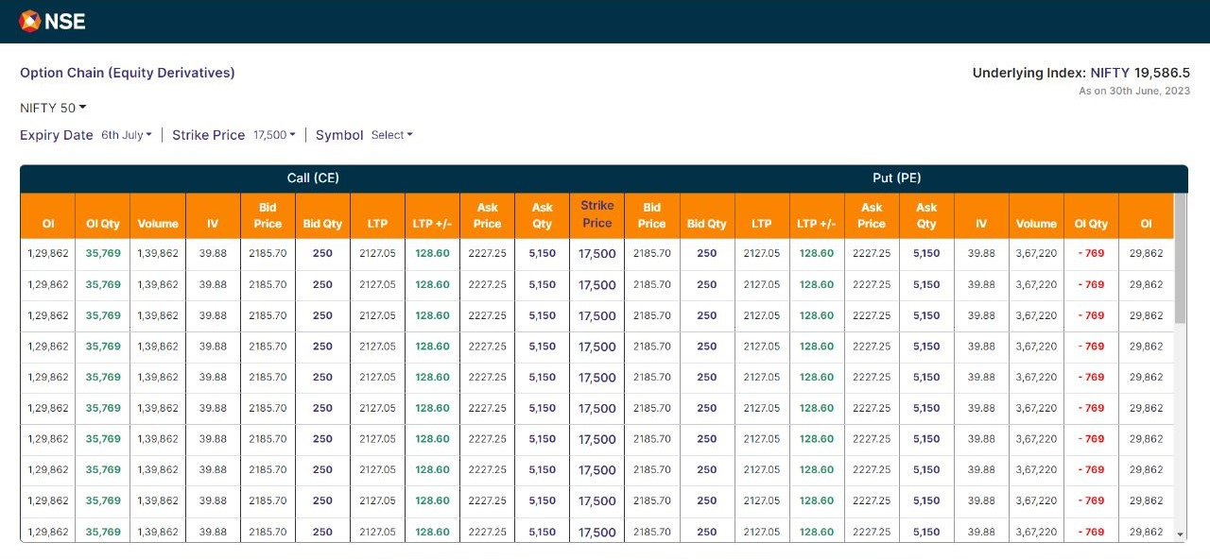
WIREFRAME OF OUR SYSTEM
8

Slide 9
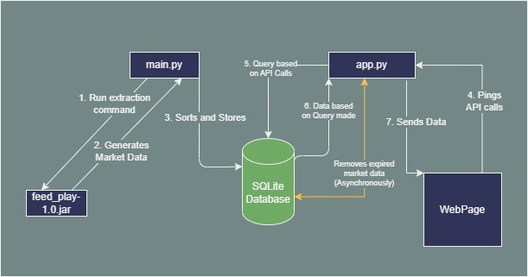
PROGRAM FLOW
9

Slide 10
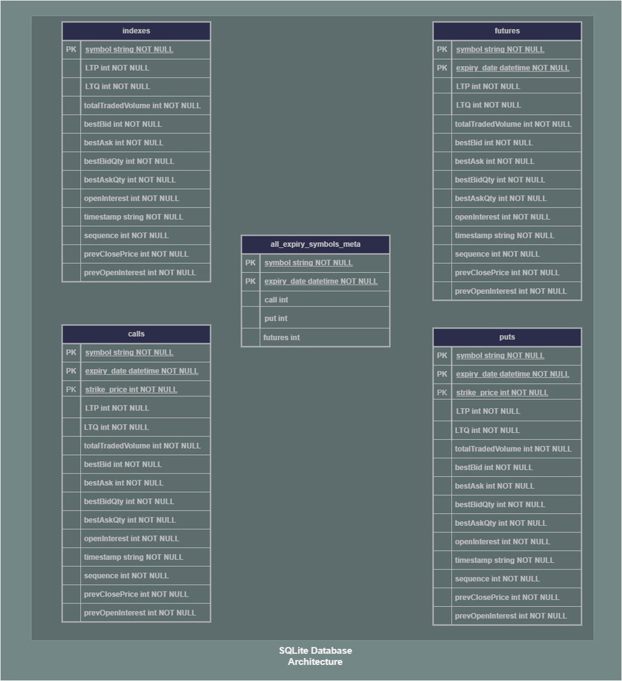
DATABASE ARCHITECTURE
10

Slide 11
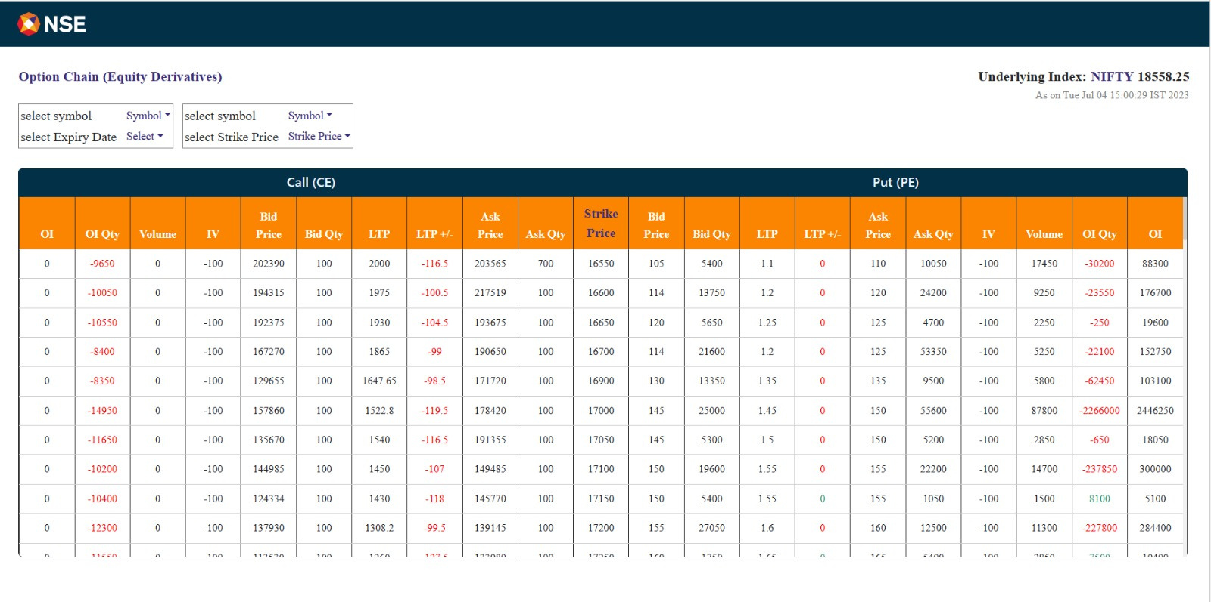
FINAL RESULTS
11
WebPage

Slide 12
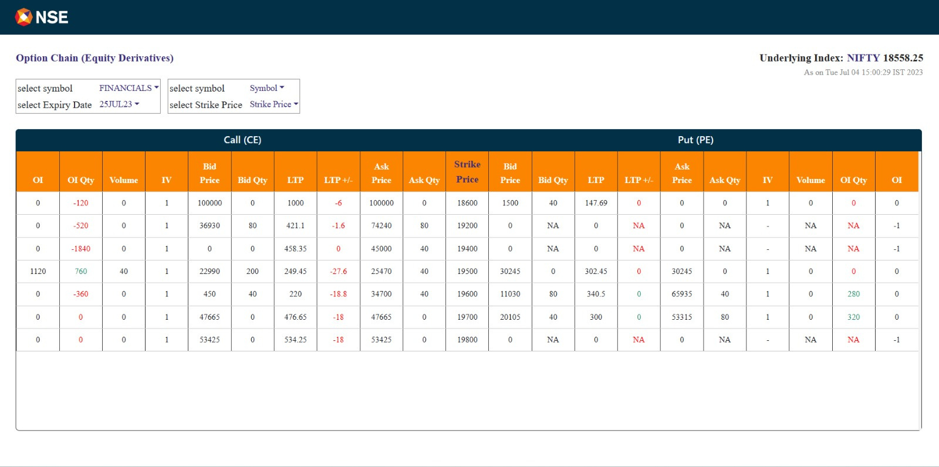
FINAL RESULTS
12
Showing Data for FINANCIALS with Expiry Date: 25JUL23

Slide 13
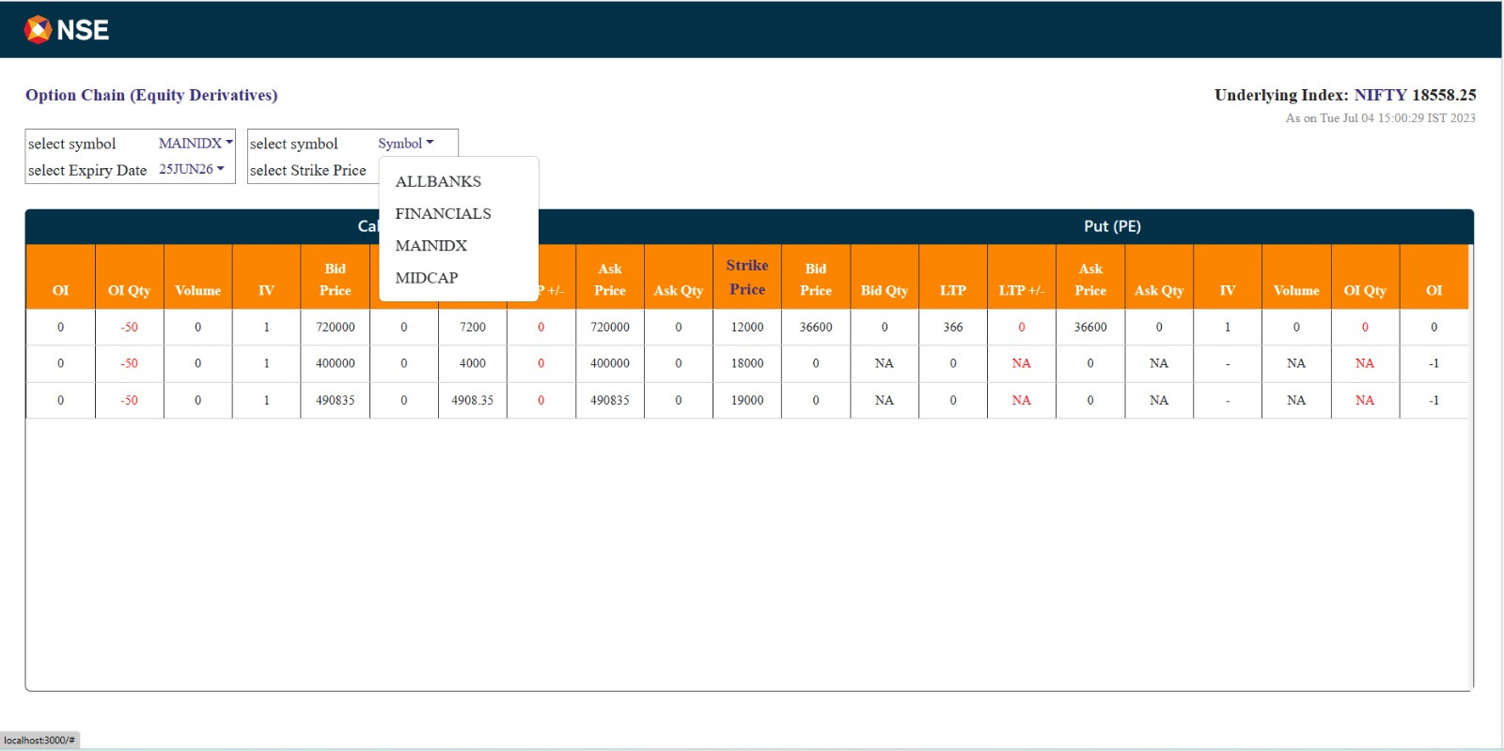
FINAL RESULTS
13
Drop Down Menu to filter based on various options

Slide 14
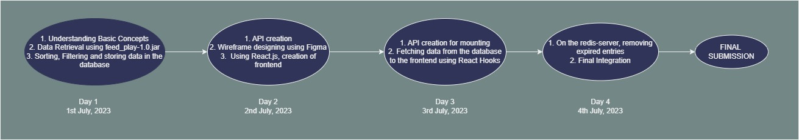
IMPLEMENTATION SCHEDULE
14

Slide 15
THANK YOU!

