Slide 1



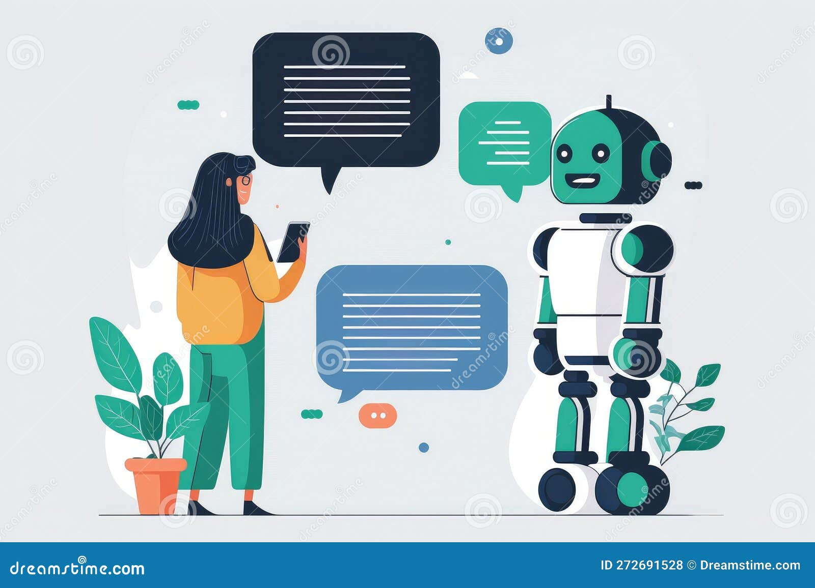
Chatbot Using NLP

Slide 2
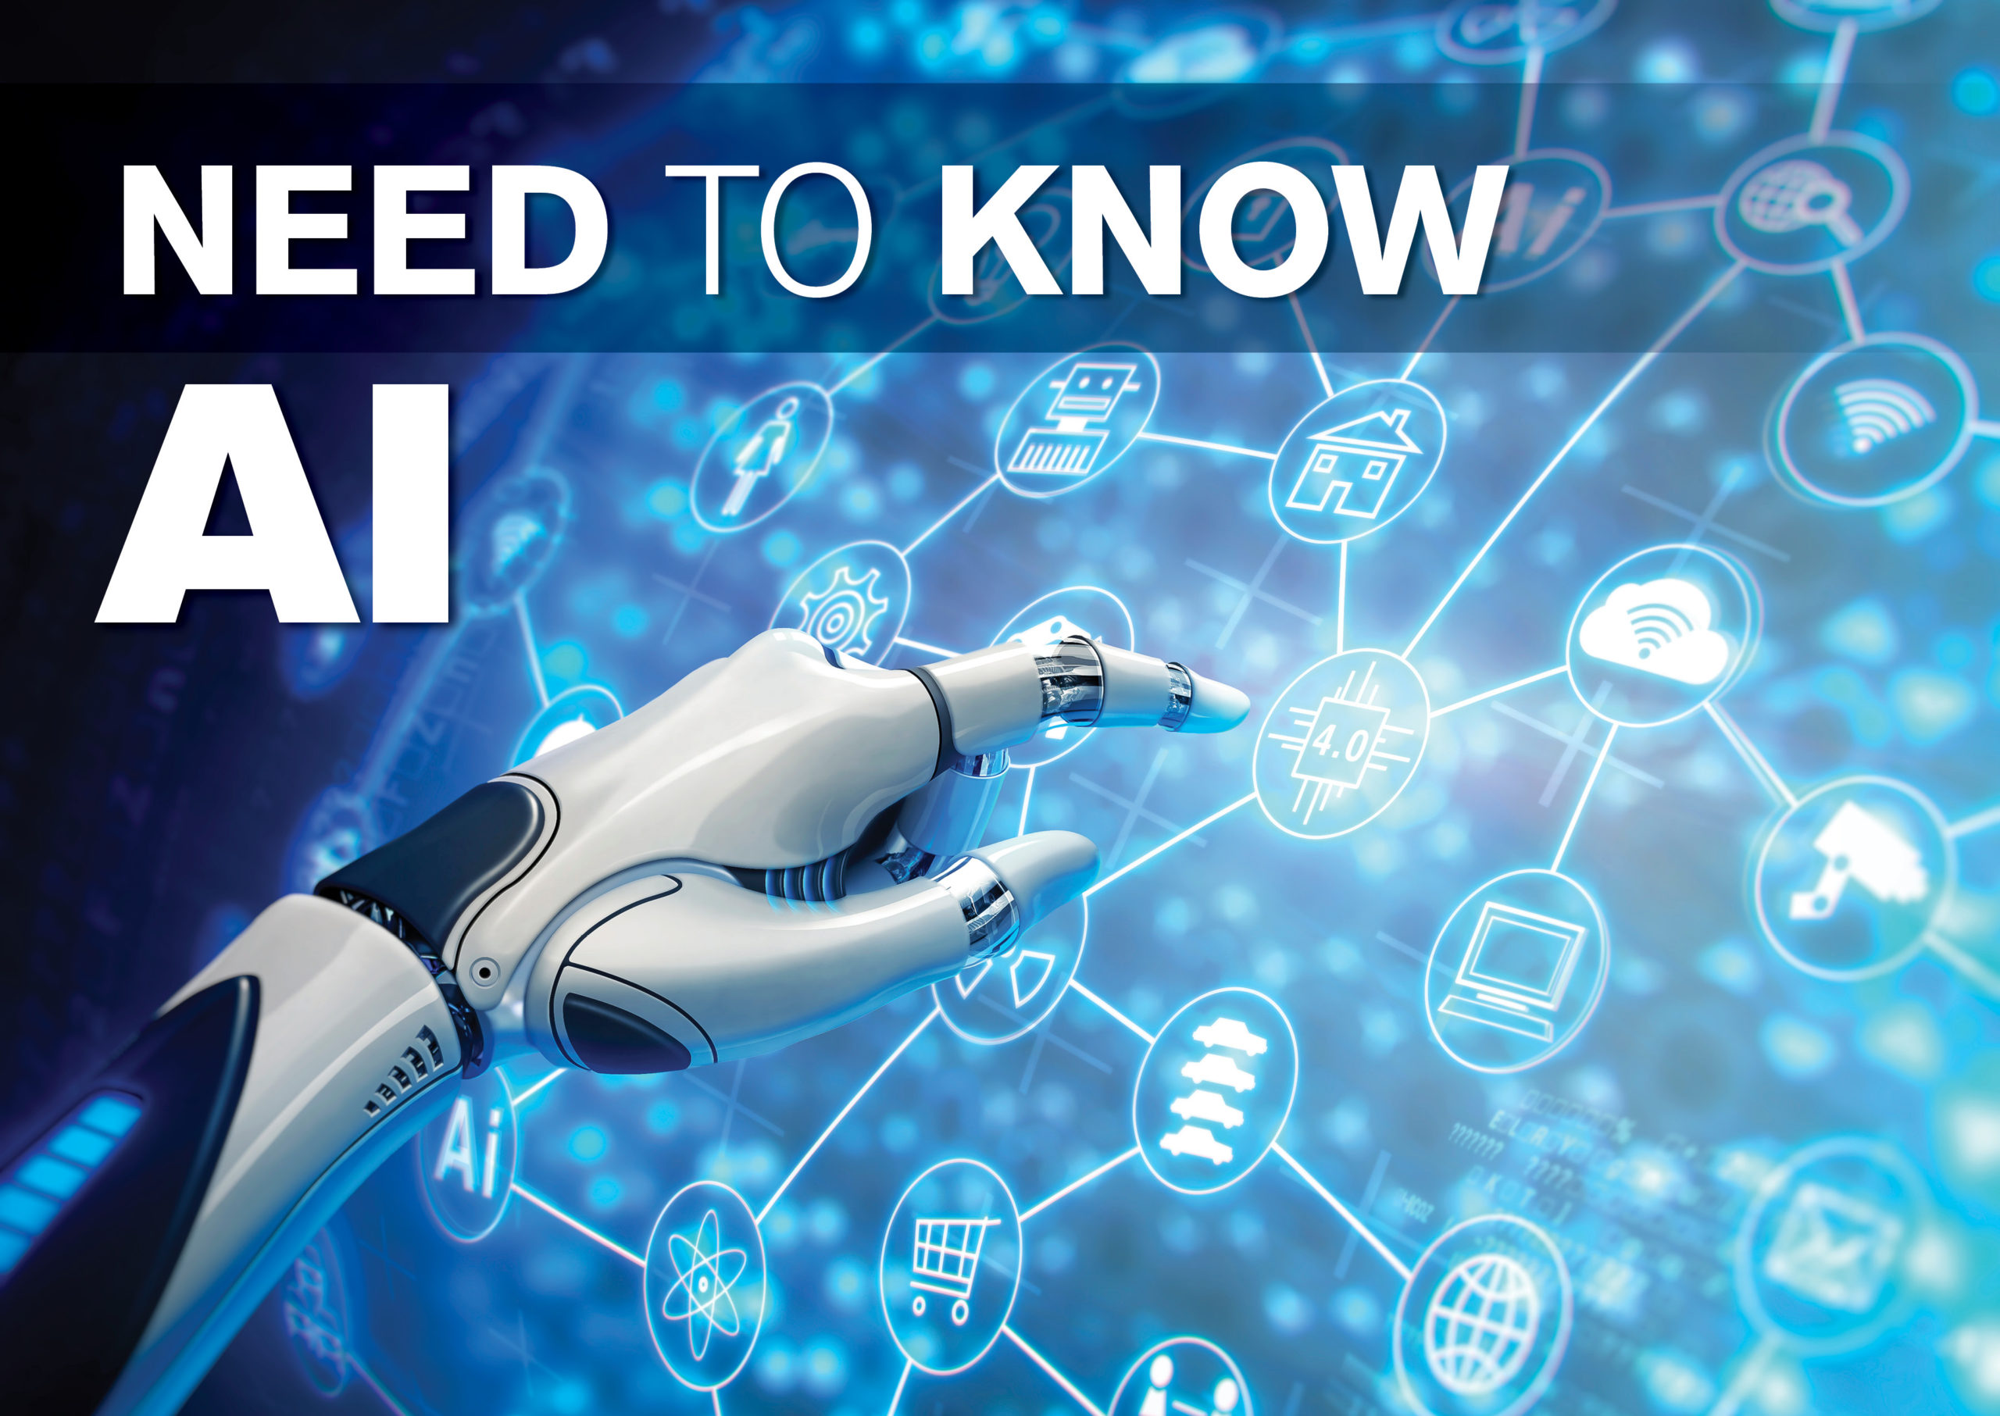

Learning Objectives
This presentation provides an overview of our chatbot project. We will explore the use of Natural Language Processing (NLP) in developing an intelligent chatbot. To understand its architecture and future enhancements.
1. NLP Fundamentals
Understand the role of NLP in modern chatbot technology.
GOAL
2. Intent-Based Training
Learn to train chatbots using intent-based classification techniques.
3. Python Implementation
Master the implementation of a chatbot using Python programming.
Source :
www.freepik.com/

Slide 3
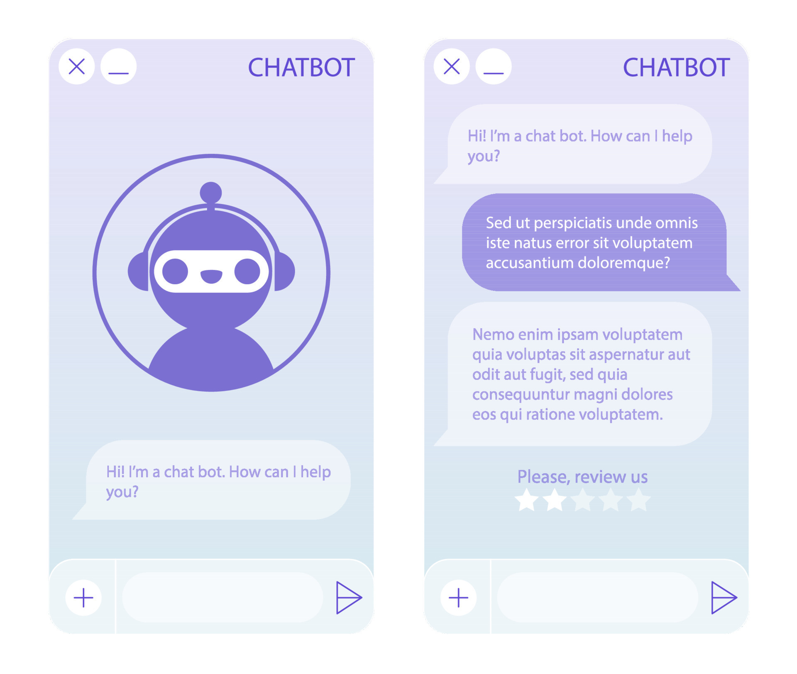
Project Goal
Understanding Queries
Develop a chatbot that understands a wide array of user questions.
Responding Intelligently
Craft suitable, relevant responses to these user queries.
Enhancing User Experience
Provide interactions that are both effective and enjoyable.

Slide 4
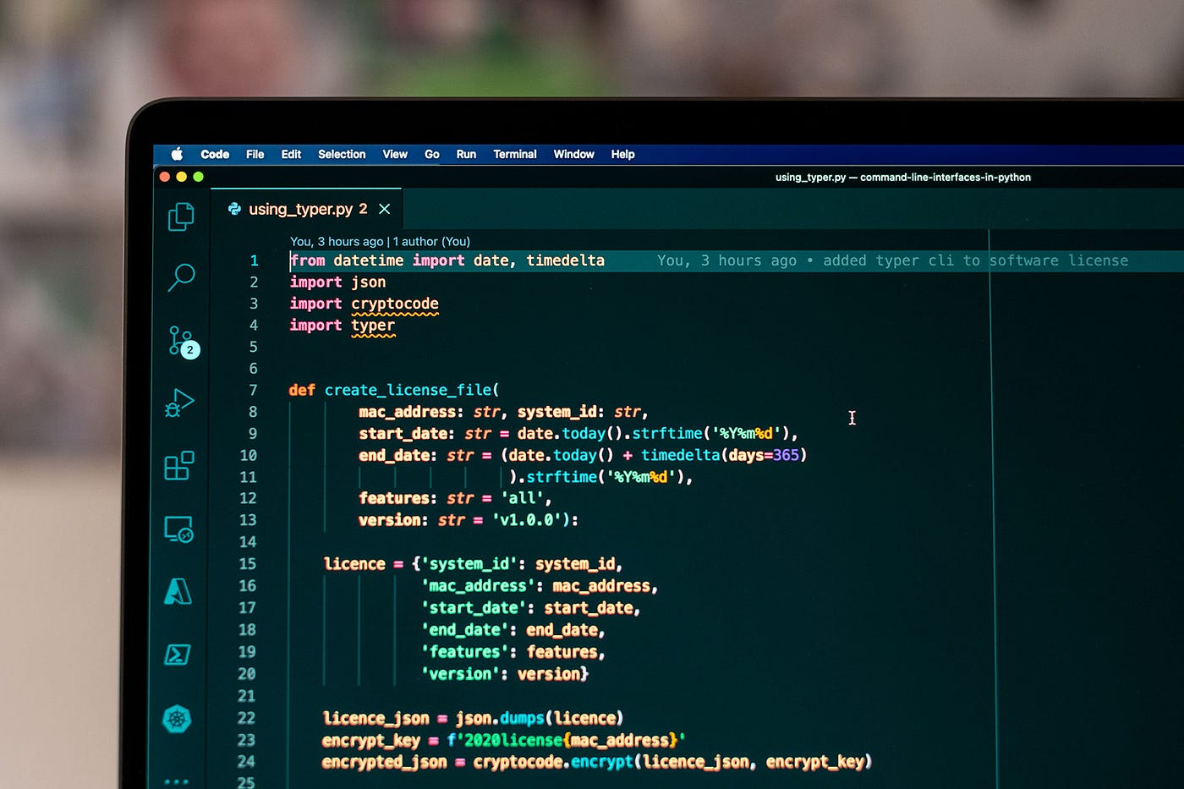
Tools and Technology used
Python
Primary programming language for chatbot development.
NLTK
Essential library for natural language processing tasks.
TensorFlow/Keras
Deep learning frameworks for neural network training.
Intents JSON
Structured data format for training chatbot responses.

Slide 5
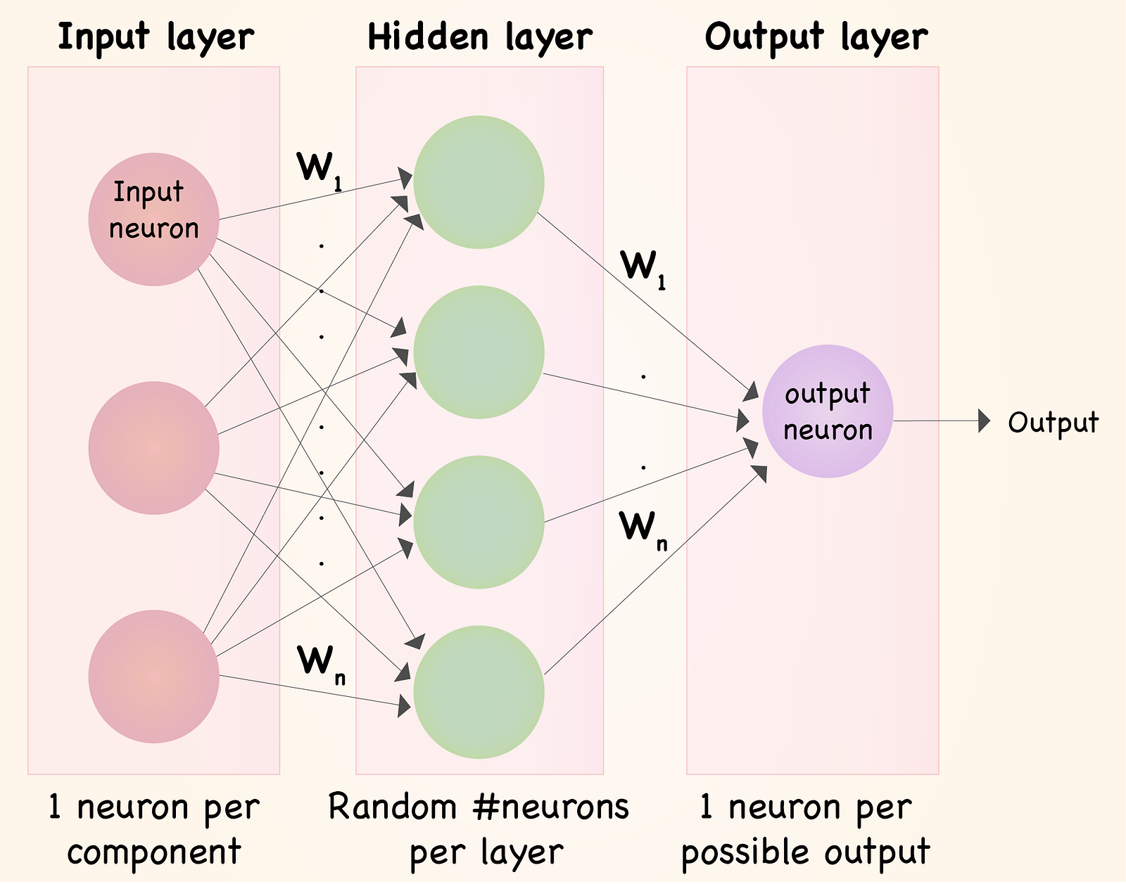
Methodology
Data Preprocessing
Tokenization and stemming techniques.
Neural Network Training
Training with TensorFlow/Keras.
Response Generation
NLP models for intelligent responses.

Slide 6
Problem Statement:
Limited Flexibility
Rule-based chatbots often struggle with diverse user inputs.
Lack of Adaptability
Traditional chatbots can't dynamically adapt to varying user needs.

Slide 7
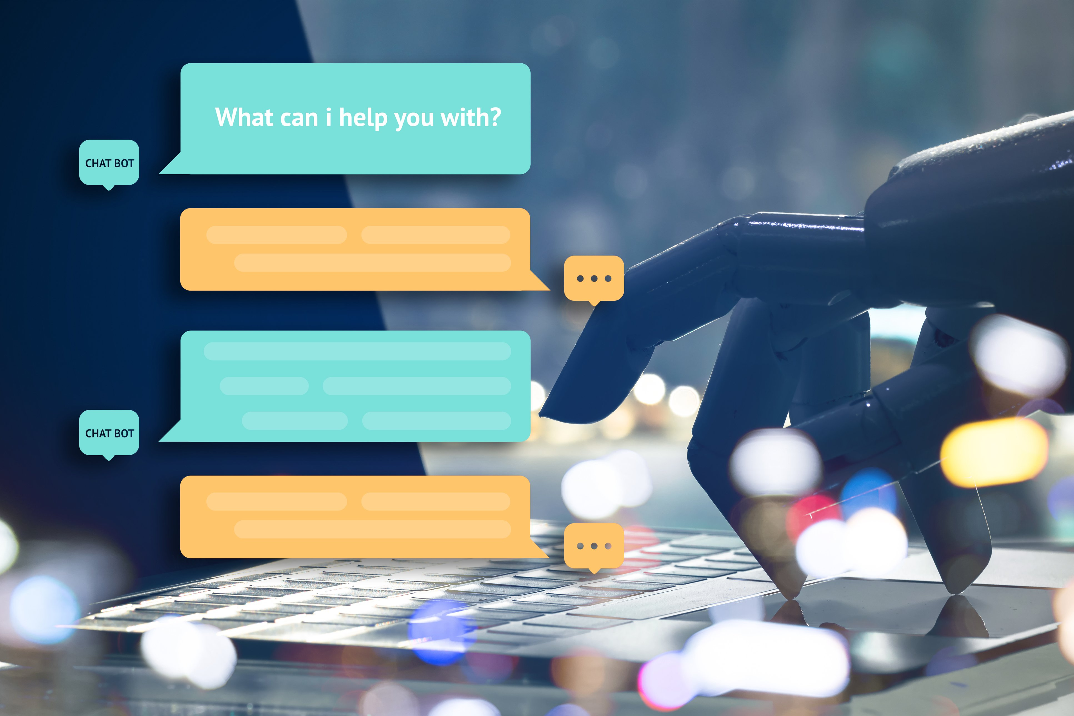
Solution:
NLP-Based Chatbot
Leverage NLP for understanding predefined intents.
Machine Learning
Enhance accuracy with machine learning algorithms.

Slide 8
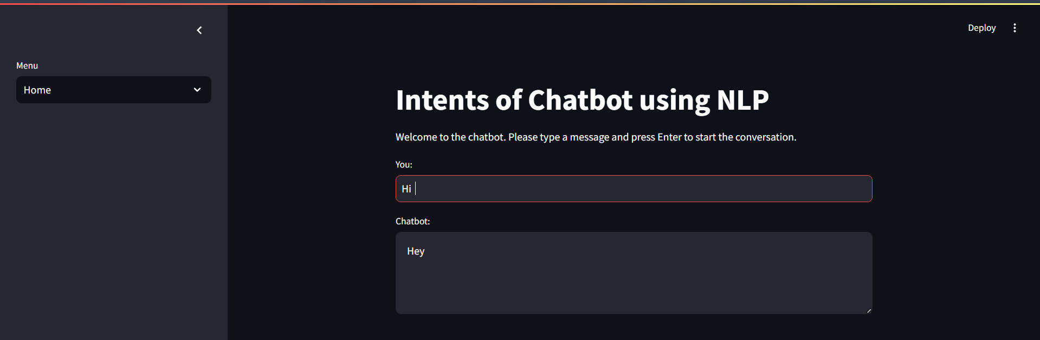
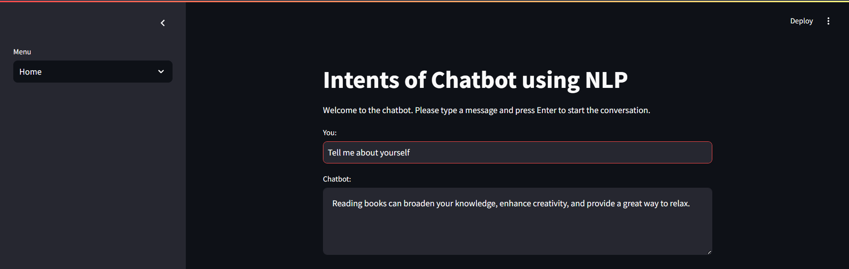
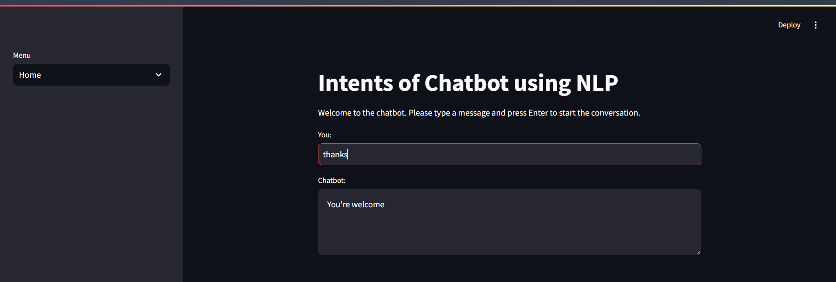
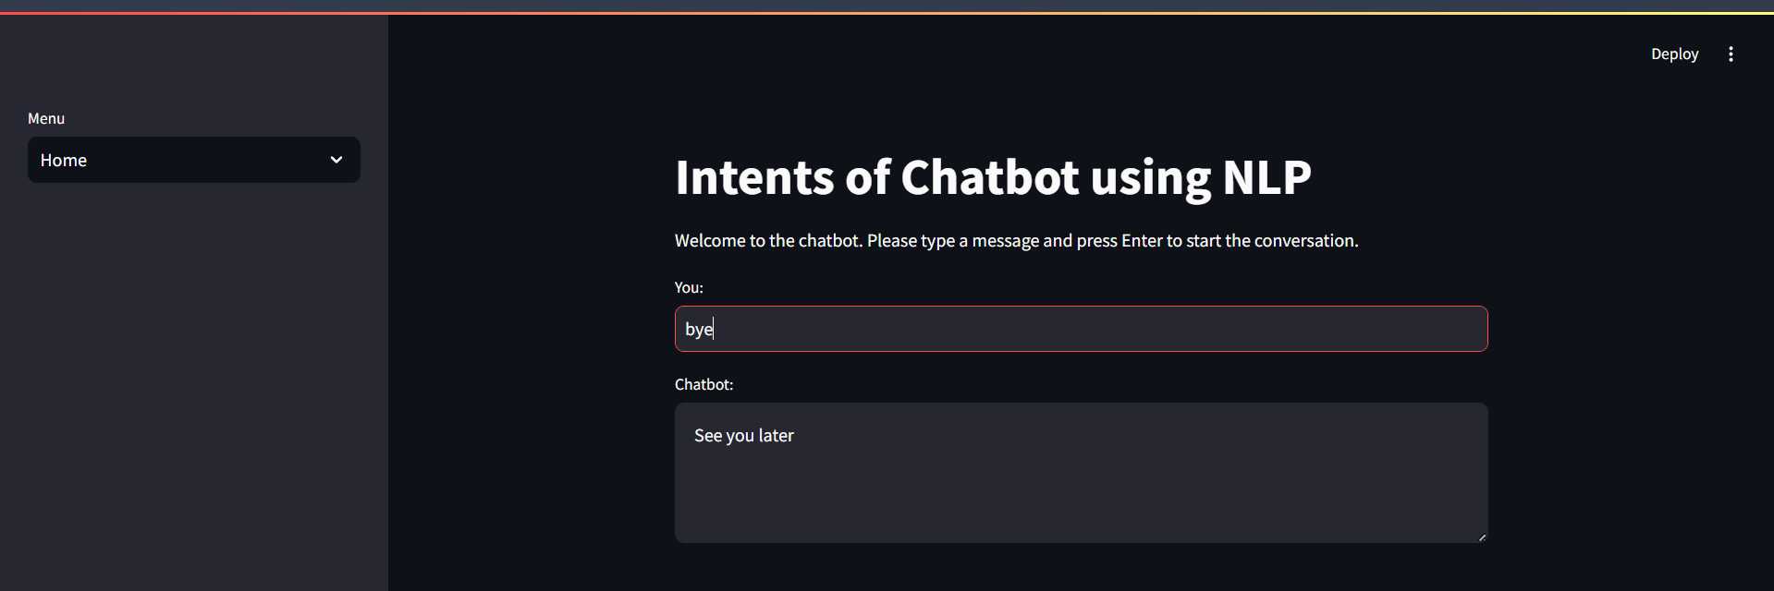
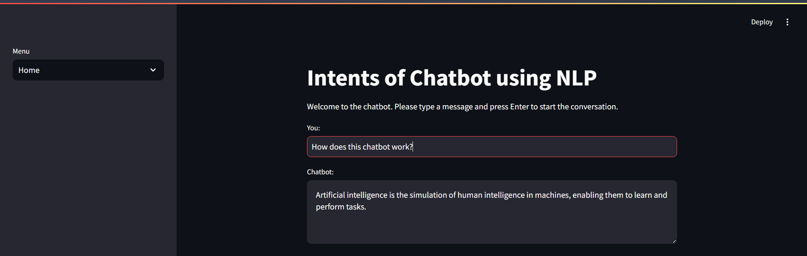
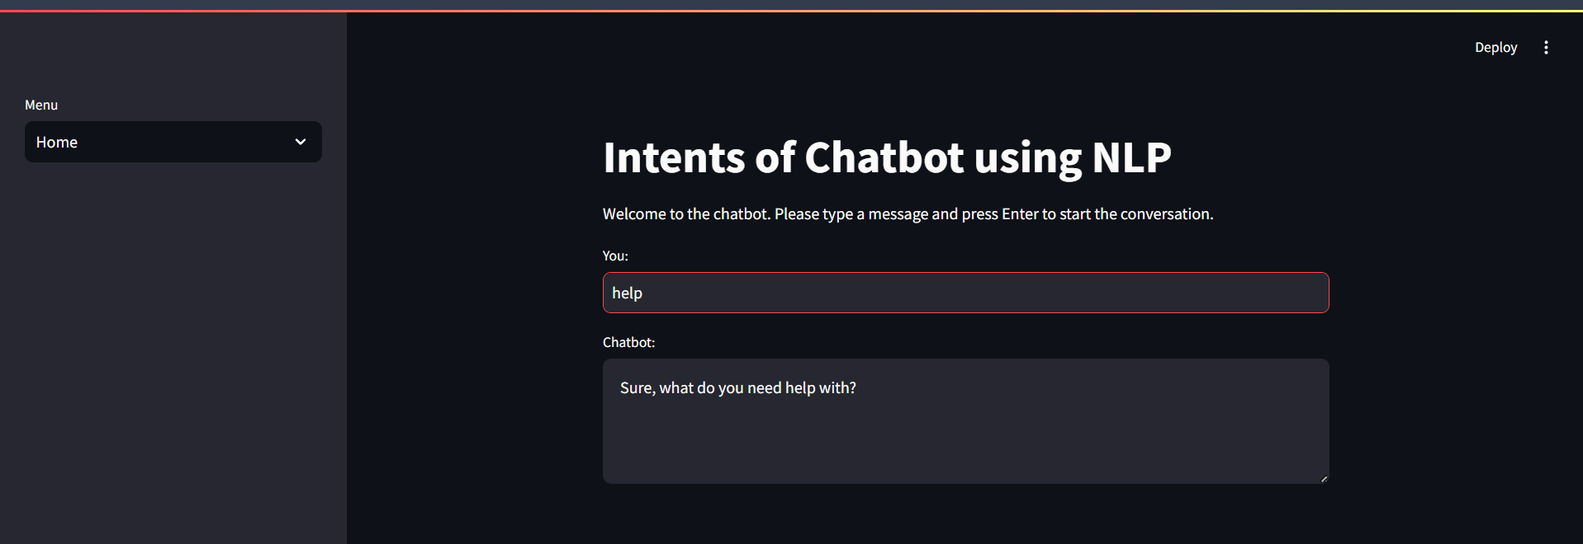
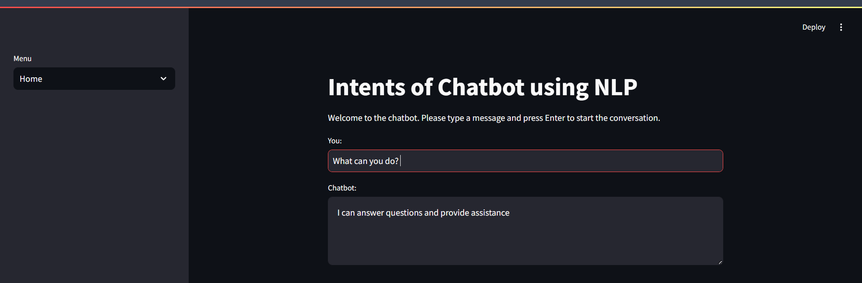
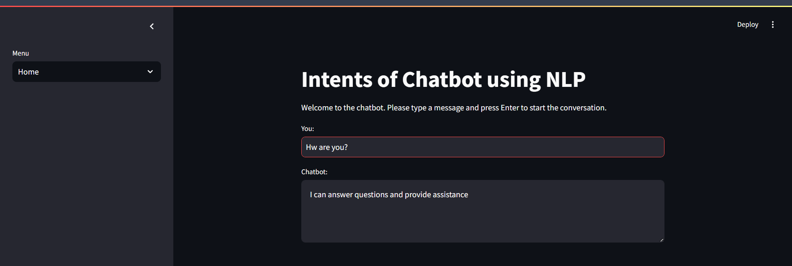
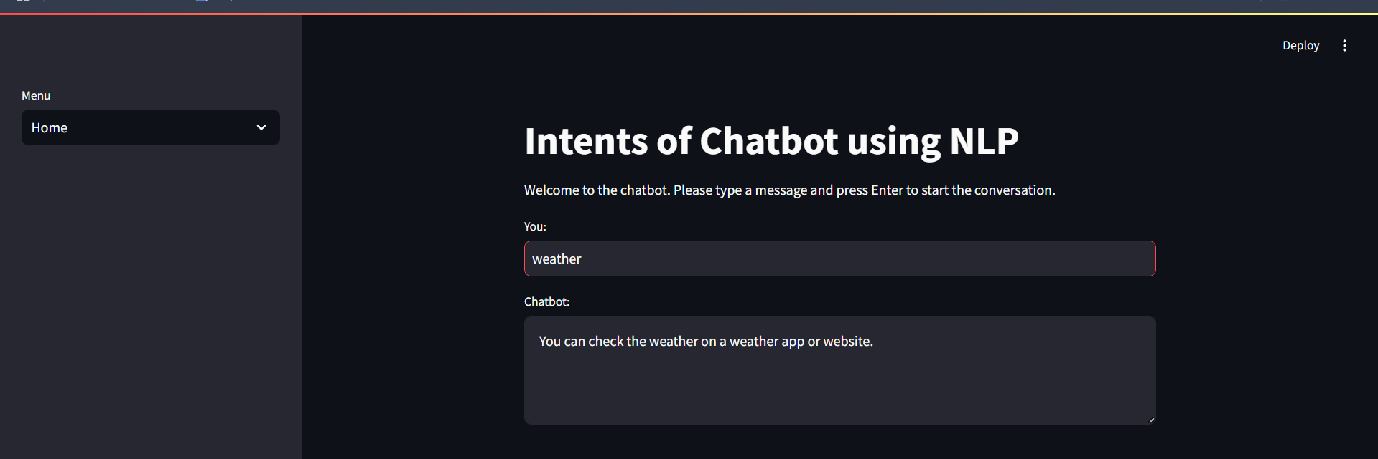
Screenshot of Output:

Slide 9
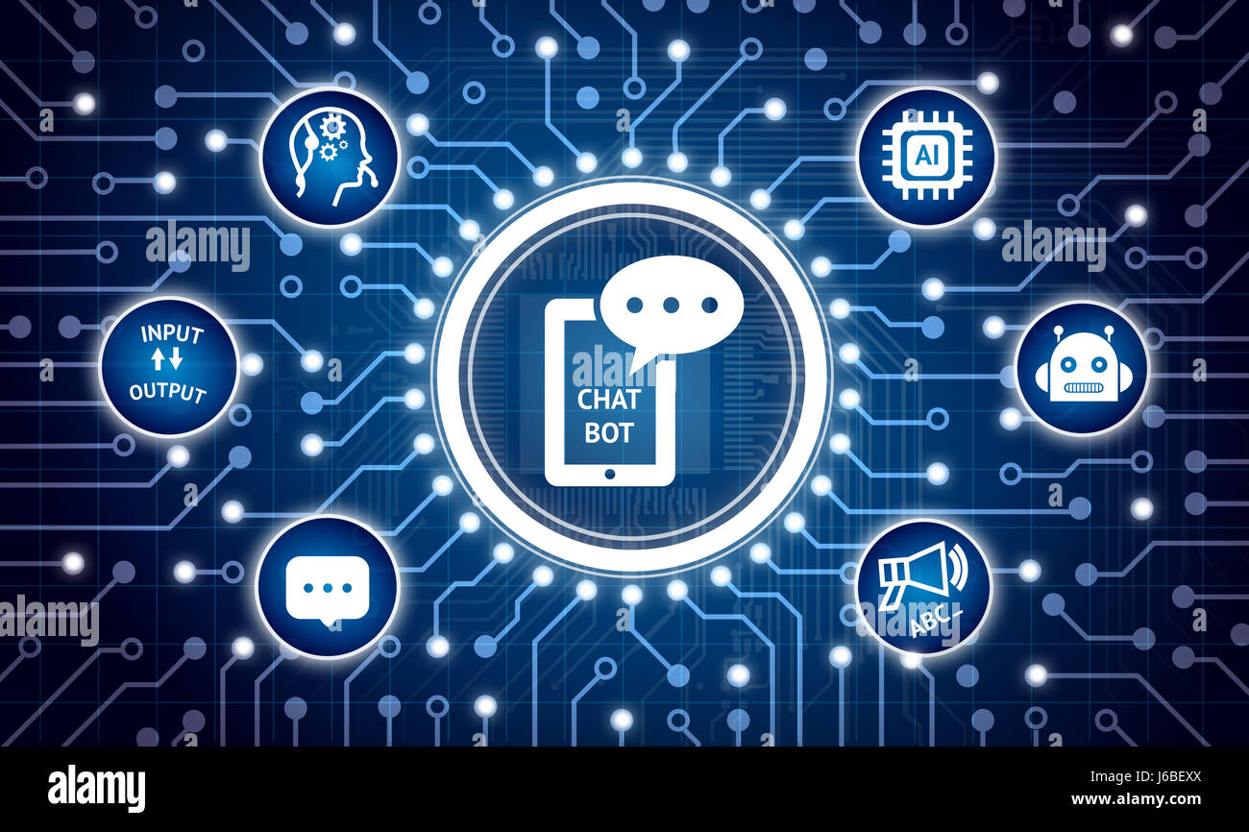
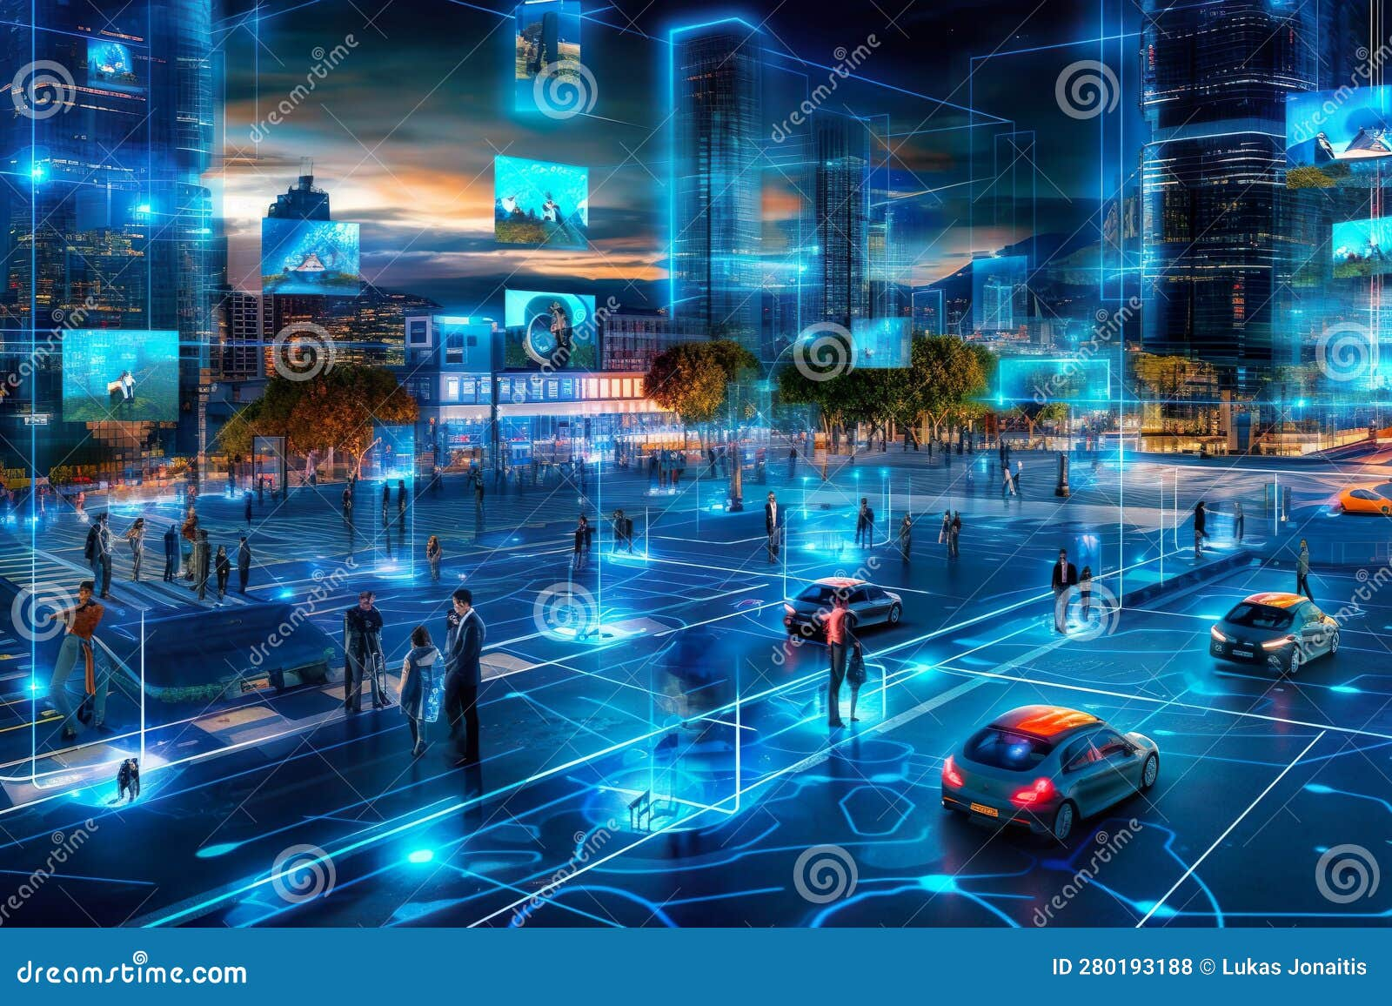
Conclusion:
Conclusion & Future Work
AI Chatbot Implemented
Database Integration
Voice Recognition
Multilingual Support
We've successfully created an AI chatbot using NLP. Future improvements include database integration, voice recognition, and multilingual support.

