Slide 1
C
Clarity Desk
A Personal Academic Companion App
One calm desk for the whole college day — timetable, attendance, tasks and notices, together.
Progressive Web App
Offline-First
Free to Run
Built & maintained by Sanghpal Bhakte & Siddesh Keware
PRN: 202501128002, 202501128021 · campusos-83365.web.app
Project Overview
Clarity Desk
01

Slide 2
THE CHALLENGE
› Problem Statement
College life is scattered across different places — the timetable lives in a WhatsApp photo, attendance is counted by hand, and deadlines are remembered from memory or a paper diary.
Manual attendance tracking is error-prone, and most students only realise they're short right before it becomes a real problem.
Typing out an entire semester's timetable by hand is tedious, so most students simply never do it.
Existing college ERP portals are slow, need a fresh login every time, and stop working the moment the connection drops.
There is no single, free tool that keeps one student's schedule, attendance, tasks and notices together in one place.
Students don't need five different tools — they need one calm desk.
Problem Statement
Clarity Desk
02

Slide 3
WHAT WE SET OUT TO DO
› Objective
Build one Progressive Web App that brings timetable, attendance, tasks and notices into a single, calm “Today” view.
Let students import their timetable by scanning a photo instead of typing out every class by hand.
Give every subject its own hub — schedule, notes and study links in one place, instead of scattered chats and folders.
Remind students about classes and deadlines even when the app is closed, not only while it's open in a tab.
Put quick access to the college ERP portal and a running changelog right on the Notice Board.
Keep the whole project free to run and free to use — no subscriptions, no paid backend, no ads.
To give every student a single, offline-first digital desk for their entire academic day.
Objective
Clarity Desk
03

Slide 4
HOW IT WAS BUILT
› Tools & Methodology
Tools & Technologies
Methodology
HTML, CSS & vanilla JavaScript — no heavy framework, kept deliberately lightweight.
Service Worker + Web App Manifest — installs like a native app, works fully offline.
Firebase — Firestore for optional cloud sync, Hosting for deployment, Cloud Messaging for push.
GitHub Actions — runs the background notification job on a free schedule, no paid backend.
Git & GitHub for version control.
Requirement analysis grounded in real day-to-day student pain points.
Built iteratively, one feature at a time — timetable → attendance → tasks → notices → notifications.
Deterministic-first logic: attendance math and OCR parsing rely on deterministic rules first, AI only as a fallback.
A fixed regression test suite plus Playwright visual & PWA smoke tests run before every release.
Used the live app personally, every day — real usage caught real bugs.
Tools & Methodology
Clarity Desk
04

Slide 5
HOW A DAY ACTUALLY FLOWS
› Implementation Process
1
2
3
4
Open the desk
One-time setup
Import timetable
Open Subject Hub
Student opens Clarity Desk and lands straight on the “Today” view.
Profile, batch & semester are set once, so every view is already filtered.
Scan a class-schedule photo (OCR) or load a sample template.
Each class opens its own hub — a single place for notes, links and quick logs for that subject.
5
6
7
8
Track tasks
Check notices
Save data
Stay reminded
Coursework with due dates; overdue items surface straight on the dashboard.
Pinned exam/academic notices, a one-tap ERP portal link, and a Dev Notes changelog.
Everything saves locally first; optional Firebase sync mirrors it across the student's own devices.
A free GitHub Actions job pushes class/deadline reminders even when the app is closed.
Implementation Process
Clarity Desk
05

Slide 6
WHERE IT'S ACTUALLY USED
› Applications
Used every day, for the whole academic routine:
Daily dashboard
Study Vault
One glance at today's classes, pending tasks and what needs attention.
Subject-wise notes, links and resources — organized and one tap away.
Ask Desk assistant
Deadline tracking
A grounded assistant that answers only from the student's real data — zero hallucinated numbers.
Nothing missed because it was never written down.
Offline access
Installable everywhere
Works in class, in the hostel, anywhere with no signal.
Runs like a native app on phone or laptop, at zero cost to run.
Applications
Clarity Desk
06

Slide 7
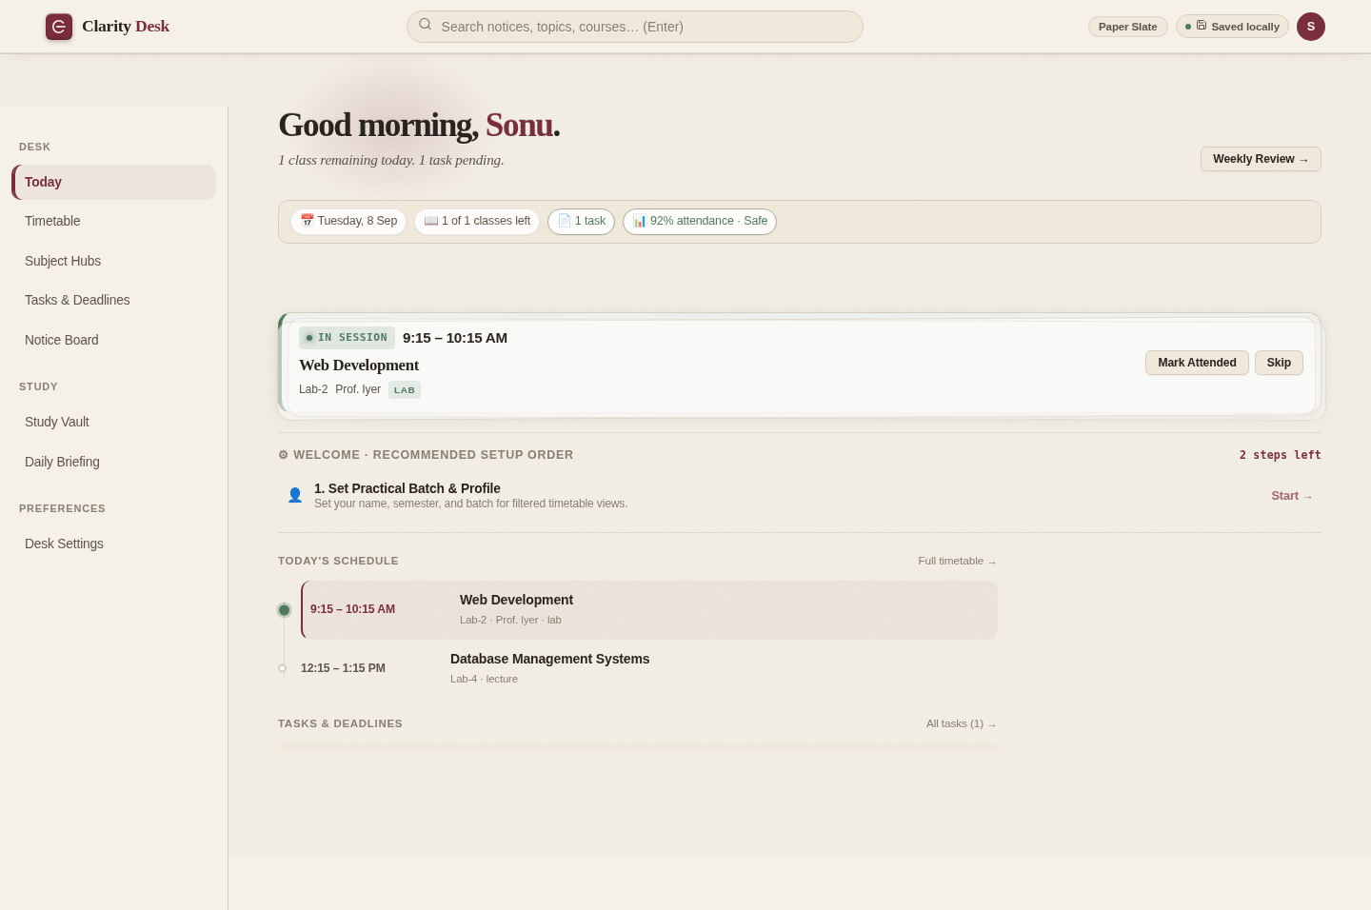
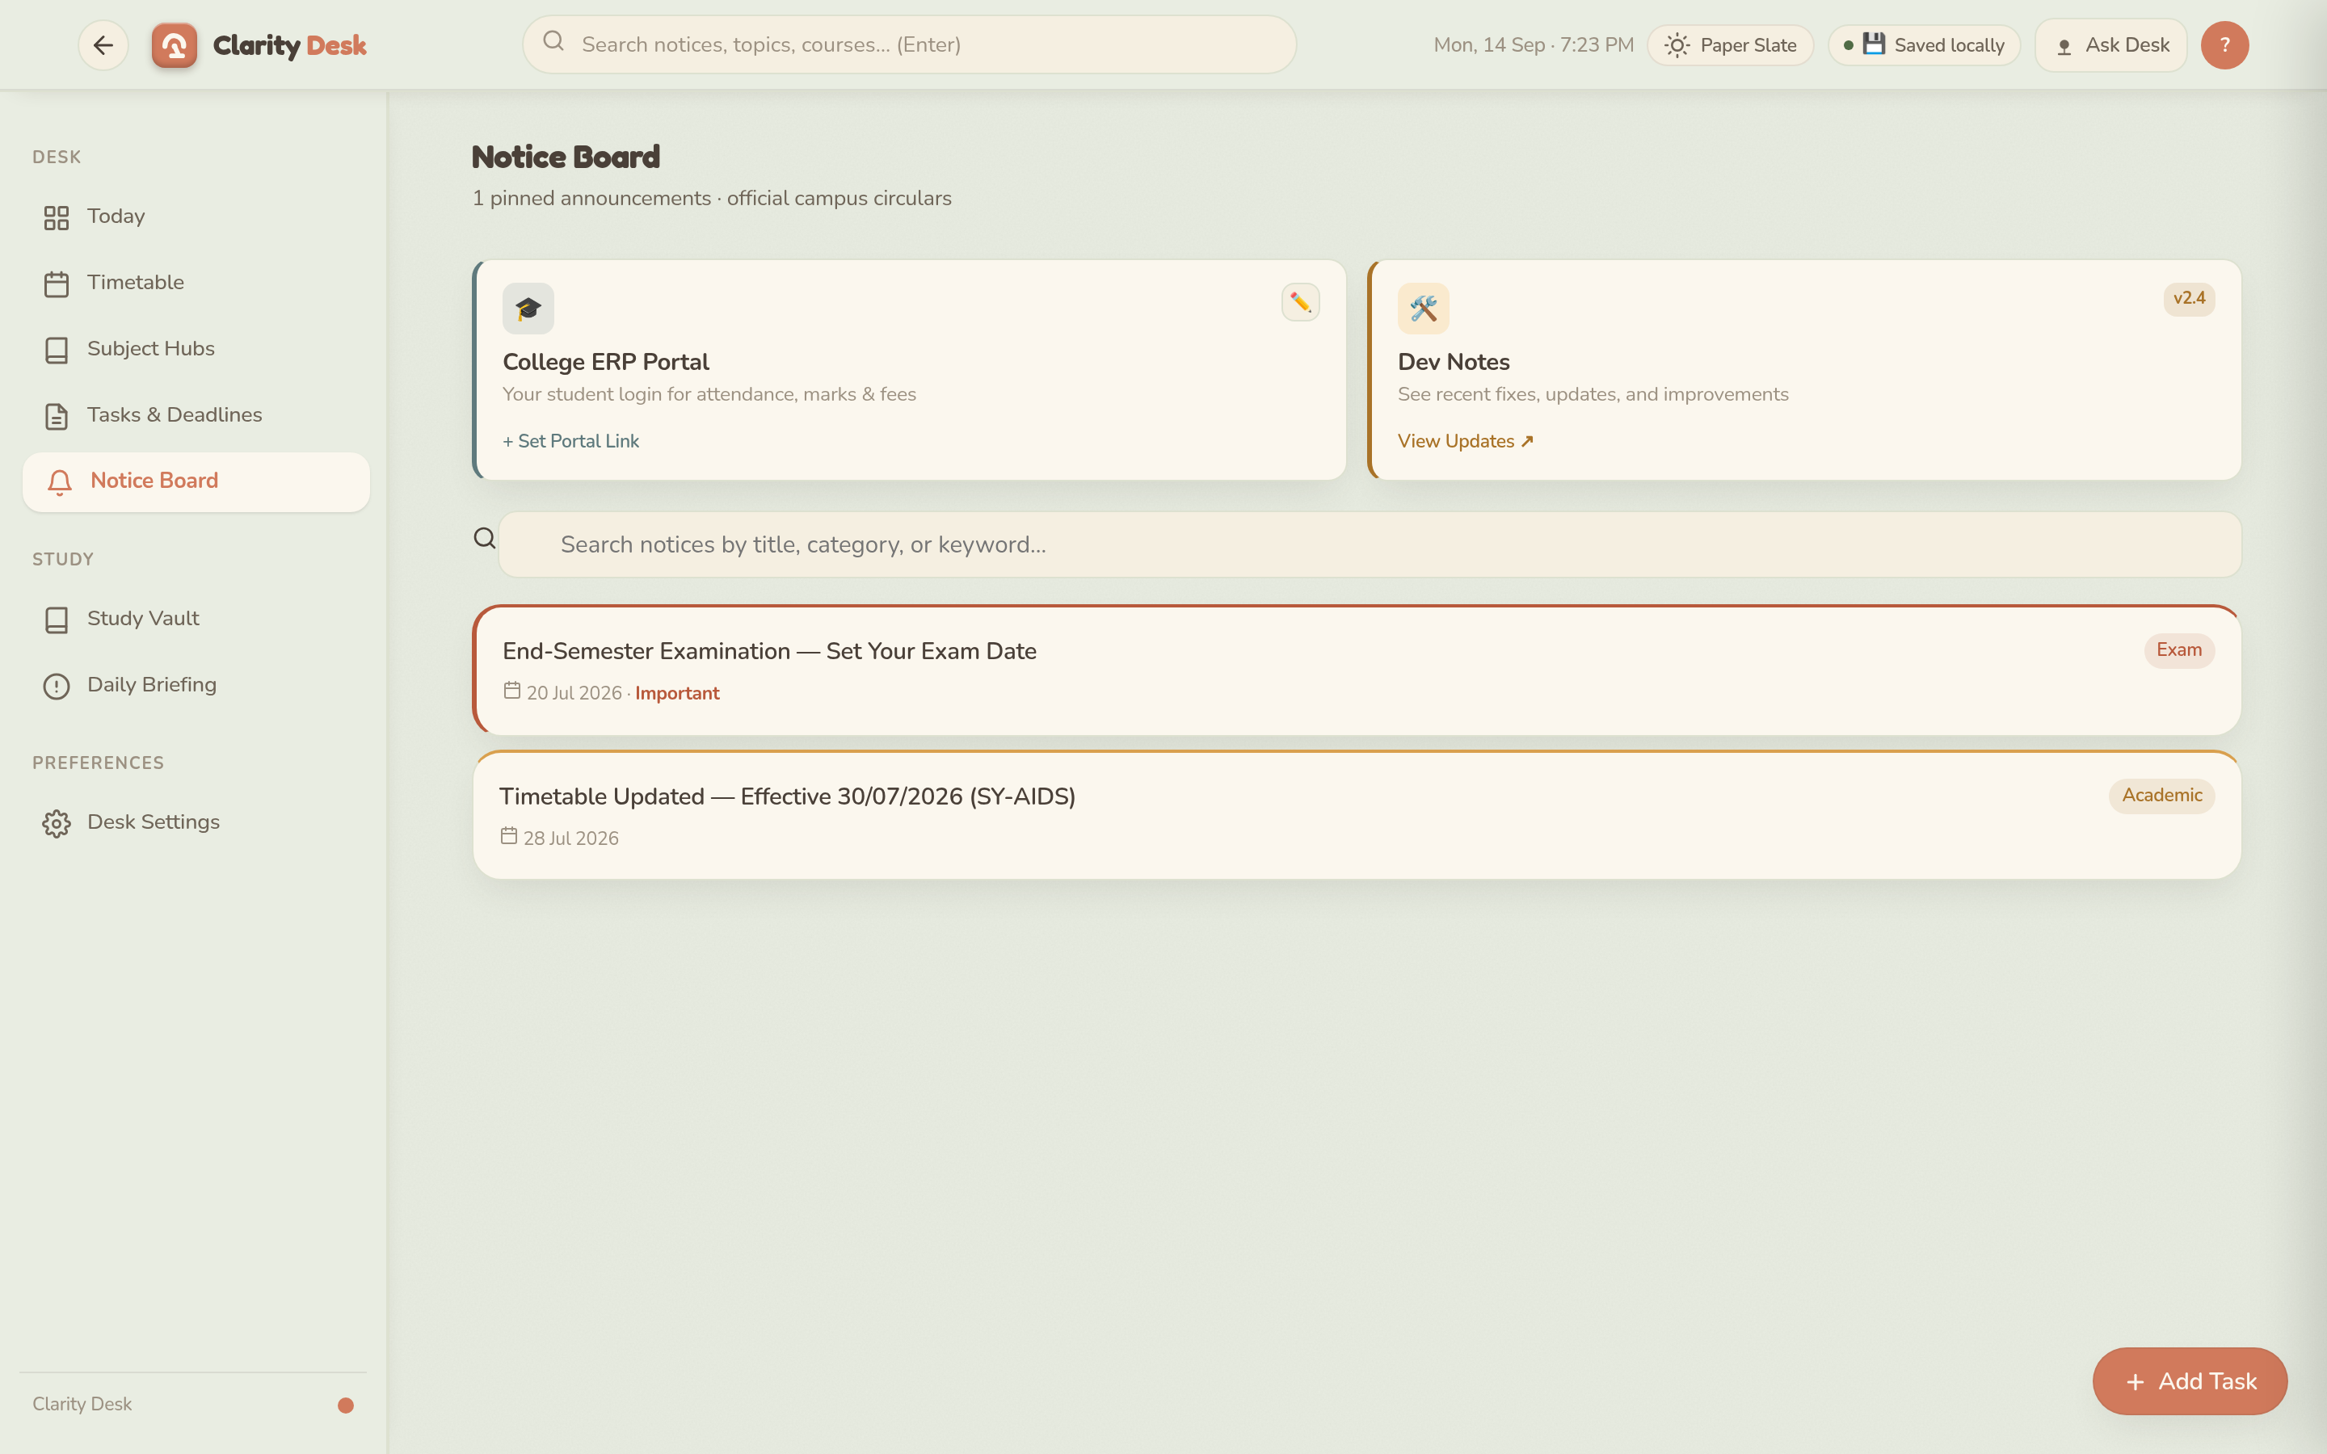
SEE IT LIVE
› Our Actual Project — Clarity Desk
Live at campusos-83365.web.app — installable, works offline, and runs entirely on free-tier infrastructure at $0/month.
The Today desk — live view
Notice Board — ERP portal + Dev Notes
Our Actual Project
Clarity Desk
07

Slide 8
Thank You
Clarity Desk — one calm desk for the whole college day.
campusos-83365.web.app

