Slide 1
Computer Principles for Programmers
Software Development:
Platforms, SDLC, Environments, Version Control
Notes:
Overview of OS and software development

Slide 2
News of the Week

Slide 3
Agenda
Lecture
Operating System Concepts
Hardware vs Software vs Firmware
Software Development
The Stack
SDLC
Environments
Version Control
Activity TLAs: API, SDLC, IoT, ver
Notes:
Activity
After we talk about all those platform variations and development considerations, just say NO to worrying about that stuff and use someone else's API.
Apply the SDLC to your Seneca school work. One student answer the week 6 quiz with SDLC = Shouldnt Delay Learning Classmaterial.
Has IoT already jumped the shark? Does the world need an IoT hairbrush?
Describe three IoT devices that the world really needs and why. Invent your own or identify an existing device.
Check out the Software Version on something you use. Find out what happened between versions – Find the release notes for that software's versions. Programmers worked hard to write those notes. Someone should read them.
Three programmers were travelling in a Level 5 autonomous vehicle. The first one hacked into the vehicle's system and said, "Watch me optimize this code." The second one said, “Wait! Don’t! Stop!” Shortly thereafter, they found themselves outside the gates of heaven in the afterlife. The third one said, “And this is why.” St. Peter waves one of them up and asks, "Operating System?" Programmer says, "I thought you'd ask about religion." St. Peter looks up, "I am. You are a programmer, aren’t you?" —"Oh, right then. Linux." —"OK, through the pearly gates, all the way down the hall, go in the door marked Eternal Rest. Be very quiet when passing the first door marked Abiding Joy. Off you go." St. Peter: "Next… Religion – I mean – Operating System? Programmer: "Is Windows OK?" St. Peter: "Yeah, we forgive most sins here, even that. Follow the last guy but look for the Perpetual Light door. And remember to sneak past the first door marked Abiding Joy." St. Peter: "Next… OS?" Programmer: "Android." —"Carry on and look for the door marked 'Google–No Longer Evil'" Pgmr: "Hey, why not a door saying Endless Bliss?" —"Best we could do." —"Alright, I got what I paid for. But why do I have to be quiet when passing Abiding Joy?" St. Peter: "It's for the Apple users." Whispering: "They think they are the only ones here."

Slide 4
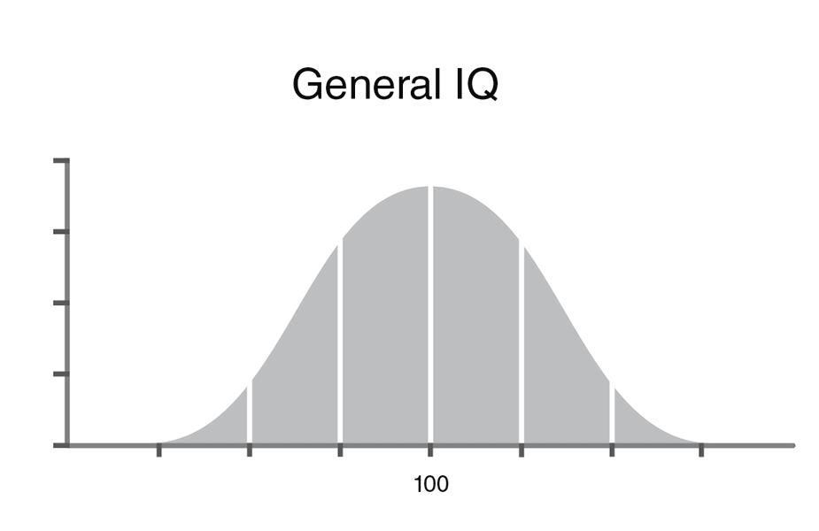
ICT has a great many languages and countless ways to do things.
100

Slide 5
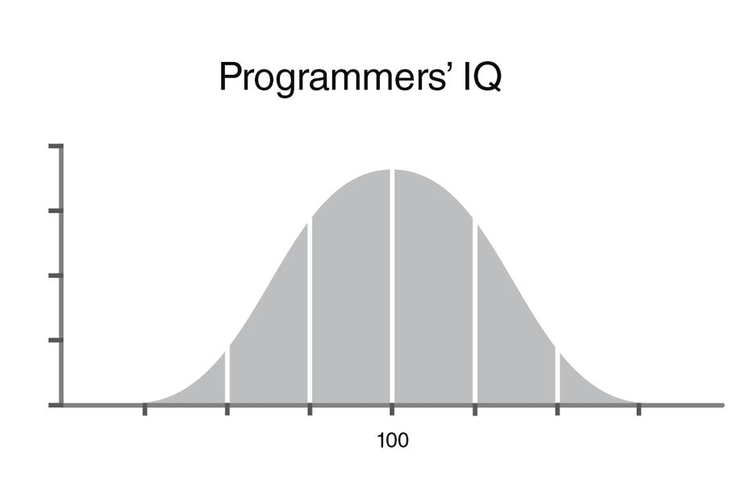
ICT has a great many languages and countless ways to do things. This is partly why.
110

Slide 6
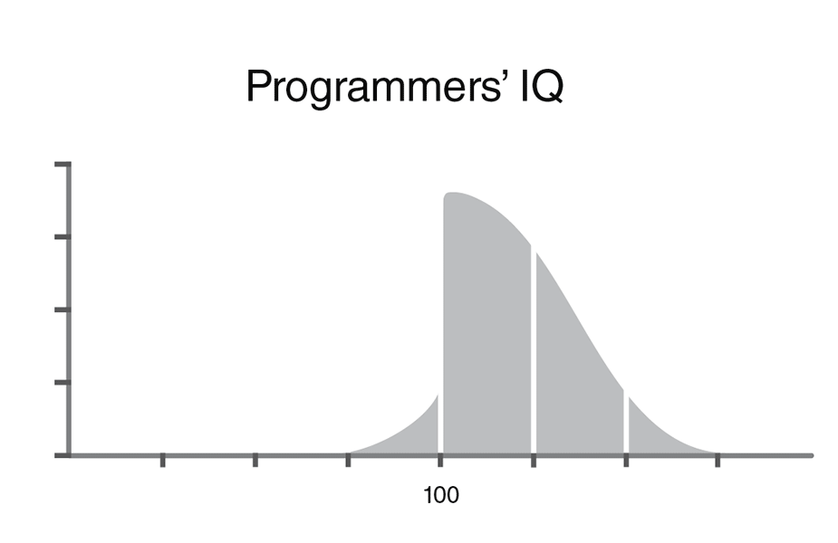
Why does ICT have many languages and countless ways to do things? This is the other part.
110
Notes:
But most programmers think they are above average. You do the math. It’s why there are so many languages, frameworks, and JavaScript packages.

Slide 7


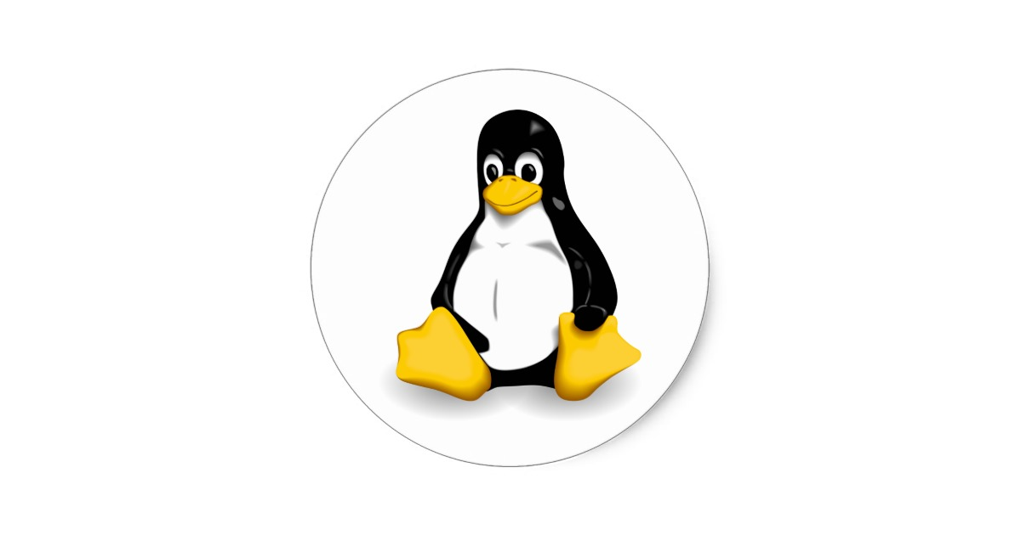
Systems
Operating System (OS)
manages hardware & software resources, provides common services for Application Software.
Application Software
An “app” or program with features and functions to solve a problem.
Platform = hardware + OS
Software Dev: the stack
Hypervisor: virtual machines & platforms
TUX penguin Torvald's UniX runs on the most hardware
Notes:
Supercomputers, which are computation intensive systems, are now all customized Linux clusters.
For transaction intensive workloads, which means processing large volumes of data, i.e. I/O intensive, IBM Mainframes do ~75% of the work, then IBM Power, SUSE & Red Hat Enterprise Linux.
Servers (smaller than mainframes): ~ 2/3 Linux & Unix incl HP Proliant and Oracle systems, ~1/3 Microsoft Windows Server
Mobile (smart phones and tablets): ~3/4 Android, ~1/4 iOS
Desktop/Laptop: ~88% Windows, ~10% macOS, ~2% Linux
https://en.wikipedia.org/wiki/Usage_share_of_operating_systems#Market_share_by_category
https://en.wikipedia.org/wiki/Hypervisor
Hypervisor creates virtual machines where multiple OS instances (same or different, AKA homogenous or heterogenous) share a portion of the same hardware. It began in IBM mainframes in the late 1960s. IBM Power midrange has been doing virtual since 1990s. VMware was first to virtualize x86 hardware ~2000. Now, server hardware and CPUs include hypervisor support.
https://en.wikipedia.org/wiki/Hyper-V (Windows)
https://developer.ibm.com/articles/cl-hypervisorcompare/
https://www.ibm.com/support/knowledgecenter/en/POWER6/iphb2/iphb2hypervisor.htm
TUX is the Linux mascot. “(T)orvalds (U)ni(X)”.
https://en.wikipedia.org/wiki/Usage_share_of_operating_systems#Desktop_and_laptop_computers
Application Software, including Web Apps, is the primary focus of the School of ICT’s software development programs.
https://en.wikipedia.org/wiki/Computing_platform
https://www.techopedia.com/definition/3411/platform
Platform is a combination of hardware + OS. E.g. “Wintel” which is Windows running on Intel CPU/hardware. macOS used to run on PowerPC architecture, now runs on Intel x86-64. Linux runs on almost anything. IBM has z (mainframe), Power servers running IBM i, AIX, Linux. https://www.youtube.com/watch?v=I0bBXPP5iWI
https://www.forbes.com/sites/patrickmoorhead/2018/03/19/headed-into-its-fifth-year-openpower-has-momentum-into-the-power9-generation/#65b93ef578a8
https://www.fool.com/investing/2018/03/22/googles-data-centers-now-have-ibm-inside.aspx
What are other platforms? iOS + Android tablets & smartphones (increasing shipments), Desktop + laptop PCs (declining shipments); in 2011 sales of mobile devices exceeded PCs. The big three personal computing platforms are Apple mac & iOS, Android, and Windows. Apple has 13.7% of smartphone market share in 2017Q1 but all of the profits. Android platforms have the rest of market share but little of the profit. Blackberry in-service devices are fading fast and their market share was zero in 2016Q4. The iOS App Store earned 75 percent more revenue than the Google Play Store in 2015 despite Apple's much smaller number of devices in service. Apple iOS users spend more than four dollars for every Android dollar on all purchases made through mobile devices.
The server market platforms: The most common operating system for mainframes is IBM's z/OS. In The midrange market is IBM Power Systems running AIX (UNIX) and IBM i/OS. The small server market includes Windows server and Linux servers.
Software Development "stacks" include LAMP (see later slide), Microsoft .NET deployed on Azure cloud, Visual Studio supports various stacks for mobile, web, and other development. MEAN stack

Slide 8
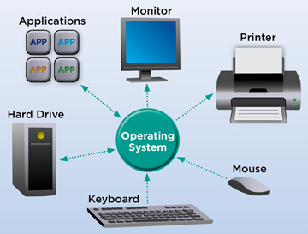
Operating System software that supports a computer's basic functions: schedule tasks, execute applications, control peripherals.
Interfaces cross system boundary
Users, other OSs and servers
Applications
OS allocates memory & resources, security, APIs.
Operating System
Computation & subsystems
Interrupts, Scheduling, I/O
Storage and File systems
Networking
Hardware
CPU, RAM, peripheral devices.
Device drivers interact with OS
Notes:
https://en.wikipedia.org/wiki/Interface_(computing) https://en.wikipedia.org/wiki/User_interface#Types
https://en.wikipedia.org/wiki/Operating_system
OS abstracts the Application software from the hardware. E.g. It presents a consistent view of a file system to application software even though files may reside on different media such as network mapped, HDD, SSD, and USB drives. Also SAN Storage Area Network, NAS Network Attached Storage.
PCs, tablets, smartphones are Single-user + multi-tasking.
Server OS are multi-user and usually multi-everything else.
An Operating System is like underwear. It should be clean, comfortable, and not call attention to itself. If you or anyone else notices it, it is not doing its job properly.

Slide 9

OS provides Layered Architecture
Interfaces
System Boundary
Applications
Programmer
System Services
Software Engineer
System Software
Hardware Engineer
Hardware
Notes:
Unlike old operating systems like DOS and early UNIX which allowed your software to access the underlying hardware, crawl through memory and disk sectors,
today's OS creates a "sandbox" where you can play. Different sandboxes for different roles, play all you like but only in your sandbox. If you want something from someone else's sandbox, you have to ask nicely for them to pass it to you.
Users use Applications on the one hand and have to deal with something called the Real World on the other.
Programmers can stay in their own geek & nerd bubble by creating Apps that use OS services. Only when forced to will programmers interact with users or brave their way into the Real World.
System Services are provided to Apps through APIs, Services are also high level Operating System functions that humans see and interact with such as the command line for system administration and operations.
System Services offered by operating systems:
User Interface to screen, keyboard, mouse, touchpads,
File system manipulation
Operator control of running processes and system services, e.g. Task Manager in Windows,
Input / Output Operations between Apps and OS
Communications
Resource Allocation, e.g. changing the running priority of a process
Software Error Detection
Security controls
Software Engineers and computer scientists create system software. E.g. connecting APIs at the Services level with Hardware at the lowest level of the OS
Input / Output Operations between Services and Hardware levels
Security enforcement
Hardware Error Detection
Hardware (Electrical and Computer) Engineers design the hardware and low level system software that lets an operating system talk to the hardware. E.g. device drivers
How many programmers does it take to change a light bulb?
None. It's a hardware problem. How many hardware engineers does it take to change a light bulb? None, they’ll fix it in software.
How many software engineers does it take to change a light bulb?
None. "We'll document it in the manual."
None. Darkness is a feature, not a bug.
"It's hard to say. Each time we separate the bulb into its modules to do unit testing, it stops working."

Slide 10
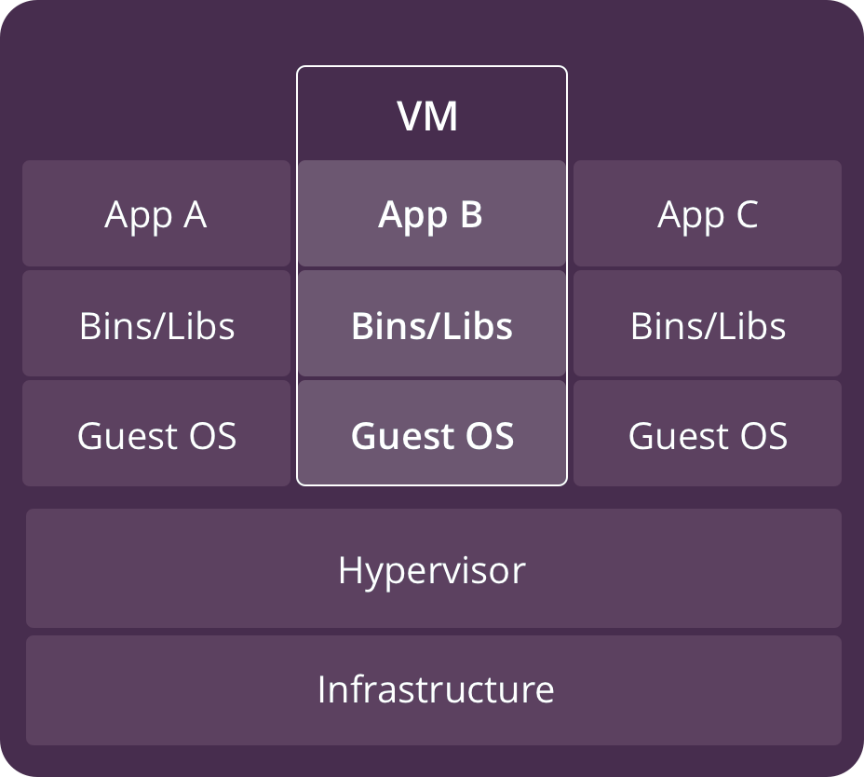
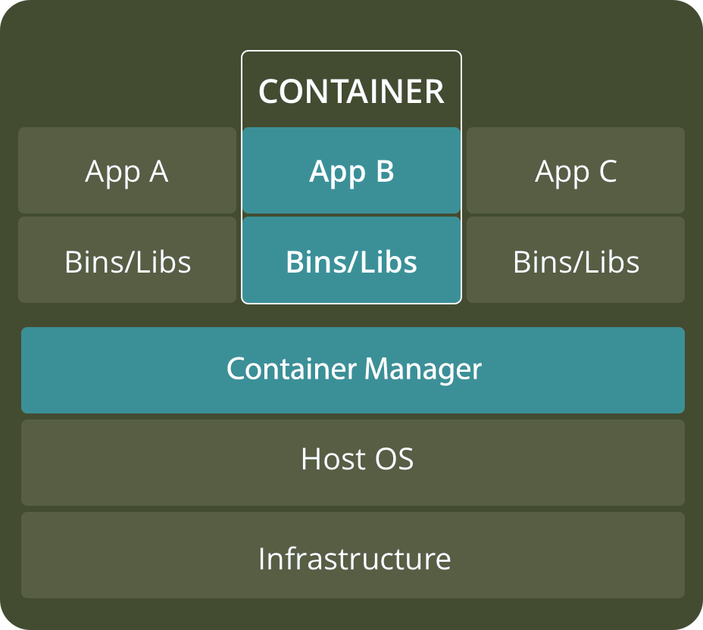
Virtual Machine vs Container
Notes:
Large applications like database systems, web servers, ERP (Enterprise Resource Planning) run best on their own machine mostly because they assume they are the only thing running and have infinite resources. However, cryptography, hashing, and compression can chew up all the CPU cycles, web services can saturate the network interface, and a DB query can clog all the I/O channels. The host OS can struggle to balance competing resources when multiple complex systems don’t play well with others.
Virtual Machines makes vendor support for these large software packages easier (fewer run time variables) and it’s harder for the vendor to blame their problem on something else.
Dependent systems work with each other through a virtual network linkage. E.g. a Web server talking to a DB server.
Remember, IT geeks and nerds call their computers 'machines'.
VMs started when application providers insisted their app package ran alone on a server. E.g. one for DB, one for Web services, one for accounting, one for sales & distribution, one for manufacturing
If an application package became very slow or intermittently unstable – and it coexisted with other applications on the same platform – it was your problem. Each app provider pointed fingers at the other app provider for stealing too many CPU cycles, eating up too much RAM, monopolizing I/O channels. It became a kindergarten class where no one played well with others.
Now there is a another option, the Container. E.g. Docker (commercial software) and Kubernetes (open source)
https://www.cio.com/article/2924995/what-are-containers-and-why-do-you-need-them.html
Benefits of VMs
+ Can run different OSs on same server hardware & all OS resources available directly to application software
- BUT Heavyweight Hypervisor between guest OS and physical hardware can limit performance (or you get a bigger server which may be better than many smaller servers but the hardware savings require lots of expertise tuning the partitions for CPU, memory, and I/O resource allocations)
+ Established management and security tools, e.g. VMware
+ Better known security controls aided by Hardware-level virtualization which Fully isolates OS instances and is hence more secure
- Startup time in minutes
Benefits of Containers
A container manager performs OS virtualization (VOS) instead of hardware virtualization
+ isolating applications in a VOS is lightweight compared to a VM hypervisor BUT gives up direct access to platform features and resources not supported by the Container Manager.
+ reduced hardware requirements, all containers share the host OS (multiple OSs require lots more memory) and get nearer to native performance on the platform (don't have to go through a Hypervisor)
+ Reduced & simplified security updates – only one OS to patch instead of several heterogeneous OSs BUT only Process-level isolation, possibly less secure
+ reduced IT management expertise and human resources needed – there is only one platform to manage with minimal hardware tuning and rebalancing of CPU, RAM, and secondary storage resources
+ Startup time in milliseconds, Quicker spinning up apps
+ Reduced size of persistent storage snapshots for backup (only one file system instead of many)
VMs are a better choice for running apps that require all of the operating system’s resources and functionality when you need to run multiple applications on servers, or have a wide variety of operating systems to manage. Containers are a better choice when the biggest priority is maximizing the number of applications running on a minimal number of servers with a homogeneous OS.
https://www.backblaze.com/blog/vm-vs-containers/

Slide 11
Embedded Systems, Firmware and the Internet of Things
2017: more IoT devices than people on Earth.
2018: twice as many IoTs as people.
2025: 5 – 6 × IoTs as people, 80ZB data, worth $trillions.
Embedded: single purpose, autonomous processor with sensors and actuators. Firmware: non-volatile, updateable storage of custom OS and application
IoT: embedded systems with network connectivity – web APIs and communication protocols create a linked environment of systems.
Notes:
Combined Annual Growth Rate (CAGR) between 2018 – 2023/2025 projected for traditional IT = 14%, IoT = 48%, data from IoT devices = 29%, 80 zettabytes or 80B terabytes during the year of 2025.
Embedded systems are small computers that have a microcontroller/microprocessor inside running a program from firmware.
AKA System on Chip (SoC) and MCU microcontroller unit with a processor, memory and programmable input/output peripherals. MCUs are designed for low-power embedded systems.
https://wire19.com/iot-devices-will-generate-80-zettabytes-of-data-in-2025/ https://www.idc.com/getdoc.jsp?containerId=prUS45213219
https://www.mckinsey.com/industries/private-equity-and-principal-investors/our-insights/growing-opportunities-in-the-internet-of-things
https://www.einfochips.com/blog/hardware-design-challenges-of-the-embedded-internet-of-things-iot/
https://www.marketwatch.com/press-release/iot-microcontroller-market-2018-global-size-segments-growth-factor-future-trends-application-company-profiles-technology-and-analysis-by-forecast-to-2023-2018-10-11
global IOT Microcontroller market is predicted to rise 12% CAGR (Combined Annual Growth Rate). IoT Microcontroller types include 8-BIT MCU, 16-BIT MCU, and 32-BIT MCU. It is the 32 bit version which will see the most growth. Machine learning and artificial intelligence (AI) combined with IoT devices are expected to increase market potential over the forecast period considerably.
Embedded device examples: Digital alarm clocks, microwave ovens and other kitchen appliances, Christmas lights that blink in patterns, vehicles have many embedded systems: throttle control to go, automatic transmissions to continue going, traction control systems to go safely, ABS (Anti-skid Braking Systems) to stop in the minimum distance.
https://www.itworldcanada.com/article/breaking-news-microsoft-designs-secure-processor-for-iot/404123
Firmware is a combined custom OS and application running on small embedded systems. These systems have very limited storage. Your microwave oven might be capable of configuration as to whether it makes that annoying beep but it will not remember that you usually turn it on at 70% power for 4 minutes to heat up a can of soup. https://en.wikipedia.org/wiki/Firmware
Software is the most temporary and malleable. Firmware is semi-permanent software that’s tied more directly to the hardware and updated less often, and hardware is the physical components that are most permanent. IoT applications run on small devices where reduced processor use means less heat, where reduced memory footprint means smaller chips; all of which means reduced power consumption and better battery life. C language is particularly good at this.
Firmware plus networking is the basis of many IoT devices. https://en.wikipedia.org/wiki/Internet_of_things
Legal scholars suggest to look at "Things" as an "inextricable mixture of hardware, software, data and service".
The Internet of Things or IoT is the internetworking of physical devices, vehicles (also referred to as "connected devices" and "smart devices"), buildings, and other items—embedded with electronics, software, sensors, actuators, and network connectivity that enable these objects to collect and exchange data. ASIC Application Specific Integrated Circuit customized for a particular use, rather than general-purpose devices such as PC and smartphones.
https://hackernoon.com/the-blockchain-iot-tech-stack-163dd1d59d27
http://www.businessinsider.com/what-is-the-internet-of-things-definition-2016-8
The Internet of Things Needs a Code of Ethics
https://www.theatlantic.com/technology/archive/2017/05/internet-of-things-ethics/524802/
Social and Ethical Behavior in the Internet of Things (important article (referenced above) by Vint Cerf – a father of the internet – and Francine Berman, computer-science professor at Rensselaer Polytechnic Institute and a long-time expert on computer infrastructure. https://cacm.acm.org/magazines/2017/2/212443-social-and-ethical-behavior-in-the-internet-of-things/fulltext
Connectivity FYI: https://www.rs-online.com/designspark/eleven-internet-of-things-iot-protocols-you-need-to-know-about,
https://www.postscapes.com/internet-of-things-protocols/
http://datasmart.ash.harvard.edu/news/article/internet-of-things-in-focus-859
http://www.zdnet.com/article/your-forgotten-iot-gadgets-will-leave-a-disastrous-toxic-legacy/
http://www.zdnet.com/article/dell-outlines-iot-strategy-plans-to-spend-1-billion-on-r-d-over-three-years/
http://www.zdnet.com/article/iot-devices-will-outnumber-the-worlds-population-this-year-for-the-first-time/
Programming for embedded systems
https://barrgroup.com/embedded-systems/books/embedded-c-coding-standard
https://embeddedgurus.com/stack-overflow/2008/06/efficient-c-tips-1-choosing-the-correct-integer-size/
IoT security – https://en.wikipedia.org/wiki/Mirai_(malware)
Real Time – QNX is a real-time OS (Canadian invention now owned by Blackberry) https://blackberry.qnx.com/en
real-time computing (RTC), or reactive computing describes hardware and software systems subject to a "real-time constraint", for example from event to system response. Real-time programs must guarantee response within specified time constraints, often referred to as "deadlines".
e.g. automotive systems such as ABS Anti-lock Braking Systems and traction control
The Coming Commodification of Life at Home
As internet-connected devices and appliances accumulate, one academic foresees “the monetization of every move you make.”
https://www.theatlantic.com/family/archive/2018/12/smart-home-devices-data-privacy/578425/?utm_source=nextdraft&utm_medium=email

Slide 12

Software Architecture Stacks
Back-end: server side
Models and Controllers
Web Servers, Data Stores
Front-end: client side, user facing
Views and Controllers
HTML content (from Model) independent of CSS View
JavaScript conducts controlled requests to Model (and View)
Full Stack
All of the above +
MVC architecture
Notes:
MVC = Model View Controller
https://en.wikipedia.org/wiki/Model%E2%80%93view%E2%80%93controller
https://en.wikipedia.org/wiki/Hierarchical_model%E2%80%93view%E2%80%93controller
The Model represents the business or database code, the View represents the page design code, and the Controller represents the navigational code.
Components
The model is the central component of the pattern. It is the application's dynamic data structure, independent of the user interface. It directly manages the data, logic, and rules governing the use of the Model by the application. The model is ideally designed to be independent of the underlaying data storage system and business rules that govern its inputs and outputs. This allows a change in the data repository without affecting the controller or view. E.g change from a server based RDBMS to a cloud based MongoDB No-SQL repo. The model is an abstraction of the data store.
A view can be any output representation of information, such as a chart or a diagram. Multiple views of the same information are possible, such as a bar chart for management and a tabular view for accountants. A View can manage displaying on screens of different size and resolutions; layout managers help with presenting UI controls in various situations (e.g. a user resizes a browser window).
The controller, accepts input, performs validation, and converts input into commands for the model or view.
Interactions
In addition to dividing the application into three kinds of components, the model–view–controller design defines the interactions between them.
The model is responsible for managing the data of the application. It receives user input from the controller.
The view means presentation of the model in a particular format. There are different overall views for desktops, tablets, and mobile devices that all use the same controller and model.
The controller responds to the user input and performs interactions on the data model objects independent of the View and the underlying implementation of the Model's data store.
frameworks, languages, packages, tools support MVC architecture.
"Full Stack" can be an ambitious term. The more complex the platform and stack, the more mystical the Full Stack developer becomes.
Full Stack developer: Omniscient knows everything there is to be known. Omnipotent capable of anything and everything. Omnipresent works everywhere up and down the stack.
What's the difference between a Full Stack developer and God? – God knows he is not a Full Stack developer.
https://www.wired.com/story/coders-efficiency-is-beautiful/
https://en.wikipedia.org/wiki/Solution_stack
https://skillcrush.com/2017/02/27/front-end-back-end-full-stack/
https://www.ibm.com/developerworks/library/wa-mean1/index.html
https://www.andyshora.com/full-stack-developers.html
https://medium.com/codingthesmartway-com-blog/the-2019-roadmap-to-fullstack-web-development-1bba67a54ae8
https://www.itworldcanada.com/article/how-to-empower-your-team-to-curate-their-own-tech-stacks-while-mitigating-risk/426532

Slide 13
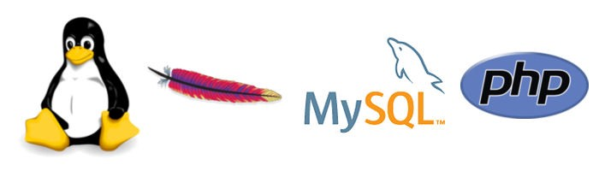
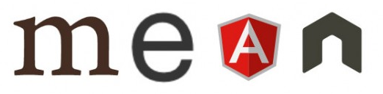
Open Source Software Dev. Stacks
MongoDB (MVC)
document oriented, JSON JavaScript Object Notation
Express.js (MVC) or Hapi.js
Backend HTTP & API web app middleware, gets client request, sends server response
Angular.js (MVC) or React.js
Frontend web app, MVC framework, single page app
Node.js
Backend event-driven I/O JavaScript engine for Express
traditional LAMP stack
Linux
standard, solid server OS
Apache HTTP Server
Web server, good with PHP
MySQL
Transaction oriented DB
Python↑ PHP↓ generate HTML
Many frameworks, support frontend from the backend
multi-page sites and CMS such as Drupal, Wordpress
Notes:
Alternative stacks:
MERN – Replacing Angular with React.js
https://medium.com/@devathon_/mean-vs-mern-stack-development-5ba3e517bc68t
Search: react vs react native, MEAN vs MERN
MHAN – Replacing Express.js with Hapi.js
Meteor is another stack. https://www.meteor.com/
See this link for opinion on the Future of traditional stacks (Java, .NET, Python, Groovy and LAMP):
https://www.techmahindra.com/sites/blogs/Why-MEAN-Stack-for-your-next-WebApp.aspx
MEAN as been in use since ~2010 and is JavaScript on both front and back ends. MEAN stack supports single-page application (SPA) is a website that re-renders its content in response to navigation actions (e.g. clicking a link) without making a request to the server to fetch new HTML. These web apps can be very responsive to user input. Origin of the term: https://www.mongodb.com/blog/post/the-mean-stack-mongodb-expressjs-angularjs-and https://www.mongodb.com/blog/post/the-modern-application-stack-part-1-introducing-the-mean-stack
LAMP stack apps tend to be traditional multi-page sites where the user facing frontend content is formatted on the back end by CMS (content management systems) such as Drupal, Wordpress
Both MEAN and LAMP are collections of Open Source projects
MEAN Stack LAMP Stack
Operating System Cross-platform Linux OS but mostly Linux but Apache, MySQL, Php, Python all run cross platform
Database MongoDB, No-SQL MySQL, the first open source database a ‘non-relational’ database a ‘relational’ database using SQL
good for documents good for business transactions and traditional data
Programming Language(s) JavaScript, back & frontend Frontend:HTML5 & JavaScript Backend:PHP/Python
Structure Slower & limited due to its blocking structure faster & scalable due to its non-blocking structure.
https://www.peerbits.com/blog/lamp-stack-vs-mean-stack.html
https://medium.com/@thinkwik/your-a-z-guide-to-mean-stack-development-f52fa987708
https://www.advaiya.com/blog/lamp-stack-vs-mean-stack/
http://www.allaboutweb.biz/a-brief-comparison-between-mean-stack-and-lamp-stack/
https://www.linkedin.com/pulse/lamp-vs-mean-deciding-right-stack-your-startup-robert-roose
https://hackernoon.com/mongodb-vs-mysql-comparison-which-database-is-better-e714b699c38b
"MySQL is well-recognized for its high performance, flexibility, reliable data protection, high availability, and management ease. Proper data indexing can solve the issue with performance, facilitate interaction and ensure robustness. But if your data is unstructured and complex, or if you can’t pre-define your schema, you’d better opt for MongoDB. And what is more, if you need to handle a large volume of data and store it as documents — MongoDB will help you to meet the challenges."
https://en.wikipedia.org/wiki/MongoDB https://www.mongodb.com/
https://en.wikipedia.org/wiki/Express.js http://expressjs.com/
https://en.wikipedia.org/wiki/MEAN_(software_bundle)
https://www.quora.com/What-are-the-pros-and-cons-of-Node-js-versus-Apache-web-server
https://www.lullabot.com/articles/will-javascript-eat-the-monolithic-cms
https://www.nginx.com/blog/nginx-vs-apache-our-view/
https://www.digitalocean.com/community/tutorials/apache-vs-nginx-practical-considerations
Why MEAN stack (statistical average? , why not AMEN (so be it, verily, truly, 'amen to that') or MANE (as a homophonic pun on int main {} )
Shopify powers 1 million merchants and serves 80K requests per second at peak.
https://www.businesswire.com/news/home/20191030005121/en/Powering-1-Million-Merchants-Shopify-Debuts-Global
See Shopify's stack (it's big) https://stackshare.io/shopify/shopify
https://stackshare.io/shopify/e-commerce-at-scale-inside-shopifys-tech-stack
Netflix stack – http://highscalability.com/blog/2015/11/9/a-360-degree-view-of-the-entire-netflix-stack.html

Slide 14
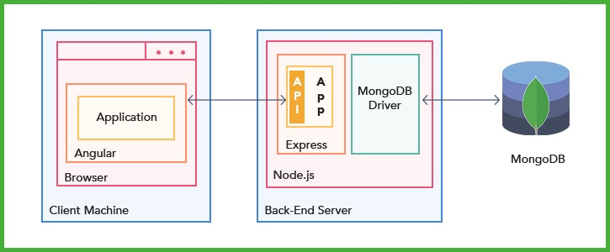
MEAN – OS independent (not exactly a stack)
Node.js is your browser's JavaScript engine…without the browser UI & user. Express.js is your browser's communications…without the browser UI & user. Express is the server framework for Node.js; it processes APIs and does HTTP. Angular is what HTML would have been, had HTML been designed for applications. "Full Stack" really means a developer who uses MEAN.
Notes:
"This tutorial walks you through the creation of a web application using the popular MEAN stack." See https://www.ibm.com/cloud/cloud-foundry

Slide 15
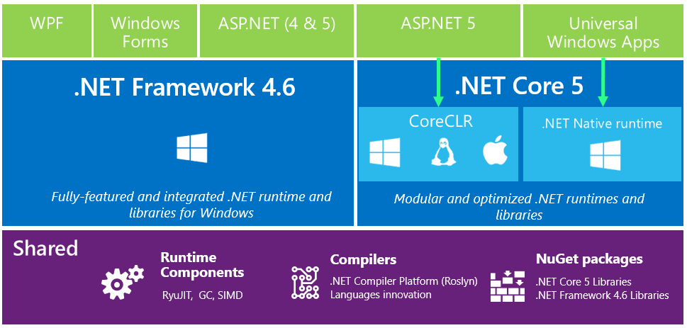
Microsoft .NET Core goes cross platform
WIMP stack: Windows Server, IIS = Internet Information Services (or Apache), MySQL or MS-SQL Server, PHP and/or Python and/or .NET
Notes:
WIMP stack: Windows Server, IIS = Internet Information Services, MySQL or MS-SQL Server, PHP and/or Python and/or .NET
WIMP stack: uses Apache instead of IIS
The .NET platform can create local standalone applications deployed to a single PC (Windows Forms) although the browser with its JavaScript engine is now the default User Interface platform.
The ASP – Active Server Pages aspect of .NET interacts with Microsoft’s web server, IIS - Internet Information Services, to run applications via a client’s browser.
There are courses using this platform in the School of ICT.
Programs written in any language for .NET Framework execute in a software environment named Common Language Runtime (CLR), an application virtual machine that provides services such as security, memory management, and exception handling. This is similar to the Java Virtual Machine concept.
The Model-View-Controller (MVC) architectural pattern is commonly used by most object oriented development platforms. MVC separates an application into three main components: the model (data domain), the view (User Interface), and the controller (handle user interaction, work with the model, and ultimately select a view to render that displays UI). This pattern is used in most object oriented development platforms. In theory, the same controller could use a browser/web view, a different view for a local application on a desktop's big screen display, keyboard, and mouse and a different view for a smartphone. The same controller talks to a model where the underlying data store could be changed from a traditional relational DB (e.g. Oracle or IBM's DB2) to a noSQL DB (e.g. MongoDB). ADO.NET allows programmers to access data and data services from any type of database. Data stores and SQL access are abstracted away from the application into a data Model.
https://msdn.microsoft.com/en-us/library/dd381412(v=vs.108).aspx ASP.NET MVC Overview
https://msdn.microsoft.com/en-us/library/ff649643.aspx (identified as "Retired Content" but a good explanation of MVC concepts)
https://msdn.microsoft.com/en-us/magazine/mt842512.aspx Simpler ASP.NET MVC Apps with Razor Pages
Web programming experts know the info here –> https://codeburst.io/how-browsers-work-6350a4234634

Slide 16
SDLC: Systems Development Life Cycle
Problem…
Describe: why do this? project plan
Details: define business & user requirements
Solution…
Design: analyse into system specifications
Develop: implement software and hardware, system and user acceptance testing
Deploy: install system, train users
D'oh: maintain system and support users
Notes:
Understanding the problem:
A couple of hunters charter a float plane which takes them, their equipment, and supplies to a remote lake for a week. Seven days later, the plane returns. Upon seeing the hunters' prize of a large moose, the pilot announces, "Listen, My plane cannot take you guys, your gear, and your moose. Lose the moose." "Nonsense," says one hunter, "we hunted a moose like this last year, got it on a plane just like this, and took off without a problem."
Against his better judgement, the pilot loads them and their gear WITH the moose; he taxis to the downwind end of the lake, and does manage to take off from the water. But the plane barely clears the tree-line. A little further along, under full power to rise from the lake's valley, they crash into a ridge.
"Where do you suppose we are?" one hunter asks the other.
"Hmmm, about 500 meters short of where we crashed last year."
The hunters did not understand the problem.
Re Details: “Furious activity is no substitute for understanding.” H. H. Williams, Oakland, California
Re Design: “If you can't write it down in English, you can't code it.” Peter Halpern, Brooklyn. New York
Re Develop: “The sooner you start to code, the longer the program will take.” Roy Carlson, University of Wisconsin
Re Design & Develop: “If the code and the comments disagree, then both are probably wrong.” Norm Schryer, Bell Labs
“When explaining a command, or language feature, or hardware widget, first describe the problem it is designed to solve.” David Martin, Norristown, Pennsylvania
“Testing can show the presence of bugs, but not their absence.” Edsger W. Dijkstra, University of Texas
Jon Bentley. 1985. Programming pearls. Communications of the ACM, Vol. 28, Issue 9 (Sept. 1985), pages 896–901. https://doi-org.libaccess.senecacollege.ca/10.1145/4284.315122
To quote Homer Simpson: D'oh! This last step is easy to forget and sometimes hard to foresee. If not done well, the fixing and supporting of the last project will slow the current one you are supposed to be working on.
Accomplishing future maintenance and supporting users is an ongoing and frequently long lived process. That process should be designed into the solution. i.e. Don't make the solution the next problem…
Only 25% of software budgets are spent on implementation of new systems. 75% of the money goes to maintenance, (why we need Version Control, see below)
There are many ways to describe the SDLC and its stages and phases but they all have the same ideas and sequence. Some methodologies will do these stages once for the entire project’s scope (called Waterfall) and others will do it iteratively for sub-stages of the project (e.g. Agile). There are many other methodologies.
Good IoT systems have maintenance & update of the device firmware designed in. It is not something that can be implemented later.
If it costs $1 to define a requirement at the beginning of the SDLC, it costs $100 – $200 to satisfy the same requirement realized at the D'oh stage of the SDLC.
“It takes three times the effort to find and fix bugs in system test than when done by the developer. It takes ten times the effort to find and fix bugs in the field than when done in system test. Therefore, insist on unit tests by the developer.” Larry Bernstein, Bell Communications Research (Bentley, 1985)
https://en.wikipedia.org/wiki/D%27oh!
https://en.wikipedia.org/wiki/Systems_development_life_cycle
https://en.wikipedia.org/wiki/Requirements_analysis

Slide 17
SDLC: Systems Development Life Cycle
What is the problem?
Determine & Define: 3rd term: Requirements Gathering Using OO Models
What is the solution?
Design: 4th term Analysis and Design Using OO Models
Develop: 5th term Project Planning and Management 6th term Project Implementation
Don't make the solution the next problem…
Deploy: install system, train users
D'oh: maintain system and support users
Notes:
Why SYS466? Don’t learn a programming language, solve a problem instead
https://medium.com/datadriveninvestor/dont-learn-a-programming-language-solve-a-problem-instead-654f6bbfb573
Courses in your program to support the SDLC
CPD & CPA
https://ict.senecacollege.ca/course/sys366
https://ict.senecacollege.ca/course/sys466
https://ict.senecacollege.ca/course/prj566
https://ict.senecacollege.ca/course/prj666
BSD
https://ict.senecacollege.ca/course/bts330
https://ict.senecacollege.ca/course/bts430
https://ict.senecacollege.ca/course/bts530
https://ict.senecacollege.ca/course/bts630

Slide 18
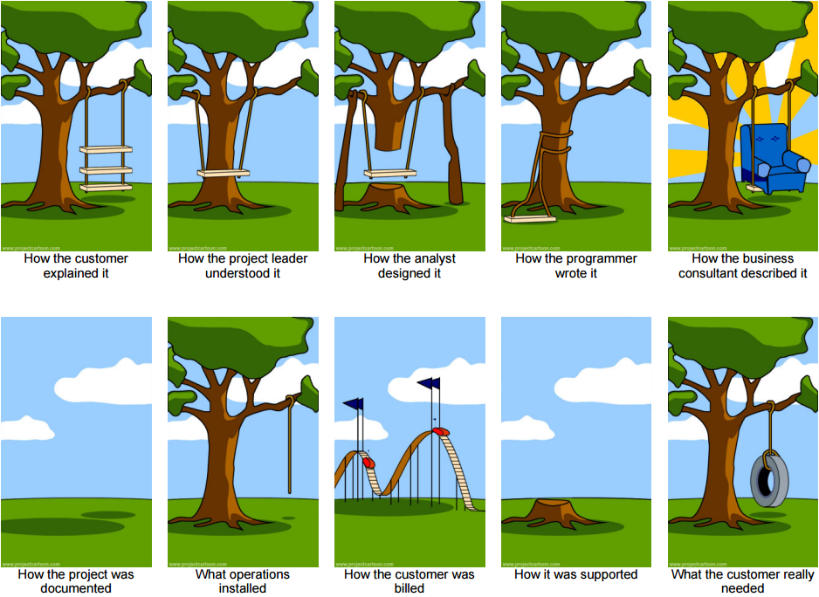
Systems Development IRL
Notes:
The customer needs more throughput and this is what they asked for. Nobody likes admitting they have a problem that they don't know how to solve; thus the client would like you to focus on their solution idea, not belabor their problems. Adding two seats will triple throughput.
It should have a wide scope and improve all branches of the customer's business
OK, if that's the way you want it, we will make sure it supports the branches
You defined a "swing" as two ropes tied to a tree with a plank tied at the other ends. That's what you asked for, that's what you got. And now, you don't like it? Rotate the tree (or gravity) -90 degrees and it will work the way you want. Doing it over again means it will cost more and take longer but we'll try to reuse some of the code (thereby preserving some of our previous misunderstandings).
We all wish it could be that way: comfortable, surrounded by sweetness and light. The sales people not only wish it, they believe it. Everything is easy for those who are not doing the work of implementing and deploying,
Nobody knew what was going on anyway.
It's the best we could do given the timeframe and resources available. With a few procedural changes, it will work like a swing. Instead of "sit on seat and pump legs", "run towards rope, jump and hold on tightly." User will be swinging in both cases.
A lot of time and materials went into this project and the invoices reflect that.
After looking at the issues log, this seemed the best approach and most merciful solution.
Oh, well. Lesson learned. On to the next project…
The brain dislikes FUD: Fear, Uncertainty, Doubt. ...the unexplained, the unknown, the lack of an obvious causal relationship. In the absence of a resolution to the FUD conundrum, the brain makes things up to quiet itself down, and INFERS a causal chain. (This is how/why conspiracy theories are formed.)
We tend to avoid problems which embodies all those FUD things, and focus on solutions which make us feel better. But a solution needs an intellectual decision, not an emotional one. But humans make most of their decisions based on 'gut feel', not with their head. You want a new smartphone, then look for reasons to rationalize your desire.
The fix is to fall in love with their problem, not your solution.
The classic original version
http://www.projectcartoon.com/cartoon/3
Expanded version:
http://www.projectcartoon.com/cartoon/2096040
Software development consulting
http://www.projectcartoon.com/cartoon/1078
The life cycle of a software development project with a consulting organization.

Slide 19
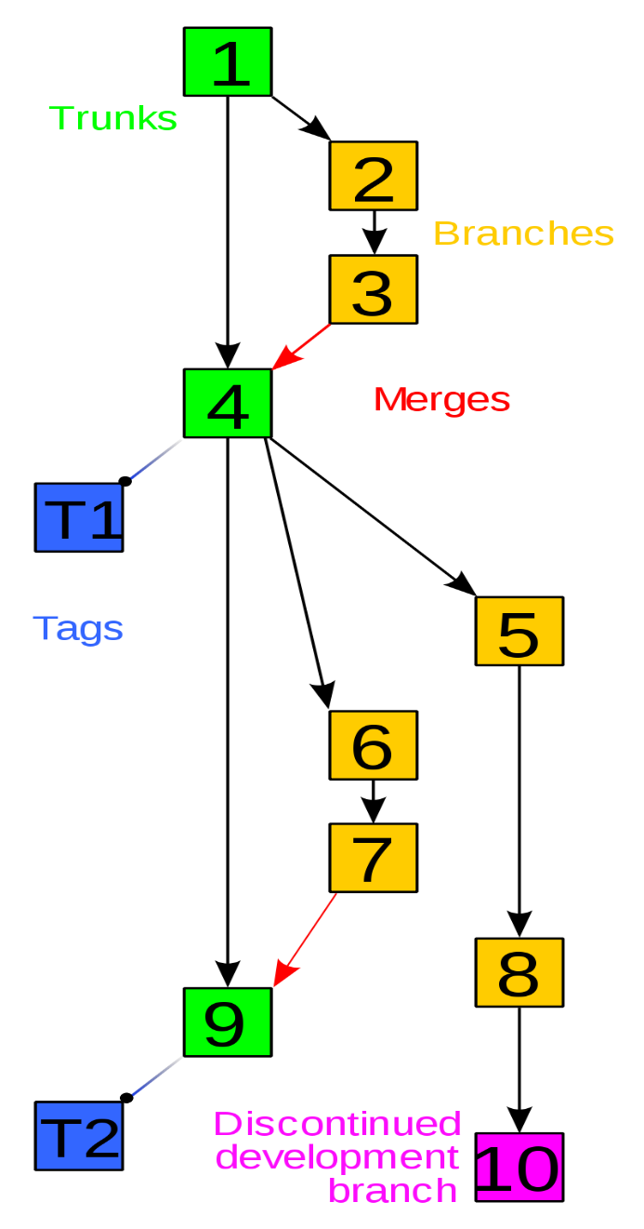
Software Development Versioning
Version control
AKA revision or source control
Repository of project files
History of all code changes
who made changes: what, where, when, and why
Version control system
Organize / manage team workflows
Maintenance of current software release
Development of new software releases
Trunk: master / baseline version
Branches: Maintenance & Development
Tags: releasable version name/number
Notes:
Version control systems, also called sub-version control or revision control, are integral to building software. They combine a repository of project files with a history of all code changes, making it easy to edit and trace changes over time. Version control helps large projects from spinning out of control by letting individual programmers, writers, or project managers tackle a project from different angles without getting in each other’s way and without doing damage that can’t be undone.
Trunks and branches are part of the same whole.
Trunk contains current, stable code and product.
A Branch is eventually merged back into the trunk.
Branch is copy of the trunk plus modifications. Code in a developer's working copy which is being maintained (fixes & mods to current release features) or developed (new release features) can be committed to the branch after unit testing. After branch is fully system tested, it is merged back into trunk where version control system notes all updates that are different from the original trunk creating version history.
By Revision_controlled_project_visualization.svg: *Subversion_project_visualization.svg: Traced by User:Stannered, original by en:User:Sami Keroladerivative work: Moxfyre (talk)derivative work: Echion2 (talk) - Revision_controlled_project_visualization.svg, CC BY-SA 3.0, https://commons.wikimedia.org/w/index.php?curid=9562807

Slide 20
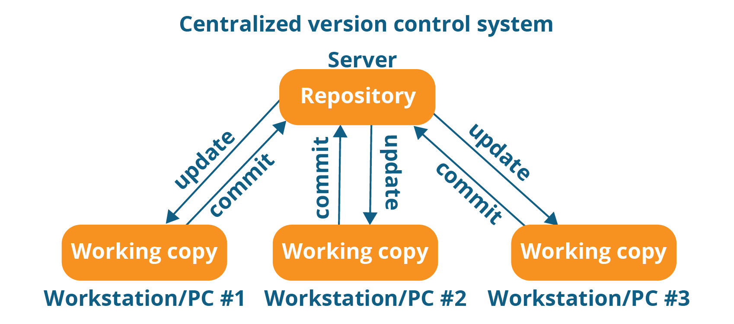
VCS – Version Control Systems
Apache Subversion (SVN)
Traditional source code revision control and software versioning
CENTRALIZED management and repository ('repo')
Client – Server architecture
One trunk with branches + net change history
Hierarchical, serial promotion process from branch to trunk
Notes:
SVN relies on a centralized system for version management. A single server has a repository containing modules (a set of related files) organized in a hierarchical directory structure. Programmers using that system should always be connected to the server's repo. A source file is checked out from the repo to a programmer's local working copy. Programmer makes changes locally. You are not the only person working on the project, right? An svn update command merges modifications committed by others and synchronizes their changes to your working copy. When you commit (check in) your changes to the repo, a similar process occurs merging your changes and the version numbering is incremented. Conflicting changes are identified in the merging process at both the working copy and repo ends. SVN has a locking option when checking a file out to prevent two users from simultaneously editing the same file at the same time. Locking files reduces complexity of merging and managing code but also reduces flexibility. SVN has "branches" to allow parallel maintenance of the current release and development of the next release but this can add many orders of complexity. There merge updates requiring developers to resolve conflicts manually needing many hours of everyone's time.
https://www.perforce.com/blog/vcs/what-svn

Slide 21
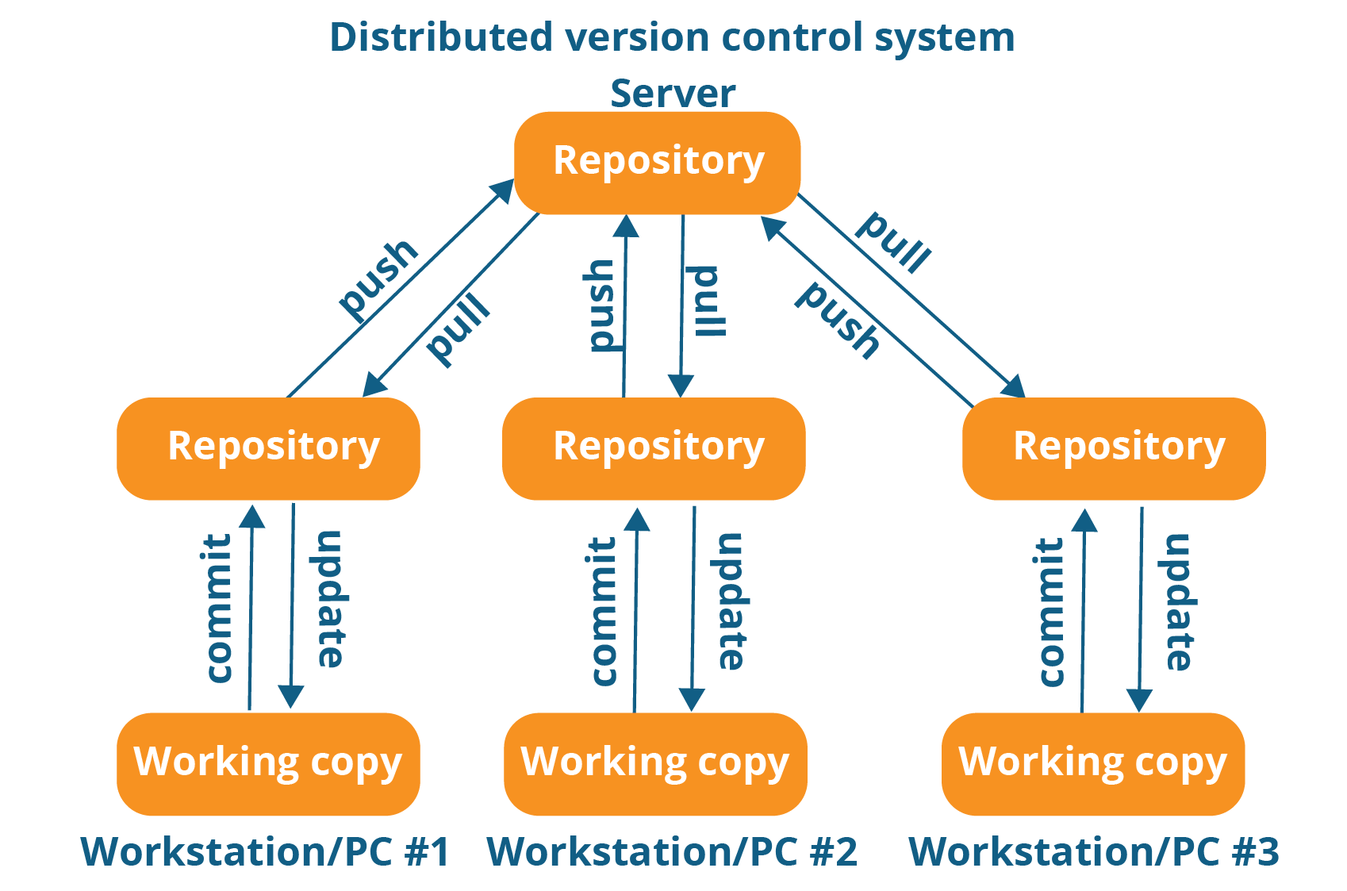
VCS – Version Control Systems
Git (GitHub is a hosting service for Git repositories)
Management of changes in any set of objects, not just source code.
DISTRIBUTED VCS, everyone has the 'repo'
Peer-to-Peer architecture
A 'fork' is a copy of the trunk at central repo. Branches created locally.
Notes:
Linus Torvalds' design of Git used CVS (precursor to SVN) as an example of what not to do; he added this advisory: if in doubt, make the opposite decision that CVS did. Torvalds wrote the initial 1,300 line version Git in 4 days, ran the first merge of multiple branches 11 days later. 11 days after that, Git made 6.7 patches per second to the Linux kernel tree (that is much faster than SVN could do it). 6.5 weeks after that, Git managed the kernel 2.6.12 release. On 21 December 2005, Git version 1.0 was released, 8.5 months after those initial 1,300 lines were written. That is fast for a project of that scope, complexity, and importance.
Git runs as a distributed version control system. A central repository exists (e.g. at GitHub or Bitbucket) from which a user downloads the entire repo creating a 'fork' which starts as a 'master' branch on their local system. This gives users the entire change history and frees them from needing a constant connection to the server with the central repo. Each user generates their own branches (pulled from their own forked master branch) that are later pushed and merged into the branch master of the central repository creating a release candidate (rc). Once the rc has been tested and approved, it is pushed to the central repo trunk.
support for distributed, non-linear workflows with ensured data integrity.
Sophisticated merging of a fork back into the central repo and speedy synchronization with other distributed forks.
FYI
DevOps "a set of practices intended to reduce the time between committing a change to a system and the change being placed into normal production, while ensuring high quality" (Bass, Weber, Zhu, Liming, 2015). DevOps: A Software Architect's Perspective. ISBN 978-0134049847.
DevOps ("development" and "operations") is a software development methodology that combines software development with information technology operations to shorten the systems development life cycle while delivering features, fixes, and updates frequently in close alignment with business objectives.
The term DevOps has been used in multiple contexts and there is no unique definition.
https://en.wikipedia.org/wiki/DevOps
https://aws.amazon.com/devops/what-is-devops/
https://engineering.shopify.com/blogs/engineering/why-shopify-moved-to-the-production-engineering-model
https://www.devopsdays.org/events/2018-toronto/program/john-arthorne/
https://speakerdeck.com/jarthorn/continuous-delivery-at-shopify see slide 5 https://speakerdeck.com/jarthorn/continuous-delivery-at-shopify?slide=5

Slide 22


Software Release Numbering
1.2.3
Major release (new version) Can be forward and backward compatible if architecture is not changed.
Minor update (feature enhance) Must be compatible within Major release but not necessarily forward compatible with next Major release.
Micro revision (bug fix) Must be forward and backward compatible within the Major release, i.e. doesn't break things
Forward compatible
Backward compatible
Notes:
A wired, landline, analog, pulse dial telephone is forward compatible with a phone system that can connect to a wireless, mobile, digital, tone dial smartphone. Similarly the smartphone is backward compatible, by virtue of the phone system, with an old landline telephone.
Backward compatibility allows for interoperability with an older legacy system, or with input designed for such a system, especially in telecommunications and computing.
e.g. plug a 50 year old analog rotary (pulse) dial telephone into a land line wall jack…will work if the digital telephone system with tone dialing is still backward compatible. New telephone systems were backward compatible for decades with old equipment, both internally within their own systems as well as at the handset end. But your new VoIP box is not backward compatible with your old dial phone.
e.g. software that can read old file formats such as early versions of jpeg or PDF files.
e.g. software that works with old hardware devices …there is a limit. Are any OS backward compatible with punch card readers or tape drives anymore?
A new game controller may be designed to be backward compatible so that older versions of game software and game consoles can be forward compatible.
Forward compatibility can be designed into a standard. ISO standard PDF/A is a future-proof PDF file format.
From https://www.pdfa.org/pdfa-faq/ Will future developments to the PDF/A standard make current PDF/A versions obsolete?
The ISO standard requires that future PDF viewing applications must be backward compatible, so that they are capable of correctly displaying older versions of PDF/A.
E.g. HTML tags are meant to be forward compatible.
A <P> tag will always mean paragraph tag.
<P align=center> The align attribute is not forward compatible with HTML5, is compatible with HTML4, is not backward compatible with very old HTML.
Browsers are usually forward and backward compatible:
A browser is forward compatible if it will not break when displaying a newer version of HTML, it should gracefully glide over tags and attributes it does not recognize.
A browser is backward compatible if it supports all older versions of HTML including deprecated tags.
"Deprecated" tags and attributes are those that have been replaced by other, newer, HTML constructs. Deprecated tags are still included in the HTML draft or recommendation but are clearly marked as deprecated. Once deprecated, tags may well become obsolete. The draft "strongly urges" the non-use of deprecated tags. Deprecation is the process of gently moving from old to new standards. Programmers creating new code are expected to avoid using deprecated items and if maintaining old code, to convert deprecated items.
https://simplicable.com/new/backward-compatibility-vs-forward-compatibility
The three tier numbering system is a convention adopted by software vendors. The purpose of the numbering system is twofold:
To communicate the order of the releases so you can track the software’s development over time.
To communicate clearly the nature and degree of changes in each release.
Release numbers are groups of numbers separated by dots – the dots are not decimals, merely separators.
The number on the right indicates micro changes to the code base. These are typically bug fixes.
Micro revisions are defined as changes which are forward and backward compatible.
This means that 3.4.2 is backward compatible with 3.4.1. Forward compatibility means that customers who install 3.5.0 should not have any compatibility problems with 3.4.2 clients, except that clients with 3.4.2 will not have the features of the 3.5.0 clients. If there are compatibility issues then it is not a micro change and the minor revision number needs to be incremented.
The minor revision number is typically used to introduce new product features of the software. Changes here must be backward compatible, but not forward compatible. For example, clients who upgraded to 3.4.2 will have no compatibility issues with 3.3.0 clients. The 3.4.2 software can read 3.3.0 files, but may silently change the format to something that the 3.3.0 clients can not be able to read in order to gain new features. Thus, minor changes are always backward compatible, but not forward compatible.
Major changes mark compatibility boundaries. A new major release will have new feature sets or require hardware changes. Thus, a new major release can be forward and backward incompatible. However, if underlying architecture has not changed, the Major release may retain forward and/or backward compatibility with previous releases. E.g. a new release may occur due to a radical change in the User Interface but be compatible with existing/future hardware, OS, and data file formats. Clients who upgrade to 3.0.0 from 2.2.2, for example, will have compatibility issues due to reengineered file formats or incompatible hardware. Or, 4.0 clients will have compatibility issues with 3.4.2 clients because of the new hardware or the new way the software works.
https://en.wikipedia.org/wiki/Software_versioning
Note: Microsoft uses build numbering; see the wiki article.
https://www.w3.org/People/Bos/DesignGuide/compatibility.html

Slide 23
Software Development Versioning
Software development is typically never finished.
At some point, it is finished enough to be released
We continue to add features, new functionalities, and fix bugs in the code.
https://xkcd.com/2224/ – Software Updates
Development Stage
Release Stage
0.1 … 0.9 unit test
1.0a - alpha α system test
1.0b - beta β usability test
1.0rc - release candidate
1.1rc
1.2rc
2.0rc
1.0.0 'point zero' release
1.0.1 bug fix
1.1.0 feature enhancement
1.1.1 bug fix
1.2.0 feature enhancement
2.0.0 new version 'point zero' release
Notes:
https://en.wikipedia.org/wiki/Software_release_life_cycle
This slide indicates a typical revision schedule for software
In the development stage, only a two numbering system is used: 0.1, 0.2, etc. Each number indicates a new build of the software.
When the software project is complete, the numbering of 1.0 is given, and the word Alpha is appended. This means that the software is not stable and has major bugs, preventing some of its features from working. The Alpha number is increased to indicate revisions in the code – usually bug fixes which improve functionality or performance.
After the major bugs have been fixed and the software is stable, the Beta phase is commenced. Notice that the numbering is still 1.0 throughout this timeframe.
When all of the known bugs have been dealt with and the software now performs as expected, the Release Candidate phase is begun. This phase provides an opportunity for selected public members to download the software and try it out. During this phase, bugs are usually discovered as well as compatibility issues due to specific system configurations. This gives software developers a method to test the software in a real world environment, but without the pressure of officially launching the software. During this phase changes are made to fix configuration issues and bugs.
When the software is really for public release and announced as a finished product, it is given the numbering of 1.0.0 (typically the last number if it is a 0 is not written, i.e. 1.0)
1.0.2 – announces bug fixes from 1.0.1 and is backward compatible with 1.0.1 and forward compatible with 1.1.0.
1.1.1 – is backward compatible with 1.1.0, but is not forward compatible with 1.2.0 because of new features or formats.
2.0 – is not backward compatible with 1.2.1, and will not be compatible with 2.1, when it is developed.

Slide 24
Software Version Installation
Keep OS, apps, and firmware up-to-date within the major release.
Apache Struts 2 patch March 2017 would have prevented Equifax breach May–Aug.
When to install a new major release?
6 months after n.0 (point zero) release
or at the n.1 (point one) minor update
Backup first! Have a roll-back plan.
Notes:
https://xkcd.com/2261/
What happens when you don't keep your patches up to date?
Google: Equifax data breach, UN breach, …a lot of breaches.
In the case of Equifax, attacked by four members of China’s People’s Liberation Army (https://www.nytimes.com/2020/02/10/us/politics/equifax-hack-china.html)
The Struts framework is designed to help developers create Java web applications that utilize a MVC architecture.
https://www.synopsys.com/blogs/software-security/what-caused-equifax-breach/ "Most bug fixes … require downloading and installing a patch, possibly rebooting a machine, and being done with it. The fix here, by contrast, typically requires each Web app that was developed with a vulnerable version of Apache Struts to be recompiled using a patched version.“ Equifax probably did not have a complete inventory of the open source components in use in their applications. Therefore, it’s likely that in March, when the vulnerability was disclosed, they didn’t even know they were at risk. "The company relied upon a single individual to manually implement its patching process across its entire network. This individual had no way to know where vulnerable software in need of patching was being run on Equifax’s systems." http://securities.stanford.edu/filings-documents/1063/EI00_15/2019128_r01x_17CV03463.pdf
https://techbeacon.com/security/why-equifax-breach-should-never-have-happened
https://www.nytimes.com/2020/02/10/opinion/equifax-breach-china-hacking.html
https://struts.apache.org/birdseye.html
Apache Struts 2 had a web application server vulnerability. A patch was issued March 6, 2017 and Apache notified users such as Equifax.
Affected Software Struts 2.1.2 to 2.3.33, Struts 2.5 to Struts 2.5.12
Recommendation Upgrade to Struts 2.3.34 or Struts 2.5.13
https://cwiki.apache.org/confluence/display/WW/S2-052
https://nvd.nist.gov/vuln/detail/CVE-2017-5638
https://www.synopsys.com/blogs/software-security/equifax-apache-struts-cve-2017-5638-vulnerability/
https://blogs.apache.org/foundation/entry/apache-struts-statement-on-Equifax
https://www.wired.com/story/equifax-breach-no-excuse/
https://www.cnbc.com/2019/02/13/equifax-mystery-where-is-the-data.html
A newer problem as of 2018-06-05:
Apache Struts versions 2.3 to 2.3.34 and 2.5 to 2.5.16 suffer from possible Remote Code Execution.
Upgrade to Struts 2.3.35 or Struts 2.5.17
http://cve.mitre.org/cgi-bin/cvename.cgi?name=CVE-2018-11776
https://cwiki.apache.org/confluence/display/WW/S2-057
Unless you really NEED a new major release, wait for others to find the bugs and vulnerabilities.

Slide 25
Software Server Environments
Development | Integration & Testing | Staging | Production
Implementation Source code developed and changed | Source code is checked in to Version Control System | Source code promoted to release candidate | Deployment Source code is released
Unit (program) testing | System tested with dependent modules and sample database. | UAT – User Acceptance Testing, User Training | Live don't even think about testing here
Notes:
Software server environments AKA Deployment environments
https://en.wikipedia.org/wiki/Deployment_environment
Environment/Tier Name Description
Local Developer's desktop/workstation for coding, e.g. using Visual Studio IDE. This is the ONLY place source code is written.
Development Development server with sample database and other software services. where unit testing of changed program is performed by the developer.
Integration System build. For developer testing of side effects of program change in context of existing system, and for technical system testing.
Test/QA/Internal Acceptance business system testing. Quality assurance team make sure that the new code will not have any impact on the existing functionality and they test major functionalities of the system once after deploying the new code in their respective environment(e.g. QA environment)
Stage/Pre-production /External-Client Acceptance User Acceptance Testing (UAT) in a mirror of production environment with proposed changes. Also used for user education and training.
Production/Live Serves end-users/clients
Hypervisors are sometimes used to host these four separate servers on the same hardware. Movement of files and data between the virtual servers is done at server hardware speed (instead of competing for bandwidth on a real network linking separate server hardware).

Slide 26
Software Server Enviro Security
Who | Development | Integration & Testing | Staging | Production
Program- mers | All authority | Most authorities | Application authority | READ ONLY authority
Business Analysts |  | Application authority | Application authority | READ ONLY authority
End Users |  |  | Application authority | Application authority
System Admin | ← Authorities as needed →
Notes:
All authority = user can change source code, compile, alter database structure, alter data in DB tables.
Most authority = user can compile promoted source code, alter database structure, alter data in DB tables.
Application authority = user can do only what application software allows. Alteration of data in DB tables strictly controlled; i.e. other than by applications. E.g. SQL CREATE and DROP to create and delete tables. INSERT, UPDATE or DELETE data (rows).
READ ONLY authority = user cannot run programs nor change data / DB . Can run Queries to analyze data. Can inspect properties of objects and files.

Slide 27
Version Control Life Cycle
Action | Development | Integration & Testing | Staging | Production
Check out | working copy | ⬅ branch1 ⬅ |  | Ver 1.0.0
Check in | ➔ | branch1
Test & Promote |  | branch1 ➔ | Ver 1.0.1rc
Check out | working copy | ⬅ branch2 ⬅ | Ver 1.0.1rc
UAT* & Release |  |  | ➔ | Ver 1.0.1
Check in | ➔ | branch2
Test & Promote |  | branch2 ➔ | Ver 1.0.2rc
UAT* & Release |  |  | ➔ | Ver 1.0.2
* UAT = User Acceptance Testing rc = release candidate
Notes:
rc = Release Candidate UAT = User Acceptance Testing
How to maintain history of source code, files, and documents? The traditional approach is shown in this slide.
The programmer "checks out" a file/program source from the Production level to a Development system, changes are made to the working copy and unit tested, then the file/program source is "checked in" to the branch at Integration & Testing. System testing is done and file/program source is promoted to the next level, Staging, where the version number is incremented and a release candidate is created. After UAT, the rc is released to Production and becomes the current version. Note that source is checked out from the next highest level so all in-progress changes are preserved. Changes are made ONLY in the working copy at the Development level.
Bug fixes to current version (1.0.n) are in progess with feature enhancement (1.n.0) in progress with major application architecture changes (n.0.0)
https://dltj.org/article/software-development-practice/
History: RCS to CVS to SVN to Git
RCS was developed to version individual files in a single project on a single server.
Like individual short stories that you can check out of a library and modify. There is only ONE copy of the short story leant to one programmer.
Big problems if those short stories are actually related chapters in a novel.
Strict file locking and mandatory check out
No central repository. Original source code location is the repository. A working directory is used for changes in progress.
OK when all development is done on the production server (not at good idea anymore).
Serial, sequential and hierarchical program changes:
bug fix 1 must be checked in and committed before bug fix 2.
Version 2 must be checked in and committed before Version 3
CVS tracks versions of your project. Can handle multiple projects
Like individual short stories that you can check out of a library and modify but with multiple copies of the same story
CONCURRENT Version System was build on top of RCS
Allows multiple bug fixes or version enhancements to be developed in parallel and merged later
There is only one canonical version of the repository code with changes pending
Added a central repository separate from source code libraries that RCS did not have
sequential and hierarchical program changes with ability to merge separate changes that have occurred in parallel (thus the name Concurrent)
Several developers may work on the same project concurrently, each one editing files within their own "working copy" of the project, and sending (or checking in) their modifications to the server. To avoid conflicts, the server only accepts changes made to the most recent version of a file. Developers are therefore expected to keep their working copy up-to-date by incorporating other people's changes on a regular basis.
CVS assigns sequential version numbers (1.1, 1.2, 1.3, ...) to each file.
easily check out only a subset of the repository.
CVS lets you expand version numbers into each file when checking it out, making it easy to identify which version a file is without reference to the repository it came from.
convenient when the repository is a collection of largely unrelated files, need to track changes on individual files
SVN
It’s like a library where you get to change and add chapters in books.
More comprehensive in scope and function than CVS
dependent on a central repository
There is only one canonical version of the repository code with changes pending
Atomic commit: a set of interrelated changes can be applied affecting multiple files. E.g. changes to ProgramX require concurrent changes to file/tableY (e.g. add a data field or column)
Better collision management with merging multiple versions of a single source file.
an improvement on CVS
revision numbers are sequential across the entire repository; a given number applies to the entire repository, not just a single file
Used when many source files used to build a single program or library; need a coherent history for the project as a whole.
Git is distributed source control, GitHub is the platform for Git providing management and collaboration.
It’s like a library where you get to change and add to the library: short stories, chapters in books, books.
There can be multiple versions of the project on standalone machines – no need for a central server…so where does the code comefrom?
GitHub is the central place to share software development
Disparate changes are easily merged. Has tools for managing possibly conflicting changes from multiple developers
https://subversion.apache.org/quick-start
https://blog.codecentric.de/en/2016/11/a-short-history-in-version-control-systems-rcs-clearcase-svn-git/
https://dzone.com/articles/version-control-git-vs-svn
https://biz30.timedoctor.com/git-mecurial-and-cvs-comparison-of-svn-software/
https://betterexplained.com/articles/a-visual-guide-to-version-control/
https://betterexplained.com/articles/intro-to-distributed-version-control-illustrated/
https://en.wikipedia.org/wiki/Software_configuration_management
https://en.wikipedia.org/wiki/Version_control
https://en.wikipedia.org/wiki/Revision_Control_System
https://en.wikipedia.org/wiki/Concurrent_Versions_System
https://en.wikipedia.org/wiki/Apache_Subversion
https://en.wikipedia.org/wiki/Capability_Maturity_Model
https://en.wikipedia.org/wiki/Capability_Immaturity_Model
http://zo-d.com/blog/Project_Management_-_Immaturity_Model_v3.pdf

Slide 28
Create code with versioning
Write all the comments first! SaveAs minor version 0.1
Satisfy comments with code
Add functionality in small tested steps
Start with a basic shell that does very simple I/O Prompt for a value, output the value. Data types OK?
Add formula/algorithm that changes Input into Output
Add validation edits for the input.
Add one feature at a time, test, debug.
SaveAs each stage as minor version 0._+1
Use Git to manage your versioning process.
Notes:
What do you call a developer who doesn't comment code? A developer.
Practice software versioning by writing a program in stages, building up its functionality.
Write the comments first!
satisfy the mythical DOWIM compiler (DO What I Mean -- compiler ignores the code and compiles your comments)
programs do what you code, not what you mean.
what do your comments say the code should do?
You don't have comments? How do you know what you mean? If you can't explain it, how can you code it?
How do you eat an elephant? One bite at a time.
Break the program into bite-sized chunks that can work on their own or with the previously debugged code. Add one part at a time.
Debugging: Removing the needles from the haystack.
Debugging is like being the both the detective and the perpetrator at the same time.
The six stages of debugging: 1--That can't happen. 2--That doesn't happen on my machine. 3--That shouldn't happen. 4--Why does that happen? 5--Oh, I see. 6--How did that ever work?
Leave the problem alone for a while and come back later. A good night's sleep is often the best help you can give yourself. After midnight, problems can take hours to solve. In the morning, they usually take minutes.
Show a colleague your problem. Another pair of eyes can often spot what you can no longer see. Also, explaining things out loud to someone else can often reveal the problem's cause. (Thinking too much can result in infinite loops.)
When testing your logic, make one change at a time and re-test. Making too many changes at once can complicate debugging. When you are all done, re-test everything to make sure a fix did not "unfix" something else.

Slide 29
Coding and testing advice from IPC144
Pay special attention to the requirements and LEARN TO INTERPRET the output samples into code.
While coding, use REASONING and LOGIC to PREVENT mismatching outputs.
Do not wait to see what’s wrong with the output AFTER coding, i.e. after submitting to matrix; that is backwards. The documentation is very clear about the expected output.
The recommended process is:
Phase-1: Code it in VS. Know the C formatting features for printf, and apply formatting to match the output during the coding process. It's what many students do NOT do.
Phase-2: Unit test as you develop the solution. Each new logical section of code added that produces output should be analyzed to ensure it is matching the expected documented output. Again, this is what many students do NOT do.
Phase-3: Run the final solution in VS and leave the command console open. Do a complete visual line by line comparison to the documented expected output.
If this is done correctly, 99.99% of the issues should be caught at this stage. The only thing that might slip by and be caught after submitting on Matrix is having an extra space(s) on the end of a line (not otherwise visible on the output side).
If students are not detailed enough to catch things like upper/lower case letters, spaces between words, newline separation, precision points on numbers, then this means:
Students are not developing their attention-to-detail skills
Nor are they able to translate specific instructions into code
Phase-4: The last step is to submit the source code on Matrix where the char-by-char comparison is performed. Jumping from Phase-1 to Phase-4 is not a shortcut, it is the long way around.
Notes:
If your program's output was being reviewed by a human, the small differences in capitalization, spacing, and layout would not be a problem. But frequently, our programs are communicating with another program (which is indeed the case on Matrix). For efficient processing, the other program is not going to parse your output to figure out what you mean; the other program expects and looks for data in the expected location; whitespace, punctuation, and context are important things which frame the data exchange.

Slide 30
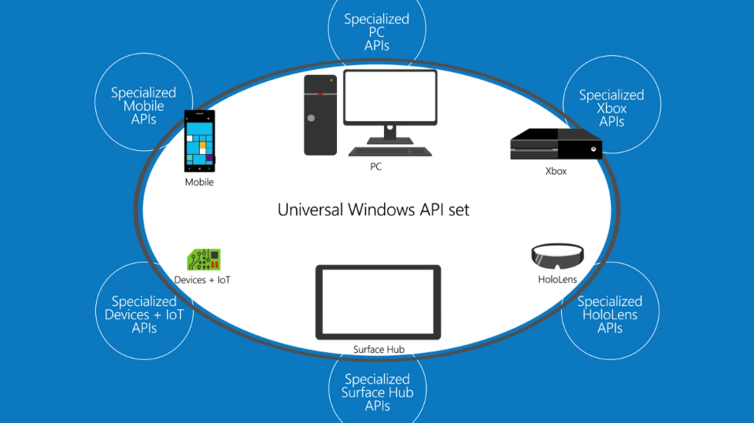
Application Programming Interface (API)
Notes:
APIs are the glue between the OS and Apps. Your app wants to prompt the user to open or save a file. The programmer does not want to know how to navigate the storage hardware or the directory tables to hardware addresses or even the dialog box that the user sees. Press Ctrl-O in Word or PowerPoint. Do you want to write that? And do it again for each platform? Not any more. We use APIs. An API is, loosely, a procedure call with parameters. E.g.call OpenFile([path\]fileName, fileHandle). Your program asks the OS for a file by name, the system sends back a “handle” which is an OS reference to that file, now opened and allocated to your program. Your program uses the handle to read and write the file, and finally close it.
The benefit is that a single API makes the applications more “portable”. For example, an application written for a Windows PC, could work on Surface Tablets, Windows Phones (not too many of those), Xbox, and Windows Server. The local implementation of the API will be different depending on the platform, but your program will not know the difference.
The disadvantage of this approach is that the APIs must be rigidly defined and adhered to which can limit programming flexibility. Advantage is… changes to an OS or hardware can be made without changing the API interface. The OS or hardware can be overhauled and improved without breaking application software because the API remains the same.
See https://www.youtube.com/watch?v=s7wmiS2mSXY in this week’s activity.

Slide 31
Additional notes

Slide 32
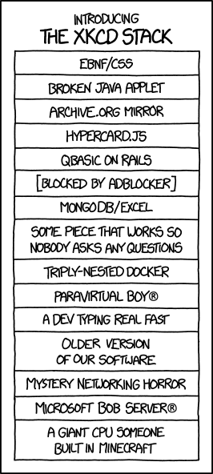
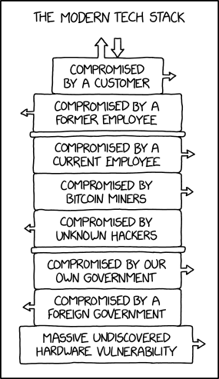
XKCD stacks
Notes:
The XKCD Stack – https://www.xkcd.com/1636/
This site requires Sun Java 6.0.0.1 (32-bit) or higher. You have Macromedia Java 7.3.8.1¾ (48-bit). Click here [link to java.com main page] to download an installer which will run fine but not really change anything.
https://www.explainxkcd.com/wiki/index.php/1636:_XKCD_Stack
The Modern Tech Stack – https://www.xkcd.com/2166/ Gotta feel kind of bad for nation-state hackers who spend years implanting and cultivating some hardware exploit, only to discover the entire target database is already exposed to anyone with a web browser.
https://www.explainxkcd.com/wiki/index.php/2166:_Stack

Slide 33
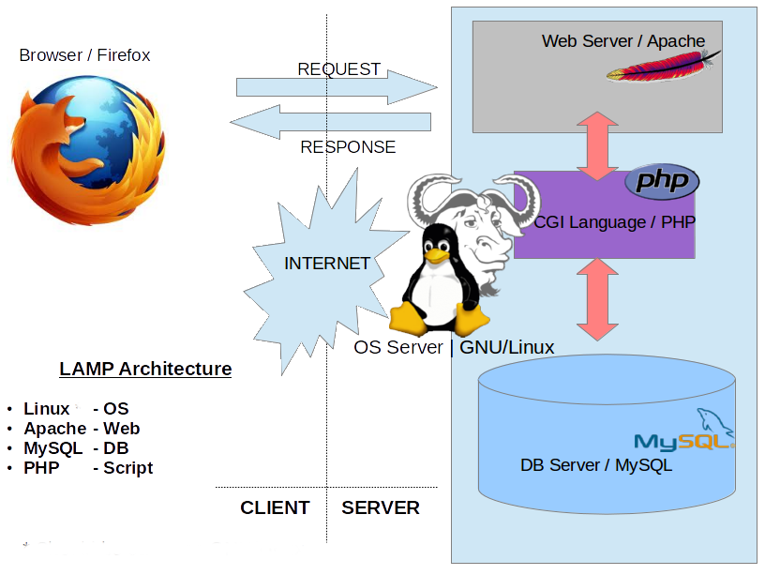
LAMP stack
Attribution: K7.india at English Wikipedia
Notes:
Inside the LAMP stack.
CGI - Common Gateway Interface, a standard for dynamic generation of web pages by a web server. Allows a web page to call a program.
PHP - PHP originally stood for Personal Home Page, but it now stands for the recursive acronym PHP: Hypertext Preprocessor.
GNU: GNU's Not Unix (another clever recursive acronym…and RMS is clever. Google: RMS GNU)

Slide 34
Software Terminology
Program
EXecutable File (EXE) MS Word
Process
Program in execution (loaded in memory) WINWORD.EXE
Threads
Tasks performed inside the process - mouse clicks - spell check - send to printer
Important OS Terms
Notes:
Program – a program is an application in an executable file, commonly with an EXE and/or DLL (Dynamic Linked Library) file extension. For example MS Word’s WINWORD.EXE. It is a file on a drive ready to be executed, i.e. run.
When a program file is run, the OS creates a process. Unique resources are reserved and memory addresses allocated for each process.
Some programs like PowerPoint will have a single process with one or more threads (AKA child process or sub-process) for each PPT file being edited. Other programs will have separate processes for each task, e.g. Chrome. [ use Task Manager to show WINWORD.EXE as the process for MS WORD ]
Inside a process, a specific action is performed in a “thread”. More than one thread can run concurrently. For example, a thread listens for a mouse click, another thread waits for you to finish typing a word and spell checks it. You can print a document and immediately continue using Word while the printing thread runs in the background.
Programming with threads is covered in our object oriented programming classes using C++, C# or Java.
About Processes and Threads
https://msdn.microsoft.com/en-us/library/windows/desktop/ms681917(v=vs.85).aspx
"Each process provides the resources needed to execute a program. A process has a virtual address space, executable code, open handles to system objects, a security context, a unique process identifier, environment variables, a priority class, minimum and maximum working set sizes, and at least one thread of execution. Each process is started with a single thread, often called the primary thread, but can create additional threads from any of its threads.
A thread is the entity within a process that can be scheduled for execution. All threads of a process share its virtual address space and system resources. In addition, each thread maintains exception handlers, a scheduling priority, thread local storage, a unique thread identifier, and a set of structures the system will use to save the thread context until it is scheduled. The thread context includes the thread's set of machine registers, the kernel stack, a thread environment block, and a user stack in the address space of the thread's process. "

Slide 35
Principles of Operating System Design
Layered Architecture
Modular vs Monolithic Design
Memory Protection
Multi-tasking & Multi-processing
Virtual Memory
Virtualization

Slide 36
1. Layered Architecture
End User
Programmer
Software Engineer
Hardware Engineer
Interface
Application Software
System Services
System Software
Hardware
Notes:
Users use Apps but they don’t change them.
Programmers create Apps and use System Services through APIs (more about that in a moment)
Software Engineers and computer scientists create services and high level Operating System functions that humans see and interact with.
Hardware (Electrical and Computer) Engineers design the hardware and low level system software that lets an operating system talk to the hardware.

Slide 37
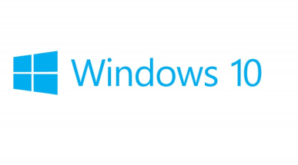

2. Modular vs Monolithic Design
MicroKernel ~50 million lines of source code
Monolithic Kernel version 4.15 23.3 million lines of source code
System Services
System Services Task Management File Management GUI Interface Device Management
Task Management
File Management
GUI Interface (Shell)
Device Management
Notes:
A modular operating system has a clear delineation of functions such as Task Management, File Management, Device Management and a GUI interface. Each function operations as a “stand-a-lone” program, called a service. Each service runs in its own memory space. This makes it easier to update modules without having to change the whole system. It also makes programming easier by defining the function components and “abstracting” them or hiding the details from the programmer.
The opposite approach is to design a monolithic system which provides the same services, but the relationship between the components is not as clear. Consequently, a simple change in one service, could have a “ripple” effect throughout the operating system. For example, a change in hardware could mean that the operating system must be recompiled to incorporate the new device driver in order for the hardware to work.
In a monolithic kernel OS, the program runs as a single large static binary file process running entirely in a single address space. Basic OS services such as task management, file management, and device management all run in same memory space. Entire services are loaded on boot up and reside in memory and work is done using system calls.

Slide 38

Modular vs Monolithic Design
Micro Kernel
Monolithic Kernel
Advantages
More reliable
Easy update, patch, extend
Advantages
Runs faster
Fewer bugs\security issues
Disadvantages
Slower performance
Larger source code
Task Management complex
Disadvantages
Difficult to update, patch, extend
Recompiling kernel time consuming
Notes:
One OS is not better than the other, just different. The question is which one is best for your circumstances, tasks, software availability.

Slide 39
3. Memory Protection
User Mode
Request
Application
Reply
Server Service
User Mode
API
Service Call
Kernel Mode
Executive Services
System Call
Hardware
Notes:
For the operating system to be more reliable, memory must be protected from bad programs or bad hardware.
increased memory protection can also provide increased security.
Thus the system is more reliable because an application program has no direct access to memory, resources or hardware. It only has the ability to request access. The request is done through an API (Application Program Interface – more on next slide), the operating system service will contact the kernel executive services which will make a system hardware call to perform the appropriate action. When the action is completed, a reply is sent back through the stack to the application program that called the API.

Slide 40

4. Multi-tasking & Multi-processing
Operating System appears to run multiple processes at the same time.
Why multi-tasking?
CPU is usually waiting on Input/Output operations
CPU + RAM are fast, I/O is slow
Multi-processing: Separate processes run simultaneously on multiple CPU cores sharing memory and peripherals.
Parallel processing: A single process uses multiple CPUs/cores simultaneously.
Notes:
Since the beginning of operating systems users have wanted to do multiple tasks at the same time and have the ability to switch between running applications. Now, it is considered normal, not so in the early days.
Multitasking uses a single CPU but switches in time slices between tasks (task=application or process).
Multiprocessing means true parallel execution of multiple but separate processes on separate CPUs within a system.
Parallel processing means a single process or task using multiple CPUs simultaneously; this requires specific application programming or an OS which carefully manages a single process's threads to avoid race conditions.
These three types of processing can all occur within the same system. The Operating System controls access to shared memory and peripherals and schedules tasks among CPUs. All contemporary PCs, tablets and smartphones have multiple CPU "cores" on a single chip.
Why multitasking? CPU + RAM are fast, I/O is slow.
MS-Word is formatting your document for printing by sending it to the print spooler which uses a holding area on secondary storage (a drive) to buffer the even slower device.
You’ve asked Outlook to check your email while that happens. But it is slow due to network bandwidth constraints and traffic on your intranet.
So you open a tab in your browser and begin that big download to your USB drive which takes time. Your internet connection is fast (for an outside network connection) and you are using a USB 3.0 device but your older computer has only USB 2.0 ports so the throughput to the your USB drive will be slow. But is the write speed slower than the internet connection? Maybe not.
So you start playing Solitaire. It runs in fast CPU + ram but the I/O to the mouse and screen is slow. Nevertheless, the mouse and screen I/O is usually faster than you can move your hand or read.
Finally, the printer spits out your document, you have new email from your course instructor, the download is finally complete…but you are still playing Solitaire.

Slide 41
4. Multi-tasking
Run
I/O Wait………..….
Run
I/O, CPU wait
Run
Process 1
Time slice expired
CPU Wait
Run
I/O wait....CPU wait
Run
Process 2
Run
Run
Wait
Run
Run
Run
CPU
Notes:
There are many strategies to multitasking depending the needs of the system. Some aspects of the operating system get priority over applications. A PC running your applications treats most apps equally. Your phone pays a little more attention to incoming signals (someone is calling you, a text arrives) than you punching numbers into the calculator app but you don’t notice because you are slowest thing running.
A computer controlling a robot pays attention in “real-time”, i.e. the robot always comes first, its interrupt signals are processed with higher priority than other OS tasks. Real-time responses are often understood to be in the order of milliseconds, and sometimes microseconds. E.g. fly-by-wire aircraft controls, anti-lock brakes in a car. The computer checks for signals from the outside world, from outside its “system boundary”, so frequently that, to a human or the robot, it appears to be operating continuously in human perceived real time. As far as the robot knows, the computer system is always available to process the robot's output and does not delay in directing the robot's next action. In "real-time", the computer is always waiting on the robot, the robot is never waiting for the computer.
https://en.wikipedia.org/wiki/Human_multitasking Human multitasking is an apparent human ability to perform more than one task, or activity, over a short period (1 hour). An example of multitasking is taking phone calls while typing an email and reading a book. Multitasking can result in time wasted due to human context switching and apparently causing more errors due to insufficient attention. Studies have shown that it is impossible to focus on more than one task at a time. However, if one is proficient at one of the tasks at hand, then it is possible to do these tasks.

Slide 42
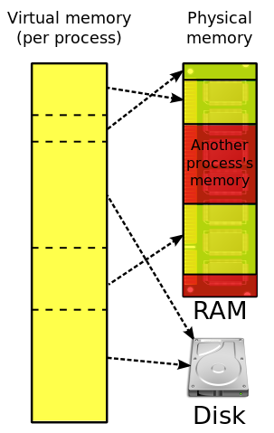
5. Virtual Memory
A 32 bit process uses up to 2GB of RAM.
Many processes can be run even though they exceed physical memory.
Memory management swaps between limited physical RAM and ~unlimited~ virtual memory on a drive.
Multi-tasking switches between processes and may trigger VM swapping.
Thrashing: The system spends more time swapping processes than running them.
It occurs when a computer's virtual memory subsystem is in a constant state of over commitment with a high degree of process switching (multi-tasking).
Notes:
Why can a 32 bit process can access only 2GB of RAM? A 32 bit unsigned integer can address 4GB (long int data types). https://superuser.com/questions/1163749/why-do-32-bit-processes-have-a-2gb-ram-limit "In the NT platform the 4 GB virtual address space is by default divided into 2 parts, the lower 2 GB for process address space and the upper 2 GB for system use."
Virtual memory and caching are memory management techniques developed for multiprocessing operating systems.
Virtual memory is a separate memory space for each program, all programs running may, in total, need more than the actual physical RAM (main memory) capacity. The OS manages this overallocation of physical memory by using slower secondary storage as if it was primary storage. The operating system “swaps” data between these fast and slow areas as needed by the applications running; the applications do not know the difference. To the application, it looks like it has the system to itself with as much memory as it needs. "In the interests of performance, security, and reliability, each process has it's own private 2 GB address space but there is only one system address space. Processes are isolated in their own private address space and cannot see others. System address space is off limits to normal processes and is accessible only to kernel level components such as the OS itself and device drivers. If a process goes astray it can only hurt itself, other processes and the OS are unaffected."
Caching is storing the most frequently used data in the fastest memory. There is expensive, very fast cache memory between the CPU and slower RAM. Available physical RAM is allocated to cache data going to and from slow I/O devices. HDDs have their own caching. Embedded cache on the HDD captures write operations quickly allowing the program to continue asap while the HDD cache and hardware independently perform the slow physical write operations.
Systems that employ virtual memory use hardware more efficiently than systems without virtual memory and make programming of applications easier. Operating systems have sophisticated algorithms to manage virtual memory and caching. The programmer rarely has to worry whether their executable program with its variables and data buffers will ‘fit’ into physical memory. To the program, it looks like it has the entire system to itself with as much memory as it needs.
https://en.wikipedia.org/wiki/Thrashing_(computer_science) Thrashing occurs when a computer's virtual memory subsystem is in a constant state of paging, rapidly exchanging data in memory for data on disk, to the exclusion of most application-level processing. This causes the performance of the computer to degrade or collapse. The situation may continue indefinitely until the underlying cause is addressed

Slide 43
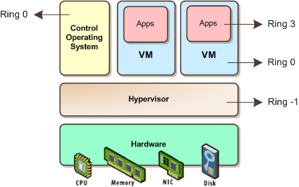
6. System Virtualization with Hyper-V or VMware
Picture taken from: http://itechthoughts.files.wordpress.com/2009/11/vbasics10.png?w=412&h=258
Notes:
A strong trend in business today is system virtualization. VMware has built a huge business doing this on the Intel platform. IBM did it long before on mainframes and Power System-i. Because CPUs are grossly under utilized, system virtualization allows businesses to run multiple instances of the same or different operating systems on the same hardware to better utilize its resources. This saves money on buying more machines, the space needed to house those machines, and the electricity to power and cool those machines. Secondly, on the Intel x86 platform, different types software rarely played well together; the web service stole memory from the database service and neither liked the accounting system which clogged the I/O channels. By virtualizing, each major application/service got its own (virtual) machine and communicated through a (virtual) network as if between different servers.
Each “guest” OS is managed by a Virtual Machine (VM) that simulates a complete hardware platform, known as a partition. The VM and IT administrator controls how much CPU, memory, and storage is allocated to each partition.
Linux is increasingly being run on mainframes and midrange servers in virtualized partitions – because it is cheaper to do that rather than run server farms of white boxes.

Slide 44
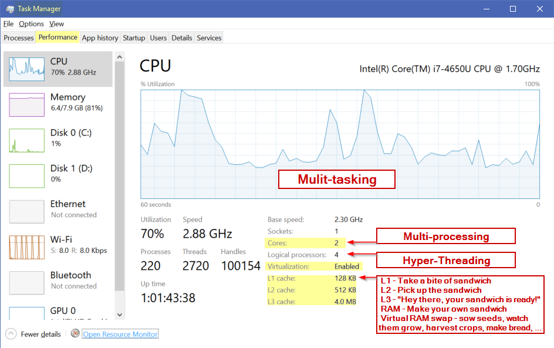
CPU cores and caches
Notes:
Programmers are encouraged to write small modules of code with contained structures (Do loops, If statements) so the code fits in Ln cache: it runs faster and has less chance of being swapped out.
http://www.new-npac.org/projects/cdroms/cewes-1999-06-vol1/nhse/hpccsurvey/orgs/sgi/bentley.html
Intel® Hyper-Threading Technology (Intel® HT Technology) uses processor resources more efficiently, enabling multiple threads to run on each core. As a performance feature, it also increases processor throughput, improving
overall performance on threaded software.
https://www.intel.com/content/www/us/en/architecture-and-technology/hyper-threading/hyper-threading-technology.html
The logical processors in a hyper-threaded core share the execution resources. These resources include the execution engine, caches, and system bus interface; the sharing of resources allows two logical processors to work with each other more efficiently, and allows a logical processor to borrow resources from a stalled logical core (assuming both logical cores are associated with the same physical core). A processor stalls when it is waiting for data it has sent for so it can finish processing the present thread. https://en.wikipedia.org/wiki/Hyper-threading

Slide 45
Hardware components cryptic quiz
What do all these TLAs mean? (Three Letter Acronyms) 4+ letter versions are xTLAs (extended TLAs)
What MOBO is on your machine?
A single CPU, FPU, or GPU may contain multiple ALUs.
RAM, RAIM, SDRAM, DDRn (main memory, volatile)
BIOS, EEPROM, UEFI (firmware, non-volatile memory)
WOM (opposite of ROM read-only memory)
SSD, HDD, USB, SD card (secondary, non-volatile storage)
SIM card – found in the mobile computer rarely used to talk to other people despite that being its original purpose
NIC, Wi-Fi
Nothing on this slide will be on the quiz.
Notes:
➔ These will not be on the quiz.
MOtherBOard
Machine – what geeks call computers
Central / Floating-point / Graphics Processing Unit, Arithmetic Logic Unit performs calcs on integer binary numbers.
Synchronous Dynamic Random-Access Memory (SDRAM) is any Dynamic Random-Access Memory (DRAM)
DDR - Double data rate synchronous dynamic random-access memory (DDR SDRAM), DDR versions 1 - 4
BIOS – Basic Input/Ouput System that boots up a computer from an EEPROM Electrically Erasable Programmable Read Only Memory
UEFI - Unified Extensible Firmware Interface (UEFI) is a specification that defines a software interface between an operating system and platform firmware. UEFI replaces the Basic Input/Output System (BIOS) firmware interface originally present in all IBM PC-compatible personal computers,
SSD solid-state drive , Hard Disk Drive, Compact Disc-Read Only Memory, Floppy Disc Drive
USB – Universal Serial Bus, Secure Digital Card (SD card)
SIM (Subscriber Identity Module)
NIC – Network Interface Card
Wi-Fi = Wi-Fi Alliance hired Interbrand to create a name that was "a little catchier than ''IEEE 802.11b Direct Sequence.' Wi-Fi is a word invented as a pun upon the word hi-fi.

Slide 46
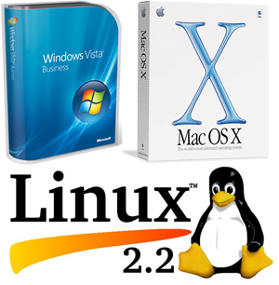
Notes: Short History of Small Systems OS
Notes:
Not on the quiz…

Slide 47
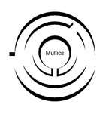




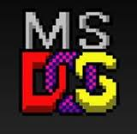


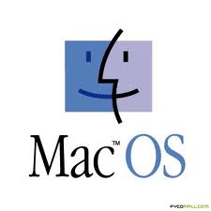

Simplified History of mini and micro systems…
problem was to fence
Notes:
In 1964, a project called “Multics” (Multiplexed Information and Computing Service) was launched. This was the first open source project to develop a multiuser, multiprocessor OS. ( the term open source had not been developed yet) The project leader was MIT with major contributors from General Electric, and Bell Labs (the research division of AT&T). See https://en.wikipedia.org/wiki/Multics
Multics was not a success. However, the ideas in Multics went on to be very successful.
The design and features of Multics greatly influenced the Unix operating system, which was originally written by two ex-programmers from the older project, Ken Thompson and Dennis Ritchie. Ritchie developed C to develop UNIX. The name Unix (originally Unics) is itself a pun on Multics. The C language allowed the OS to be very portable (unlike the Assembler of Multics) requiring only a relatively small amount of machine-dependent code to be replaced when porting Unix to other computing platforms. This greatly contributed to its success.
UNIX was designed by computer scientists for computer scientists to conduct research. The earliest distributions of Unix from Bell Labs in the 1970s included the source code to the operating system, allowing researchers at universities to modify and extend Unix. As the project matured, some of the contributors to the project decided in 1983 to create commercial versions of the OS, System V (five) -- which is why today there are many different versions of UNIX IBM AIX, HP/X, Solaris. Through the 1970s and into the 1980s, the University of California at Berkeley continued to share its version of UNIX, known as the Berkeley Standard Distribution (BSD).
Subsequently, many lawyers became rich sorting out whose UNIX intellectual property was whose. The 1992 lawsuit and injunction on distribution slowed development of the free-software descendants of BSD. Linus Torvalds has said that if 386BSD or the GNU kernel had been available at the time, he probably would not have created Linux.
OpenBSD descended from BSD after the lawsuit dust settled. It is important as an OS because it has different goals than Linux. The MAC Leopard OS and iOS are a BSD-based variants.
VMS operating systems was developed by DEC (Digital Equipment Corporation) for its VAX line of computers and in the 80’s the VAX was the most popular minicomputer (small mainframe, VAX is also in common use today along with the IBM iSeries or PowerServer with IBM-i or the original AS-400 which is taught at Seneca) and is still in common use today.
VMS is important for 2 reasons:
it was the first to develop the use of Virtual memory which is now a standard feature of all operating systems.
the project leader for VMS was a man by the name of Dave Cutler, who had worked on both Multics and UNIX projects.
DEC was purchased by HP and today, HP is project leader for OpenVMS (the latter is not open source, but uses open standards)
CP/M stands for Control Programming Module. It was designed by Gary Kildall when he worked for Intel. He left Intel and formed a company called Digital Research Inc (DRI) Unlike UNIX, CP/M is a single user, single task operating system. CP/M is important because it was the first operating system designed for the new microcomputer (PC). IBM had developed the PC hardware but it not have an operating system. IBM failed to come to licensing terms with DRI and turned to a new company called Microsoft to develop the OS. Microsoft did not actually have or own what it sold to IBM at the time of the deal. Microsoft later bought all rights to a clone of CP/M called QDOS (Quick and Dirty Operating System) for $75,000 and renamed it PC-DOS for IBM, the Personal Computer Disk Operating System. Bill Gates wisely negotiated a non-exclusive arrangement with IBM so Microsoft could sell MS-DOS. Because everything in the IBM PC was off-the-shelf components except for the BIOS, the clone computer market could flourish. MS-DOS was the basis of the Microsoft residential code base for the Windows 9x operating systems (Windows 95, 98 and Me).
Microsoft wanted to develop a new operating system that could be used for large commercial enterprises. In 1988, Microsoft formed what would become the development team for the Microsoft Windows NT® product. The team's goal was to develop a 32-bit, multi-user, multi-process operating system that was better than UNIX. At the same time, DEC had cut back on Dave Cutlets project to build an more efficient OS, not based on UNIX design. Discouraged by DEC ‘s decision, Microsoft was able to hire Dave Cutler and most of his programming team to develop this more efficient OS which became known as NT (New Technology AKA Not Today). DEC also believed Cutler brought source code to Microsoft and sued. Microsoft eventually paid US$150 million and agreed to support DEC's Alpha CPU chip on NT.
https://superuser.com/questions/1163749/why-do-32-bit-processes-have-a-2gb-ram-limit
"In the NT platform the 4 GB virtual address space is by default divided into 2 parts, the lower 2 GB for process address space and the upper 2 GB for system use."
This was a design decision made in the interests of performance, security, and reliability. Each process has it's own private 2 GB address space but there is only one system address space. Processes are isolated in their own private address space and cannot even see others. There is provision for sharing address among 2 or more processes when necessary. System address space is off limits to normal processes and is accessible only to kernel level components such as the OS itself and device drivers. If a process goes astray it can only hurt itself, other processes and the OS are unaffected.

Slide 48
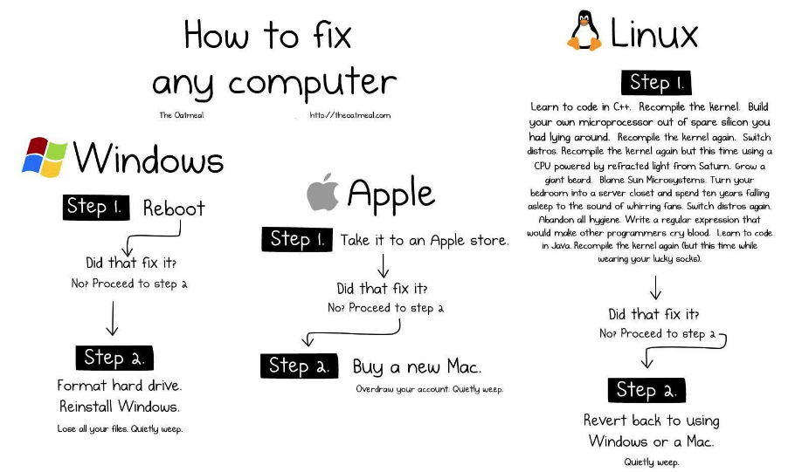
Notes:
Illustration source from http://theoatmeal.com/blog/fix_computer
The age old debate Windows vs Apple. And then there is Linux.
Microsoft designed its operating systems to be compatible with hardware created by a wide range of computer companies allowing for broad distribution. Apple didn’t. The downside for Microsoft was allowing the world’s most complex OS at the time, Windows 95 with 15 million lines of code, to run on the world’s cheapest hardware garnering a reputation for crashing. (Tim McKenna’s personal record to lock up Win95 was 45 seconds after beginning to use a freshly booted machine with a new image.) However, if you ran a Microsoft OS on an IBM PC, it was fine but only if you ran every other version of the OS. (DOS 1, 3, 5 were fine. 2, 4, 6 were stinkers. Windows 95, XP, 7 were OK. 98/ME and Vista were stinkers. Windows 8 and 10 are the only even numbered versions that were not total stinkers.) So Microsoft themselves were half of their own reputation problem. Combine that with people running Microsoft on cheaped-out hardware and it’s no wonder Windows has the reputation it does. Despite that, they have 90% of the small computer market. Go figure.
Macs were not perfect either but no one heard about Mac crashes because there were so few to hear about. Human beings are terrible at thinking statistically and without bias. (Kahneman, 2011. Thinking, Fast and Slow) They pay attention to what they notice most often.
“Operating systems are like underwear — nobody really wants to look at them.” – said by Bill Joy who wrote BSD unix, the vi editor, and much else. https://en.wikipedia.org/wiki/Bill_Joy
An operating system should be like underwear: clean, comfortable, and does the job without you or anyone else noticing it.
Use whatever OS/platform you like. These days, no OS is better than the other, only different. Apple and Linux are no more resistant to viruses and attacks than Windows; today Macs are potentially more vulnerable because there are now enough Macs out there to make them a worthwhile target (having clawed their way from 5% up to 9% market share in 2016), Mac users also have the most money (or had until they bought an Apple product), and many Mac users still think they are immune from malware which is the real problem. Linux, etc. is open source so vulnerabilities can be seen—it’s a race between the Black Hats and the White Hats. Microsoft has many APIs to make the platform customizable for businesses and those APIs can allow holes but Microsoft does have an effective update process.
Apple has better hardware and stability if you compare a Mac to a cheap PC; and a Mercedes car is better than a Kia but no one blames Kia for not being as good as Mercedes. Windows running on quality hardware is as reliable—and as expensive—as a Mac.
The real platform issue for businesses is Total Cost of Ownership, tech support, and compatibility with everyone else in the company.
Somebody dies and goes to heaven. On arrival, St. Peter gives him the quick tour of the place. As they go through heaven from place to place, they look at the mall, the school, the park … and they keep seeing a high wall on one side or the other. Finally, the new arrival can’t resist asking: “What’s with the wall?” St. Peter Answers: “That’s where we keep the Mac users. They like to think they’re the only ones here.”
http://www.macworld.co.uk/feature/mac/mac-or-pc-ten-reasons-why-macs-are-better-pcs-2015-3493363/
http://www.pcadvisor.co.uk/videos/3493092/5-reasons-why-pcs-are-better-than-macs-mac-vs-windows-pc--which-is-best/
https://xkcd.com/934/
http://www.cashen.com/html/os_quotes.html
Complete 66 Mac vs PC ads
https://www.youtube.com/watch?v=0eEG5LVXdKo&t=107s
iPad vs Surface
https://www.youtube.com/watch?v=0NwkczSuwL8
Apple being honest https://www.youtube.com/watch?v=e67OCOMaXXA
Microsoft being honest https://www.youtube.com/watch?v=HU2aLZF3k_0

