Slide 1


Evolutionary Principal Component Approach (E-PCA) and the Adapted Function of Punishment
Dissertation Defense
2015-1201 HSSB 1001
Sangin Kim
Ph.D. Candidate in Anthropology, UCSB
M.A. in Statistics, UCSB

Slide 2
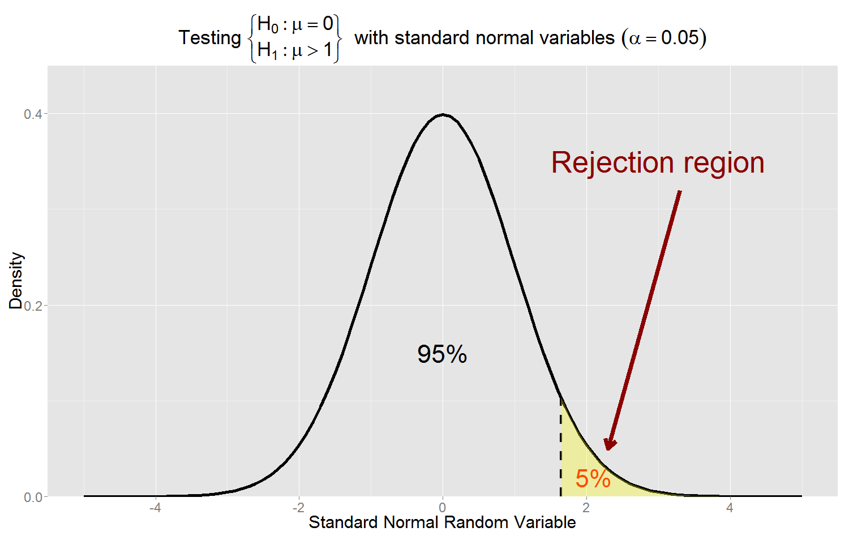
Null Distribution & Rejection Region

Slide 3
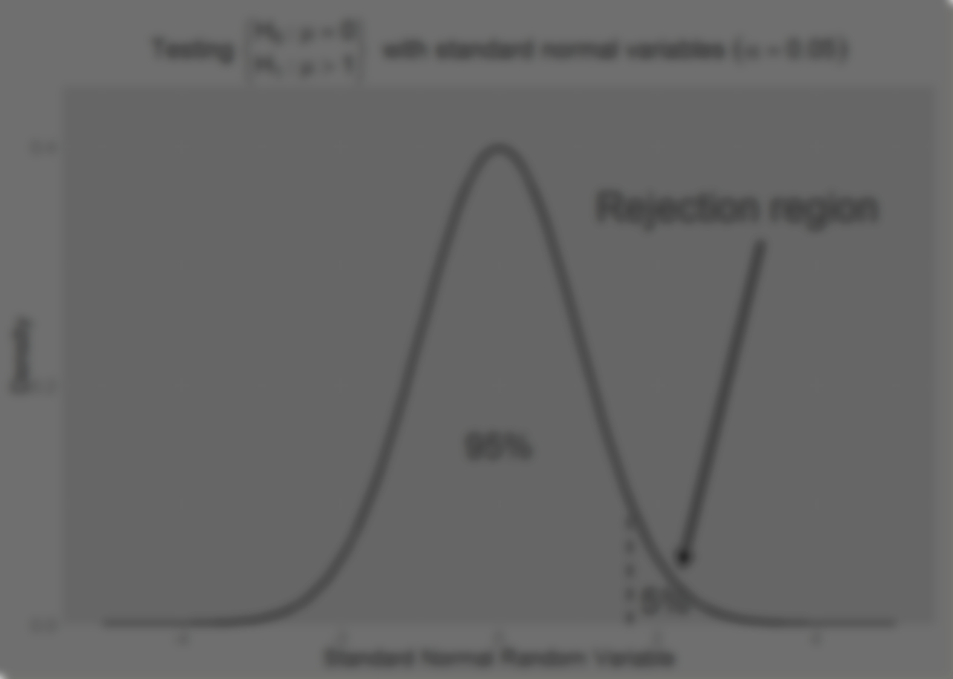
Protection Against Stochasticity
Rejecting a truthful null model (Type I error)
Allowance of error and noise
Proof by contradiction

Slide 4
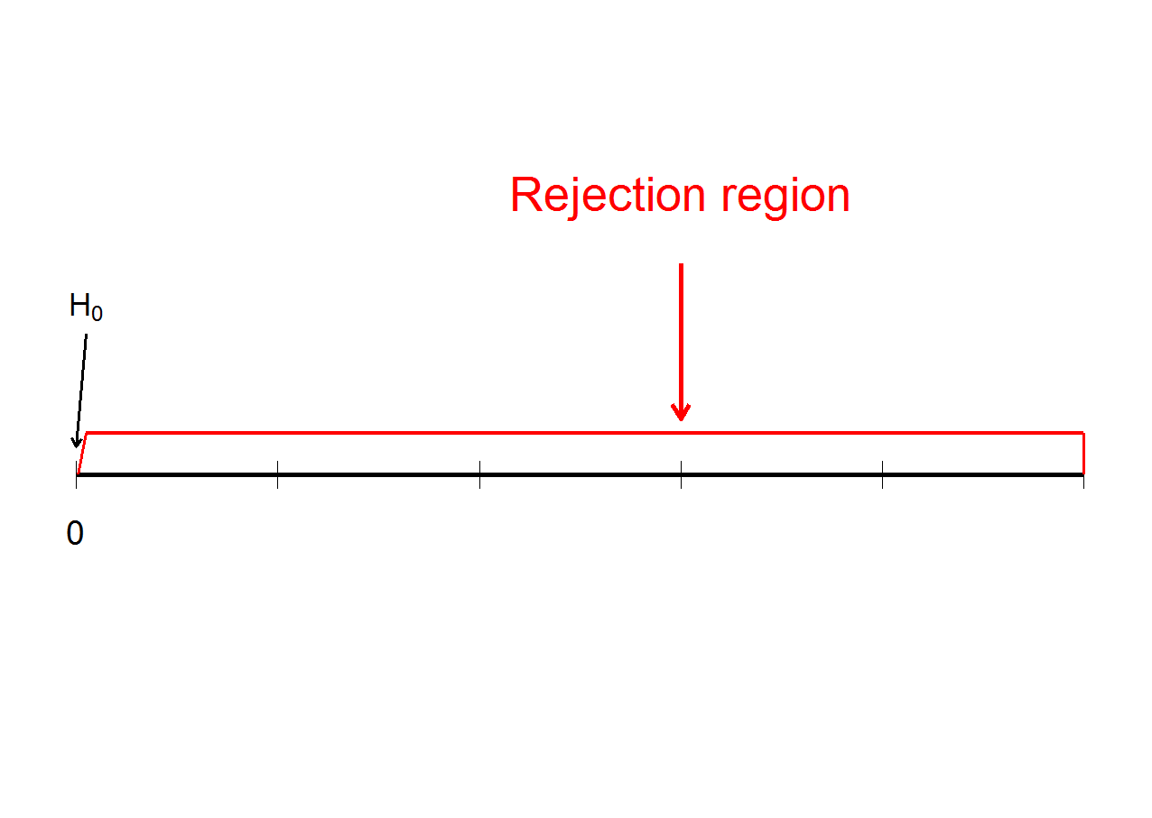
Evolutionary Null-hypothesis Testing Approach (ENTA)

Slide 5
Theory and Predictions
 | Group selection | Individual selection
Selection criteria | max( aggregate group fitness ) | Optimize relative individual fitness (e.g., rank)
Attitudes toward other cooperators/punishers | Cooperative | Competitive
Signaling among cooperators/punishers | Honest and coordinating | Dishonest and manipulative
Second-order free riding | Not a major adaptive problem; indirect solution through population dynamics | Adaptive problem to be solved through cognitive solution
Pareto-improvement that benefits others | Pareto-efficient choice | Pareto-damaging choice
Changing own punishment spending wrt that of others | No change | Reducing own spending
C/B analysis | Group accounting (joint production/consumption) | Private accounting

