Slide 1

Hotel Reservation Analysis with SQL
Presented by Sangita Deka

Slide 2

OVERVIEW
In this project, you will leverage SQL to explore and analyse a comprehensive hotel reservation dataset. This practical experience will enhance your data analysis skills by enabling you to answer critical questions and extract meaningful insights from real-world data.
The hotel industry increasingly relies on data-driven decision-making to optimize operations, enhance guest satisfaction, and boost profitability. By working with a hotel reservation dataset, you will delve into various aspects of hotel management, including guest preferences, booking trends, and operational efficiency. Through SQL queries, you will uncover patterns and answer specific questions that can help improve hotel services and strategies.

Slide 3

DATASET DETAILS
The dataset includes the following columns:-
Booking_ID: A unique identifier for each hotel reservation.
no_of_adults: The number of adults in the reservation.
no_of_children: The number of children in the reservation.
no_of_weekend_nights: The number of nights in the reservation that fall on weekends.
no_of_week_nights: The number of nights in the reservation that fall on weekdays.
type_of_meal_plan: The meal plan chosen by the guests.
room_type_reserved: The type of room reserved by the guests.
lead_time: The number of days between booking and arrival.
arrival_date: The date of arrival.
market_segment_type: The market segment to which the reservation belongs.
avg_price_per_room: The average price per room in the reservation.
booking_status: The status of the booking.

Slide 4
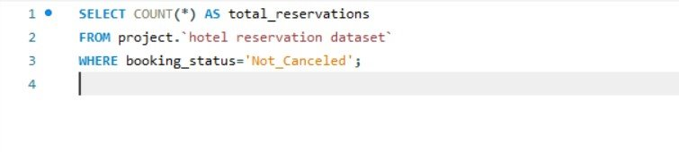
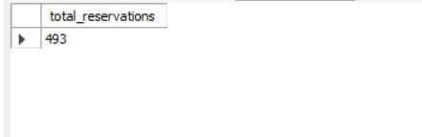
1. What is the total number of reservations in the dataset?

Slide 5
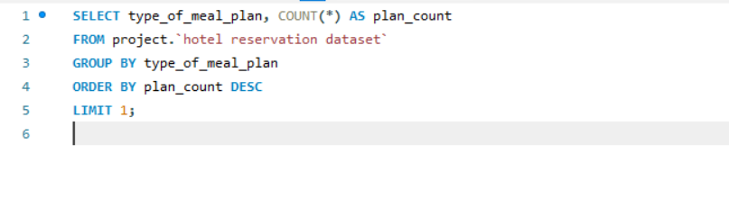
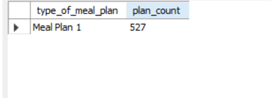
2. Which meal plan is the most popular among guests?

Slide 6
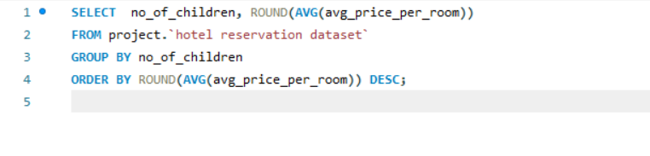
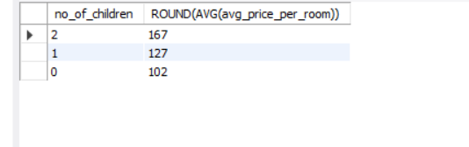
3. What is the average price per room for reservations involving children?

Slide 7
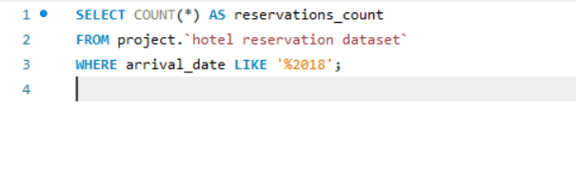
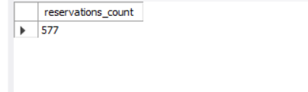
4. How many reservations were made for the year 2018?

Slide 8
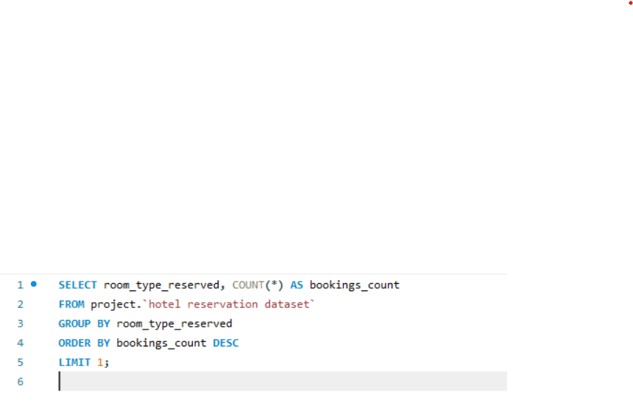
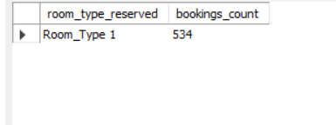
5. What is the most commonly booked room type?

Slide 9
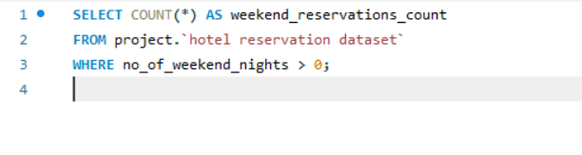
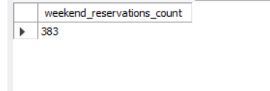
6. How many reservations fall on a weekend (no_of_weekend_nights > 0)?

Slide 10
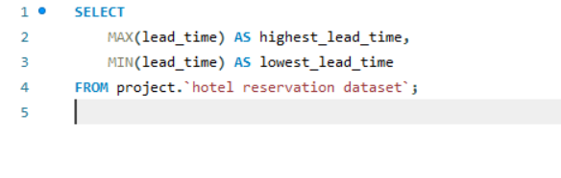
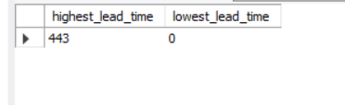
7. What is the highest and lowest lead time for reservations?

Slide 11
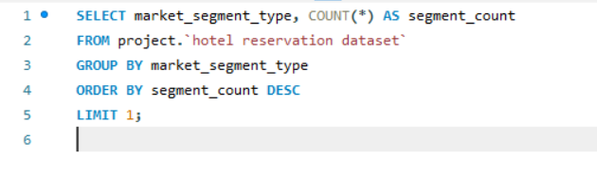
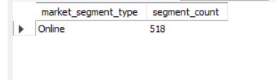
8. What is the most common market segment type for reservations?

Slide 12
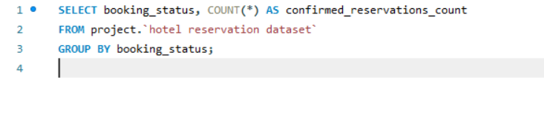
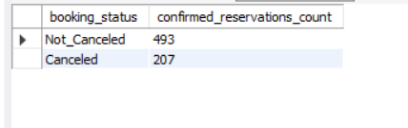
9. How many reservations have a booking status of "Confirmed"?

Slide 13
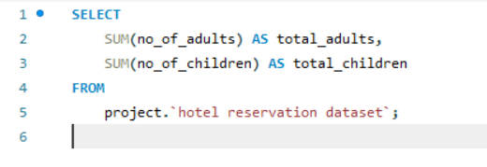

10. What is the total number of adults and children across all reservations?

Slide 14
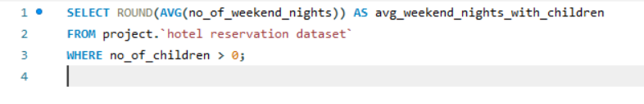
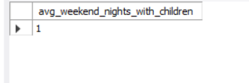
11. What is the average number of weekend nights for reservations involving children?

Slide 15
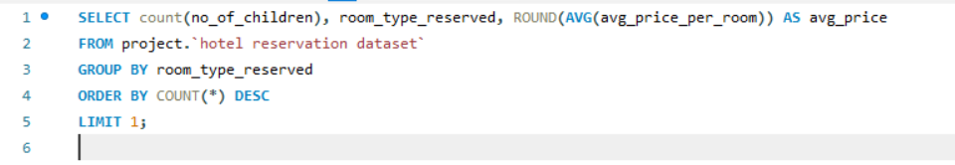
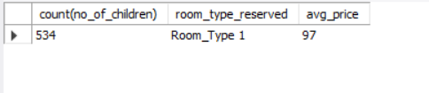
14. For reservations involving children, what is the most common room type, and what is the average price for that room type?

Slide 16
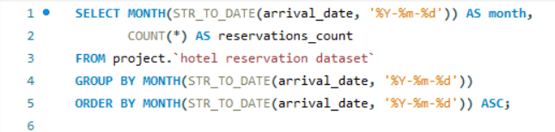
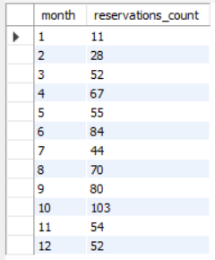
12. How many reservations were made in each month of the year?

Slide 17
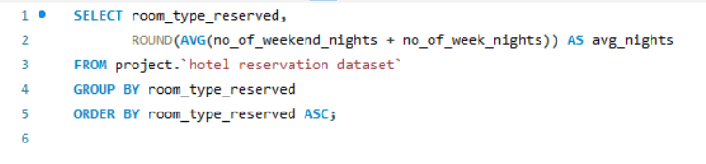
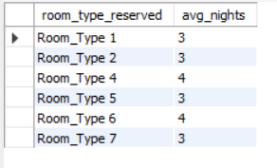
13. What is the average number of nights (both weekend and weekday) spent by guests for each room type?

Slide 18
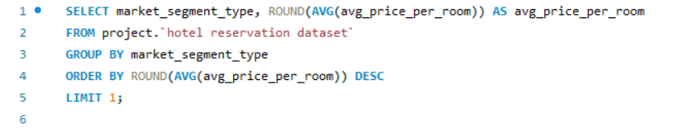

15. Find the market segment type that generates the highest average price per room.

Slide 19
THANK YOU!

