Slide 1

Inventory Management System - QA
Sangiv Giovanni Karunakaran

Slide 2
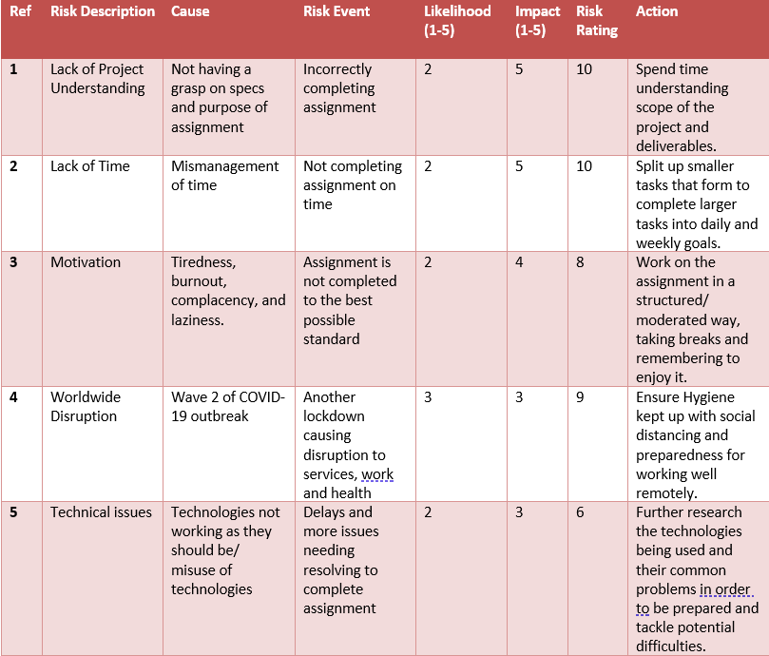
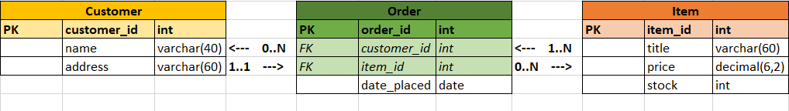
Approach

Slide 3
Consultant Journey
Agile – Scrum, Kanban (Jira)
Source Control – Git, GitHub
Cloud – GCP
Database – MYSQL
Programming Language – Java
Build Tool – Maven
Testing - JUnit

Slide 4
CI PIPELINE
Push
Update Work
Source Code
Version Control System
Project Tracking
Java
Pull
Get Work
Jira
Git/GitHub
Database Server
CI Server
Build Tool
MYSQL
Maven
Test Results
Send Tests
Automated Testing
JUnit

