Slide 1

To Do List App- QA
Sangiv Giovanni Karunakaran

Slide 2
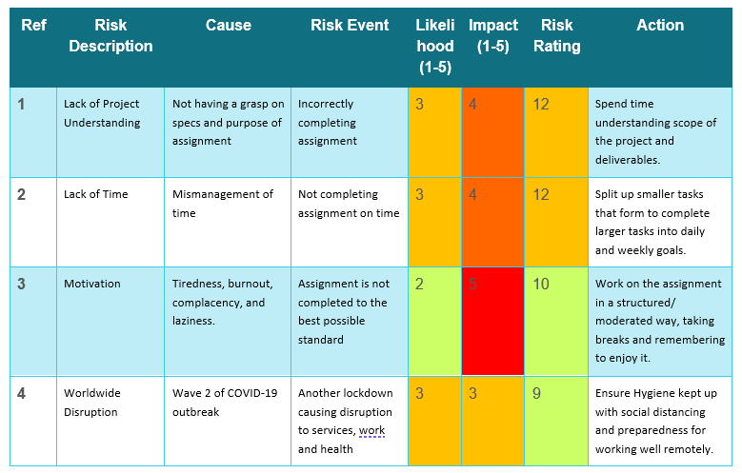

Approach

Slide 3
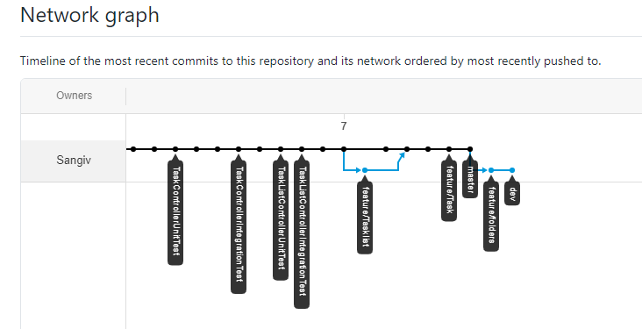
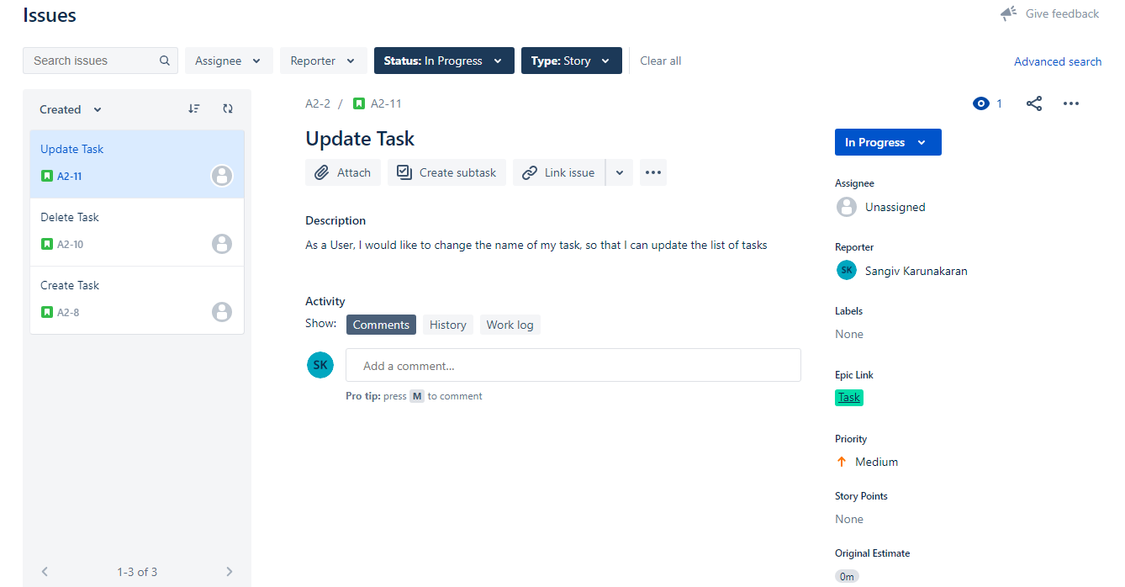
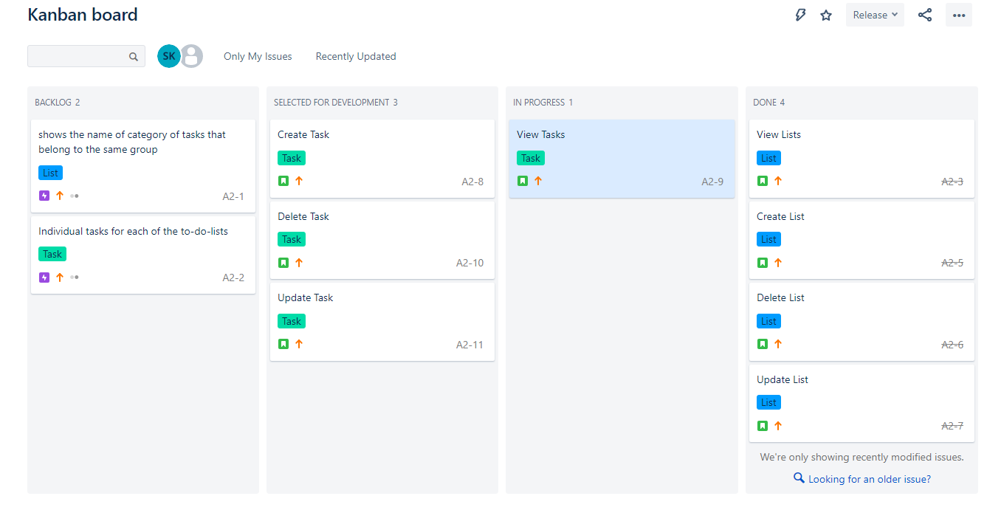
Approach

Slide 4
Consultant Journey
Agile – Scrum, Kanban (Jira)
Source Control – Git, GitHub
Cloud – GCP
Database – MYSQL
Programming Language – Java
Build Tool – Maven
Testing – Junit, Mockito

Slide 5
Consultant Journey
Agile – Scrum, Kanban (Jira)
Source Control – Git, GitHub
Cloud – GCP
Database – MYSQL
Programming Language – Java
Build Tool – Maven
Testing – Junit, Mockito

Slide 6
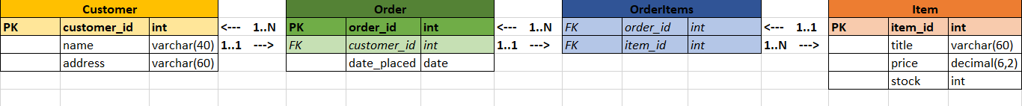
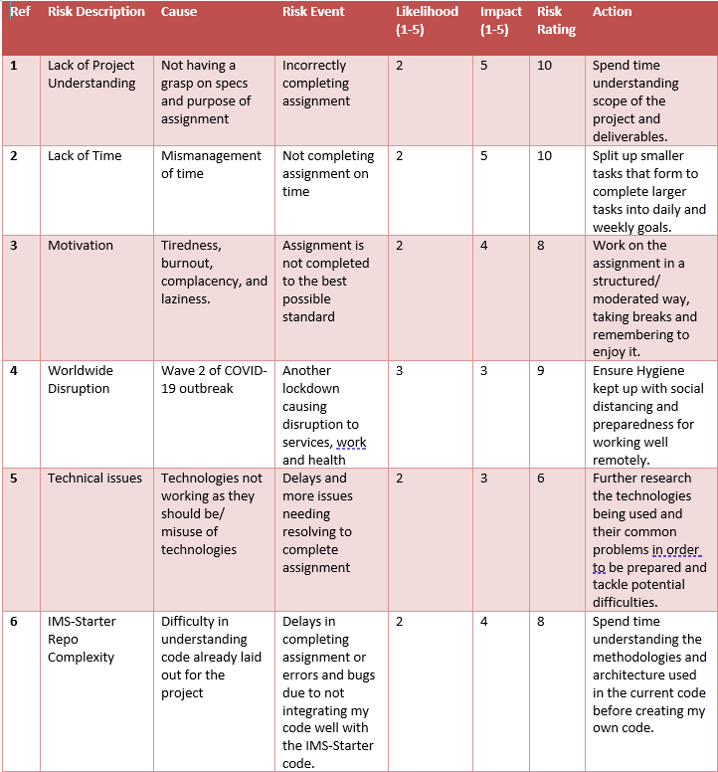
IMS Starter…

Slide 7
CI PIPELINE
Push
Update Work
Source Code
Version Control System
Project Tracking
Access database
Pull
Java
Git/GitHub
Get Work
Jira
Send schema and data
Database Server
CI Server
Build Tool
MYSQL
Jenkins
Maven
Test Results
Send Tests
Automated Testing
Junit, Mockito

Slide 8
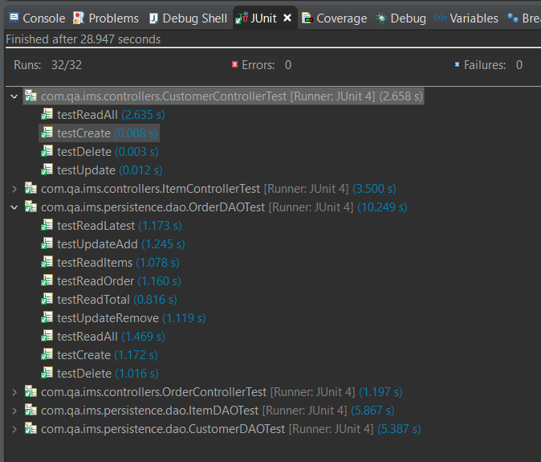
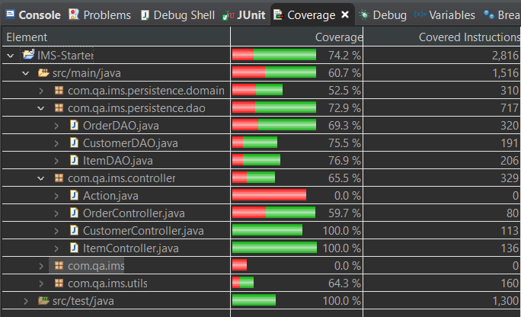
Testing

Slide 9
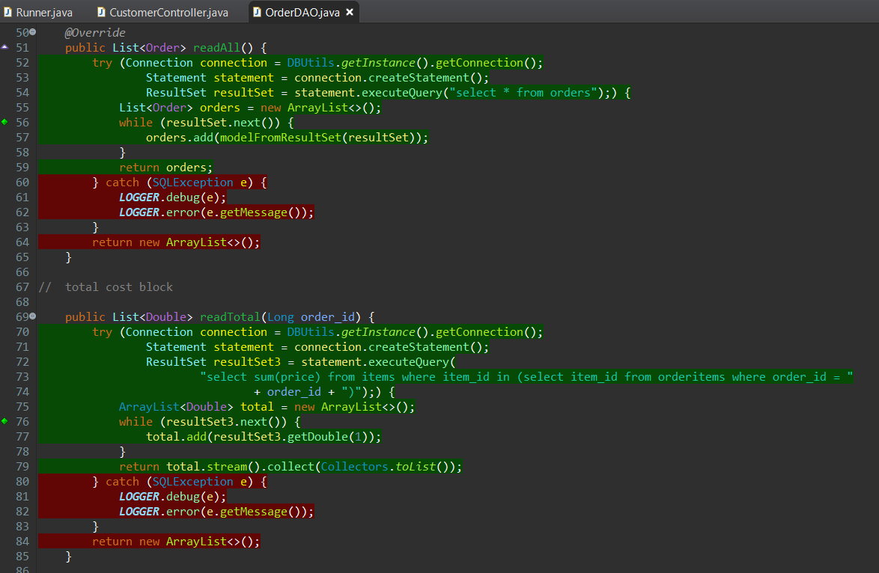
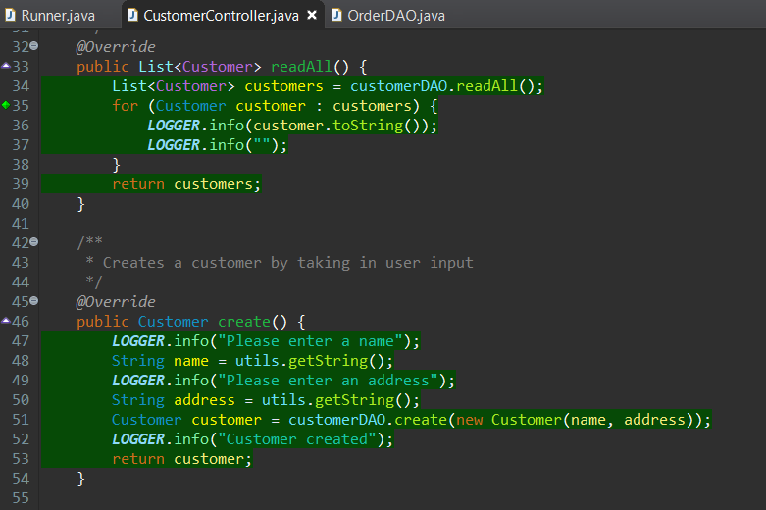
Testing

Slide 10

Let’s Run IMS

Slide 11

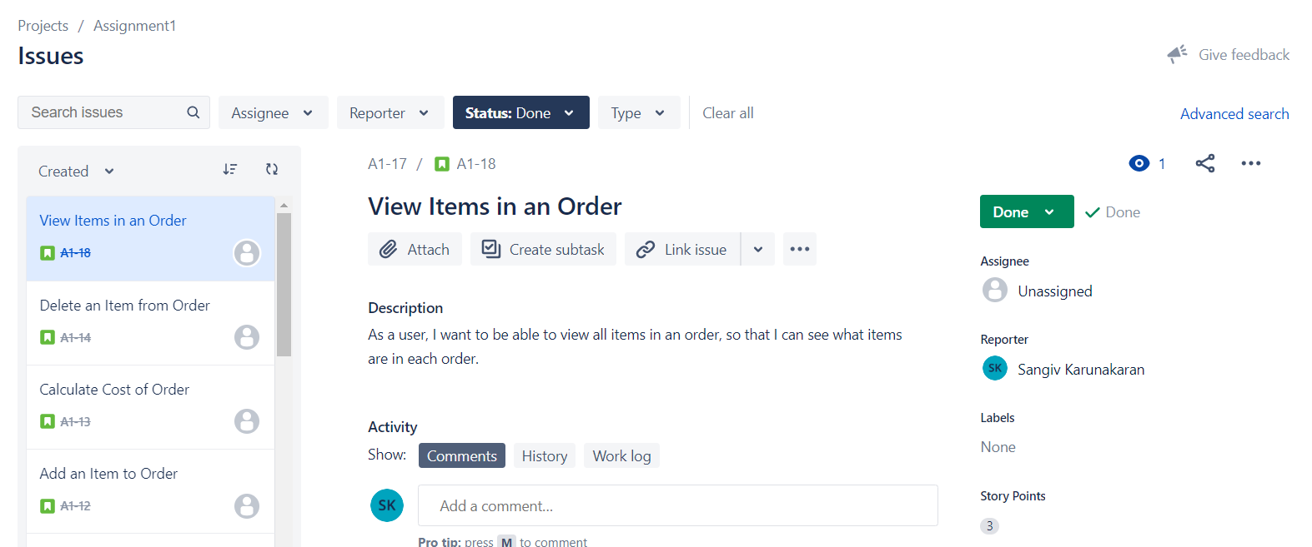
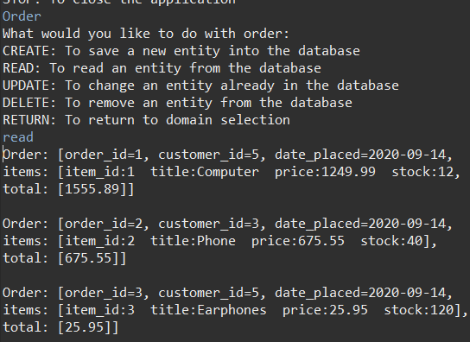
Sprint Review

Slide 12
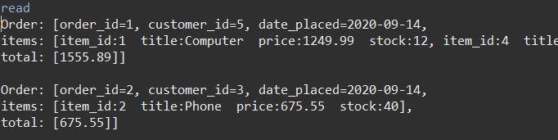
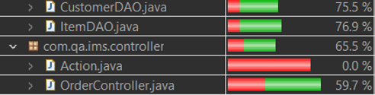
Sprint Retrospective

Slide 13

Conclusion

