Slide 1

Inventory Management System - QA
Sangiv Giovanni Karunakaran

Slide 2
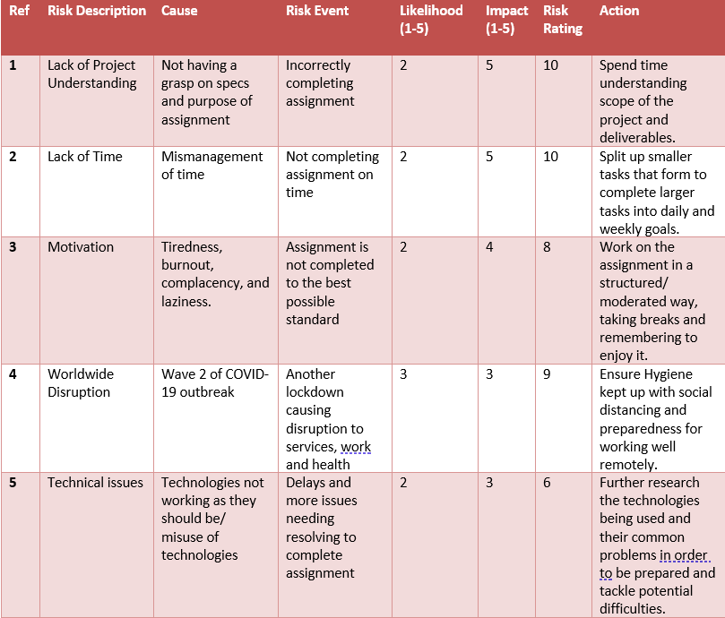
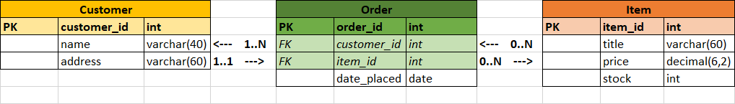
Approach

Slide 3
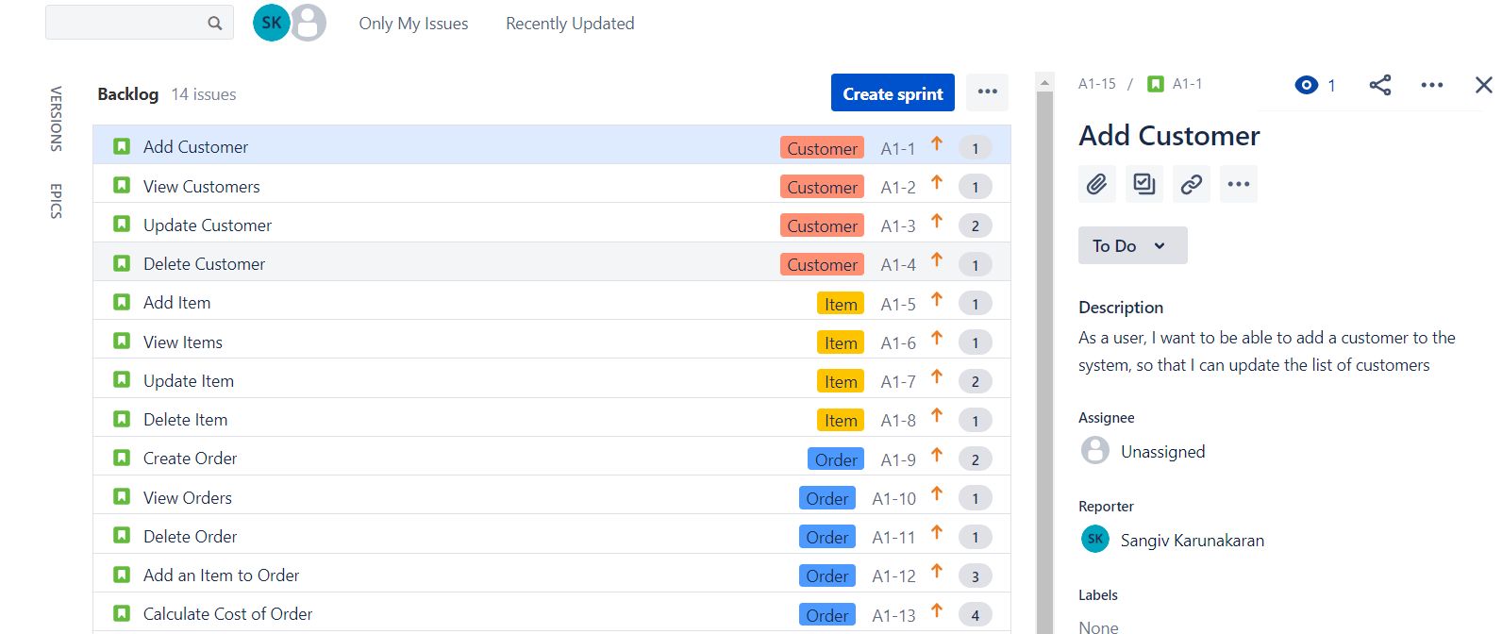
Approach

Slide 4
Consultant Journey
Agile – Scrum, Kanban (Jira)
Source Control – Git, GitHub
Cloud – GCP
Database – MYSQL
Programming Language – Java
Build Tool – Maven
Testing – Junit, Mockito

Slide 5
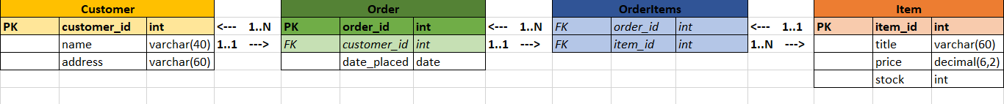
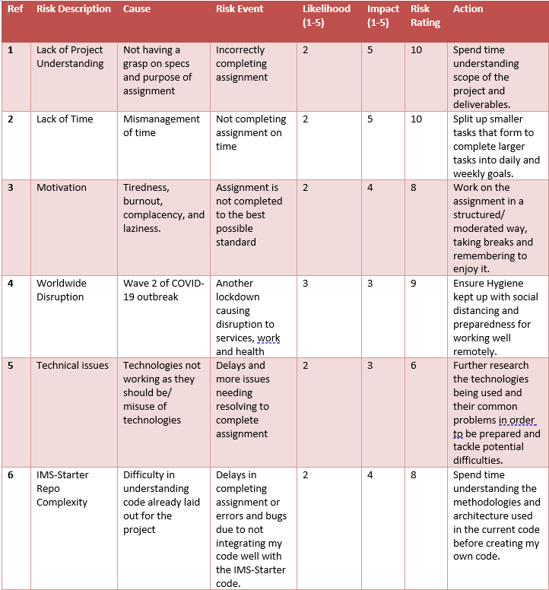
IMS Starter…

Slide 6
CI PIPELINE
Push
Update Work
Source Code
Version Control System
Project Tracking
Access database
Pull
Java
Git/GitHub
Get Work
Jira
Send schema and data
Database Server
CI Server
Build Tool
MYSQL
Jenkins
Maven
Test Results
Send Tests
Automated Testing
Junit, Mockito

Slide 7
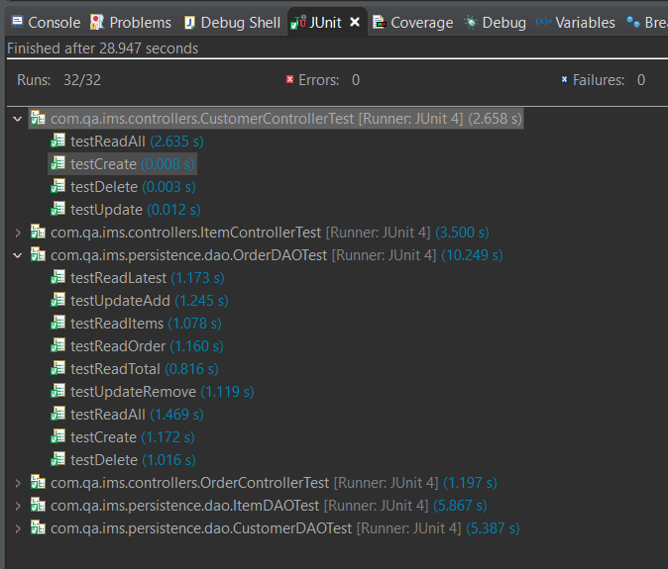
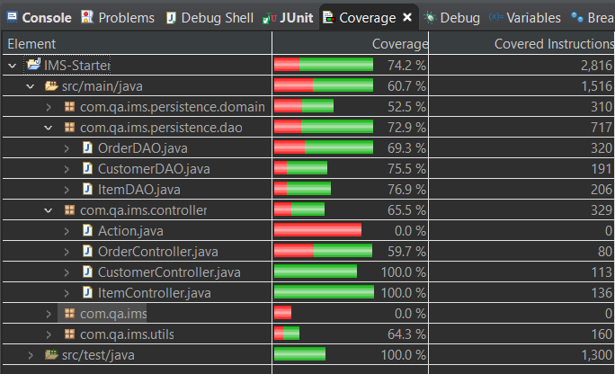
Testing

Slide 8
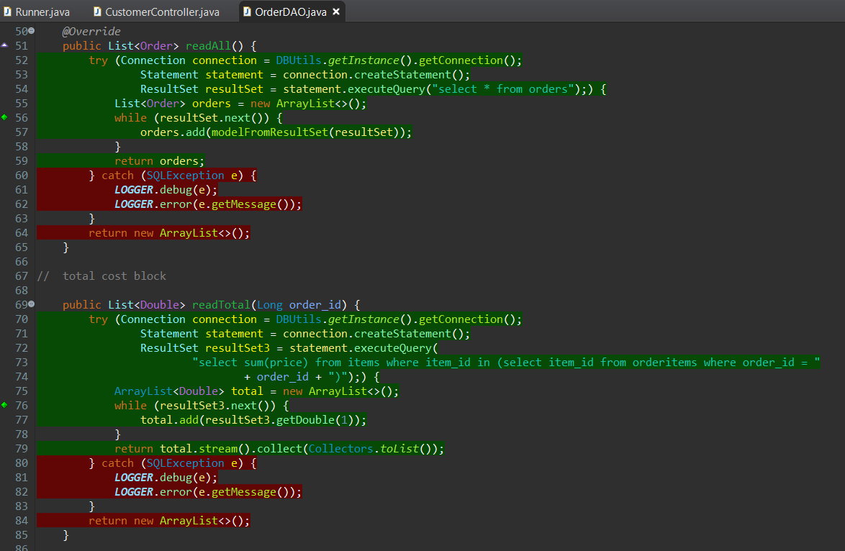
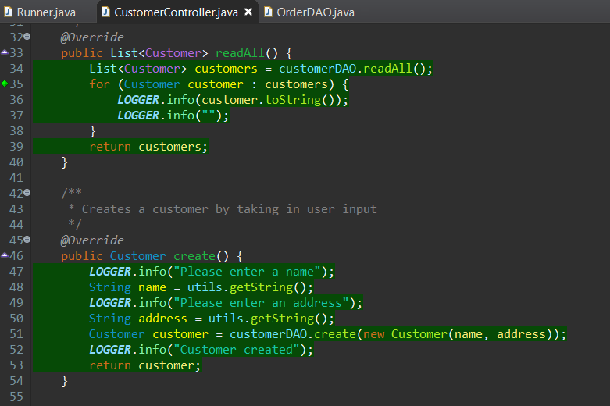
Testing

Slide 9

Let’s Run IMS

Slide 10

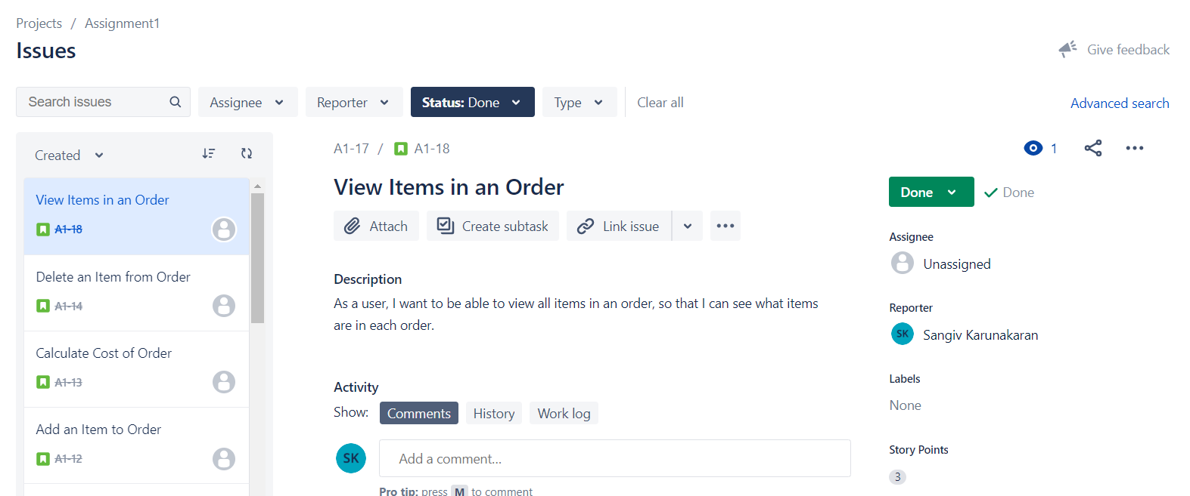
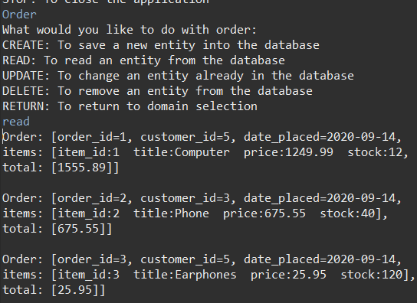
Sprint Review

Slide 11
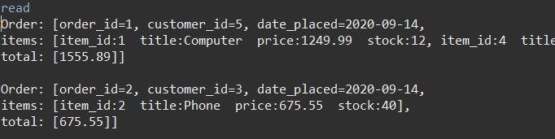
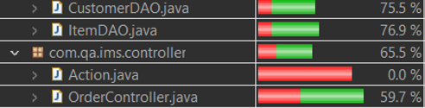
Sprint Retrospective

Slide 12

Conclusion

