Slide 1


Hospital Readmissions Analysis for Diabetic Patients
This presentation provides an in-depth analysis of hospital readmissions among diabetic patients, a critical area for improving healthcare quality. We aim to identify key risk factors contributing to readmission rates, particularly focusing on those readmitted within 30 days. This metric is vital for assessing the effectiveness of patient care and hospital management. Prepared by Sangram Sonawane on April 30, 2025, this analysis seeks to offer actionable insights and strategies to reduce readmission rates, ultimately enhancing patient outcomes and reducing healthcare costs.
by Sangram Sonawane

Slide 2
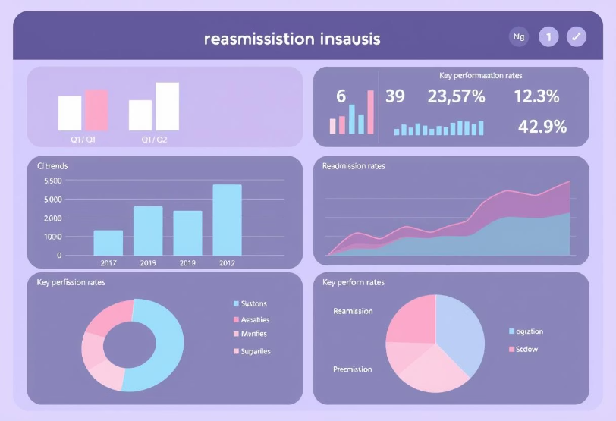
Problem Statement
The primary objective is to analyze hospital readmissions among diabetic patients to pinpoint significant risk factors and propose strategies to lower readmission rates. Emphasis is placed on patients readmitted within 30 days, a crucial metric reflecting healthcare quality.
Our approach involves comprehensive data analysis, encompassing data cleaning, outlier detection, visualization, and insightful interpretations. By examining these elements, we aim to uncover underlying patterns and correlations that contribute to the high readmission rates.

Slide 3





Data Cleaning and Preprocessing
Remove Duplicates
Eliminate redundant data entries to ensure accuracy.
Handle Null Values
Employ suitable imputation techniques to address missing data.
Convert Categorical Data
Transform categorical variables and simplify complex codes for effective analysis.
Map Readmission Codes (Replace)
Use label encoding to categorize readmission statuses (0=less than 30 days, 1=more than 30 days, or 2=no readmission).

Slide 4

Handling Null Values
Insufficient Information
Columns with over 40% null values lack adequate data, leading to unreliable insights.
Bias Introduction
Numerous missing values can introduce bias and noise, diminishing model accuracy.
Risk of False Patterns
Imputing large gaps risks creating false or misleading data patterns.
Performance Improvement
Removing such columns enhances the model's performance and efficiency.
Threshold
40% is a practical threshold to retain
Mean, Median, Mode
•Other columns data replace with mean, median or mode values.

Slide 5
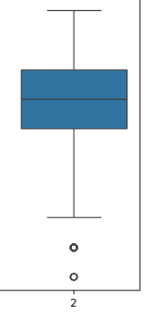



Outlier Detection and Handling
Boxplots
Utilized to detect outliers in numerical columns, such as the number of medications.
Analysis
Extreme outliers above the whiskers were analyzed for impact and capped/removed.
Patterns
Outliers revealed patterns in polypharmacy and poor glucose management.

Slide 6
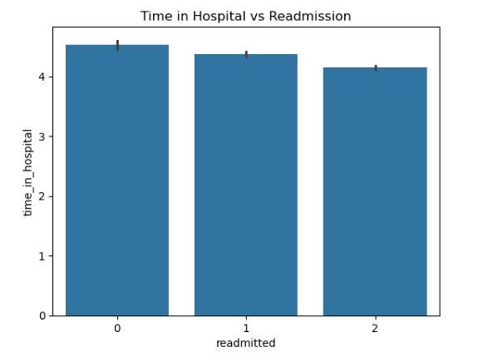
Key Visualizations
Readmission Countplot
Visual representation of readmission categories (0, 1, 2).
Medication Boxplot
Boxplot illustrating the number of medications by readmission status.
Insulin Bar Chart
Bar chart depicting insulin usage versus readmission rate.
Readmission Distribution
Readmission distribution across age groups, gender, and race.

Slide 7



Insights: Insulin Use and Readmission
Higher Readmission
2
Patients with increased or steady insulin levels showed higher readmission rates within 30 days.
Insulin Usage
1
Indicates severe diabetes or uncontrolled blood sugar levels.
Improper Use
Improper insulin use post-discharge may lead to hypoglycemia or readmission.
3

Slide 8
Why Patients Are Readmitted Within 30 Days
Infection/Complications
1
Post-hospitalization infections or complications.
Missed Appointments
2
Delayed or missed follow-up appointments.
Lack of Support
3
Insufficient family or social support.
Non-Adherence
4
Failure to adhere to the treatment plan.

Slide 9




Recommendations to Reduce Readmissions
Monitoring & Education
1
Improve post-discharge monitoring and insulin education.
Follow-Up Visits
2
Schedule follow-up visits within 7 days.
Identify High-Risk
3
Pinpoint patients with many meds or prior readmissions.
Predictive Models
4
Employ predictive models for early intervention.

Slide 10

Conclusion
The analysis indicates that insulin usage, high medication count, and inadequate post-discharge care are significant risk factors for 30-day readmissions among diabetic patients. Addressing these areas can enable healthcare providers to decrease avoidable readmissions and enhance patient outcomes.
Targeted interventions and improved support systems are crucial for managing these risks effectively. By prioritizing these key areas, hospitals can improve their quality of care and ensure better health outcomes for diabetic patients.

