Slide 1

Hospital Readmissions Analysis for Diabetic Patients
This presentation provides an in-depth analysis of hospital readmissions among diabetic patients, a critical area for improving healthcare quality. We aim to identify key risk factors contributing to readmission rates, particularly focusing on those readmitted within 30 days. This metric is vital for assessing the effectiveness of patient care and hospital management. Prepared by Sangram Sonawane on April 30, 2025, this analysis seeks to offer actionable insights and strategies to reduce readmission rates, ultimately enhancing patient outcomes and reducing healthcare costs.
by Sangram Sonawane

Slide 2
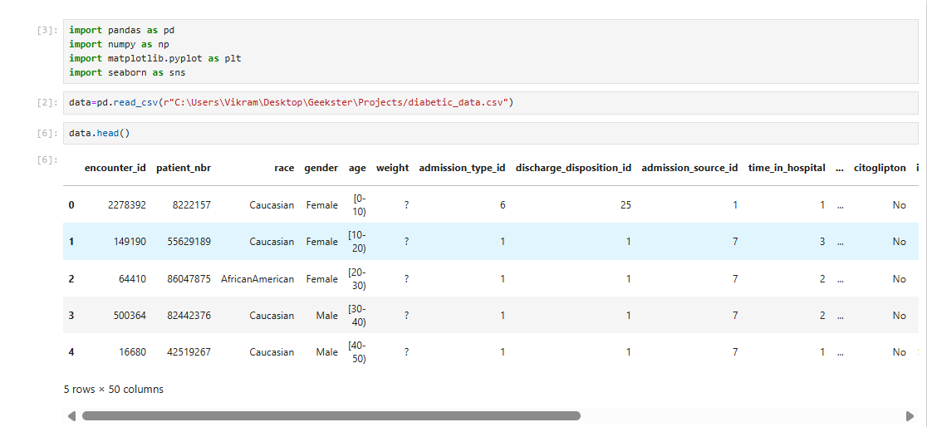

Slide 3


Slide 4


Slide 5


Slide 6


Slide 7


Slide 8
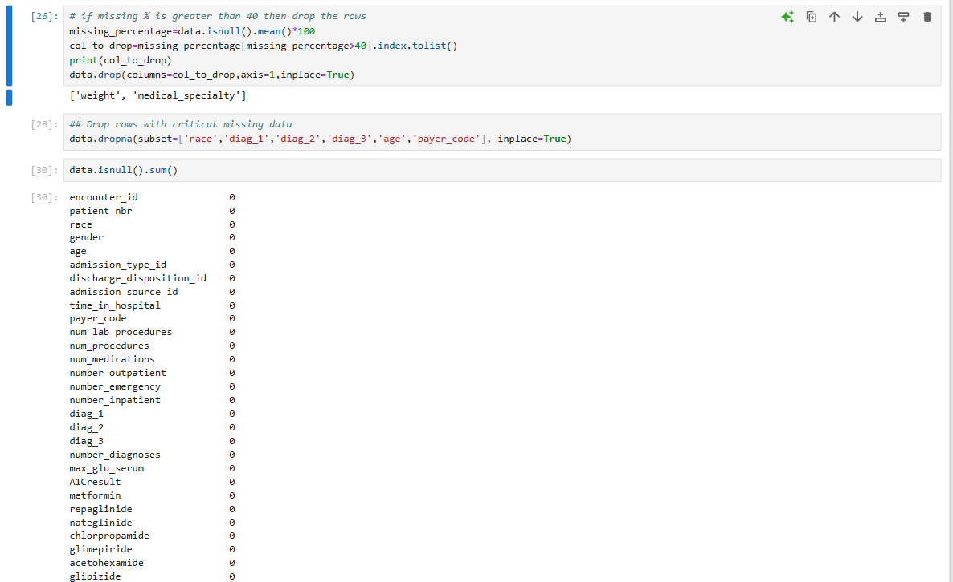

Slide 9
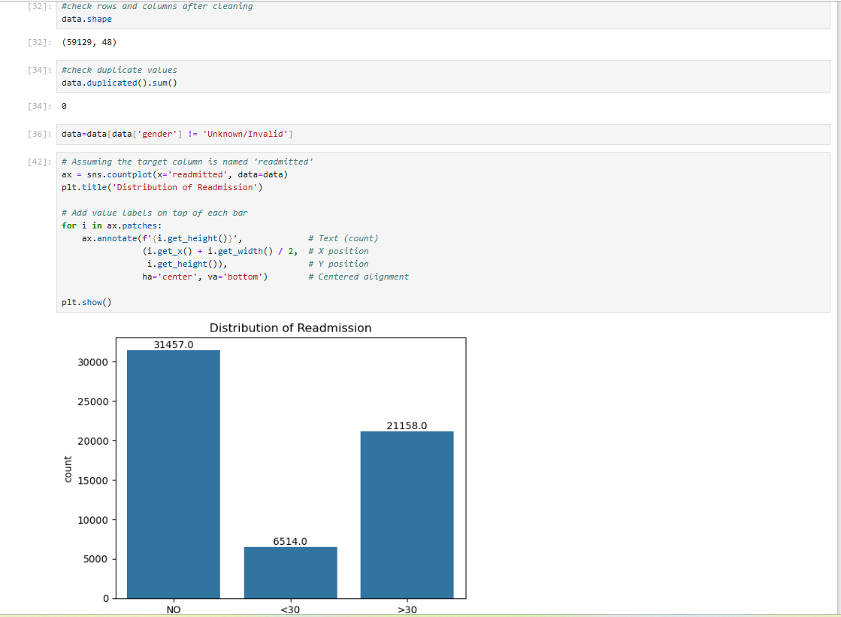

Slide 10
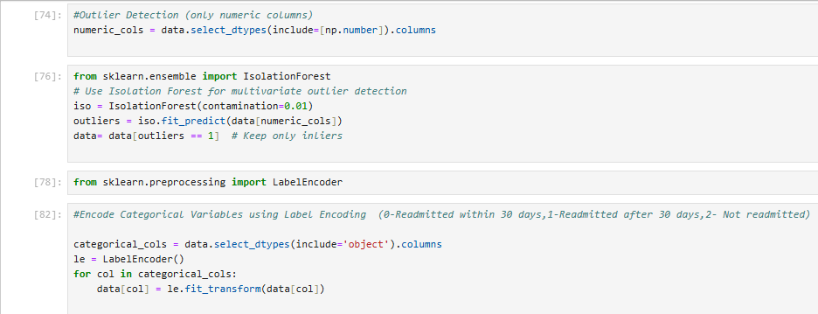

Slide 11
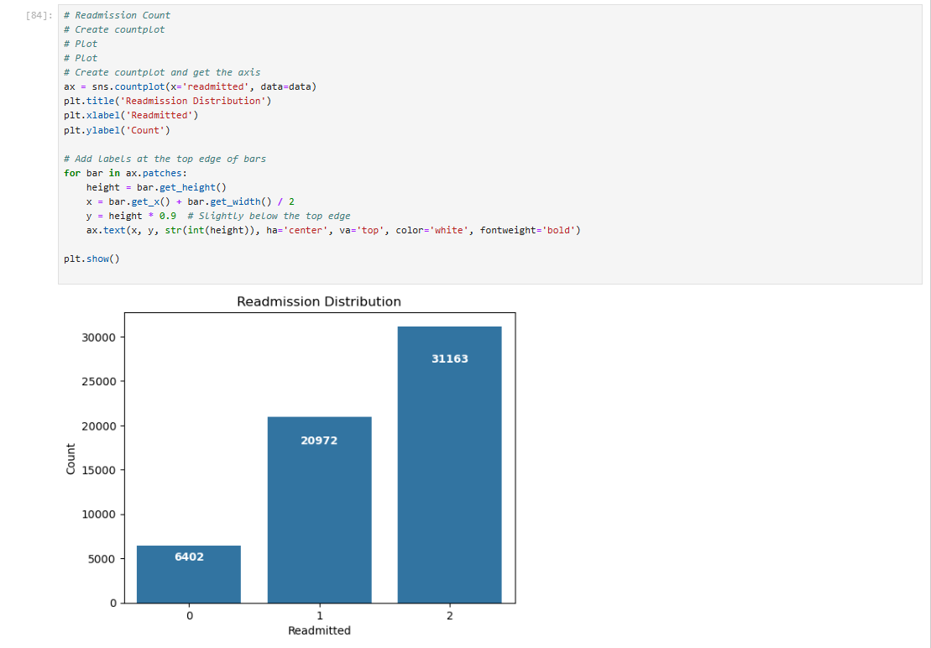

Slide 12
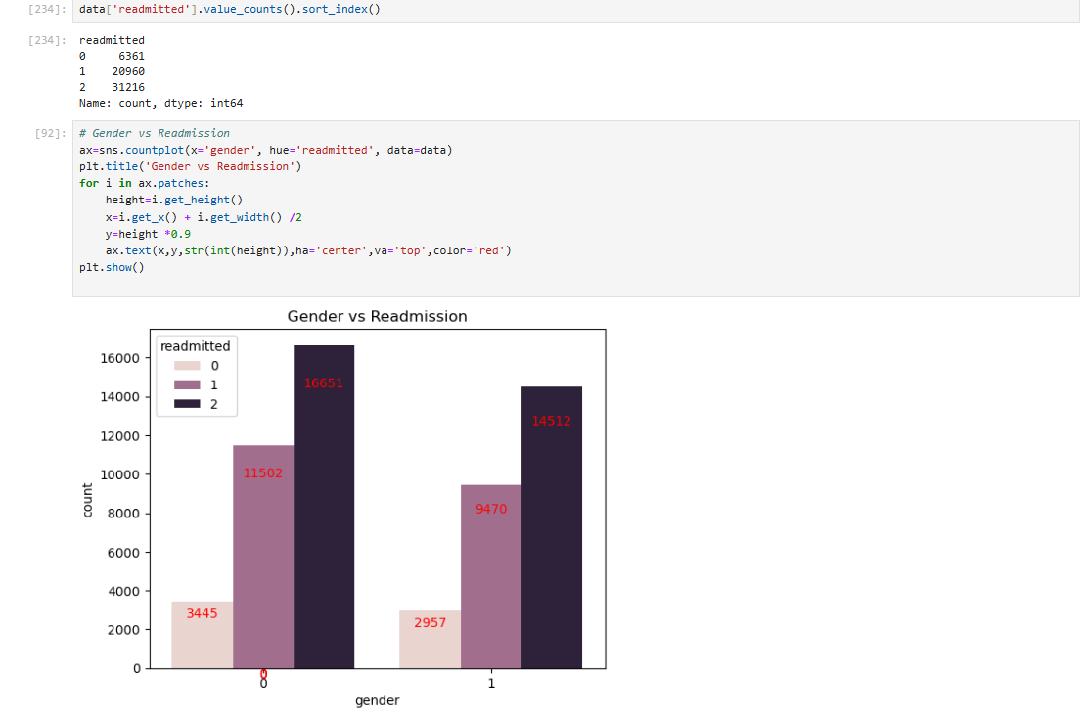

Slide 13
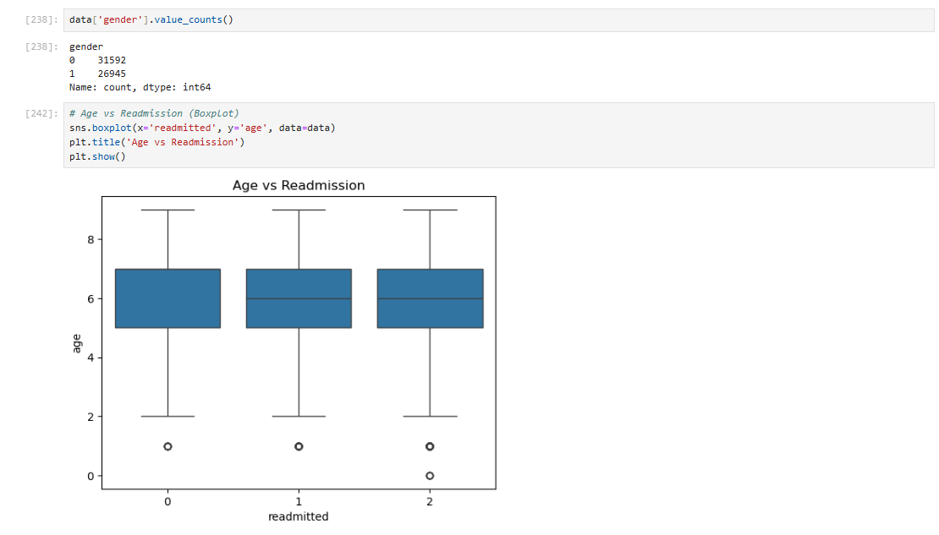

Slide 14
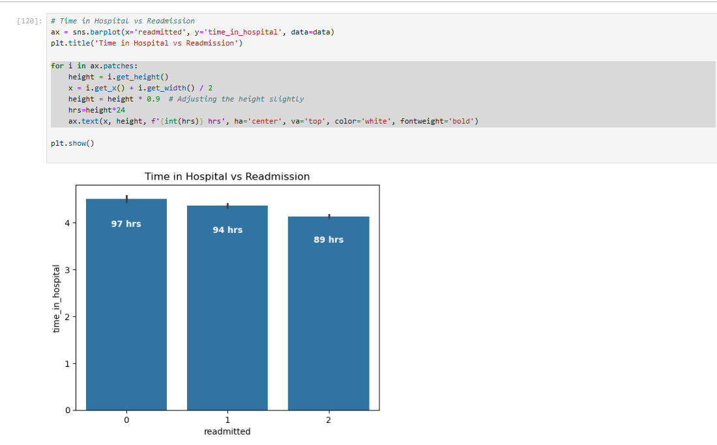

Slide 15
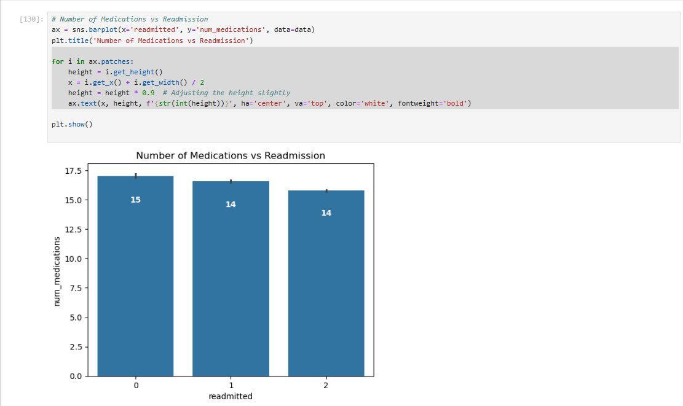

Slide 16
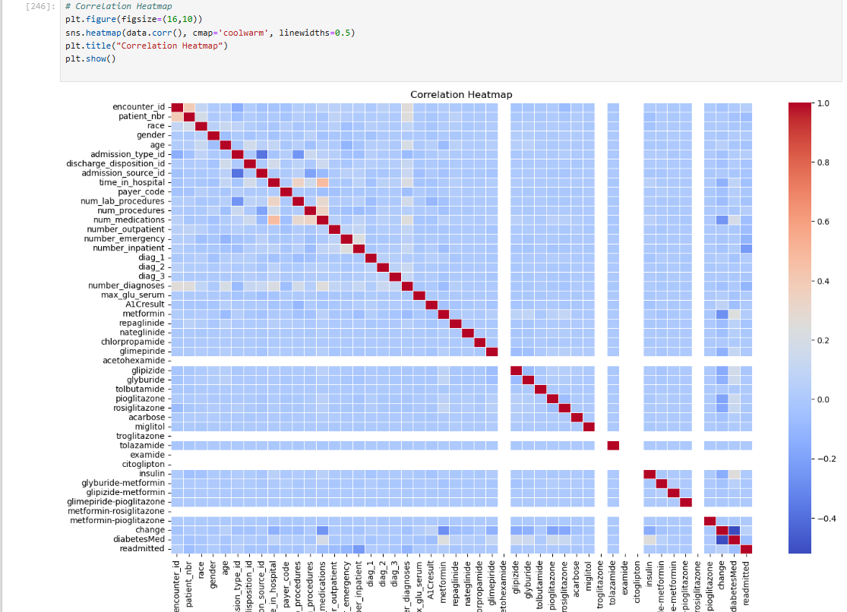

Slide 17
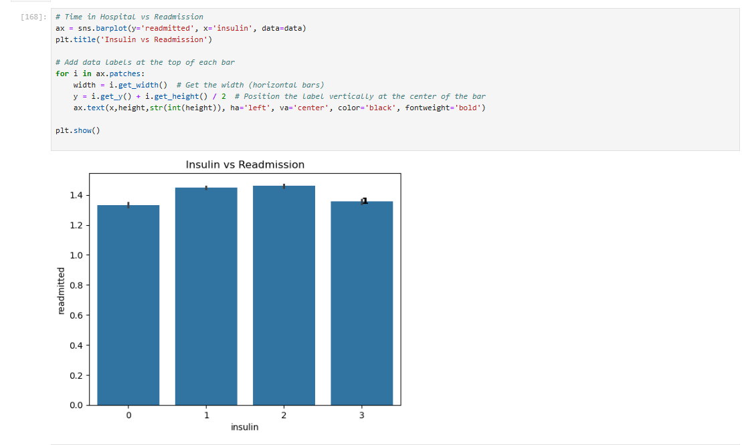

Slide 18
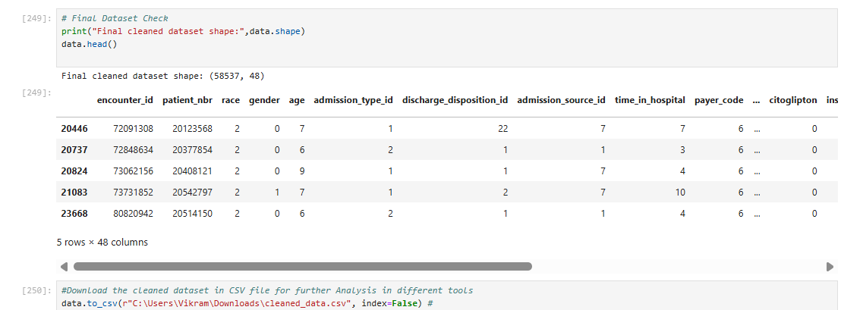

Slide 19
Summary & Insights
Patients under age 40 and above 70 have a relatively higher chance of readmission.
Longer hospital stays and higher number of medications are linked with increased readmissions.
Gender shows slight variations in readmission trends.
Patients with insulin changes (Up/Down) tend to have higher readmission chances.
These insights can help hospitals identify at-risk patients and personalize post-discharge care plans.

