Slide 1



ARTEMIS HACKATHON 2026
TITLE PAGE
Problem Statement No – 01
Problem Statement Title - Agriguard AI
PS Category- Software
Team Name – Falcon05

Slide 2
PROBLEM STATEMENT
Problem:-
Farmers cannot easily identify plant diseases at early stages
Lack of agricultural experts in rural areas
Wrong pesticide usage increases cost and soil damage
Crop loss reduces farmer income
Who faces this?
Small and medium farmers
Rural agricultural communities
Current Challenges:-
Manual inspection
Delayed diagnosis
No instant expert guidance
Real-world relevance:-
India is agriculture dependent
Early disease detection increases productivity
Supports Digital India & Smart Farming

Slide 3
PROPOSED SOLUTION
(YOUR IDEA)
Concept:-
An AI-powered web application that:
Detects plant diseases using leaf images
Provides suitable treatment suggestions instantly
How it works (High Level):-
Farmer uploads plant leaf image
ML model predicts disease
System shows:
Disease name
Confidence percentage
Suggested treatment
Main Features:-
Image-based disease detection
Instant AI prediction
Simple web interface
Treatment & pesticide suggestion
Works on mobile browser

Slide 4
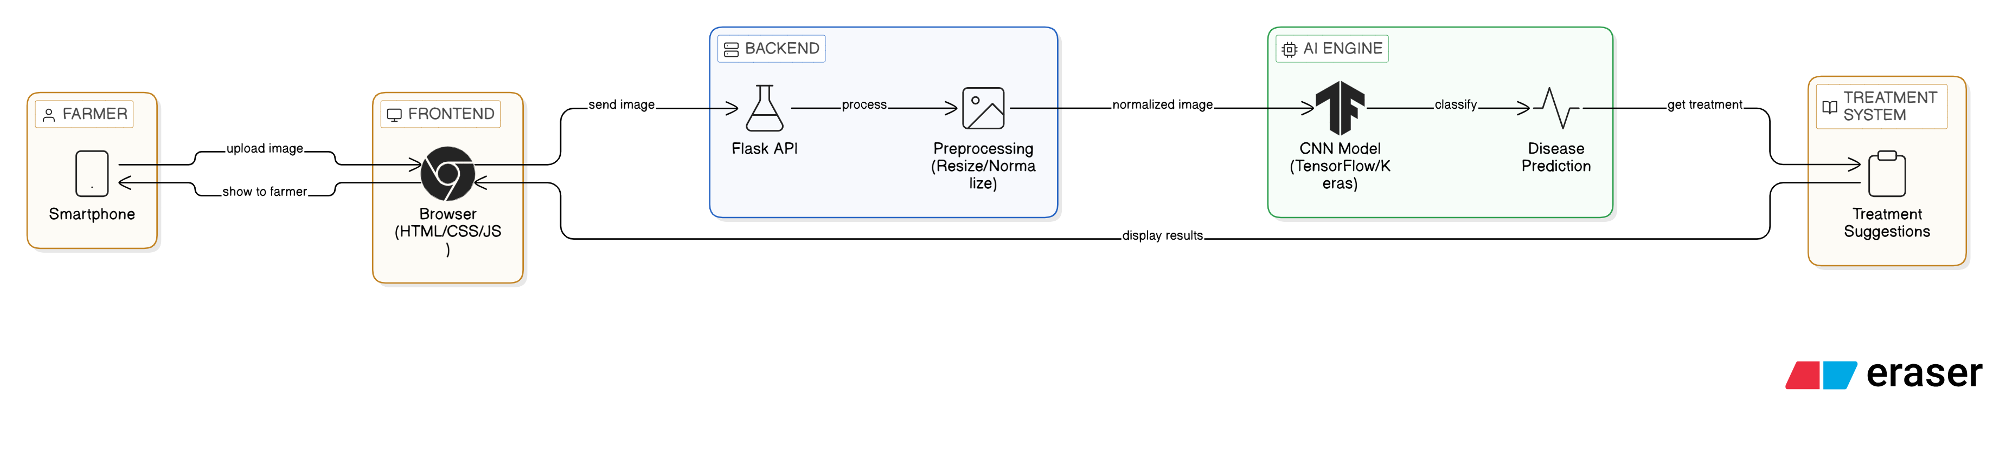
TECHNICAL APPROACH
Technologies Used:-
Python
TensorFlow / Keras (CNN Model)
Flask (Backend API)
HTML
CSS
JavaScript

Slide 5
FEASIBILITY AND VIABILITY
Feasibility:-
No hardware required
Low cost implementation
Uses open-source tools
Challenges:-
Model accuracy depends on dataset
Internet requirement
Different lighting conditions in images
Solutions:-
Data augmentation
Model retraining
Optimize for mobile usage

Slide 6
CHALLENGES & RISKS
Incorrect prediction risk
Limited dataset coverage
Farmers may upload unclear images
Mitigation:-
Confidence score display
Clear instructions for image upload
Continuous model improvement

Slide 7
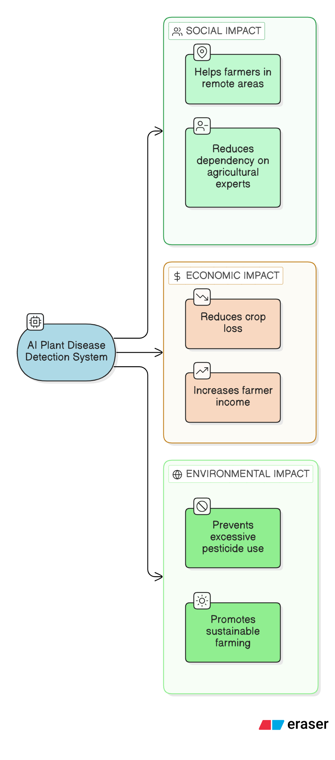
IMPACT AND BENEFITS
Social Impact:-
Helps farmers in remote areas
Reduces dependency on experts
Economic Impact:-
Reduces crop loss
Increases farmer income
Environmental Impact:-
Prevents excessive pesticide use
Promotes sustainable farming

Slide 8
TARGET USERS
Farmers
Agricultural students
Government agriculture departments
Agri start-ups

Slide 9
FUTURE SCOPE
Multi-language support (Hindi, Marathi, etc.)
Voice-based interaction
Offline model deployment
Integration with weather data
Government agriculture portal integration

Slide 10
BUSINESS MODEL / PROFIT STRATEGY
Free basic disease detection
Premium subscription for:
* Advanced analytics
* Personalized farming tips
Government collaboration
Agri-company partnerships

Slide 11
RESEARCH AND REFERENCES
Plant Village Dataset
TensorFlow Documentation
Research papers on CNN for plant disease detection

