Slide 1


Python - Django Web Framework Deloitte US India December 16, 2019

Slide 2
Meet the trainers
Niranjan Patidar(BTA)
Analytics and Cognitive
npatidar@deloitte.com
Mumbai
Swatantra Yadav (BTA)
Analytics and Cognitive
swayadav@deloitte.com
Mumbai

Slide 3
Agenda
Day 1
Python Installation
Python Variables and functions
Conditional structure and Loops
Lists, Tuple, Dictionary, Set
List comprehension
File Processing

Slide 4
Agenda
Day 2
Python Classes
Exception Handling
Python Program Hands-on
Django Introduction and setup
Folder Structure and MVT working
URL Routing
Day 3
Model design
Views Scripting
Template
A Small Data Visualization App

Slide 5
Day 1

Slide 6
Python Introduction
Python is a high level programming language.
The Python is a strong dynamically typed language.
The core areas of Python use are scientific / numerical analysis (replacing Fortran), educational tools (Raspberry Pi etc.), config management, and of course web software.
Written in C – high performance, ability to link to C libraries for extensions
Interpreted script language compiled on the fly into bytecode
Easier to read coding standards – whitespace sensitive
Object Oriented

Slide 7
Introduction to Computing Using Python
Python program
line1 = 'Hello Python developer...'
A Python program is a sequence of Python statements
Stored in a text file called a Python module
Executed using an IDE or “from the command line”
line2 = 'Welcome to the world of Python!'
A Python program is a sequence of Python statements
Stored in a text file called a Python module
Executed using an IDE or “from the command line”
print(line1)
print(line2)
hello.py
$ python hello.py
Hello Python developer…
Welcome to the world of Python!
line1 = 'Hello Python developer...'
line2 = 'Welcome to the world of Python!'
print(line1)
print(line2)
$ python hello.py
line1 = 'Hello Python developer...'
line2 = 'Welcome to the world of Python!'
print(line1)
print(line2)
line1 = 'Hello Python developer...'
line2 = 'Welcome to the world of Python!'
print(line1)
print(line2)
line1 = 'Hello Python developer...'
line2 = 'Welcome to the world of Python!'
print(line1)
print(line2)
line1 = 'Hello Python developer...'
line2 = 'Welcome to the world of Python!'
print(line1)
print(line2)
$ python hello.py
Hello Python developer…

Slide 8
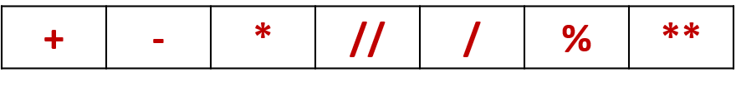
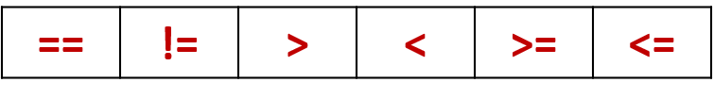
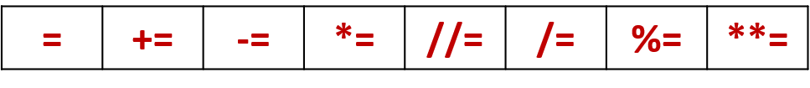
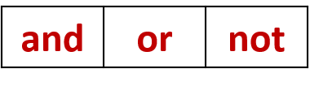

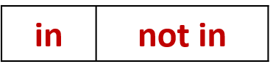
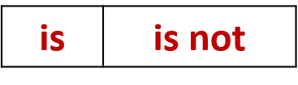
Operators
Arithmetic
Comparison
Assignment
Logical
Bitwise
Membership
Identity

Slide 9
Sequence Data Types - Lists
List is a collection which is ordered and changeable. Allows duplicate members.
Tuple is a collection which is ordered and unchangeable. Allows duplicate members.
Set is a collection which is unordered and unindexed. No duplicate members.
Dictionary is a collection which is unordered, changeable and indexed. No duplicate members.
Access Item
thislist = ["apple", "banana", "cherry"]
print(thislist[1]) # ["banana“]
Negative Index
thislist = ["apple", "banana", "cherry"]
print(thislist[-1]) # ["cherry"]
Range of Index
thislist = ["apple", "banana", "cherry", "orange", "kiwi", "melon", "mango"]
print(thislist[2:5]) # ["cherry", "orange", "kiwi“]

Slide 10
More List Operations
>>> a = range(5) # [0,1,2,3,4]
>>> a.append(5) # [0,1,2,3,4,5]
>>> a.pop() # [0,1,2,3,4]
5
>>> a.insert(0, 42) # [42,0,1,2,3,4]
>>> a.pop(0) # [0,1,2,3,4]
>>> a.reverse() # [4,3,2,1,0]
>>> a.sort() # [0,1,2,3,4]

Slide 11
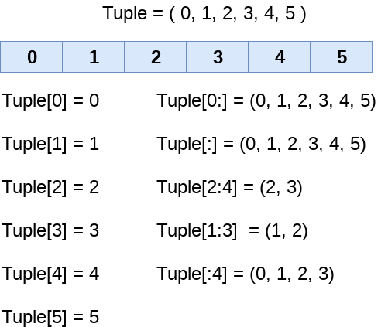
Tuples
key = (lastname, firstname)
point = x, y, z # parentheses optional
x, y, z = point # unpack
lastname = key[0]
singleton = (1,) # trailing comma!!!
empty = () # parentheses!
tuples vs. lists; tuples immutable

Slide 12
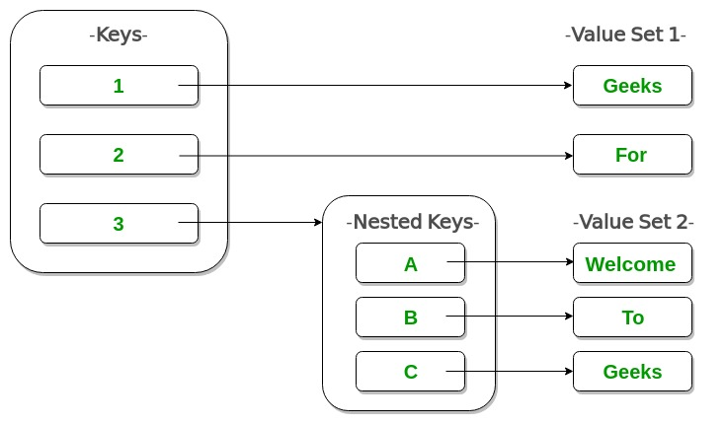
Dictionary
We can use List, Tuple and Set to represent a group of individual objects as a single entity.
If we want to represent a group of objects as key-value pairs then we should go for Dictionary.
Hash tables, "associative arrays“
d = {"duck": "eend", "water": "water"}
Lookup:
d["duck"] -> "eend“
d["back"] # raises KeyError exception
Delete, insert, overwrite:
del d["water"] # {"duck": "eend", "back": "rug"}
d["back"] = "rug" # {"duck": "eend", "back": "rug"}
d["duck"] = "duik" # {"duck": "duik", "back": "rug"}

Slide 13
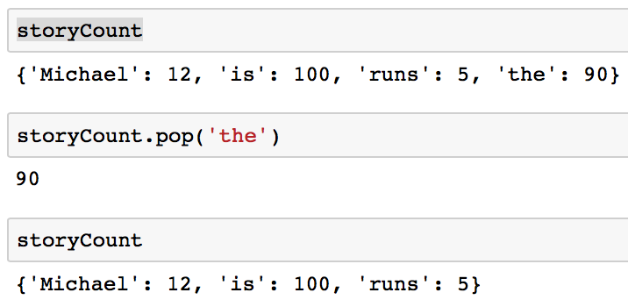
More Dictionary Options
Keys, values, items:
d.keys() -> ["duck", "back"]
d.values() -> ["duik", "rug"]
d.items() -> [("duck","duik"), ("back","rug")]
Presence check:
d.has_key("duck") -> 1; d.has_key("spam") -> 0
Values of any type; keys almost any
{"name":"Guido", "age":43, ("hello","world"):1, 42:"yes", "flag": ["red","white","blue

Slide 14
Sets
A Set is an unordered collection data type that is iterable, mutable, and has no duplicate elements. Python’s set class represents the mathematical notion of a set. The major advantage of using a set, as opposed to a list, is that it has a highly optimized method for checking whether a specific element is contained in the set.
Frozen sets are immutable objects that only support methods and operators that produce a result without ejecting the frozen set or sets to which they are applied
Normal Set set(['a', 'c', 'b', 'd’])
Frozen Set frozenset(['e', 'g', 'f’])

Slide 15
Sets Method
people = {"Jay", "Idrish", "Archil"}
people.add("Daxit")
add(x) Method:
union(s) Method:
intersect(s) Method:
difference(s) Method:
clear() Method:
people = {"Jay", "Idrish", "Archil"}
vampires = {"Karan", "Arjun"}
population = people.union(vampires)
victims = people.intersection(vampires)
ssafe = people.difference(vampires)
victims.clear()

Slide 16
Introduction to Computing Using Python
Mutable and immutable types
a
b
c
d
>>> a
3
>>> a = 6
>>> a
6
>>> d
[1, 2, 3]
>>> a
3
>>> a = 6
>>> a
6
>>> a
3
[1, 7, 3]
>>> a
3
>>> a = 6
>>> a
6
>>> d
[1, 2, 3]
>>> d[1] = 7
>>> d
[1, 7, 3]
3
[1, 2, 3]
'three'
3.3
6
The object (3) referred to by variable a does not change; instead, a refers to a new object (6)
Integers are immutable
The object ([1, 2, 3]) referred to by d changes
Lists are mutable

Slide 17
Introduction to Computing Using Python
Assignment and mutability
>>> a
6
>>> b
3.3
>>> b = a
>>> b
6
>>> a = 9
>>> b
6
>>> c = d
>>> c
[1, 7, 3]
>>> a
6
>>> b
3.3
>>> b = a
>>> b
6
>>> a = 9
>>> b
6
>>> c = d
>>> c
[1, 7, 3]
>>> d[2] = 9
>>> c
[1, 7, 9]
>>> a
6
>>> b
3.3
>>> b = a
>>> b
6
>>> a = 9
>>> b
6
>>> a
6
>>> b
3.3
a
b
c
d
>>> a
6
>>> b
3.3
>>> b = a
>>> b
6
9
[1, 7, 9]
3
[1, 7, 3]
3.3
6
'three'
a and b refer to the same integer object
c and d refer to the same list object
The list that c refers to changes; d refers to the same list object, so it changes too
Because lists are mutable, a change to d affects c
a now refers to a new object (9); b still refers to the old object (6)
Because integers are immutable, a change to a does not affect the value of b

Slide 18
Introduction to Computing Using Python
Defining new functions
New functions can be defined using def
>>result = f(10)
>>result
110
def: function definition keyword
f: name of function
x: variable name for input argument
def f(x):
res = x**2 + 10
return res
return: specifies function output

Slide 19
Introduction to Computing Using Python
if statement
if temp > 86:
print('It is hot!')
print('Be sure to drink liquids.')
print('Goodbye.')
if temp > 86:
print('It is hot!')
print('Be sure to drink liquids.')
print('Goodbye.')
if temp > 86:
print('It is hot!')
print('Be sure to drink liquids.')
print('Goodbye.')
if <condition>:
<indented code block>
<non-indented statement>
The value of temp is 50.
The value of temp is 90.
temp > 86:
True
print('It is hot!')
False
print('Be sure to drink liquids.')
Print('Goddbye.')

Slide 20
Introduction to Computing Using Python
Indentation is critical
if temp > 86:
print('It is hot!')
print('Drink liquids.')
print('Goodbye.')
if temp > 86:
print('It is hot!')
print('Drink liquids.')
print('Goodbye.')
temp > 86:
temp > 86:
True
True
print('It is hot!')
print('It is hot!')
False
False
print('Drink liquids.')
print('Drink liquids.')
print('Goddbye.')
print('Goddbye.')

Slide 21
Introduction to Computing Using Python
Two-way if statement
if temp > 86:
print('It is hot!')
print('Be sure to drink liquids.')
else:
print('It is not hot.')
print('Bring a jacket.')
print('Goodbye.')
if temp > 86:
print('It is hot!')
print('Be sure to drink liquids.')
else:
print('It is not hot.')
print('Bring a jacket.')
print('Goodbye.')
if <condition>:
<indented code block 1>
else:
<indented code block 2>
<non-indented statement>
if temp > 86:
print('It is hot!')
print('Be sure to drink liquids.')
else:
print('It is not hot.')
print('Bring a jacket.')
print('Goodbye.')
The value of temp is 50.
The value of temp is 90.
temp > 86:
False
True
print('It is not hot!')
print('It is hot!')
print('Bring a jacket.')
print('Be sure to drink liquids.')
print('Bring a jacket.')

Slide 22
Introduction to Computing Using Python
for loop
Executes a block of code for every item of a sequence
If sequence is a string, items are its characters (single-character strings)
>>> name = 'Apple'
>>> for char in name:
print(char)
>>> name = 'Apple'
>>> for char in name:
print(char)
>>> name = 'Apple'
>>> for char in name:
print(char)
A
p
p
>>> name = 'Apple'
>>> for char in name:
print(char)
A
>>> name = 'Apple'
>>> for char in name:
print(char)
A
>>> name = 'Apple'
>>> for char in name:
print(char)
A
p
p
l
>>> name = 'Apple'
>>> for char in name:
print(char)
A
p
p
l
e
>>> name = 'Apple'
>>> for char in name:
print(char)
A
p
>>> name = 'Apple'
>>> for char in name:
print(char)
A
p
>>> name = 'Apple'
>>> for char in name:
print(char)
A
p
p
>>> name = 'Apple'
>>> for char in name:
print(char)
A
p
p
l
name =
'A p p l e'
char =
'A'
char =
'p'
char =
'p'
char =
'l'
char =
'e'

Slide 23
While Statement
while (expression):
S1
S2
FALSE
expression
TRUE
S1
S2
Evaluate expression
If TRUE then
execute statement1
goto step 1.
If FALSE then execute statement2.

Slide 24
File Handling
We use open () function in Python to open a file in read or write mode.
“ r “, for reading.
“ w “, for writing.
“ a “, for appending.
“ r+ “, for both reading and writing
Definitions
"r" - Read - Default value. Opens a file for reading, error if the file does not exist
"a" - Append - Opens a file for appending, creates the file if it does not exist
"w" - Write - Opens a file for writing, creates the file if it does not exist
"x" - Create - Creates the specified file, returns an error if the file exists

Slide 25

Thank You

