Slide 1
ZamWealth Quest
Level Up Your
Financial Life.
A gamified mobile platform building financial intelligence
for every young Zambian — one level at a time.
Team ZamWealth Quest • UNILUS • May 11, 2025
Presented by: Chitundu | Pitch Lead & QA

Slide 2
The Problem
Millions of Zambians are navigating a financial world they were never taught to understand.
Low
60%+
Informal
Household Savings Rate
Population Under 25
Economy Dominates
Most Zambian families have little or no financial safety net, leaving them exposed to economic shocks.
A massive youth population with limited access to practical, relevant financial education tools.
Millions transact outside formal financial systems, missing opportunities to save, invest, and grow.
"The system wasn't built to teach them. ZamWealth Quest is."

Slide 3
Our Solution
ZamWealth Quest
🏘️ Zambian Neighbourhoods
Set in real local contexts like Kabulonga, Woodlands & Levy
is a gamified mobile platform that teaches Zambians how to save, invest, and build businesses — through simulated Zambian neighbourhoods, businesses, and real economic scenarios.
📱 Mobile-First Design
Built for smartphones — where Zambians already are
Think Duolingo, but for your wallet.
🎮 Learn Through Play
Gamified levels, rewards, and real-world scenario simulations
No textbooks. No lectures. Just interactive, locally relevant simulations that make financial learning feel like a game — because it is.
📈 Real Skills
Budgeting, credit, investing, and business registration

Slide 4
How It Works
Four progressive levels, each unlocking deeper financial knowledge and richer simulations.
LEVEL 01
LEVEL 02
LEVEL 03
LEVEL 04
FREE
SMART GROWTH
INVESTMENT
ENTREPRENEURSHIP
Kabulonga Gardens
Woodlands Heights
Levy Financial District
Mukuba Enterprise Park
Budgeting basics, tracking income & expenses, and understanding financial goals. Perfect for complete beginners.
Managing credit, understanding loans, building good financial habits and navigating banking systems.
Simulated stock trading, understanding markets, building an investment portfolio and evaluating risk.
Registering a PACRA business, financial planning for SMEs, pitching to investors, and scaling operations.
→
→
→
Users progress naturally — each level builds on the last, reinforcing real financial habits through play.

Slide 5
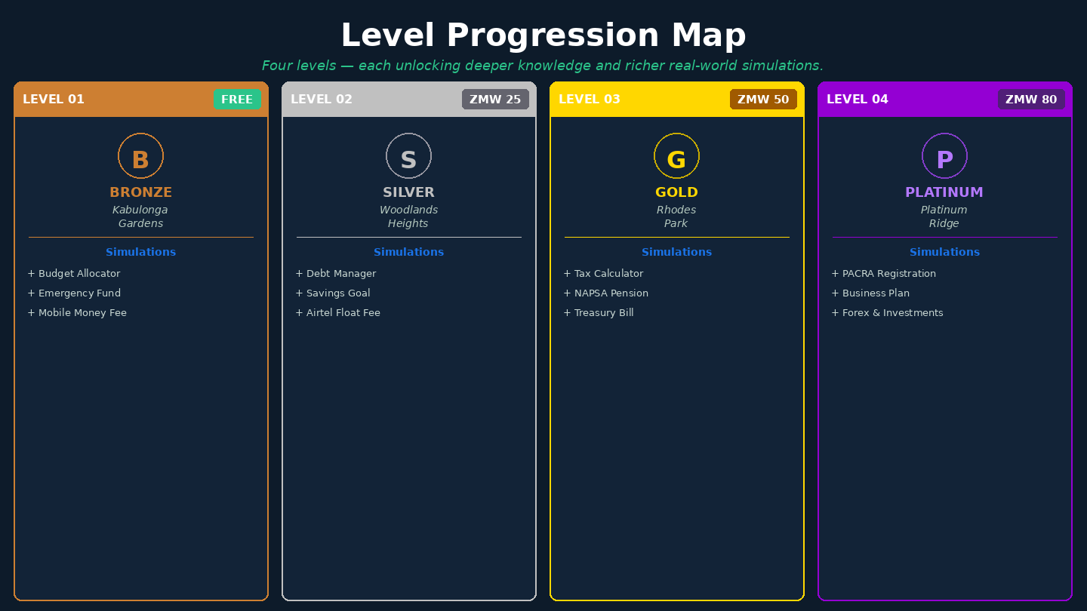

Slide 6
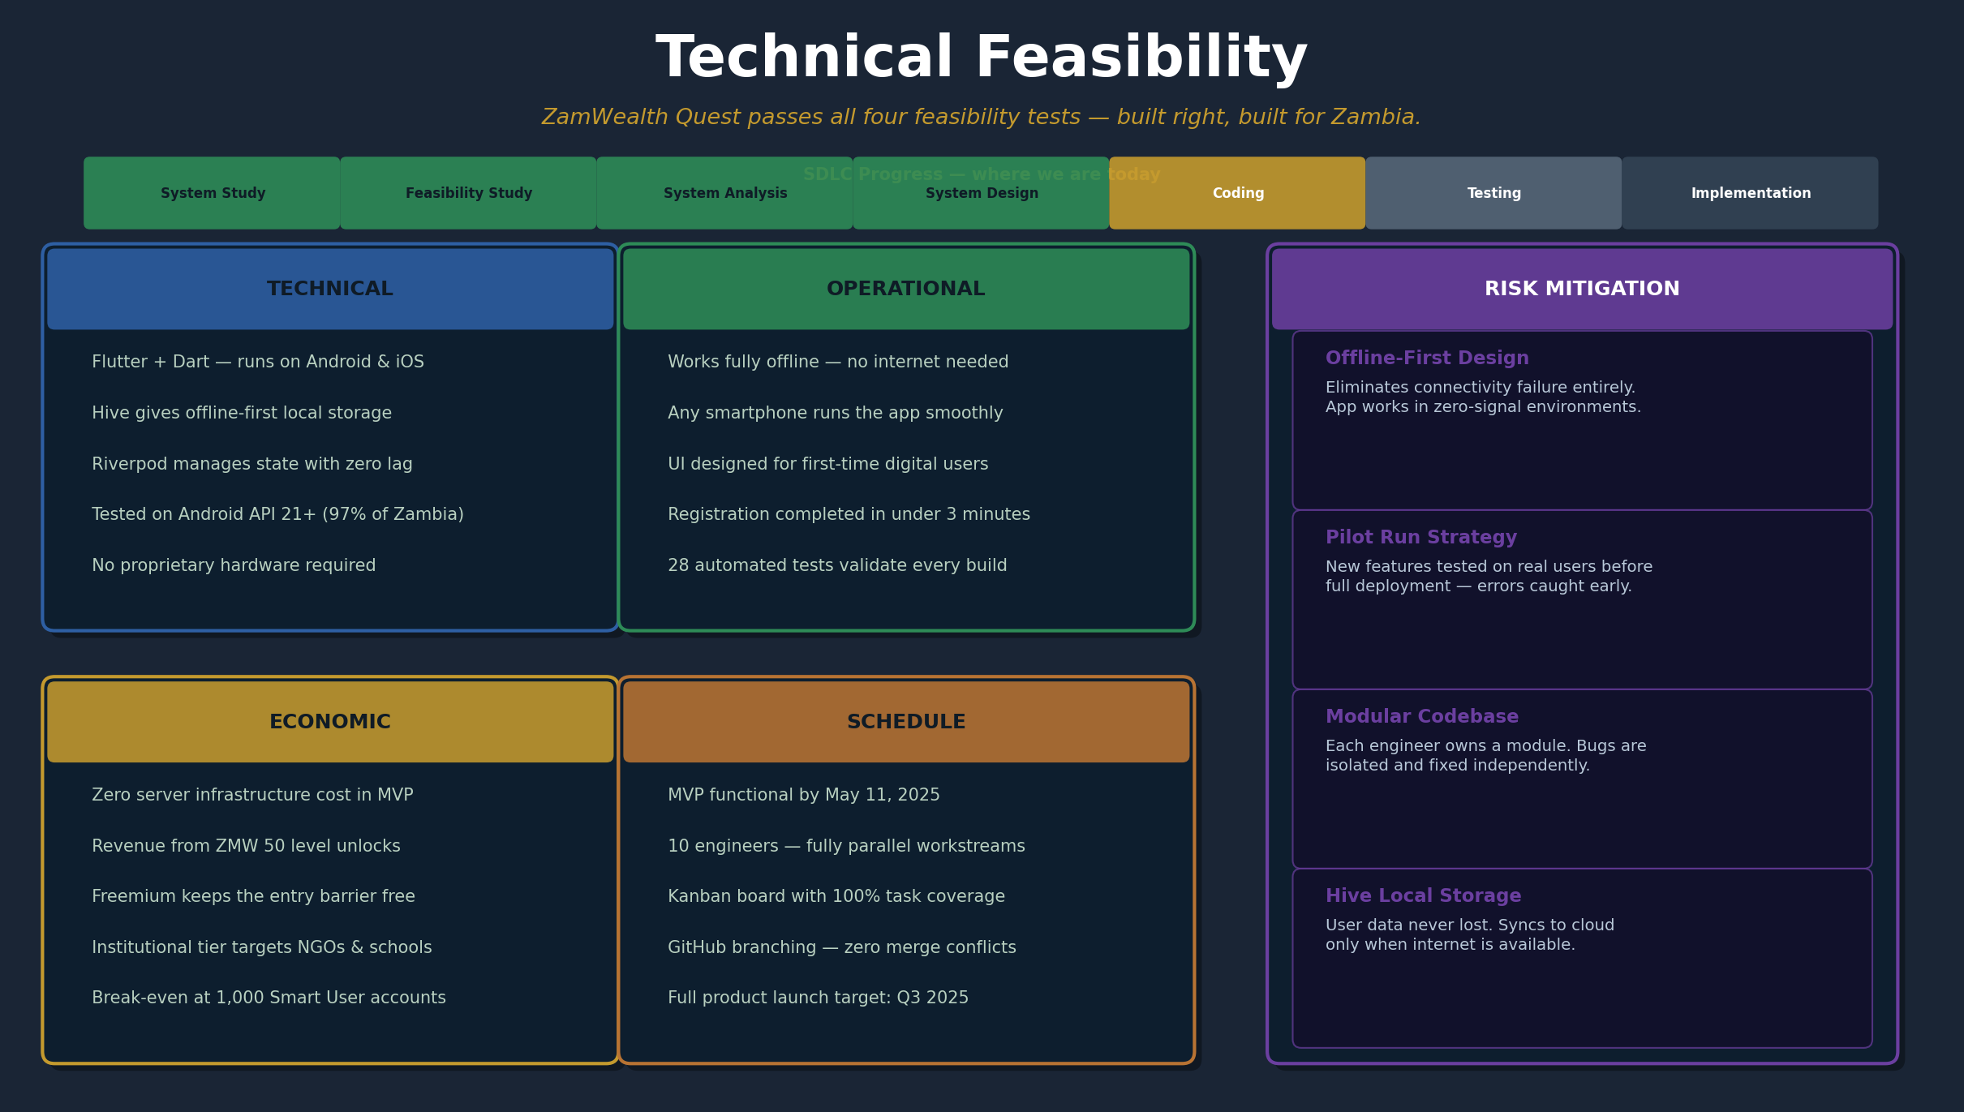

Slide 7
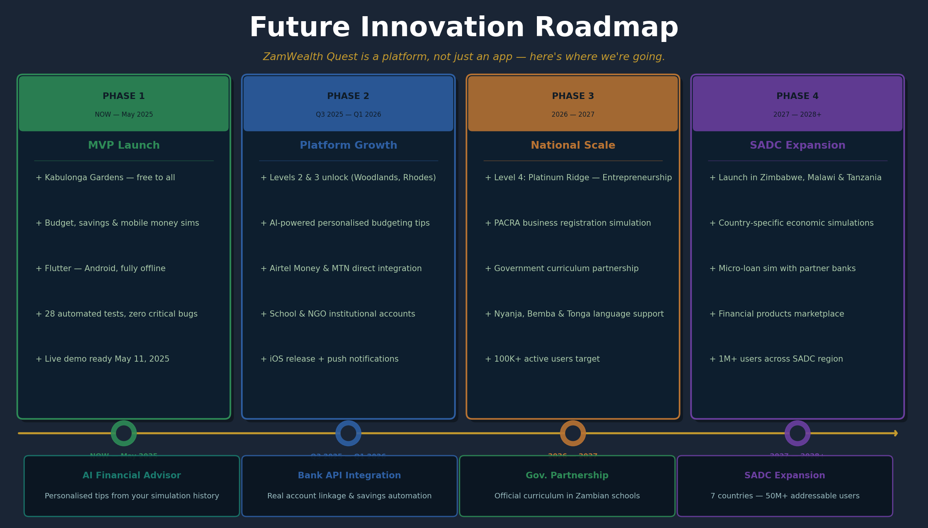

Slide 8
Market Opportunity
Zambia's demographics and mobile growth create a once-in-a-generation opening.
19M+
7M+
50K
Zambia's entire population
Youth & smartphone users
Active users by Year 3
Every Zambian who could benefit from financial literacy tools — from students to SME owners.
Over 60% of Zambians are under 25, with rapidly growing smartphone and mobile money adoption.
Starting with university students and scaling through schools, NGOs, and institutional partners.
Mobile money — MTN MoMo & Airtel Money — has already primed Zambia for digital financial tools. We are not creating new behaviour. We are channelling it.

Slide 9
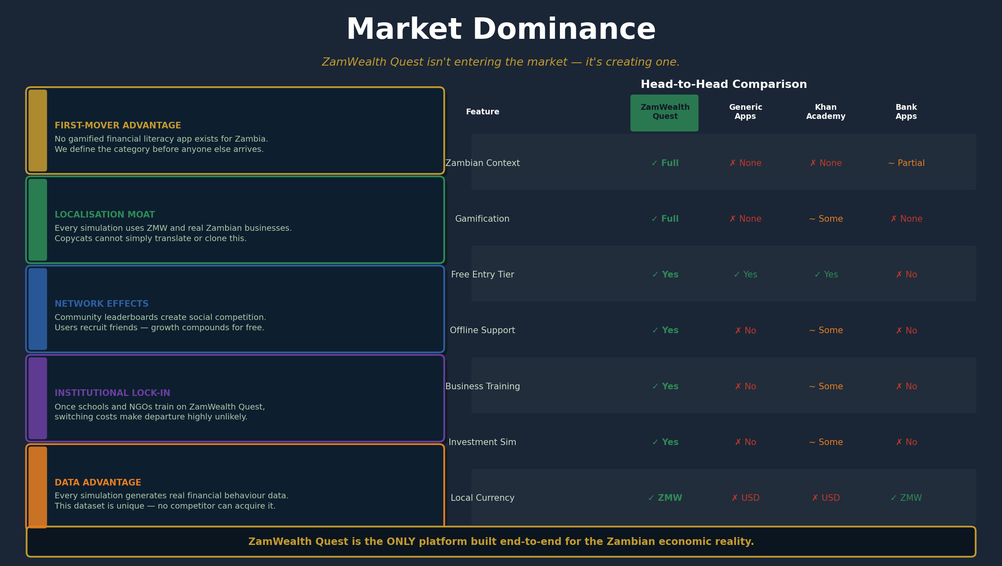

Slide 10
Revenue Model
Three revenue streams designed for the Zambian income reality — accessible, scalable, and sustainable.
🌱 FREEMIUM
⭐ SMART USER
🏛️ INSTITUTIONAL
Free
K50–K120
Custom
Forever
/ month
licensing
✓ Level 1 (Kabulonga Gardens) free
✓ All 4 levels unlocked
✓ School & NGO white-labelling
✓ Core budgeting simulations
✓ Advanced investment simulations
✓ Bulk student accounts
✓ Progress tracking & badges
✓ Personalised learning paths
✓ Admin dashboard & reporting
✓ Community leaderboards
✓ Certificate of completion
✓ Banks, MFIs & corporates
Target: All Zambian users
Target: Students & young professionals
Target: Schools, NGOs, Banks

Slide 11
3–5 Year Projections
Year 1
University launch — UNILUS & partners
Users: 5,000 Rev: K 90K
Year 2
School & NGO contracts begin
Users: 18,000 Rev: K 540K
Year 3
10+ schools, 3 NGOs signed
Users: 50,000 Rev: K 1.8M
Year 4
Corporate partnerships active
Users: 120,000 Rev: K 5M+
Year 5
SADC expansion: Zimbabwe & Malawi
Users: 300,000 Rev: K 12M+
Revenue estimates based on freemium conversion rate of 5% and institutional licensing at K8,000–K25,000/yr per partner.

Slide 12
Go-To-Market Strategy
A phased rollout that builds trust, credibility, and scale — starting where our users already are.
🎓 PHASE 1
🏫 PHASE 2
🌍 PHASE 3
Months 1–6
Months 7–18
Year 3–5
University Launch
Schools, NGOs & Banks
SADC Region Expansion
→ Launch at UNILUS as flagship university
→ Pilot with secondary schools via institutional licensing
→ Expand to Zimbabwe and Malawi first
→ Partner with student finance clubs & unions
→ Partner with NGOs for financial inclusion programmes
→ Adapt platform for local currencies & regulations
→ Community ambassador programme — top users become advocates
→ BongoHive & CEEC endorsement for credibility
→ Pursue World Bank / IFC financial inclusion grants
→ Target: 5,000 active users
→ Bank partnerships for real account sign-up rewards
→ Regional institutional licensing — 100K+ users target

Slide 13
Economic & Social Impact
Beyond profit — ZamWealth Quest creates measurable economic value for Zambia.
🏢 SMEs Formed
💰 Savings Accounts Opened
1,000+
Every entrepreneur who simulates PACRA registration is one step closer to doing it for real. We track actual business registrations by our users.
15,000+
Our banking partnerships reward users who open real accounts. We measure financial inclusion through actual behaviour change, not just knowledge.
by Year 5
by Year 3
📊 Investments Made
👥 Jobs & Incomes Created
K 2M+
Users who complete the investment level show 3x higher likelihood of engaging with real investment products. We partner with regulated brokers.
500+
Ambassadors, content creators, and SMEs formed through our platform generate livelihoods across Zambia's informal and formal economy.
estimated by Year 4
direct indirect roles
We don't just measure downloads. We measure lives changed.

Slide 14
The Team
10 engineers from UNILUS — each owning a critical piece of Zambia's financial future.
S
Sangu
W
Wallace
L
Lumuno
S
Sam
C
Chris
Project Manager
UI/UX Engineer
UI/UX Engineer
UI/UX Engineer
UI/UX Engineer
Establishes dev rules & workflow. Enforces branching strategy on GitHub. Manages Kanban board & sprint cadence. Also handles Cloud & Security (Firebase/Supabase auth + database architecture).
Builds Registration & Profile screens. Captures income category, financial goals, and risk appetite data from new users entering the platform.
Builds Level 1 Dashboard — Kabulonga Gardens (Free Tier). Creates interactive business cards: Manda Mini Mart, ZamFresh Market, and CityConnect Airtime.
Builds Level 2 Dashboard — Woodlands Heights (Paid Tier). Designs the locked-state UI and the upgrade/payment interaction flow to unlock the next level.
Co-builds the Level 2 (Woodlands Heights) paid tier. Handles visual polish, animations, and micro-interactions that make the game feel alive and rewarding.
Em
Emmanuel
T
Temwani
D
David
V
Vanessa
C
Chitundu
Data Engineer
Gamification
Gamification
Systems Analyst
QA / Pitch Lead
Local Storage lead. Implements Hive setup for offline mode. Creates the UserProfile Dart model and writes logic to persist registration data locally.
Defines Level 1 simulation logic — starting budgets, Needs vs Wants allocation math at Manda Mini Mart & ZamFresh. Determines unlock criteria for Level 2.
Co-designs the economic model powering the app. Defines exact criteria and cost for unlocking Woodlands Heights. Hands logic specs to the Data Engineers.
Translates network diagrams & flowcharts into pitch-ready visuals. Maps data flow from UI → Hive → Firebase so investors understand technical feasibility.
Sets up Flutter test environment, writes widget & unit tests, and runs them the moment screens are pushed to GitHub. Also leads the pitch script, deck, and May 11th presentation.
Role Legend:
Project Manager
UI/UX Engineer
Data Engineer
Gamification
Systems Analyst
QA / Pitch Lead

Slide 15
🚀 Incubation Support
Access to BongoHive's incubation programme for mentorship, workspace, and network connections to accelerate our build.
The
Ask
🤝 Pilot Partnership
A formal pilot agreement with CEEC or a government partner to deploy ZamWealth Quest in at least one school or institution.
💡 Mentorship
Guidance from experienced fintech, edtech, and business leaders who can help us navigate Zambia's regulatory and market landscape.
ZamWealth Quest is ready.
Zambia is ready.
💰 Seed Funding
Initial investment to cover product development, server infrastructure, and our first 6-month go-to-market campaign.
Thank You — Let's Build Zambia's Financial Future Together.

