Slide 1
Machine Learning Project Ames housing Sales Price
Sangwoo Lee
Shailendra Dhondiyal

Slide 2
Introduction
Dataset: Information on 1460 home sales in Ames, Iowa between 2006 and 2010 with 79 features influencing the sale prices
Motivation: To apply machine learning knowledge to uncover the key drivers of prices, which can help a business:
In optimal pricing
Knowing which features to focus on
Achieve high profitability when combined with the cost of these features

Slide 3
Overall Procedure
Predictor categorization: continuous vs nominal vs ordinal
EDA
Continous(34):
predictor vs. SalePrice plots
Pearson correlation
Nominal(24)/Ordinal(23):
predictor vs. SalePrice boxplot
Spearman correlation
Pre-processing
Missingness
Standardization/
normalization
Imputation
Predictors shortlisted
MLR: training set RMSE vs validation set RMSE, p-value,VIF
Ridge/Lasso/ElasticNet regression with parameter tuning
training set RMSE vs validation set RMSE
SVM/GD/RF regression with parameter turning:
training set RMSE vs validation set RMSE

Slide 4
Exploratory Data Analysis

Slide 5
Missingness
Many features showed high number of NaN, but on checking the data-description there was a response of NA, which meant this feature was not available in the house, for many features. We replaced with 0 as per our understanding whether the given number can be of such houses.
Features | NaN | Action Taken
LotFrontage | 259 | Replaced by 0
Alley | 1369 | Replaced by 0
MasVnrType | 8 | Replaced by 0
MasVnrArea | 8 | Interpolated: (method='linear’)
BsmtQual | 37 | Replaced by 0
BsmtCond | 37 | Replaced by 0
BsmtExposure | 38 | Replaced by 0
BsmtFinType1 | 37 | Replaced by 0
BsmtFinType2 | 38 | Replaced by 0
Electrical | 1 | Replaced by 0
FireplaceQu | 690 | Replaced by 0
GarageType | 81 | Replaced by 0
GarageYrBlt | 81 | Interpolated: (method='linear’)
GarageFinish | 81 | Replaced by 0
GarageQual | 81 | Replaced by 0
GarageCond | 81 | Replaced by 0
PoolQC | 1453 | Replaced by 0
Fence | 1179 | Replaced by 0
MiscFeature | 1406 | dropped

Slide 6
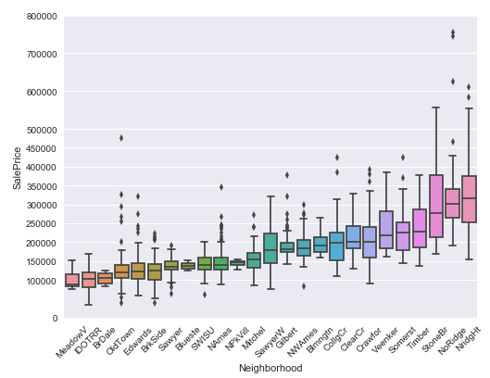
Features
Features a mix of numeric, ordinal and nominal
Values of ordinal variables replaced by integers as per order
# e.g. train.BsmtCond = train.BsmtCond.replace({"Ex": 5, 'Gd': 4, 'TA': 3, 'Fa': 2, 'Po': 1})
Nominal variables converted into ordinal by deciding order on the basis of median SalePrice within group
# e.g. train.LandContour.replace({"Lvl": 0, "Bnk": 0, "HLS": 1, "Low": 1})
Where the levels were high, grouped on the basis of median
SalePrice
# e.g. train.Neighborhood.replace({"Blmngtn":1, "Blueste":0, "BrDale":0, \
"BrkSide":0, "ClearCr":2, "CollgCr":2, "Crawfor":2, "Edwards":0, "Gilbert":1, \
"IDOTRR":0, "MeadowV":0, "Mitchel":1, "NAmes":0, "NoRidge":4, "NPkVill":0, \
"NridgHt":4, "NWAmes":1, "OldTown":0, "SWISU":0, "Sawyer":0,"SawyerW":1, \
"Somerst":2, "StoneBr":3, "Timber":2, "Veenker":2})
numeric_col = [ 'LotFrontage', 'LotArea', 'YearBuilt', 'YearRemodAdd', 'MasVnrArea', 'BsmtFinSF1', 'BsmtFinSF2',
'BsmtUnfSF', 'TotalBsmtSF', '1stFlrSF', '2ndFlrSF', 'LowQualFinSF', 'GrLivArea', 'BsmtFullBath',
'BsmtHalfBath', 'FullBath', 'HalfBath', 'BedroomAbvGr', 'KitchenAbvGr', 'TotRmsAbvGrd', 'Fireplaces',
'GarageYrBlt', 'GarageCars', 'GarageArea', 'WoodDeckSF', 'OpenPorchSF', 'EnclosedPorch', '3SsnPorch',
'ScreenPorch', 'PoolArea', 'MiscVal', 'MoSold', 'YrSold']
ordinal_col = ['LotShape', 'Utilities', 'LandSlope', 'OverallQual', 'OverallCond', 'ExterQual', 'ExterCond', 'BsmtQual',
'BsmtCond', 'BsmtExposure', 'BsmtFinType1', 'BsmtFinType2', 'HeatingQC', 'Electrical', 'KitchenQual',
'Functional', 'FireplaceQu', 'GarageFinish', 'GarageQual', 'GarageCond', 'PoolQC', 'Fence']
nominal_col = ['MSSubClass', 'MSZoning', 'Street', 'Alley', 'LandContour', 'LotConfig', 'Neighborhood', 'Condition1',
'Condition2', 'BldgType', 'HouseStyle', 'RoofStyle', 'RoofMatl', 'Exterior1st', 'Exterior2nd', 'MasVnrType',
'Foundation', 'Heating', 'CentralAir', 'GarageType', 'PavedDrive' 'MiscFeature', 'SaleType', 'SaleCondition']

Slide 7
Shortlisting the Features
For further analysis we decided to shortlist features on the basis of a threshold correlation of 0.4 (moderate and above) with SalePrice
Continuous variables were shortlisted on the basis of 'pearson’ correlation
Ordinal and Nominal(converted to ordinal) were shortlisted on the basis of 'spearman' correlation
After shortlisting we arrived at a reduced dataframe with 27 features and 1 response variable was

Slide 8
Linear Regression Assumptions

Slide 9
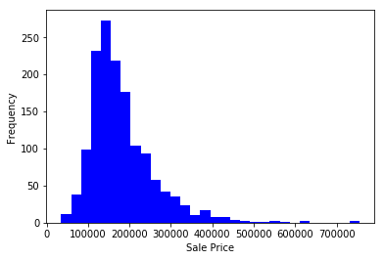
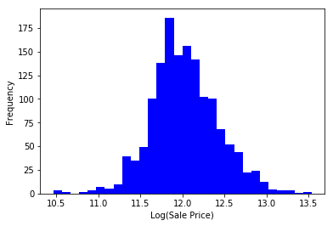
Linear Regression Assumptions (1 of 5)
Normal distribution of Response Variable:
Log transformation of ‘SalePrice’ to address skew to right

Slide 10
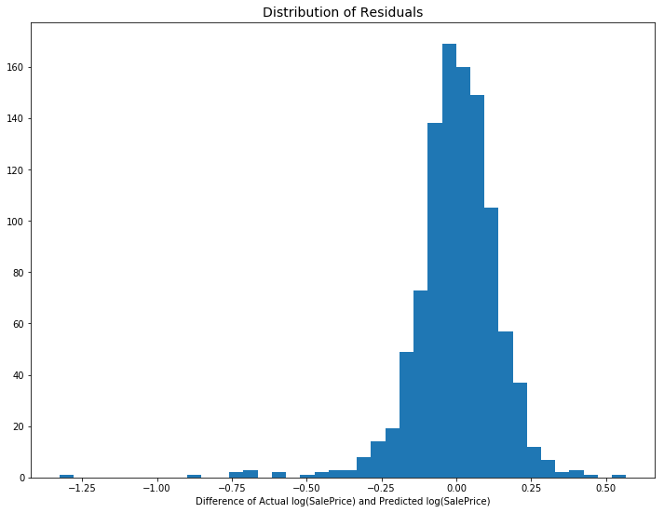
Linear Regression Assumptions (2 of 5)
Normal distribution of Residuals:
Except for a few points to left there is no major violation of normality of residuals

Slide 11
Linear Regression Assumptions (3 of 5)
Linear relationship between the outcome variable and the independent variables:
all features showed correlation of moderate to high with log(SalePrice)
OverallQual | 0.791 |  | FireplaceQu | 0.520
Neighborhood | 0.711 |  | YearRemodAdd | 0.507
GrLivArea | 0.709 |  | Foundation | 0.498
ExterQual | 0.683 |  | GarageType | 0.484
KitchenQual | 0.660 |  | MasVnrArea | 0.474
GarageCars | 0.640 |  | GarageYrBlt | 0.467
GarageArea | 0.623 |  | Fireplaces | 0.467
TotalBsmtSF | 0.614 |  | HeatingQC | 0.428
1stFlrSF | 0.606 |  | MasVnrType | 0.427
BsmtQual | 0.585 |  | MSSubClass | 0.393
FullBath | 0.561 |  | Exterior1st | 0.370
GarageFinish | 0.549 |  | Exterior2nd | 0.366
TotRmsAbvGrd | 0.534 |  | MSZoning | 0.318
YearBuilt | 0.523

Slide 12
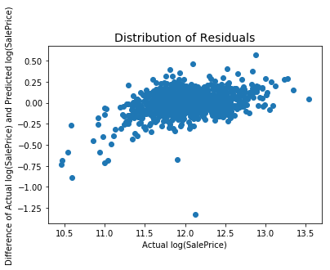
Linear Regression Assumptions (4 of 5)
Constant Variation and Auto-correlation:
The spread (variance) is not changing much with y values, but is an issue of auto-correlation as residuals are going up with log(SalePrice)

Slide 13
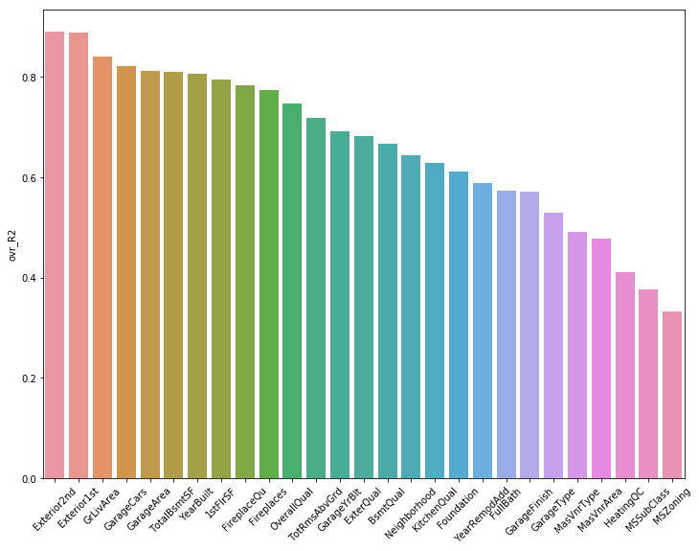
Linear Regression Assumptions (5 of 5)
Multicollinearity (Checking One-Feature-vs-Rest):
There is an issue of multicollinearity as many features are showing high R_sqr values when regressed against other features

Slide 14
Regression Models

Slide 15
Modeling Results
Regression Model | RMSE.log.diff (train) | RMSE.log.diff (test) | Best Hyperparameters* | Noter
Linear Regression | 0.147 | 0.153
Linear Regression with backward BIC | 0.148 | 0.151 |  | Shortlisted predictors – [YearBuilt ,MasVnrArea, TotalBsmtSF,FullBath, Exterior1st,Exterior2nd,MasVnrType Foundation,GarageType ExterQual FireplaceQu
Ridge Regression | 0.147 | 0.152 | alpha=50.5
Lasso Regression | 0.147 | 0.152 | alpha=0.001,
ElasticNet Regression | 0.147 | 0.152 | alpha=0.001; l1_ratio=1.21
Random Forest Regression | 0.064 | 0.134 | n_estimators=100; max_features=12; | Kaggle score 0.1527
Gradient Boosting Regression | 0.098 | 0.135 | learning_rate=0.005; n_estimators=1400; max_depth=3
Gradient Boosting Regression | 0.102 | 0.136 | learning_rate=0.001; n_estimators=1500; max_depth=3 | Kaggle score 0.14544
Support Vector Regression | 0.088 | 0.137 | kernel='sigmoid'; gamma=5e-06; epsilon=0.1; C=7000
* after gridsearch tuning

Slide 16
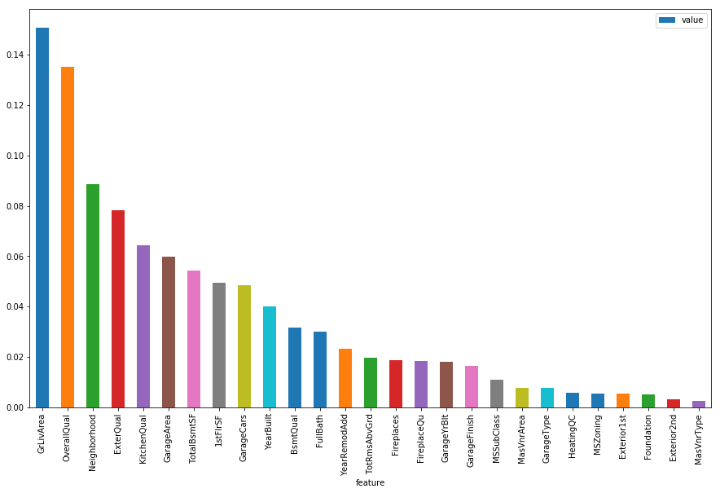
Feature Importance as per Random Forest

Slide 17
Discussion
* Conclusion
Kaggle score: 0.14544
* Further studies
- More work on data pre-processing and feature selection for linear regression models
- More work on parameter turning and cross validation for GD/RF/SV regression

