Slide 1
Machine Learning Project Ames housing Sales Price
Sangwoo Lee
Shailendra Dhondiyal

Slide 2
Introduction
Dataset: Information on 1460 home sales in Ames, Iowa between 2006 and 2010 with 79 features influencing the sale prices
Motivation: To apply machine learning knowledge to uncover the key drivers of prices, which can help a business:
In optimal pricing
Knowing which features to focus on
Achieve high profitability when combined with the cost of these features

Slide 3
Exploratory Data Analysis

Slide 4
Missingness
Many features showed high number of NaN, but on checking the data-description there was a response of NA, which meant this feature was not available in the house, for many features. We replaced with 0 as per our understanding whether the given number can be of such houses.
Features | NaN | Action Taken
LotFrontage | 259 | Replaced by 0
Alley | 1369 | Replaced by 0
MasVnrType | 8 | Replaced by 0
MasVnrArea | 8 | Interpolated: (method='linear’)
BsmtQual | 37 | Replaced by 0
BsmtCond | 37 | Replaced by 0
BsmtExposure | 38 | Replaced by 0
BsmtFinType1 | 37 | Replaced by 0
BsmtFinType2 | 38 | Replaced by 0
Electrical | 1 | Replaced by 0
FireplaceQu | 690 | Replaced by 0
GarageType | 81 | Replaced by 0
GarageYrBlt | 81 | Interpolated: (method='linear’)
GarageFinish | 81 | Replaced by 0
GarageQual | 81 | Replaced by 0
GarageCond | 81 | Replaced by 0
PoolQC | 1453 | Replaced by 0
Fence | 1179 | Replaced by 0
MiscFeature | 1406 | dropped

Slide 5
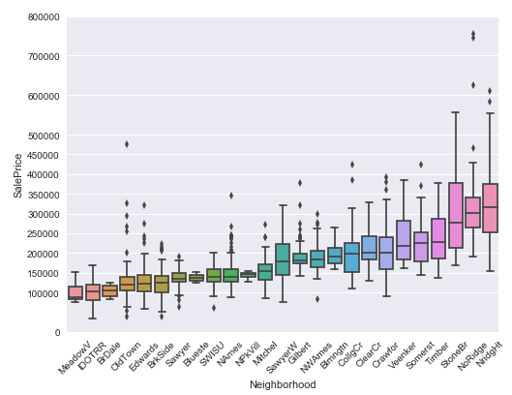
Features
Features a mix of numeric, ordinal and nominal
Values of ordinal variables replaced by integers as per order
# e.g. train.BsmtCond = train.BsmtCond.replace({"Ex": 5, 'Gd': 4, 'TA': 3, 'Fa': 2, 'Po': 1})
Nominal variables converted into ordinal by deciding order on the basis of median SalePrice within group
# e.g. train.LandContour.replace({"Lvl": 0, "Bnk": 0, "HLS": 1, "Low": 1})
Where the levels were high, grouped on the basis of median
SalePrice
# e.g. train.Neighborhood.replace({"Blmngtn":1, "Blueste":0, "BrDale":0, \
"BrkSide":0, "ClearCr":2, "CollgCr":2, "Crawfor":2, "Edwards":0, "Gilbert":1, \
"IDOTRR":0, "MeadowV":0, "Mitchel":1, "NAmes":0, "NoRidge":4, "NPkVill":0, \
"NridgHt":4, "NWAmes":1, "OldTown":0, "SWISU":0, "Sawyer":0,"SawyerW":1, \
"Somerst":2, "StoneBr":3, "Timber":2, "Veenker":2})
numeric_col = [ 'LotFrontage', 'LotArea', 'YearBuilt', 'YearRemodAdd', 'MasVnrArea', 'BsmtFinSF1', 'BsmtFinSF2',
'BsmtUnfSF', 'TotalBsmtSF', '1stFlrSF', '2ndFlrSF', 'LowQualFinSF', 'GrLivArea', 'BsmtFullBath',
'BsmtHalfBath', 'FullBath', 'HalfBath', 'BedroomAbvGr', 'KitchenAbvGr', 'TotRmsAbvGrd', 'Fireplaces',
'GarageYrBlt', 'GarageCars', 'GarageArea', 'WoodDeckSF', 'OpenPorchSF', 'EnclosedPorch', '3SsnPorch',
'ScreenPorch', 'PoolArea', 'MiscVal', 'MoSold', 'YrSold']
ordinal_col = ['LotShape', 'Utilities', 'LandSlope', 'OverallQual', 'OverallCond', 'ExterQual', 'ExterCond', 'BsmtQual',
'BsmtCond', 'BsmtExposure', 'BsmtFinType1', 'BsmtFinType2', 'HeatingQC', 'Electrical', 'KitchenQual',
'Functional', 'FireplaceQu', 'GarageFinish', 'GarageQual', 'GarageCond', 'PoolQC', 'Fence']
nominal_col = ['MSSubClass', 'MSZoning', 'Street', 'Alley', 'LandContour', 'LotConfig', 'Neighborhood', 'Condition1',
'Condition2', 'BldgType', 'HouseStyle', 'RoofStyle', 'RoofMatl', 'Exterior1st', 'Exterior2nd', 'MasVnrType',
'Foundation', 'Heating', 'CentralAir', 'GarageType', 'PavedDrive' 'MiscFeature', 'SaleType', 'SaleCondition']

Slide 6
Shortlisting the Features
For further analysis we decided to shortlist features on the basis of a threshold correlation of 0.4 (moderate and above) with SalePrice
Continuous variables were shortlisted on the basis of 'pearson’ correlation
Ordinal and Nominal(converted to ordinal) were shortlisted on the basis of 'spearman' correlation
After shortlisting we arrived at a reduced dataframe with 27 features and 1 response variable was

Slide 7
Linear Regression Assumptions

Slide 8
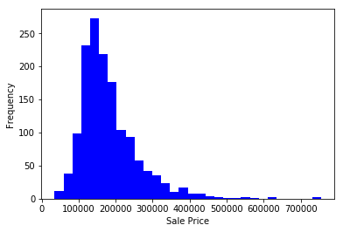
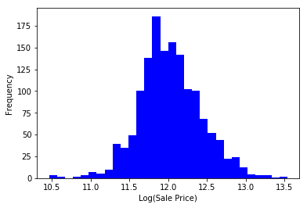
Linear Regression Assumptions (1 of 5)
Normal distribution of Response Variable:
Log transformation of ‘SalePrice’ to address skew to right

Slide 9
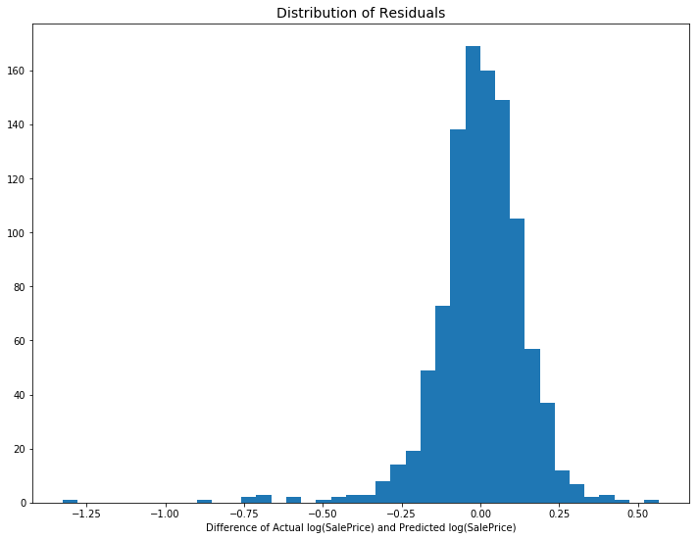
Linear Regression Assumptions (2 of 5)
Normal distribution of Residuals:
Except for a few points to left there is no major violation of normality of residuals

Slide 10
Linear Regression Assumptions (3 of 5)
Linear relationship between the outcome variable and the independent variables:
all features showed correlation of moderate to high with log(SalePrice)
OverallQual | 0.791 |  | FireplaceQu | 0.520
Neighborhood | 0.711 |  | YearRemodAdd | 0.507
GrLivArea | 0.709 |  | Foundation | 0.498
ExterQual | 0.683 |  | GarageType | 0.484
KitchenQual | 0.660 |  | MasVnrArea | 0.474
GarageCars | 0.640 |  | GarageYrBlt | 0.467
GarageArea | 0.623 |  | Fireplaces | 0.467
TotalBsmtSF | 0.614 |  | HeatingQC | 0.428
1stFlrSF | 0.606 |  | MasVnrType | 0.427
BsmtQual | 0.585 |  | MSSubClass | 0.393
FullBath | 0.561 |  | Exterior1st | 0.370
GarageFinish | 0.549 |  | Exterior2nd | 0.366
TotRmsAbvGrd | 0.534 |  | MSZoning | 0.318
YearBuilt | 0.523

Slide 11
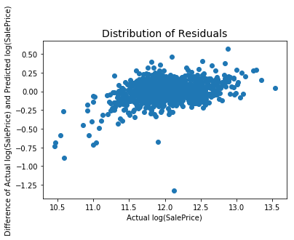
Linear Regression Assumptions (4 of 5)
Constant Variation and Auto-correlation:
The spread (variance) is not changing much with y values, but is an issue of auto-correlation as residuals are going up with log(SalePrice)

Slide 12
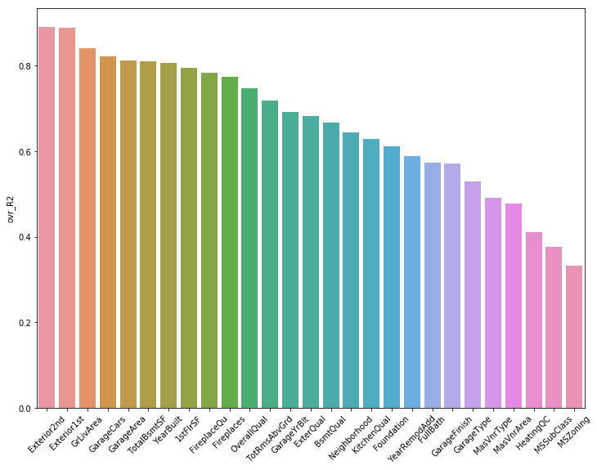
Linear Regression Assumptions (5 of 5)
Multicollinearity (Checking One-Feature-vs-Rest):
There is an issue of multicollinearity as many features are showing high R_sqr values when regressed against other features

Slide 13
Regression Models

Slide 14
Modeling Results
Regression Model | RMSE.log.diff (train) | RMSE.log.diff (test) | Best Hyperparameters*
Linear Regression | 0.147 | 0.153
Linear Regression (after dropping 4 features having high multicollinearity) | 0.151 | 0.162
Ridge Regression | 0.147 | 0.152 | alpha=50.5
Lasso Regression | 0.147 | 0.152 | alpha=0.001
ElasticNet Regression | 0.147 | 0.152 | alpha=0.001; l1_ratio=1.21
Random Forest Regression | 0.064 | 0.134 | n_estimators=100; max_features=12;
Gradient Boosting | 0.098 | 0.135 | learning_rate=0.005; n_estimators=1400; max_depth=3
Support Vector Regression | 0.088 | 0.137 | kernel='sigmoid'; gamma=5e-06; epsilon=0.1; C=7000
* after gridsearch tuning

Slide 15
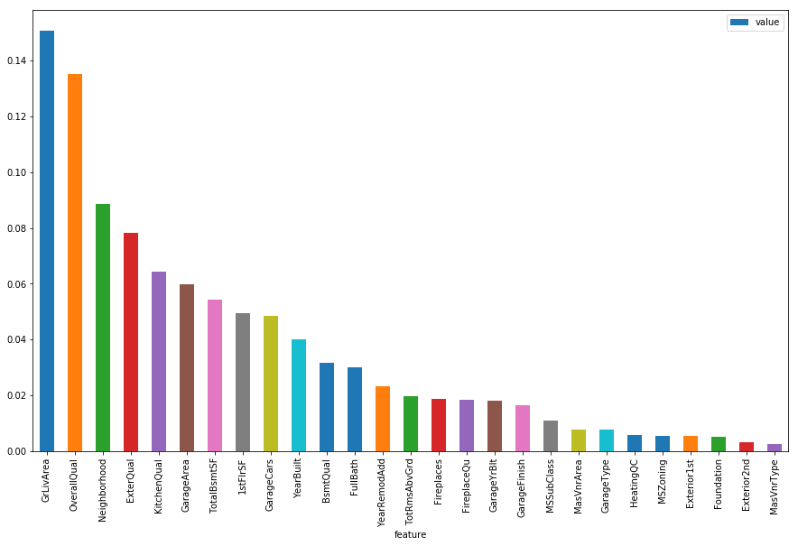
Feature Importance as per Random Forest

Slide 16
Conclusion, Discussion

