Slide 1
1.5 Aerodynamic forces and moments
Aerodynamic forces and moments on a moving body are due to only two basic sources:
1. Pressure distribution over the body surface
2. Shear stress distribution over the body surface
Both pressure and shear stress have dimensions of force per unit area.

Slide 2
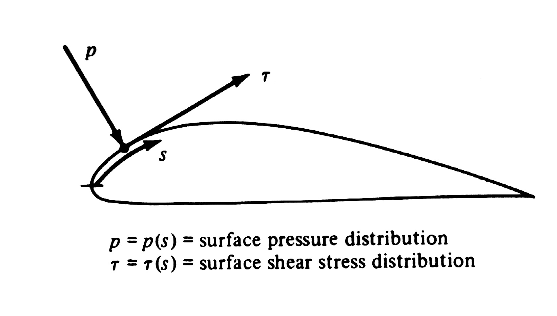
pressure acts normal to the body surface.
shear stress acts tangential to the surface.

Slide 3
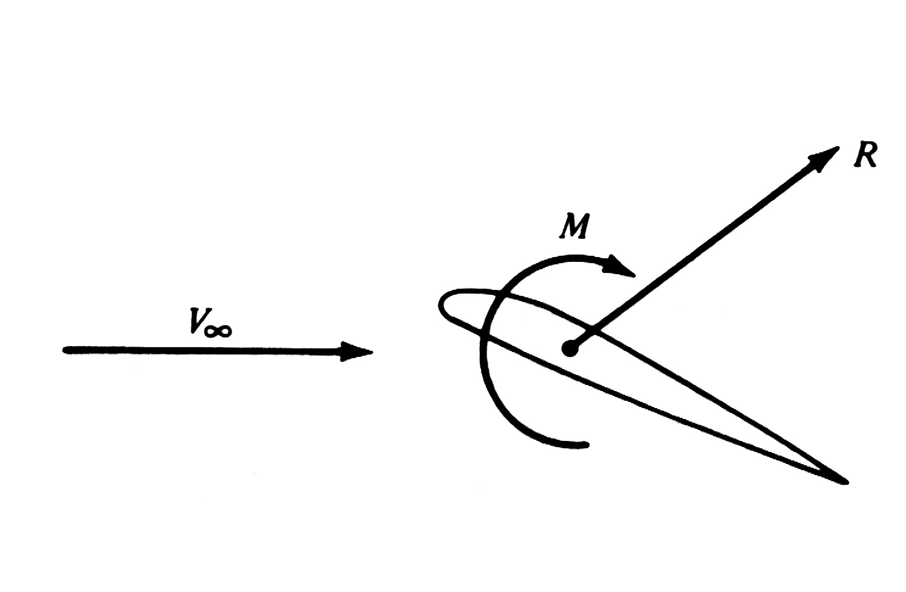

The net effect of the pressure and shear stress distribution results in a aerodynamic force R and moment M on the body.
是相对气流，代表物体前方远处的气体流动速度，也被叫做自由来流速度。
自由来流：离物体很远处的流动。

Slide 4
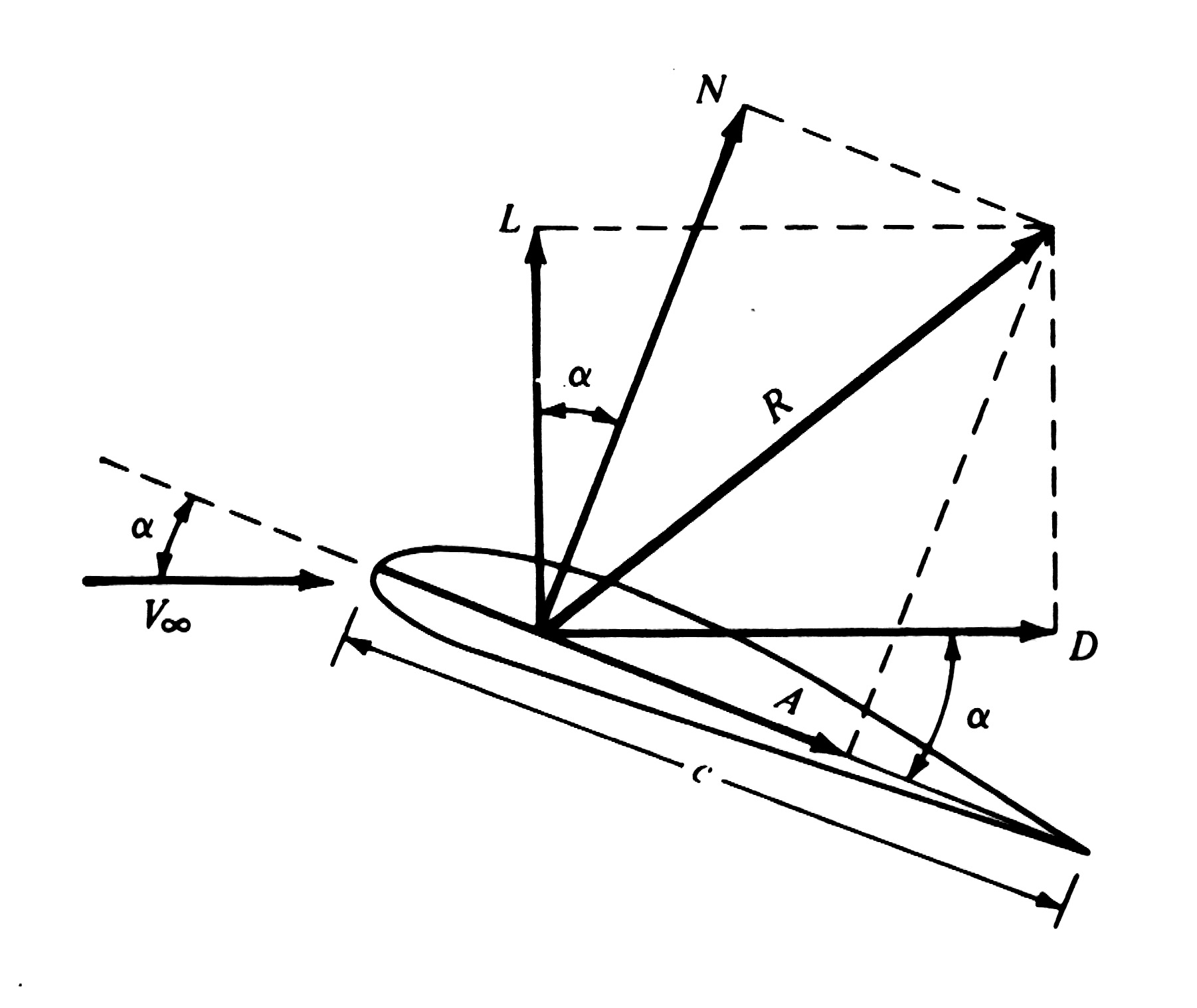
The resultant force R can be split into components

Slide 5
L = lift : component of R perpendicular to
D = drag : components of R parallel to
(wind system，风轴系)
N = normal force :
component of R perpendicular to c
A = axial force :
components of R parallel to c
(body system，体轴系)

Slide 6
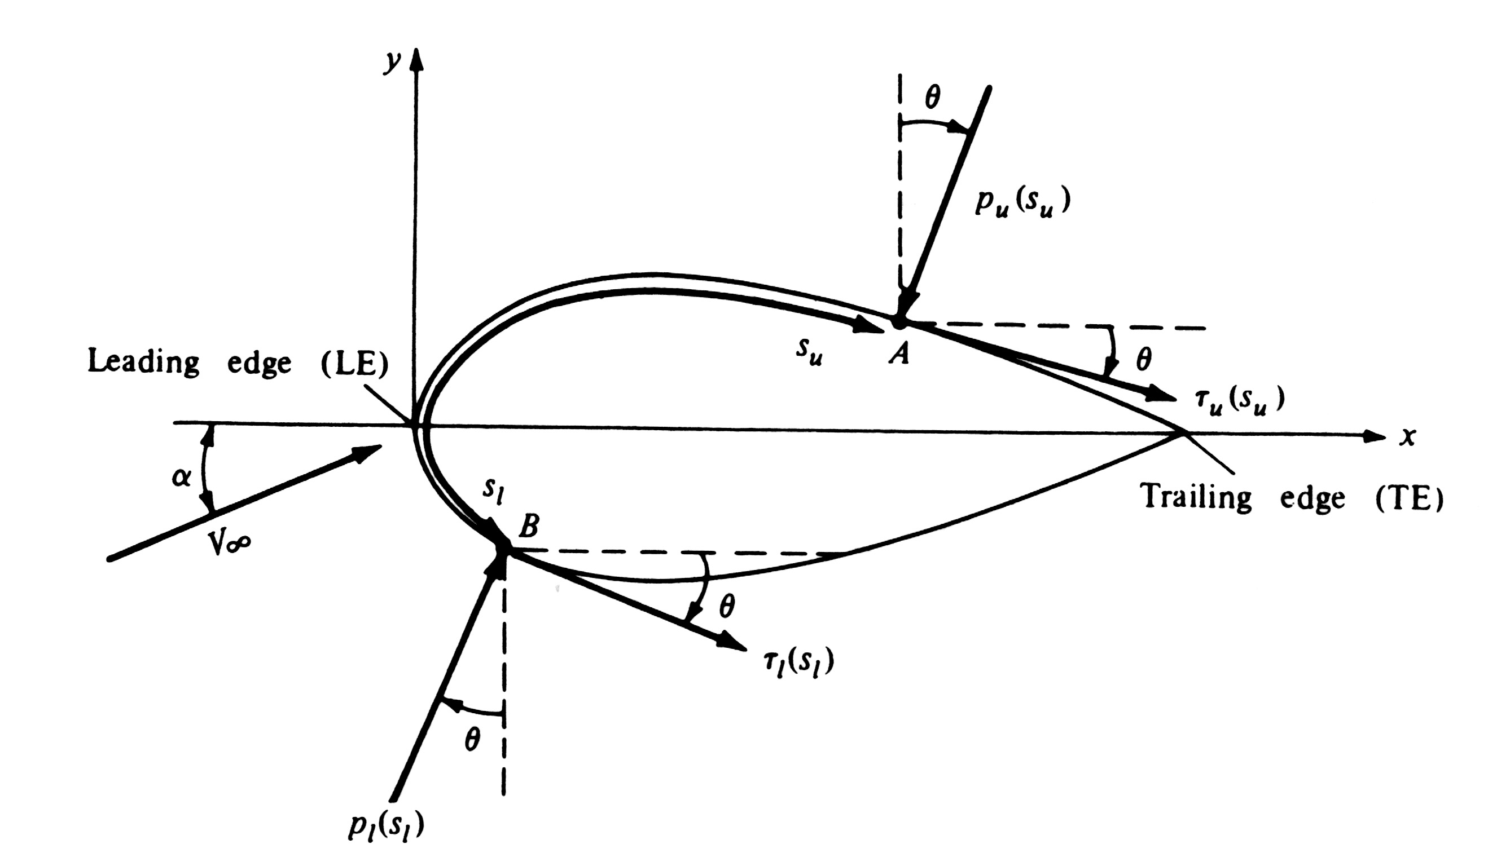
After the pressure and shear stress distributions being defined, and the geometry shape of the body being known, the resultant aerodynamic force can be obtained by the integration of the pressure and shear stress distributions along the surface of the body.

Slide 7
From Eqs. (1.7),(1.8) and (1.11), we can see clearly, that the sources of the aerodynamic lift, drag, and moments on a body are the pressure and shear stress distribution integrated over the body.
The basic task of theoretical aerodynamics is to calculate p(s) and τ(s) for a given body shape and freestream conditions, and then obtain the aerodynamic forces and moments with the use of Eqs. (1.7),(1.8) and (1.11)

Slide 8
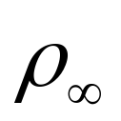
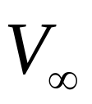
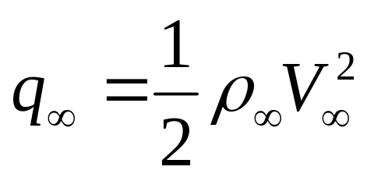
* Dimensionless aerodynamic force and moment coefficients are even more important than the aerodynamic forces and moments.
Definition of and
density and velocity in the freestream, which is far ahead of the body.
Definition of dynamic pressure
The dynamic pressure has the unit of pressure

Slide 9
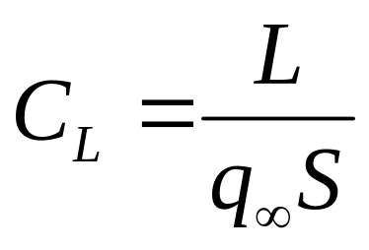
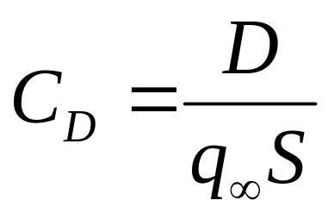
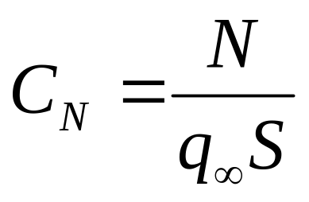
Definition of dimensionless force and moment coefficients
Lift coefficient:
Drag coefficient:
Normal force coefficient:

Slide 10
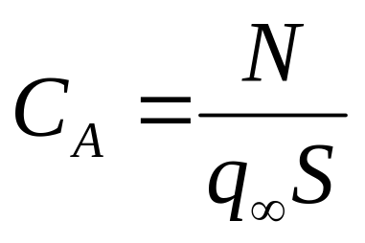
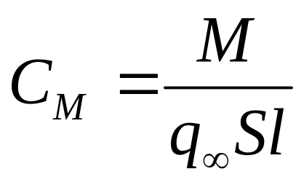


Axial force coefficient:
Moment coefficient:
: reference area
: reference length

Slide 11
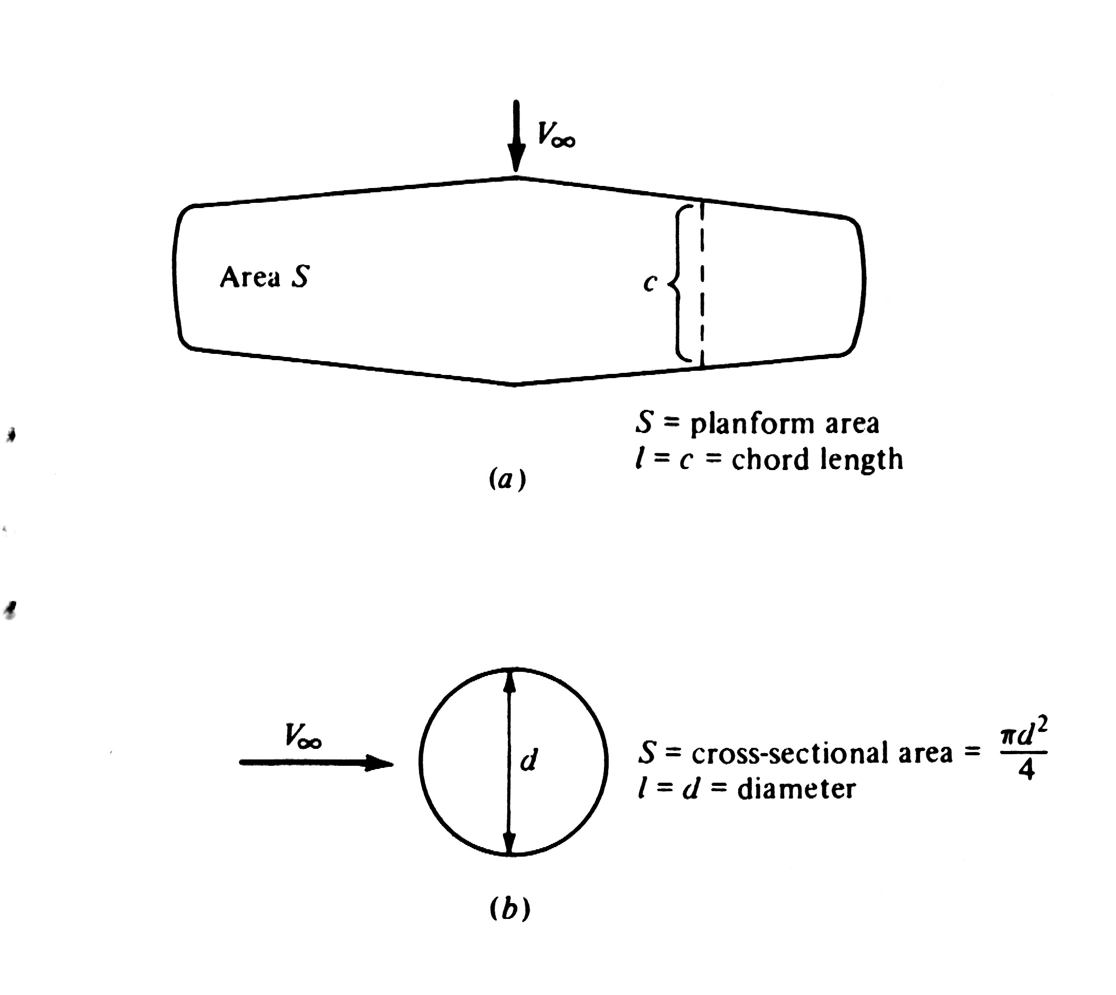
Definition of and may be different for different shapes of the body being concerned.

Slide 12
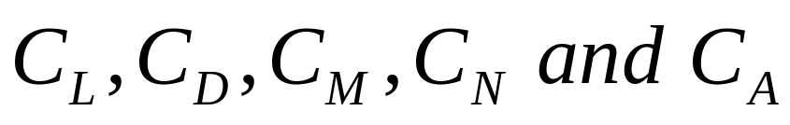
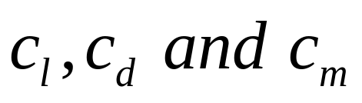
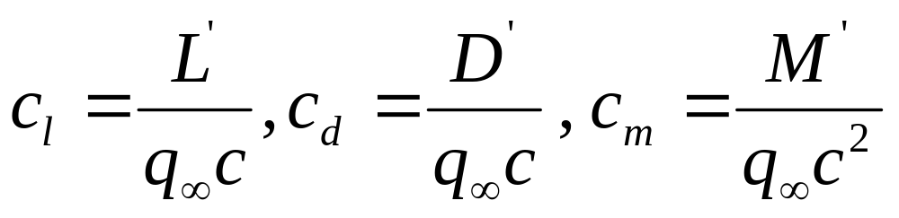
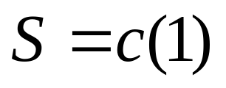
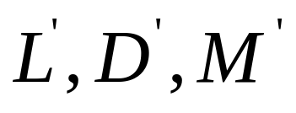
The symbols in capital letters, such as
represents the force and moment coefficients for a three-dimensional body.
The symbols in lowercase letters
denote the force and moment coefficients for a two-dimensional body
are force and moments per unit span

Slide 13
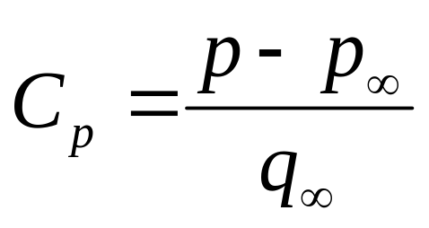
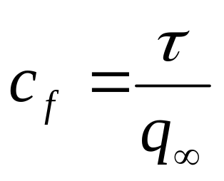
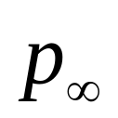
Two additional dimensionless quantities of immediate use are
Pressure coefficient
Skin friction coefficient
Where is the free stream pressure

Slide 14
公式（1.7）,（1.8）,（1.11）以及（1.1）,（1.2）采用无量纲的表示形式？

Slide 15
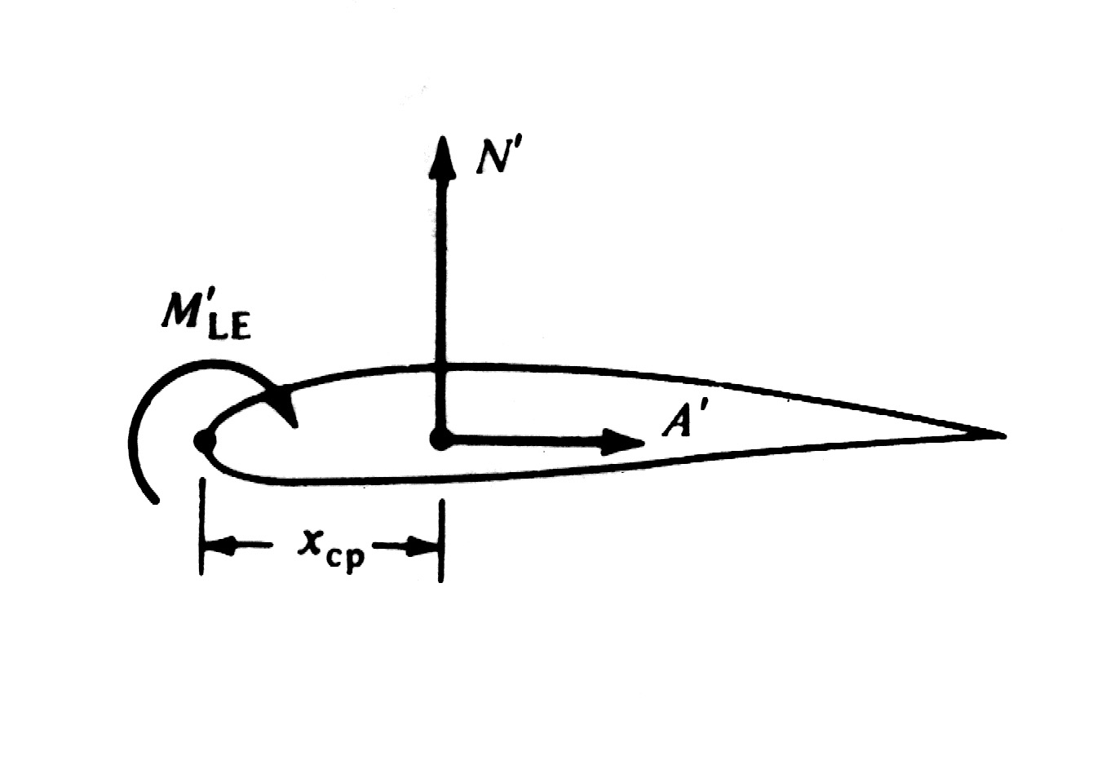
1.6 Center of pressure（压力中心）
The center of the pressure is a point on the body about which the aerodynamic moment contributed by the pressure and shear stress distributions is equal to zero.

Slide 16
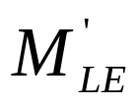

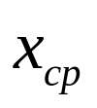
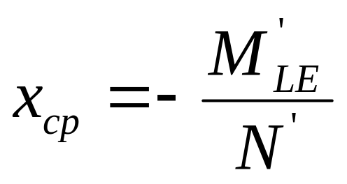
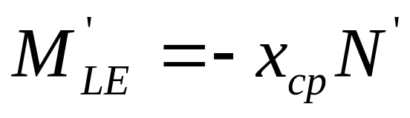

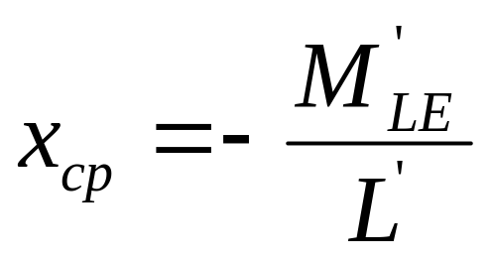
If is defined as the moment generated by the distributed loads, and is the component of the resultant force, then the pressure center must be located downstream of the leading edge
If the angle of attack is small, ,thus

Slide 17
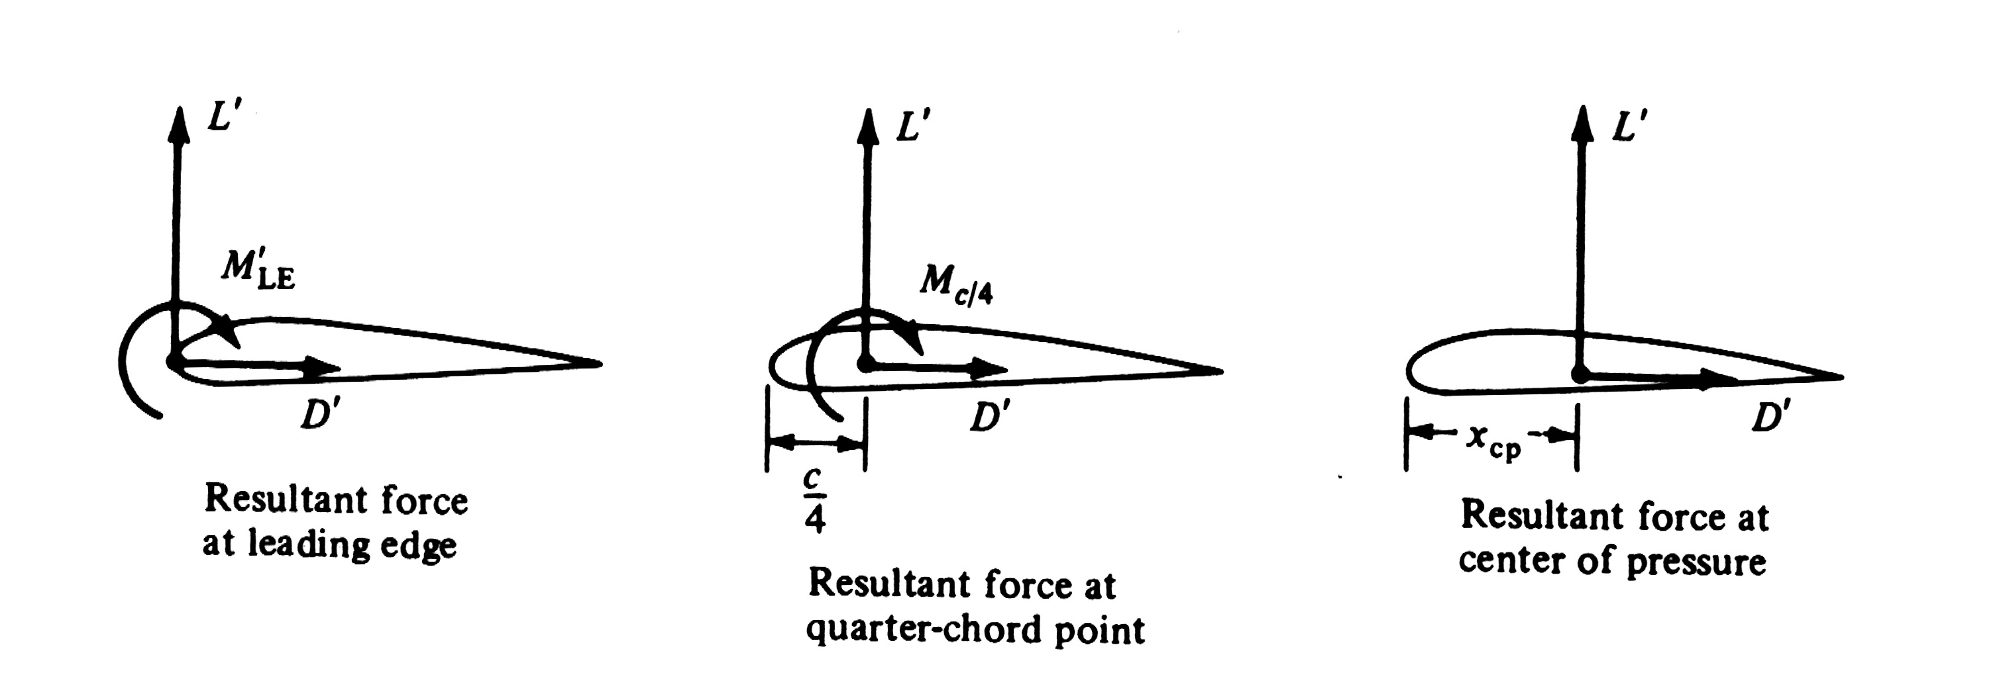
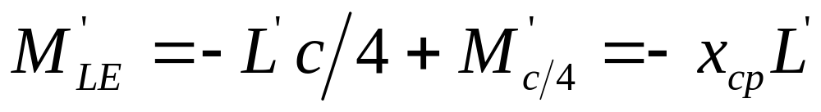
It is clear to see that as lift approaches to zero, the center of pressure moves to infinity. So, the center of pressure is not always a convenient concept in aerodynamics. There are other ways to define the force-and-moment system on an airfoil

Slide 18
量纲分析及流动相似
1、量纲分析，白金汉的PI定理
为什么要进行量纲分析，什么是量纲分析，它的主要理论根据
及作用是什么？
2、流动相似的定义及判断准则
什么是流动相似，如何去判断两个流动是相似的

Slide 19
1.7 量纲分析：PI定理
※那些物理量的改变会影响到气动力和力矩? :
1. 自由来流速度，Freestream velocity
2. 自由来流密度，Freestream density
3. 流体的粘性，Viscosity of the fluid
4. 物体的尺寸（尺度），The size of the body
5. 流体的压缩性 ，The compressibility of the fluid

Slide 20
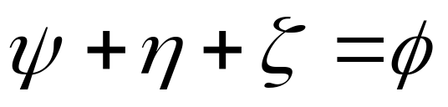
※ 如何在这些物理量和气动力之间建立一个准确的函数关系式?
进行大量的风洞试验也许是一个办法。
还有其它更有效的办法吗?
有，量纲分析
※量纲分析基于以下的一个简单物理事实：
所有在上式中的物理量必须具有相同的量纲。

Slide 21

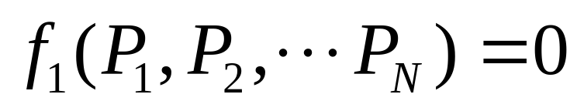
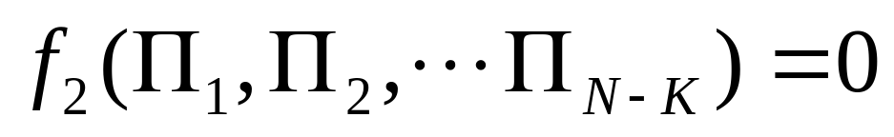
※白金汉 PI 定理
Let K to be the number of fundamental dimensions required to describe the physical variables
假设物理量的基本量纲有K个
2. Let represent N physical variables in the physical relation
3. Then the physical relation can be reexpressed as a relation of (N-K) dimensionless products.

Slide 22
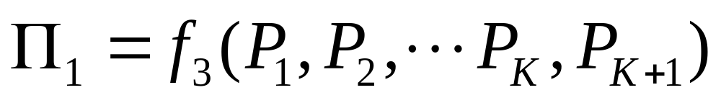
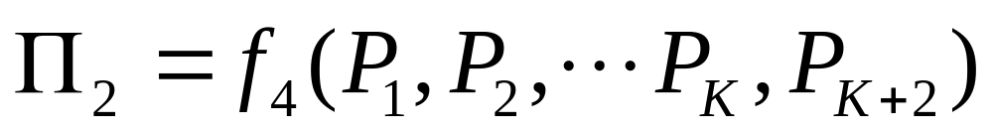
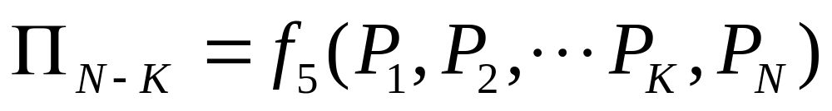

4. Every product is a dimensionless product of a set of K physical variables plus one other physical variable.
5. is called repeating variables. These variables should include all the K dimensions used in the problem.

Slide 23
※Aerodynamic force on a given body at a given angle of attack.
对于给定的外形（物体）在给定的攻角下的气动力
1. Eq. (1.23)
can be expressed as
2. Following Buckingham theorem and our physical intuition, the fundamental dimensions are m,l and t .
Hence, K=3

Slide 24
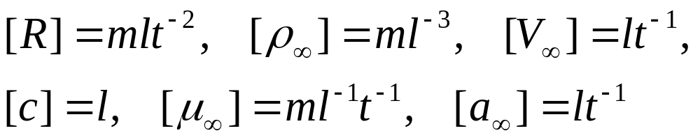

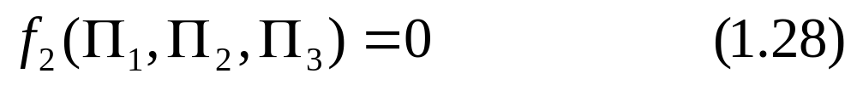
3. The physical variables and their dimensions are
and N=6
4. As explained by Buckingham theorem, Eq.(1.27) can be reexpressed in terms of N-K=3 dimensionless
products, that is

Slide 25
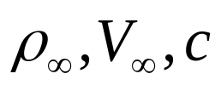
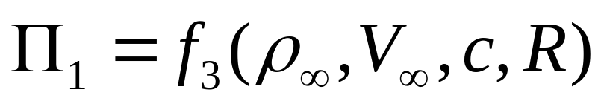
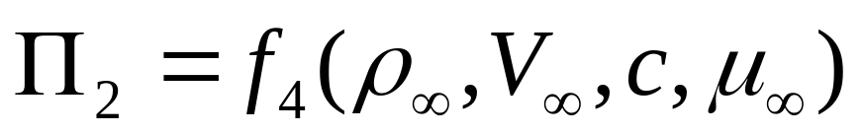
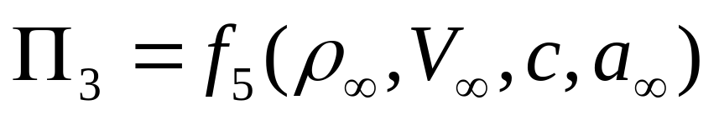
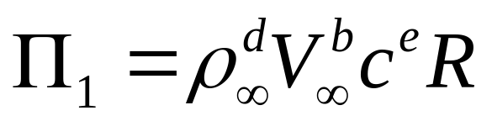
5. Now, we chose as repeating variables, from Eq.(1.26), these products are
5. Assume

Slide 26
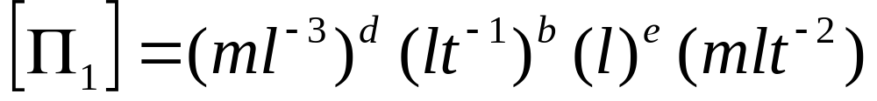

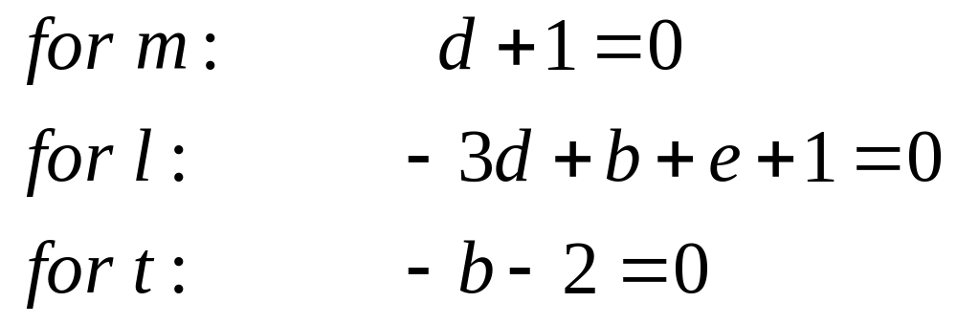
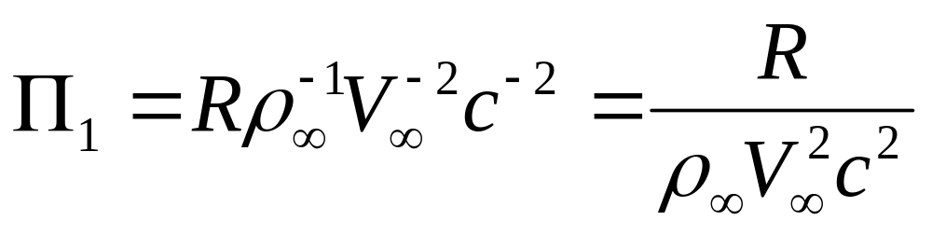
in dimensional form
6. As is dimensionless, then
7. The above Equations give d=-1,b=-2,and e=-2 , then we have

Slide 27
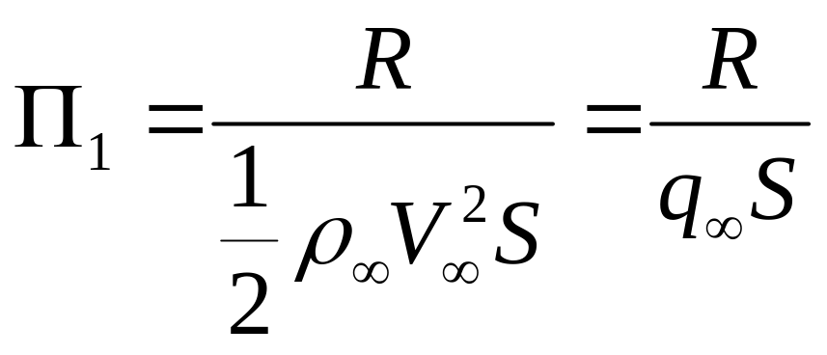
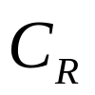
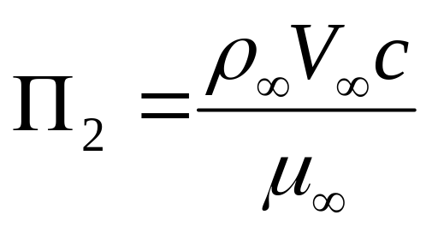
or
where S is defined as reference area
is a force coefficient, defined as
8. In the same way, we can obtain the remaining products as follows
Reynolds Number 雷诺数

Slide 28
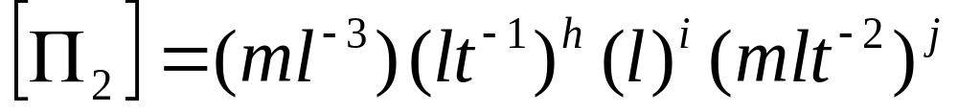
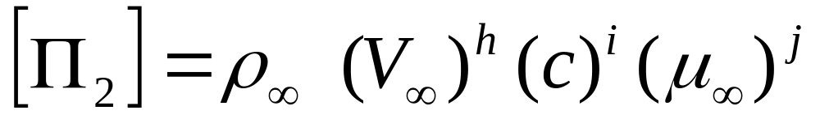

Thus , j=-1, h=1, and i=1

Slide 29




Mach Number 马赫数
9. Inserting all the products into Eq. (1.28)
or
or

Slide 30

10. Important conclusion:
In the general function form, R is expressed with five independent physical variables
After our dimensional analysis, R can be expressed with only two independent variables
R can be expressed in terms of a dimensionless force coefficient
is a function of only Re and
11. Important applications of Re and .
similarity parameters

Slide 31



11. As lift and drag are components of the resultant force, then the lift and drag coefficients are also functions of only Re and .
Moreover, a relation similar to aerodynamic forces holds for aerodynamic moments, and dimension analysis yields

Slide 32




12. If the angle of attack is allowed to vary, then, the lift, drag and moment coefficients will in general depend on the value of .

Slide 33



13. Other similarity parameters associated with thermodynamics and heat transfer.
Physical variables should be added
temperature, specific heat , thermal conductivity,
temperature of the body surface
Fundamental dimension should be added
unit of the temperature(K)
Similarity parameters created

Slide 34

1.8 Flow similarity（流动相似）
※Definition of flow similarity
Different flows are dynamically similar if:
The streamline patterns are geometrically similar
2. The distributions of etc.,
throughout the flow field are the same when plotted against common nondimensional coordinates.
3. The force coefficients are the same

Slide 35
※Criteria to ensure flow similarity
The bodies and any other solid boundaries are geometrically similar for both flows.
2. The similarity parameters are identical for both flows.
3. Reynolds and Mach number are the most dominant similarity parameters for many aerodynamic problems.
※Examples 1.4 and 1.5

Slide 36
1.10 Types of Flow （流动类型）
1. The purpose for categorizing different types of flow.
2. The strategy to simplify the flow problems.
3. Itemization and comparison of different types of flow, and brief description of their most important physical phenomena.

Slide 37



1.10.1 Continuum versus free molecule flow
Definition of mean-free path .
分子在与邻近的分子碰撞前所经过的平均距离定义为平均自由程 。
2. Continuum flow .
3. Free molecule flow
4. In most aerodynamic problems, we will always treat the fluid as continuum flow.
注意：d the scall of the body.运动物体的尺度。

Slide 38
1.10.2 Inviscid versus viscous flow
1. The random motion of the molecule will transport their mass, momentum, and energy from one location to another in the fluid. This transport on a molecule scale gives rise to the phenomena of mass diffusion, viscosity, and thermal conduction. All real flows exhibit the effect of these transport phenomena; such flows are call viscous flows.
2. A flow that is assumed no these phenomena above is called inviscid flow .
3. Inviscid flow is approached in the limit as the Reynolds number goes to infinity.
4. The flow with high Reynolds number,can be assumed to be inviscid. And the influence of

Slide 39

friction, thermal conduction, and diffusion is limited in the boundary layer.

Slide 40
5. The inviscid theory can be used to predicts the pressure distribution and lift. However, it cannot predicts total drag.
6. Flows dominated by viscous effects.

Slide 41

Flow around airfoil
at high angle of
attack
Flow around blunt
body

Slide 42

7. No inviscid theory can independently predict the aerodynamics of such flows.
1.10.3 Incompressible versus compressible Flows
A flow in which the density is constant is called incompressible. In contrast, a flow where the density is variable is called compressible.
2. All the flows are compressible, more or less
3. There are a number of aerodynamic problems that can be modeled as being incompressible without any detrimental loss of accuracy.
4. In many cases, whether the compressibility should be considered or not, is manly based on

Slide 43




the Mach number of the flow.
1.10.4 Mach number regimes
Local definition
Subsonic if
Sonic if
Supersonic if
Where is the local Mach number at an arbitrary point
in a flow field.

Slide 44

2. Definition for whole flow field

Slide 45


Slide 46

3. Block diagram categorizing the types of aerodynamic flows

