Slide 1
PART II
INVISCID INCOMPRESSIBLE FLOW
无粘不可压缩流动
In part II, we deal with the flow of a fluid which has constant density – incompressible flow. This applies to the flow of liquids, such as water flow, and to low-speed flow of gases. The material covered here is applicable to low-speed flight through the atmosphere—flight at a Mach number of about 0.3
第二部分，处理密度为常数的流动，用于各种液体，水，低速气体等。所涉及到的内容适用于在大气中的低速飞行---Ma<0.3

Slide 2
Chapter 3
Fundamentals of Inviscid, incompressible Flow
Theoretical fluid dynamics, being a difficult subject, is for convenience, commonly divided into two branches, one treating frictionless or perfect fluids, the other treating of viscous or imperfect fluids. The frictionless fluid has no existence in nature, but is hypothesized by mathematicians in order to facilitate the investigation of important laws and principles that may be approximately true of viscous or natural fluids.

Slide 3
3.1 Introduction and Road Map
From an aerodynamic point of view, at air velocities between 0 to 360km/h the air density remains essentially constant, varying only a few percent.
Purpose of this chapter is to establish some fundamental relations applicable to inviscid, incompressible flows and to discuss some simple but important flow fields and applications.

Slide 4
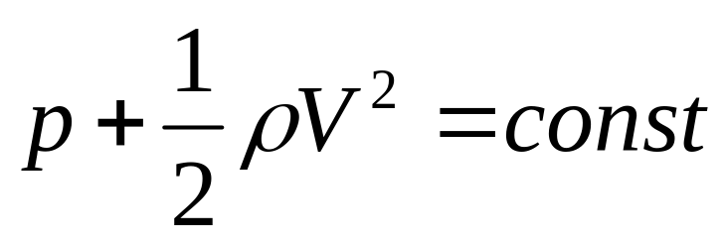
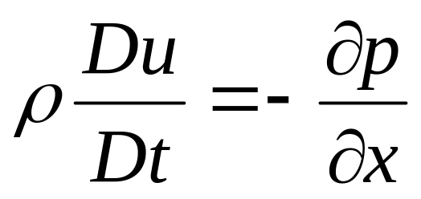
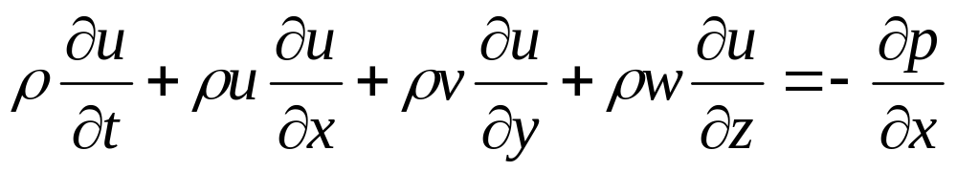
3.2 Bernoulli’s Equation
Derivation of Bernoulli’s equation
Step 1. x component momentum equation without viscous effect and body forces --无粘、忽略体积力
or

Slide 5
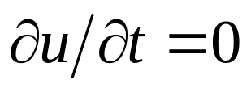
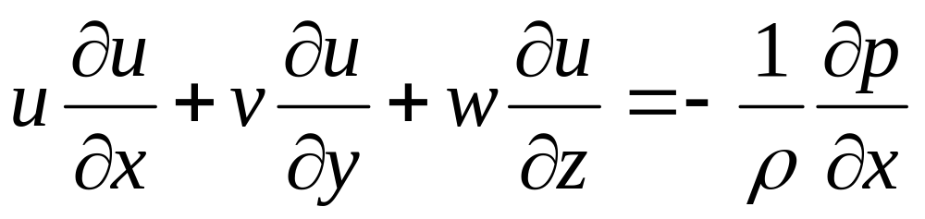

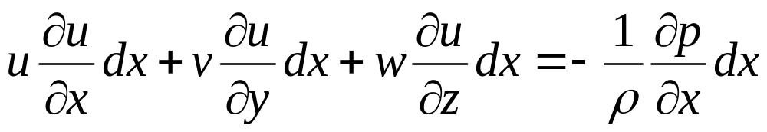
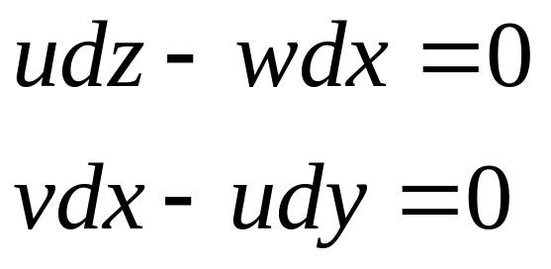
For steady flow—定常, , then
Multiply both sides with
Along a streamline in 3D space—沿流线, there are

Slide 6
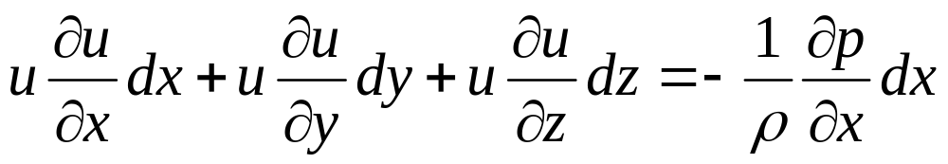
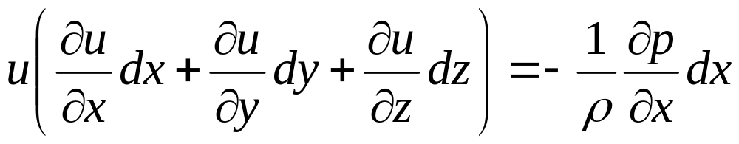
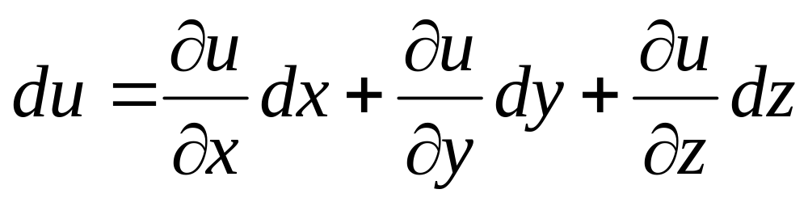
Substituting the differential equations of the streamline into x component momentum equation
or
as

Slide 7
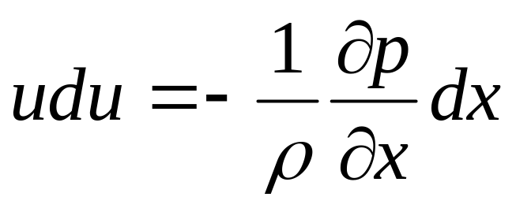
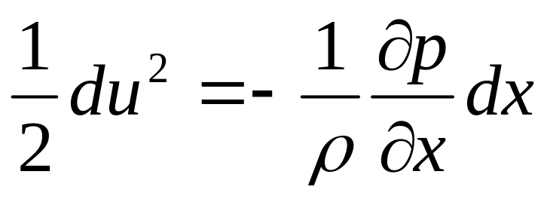
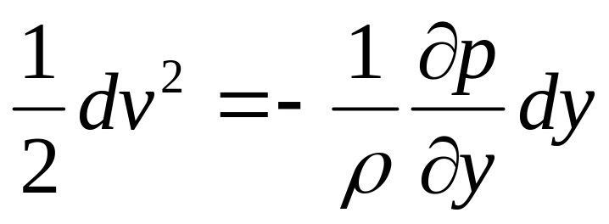
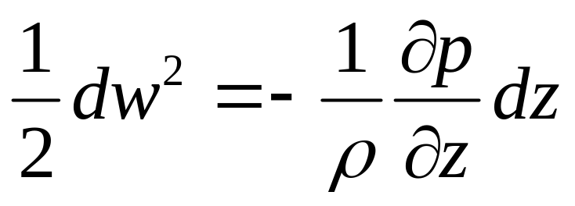
We have
or
In the same way, we can get

Slide 8
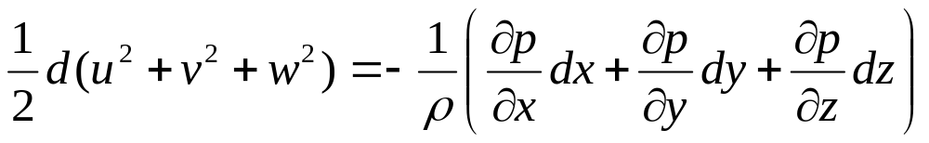
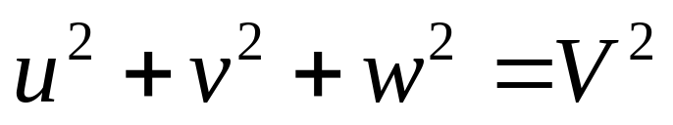
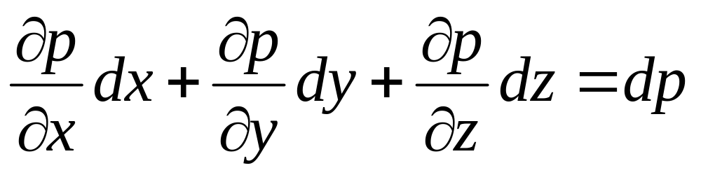
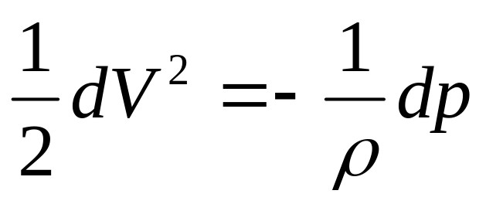
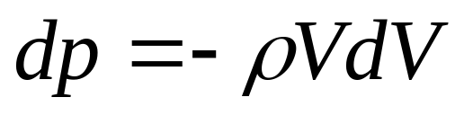
as
and
Then, we have
or

Slide 9
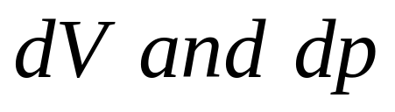
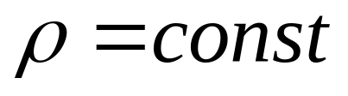
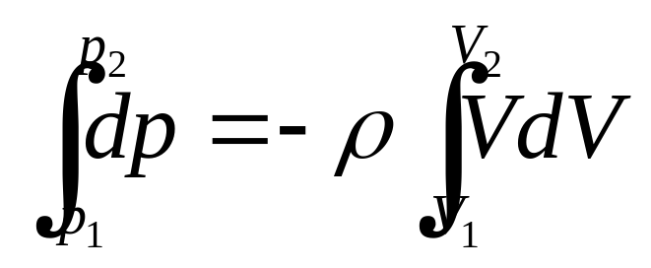
The above equation is called Euler’s Equation.欧拉方程
precondition: steady，inviscid, without body force, along a streamline.
适用前提条件：定常，无粘，忽略体积力，沿流线
usage: setup the relation between
Step 2. integration of Euler’s equation
For incompressible flows,， ，密度为常数
The integration from point 1 to point 2 along a streamline is

Slide 10
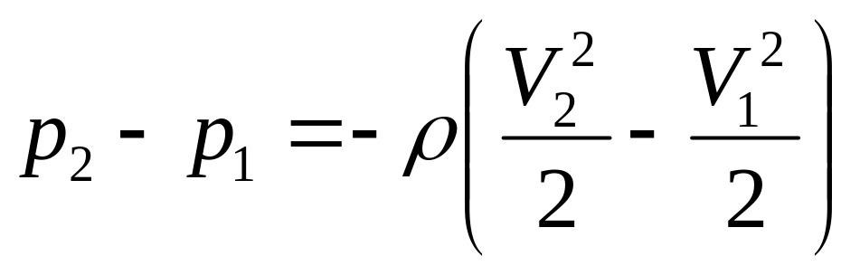
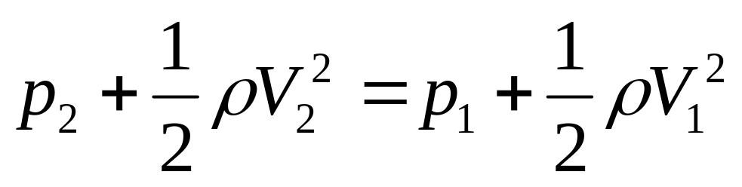
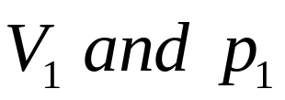
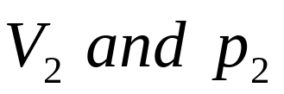
or
or
The above equation is called Bernoulli’s Equation.
precondition: steady, inviscid, incompressible, without body force, along a streamline.
usage: setup the relation between at point 1 on a streamline to at another point 2 on the same streamline.

Slide 11

As point 1 and point 2 are arbitrarily chosen on a streamline, so
Along a streamline
As there are no stipulation being made to whether the flow is rotational or irrotational, it satisfies for both irrotational flows and rotational flows as well.
不管流动是否有旋，都适用。
2. The value of the constant will change from one streamline to another.右端的常数在不同的流线上是不同的。
3. For irrotational flows，对于无旋流动：
Through out the flow

Slide 12
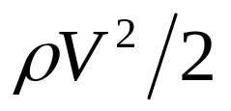
Bernoulli’s equation is also a relation for mechanical energy in an incompressible flow
where is the kinetic energy per unit volume
As Bernoulli’s equation can also be derived from the energy equation, the energy equation is redundant for the analysis of inviscid, incompressible flow.

Slide 13
The way for solving inviscid, incompressible flows:
Obtain the velocity field from the governing equations.从控制方程得到速度场
2. Obtain the pressure field from Bernoulli’s equation
利用伯努利方程，得到压强分布。

Slide 14
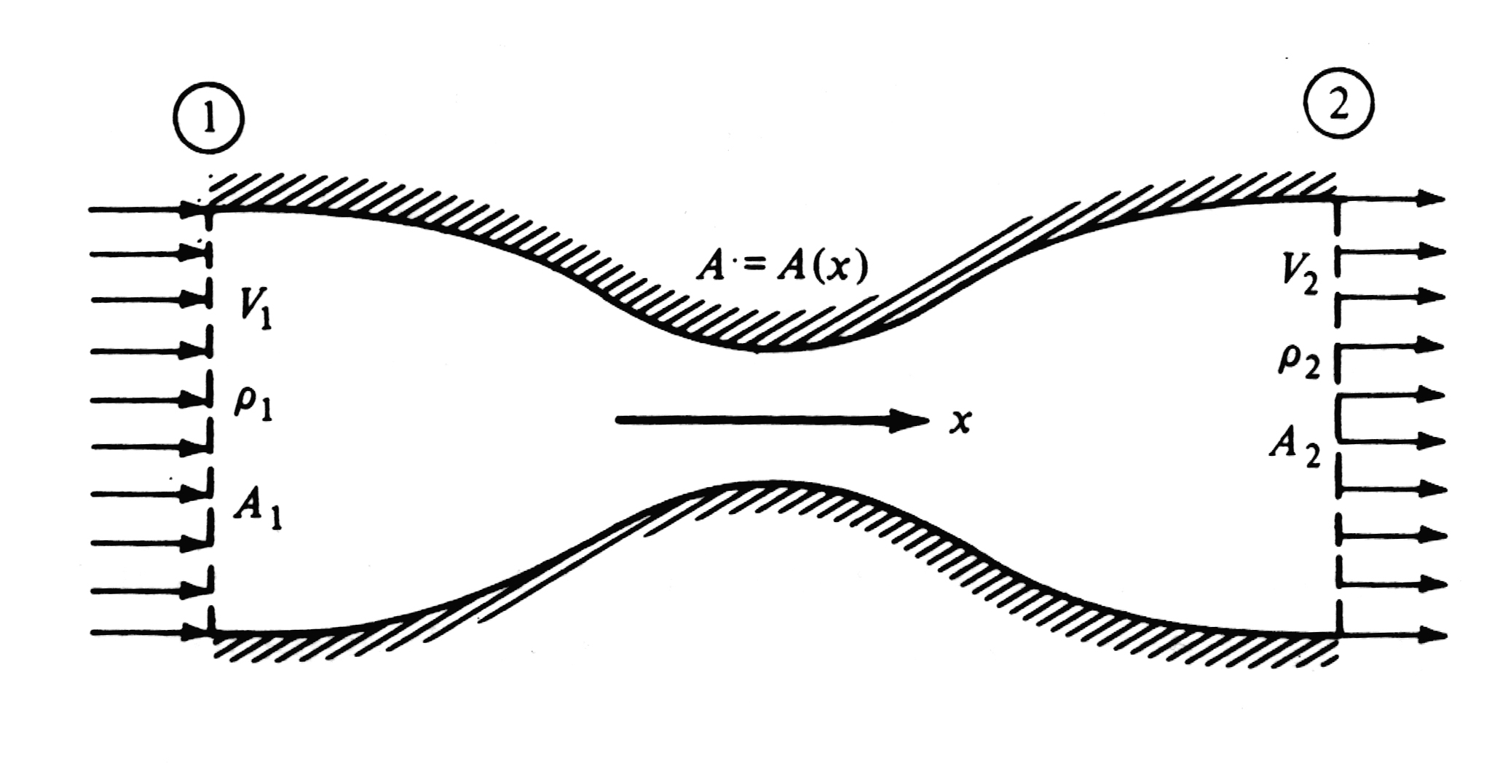
3.3 Incompressible flow in a duct: the Venturi tube and low-speed wind tunnel
管道中的不可压流动，文德利管和低速风动

Slide 15
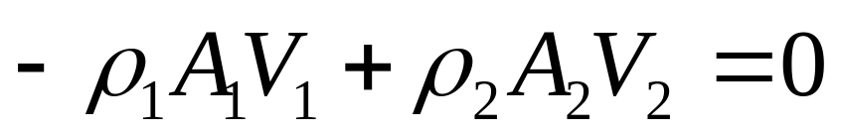
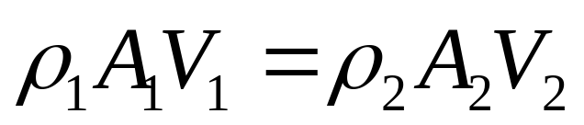
Assumption of quasi-one-dimensional flows
Flow-field properties are uniform across any cross section.在任意横截面上的流动都是均匀的
2. All the flow-field properties are assumed to be functions of x only.流场参数假设只随X变化
Respect to continuity equation, and for steady case
根据连续方程，针对定常流动：
or

Slide 16
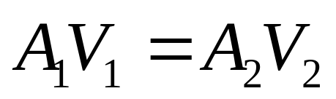
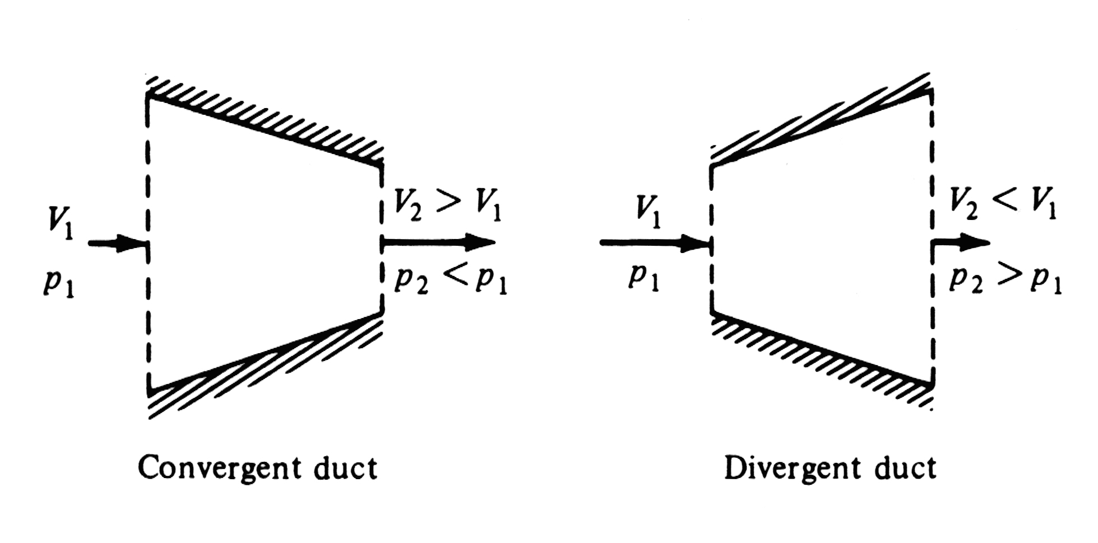
For incompressible flow，不可压流动：
Applications of venturi tube

Slide 17
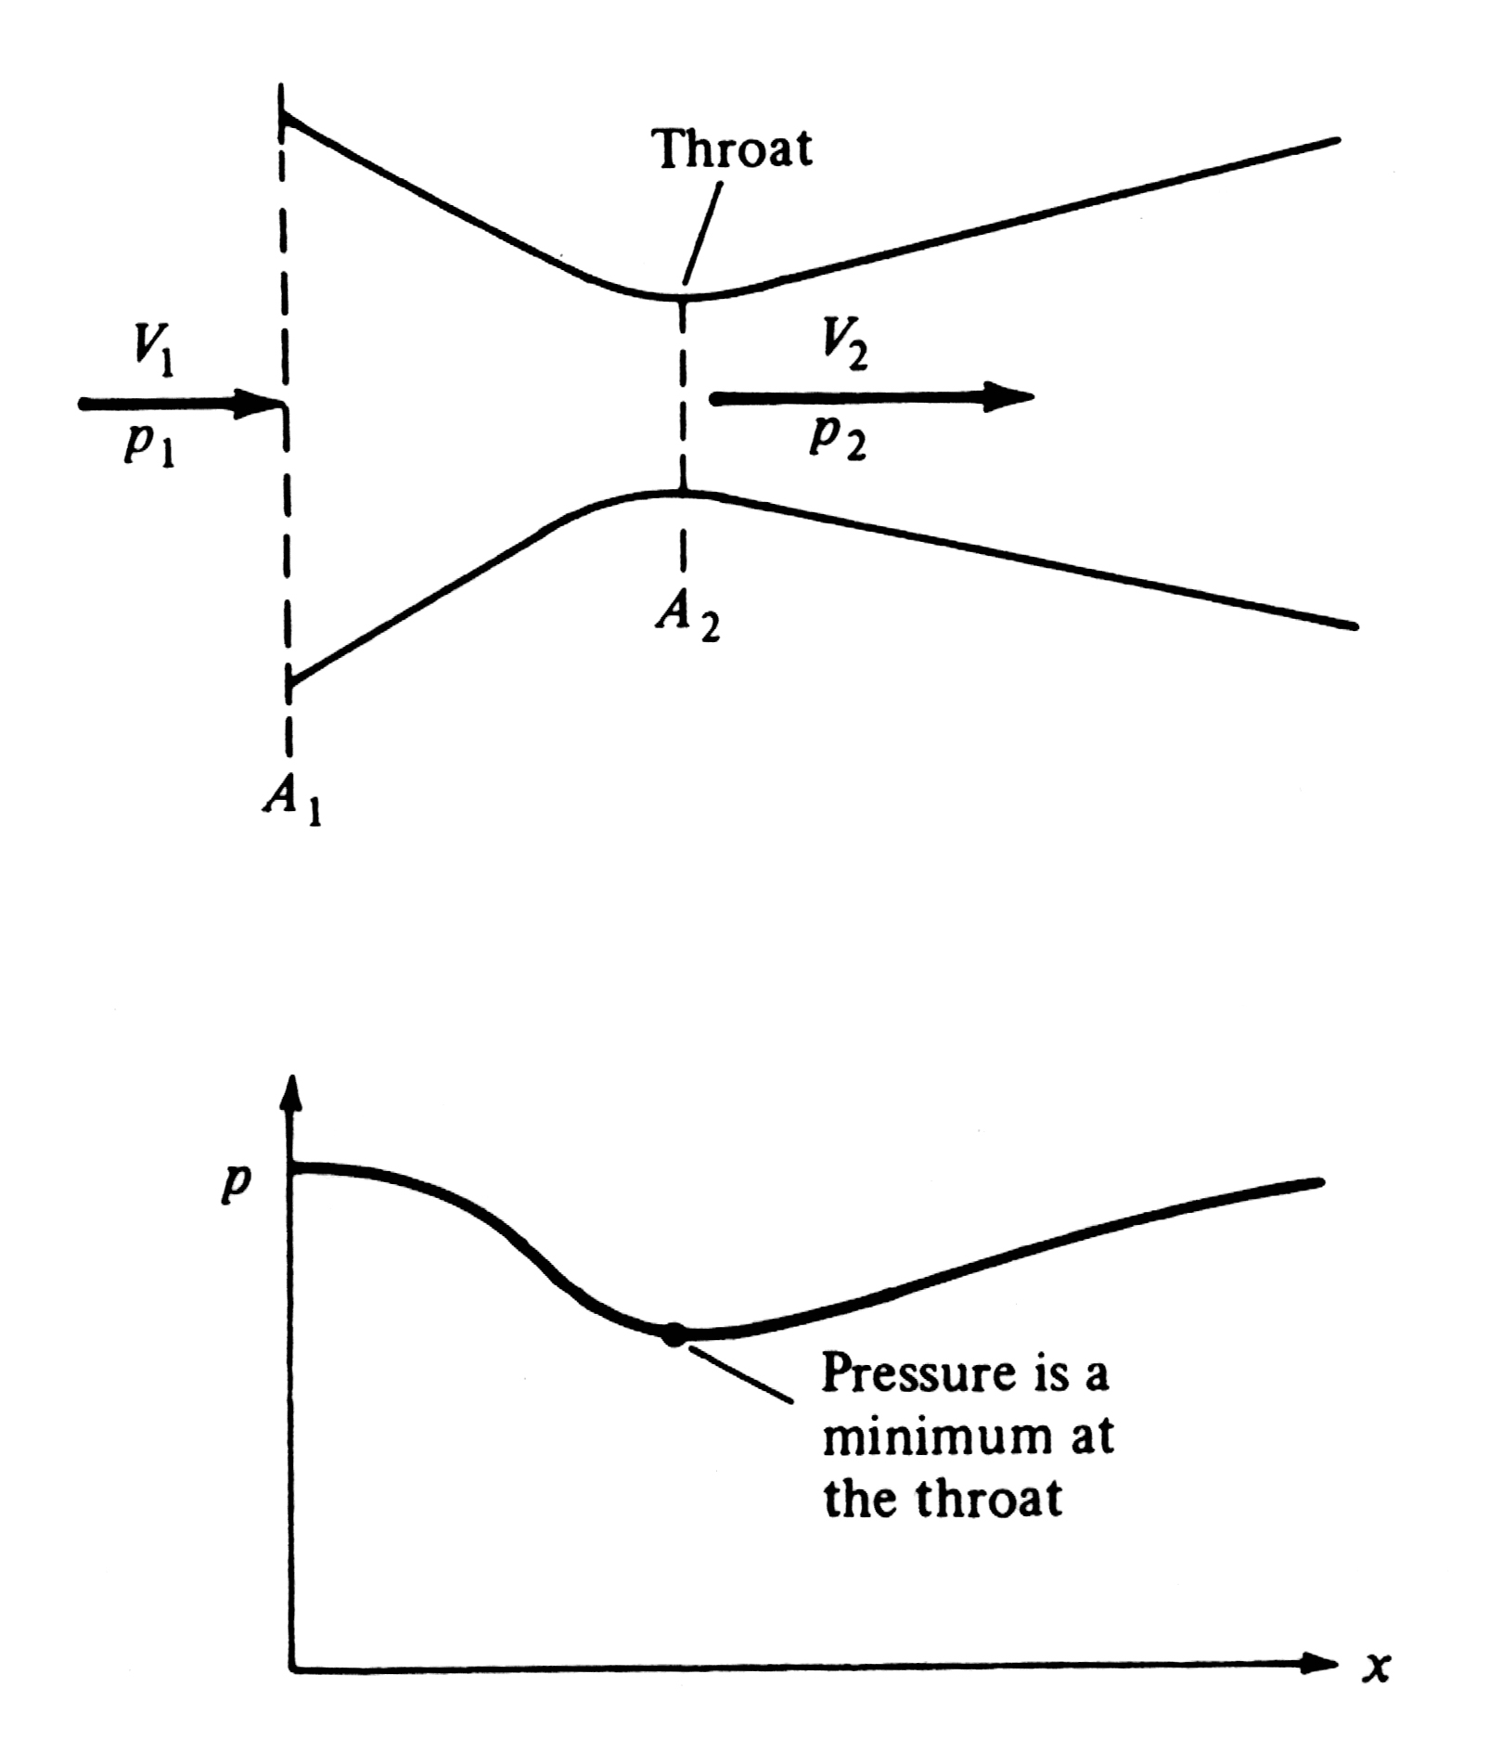

Slide 18
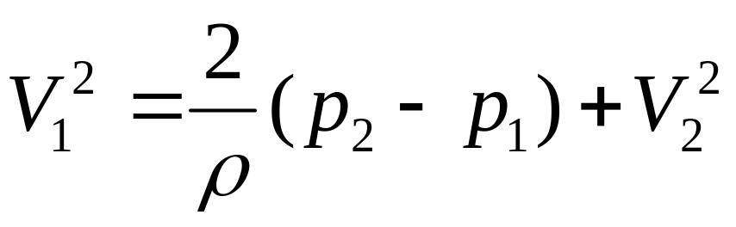
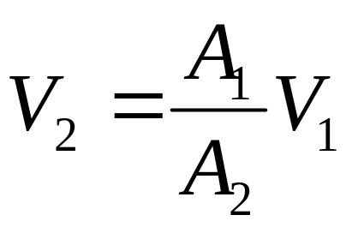
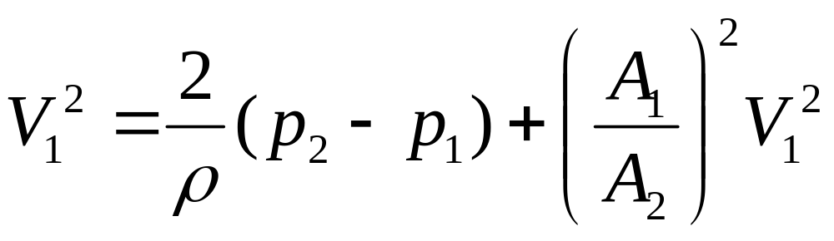
Measurements of flow speed in a duct.
From Bernoulli’s equation
From continuity equation, we have
Then

Slide 19
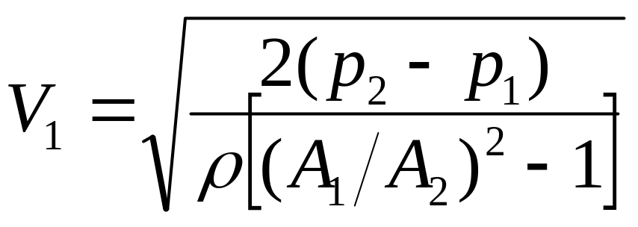

Slide 20
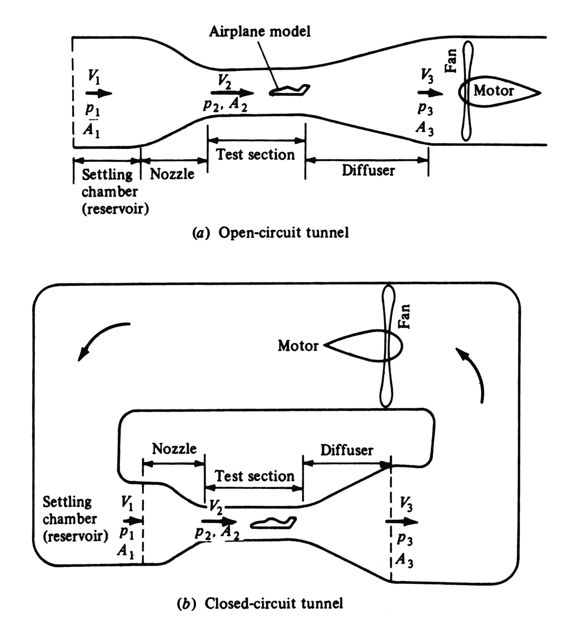

Slide 21
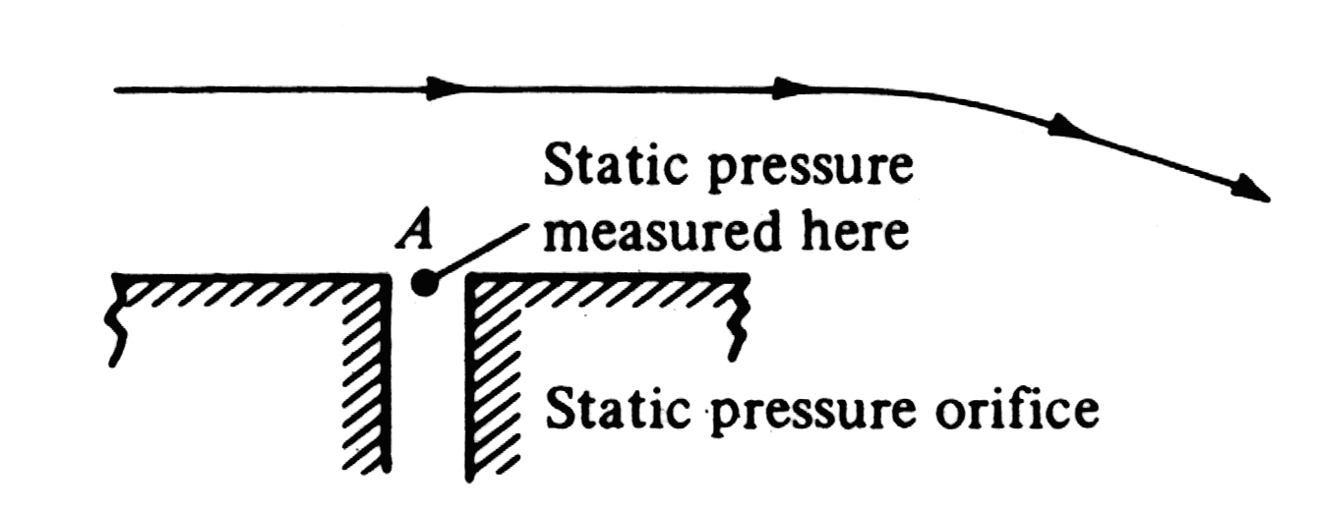
3.4 Pitot tube: measurement of airspeed
Definition of static pressure, the measurement of the static pressure.

Slide 22
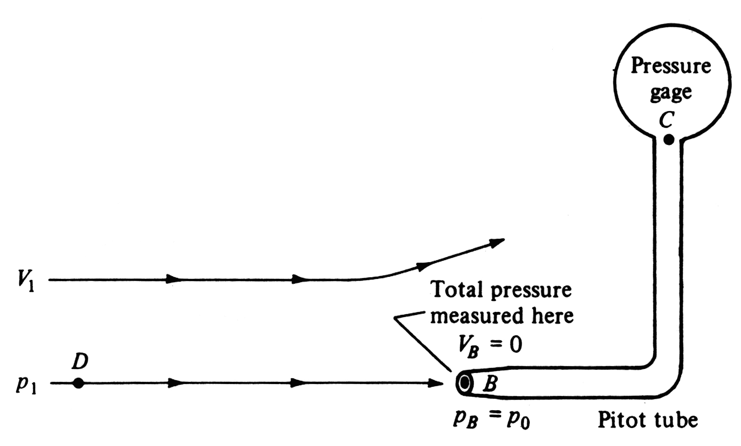
Definition of stagnation pressure, the measurement of the stagnation pressure.

Slide 23



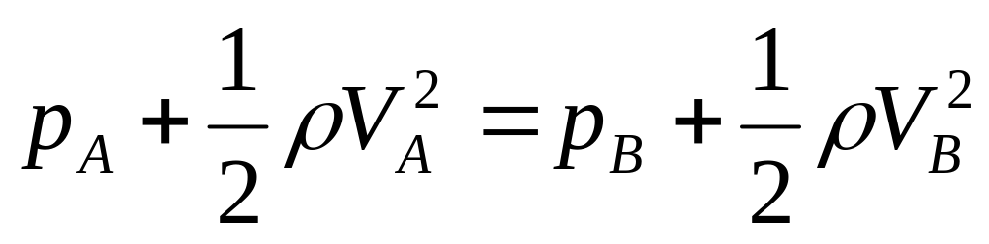
The usage of Pitot tube.
The pressure at point C is the stagnation pressure
The speed at point C is equal to zero
The pressure at point A is the static pressure
The speed at point A is equal to free stream velocity
The speed and pressure and at point A and B are the same, apply Bernoulli’s equation, we have

Slide 24
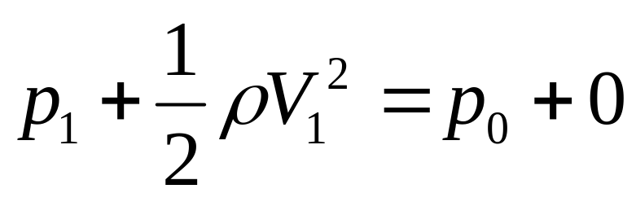
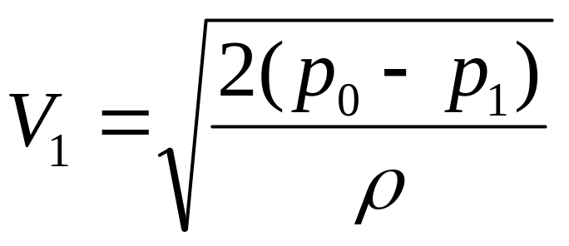
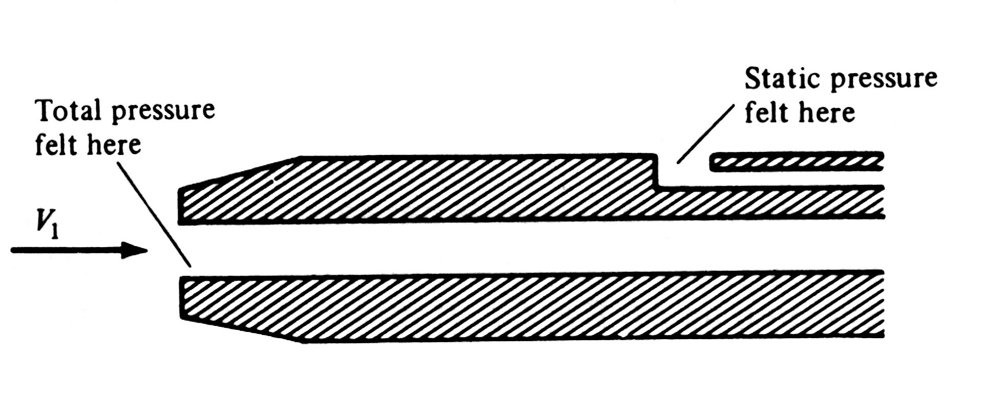
or
Combined instrument for the measurement of both static and total(stagnation) pressure.

Slide 25
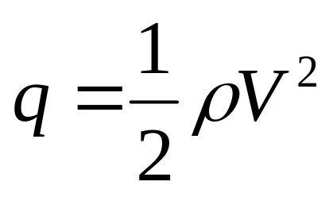
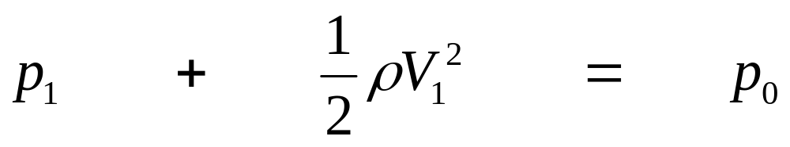
Definition of dynamic pressure, the relationship between of the static pressure,total pressure and dynamic pressure.
For incompressible flows
static pressure
dynamic pressure
total pressure

Slide 26
Keep in mind !!!!!
Any result derived from Bernoulli’s equation holds for incompressible flow only

Slide 27
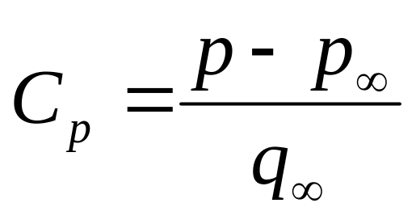
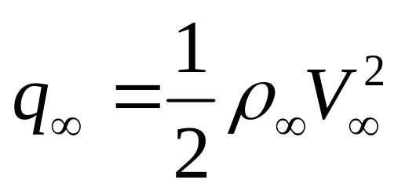
3.5 Pressure coefficient
Definition of the pressure coefficient
where
The pressure coefficient is a nondimensional value, it can be used throughout aerodynamics, for both compressible flow and incompressible flow.
压力系数是一个无量纲的量，不管可压、不可压流动都会用到

Slide 28

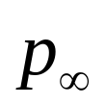


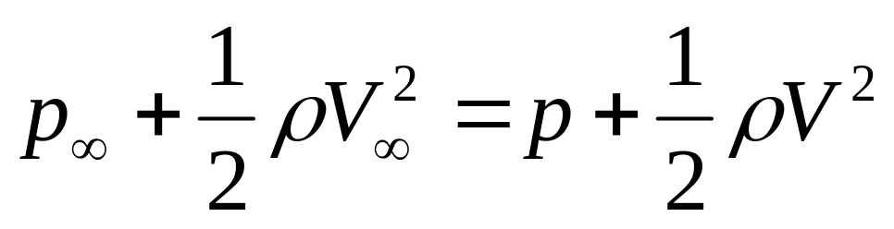

For incompressible flow, the pressure coefficient can be expressed in terms of velocity only
If and are defined as the freestream velocity and pressure. And and are the velocity and pressure at an arbitrary point in the flow. Then, with Bernoulli’s equation,
or

Slide 29



or
Valid for incompressible flow only

Slide 30


Slide 31
3.6 Condition on velocity for incompressible flow
Contents in the center branch
Laplace’s equation ，拉普拉斯方程
General philosophy and use in solving problems
Synthesis of complex flows from a superposition of elementary flows，从基本流动叠加出复杂流动
Basic condition on velocity in an incompressible flow.
From the definition for the divergence of velocity

Slide 32



If the density of the fluid is equal to a constant , then
如果密度是常数，那么 (原因?)
That means, for incompressible flow, the velocity must satisfies ，也就是说，不可压流动，速度必须满足：

Slide 33



根据连续性方程可以得出同样的结论，If we consider the continuity equation
And apply it for the incompressible flows, then, the continuity equation becomes

Slide 34


3.7 Governing equation for irrotational, incompressible flow: Laplace’s Equation
无旋不可压流动的拉普拉斯方程：
The continuity equation for incompressible flow is
If the flow is irrotational, then, the velocity can be expressed with velocity potential，无旋则有势：
Therefore, for incompressible and irrotational flows，无旋不可压流动
Laplace’s equation，拉普拉斯方程

Slide 35


Solutions of Laplace’s Equation are called harmonic functions.谐函数，数学上的特性就是可叠加。
Solutions of Laplace’s Equation
in Cartesian coordinates:
in cylindrical coordinates:

Slide 36


For 2D incompressible flow, a stream function can be defined, and the relation between velocity and stream function is
The continuity equation, expressed in Cartesian coordinates is，对于不可压流动:

Slide 37

The very definition and use of stream function is a statement of the continuity equation of mass, and therefore Equations bellow
Can be used in place of the continuity equation itself.
对于不可压流动，流函数可以代替连续性方程。

Slide 38




If the flow is irrotational, then，对于无旋流动
Laplace’s equation

Slide 39
Important conclusions
Any irrotational, incompressible flow has a velocity potential and stream function(for 2D flow) that both satisfy Laplace’s Equation，对于任意无旋，不可压流动，都存在速度势，对于二维流动，存在流函数，并且速度势和流函数都满足拉普拉斯方程
Conversely, any solution of Laplace’s Equation represents the velocity potential or stream function(2D) for an irrotational and incompresible flow.对于无旋，不可压流动，求解拉普拉斯方程可以得到速度势和流函数（仅对二维流动）

Slide 40


Superposition of the solutions of Laplace’s Equation
The Laplace’s Equation is a second-order linear partial differential equation. The sum of any particular solutions of a linear differential equation is also a solution of the equation(Laplace’s Equation). For example: if represent n separate solutions of the Laplace’s equation, then the sum
拉普拉斯方程是二阶线性偏微分方程，任意的线性偏微分方程的解的和，仍然是原方程的解
is also a solution of the Laplace’s equation

Slide 41
Conclusion respects to the superposition of the solutions of Laplace’s equation
A complicated flow pattern for an irrotational, incompressible flow can be synthesized by adding together a number of elementary flows which are also irrotational and incompressible.
对于任意无旋不可压的复杂流动，都可以通过一系列的基本简单流动叠加得出
How to make the difference between irrotational and incompressible flows around different aerodynamic shapes, --- Boundary conditions

Slide 42


Slide 43




3.7.1 Infinity boundary conditions
Far away from the body( infinity in the flow field):
远离物体，无穷远处：
3.7.2 Wall boundary conditions
On the surface of a solid body, respecting to
or
以速度表示的物面边界

Slide 44




On the surface of a solid body, respecting to ：
仍然是物面边界，下式左边用流函数表示的速度
用流函数表示的物面无穿透边界：
On the surface of a solid body, respecting to streamline

Slide 45


3.8 Interim summary
General approach to solve the incompressible and irrotational flows，求解不可压，无旋流动的基本步骤
Solve Laplace’s equation for or along with the proper boundary conditions. These solutions are usually in the form of a sum of elementary solutions. 求解拉普拉斯方程
Obtain the flow velocity from or
3. Obtain the pressure from Bernoulli’s equation

