Slide 1
PART II
INVISCID INCOMPRESSIBLE FLOW
无粘不可压缩流动
In part II, we deal with the flow of a fluid which has constant density– incompressible flow. This applies to the flow of liquids, such as water flow, and to low-speed flow of gases. The material covered here is applicable to low-speed flight through the atmosphere—flight at a Mach number of about 0.3

Slide 2
Chapter 3
Fundamentals of Inviscid, incompressible Flow
Theoretical fluid dynamics, being a difficult subject, is for convenience, commonly divided into two branches, one treating frictionless or perfect fluids, the other treating of viscous or imperfect fluids. The frictionless fluid has no existence in nature, but is hypothesized by mathematicians in order to facilitate the investigation of important laws and principles that may be approximately true of viscous or natural fluids.

Slide 3
3.1 Introduction and Road Map
From an aerodynamic point of view, at air velocities between 0 to 360km/h the air density remains essentially constant, varying only a few percent.
Purpose of this chapter is to establish some fundamental relations applicable to inviscid, incompressible flows and to discuss some simple but important flow fields and applications.

Slide 4
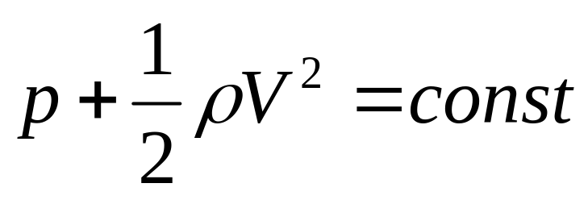
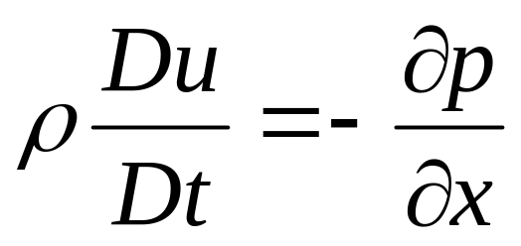
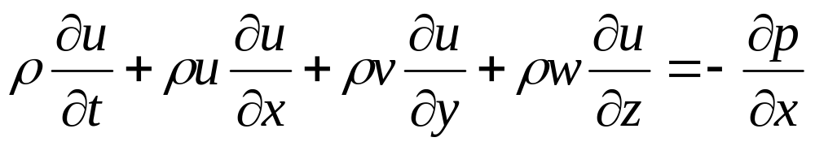
3.2 Bernoulli’s Equation
Derivation of Bernoulli’s equation
Step 1. x component momentum equation without viscous effect and body forces
or

Slide 5
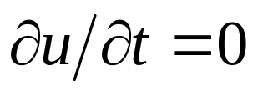
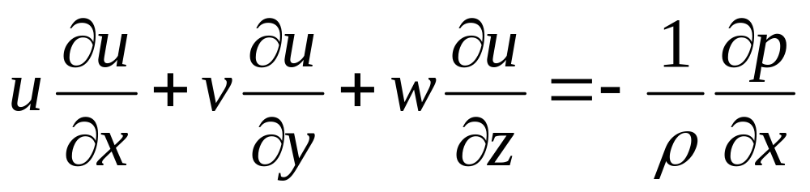

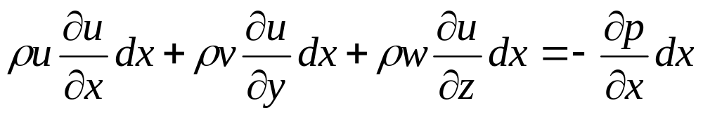
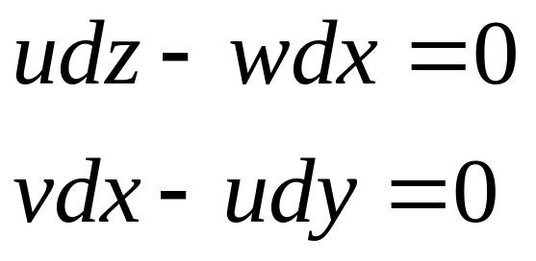
For steady flow, , then
Multiply both sides with
Along a streamline in 3D space, there are

Slide 6
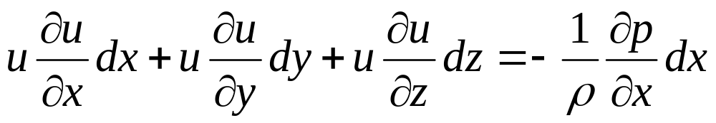
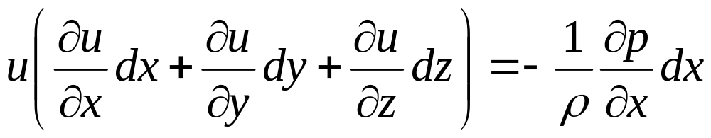
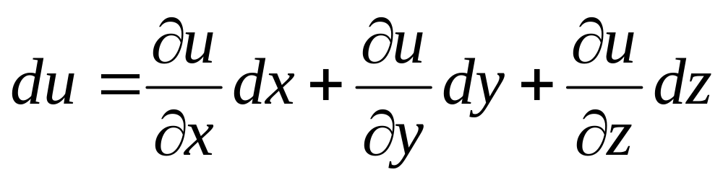
Substituting the differential equations of the streamline into x component momentum equation
or
as

Slide 7
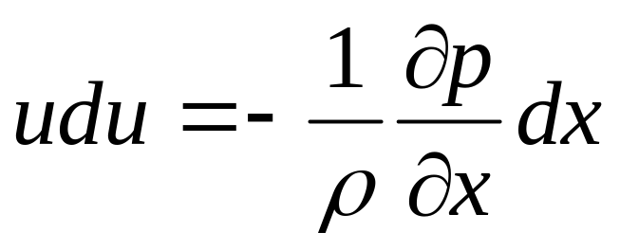
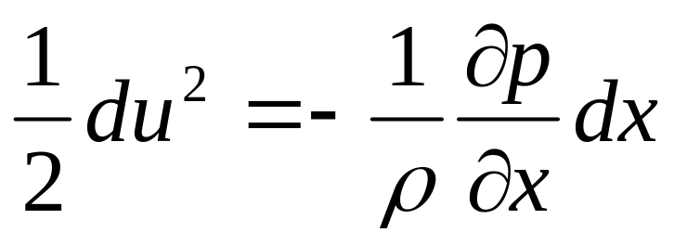
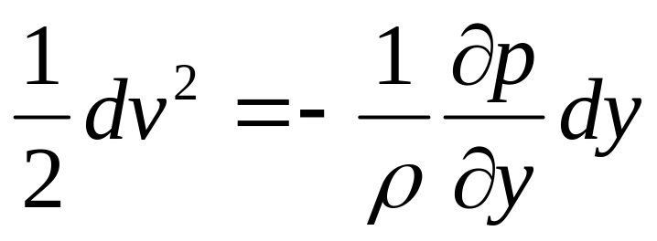
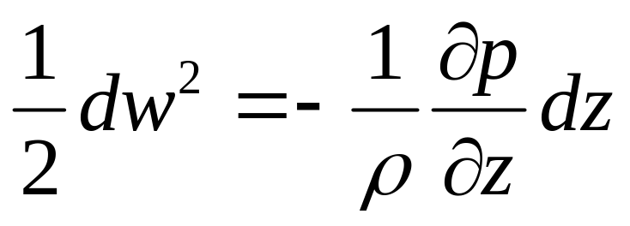
We have
or
In the same way, we can get

Slide 8
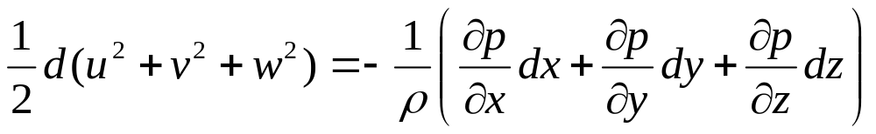
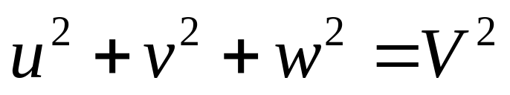
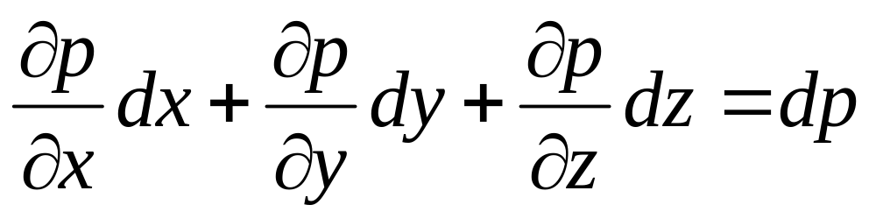
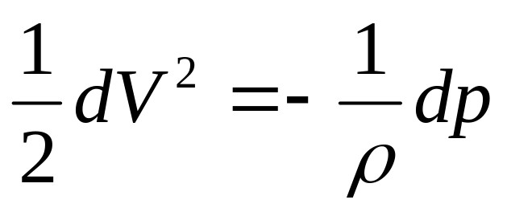
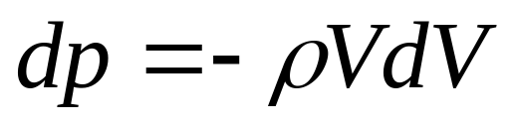
as
and
Then, we have
or

Slide 9
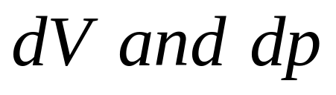
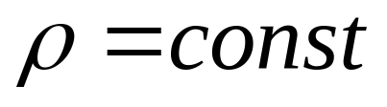
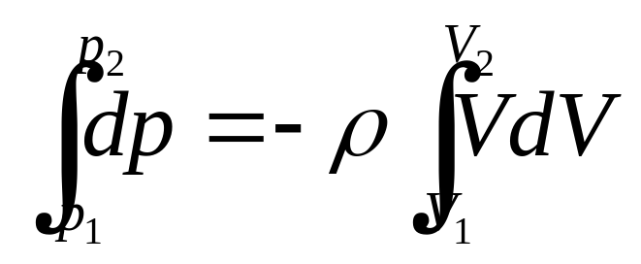
The above equation is called Euler’s Equation.
precondition: inviscid, without body force, along a streamline.
usage: setup the relation between
Step 2. integration of Euler’s equation
For incompressible flows,
The integration from point 1 to point 2 along a streamline is

Slide 10
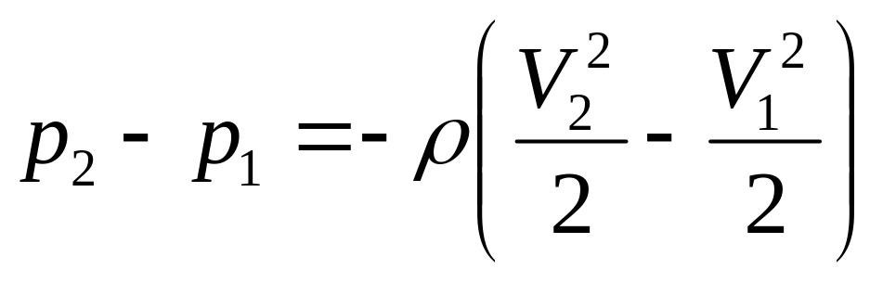
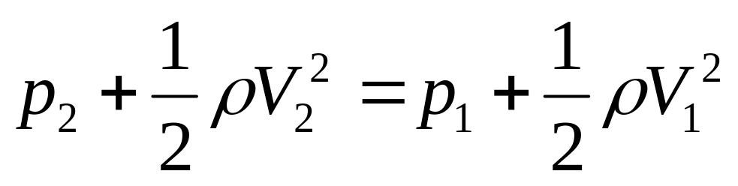
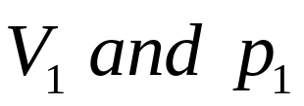
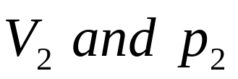
or
or
The above equation is called Bernoulli’s Equation.
precondition: steady, inviscid, incompressible, without body force, along a streamline.
usage: setup the relation between at point 1 on a streamline to at another point 2 on the same streamline.

Slide 11

As point 1 and point 2 are arbitrarily chosen on a streamline, so
Along a streamline
1. As there are no stipulation being made to whether the flow is rotational or irrotational, it satisfies for both irrotational flows and rotational flows as well.
2. The value of the constant will change from one streamline to another.
3. For irrotational flows
Through out the flow

Slide 12
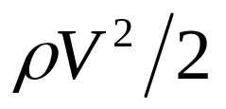
Bernoulli’s equation is also a relation for mechanical energy in an incompressible flow
where is the kinetic energy per unit volume
As Bernoulli’s equation can also be derived from the energy equation, the energy equation is redundant for the analysis of inviscid, incompressible flow.

Slide 13
The way for solving inviscid, incompressible flows:
Obtain the velocity field from the governing equations.
2. Obtain the pressure field from Bernoulli’s equation

Slide 14
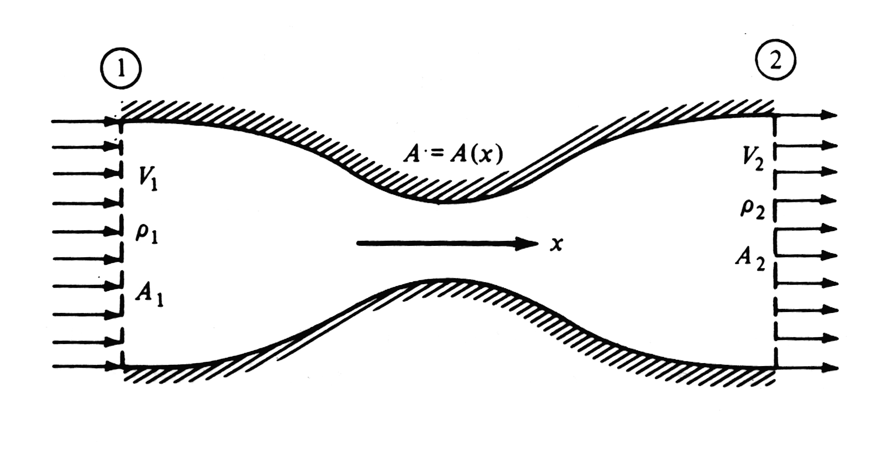
3.3 Incompressible flow in a duct: the Venturi tube and low-speed wind tunnel

Slide 15
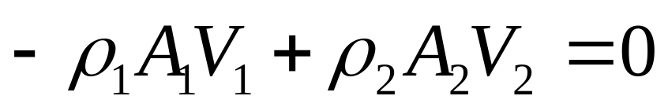
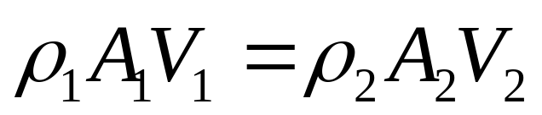
Assumption of quasi-one-dimensional flows
Flow-field properties are uniform across any cross section.
2. All the flow-field properties are assumed to be functions of x only.
Respect to continuity equation, and for steady case
or

Slide 16
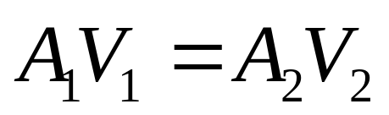
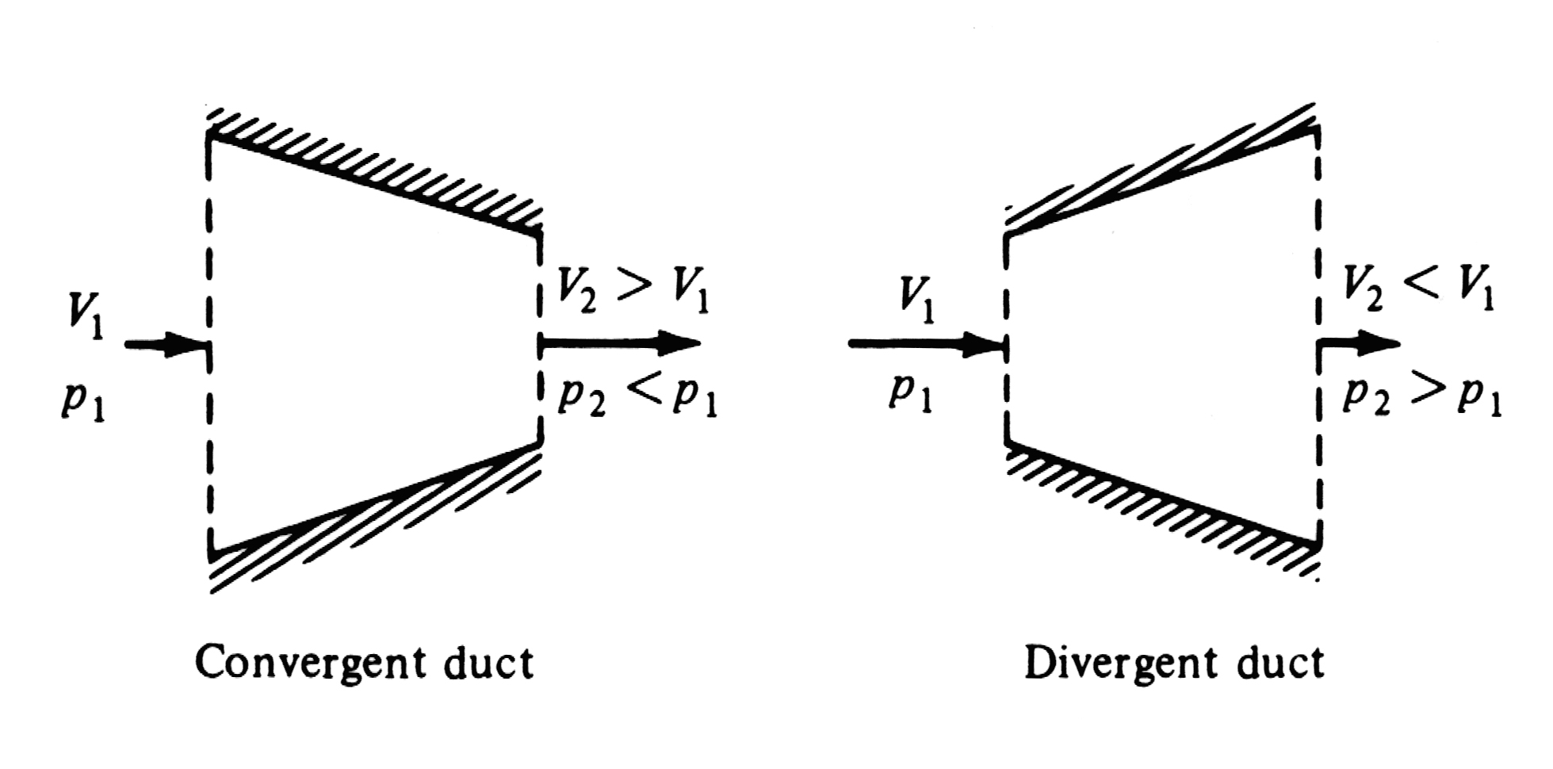
For incompressible flow
Applications of venturi tube

Slide 17
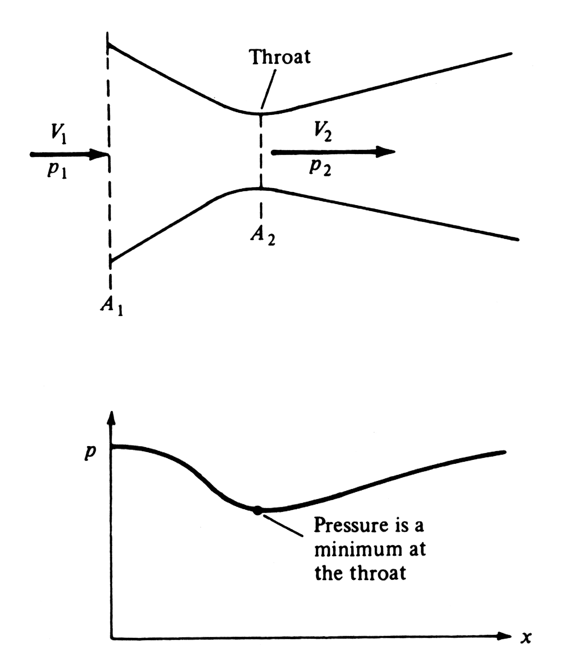

Slide 18
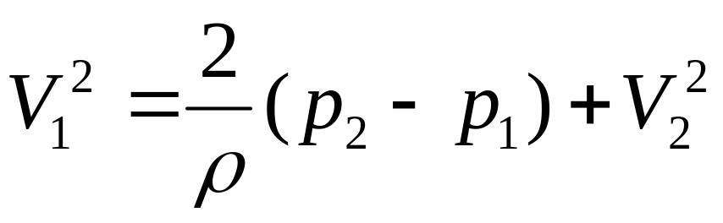
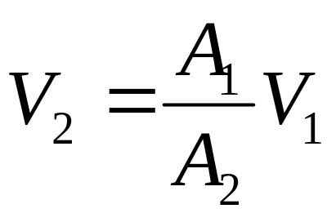
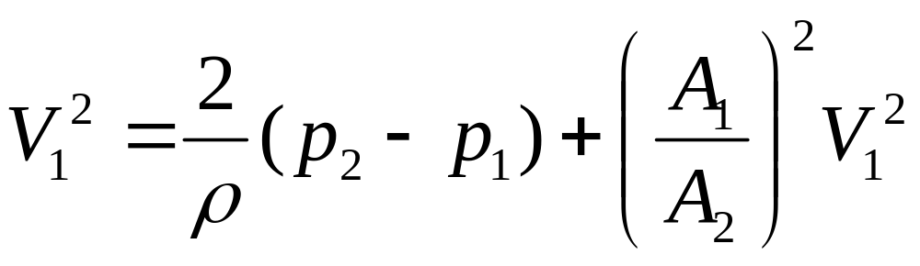
Measurements of flow speed in a duct.
From Bernoulli’s equation
From continuity equation, we have
Then

Slide 19
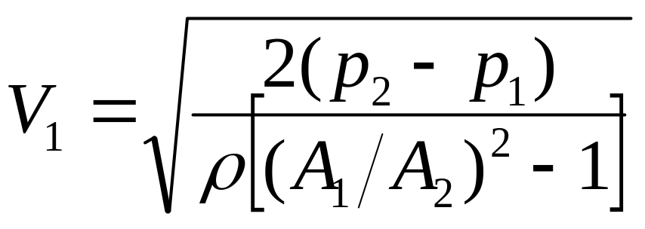

Slide 20
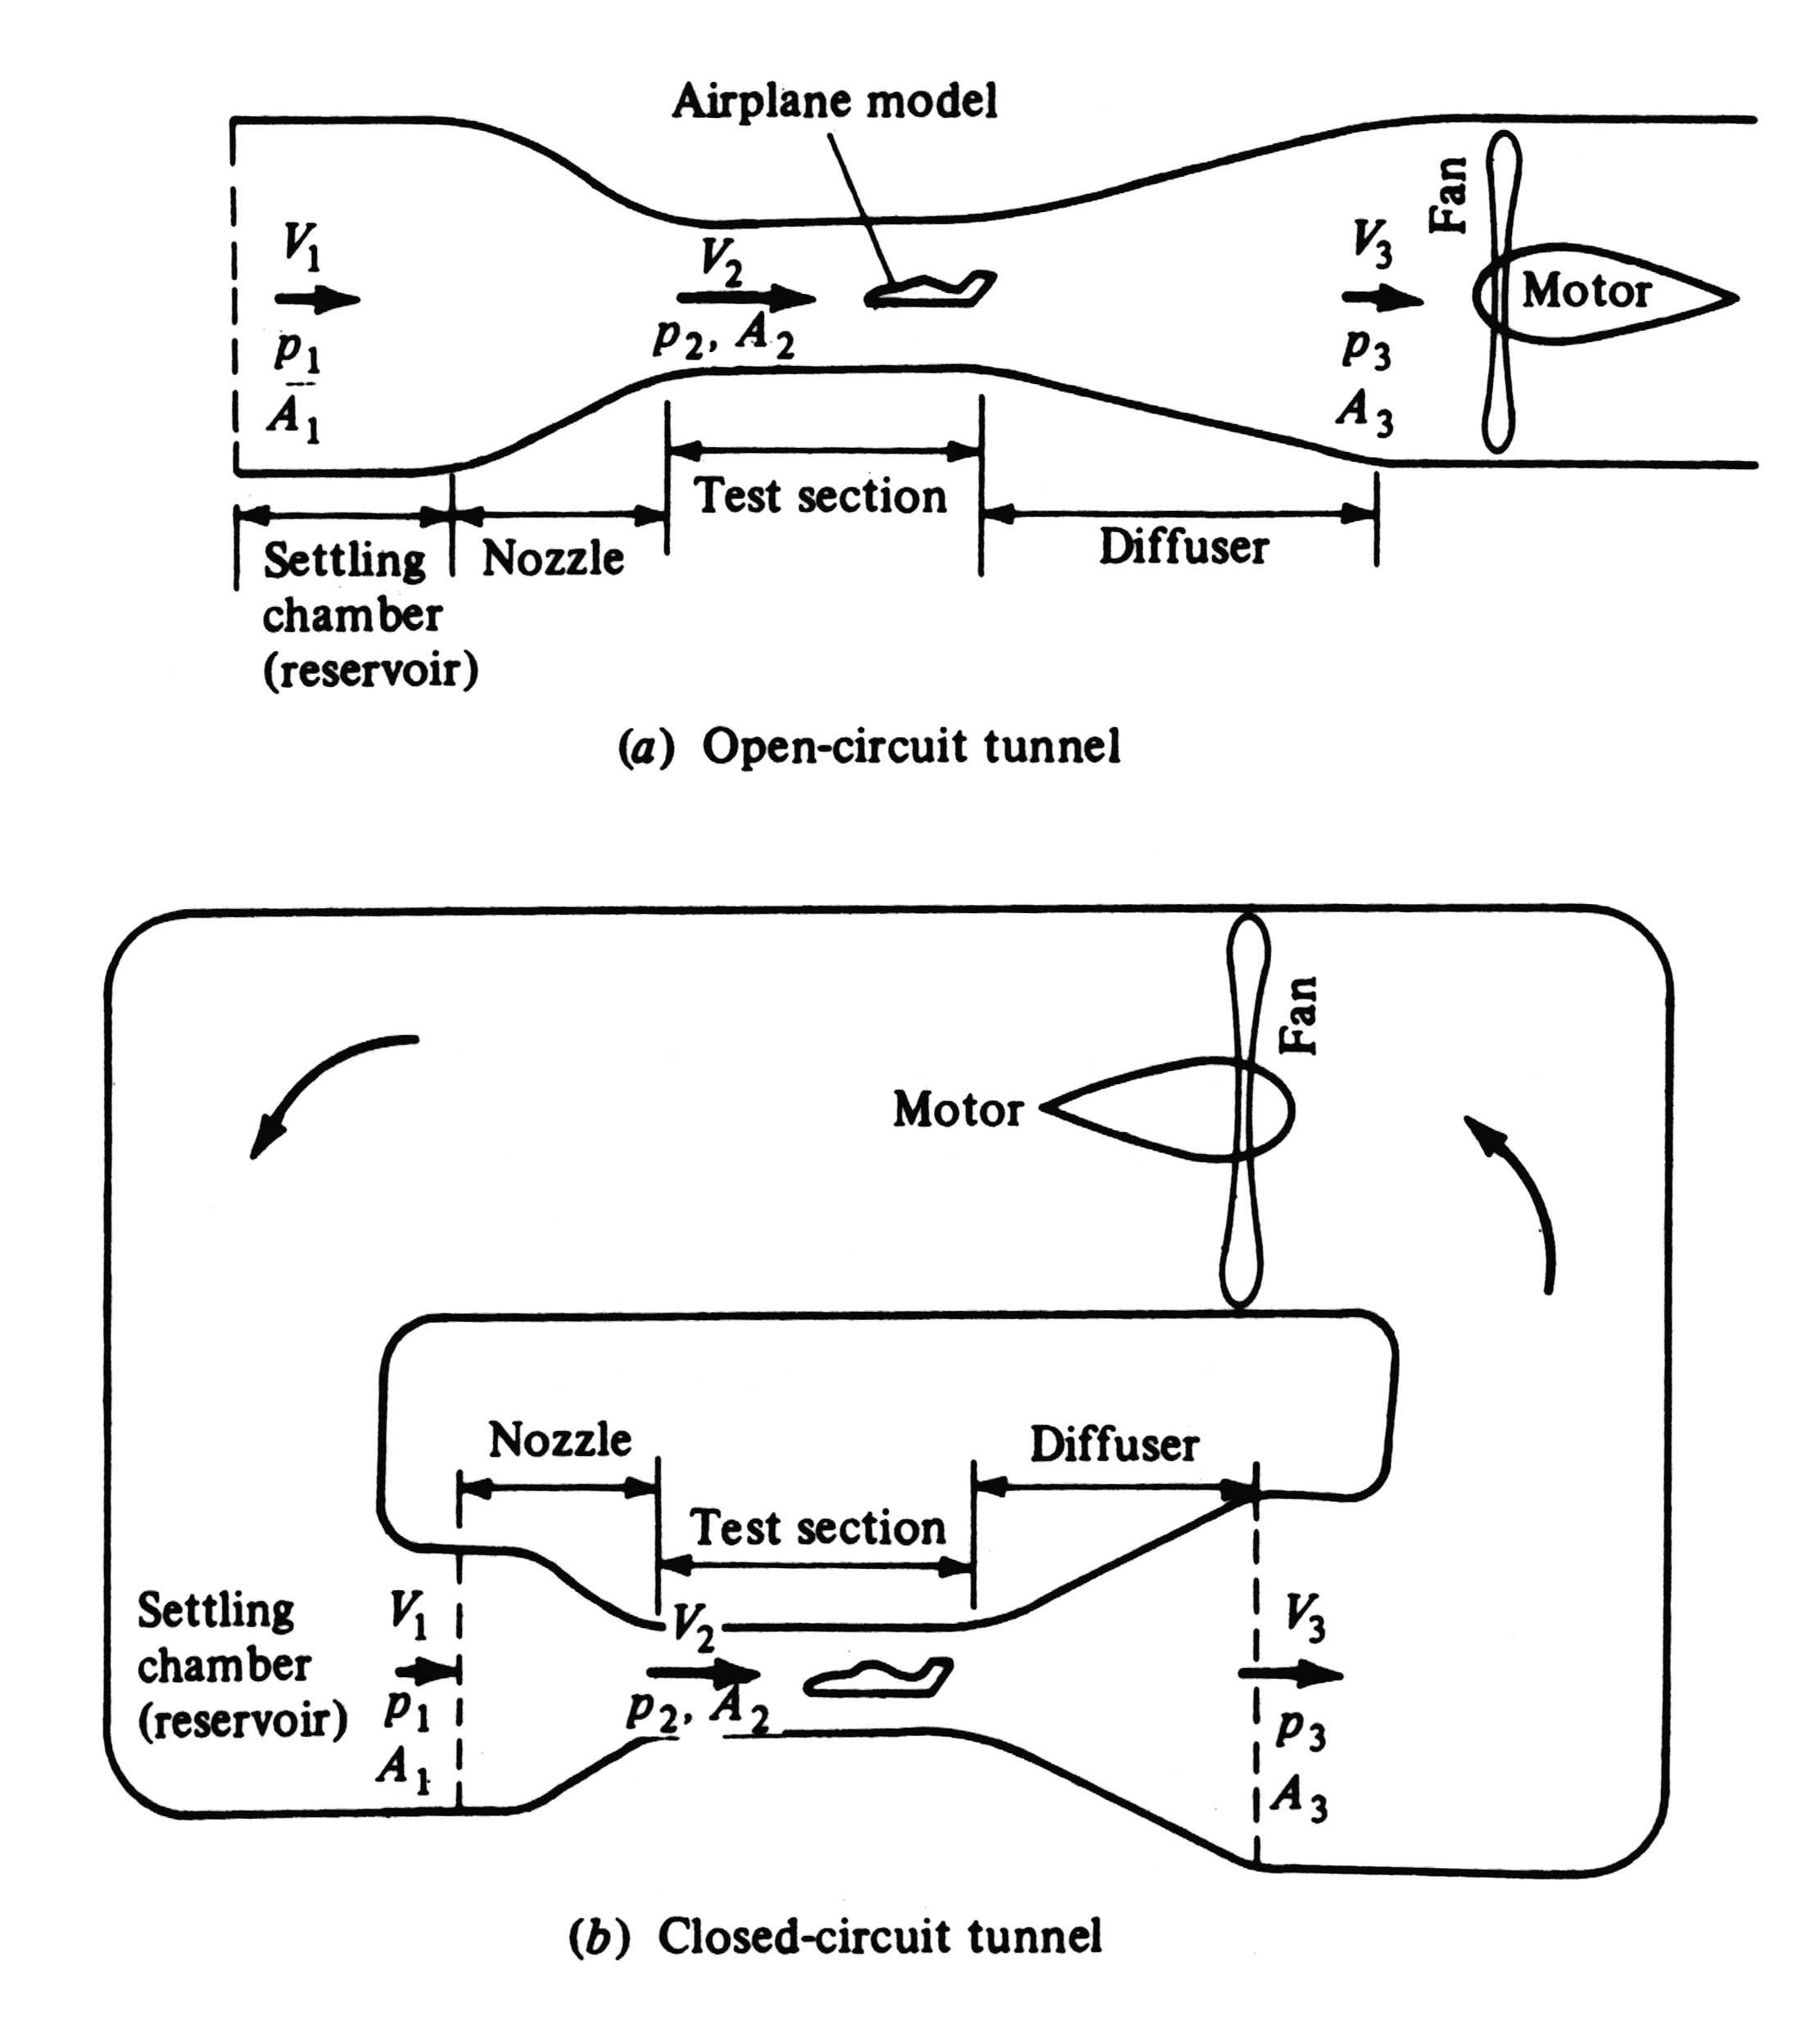

Slide 21
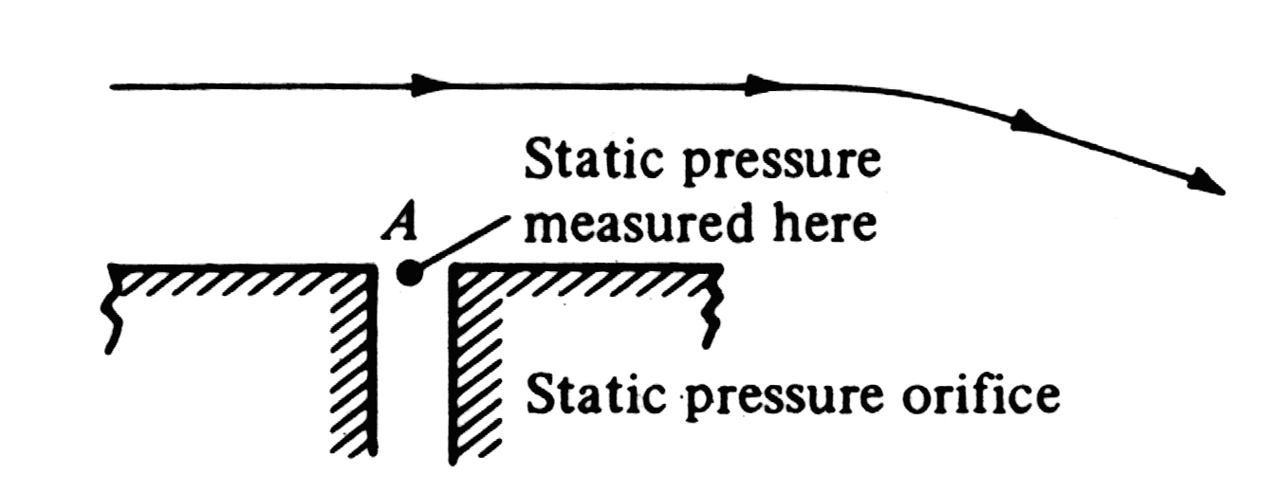
3.4 Pitot tube: measurement of airspeed
Definition of static pressure, the measurement of the static pressure.

Slide 22
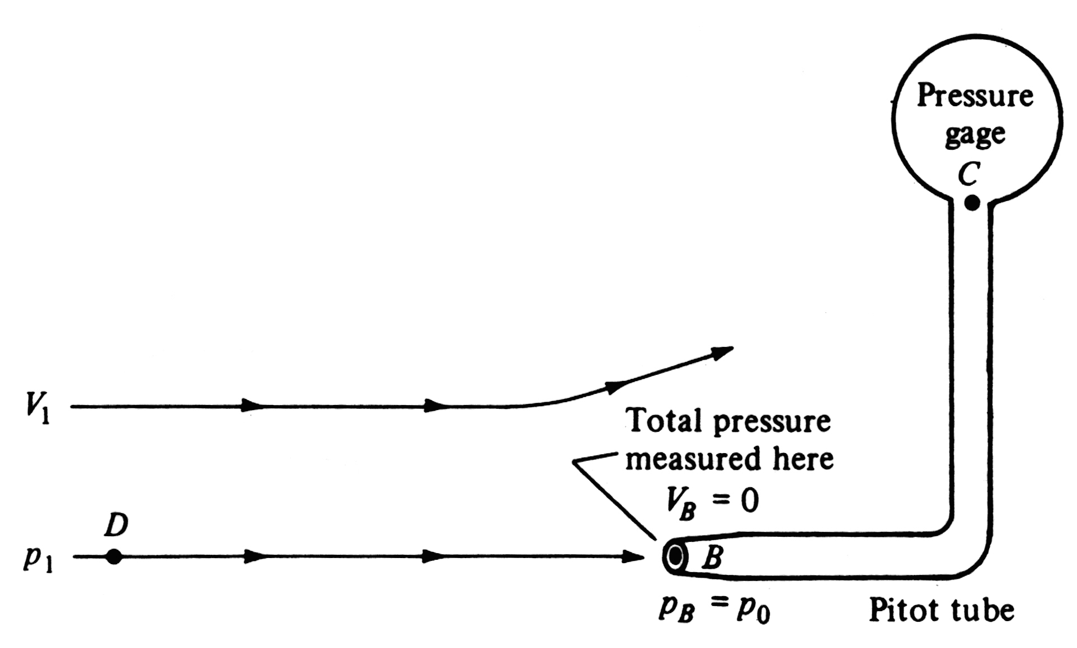
Definition of stagnation pressure, the measurement of the stagnation pressure.

Slide 23



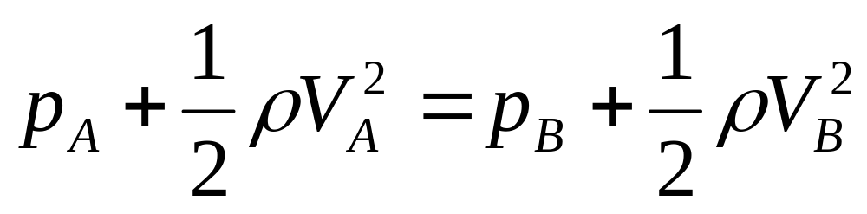
The usage of Pitot tube.
The pressure at point C is the stagnation pressure
The speed at point C is equal to zero
The pressure at point A is the static pressure
The speed at point A is equal to free stream velocity
The speed and pressure and at point A and B are the same, apply Bernoulli’s equation, we have

Slide 24
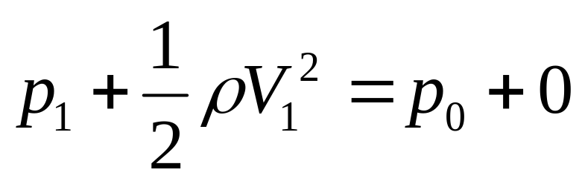
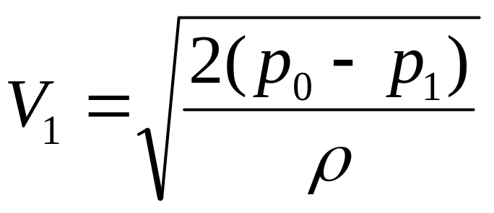
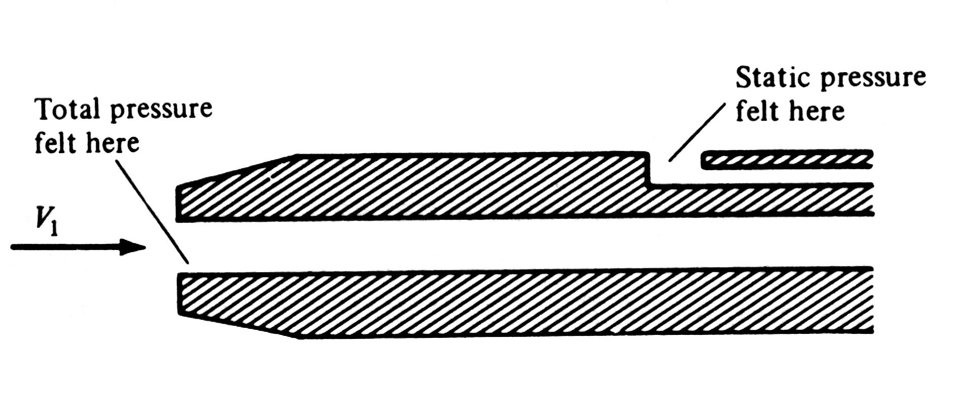
or
Combined instrument for the measurement of both static and total(stagnation) pressure.

Slide 25
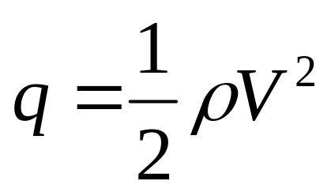
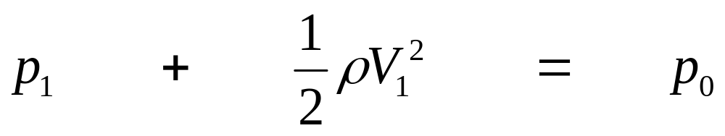
Definition of dynamic pressure, the relationship between of the static pressure,total pressure and dynamic pressure.
For incompressible flows
static pressure
dynamic pressure
total pressure

Slide 26
Keep in mind !!!!!
Any result derived from Bernoulli’s equation holds for incompressible flow only

Slide 27
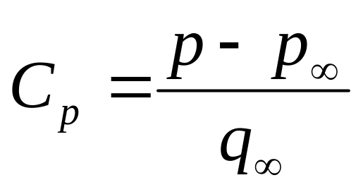
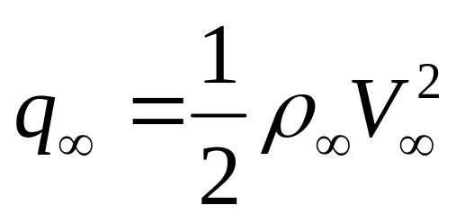
3.5 Pressure coefficient
Definition of the pressure coefficient
where
The pressure coefficient is a nondimensional value, it can be used throughout aerodynamics, for both compressible flow and incompressible flow.

Slide 28

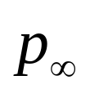


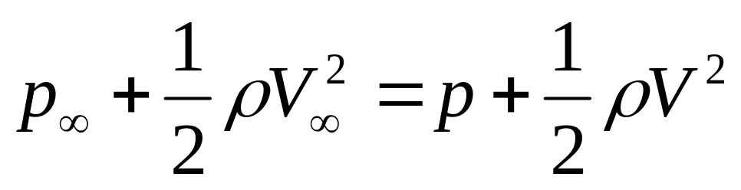

For incompressible flow, the pressure coefficient can be expressed in terms of velocity only
If and are defined as the freestream velocity and pressure. And and are the velocity and pressure at an arbitrary point in the flow. Then, with Bernoulli’s equation,
or

Slide 29



or
Valid for incompressible flow only

Slide 30


