Slide 1
PART I
FUNDAMENTAL PRINCIPLES
（基本原理）
In part I, we cover some of the basic principles that apply to aerodynamics in general. These are the pillars on which all of aerodynamics is based

Slide 2
第二章
Aerodynamics: Some Fundamental
Principles and Equations
There is so great a difference between a fluid and a collection of solid particles that the laws of pressure and of equilibrium of fluids are very different from the laws of the pressure and equilibrium of solids .
Jean Le Rond d’Alembert, 1768

Slide 3
2.1 Introduction and Road Map
Preparation of tools for the analysis of aerodynamics
Every aerodynamic tool we developed in this and subsequent chapters is important for the analysis and understanding of practical problems
Orientation offered by the road map

Slide 4
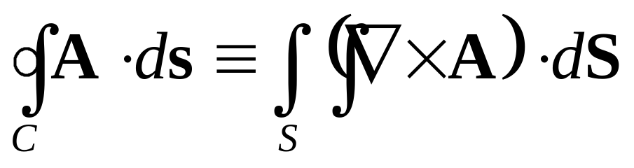
2.2 Review of Vector relations
2.2.1 to 2.2.10 矢量分析与场论
2.2.11 Relations between line, surface, and volume integrals
The line integral of A over C is related to the surface integral of A(curl of A) over S by Stokes’ theorem:
Where aera S is bounded by the closed curve C:

Slide 5
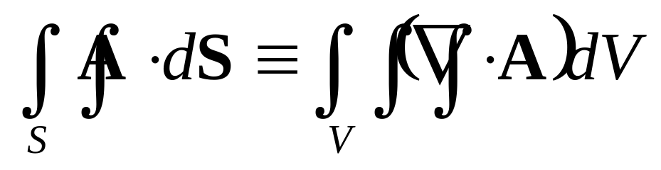
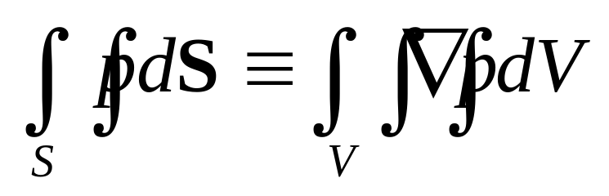
The surface integral of A over S is related to the volume integral of A(divergence of A) over V by divergence’ theorem:
Where volume V is bounded by the closed surface S:
If p represents a scalar field, a vector relationship analogous to divergence theorem is given by gradient theorem:

Slide 6
2.3 Models of the fluid: control volumes and fluid particles
Importance to create physical feeling from physical observation.
How to make reasonable judgments on difficult problems.
In this chapter, basic equations of aerodynamics will be derived.
Philosophical procedure involved with the development of these equations

Slide 7
Invoke three fundamental physical principles which are deeply entrenched in our macroscopic observations of nature, namely,
a. Mass is conserved, that’s to say, mass can be neither created nor destroyed.
b. Newton’s second law: force=mass☓acceleration
c. Energy is conserved; it can only change from one form to another
2. Determine a suitable model of the fluid.
3. Apply the fundamental physical principles listed in item 1 to the model of the fluid determined in item2 in order to obtain mathematical equations which properly describe the physics of the flow.

Slide 8
*Emphasis of this section:
What is a suitable model of the fluid?
How do we visualize this squishy substance in order to apply the three fundamental principles?
Three different models mostly used to deal with aerodynamics.
finite control volume （有限控制体）
infinitesimal fluid element （无限小流体微团）
molecular （自由分子）

Slide 9
2.3.1 Finite control volume approach
Definition of finite control volume:
a closed volume sculptured within a finite region of the flow. The volume is called control volume V, and the curved surface which envelops this region is defined as control surface S.
Fixed control volume and moving control volume.
Focus of our investigation for fluid flow.

Slide 10
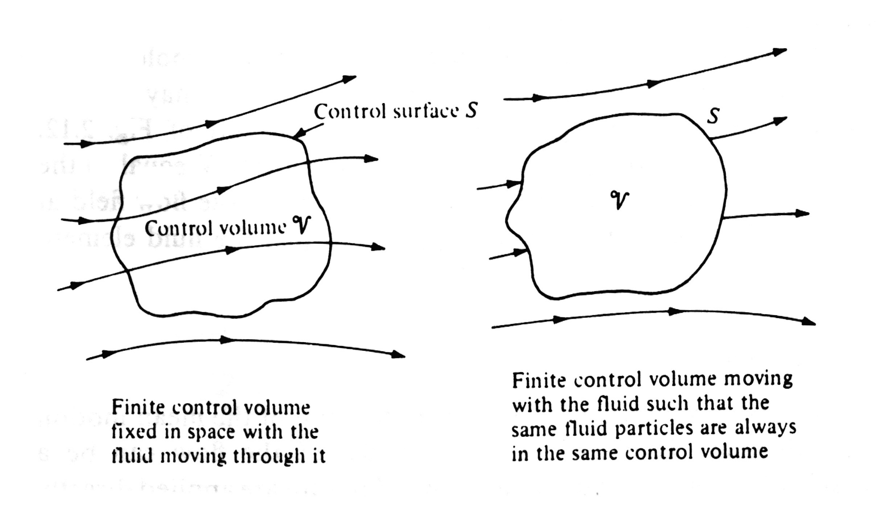

Slide 11
2.3.2 Infinitesimal fluid element approach
Definition of infinitesimal fluid element:
an infinitesimally small fluid element in the flow, with a differential volume.
It contains huge large amount of molecules
Fixed and moving infinitesimal fluid element.
Focus of our investigation for fluid flow.

Slide 12
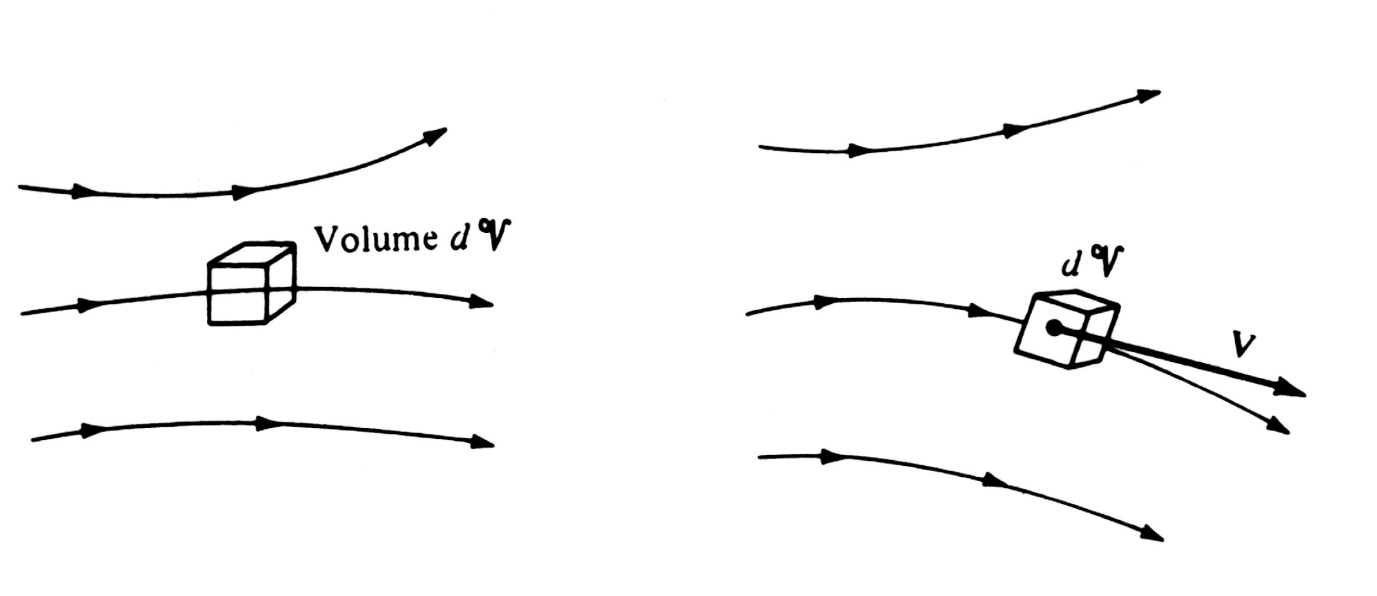
The fluid element may be fixed in space with fluid moving through it, or it may be moving along a streamline with velocity V equal to the flow velocity at each point as well.

Slide 13
2.3.3 Molecule approach
Definition of molecule approach:
The fluid properties are defined with the use of suitable statistical averaging in the microscope wherein the fundamental laws of nature are applied directly to atoms and molecules.
In summary, although many variations on the theme can be found in different texts for the derivation of the general equations of the fluid flow, the flow model can be usually be categorized under one of the approach described above.

Slide 14
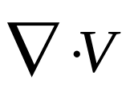
2.3.4 Physical meaning of the divergence of velocity
Definition of :
is physically the time rate of change of the volume of a moving fluid element of fixed mass per unit volume of that element.
Analysis of the above definition:
Step 1. Select a suitable model to give a frame under which the flow field is being described.
a moving control volume is selected.

Slide 15
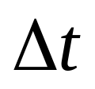
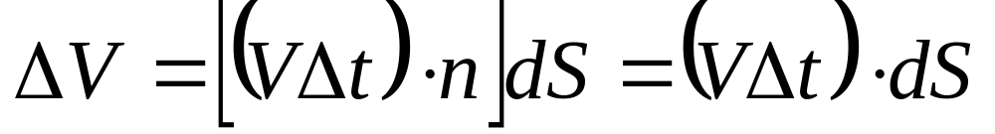
Step 3. How about the characteristics for this moving control volume?
volume, control surface and density will be changing as it moves to different region of the flow.
Step 4. Chang in volume due to the movement of an infinitesimal element of the surface dS over .

Slide 16
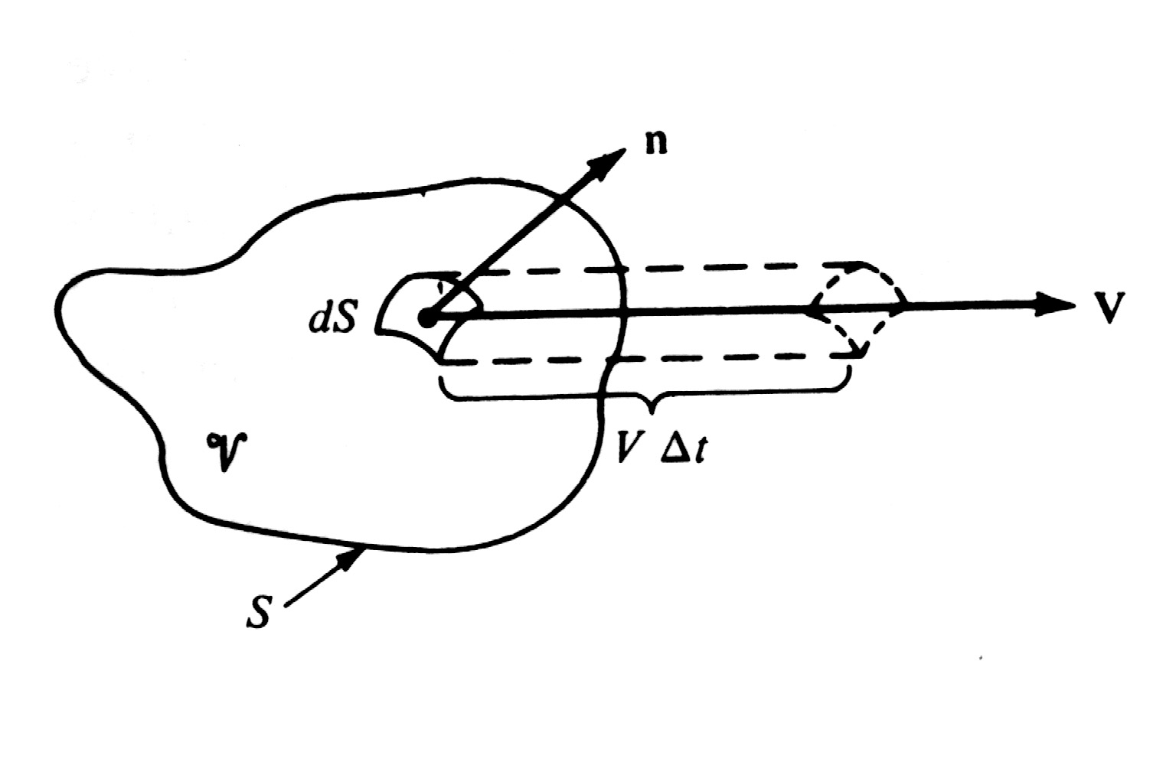
Step 4. Chang in volume due to the movement of an infinitesimal element of the surface dS over .

Slide 17
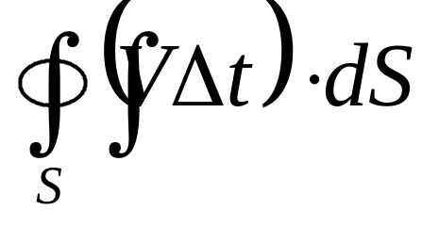
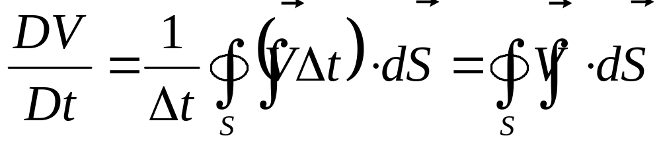
The total change in volume of the whole control volume over the time increment is obviously given as bellow
Step 5. If the integral above is divided by .the result is physically the time rate change of the control volume

Slide 18
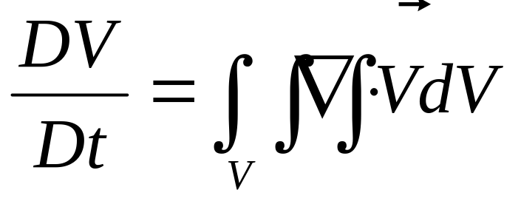
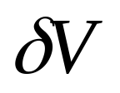
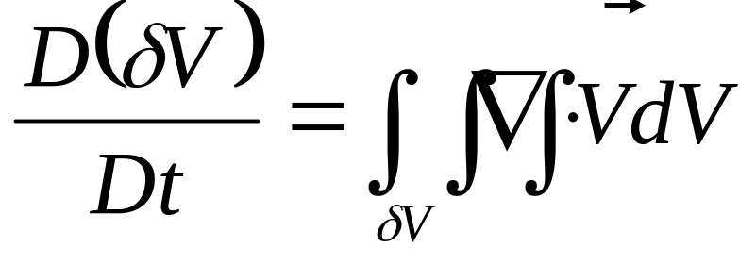
Step 6. Applying Gauss theorem, we have
Step 7. As the moving control volume approaches to a infinitesimal volume, . Then the above equation can be rewritten as

Slide 19
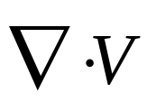
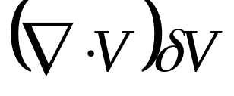
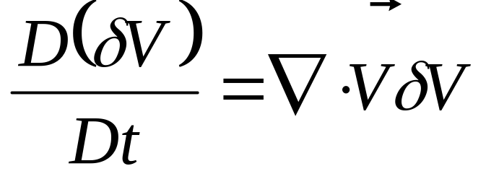
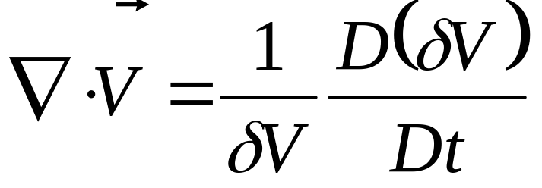
Assume that is small enough such that is the same through out . Then, the integral can be approximated as , we have
or
Definition of :
is physically the time rate of change of the volume of a moving fluid element of fixed mass per unit volume of that element.

Slide 20
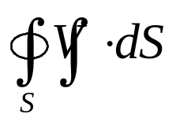





Another description of and :
Assume is a control surface corresponding to control volume , which is selected in the space at time .
At time the fluid particles enclosed by at time will have moved to the region enclosed by the surface .
The volume of the group of particles with fixed identity enclosed by at time is the sum of the volume in region A and B. And at time , this volume will be the sum of the volume in region B and C.
As time interval approaches to zero, coincides with . If is considered as a fixed control volume, then, the region in A can be imagined as the volume enter into the control surface, C leave out.

Slide 21
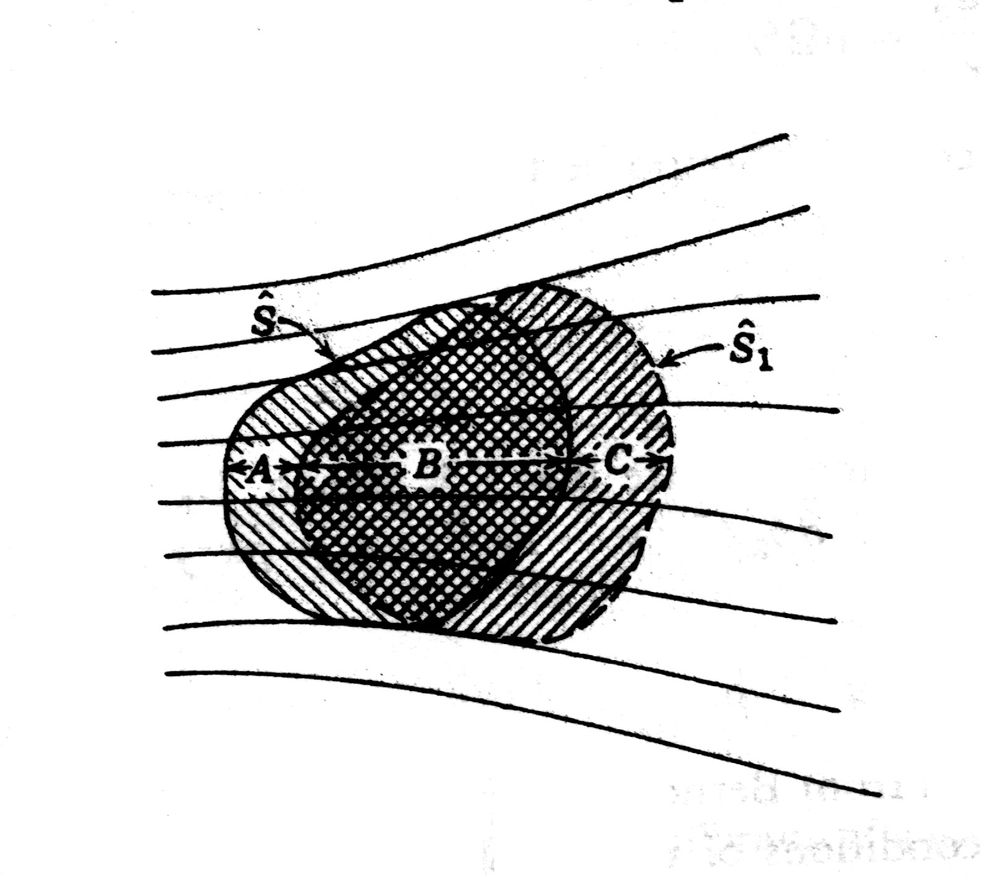

Slide 22
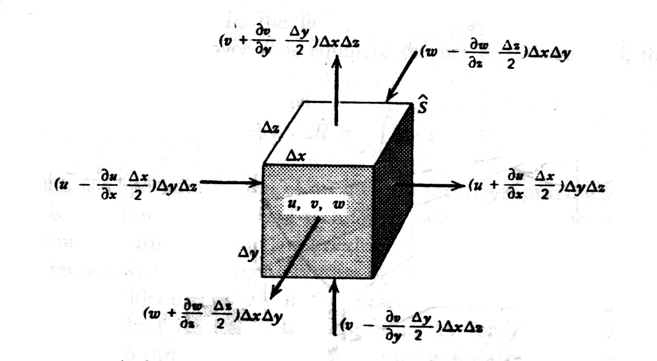
Based on the argument above, the integral of can be expressed as volume flux through fixed control surface. Further, can be expressed as the rate at which fluid volume is leaving a point per unit volume.

Slide 23
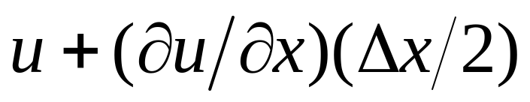
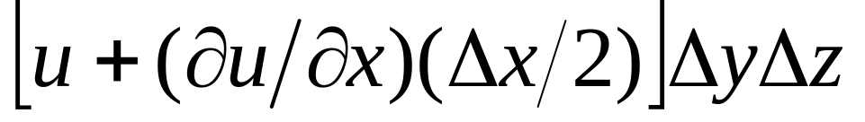
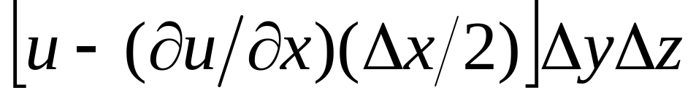
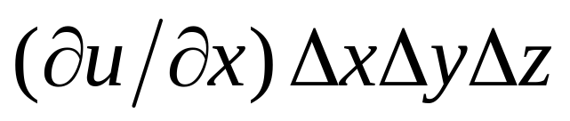
The average value of the velocity component on the right-hand x face is
The rate of volume flow out of the right-hand x face is
That into the left-hand x face is
The net outflow from the x faces is
per unit time

Slide 24
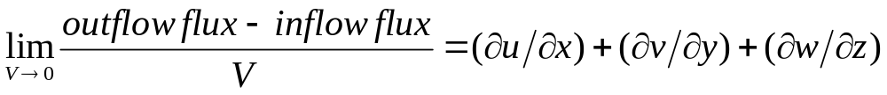
The net outflow from all the faces in x,y,z directions per unit time is
The flux of volume from a point is

