Slide 1
2.4 Continuity equation
In this section, we will apply fundamental physical principles to the fluid model. More attention should be given for the way we are progressing in the derivation of basic flow equations.
Derivation of continuity equation
Step 1. Selection of fluid model. A fixed finite control volume is employed as the frame for the analysis of the flow. Herein, the control surface and control volume is fixed in space.

Slide 2
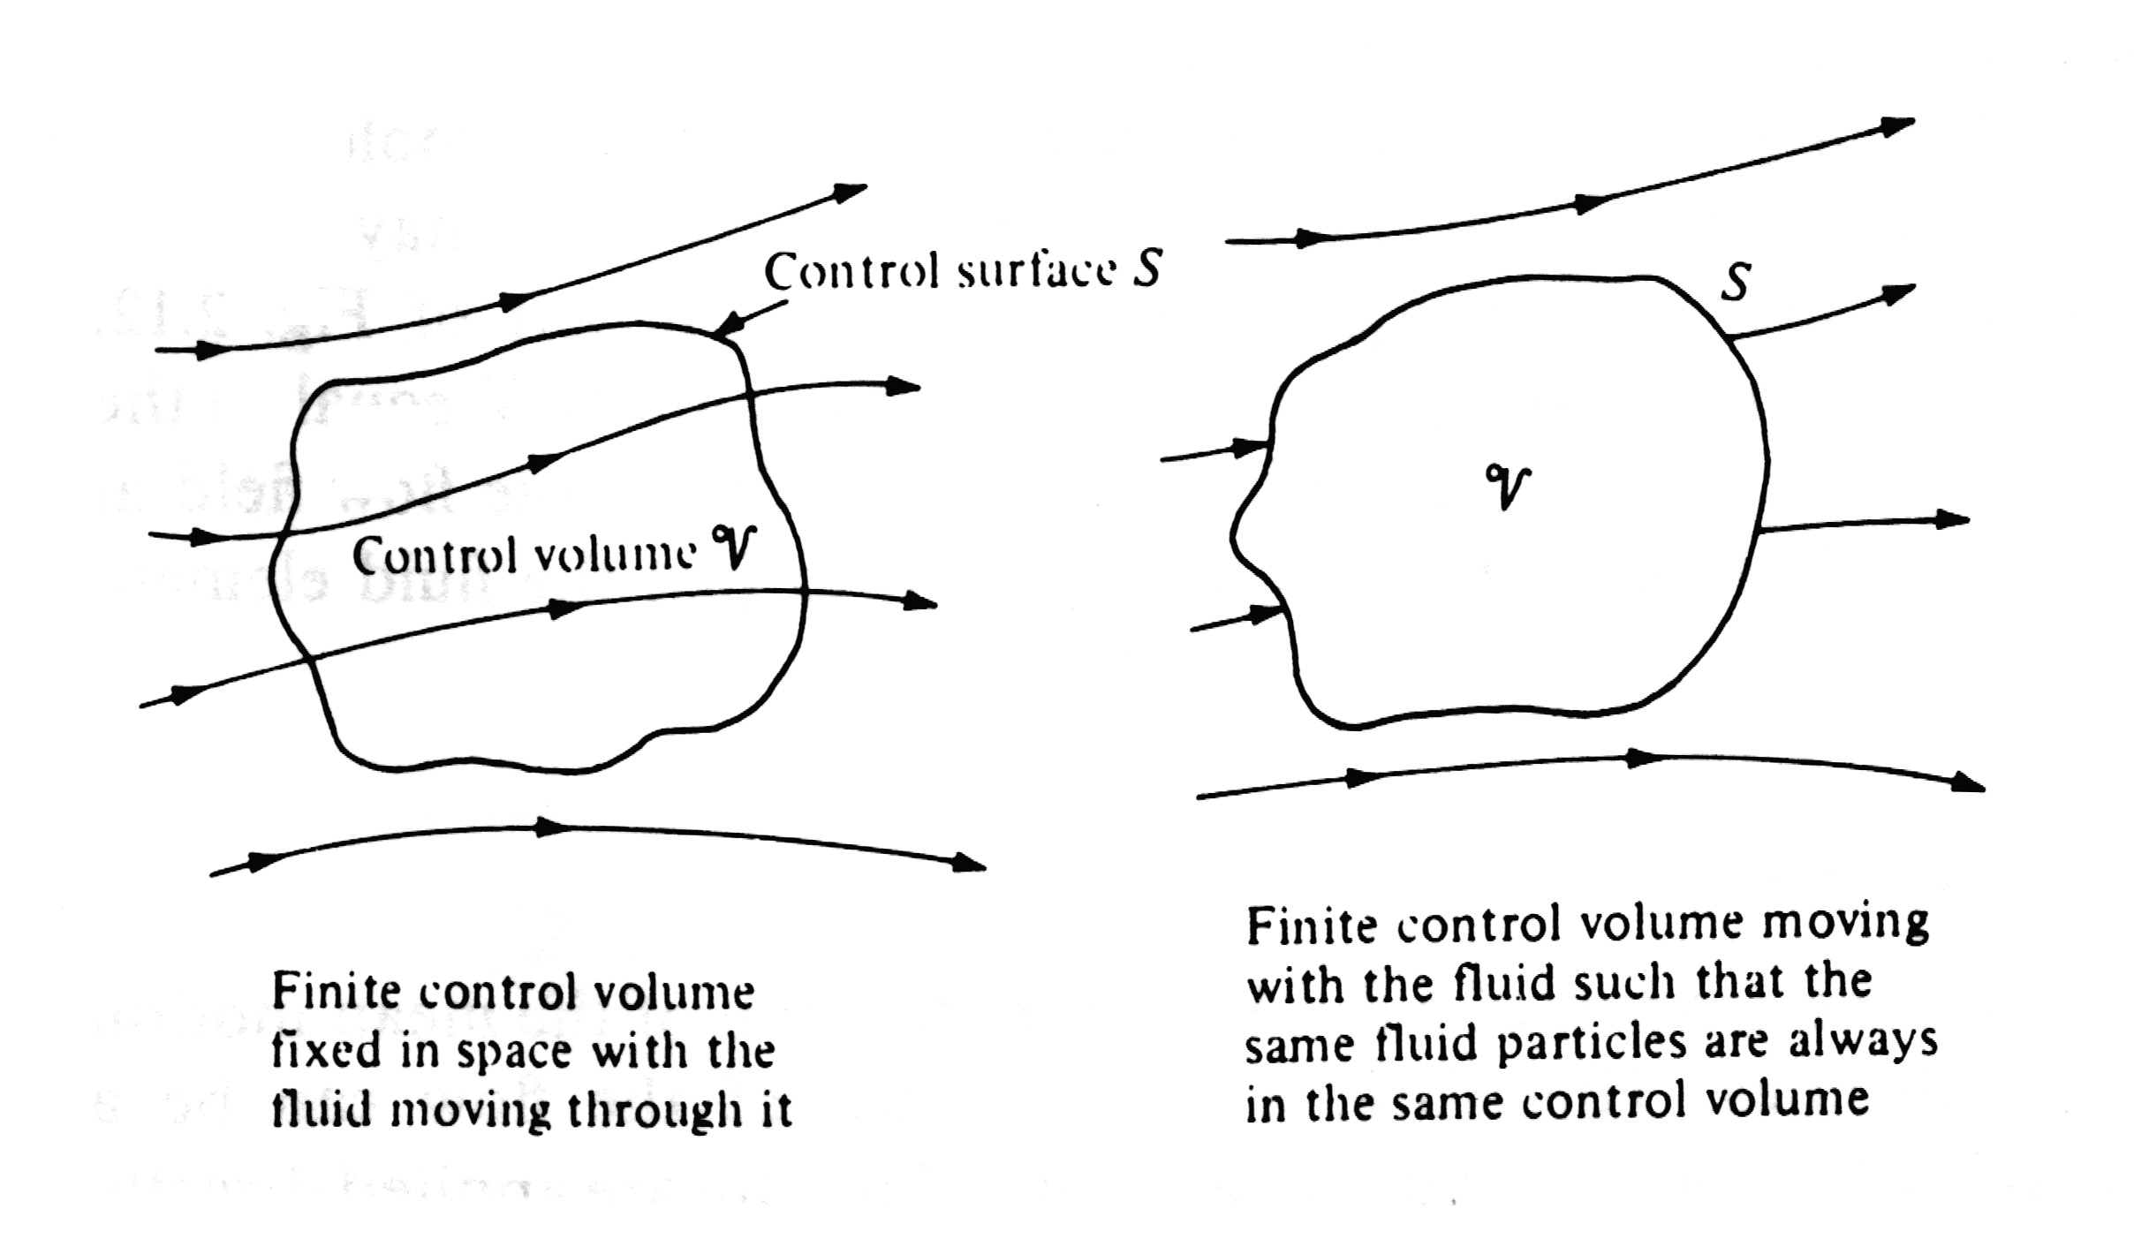

Slide 3
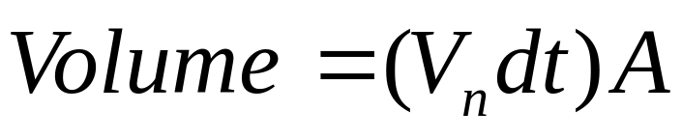
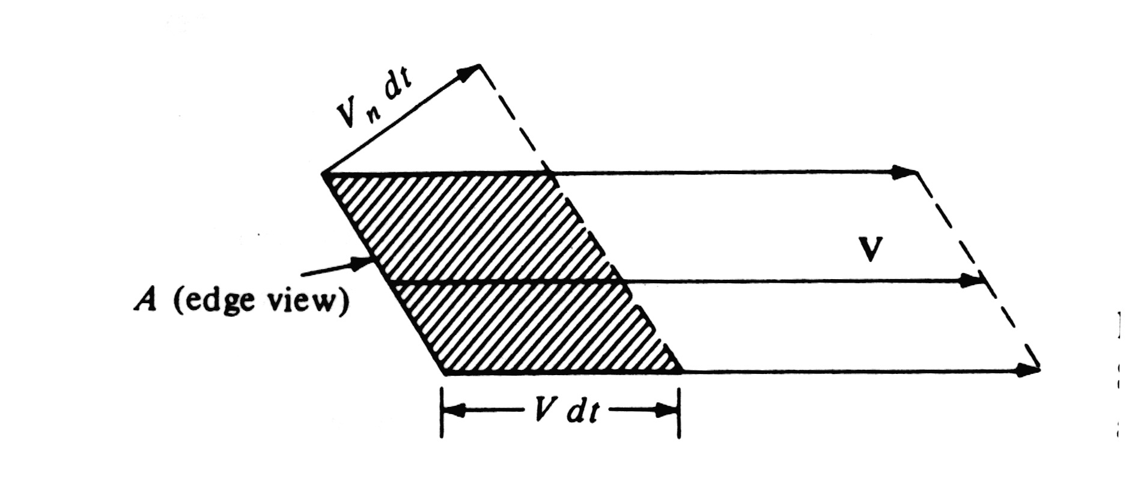
Step 2. Introduction of the concept of mass flow. Let a given area A is arbitrarily oriented in a flow, the figure given bellow is an edge view. If A is small enough, then the velocity V over the area is uniform across A. The volume across the area A in time interval dt can be given as

Slide 4
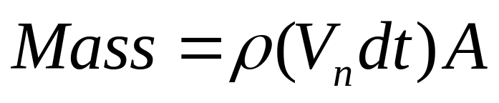

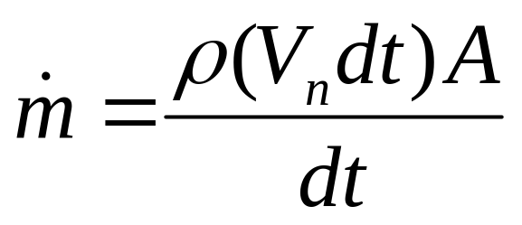
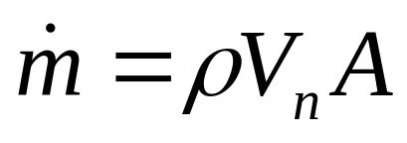
The mass inside the shaded volume is
The mass flow is defined as the mass crossing A per unit second, and denoted as
or

Slide 5
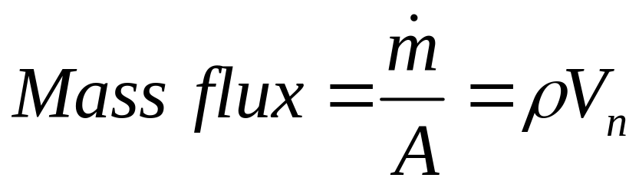
The equation above states that mass flow through A is given by the product :
Area X density X component of flow velocity normal to the area
mass flux is defined as the mass flow per unit area

Slide 6
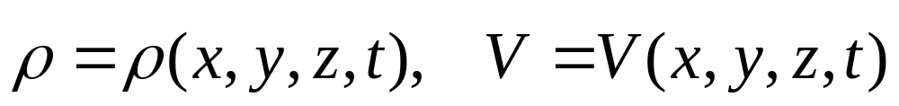
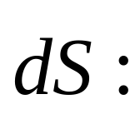
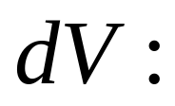
Step 3. Physical principle Mass can be neither created nor destroyed.
Step 4. Description of the flow field, control volume and control surface.
Directional elementary surface area on the control surface
Elementary volume inside the finite control volume

Slide 7

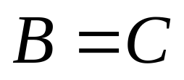

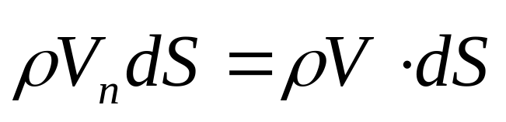
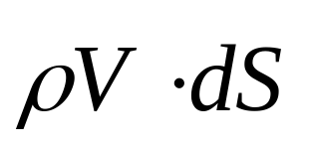
Step 5. Apply the mass conservation law to this control volume.
Net mass flow out of control volume through surface S
Time rate decrease of mass inside control volume V
or
Step 6. Mathematical expression of B
The elemental mass flow across the area is
The physical meaning of positive and negative of

Slide 8
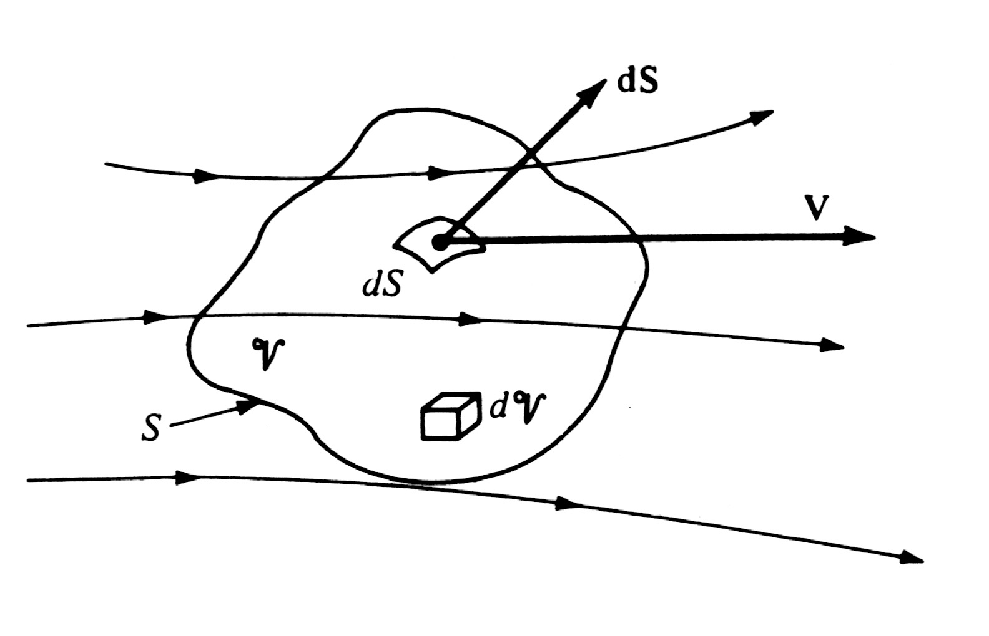

Slide 9
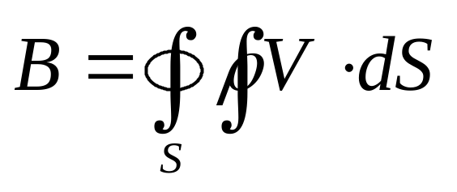
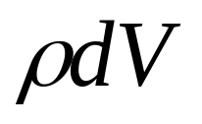
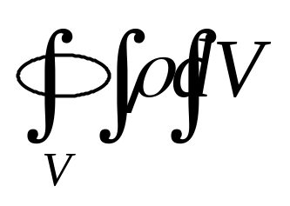
The net mass flow out of the whole control surface S
Step 7. Mathematical expression of C
The mass contained inside the elemental volume V is
The mass inside the entire control volume is

Slide 10
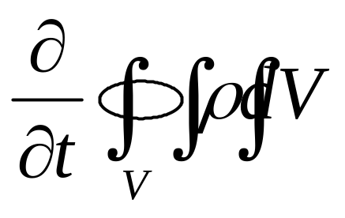
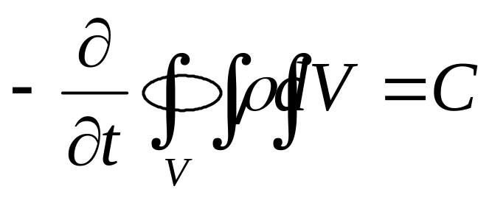
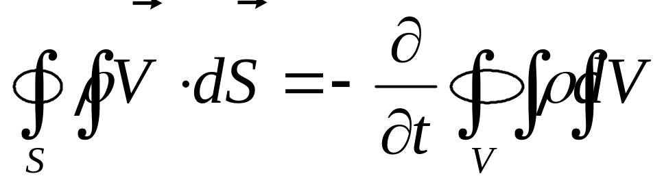
The time rate of increase of the mass inside V is
The time rate of decrease of the mass inside V is
Step 8. Final result of the derivation
Let B=C , then we get

Slide 11
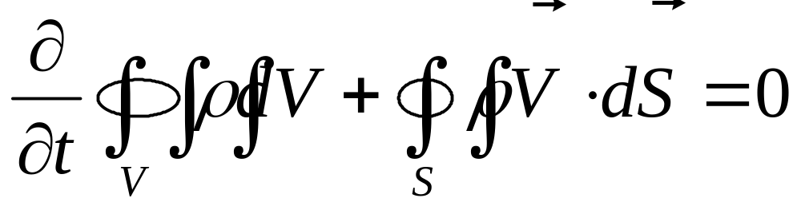
or

Slide 12
Step 9. Notes for the Continuity Equation above
The continuity equation above is in integral form, it gives the physical behaviour over a finite region of space without detailed concerns for every distinct point.
This feature gives us numerous opportunities to apply the integral form of continuity equation for practical fluid dynamic or aerodynamic problems.
If we want to get the detailed performance at a given point, then, what shall we deal with the integral form above to get a proper mathematic description for mass conservation law?

Slide 13

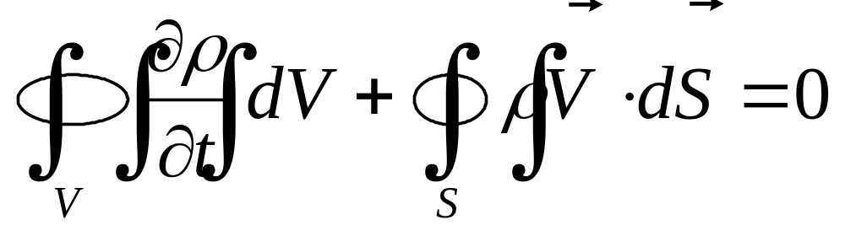
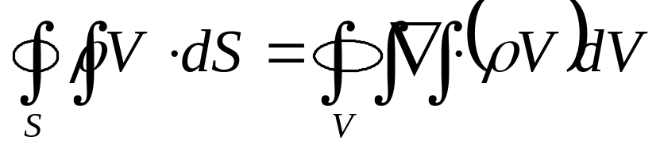
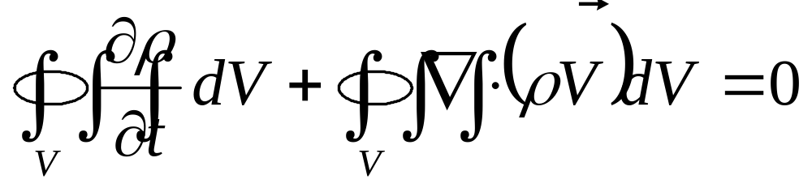
Step 10. Continuity Equation in Differential form
The integral limit is not the same
Control volume is fixed in space
The integral limit is the same

Slide 14
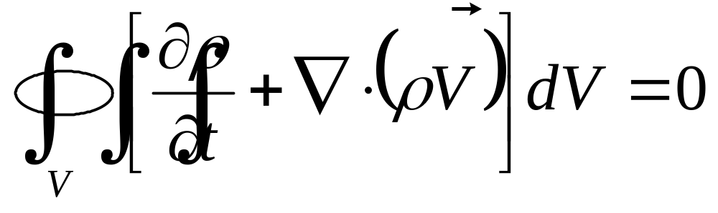
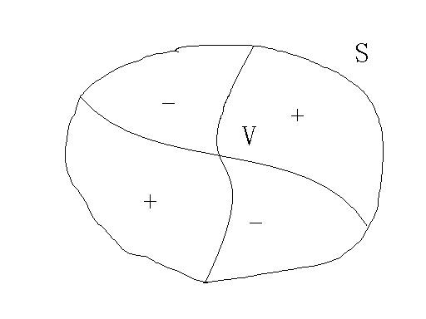
or
A possible case for the integral over the control volume

Slide 15
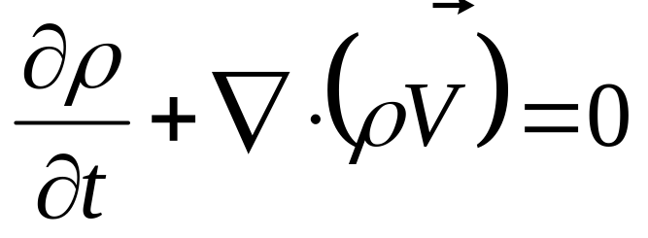
If the finite control volume is arbitrarily chosen in the space, the only way to make the equation being satisfied is that, the integrand of the equation must be zero at all points within the control volume. That is,
That is the continuity equation in a partial differential form. It concerns the flow field variables at a point in the flow with respect to the mass conservation law
It is important to keep in mind that the continuity equations in integral form and differential form are equally valid statements of the physical principles of conservation of mass.they are mathematical representations, but always remember that they speak words.

Slide 16
Step 11. Limitations of the equations derived
Continuum flow or molecular flow
As the nature of the fluid is assumed as Continuum flow in the derivation so
It satisfies only for Continuum flow
Steady flow or unsteady flow
It satisfies both steady and unsteady flows
viscous flow or inviscid flow
It satisfies both viscous and inviscid flows
Compressible flow or incompressiblw flow
It satisfies both Compressible and incompressiblw flows

Slide 17
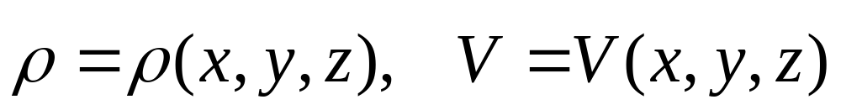
Difference between steady and unsteady flow
Unsteady flow:
The flow-field variables are a function of both spatial location and time, that is
Steady flow:
The flow-field variables are a function of spatial location only, that is

Slide 18
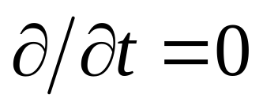
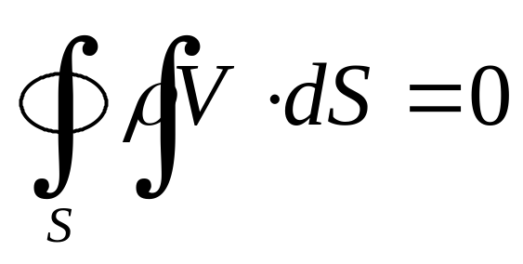

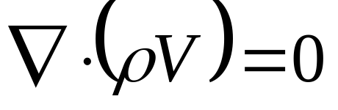
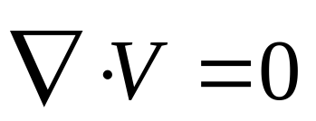
For steady flow:
For steady incompressible flow:

Slide 19
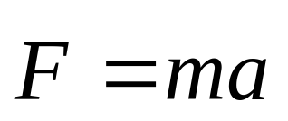
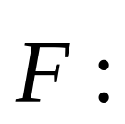


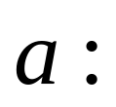
2.5 Momentum equation
Newton’s second law
where
Force exerted on a body of mass
Mass of the body
Acceleration

Slide 20
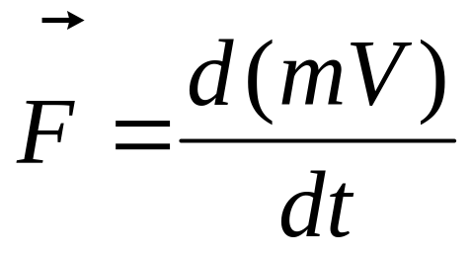
Consider a finite moving control volume, the mass inside this control volume should be constant as the control volume moving through the flow field. So that, Newton’s second law can be rewritten as
Derivation of momentum equation
Step 1. Selection of fluid model. A fixed finite control volume is employed as the frame for the analysis of the flow.

Slide 22
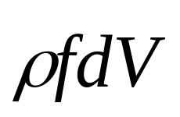
Step 2. Physical principle
Force = time rate change of momentum
Step 3. Expression of the left side of the equation of Newton’s second law, i.e., the force exerted on the fluid as it flows through the control volume.
Two sources for this force:
Body forces: over every part of V
2. Surface forces: over every elemental surface of S
Body force on a elemental volume

Slide 23
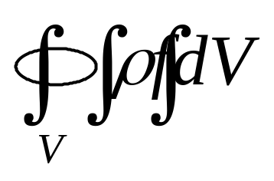
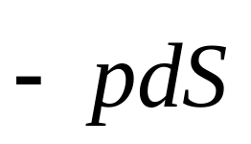
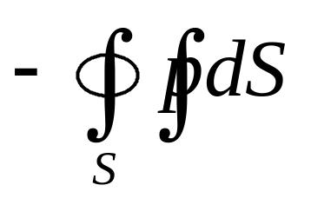
Body force over the control volume
Surface forces over the control surface can be divided into two parts, one is due to the pressure distribution, and the other is due to the viscous distribution.
Pressure force acting on the elemental surface
Note: indication of the negative sign
Complete pressure force over the entire control surface

Slide 24
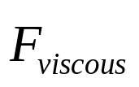
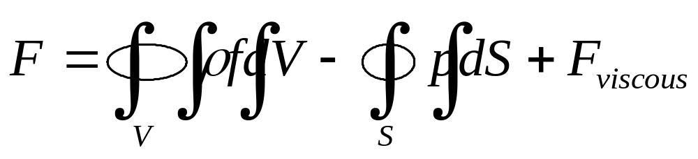
The surface force due to the viscous effect is simply expressed by
Total force acting on the fluid inside the control volume as it is sweeping through the fixed control volume is given as the sum of all the forces we have analyzed
Step 4. Expression of the right side of the equation of Newton’s second law, i.e., the time rate change of momentum of the fluid as it sweeps through the fixed control volume.

Slide 25
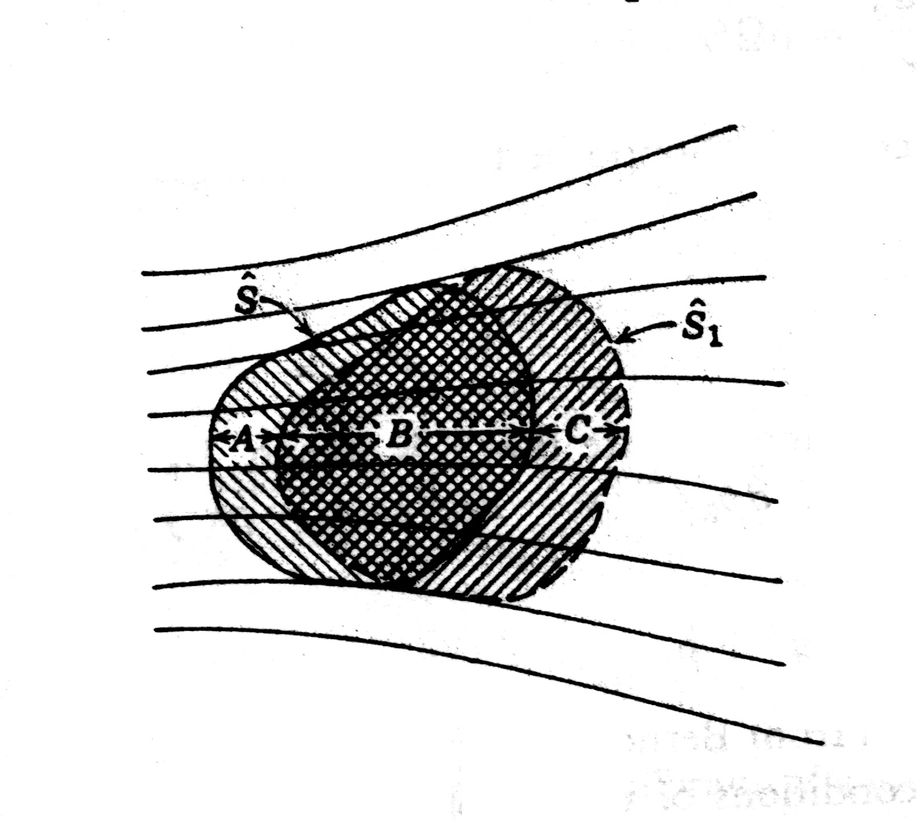
Moving control volume??
FIX??

Slide 26

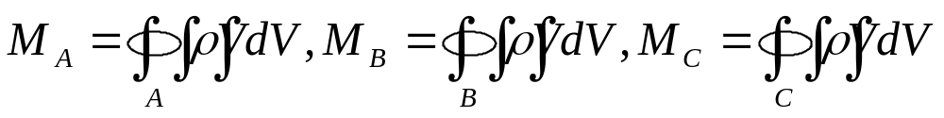


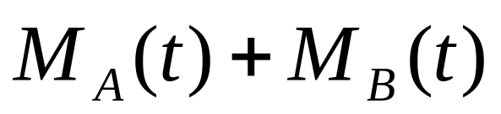


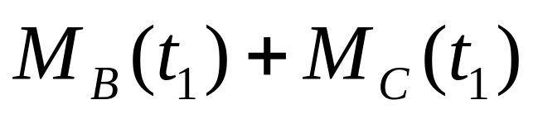
Let be the momentum of the fluid within region A, B, and C. for instance,
At time , the momentum inside is
At time , the momentum inside is

Slide 27
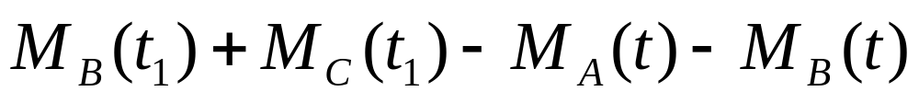
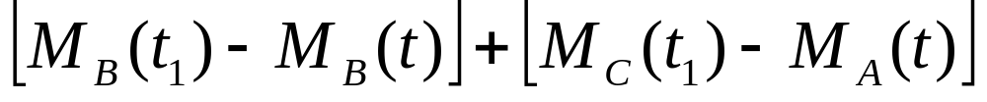

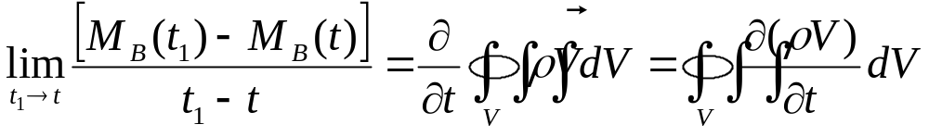
The momentum change during the time interval
or
As the time interval approaches to zero, the region B will coincide with S in the space, and the two limits

Slide 28
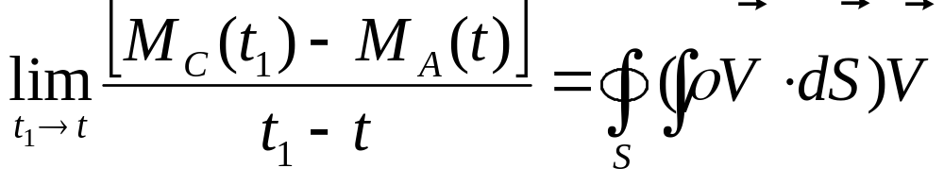



Net momentum flow out of control volume across surface S
Time rate change of momentum due to unsteady fluctuations of flow properties inside V
The explanations above helps us to make a better understanding of the arguments given in the text book bellow

Slide 29





Net momentum flow out of control volume across surface S
Time rate of change of momentum due to unsteady fluctuations of flow properties inside control volume V
Step 5. Mathematical description of
mass flow across the elemental area dS is
momentum flow across the elemental area dS is

Slide 30



The net flow of momentum out of the control volume through S is
Step 6. Mathematical description of
The momentum in the elemental volume dV is
The momentum contained at any instant inside the control volume V is

Slide 31

Its time rate change due to unsteady flow fluctuation is

Slide 32



Step 7. Final result of the derivation
Combine the expressions of the forces acting on the fluid and the time rate change due to term and , respectively, according to Newton’s second low

Slide 33

It’s the momentum equation in integral form
It’s a vector equation
Advantages for momentum equation in integral form

Slide 34

Step 8. Momentum Equation in Differential form
Try to rearrange the every integrals to share the same limit
gradient theorem

Slide 35


control volume is fixed in space
Then we get

Slide 36


Split this vector equation as three scalar equations with
Momentum equation in x direction is

Slide 37



divergence theorem
As the control volume is arbitrary chosen, then the integrand should be equal to zero at any point, that is

Slide 38



x direction
y direction
z direction
These equations can applied for unsteady, 3D flow of any fluid, compressible or incompressible, viscous or inviscid.

Slide 39




Steady and inviscid flow without body forces

Slide 40
Euler’s Equations and Navier-Stokes equations
Whether the viscous effects are being considered or not
Eulers Equations: inviscid flow
Navier-Stokes equations: viscous flow

Slide 41

Deep understanding of different terms in continuity and momentum equations

Slide 42


Time rate change of mass inside control volume
Time rate change of momentum inside control volume

Slide 43



Net flow of volume out of the control volume through control surface S
Net flow of mass out of the control volume through control surface S
Net flow of momentum out of the control volume through control surface S

Slide 44


Body force through out the control volume V
Surface force over the control surface S

Slide 45



What we can foresee the applications for aerodynamic problems with basic flow equations on hand?
If the steady incompressible inviscid flows are concerned
Partial differential equation for velocity
Partial differential equation for velocity and pressure

Slide 46
2.6 An application of the momentum equation: drag of a 2D body
How to design a 2D wind tunnel test?
How to measure the lift and drag exerted on the airfoil by the fluid?

Slide 47

A selected control volume around an airfoil

Slide 48




Descriptions of the control volume
1. The upper and lower streamlines far above and below the body (ab and hi).
2. Lines perpendicular to the flow velocity far ahead and behind the body(ai and bh)
3. A cut that surrounds and wraps the surface of the body(cdefg)
1. Pressure at ab and hi.
2. Pressure at ai and bh . ,velocity ,
3. The pressure force over the surface abhi

Slide 49


Slide 50


4. The surface force on def by the presence of the body, this force includes the skin friction drag, and denoted as per unit span.
5. The surface forces on cd and fg cancel each other.
6. The total surface force on the entire control volume is
7. The body force is negligible

Slide 51


Apply to momentum equation, we have
for steady flow
Note: it’s a vector equation.

Slide 52




If we only concern the x component of the equation, with represents the x component of .
As boundaries of the control volume abhi are chosen far away from the body, the pressure perturbation due to the presence of the body can be neglected, that means, the pressure there equal to the freestream pressure. If the pressure distribution over abhi is constant, then

Slide 53



So that
As ab, hi, def are streamlines, then
As cd, fg are are adjacent to each other, then

Slide 54

The only contribution to momentum flow through the control surface come from the boundaries ai and bh. For dS=dy(1), the momentum flow through the control surface is
Note:
The sign in front of each integrals on the right hand side of the equation
2. The integral limits for each integrals on the right hand side of the equation

Slide 55




Consider the integral form of the continuity equation for steady flow,
or
As is a constant

Slide 56



Slide 57



The final result gives the drag per unit span
The drag per unit span can be expressed in terms of the known freestream velocity and flow-field properties ,across a vertical station downstream of the body.

Slide 58



Physical meaning behind the equation
Mass flow out of the control volume
Velocity decrement
Momentum decrement per second

Slide 59

For incompressible flow, that is, the density is constant

Slide 60
2.6.1 Comments
With the application of momentum principle to a large, fixed control volume, an accurate result for overall quantity such as drag on a body can be predicted with knowing the detailed flow properties along the control surface. That to say, it is unnecessary to know the the details along the surface of the body.

Slide 61



2.7 Energy equation
For steady incompressible invicid flows
Continuity equation
Momentum equation
Unknowns:

Slide 62



For compressible flows
is an additional variable, and therefore we need an additional fundamental equation to complete the system. This fundamental equation is the energy equation, which we are going to develop.
Two additional flow-field variables will appear to the energy equation, that is internal energy and temperature .
Energy equation is only necessary for compressible flows.

Slide 63


Physical principle(first law of thermodynamics)
Energy can be neither created nor destroyed; it can only change in form
Definitions of system and internal energy per unit mass e
Definition of surroundings
Heat transferred from the surroundings to the system
Work done on the surroundings by the system

Slide 64


Change of internal energy in system due to the heat transferred and the work done
As energy is conserved, so
Apply the first law to the fluid flowing trough the fixed control volume, and let
B1 = rate of heat added to fluid inside control volume from surroundings.
B2 = rate of work done on fluid inside control volume.
B3 = rate of change of energy of fluid as it flows through control volume.

Slide 65


As first law should be satisfied, then
B1+B2 = B3
Actually speaking, the equation above is a power equation.
Rate of volumetric heating
If the flow is viscous
B1 =

Slide 66




Rate of volumetric heating =
The force includes three parts
Pressure force, body force and skin friction force
Rate of work done on fluid inside V due to pressure force on S
Rate of work done on fluid inside V due to body force

Slide 67





B2 =
Since the fluid inside the control volume is not stationary, it is moving at the local velocity with a consequent kinetic energy per unit mass , so, the total energy per unit mass is
Net rate of flow of total energy across control surface S

Slide 68


Time rate change of total energy inside V due to transient variations of flow-field properties
B3 =

Slide 69

B1+B2 = B3
Energy equation in integral form
Notes in the text book

Slide 70


Energy equation in partial differential form
If the flow is steady, inviscid, adiabatic, without body force

Slide 71




After apply three fundamental physical principles, we have derived three basic equations for fluid flow. And there are three variables, such as
For calorically perfect gases
Then, one more property is added, but with perfect gas equation

Slide 72

Continuity, momentum and energy equation with two additional equations are five independent equations, and there five unknowns . So that we have got a closed system for the flow problems.

Slide 73
2.8 Interim summary

