Slide 1
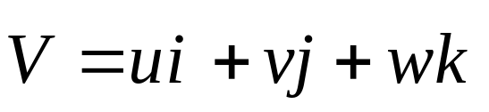
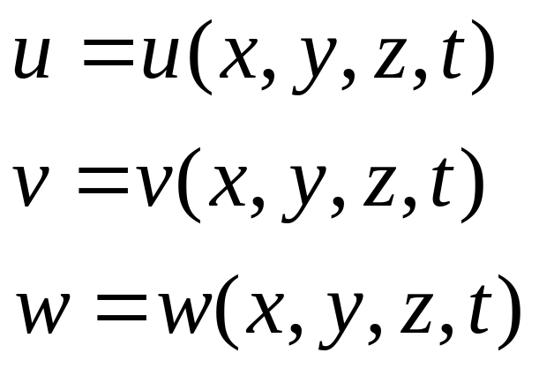
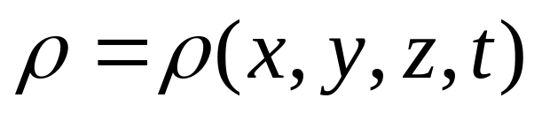
2.9 实质导数
通过流场中某一点的无限小的流体微元. 速度场由下式给出：
密度可以写成

Slide 2
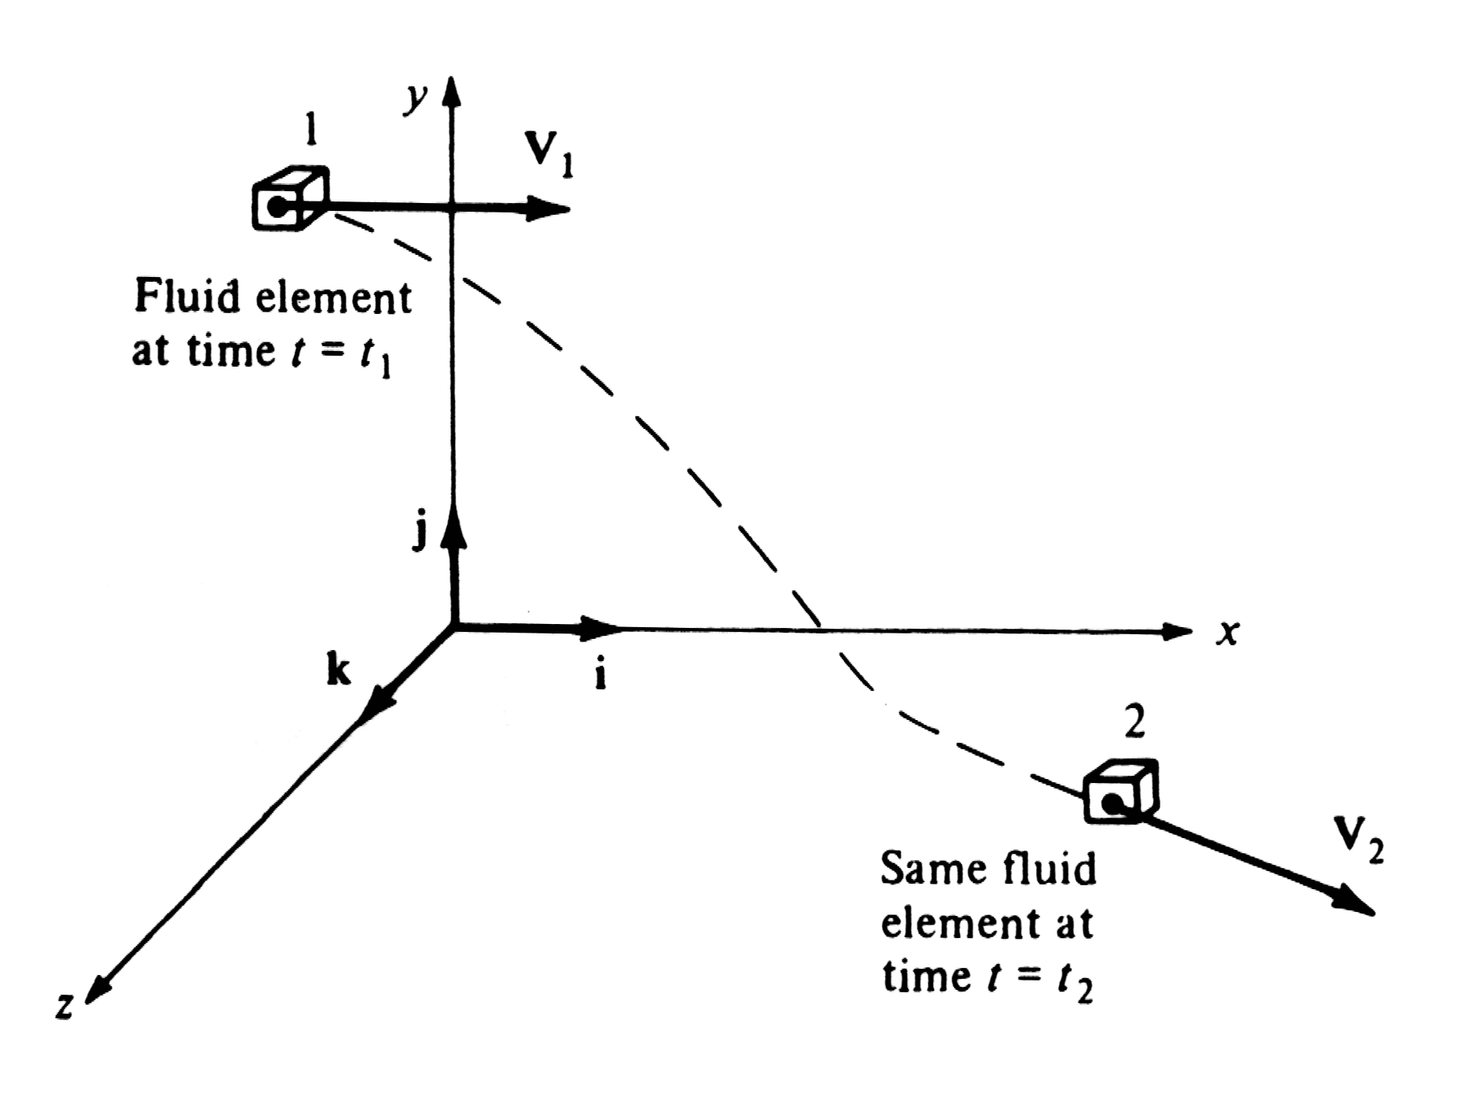

Slide 3
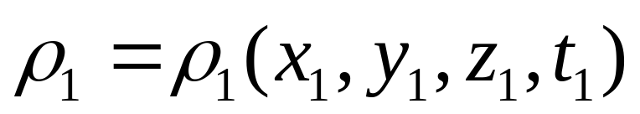

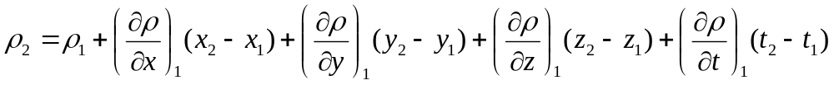

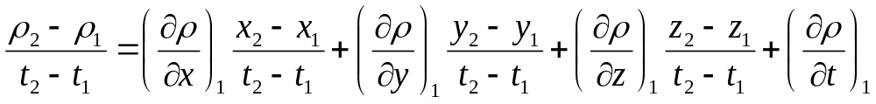
利用一阶泰勒展开，忽略高阶小量，可以得到：
两边同时除以

Slide 4
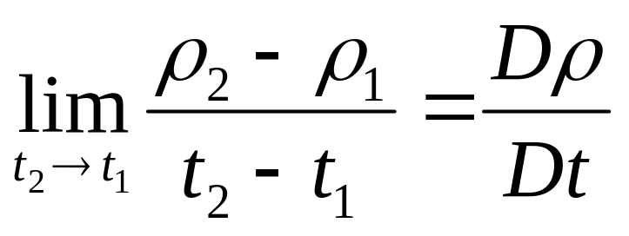
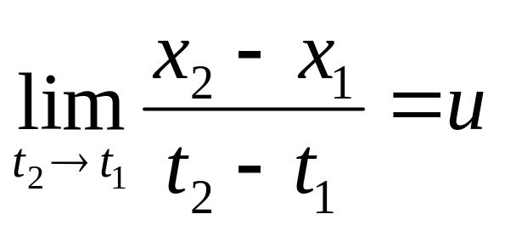
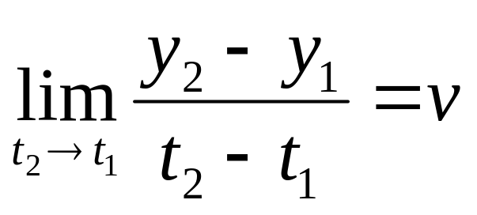
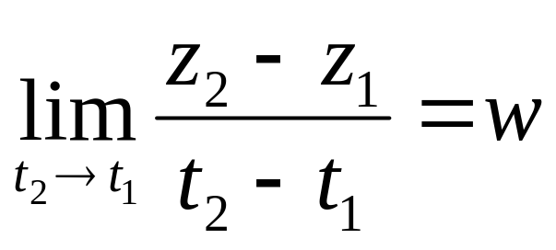
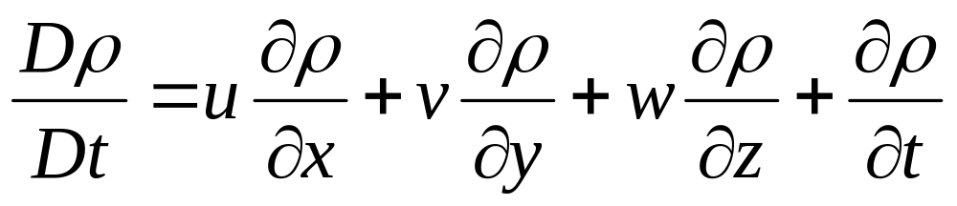
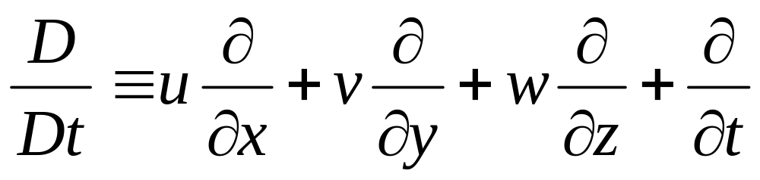
上式右端表示一个运动的流体微元通过点1时，它的密度的瞬时时间变化率，定义为实质导数。

Slide 5
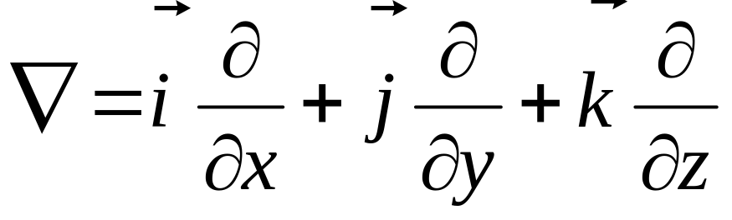
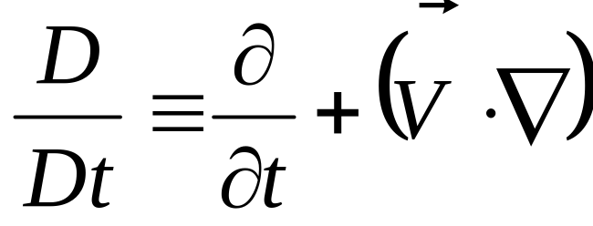
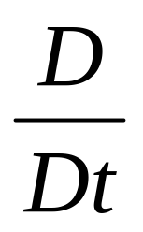
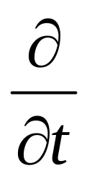
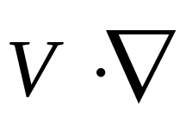
在笛卡尔坐标系下, 哈密顿算子
那么
Substantial derivative，实质导数
Local derivative，当地导数
convective derivative ，迁移导数

Slide 6
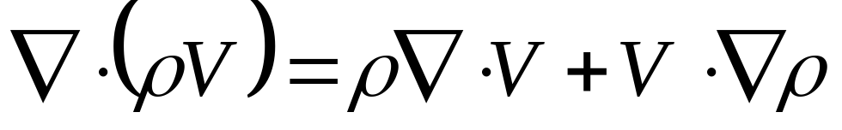
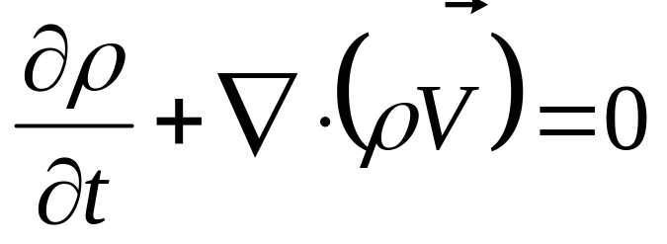
2.10 用实质导数表示的基本方程
本节我们把连续性方程、动量方程、能量方程 表示成实质导数的形式
The continuity equation in differential form is

Slide 7
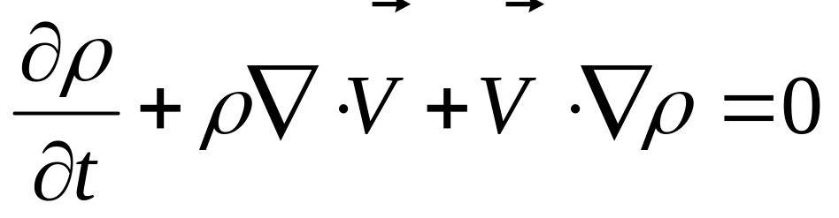
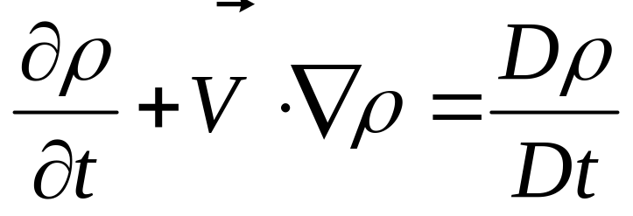
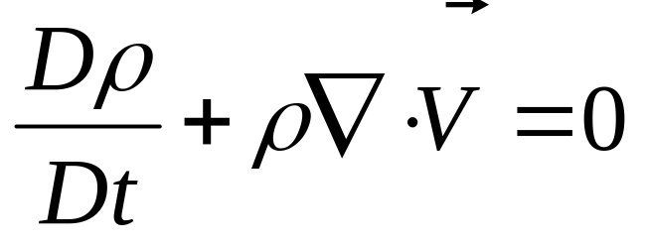
展开之后：
由于
那么
This is the continuity equation in terms of substantial derivative

Slide 8
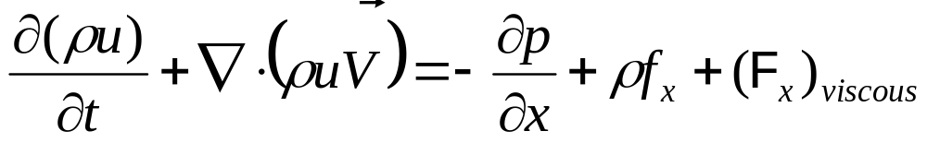
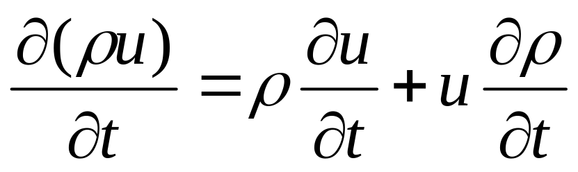
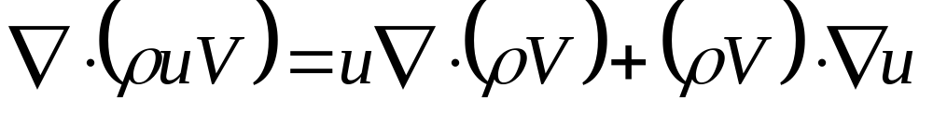
x 方向的动量方程的微分形式

Slide 9
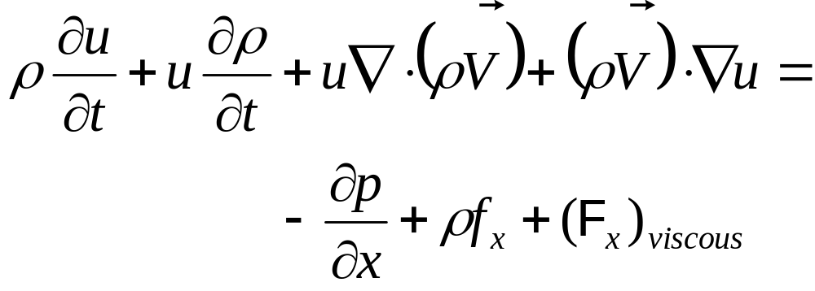
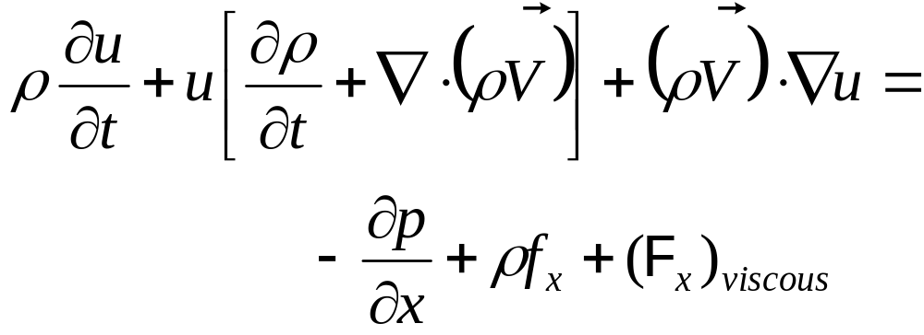
or

Slide 10
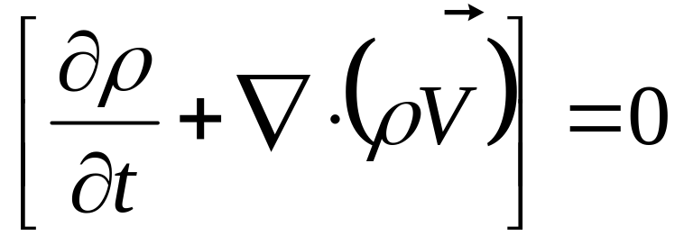
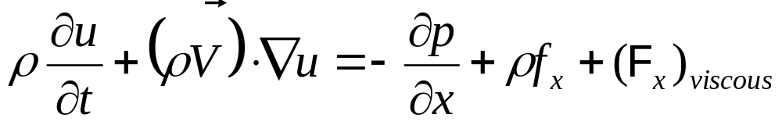

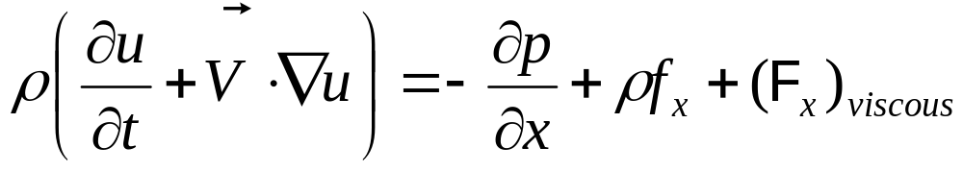
连续性方程
那么

Slide 11
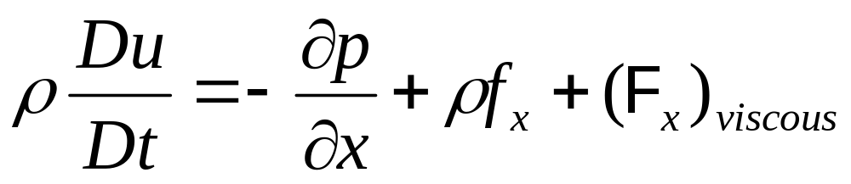
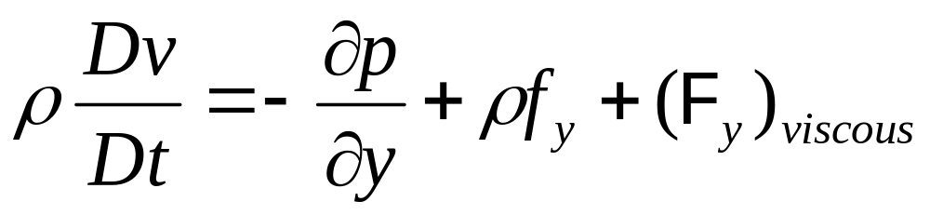

In the same way we can get
these are the momentum equations in terms of substantial derivative in x,y,z directions respectively

Slide 12
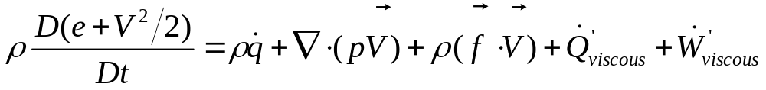
Energy equation in terms of substantial derivative
Detailed descriptions for the comparison between the basic flow equations in different forms, refer to the text book

Slide 13
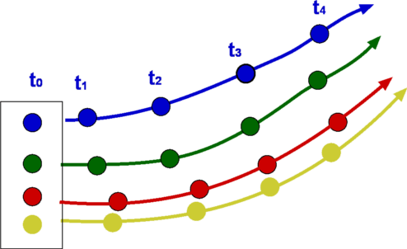
2.11 Pathlines and streamlines of a flow
迹线和流线
迹线：流体微元在一段时间内的运动轨迹，或者说它的运动路径
迹线是经过一段时间，流体微元运动所经过曲线的描述。一般而言，对非定常流动，通过同一空间某点的不同流体微元的迹线是不同的。

Slide 14
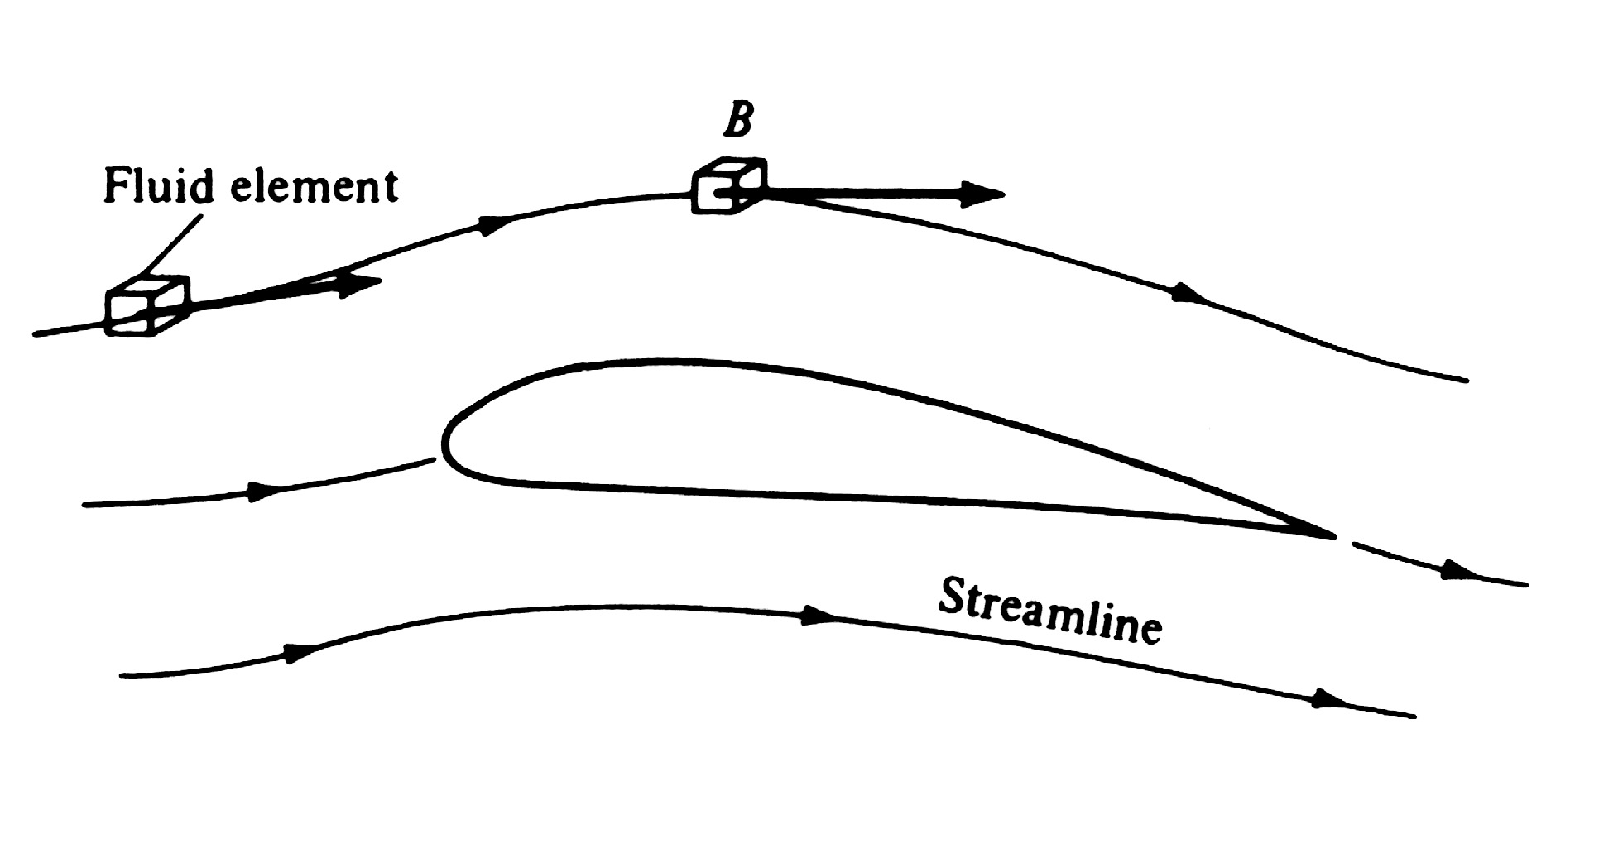
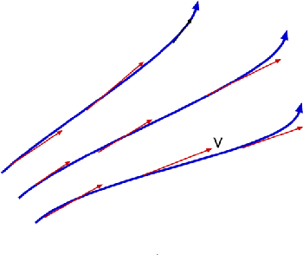
流线
流线是这样一种曲线：其上任意一点的切线方向为这一点的速度方向

Slide 15

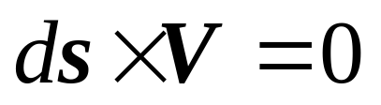
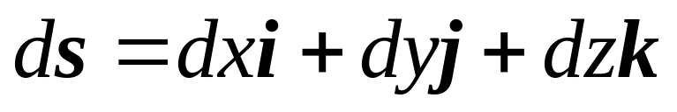
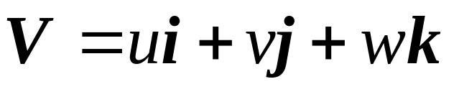
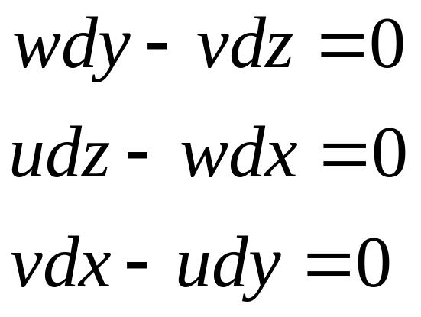
如果速度场已知，如何确定流线的数学方程？(steady)
2.117(a)-(c)

Slide 16
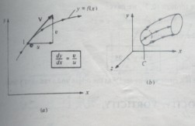
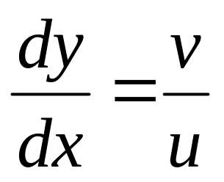

Slide 17
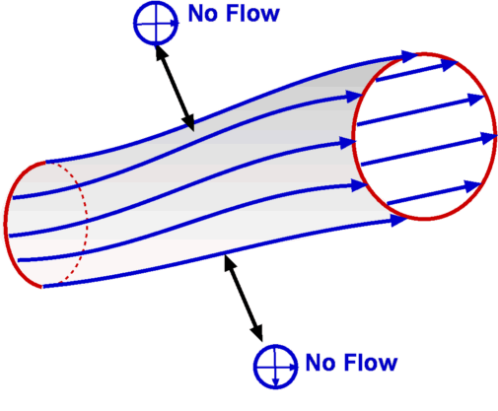
流管

Slide 18
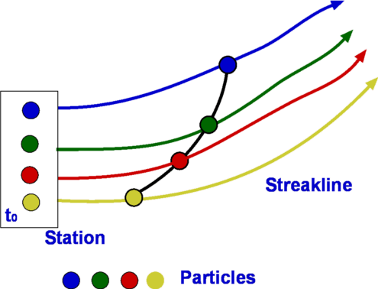
染色线

Slide 19
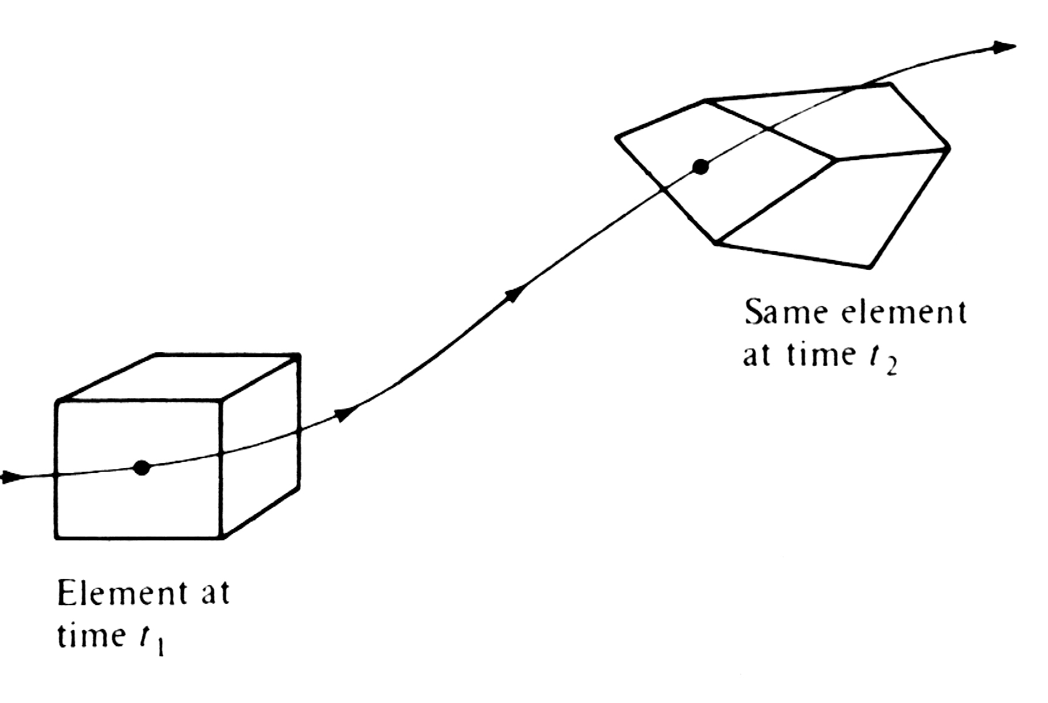
2.12 Angular velocity, vorticity and strain
旋转角速度，涡量及应变
Motion of a fluid element along a streamline

Slide 20
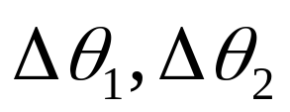
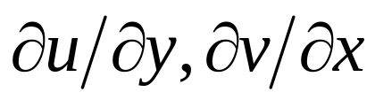

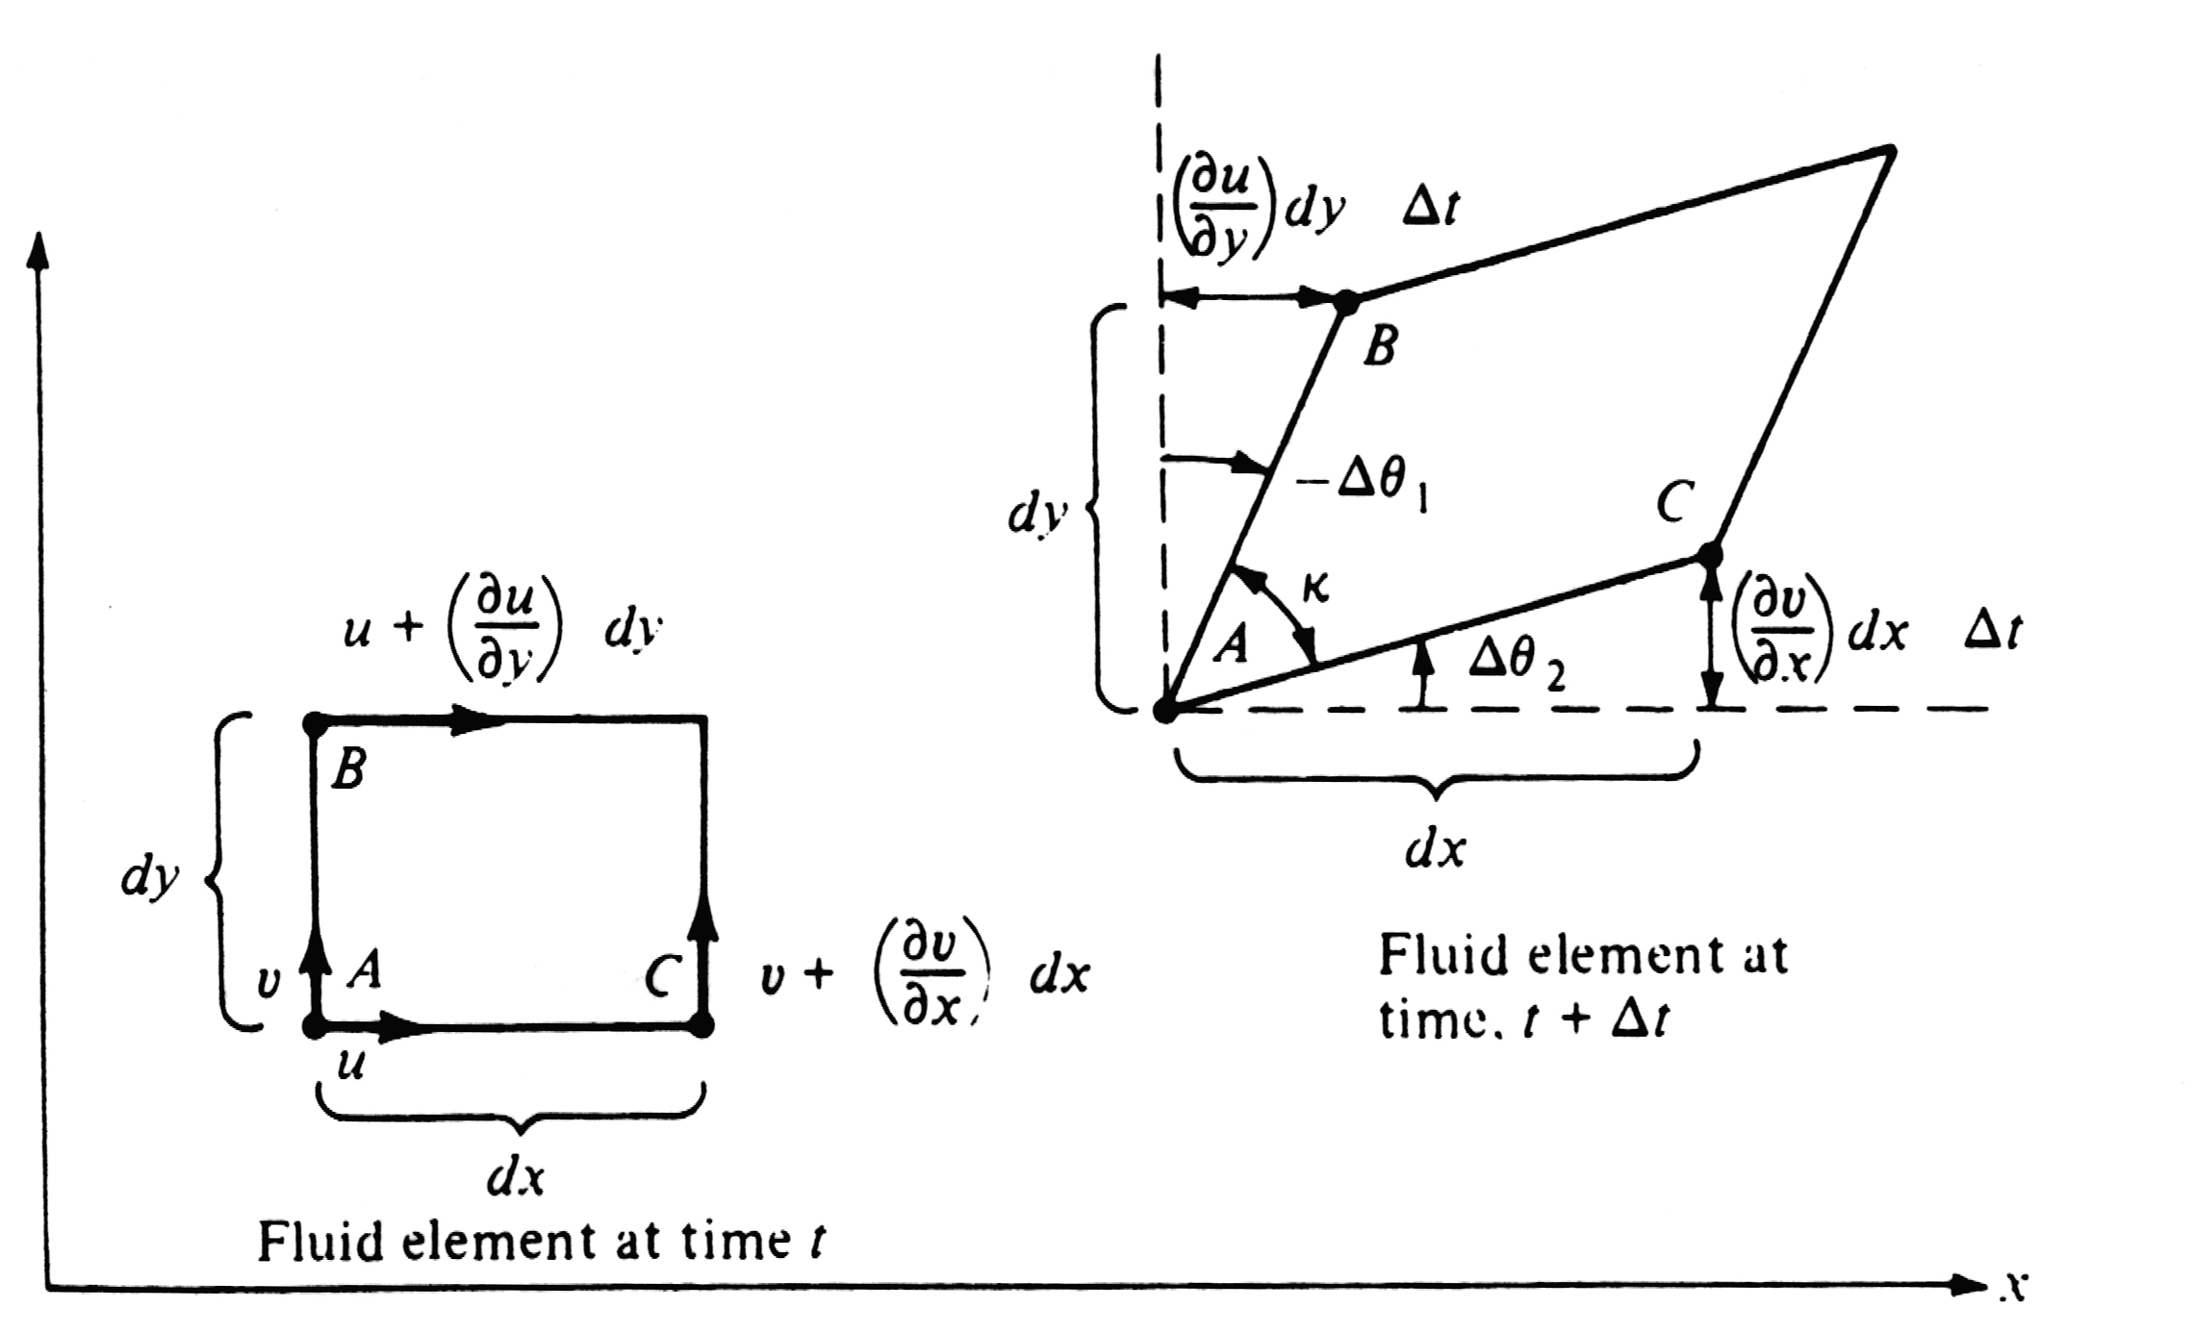
Try to set up the relationships between with and

Slide 21

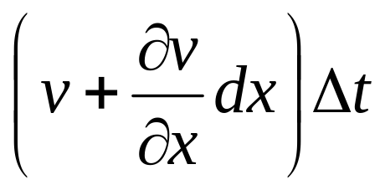

Distance in y direction that A moves during time increment
Distance in y direction that C moves during time increment
Net displacement in y direction of C relative to A

Slide 22





Since is a small angle
Similarly

Slide 23



Definition: angular velocity of the fluid element is the average angular velocity of lines AB and AC, they are perpendicular to each other at the time t

Slide 24


Slide 25



vorticity
In a velocity field, the curl of the velocity is equal to the vorticity

Slide 26


If at every point in a flow field, the flow is called rotational. This implies that the fluid elements have a finite angular velocity
If at every point in a flow, the flow is called irrotational. This implies that the fluid element have no angular velocity; their motion through space is a pure translation

Slide 27


Slide 28


Slide 29


应变的定义: the strain of the fluid element in xy plane is the change of in k , where the positive strain corresponds to a decreasing k. and k is the angle between sides AB and AC, they are perpendicular to each other at the time t
Strain =
The time rate of strain in xy plane is

Slide 30

In the matrix above which is composed of velocity derivatives, the diagonal terms represent the dilatation(膨胀) of a fluid element. The off diagonal terms are associated with rotation and strain rate of fluid element.

Slide 31

Relations between viscous effect and rotation of a fluid element.
Irrotational and rotational flows in practical aerodynamic problems

Slide 32


2.13 Circulation
Important tool for we to obtain solutions for some very practical and exciting aerodynamic problems.
Circulation can be used to calculate lift exerted on an airfoil with unit span.
Definition of circulation

Slide 33


Note:the negative sign in front of the line integral
Stokes’ theorem
Referring to the vector analysis, what is the physical meaning that the equation bellow speak?

Slide 34


Slide 35



2.14 Stream function，流函数
In a steady 2D flow, the differential form of streamlines can be expressed as
If are known functions of , then, after the equation above being integrated, we can get the algebraic equation of the streamline

Slide 36






For each streamline, is a constant. Its value varies with different streamlines. Replacing the symbol with , then we have
The function is called stream function. Different value of the , i.e, , represents different streamlines in the flow field.

Slide 37

Two streamlines respecting with different values of

Slide 38

Physical meaning of the stream function
Arbitrariness of the integrand constant
Difference in stream function between two individual streamlines
Mass flow between the two streamlines ab and cd.
(per unit depth perpendicular to the page)
How to remove the arbitrariness of the constant of integration?

Slide 39

What will be the mass flow through an arbitrary curve connecting two points on a streamline?

Slide 40
For a steady flow, the mass flow inside a given streamtube is constant.

Slide 41






Important properties of the stream function
If is small, is a constant value across
or
as

Slide 42



The equation above states that, if we know the distribution of , then we can obtain the product by differentiating in the direction normal to
Note: is a scalar variable, its direction is defined by the streamlines.
Relationship between and differential of

Slide 43


Slide 44









As , then the chain rule of calculus states
Comparing the two equations above, we have
If is known for a given flow field, then at any point in the flow the products and can be obtained by differentiating in the directions normal to and , respectively.

Slide 45





In polar coordinates
is equal to mass flow, for incompressible flow, that is . Then, the velocity along a streamline can be written as
if we define , then

Slide 46




The features for the function of . For incompressible flow, is constant along a streamline. Represents the equation of a streamline.
Mass flow between two streamlines
Volume flow between two streamlines

Slide 47


Two primary reasons for the concept of the stream function to be a powerful tool in aerodynamics .
1. (or ) gives the equation of a srteamline.
2. The flow velocity can be obtained by differentiating
How to give the determination of the stream function?

Slide 48



2.15 Velocity potential
For an irrotational flow (no matter it is compressible or incompressible)
Then, there must exists a scalar function , for which
where, is called velocity potential
another explanation for the existence of the vlocity potential for a irrotational flow

Slide 49





Slide 50


The equation above shows that the line integral of the velocity is independent with the path of the integration. Or to say, the result of the integral is a function of the start and end positions only. If the start point(A) is fixed somewhere in the space, we have

Slide 51




Slide 52
The features for the velocity potential analogous to the stream function ----- derivatives of yield the flow-velocities.
Distinction between and
1. The flow-field velocity are obtained by differentiating in the same direction as the velocities, whereas is differentiated normal to the velocity direction
2. The velocity potential is defined for irrotational flow only. In contrast, the stream function can be used in either rotational or irrotational.
3. The velocity potential applies to three dimensional flows, whereas the stream function for 2D only.

Slide 53
Why the analysis of irrotational flow is simpler than that of rotational flows?
Irrotational flows is usually called potential flows
How to give the determination of the velocity potential?

