Slide 1
Chapter 5
Incompressible Flow Finite Wings

Slide 2
5.1 Introduction
The properties of airfoils are the same as the properties of a wing with infinite span. However, all real airplanes have wings of finite span.
In the present chapter, we will apply our knowledge of airfoil properties to the analysis for finite wings.
As we have mentioned in the previous chapter, the analysis for the aerodynamics of wings is separated in two steps. Now, we are going on the second step in Prandtl’s philosophy of wing theory.

Slide 3
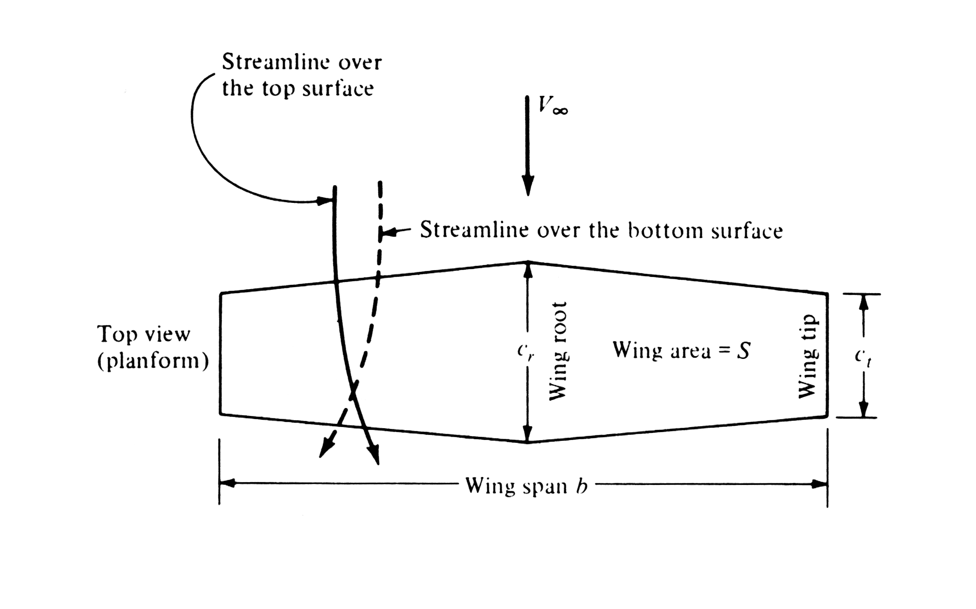

Slide 4
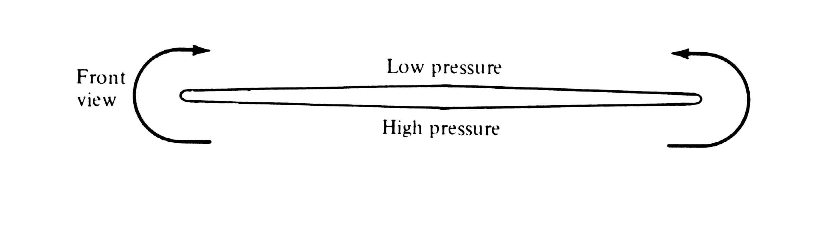

Slide 5
Question : why are the aerodynamic characteristics of a wing any different from the properties of its section? Airfoil can be respected as two-dimensional body, but any finite wing is a three-dimensional body.
※Attention should be paid for the flow pattern near the wing tips. And try to understand the reason for such a flow phenomena.
※ For general cases, there is a spanwise velocity component on both top and bottom surface of the wing, but their direction are different.
※ A trailing vortex is created at each wing tip. These wing-tip vortices downstream of the wing induce a small downward velocity in the neighborhood of the wing itself.

Slide 6
※ The two vortices tend to drag the surrounding air with them, and this secondary movment induces a small component is called downwash(下洗）.
※ The downwash velocity combines with the freestream velocity to produce a local relative wind which is canted downward in the vicinity of each airfoil section of the wing.
※ definition of induced angle of attack

Slide 7
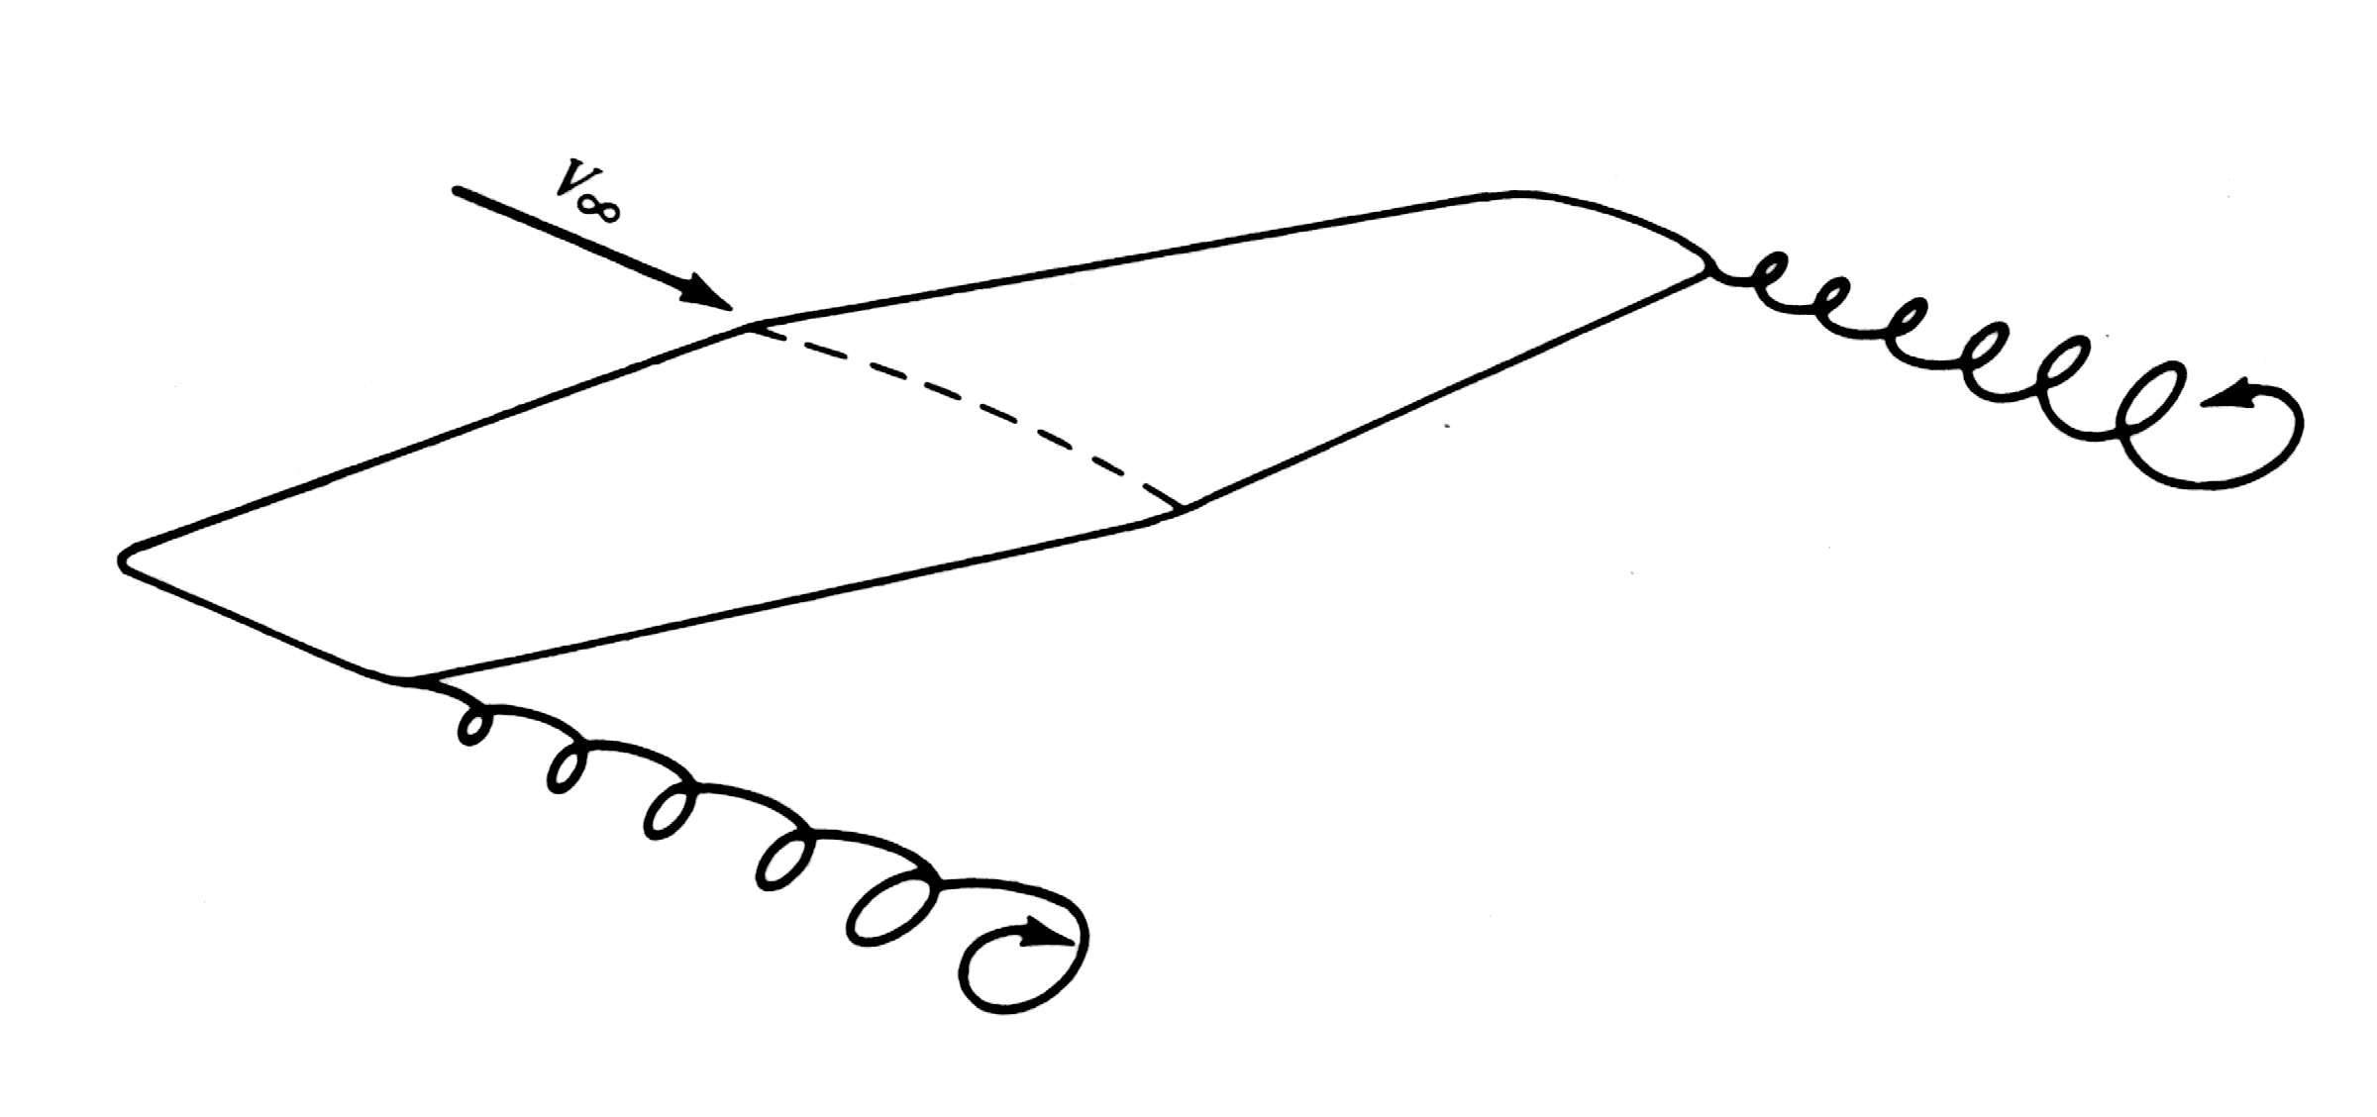

Slide 8
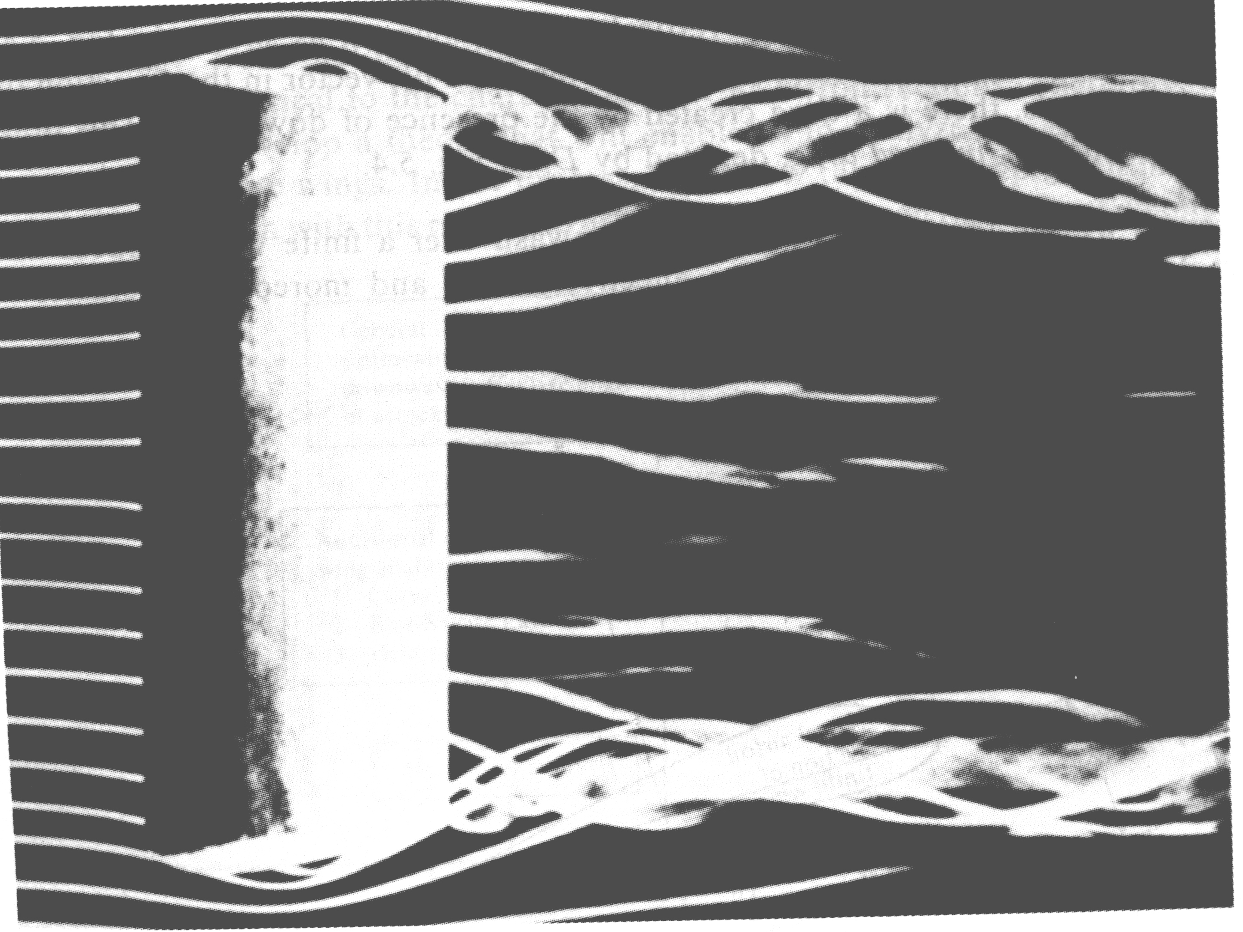

Slide 9
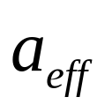
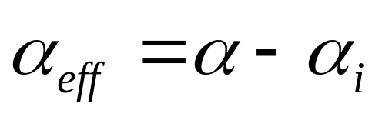
※ Two important effects due to the downwash.
1 the angle of attack actually seen(or feel) by the local section is the angle between the chord line and the local relative wind. This angle is defined by
2 The local lift vector is in the direction perpendicular to the local relative wind. As a subsequence, there is a drag created by the presence of downwash.

Slide 10
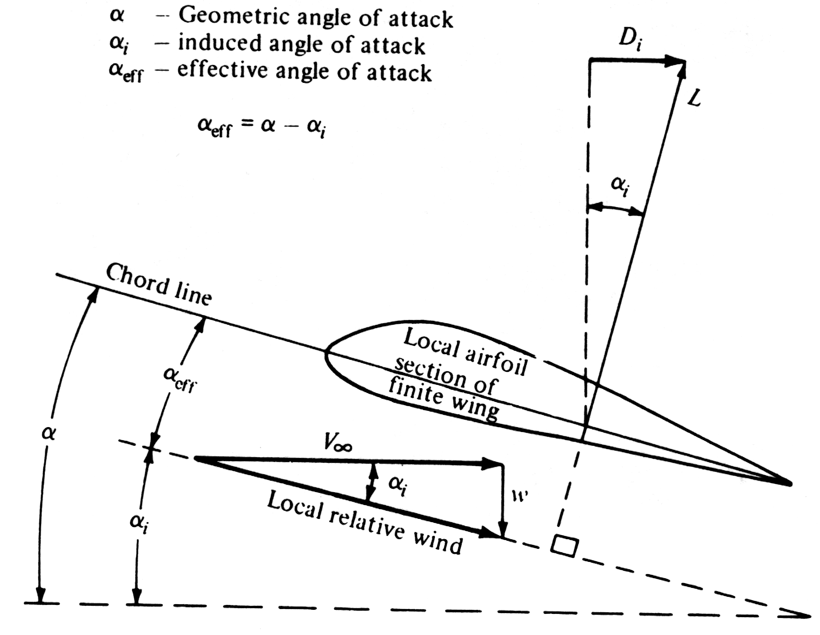

Slide 11
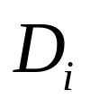
Conclusion: the presence of downwash over a finite wing reduces the angle of attack that each section effectively sees, and moreover, it creates a component of drag ---- the induced drag . And this drag is not produced by viscous friction.
Explanation of induced drag in physical sense
a wing-tip vortices destroy the net pressure balance
b the wing-tip vortices contain large amount of translational and rotational energy, and this energy serves no useful purpose. In effect, the extra power should be provided by the engine to overcome the the induced drag.

Slide 12
※ Road map and purpose of this chapter
※ Support points for our analysis
1. Curved vortex filament
2. Biot-Savart Law
3. Helmholtz’s vortex theorems

Slide 13
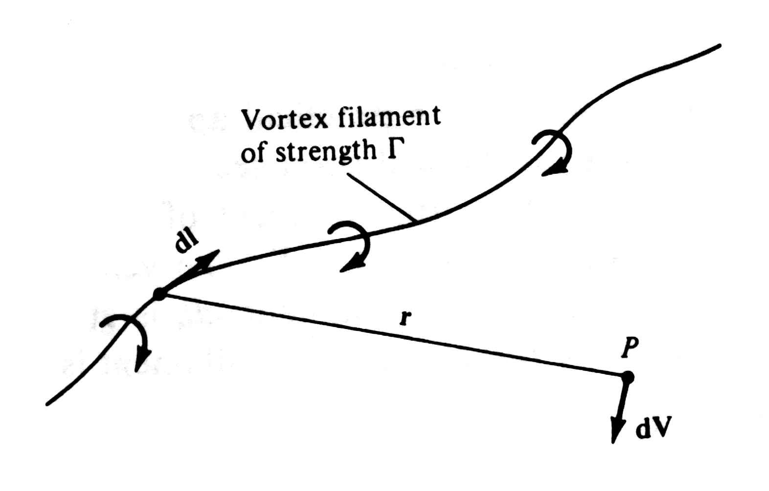
5.2 The Vortex Filament, The Biot-Savart Law, And Helmholtz’s Theorems
The vortex filament

Slide 14
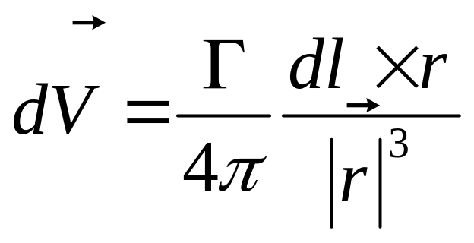
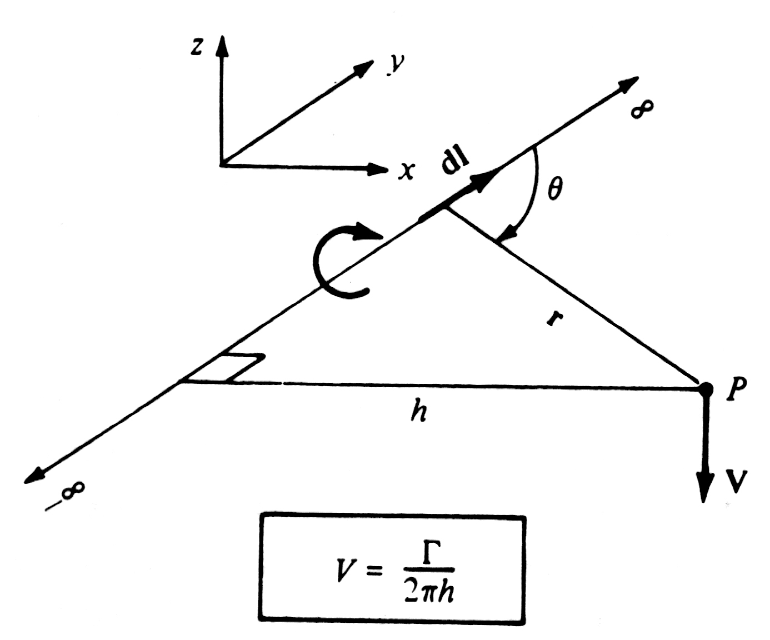
Biot-Savart Law
Application of Biot-Savart Law
1. To a straight vortex filament of infinite length

Slide 15
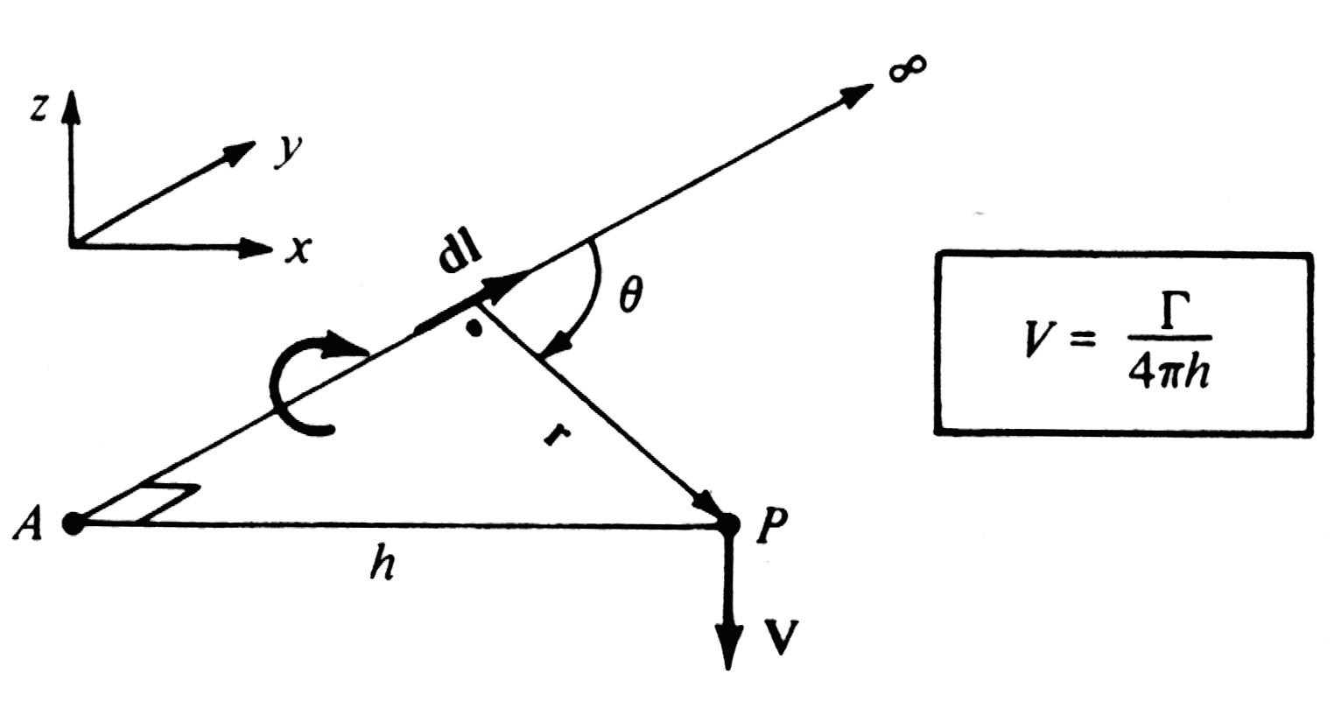
2. To a semi-infinite vortex filament

Slide 16
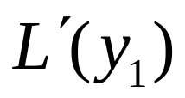

Helmholtz’s Theorems
For inviscid and incompressible flows
1. The strength of a vortex filament is constant along its length.
2. A vortex filament cannot end in a fluid; it must extend to the boundary of the fluid or form a closed path.
Concept of lift distribution along the span of a finite wing
1. : lift per unit span at location

Slide 17
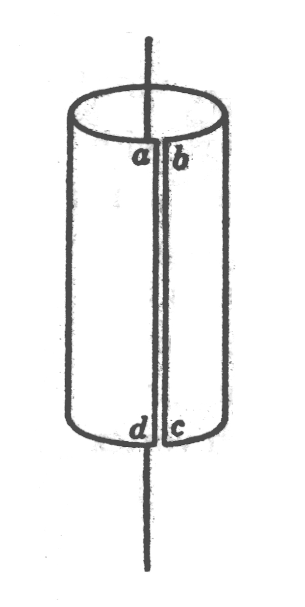

Slide 18


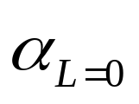

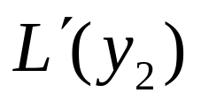
2. With the different location in the span direction, the chord and attack angle may be different, that means
will be different.
3. Concept of geometric twist. washout and washin.
has a distribution along the span direction
4. Concept of aerodynamic twist.
has a distribution along the span direction
5. As there is different distribution of the chord of the airfoil, geometric angle of attack, and zero lift angle of attack, the lift per unit span at location , will be different from

Slide 19
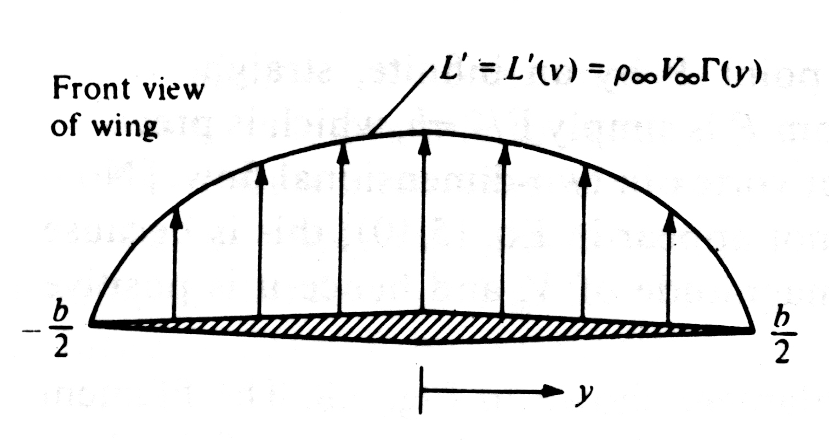
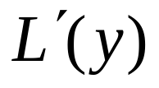
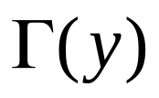
6. As the lift per unit span is proportional to the circulation, so, the circulation is also a function of y
7. The lift distribution goes to zero at the wing tips.
8. The calculation of the lift distribution [or the circulation distribution ] is one of the central problems of the finite-wing theory.

