Slide 1
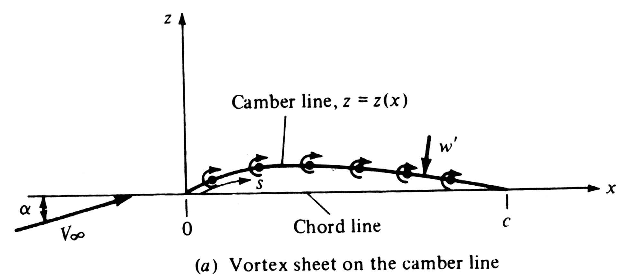
4.7 Classical thin airfoil theory:
the symmetrical airfoil
Where are we in the road map of this chapter?
Under the assumption of thin airfoil, the vortex is distributed along the mean camber line.

Slide 2
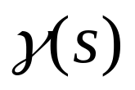
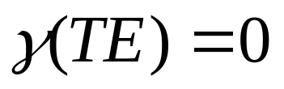
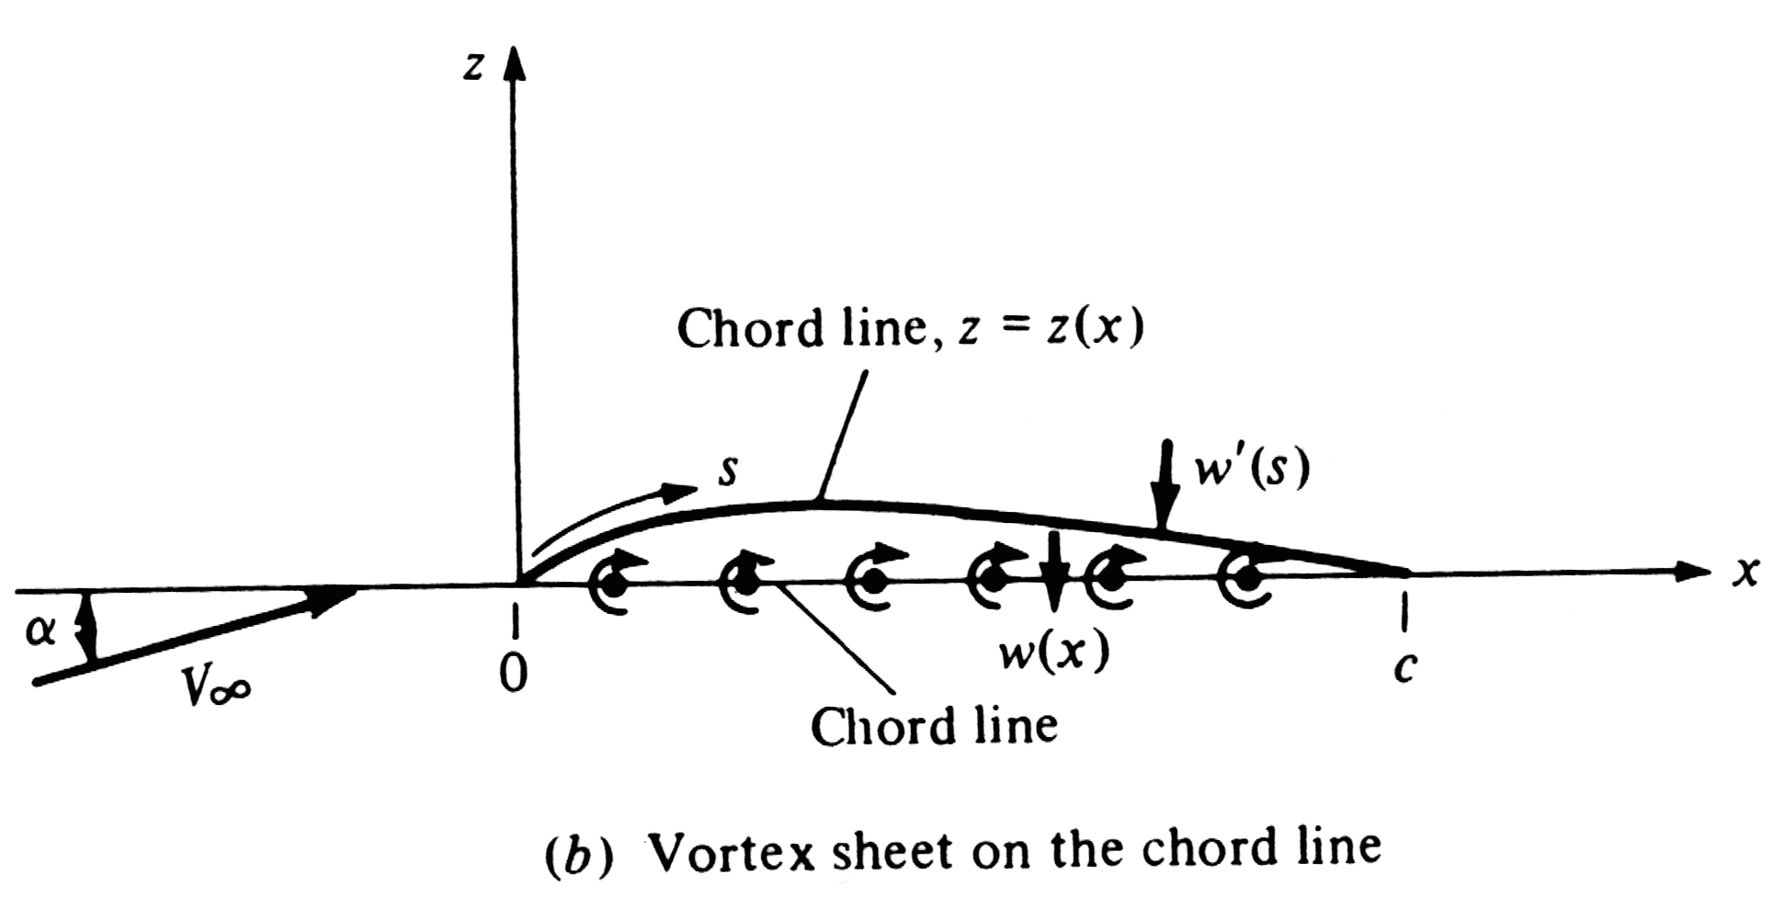
what will be the condition for the variation of ?
The mean camber line should be a streamline of the combined flow and Kutta condition is satisfied at the trailing edge, i.e.,
further approximation of the placement of the vortex sheet

Slide 3
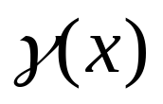
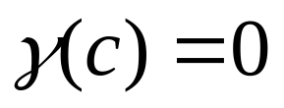
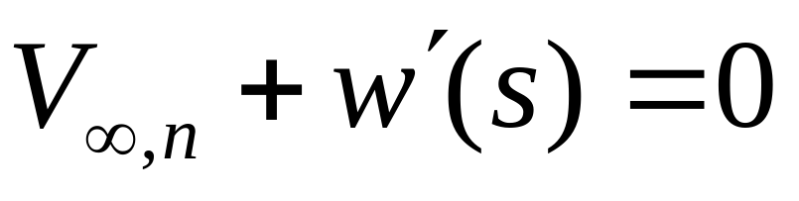
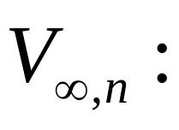
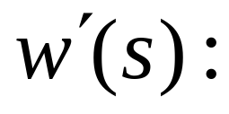
what will be the condition for the variation of ?
The mean camber line should be a streamline of the combined flow and Kutta condition is satisfied at the trailing edge, i.e.,
condition expressed by velocity components
Component of the free stream velocity normal to the camber line.
Component of the velocity induced by vortex sheet normal to the camber line.

Slide 4
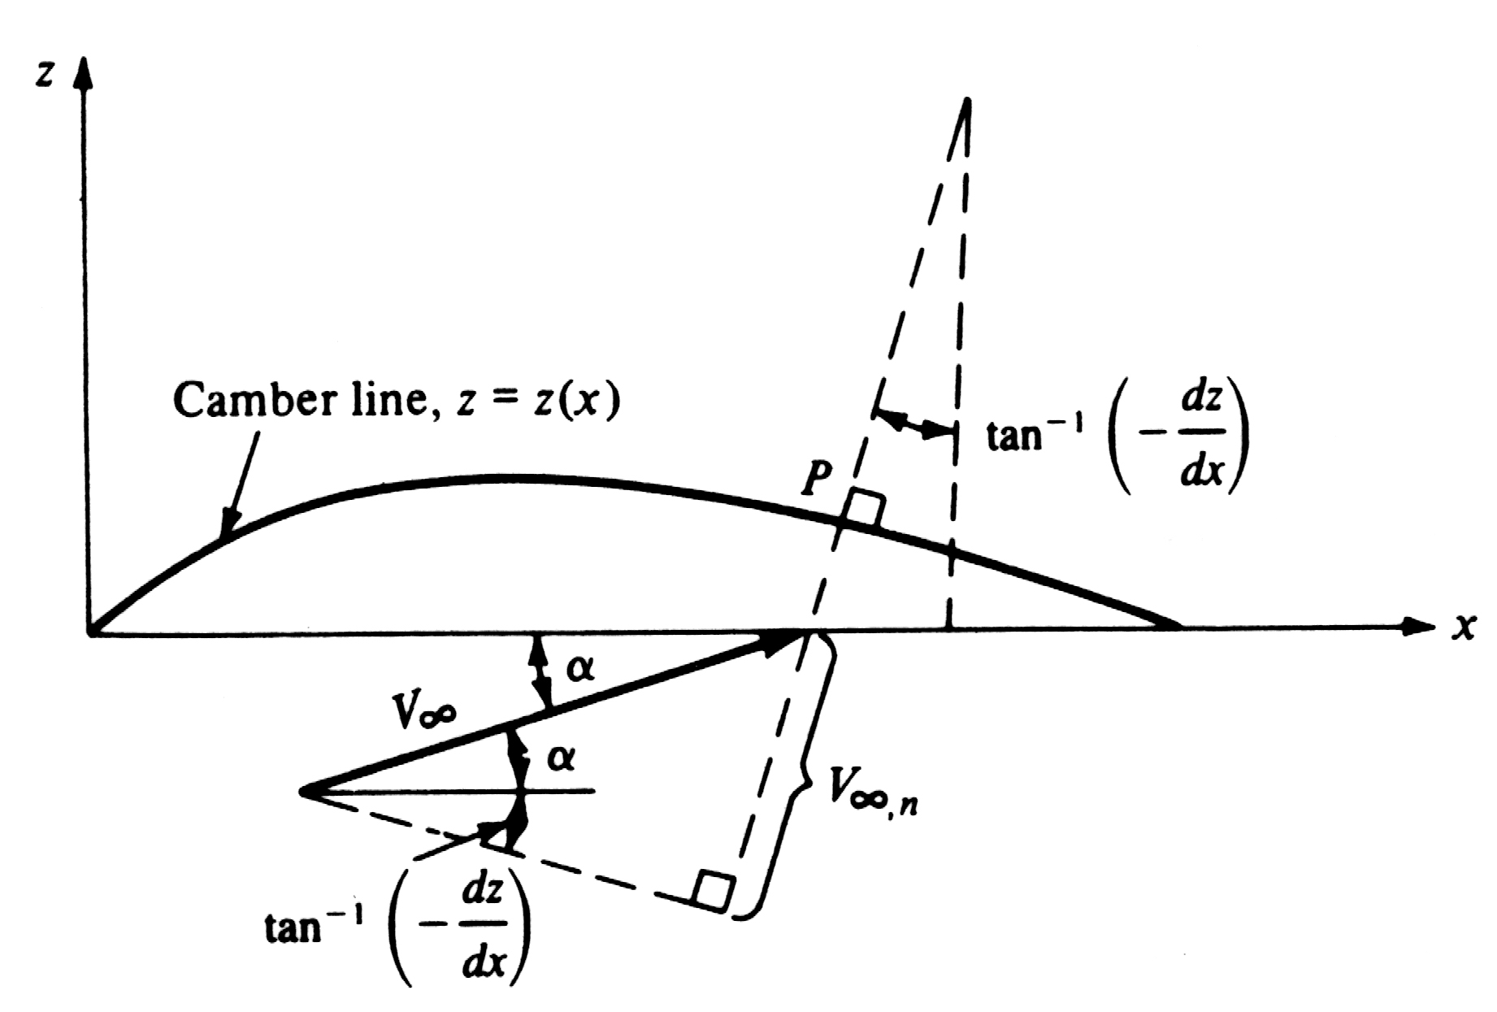
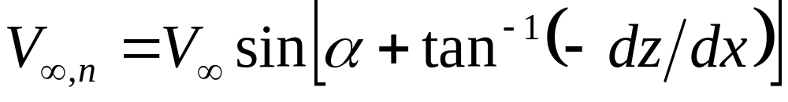

Slide 5
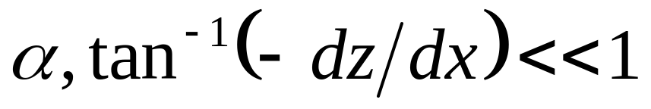
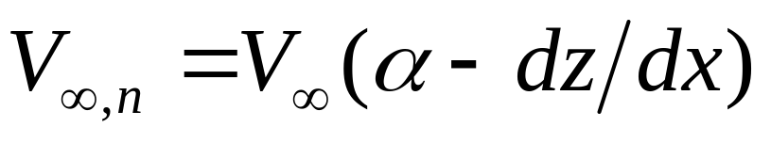
For small angle of attack and small camber.
so that

Slide 6
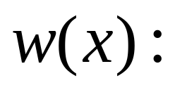
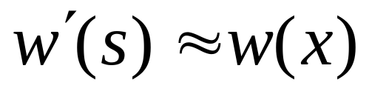
Component of the velocity induced by vortex sheet normal to the camber line.
Component of the velocity induced by vortex sheet normal to the chord line.
For thin airfoil, the approximation bellow is consistent with the thin airfoil theory

Slide 7
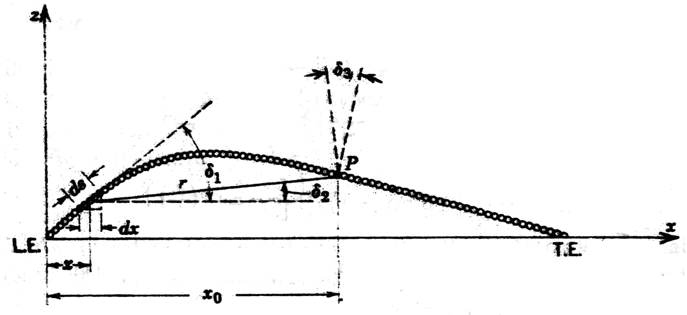
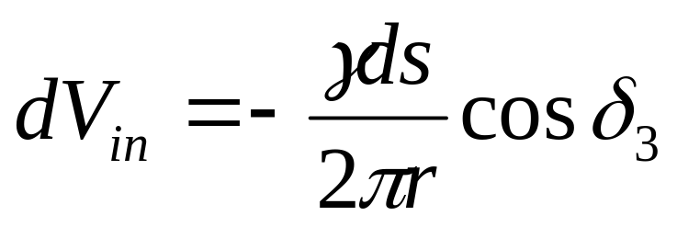
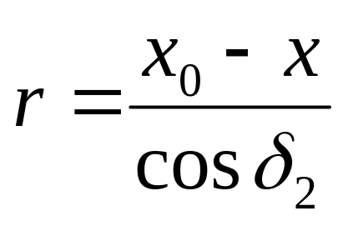
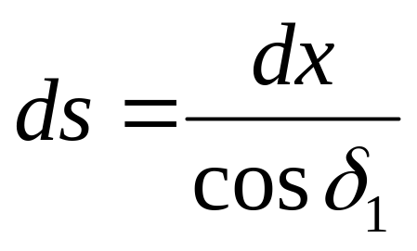
incremental normal velocity induced by the vortex sheet placed on the camber line

Slide 8
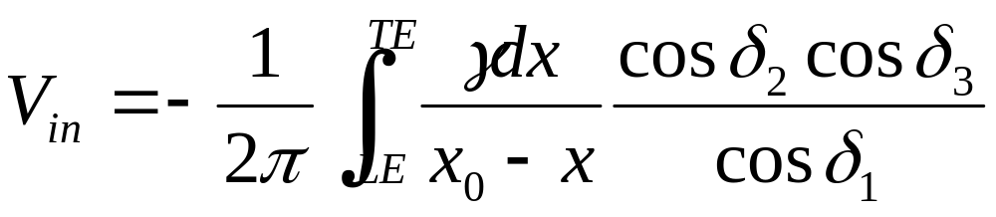
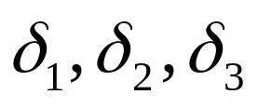
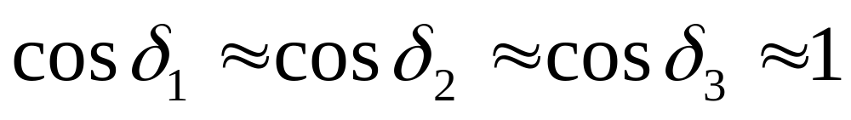
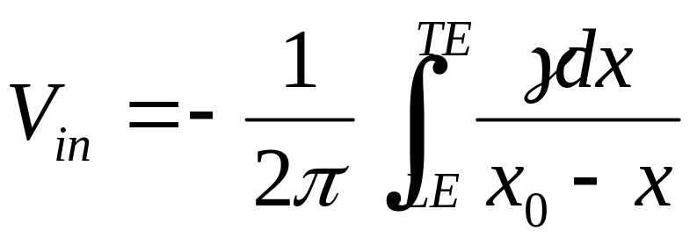
Where, if the shape of the camber line is given, are functions of x .
For small cambered airfoil, are small values, that means

Slide 9
Conclusion:
Simplification introduced above is equivalent to satisfying the boundary conditions on the x axis instead of the mean camber line.

Slide 10
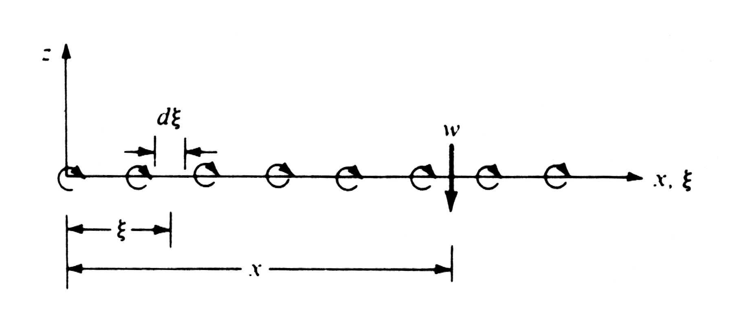
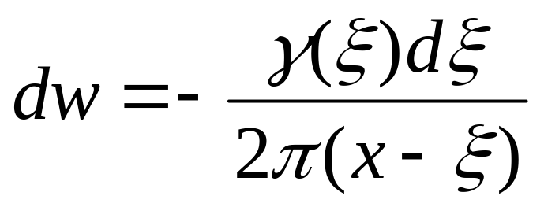
Velocity dw at ponit x induced by the elemental vortex segment at point ξ

Slide 11
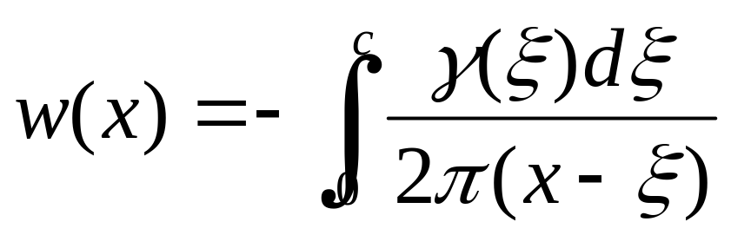
Velocity w at ponit x induced by all elemental vortex segments at along the chord line is obtained by integrating dw from ξ=0 to ξ=c
The mean camber line should be a streamline of the combined flow and Kutta condition is satisfied at the trailing edge, i.e.,

Slide 12
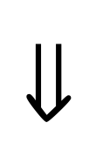
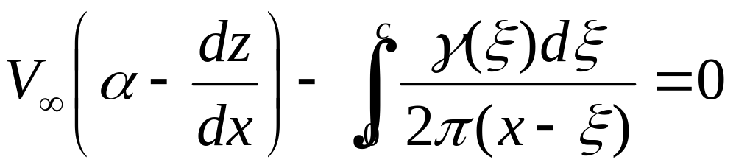
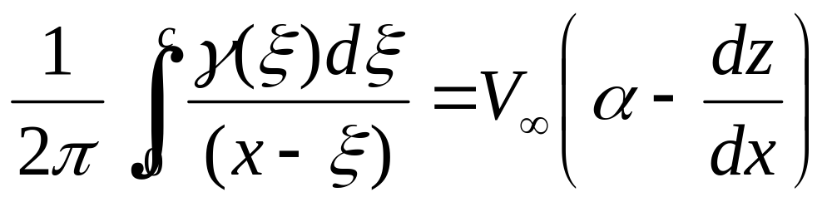

Slide 13
Fundamental equation of thin airfoil theory
It is simply a statement that the camber line is a streamline of the flow.
Note: referring to the textbook(page 270).

Slide 14
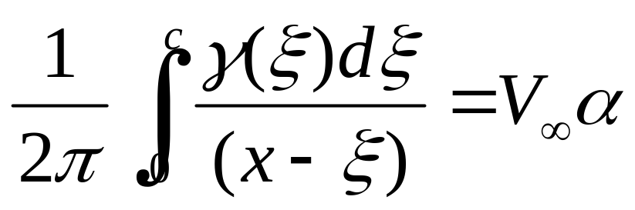
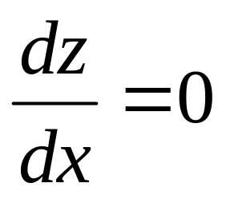

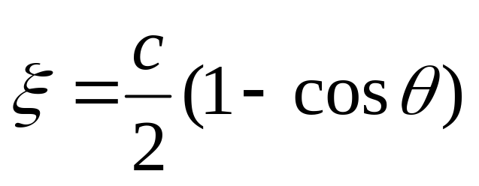
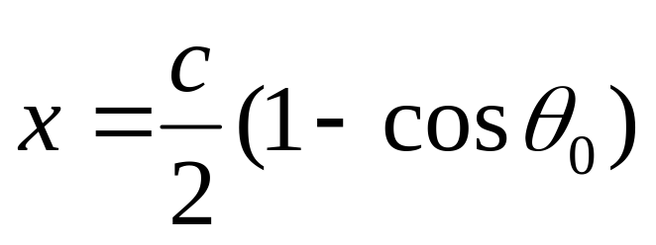
Analysis for a symmetric airfoil
Step 1. Fundamental equation for a symmetric airfoil
Step 2. Transform ξ into θ
Note: ξ is a dummy variable, x is a fixed point

Slide 15
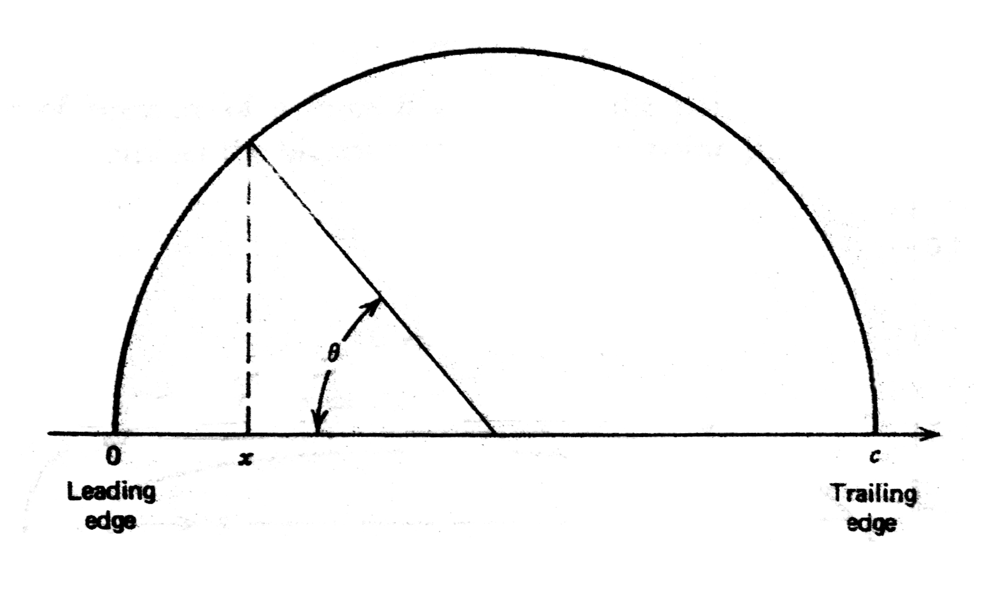

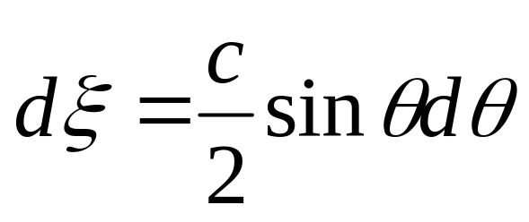


Slide 16
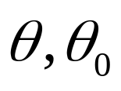

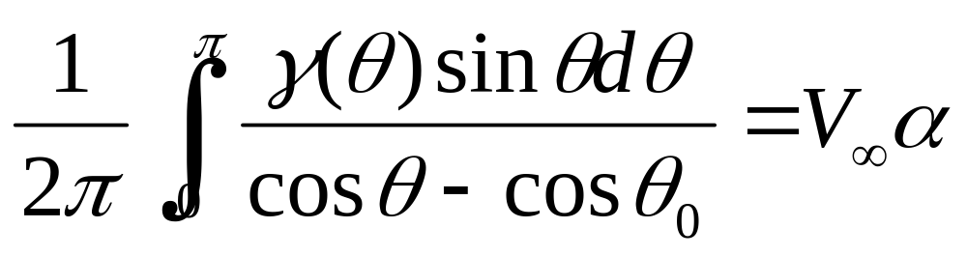
Step 3. Rewritten the fundamental equation of thin airfoil theory in the arguments of
Note: pay attention to the limits of integral

Slide 17
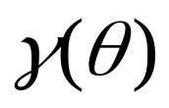
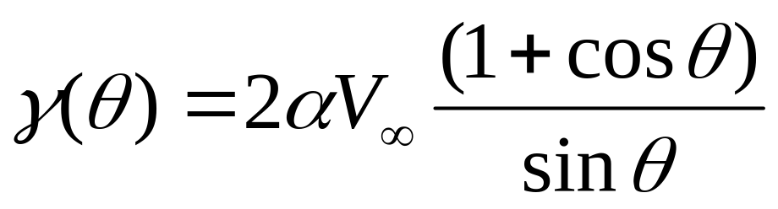
Step 4. An rigorous solution of the equation above for can be obtained from complex variable analysis, but it is beyond the scope of this textbook.
The solution is:
After the solution been given, what should we do now? Is it a true for our problem? How to prove it? What is the principle to be based to prove?

Slide 18
Step 5. Verification for the solution
There are two conditions which the solution must satisfy, they are wall condition and Kutta condition.
Wall condition………
Substituting the solution into the wall condition given above

Slide 19
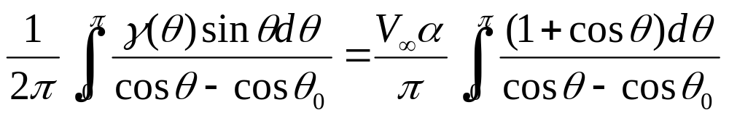
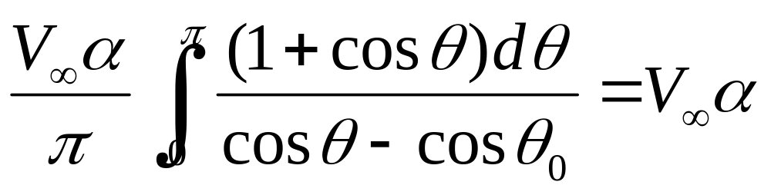
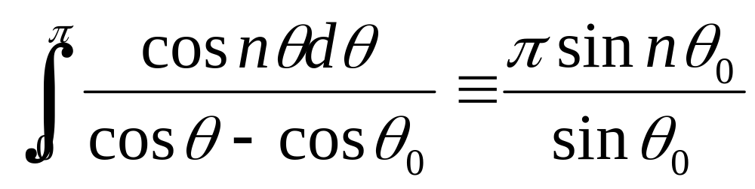
Now we have to prove that
Fortunately, there is a standard integral given as

Slide 20
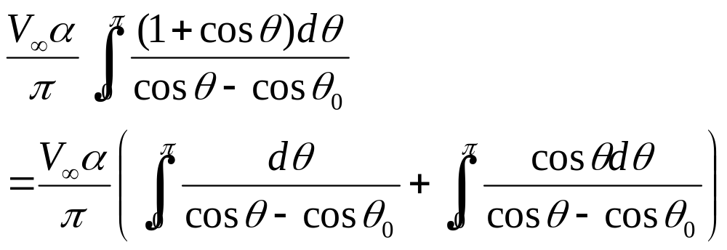
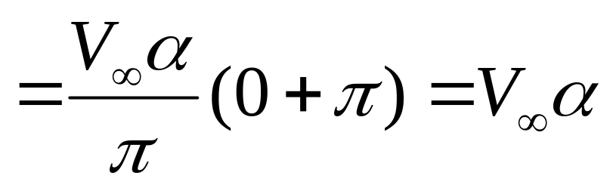
So, the solution satisfies the fundamental equation of thin airfoil theory

Slide 21
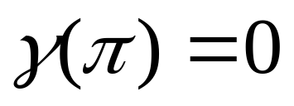
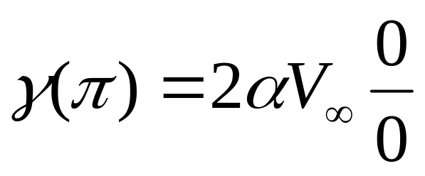
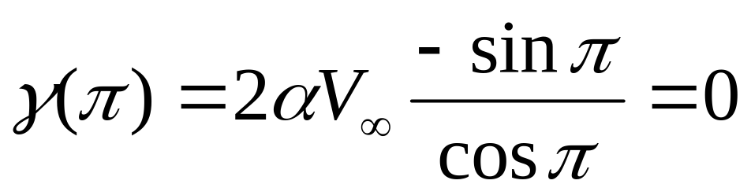
Kutta condition… … …
the value is undetermined
With L’Hospital’s rule(罗毕塔法则）
So, the solution satisfies Kutta condition

Slide 22
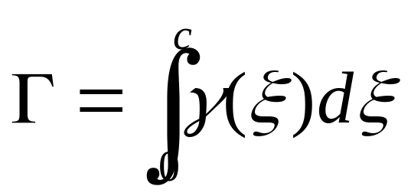
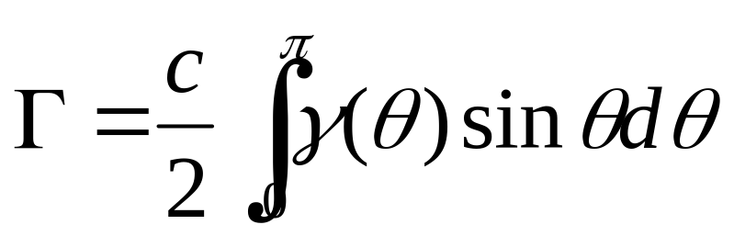
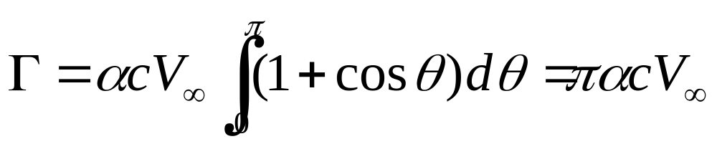
Step 6. Calculation of the characteristics for thin airfoils

Slide 23





Lift per unit span, (Kutta-joukovski)
The lift coefficient
Lift slope =

Slide 24


Moment coefficient about the leading edge
Incremental lift contributed by the elemental vortex segment dξ is :

Slide 25



This incremental lift creates a moment about the leading edge
The total moment about the leading edge(per unit span) due to the entire vortex sheet is
(Problem 4.4)

Slide 26



Moment coefficient
as
so

Slide 27



The moment coefficient about the quarter-chord point is
The center of pressure is at the quarter-chord point for a symmetric airfoil

Slide 28
As the moment coefficient about the quarter-chord point of a symmetric airfoil is independent of the attack angle, that is always equal to zero, then, the quarter-chord point of a symmetric airfoil is called as aerodynamic center.
Summary: referring back to the textbook
Experiment results for a symmetric airfoil

Slide 29


Slide 30


Theoretical results for a symmetric airfoil
1.
2. Lift slope
3. The center of pressure and the aerodynamic center are both located at the quarter-chord point.

