Slide 1
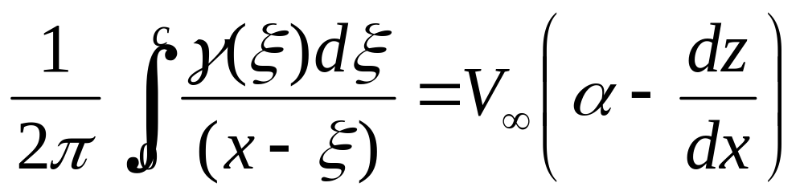
4.8 The cambered airfoil
Thin airfoil theory for a cambered airfoil is a generalization of the method for a symmetric airfoil. That means, the result for a symmetrical airfoil is a special case of the cambered airfoil. To keep the mean camber line of a cambered airfoil be a streamline of the flow, the condition is

Slide 2
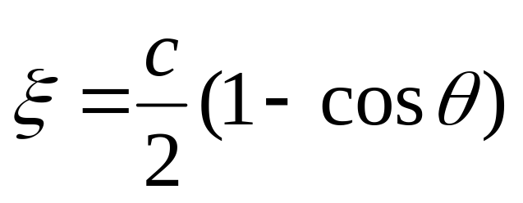
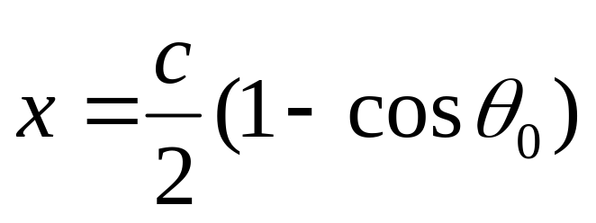
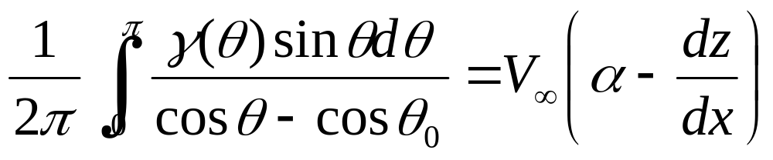
as the value of the camber is not zero, it makes the analysis more difficult than in the case of symmetric airfoil.
After we use the same transform
We obtain

Slide 3
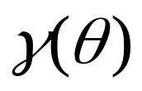
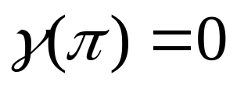
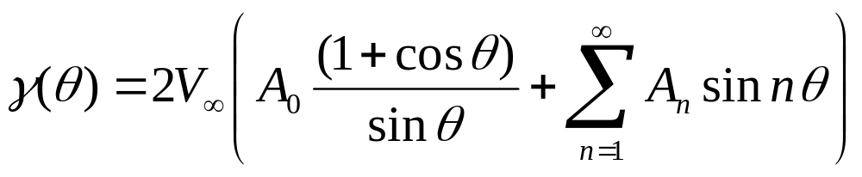
find a solution for from the equation above, at the same time, the solution of must satisfy the Kutta condition
Step 1. Introduction of a rigorous solution
At the very first, let us make a closed comparison between the styles of the solution of symmetric airfoil and the solution of cambered airfoil.

Slide 4
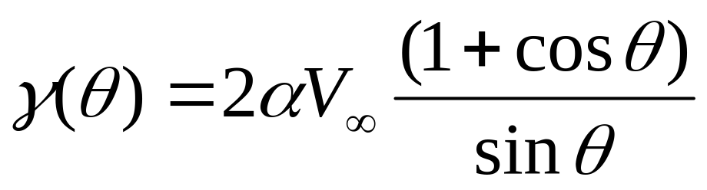
Symmetric airfoil
Cambered airfoil

Slide 5
The form of the first term in the solution of a cambered airfoil is nearly the same to the solution of the symmetric airfoil. This term can be looked as the skeleton for the solutions for both symmetrical or cambered airfoil.
The Fourier sine series can be looked as a fine tuning of the solutions, so that the camber can be taken in to account.

Slide 6


Step 2. To find the solution of is equal to find the specific values of all the coefficients,
Substituting the solution into the fundamental equation.

Slide 7
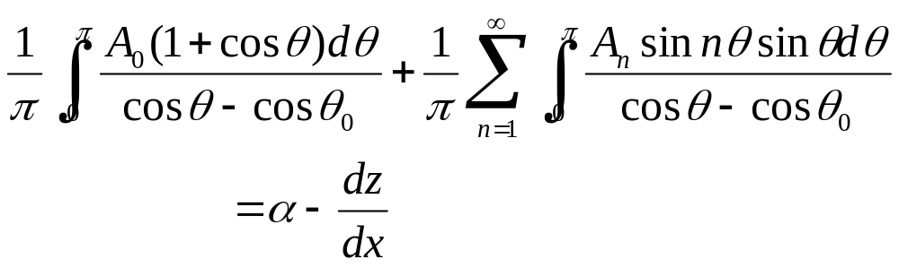
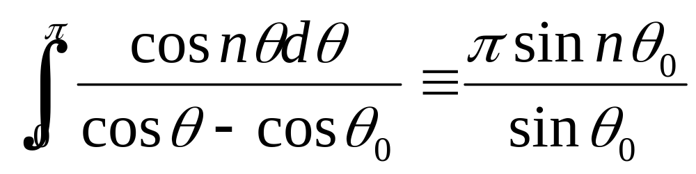
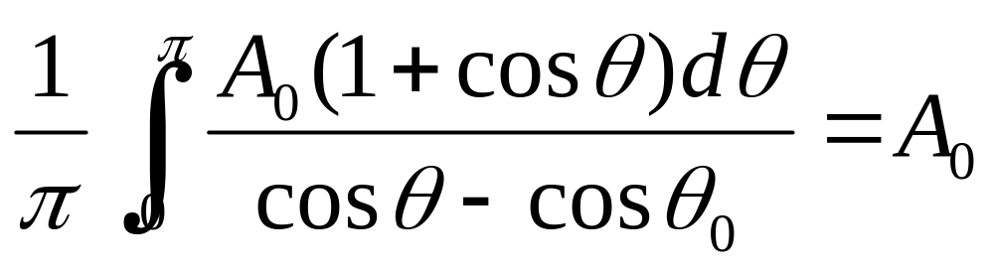
from
We can have

Slide 8
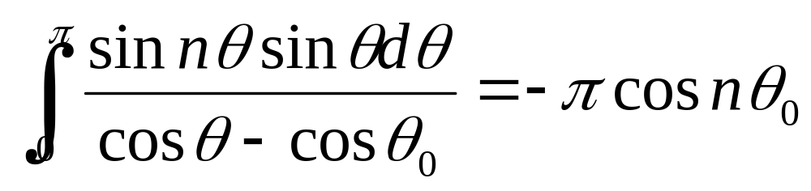
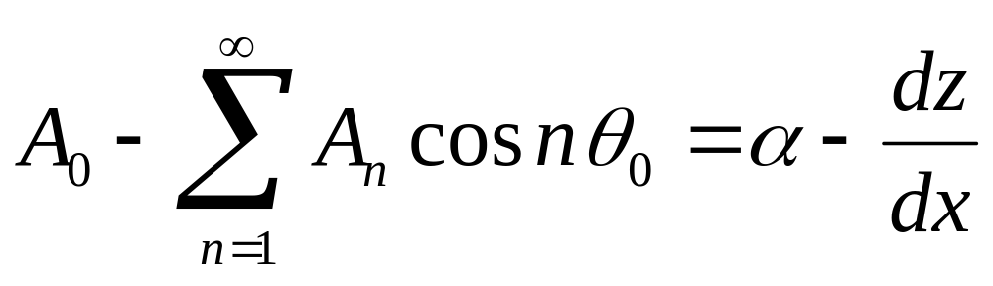
and as
then
Reduced to

Slide 9
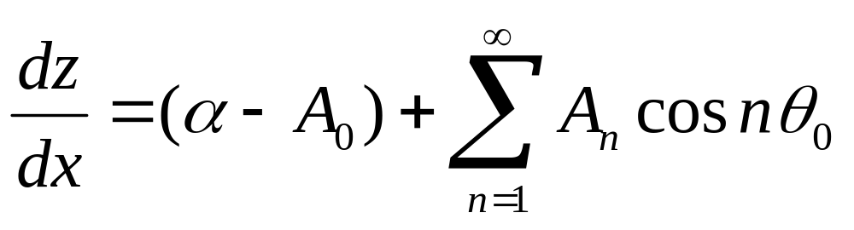
or
It is the transformed version of the fundamental equation of thin airfoil theory
Note: the equation
is evaluated at a given point x along the chord

Slide 10
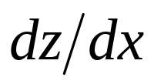

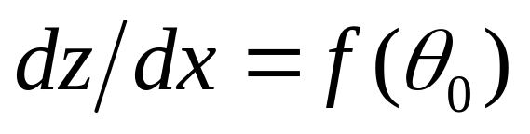
hence the equation
is also evaluated at a given point x along the chord, here, and correspond to the same point x along the chord.
is a function of . And

Slide 11
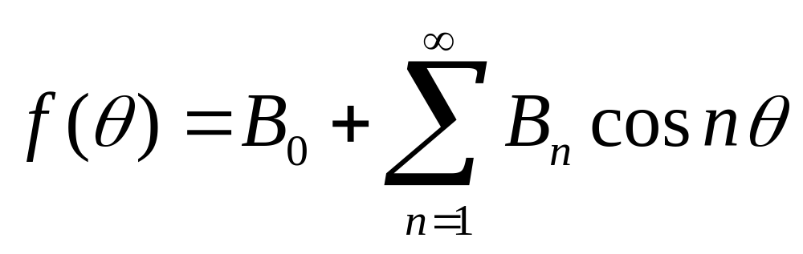
Step 3. Investigation of Fourier cosine series expansion
The general form of the Fourier cosine series expansion representing a function of f(θ) over an interval 0≤ θ ≤π is given by
If an integration is taken on the both side over the interval 0≤ θ ≤π , then

Slide 12
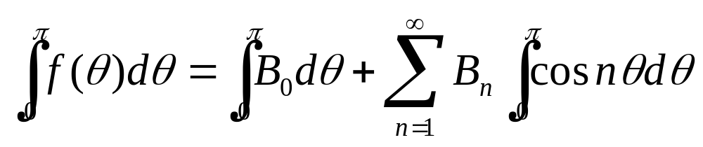

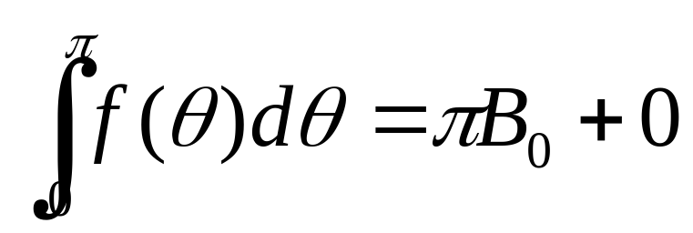
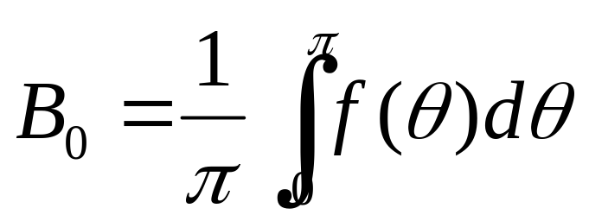

Slide 13
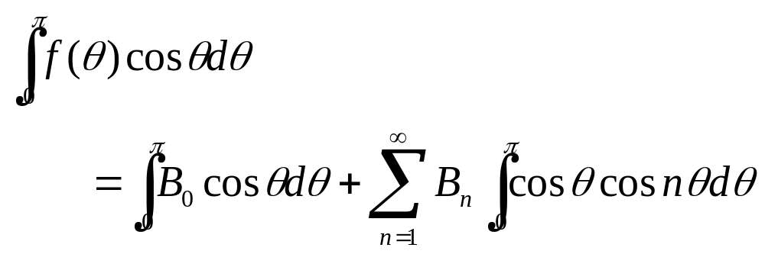
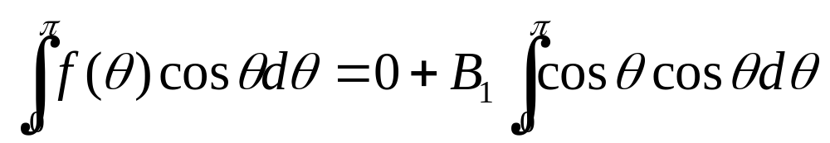
If we multiplies cos(θ) on the both sides, and an integration is taken on the both side over the interval 0≤ θ ≤π , then

Slide 14
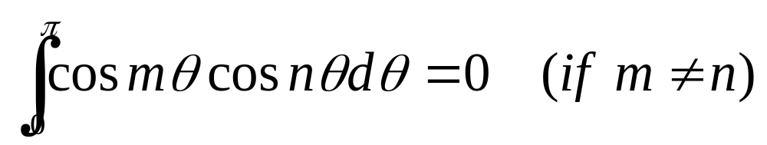
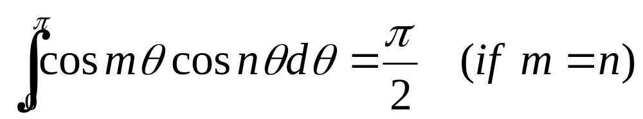
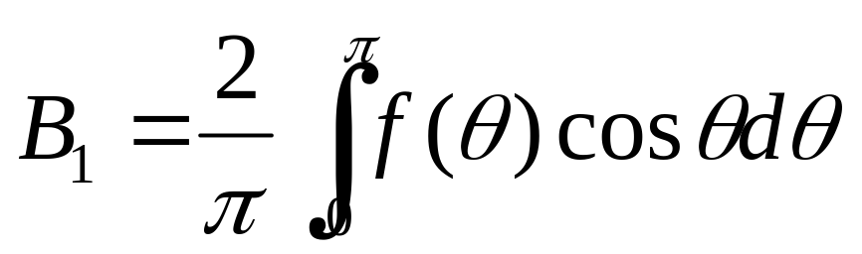

Slide 15
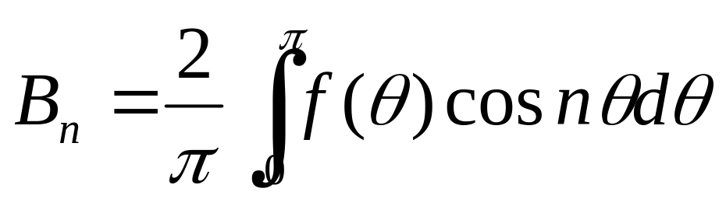


In the same way, we can prove
Conclusion: if a function of f(θ) over an interval 0≤ θ ≤π is given by
The coefficients and should be

Slide 16
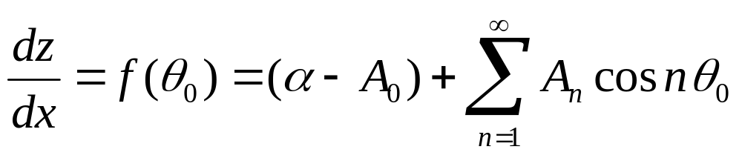
Step 4. Solution of and
as

Slide 17
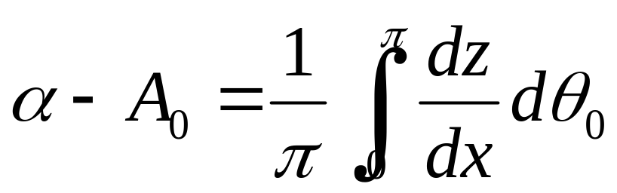
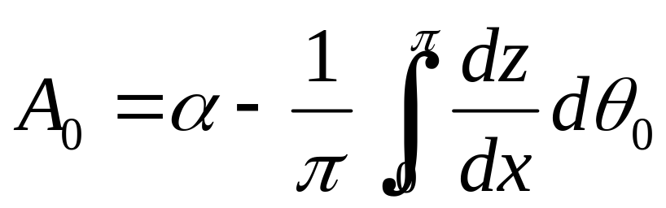
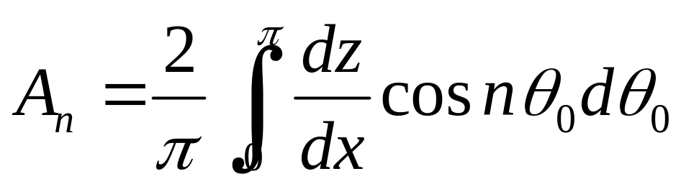
With the use of the results for the investigation of Fourier series expansion, we can get a direct expression of and
or
and

Slide 18
What shall we keep in mind? and what we have to think about at this moment?
Please back to our textbook at page 276.

Slide 19
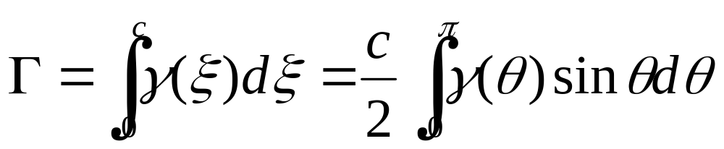

after we get the solution of , then we are ready to obtain expressions for the aerodynamic coefficients for a cambered airfoil
Step 1. Calculation of the total circulation of the vortex sheet

Slide 20
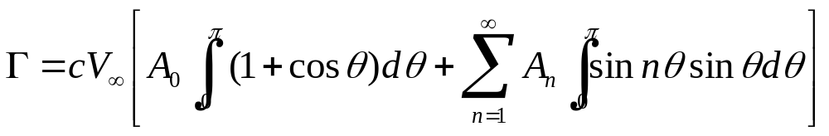
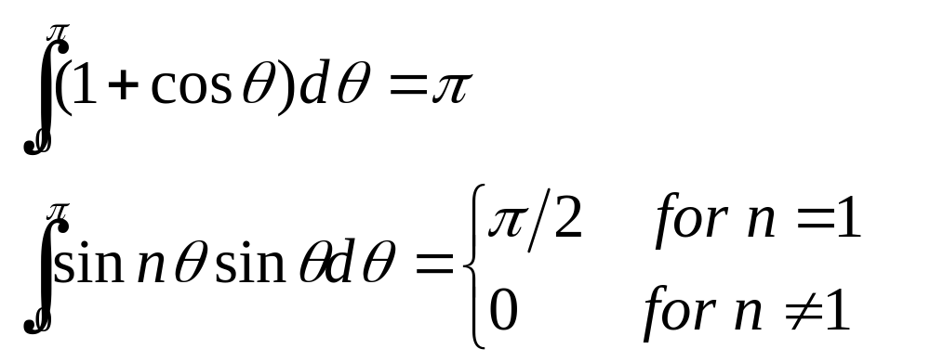
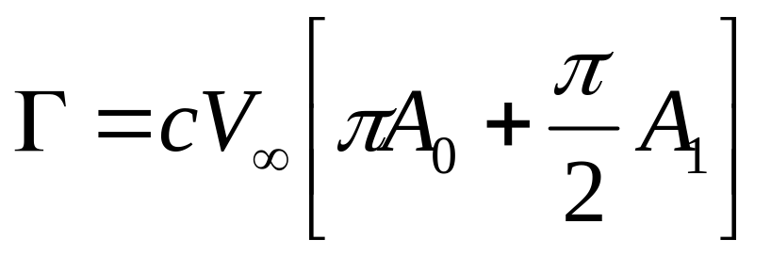

Slide 21
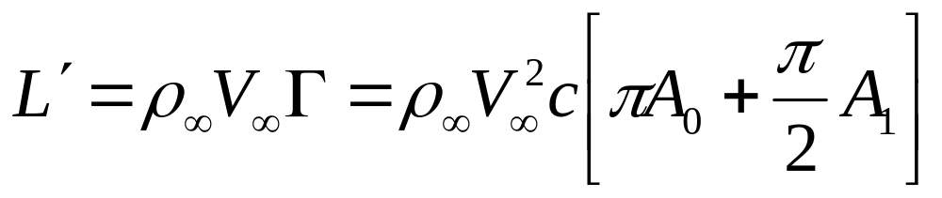
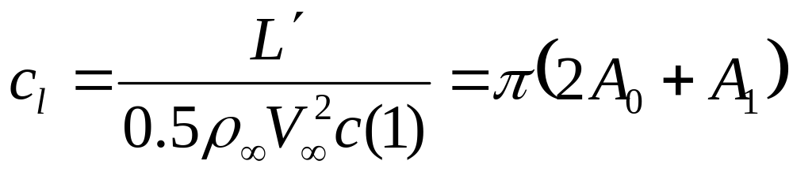
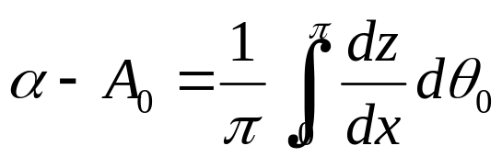
Step 2. After the total circulation being evaluated, the lift per unit span is
Step 3. The lift coefficient is

Slide 22
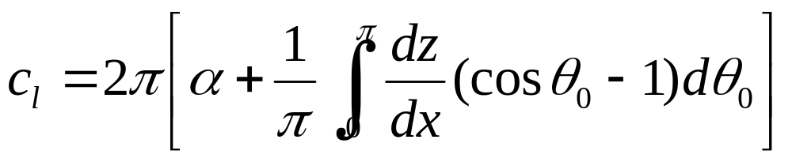
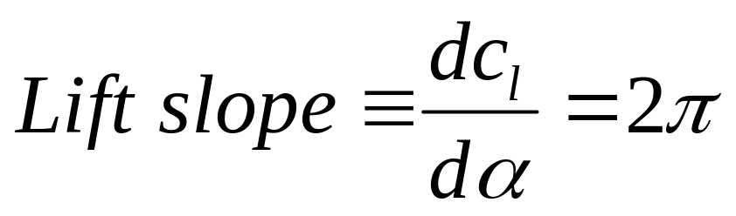
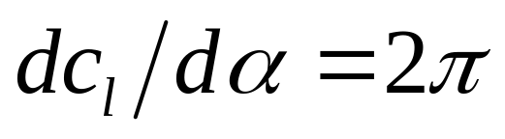
From thin airfoil theory for any shape airfoil

Slide 23
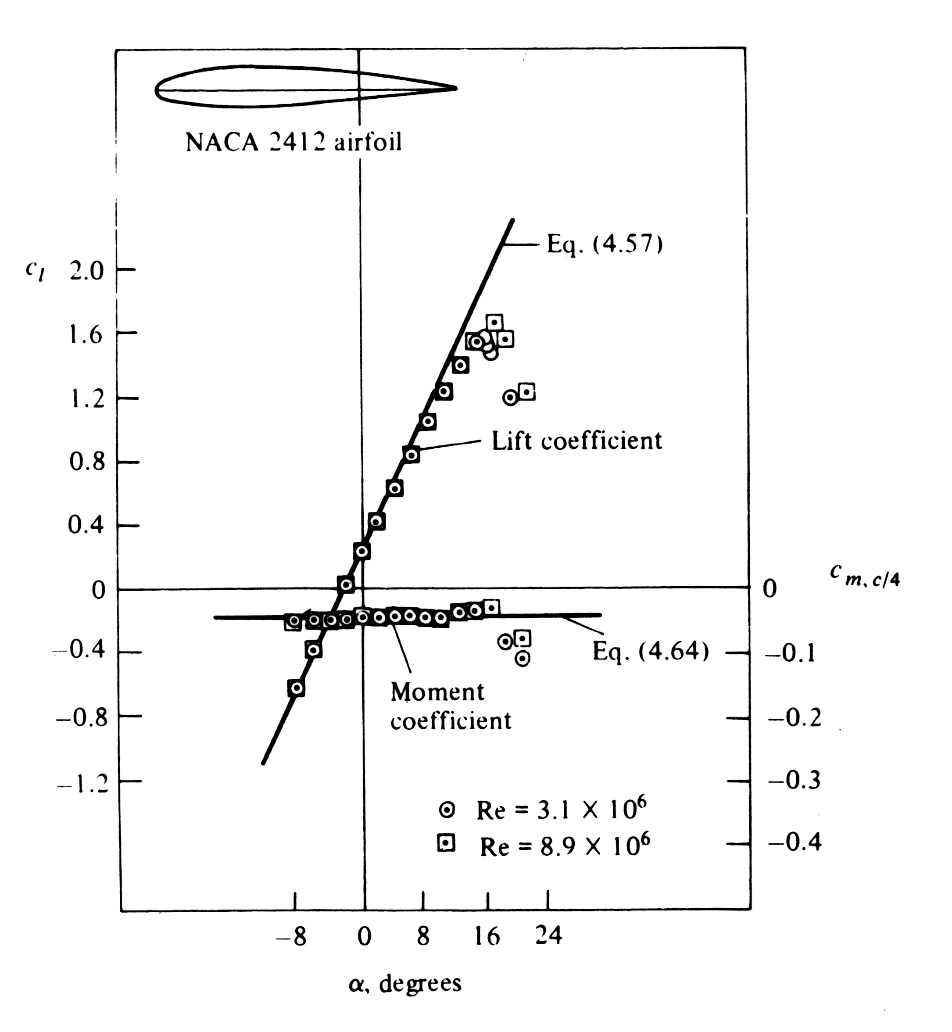
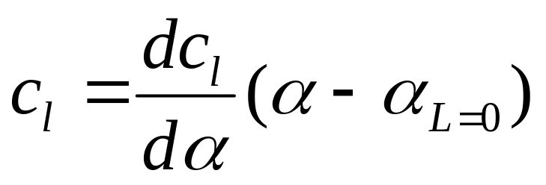
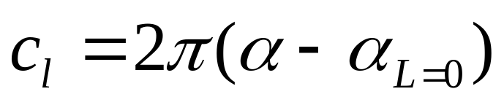
Step 4. Definition of zero lift angle

Slide 24
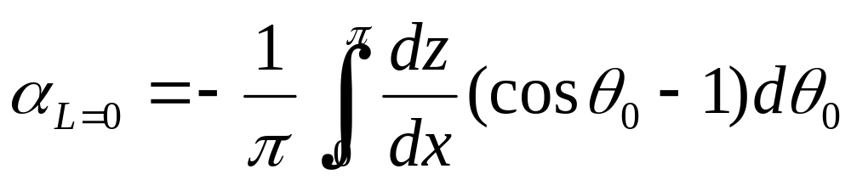
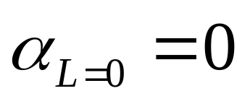
Comparison between two expressions of the lift coefficient
We have
For symmetric airfoil

Slide 25
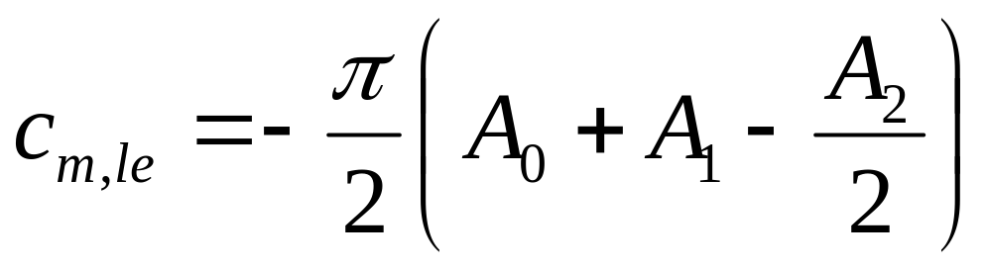
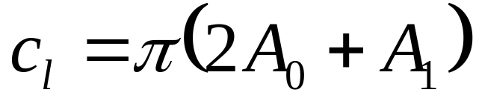
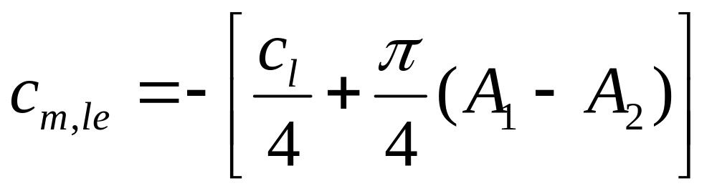
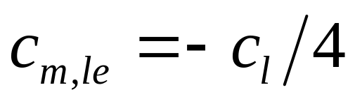
Step 5. Moment coefficient
For symmetric airfoil

Slide 26
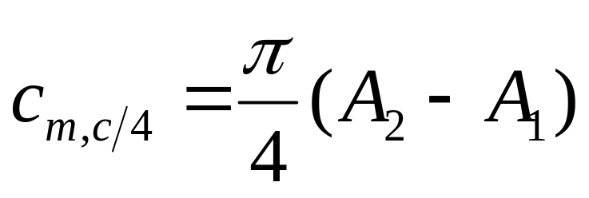
Moment coefficient about the quarter-chord point
It is independent to the attack angle, it depends on the shape of the camber line of the airfoil.
Thus, the quarter-chord point is the theoretical location of the aerodynamic center for a cambered airfoil

Slide 27


Step 6. Location of the pressure center

Slide 28
4.9 Lifting flows over arbitrary bodies: the vortex panel numerical method
Advantages for thin airfoil theory, and its limit for applications.
Method suited to calculated the aerodynamic characteristics of bodies of arbitrary shape, thickness and orientation: the vortex panel method
Comparison between the vortex panel method and source panel method: lifting body and nonlifting body.

Slide 29

Philosophy of the vortex panel method
Covering the body surface with a vortex sheet.
Find the strength distribution to make the surface a streamline of the flow.

Slide 30


Approximate the vortex sheet by a series of straight panels.
Let the vortex strength per unit length be constant over a given panel.

Slide 31

If the number of vortex panels is n, there will be n unknowns to be solved, that is
Solve the n unknowns, such that the body surface becomes a streamline of the flow and that the Kutta condition is satisfied.

Slide 32

Algorithm of the vortex panel method
Velocity potential introduced at P due to the j^{th} panel

Slide 33



where is a constant over the j^{th} panel
and
Velocity potential introduced at P due to all the panels

Slide 34

Put P at the control point of the i^{th} panel
Put P at the control point of the i^{th} panel， that means point P is located at , then

Slide 35



and
At the control points, the normal component of the velocity is zero, that is

Slide 36






Slide 37




It represents n equations with n unknowns
Kutta condition should be satisfied at the trailing edge,

