Slide 1

Student Activity
Portal
Your Hub for Seamless Student Management
Prepared By :
Name : SANIYA VAGHANI SANJAYBHAI
Enrollment No. : 23002171310143
Roll No. : 7
Branch : CST

Slide 2
Project Outline
01
02
03
04
Introduction
Class Diagram
Use Case Diagram
ER Diagram
05
Functionalities
06
Merits
07
Demerits
08
Future Scope

Slide 3
01
Introduction
This Java program is designed to manage student activities and information within a school or university. It provides features for both students and administrators, allowing them to access and manage their respective data.

Slide 4
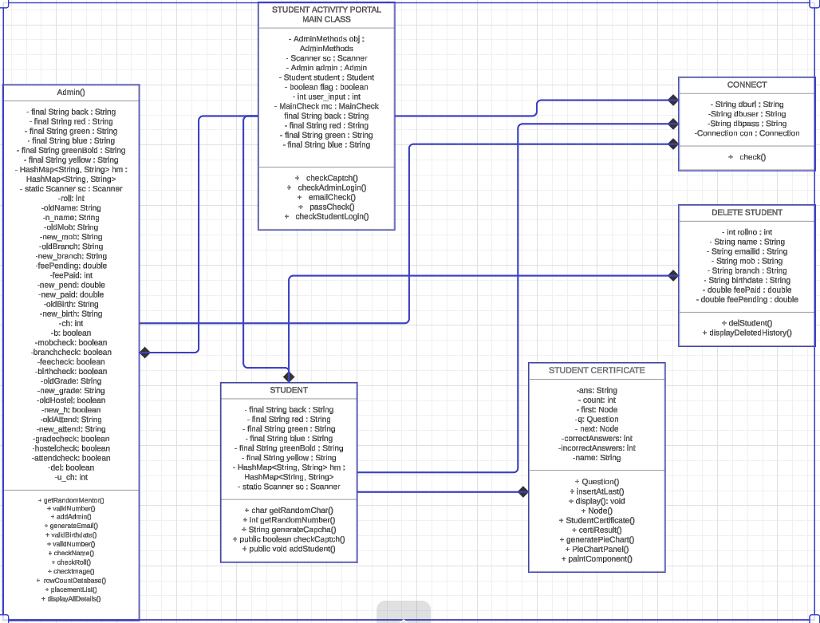
Class Diagram

Slide 5
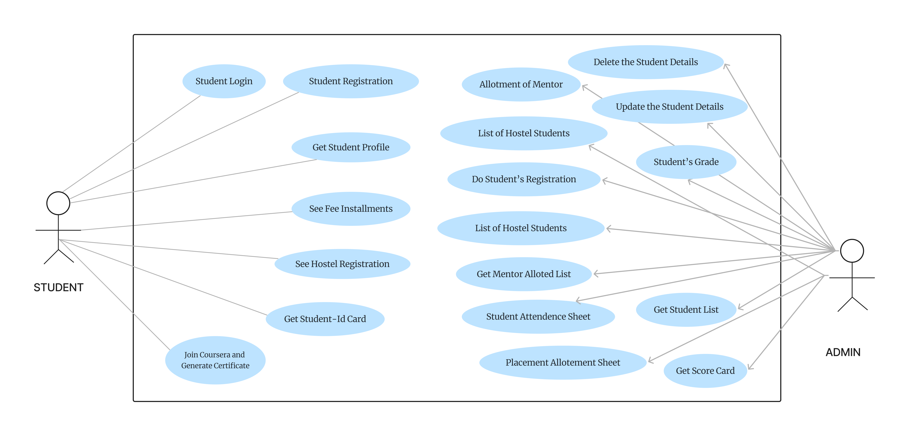
Use Case Diagram

Slide 6
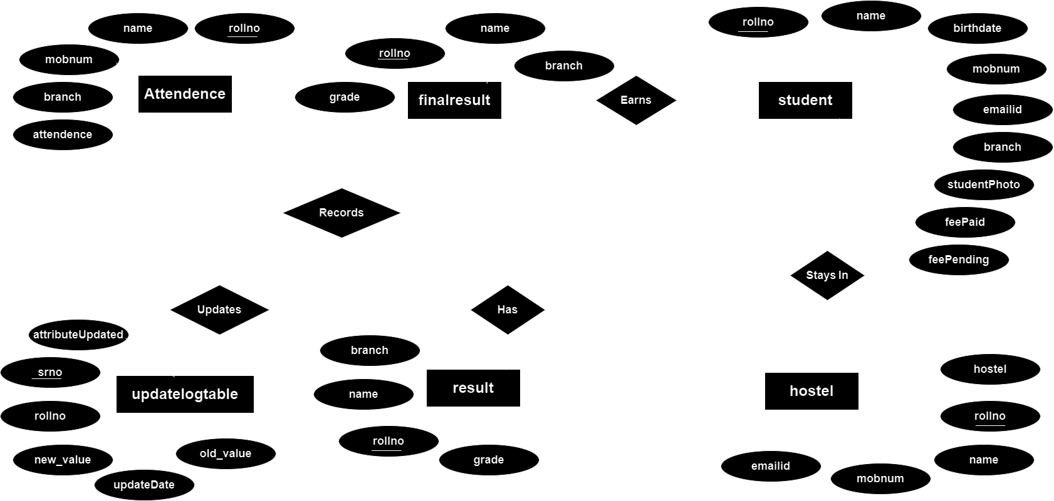
ER Diagram

Slide 7
Functionalities
Data Structures using JAVA
JAVA - II
DATABASE MANAGEMENT
Insert ,Update ,Delete and Select Queries
Stack using Linked List
OOPs
Linked List
Java Database Connectivity
Primary & Foreign Key
HashMap
Exception Handling
Procedure to insert Entry
Array List
File Handling

Slide 8
Merits
Centralized Management : Consolidates student data and activities in one platform.
Data Integrity : Maintains consistent data with foreign keys
Customizable and Scalable : Adapts to different institutional needs.
Automation : Reduces manual tasks and errors.
Improved Communication : Enhances interaction between students and admins.

Slide 9
Demerits
Limited Accessibility : May not be accessible on all devices or locations.
Scalability Issues : Might struggle with increasing data volumes.
Security Risks : Potential for data breaches if not secured properly.
Maintenance Needs : Requires ongoing updates and support.
Internet Dependency : Functionality might be impacted by poor connectivity.

Slide 10
Future Scope
Mobile App : Develop a mobile version for greater accessibility.
Real-Time Notifications : Keep users updated with alerts and reminders.
Cloud-Based : Move to the cloud for better scalability and security.
Integration : Link with other educational tools and systems.
AI/ML : Use artificial intelligence for personalized learning and insights.

Slide 11
Thank You

