Slide 1
EnviroScan: AI-Powered Pollution Source Identifier using Geospatial Analytics
Name: Kuldip Kishor Mahale Roll No: 60 College: R. C. Patel Institute of Technology, Shirpur

Slide 2
Project Statement
Pollution monitoring systems measure pollutant levels but fail to identify pollution sources.
EnviroScan uses Machine Learning, weather data, and geospatial analytics to predict likely sources such as industrial, vehicular, agricultural, or natural causes.
The system supports data-driven environmental decision-making through real-time analytics and alerts.

Slide 3
Project Objectives / Outcomes
Predict likely sources of pollution.
Display real-time pollution hotspots and risk zones on interactive maps.
Trigger alerts based on threshold exceedance.
Support evidence-based environmental policy-making.
Generate reports and visualizations for agencies.

Slide 4
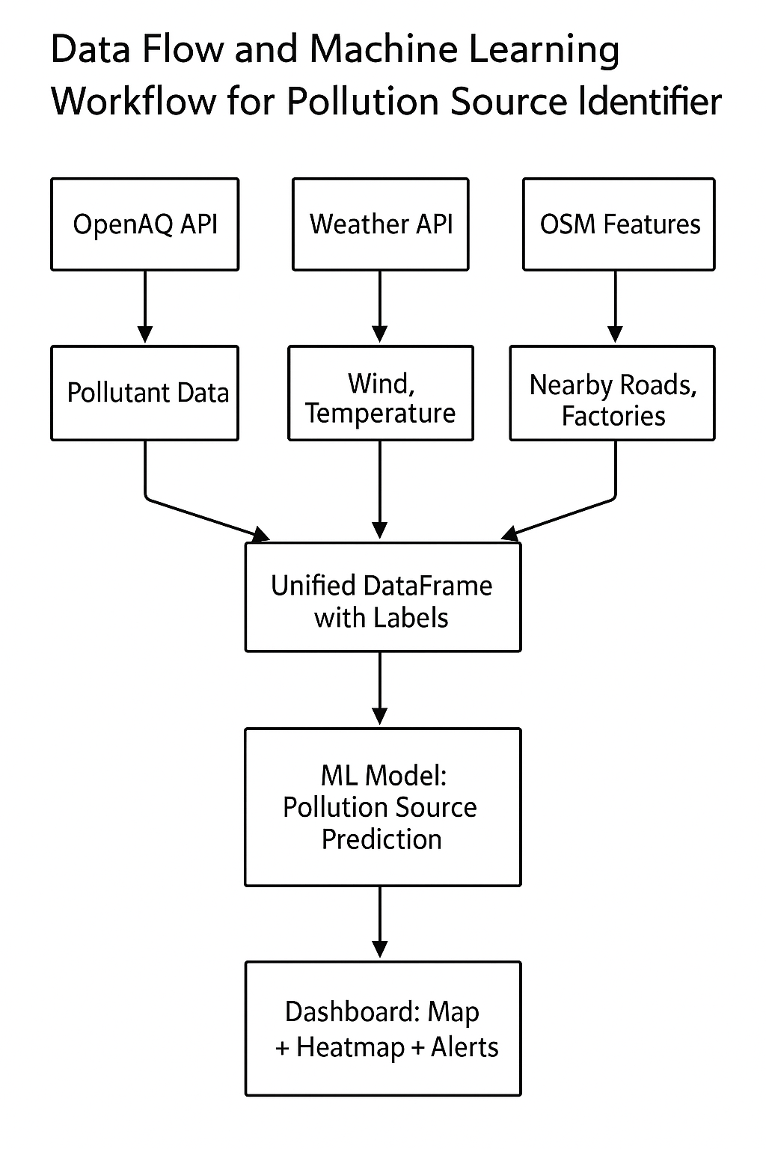
System Architecture

Slide 5
Data Sources
Source Data | Type | Parameters
OpenAQ API | Air Quality | PM2.5, PM10, NO₂, CO, SO₂, O₃
OpenWeatherMap | Weather | Temperature, Humidity, Wind
OpenStreetMap (OSMnx) | Geospatial | Roads, Industries, Farms, Dump Sites

Slide 6
Milestone 1: Data Collection
Collected pollution, weather & GPS data via APIs.
Tagged with coordinates & timestamps.
Stored in CSV/JSON for modeling. (Insert dataset screenshot)

Slide 7
Milestone 2: Data Cleaning & Feature Engineering
Removed duplicates & filled missing values.
Standardized units & timestamps.
Added spatial & temporal features. (Insert chart/table placeholder)

Slide 8
Milestone 3: Source Labeling & Simulation
Context | Rule | Label
Near road + high NO₂ | Vehicular pollution | Vehicular
Near factory + high SO₂ | Industrial emission | Industrial
Farmland + dry season + high PM | Crop burning | Agricultural
Remote + no activity | Natural | Natural

Slide 9
Milestone 4: Model Training & Source Prediction
Trained models: Random Forest, XGBoost, Decision Tree.
Inputs: pollutant + weather + proximity data.
Evaluated using Accuracy, Precision, Recall, F1-score. (Insert confusion matrix/accuracy chart)

Slide 10
Milestone 5: Geospatial Mapping & Heatmap
Built heatmaps with Folium/GeoPandas.
Displayed pollution sources via markers.
Gradient colors show pollutant intensity. (Insert heatmap visualization)

Slide 11
Milestone 6: Dashboard & Alerts
Developed Streamlit-based live dashboard.
Inputs: city/coordinates/time range.
Shows alerts, charts & predictions. (Insert dashboard screenshot)

Slide 12
Conclusion
Successfully built an AI-driven pollution source identification system.
Integrated data collection, cleaning, labeling, modeling & visualization.
Achieved accurate source prediction using ML algorithms.
Geospatial mapping and dashboards enable real-time monitoring.
Supports sustainable decision-making aligned with SDG goals.
(Insert thank-you or project logo image)

