Slide 1
ML driven Income Classification
Sania Sharma

Slide 2
Problem statement
Objective
Subsidy Inc. delivers subsidies to individuals based on their income. Subsidy inc. has obtained a large data set of authenticated data on individual income, demographic parameters, and a few financial parameters. Subsidy Inc. wishes to develop an income classifier system for individuals.
Develop income classifier system.
Simplify the system by reducing the number of variables to be studied without sacrificing too much accuracy.
Such a system would help Subsidy Inc. in planning subsidy outlay, monitoring and preventing misuse.

Slide 3
Understanding the dataset
DATA STRUCTURE
INTEGER VARIABLE TYPES
OBJECT VARIABLE TYPES
The income dataset has 31978 records and 13 variables including details on education, job, relations, geographic location.
The dataset is a mixture of integer and object type.
There are 4 integer type variable - age, capital_gain, capital_loss, hours_per_week.
There are 9 object type variable - job, education, marital_status, occupation, relationship, race, gender, native_country, salary_status.
Our target variable is salary_status(Sal_Stat)

Slide 4
Numerical Statistical Analysis
Age
Age ranges from 17 to 90 i.e., a large working age people.
The age spread is balanced but slightly skewed towards young age population.
Capital gain
With the 25th, 50th, and 75th percentiles all at 0, most individuals seem to have no capital gain at all.
Capital loss
The dataset has a skewed distribution for capital gain and loss with numerous zeros, indicating that only a small fraction of individuals report gains or losses.
Hours per week
Work hours are fairly consistent, reflecting typical full-time employment practices.

Slide 5
Categorical Statistical Analysis
The dataset reflects a concentration of individuals in the Private sector, with high school graduates being the largest education group and most individuals earning less than or equal to $50,000.
There are noticeable patterns in race, gender, and relationships, with the dataset predominantly featuring White males, often in traditional household roles like husbands.
While diverse in some aspects, such as occupation and education, the dataset also reveals strong majorities in several categories.

Slide 6
Missing Data
DATA EXPLORATION
IMPUTING TECHNIQUES
VALIDATION
Thoroughly examine the dataset for any missing values, which can impact the analysis and modeling.
If missing data is found, consider appropriate imputation methods to fill in the gaps without introducing bias.
Validate the imputed data to ensure it does not significantly alter the original data distribution and relationships

Slide 7
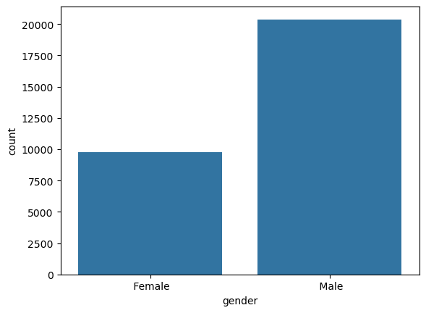
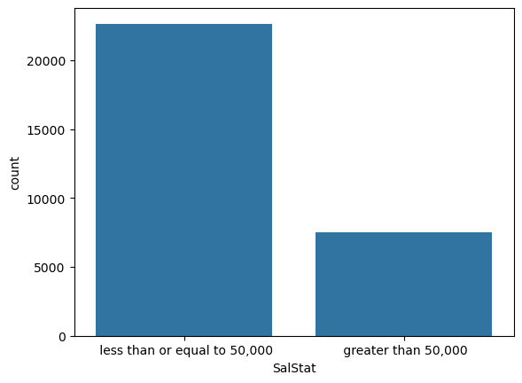
Data Exploration and Visualization
Univariate Analysis
GENDER
The distribution indicates that 67.57% of the dataset consists of males, while 32.43% are females. This suggests a significant gender imbalance in the dataset.
2. SALARYSTATUS
75.11% of individuals fall under "SalStat = less than or equal to 50000", making data set skewed towards it.

Slide 8
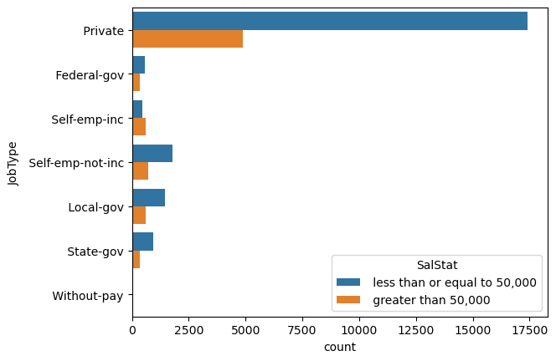
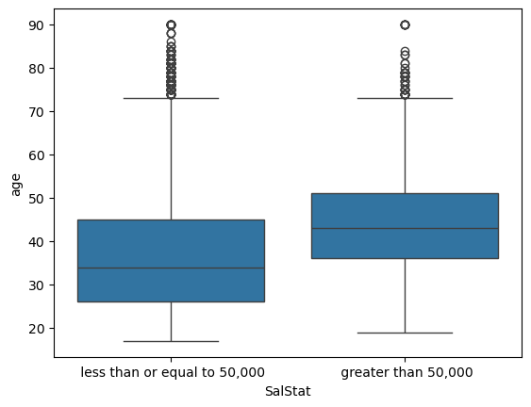
Bivariate Analysis
SalStat of Jobtype
The dataset reveals that 75.1% of individuals fall in the lower-income bracket, reflecting an overall trend skewed towards lower-income groups.
2. SalStat vs age
The data suggests that age has a strong correlation with income levels, with the majority of individuals, regardless of age, belonging to "SalStat = less than or equal to 50000."

Slide 9
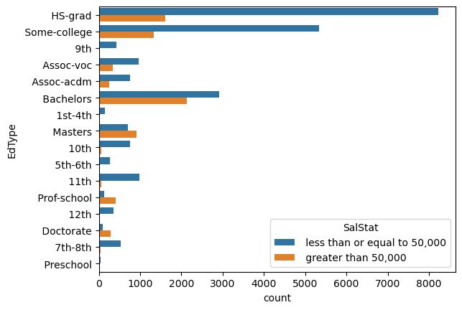
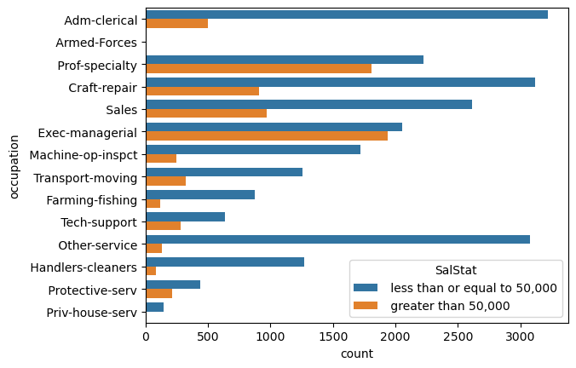
3. EDTYPE OF SALSTAT
The data clearly indicates that higher education levels strongly correlate with a greater likelihood of higher income.
4. OCCUPATION VS SALSTAT
High-Income Occupations (Greater than 50,000) : Executive/managerial roles, Professional specialties, Technical support.

Slide 10
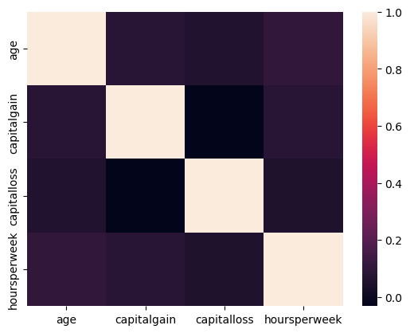
Correlation Analysis
The correlations are quite weak, suggesting that these variables have limited linear relationships with each other.
The weak negative correlation between capitalgain and capitalloss shows that individuals usually don't experience high capital gains and losses together.

Slide 11
MODEL BUILDING
LOGISTIC REGRESSION A statistical model used to predict binary outcomes(Yes / No). It calculates probabilities using a logistic function.
KNN A classification algorithm that predicts the class of a data point by finding the "K" closest points and using their majority class.
Prepare Data
Build Model
Evaluate Model
Ensure the dataset is clean and ready for modeling by handling missing values and variable transformation.
Develop a logistic regression model and a KNN model to classify and predict output(Salary_Status) variable.
Assess the model’s performance, statistical significance and assumptions to ensure it provides reliable and interpretable insights.

Slide 12
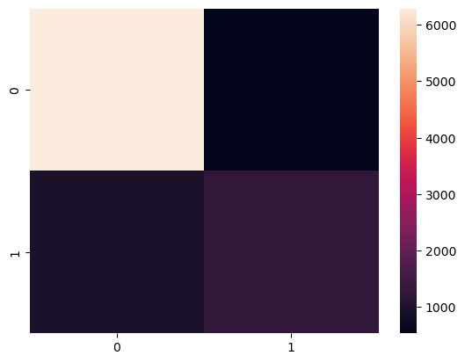
Results & Metrics
The Logistic regression prediction of the test data shows :
“Less than or equal to 50000” -> 7235 predictions
“More than 50000” -> 1814 predictions
The KNN model predictions of the test data shows:
“Less than or equal to 50000” -> 7024 predictions
“More than 50000” -> 2025 predictions
Accuracy
Logistic regression : 83.66%
KNN : 93.51%
Misclassified samples
Logistic regression : 1478
KNN : 587
This is the heatmap of confusion matrix of actual output variable(Salary_Status) and predicted output variable. [Logistic_regression]

Slide 13
Further Steps
Address Class Imbalance
Try Ensemble Methods
Policy implications: Ensure the model aligns with ethical considerations for subsidy allocation.
Deploy the model via web apps or dashboards for policymakers or organizations.
Gather feedback and continuously update the model with new data.
~ SANIA SHARMA
THANKYOU

