Slide 1

REAL TIME FALL ​ DETECTION APP​ ​
​
Team number- STREPC 1245
Team Name- Bits N’ Bytes
Team Leader-Vineet Alok
Team members- Sania , Neha, Ripudaman
Institution- The Northcap University
Mentor- Dr Nidhi Malik

Slide 2

Agenda
Challenge
Problem statement
Research work
Workflow
Solution
Use cases/Applicability
Business Model Canvas
Credits

Slide 3
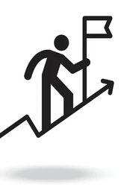
Challenge
To create a system that can detect falls with high accuracy, respond quickly and effectively, and provide a user-friendly experience that can be trusted and adopted by the elderly and people with mobility issues.

Slide 4
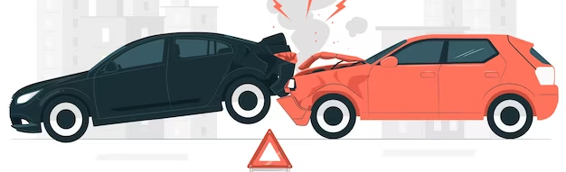

Problem statement
Description of the Idea: Accidents related to falling or car accidents is a major issue in India
It is important that a person that suffers an accident is aided as quickly as possible.
Unable to call for help as the person can be injured or unconscious.
Purpose: to examine the possibility of using sensors available in smartphones to implement an application for fall detection.
Send an automatic alert notification could be of great use.

Slide 5


Problem statement
Develop a system that can accurately detect falls, quickly respond to the event, and aid the person who has fallen.
It must consider the limitations of smartphone sensors and processing power, as well as the diverse and changing environments in which falls can occur.
Additionally, the system must consider privacy concerns and the need for easy user interaction.

Slide 6

Research work
How Rishabh Pant was rescued: 'The car had already caught sparks so I and the conductor rushed to get him out'
Globally, an average of 37.3 million people suffer from injuries related to a fall each year, which are severe enough to seek medical attention.
Out of these, no less than an estimated 640000 individuals die as a direct consequence of the fall.

Slide 7
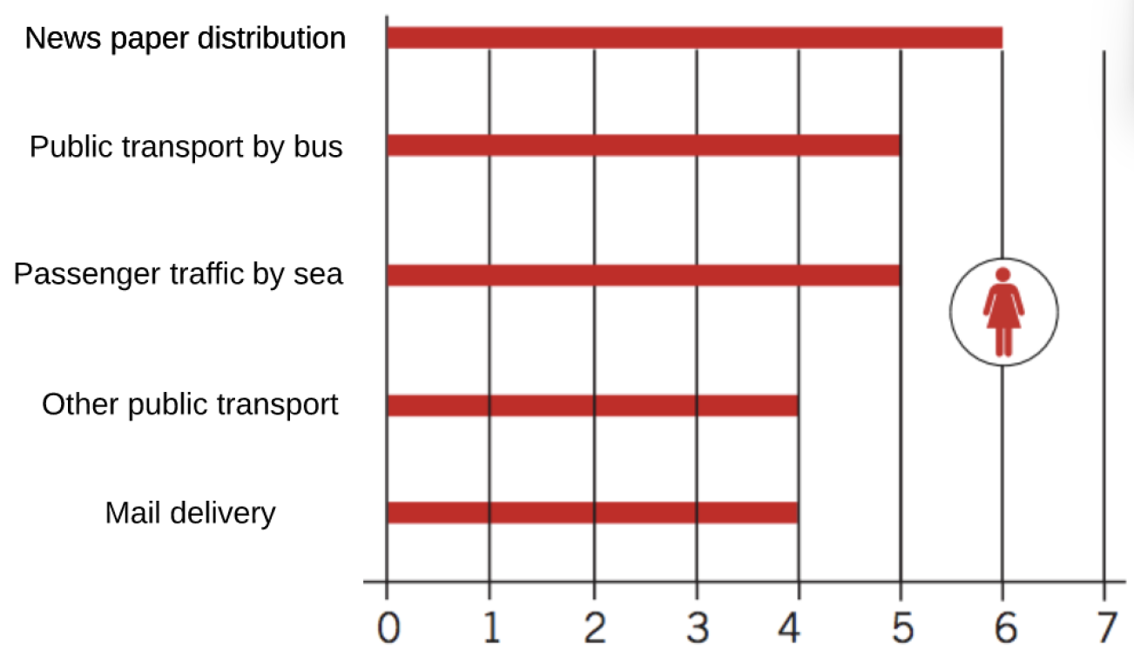
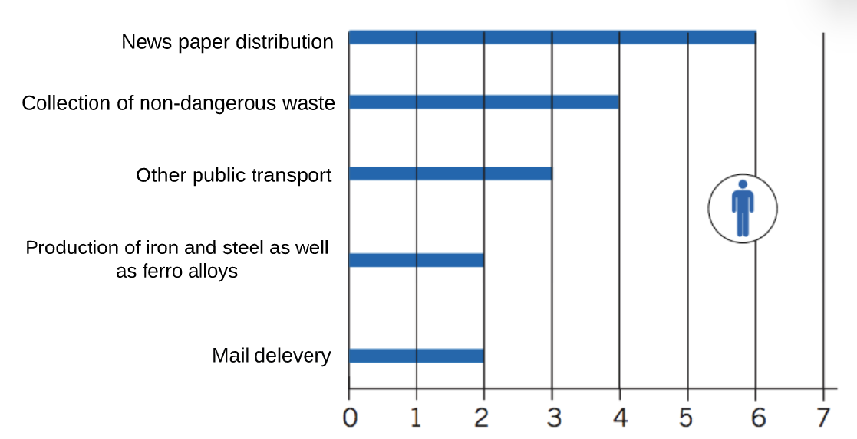
Fig:1 Work areas with most reported fall accidents from standing level. Amount per 1000 employed women and men respectively
Research work

Slide 8
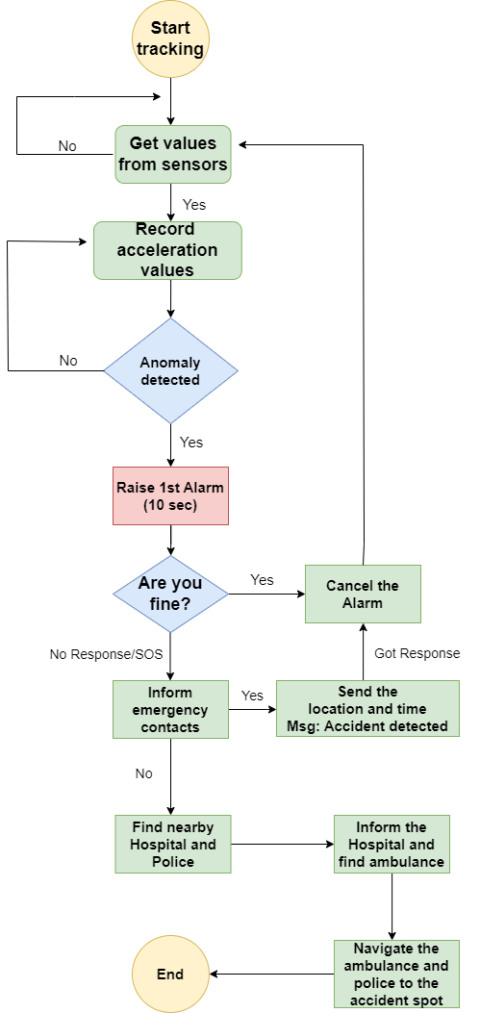
Workflow

Slide 9


Solution
A fall detection app is a mobile application designed to detect and respond to falls, by using sensors in a smartphone or wearable device.
It can alert emergency contacts or send a call for help in case of a fall.
Provide a fast and reliable way to get help in the event of a fall, especially for elderly or vulnerable individuals who may have trouble getting up after a fall or calling for help.

Slide 10
Solution
The application will read real-time data using smartphone sensors and location services.
Accelerometer and gyroscope data signals are then fed to a model. The model detects anomalies in the data and predicts a fall.
After a fall is predicted an alert notification will be sent to the user and if the user does not respond, an SOS will be sent to the emergency contact.

Slide 11
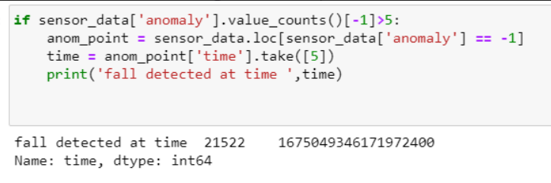

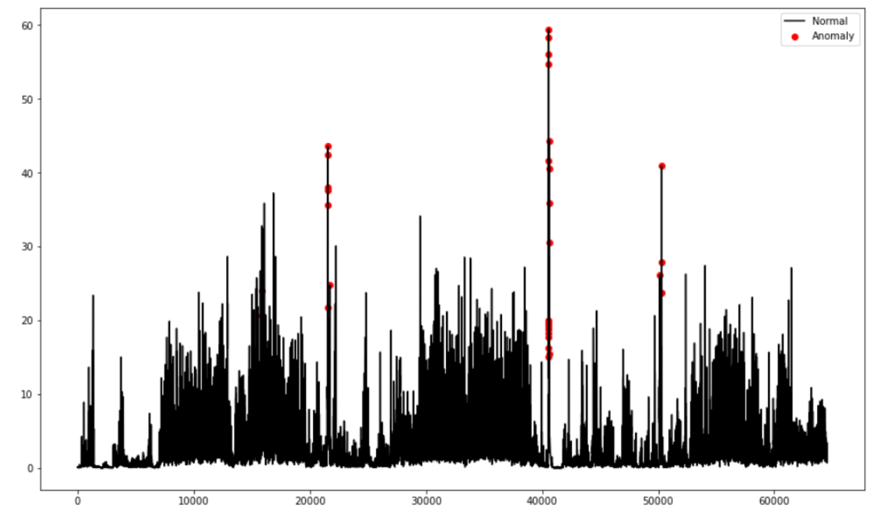
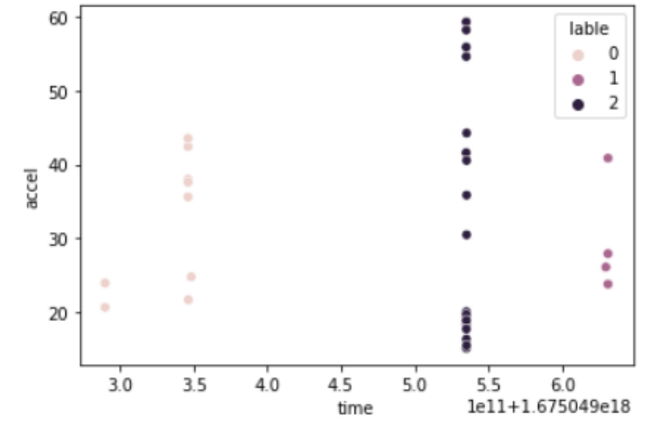
Solution (code snippets)
Isolation Forest Training Model

Slide 12
USE CASES / APPLICABILITY
Elderly Care
Health Monitoring
Sports & Adventure Activities
Industrial Safety
Smart Homes

Slide 13
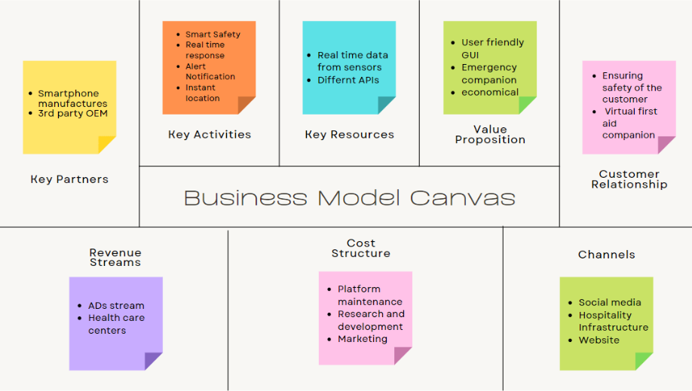
Business Model Canvas

Slide 14

Credits:
Dr Nidhi Malik (Mentor)
https://link.springer.com/article/10.1007/s10586-020-03051-z
https://www.mdpi.com/1424-8220/21/15/5134
https://www.hindawi.com/journals/bmri/2020/2167160/

