Slide 1

Healthcare Cost Prediction using EDA and Regression
DSA0404 – Fundamentals of Data Science
Guided by:
Presented by:
Dr. Krishnaraj Mony
Associate Professor/CSE
Y . Anjani Priya(192324176)
M . Apurva(192325138)
Sania Herbert(192324062)

Slide 2


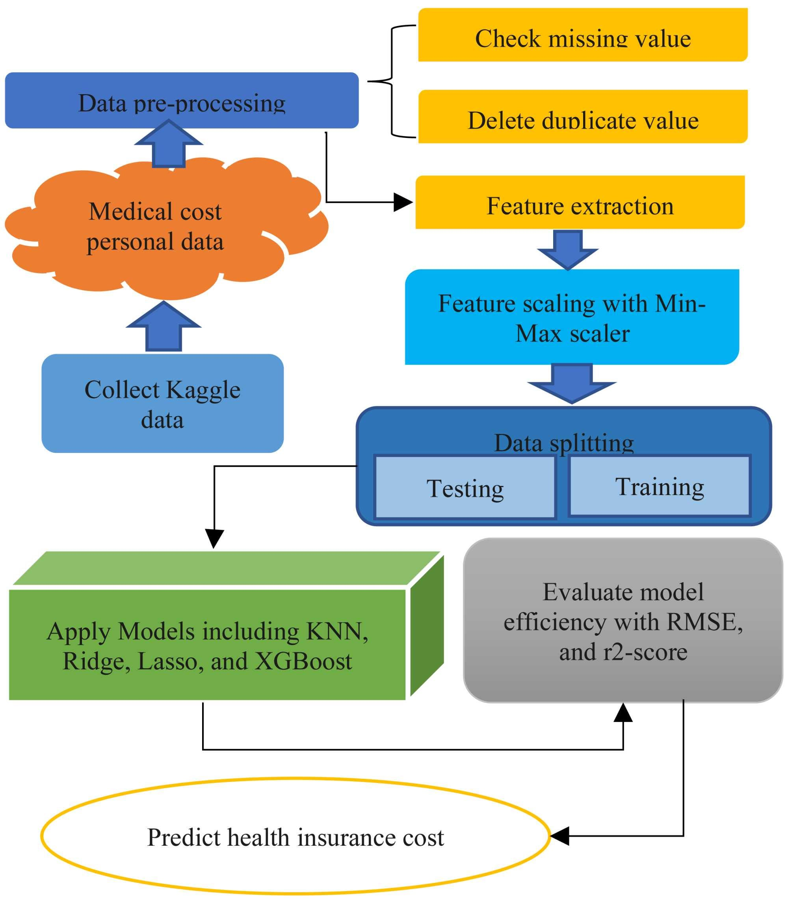
INTRODUCTION
Healthcare Cost Prediction using EDA and Regression
Healthcare expenses have increased significantly due to factors such as age, lifestyle, medical conditions, and treatment costs.
Predicting medical insurance charges helps individuals, hospitals, and insurance companies estimate future healthcare expenses accurately.
Exploratory Data Analysis (EDA)
Is used to understand the dataset, identify trends, detect outliers, and discover relationships between variables.
Regression techniques
Are applied to build predictive models that estimate healthcare costs based on patient characteristics.

Slide 3
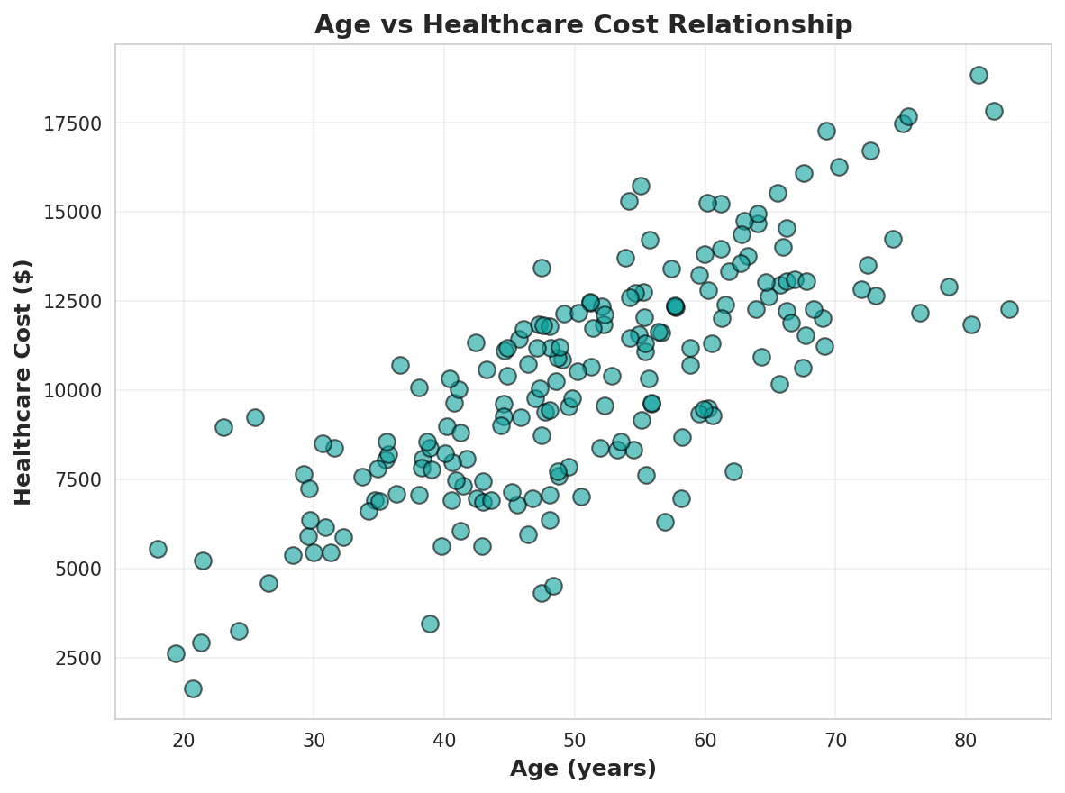
OBJECTIVES
To analyze the healthcare insurance dataset using Exploratory Data Analysis (EDA).
To identify the key factors influencing healthcare costs, such as age, BMI, smoking status, gender, number of children, and region.
To clean and preprocess the dataset by handling missing values, duplicates, and outliers.
To visualize relationships between features and medical insurance charges using graphs and statistical techniques.
To compare predicted healthcare costs with actual costs and assess prediction accuracy.
To provide insights that support better financial planning, insurance pricing, and healthcare decision-making.

Slide 4
LITERATURE SURVEY
S.No | Title | Authors | Year | Techniques Used
1 | Predicting Healthcare Costs Using Machine Learning | Smith & Johnson | 2023 | Linear Regression, Random Forest
2 | Deep Learning for Medical Cost Analysis | Chen et al. | 2024 | Neural Networks, LSTM
3 | Feature Selection in Healthcare Cost Prediction | Patel & Kumar | 2024 | Feature Engineering, XGBoost
4 | Ensemble Methods for Healthcare Expense Forecasting | Williams et al. | 2024 | Gradient Boosting, Stacking
5 | EDA-Based Healthcare Cost Analysis | Anderson & Lee | 2025 | Statistical Analysis, Regression

Slide 5
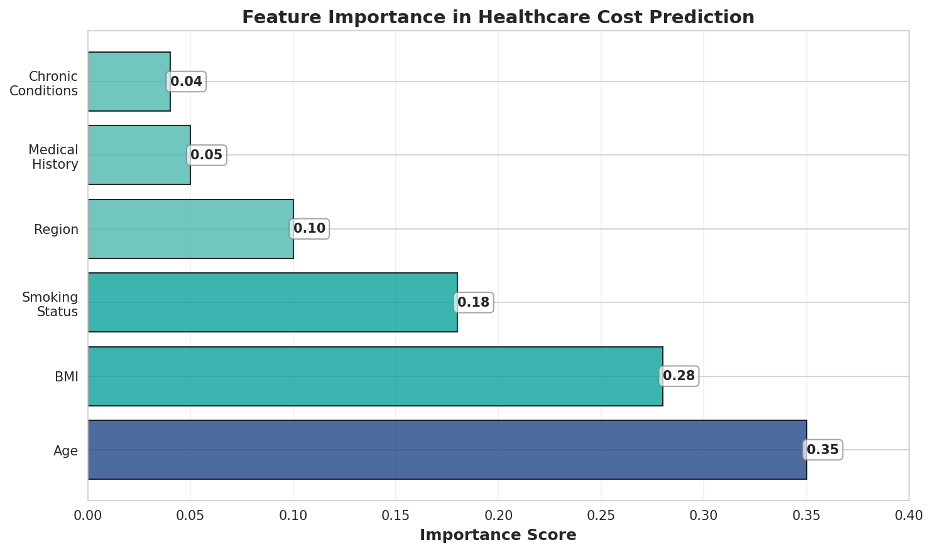
EXISTING SYSTEM
Healthcare cost estimation is often performed using manual calculations or fixed insurance pricing rules.
Traditional methods rely on limited patient information, which may not capture all factors affecting medical expenses.
Many existing systems use basic statistical methods that have lower prediction accuracy.
Cost estimation is often time-consuming and may vary depending on human judgment.
Traditional approaches provide limited data analysis and visualization, making it difficult to identify patterns and trends.

Slide 6
PROPOSED SYSTEM
Develop a Healthcare Cost Prediction System using Exploratory Data Analysis (EDA) and Regression techniques.
Collect and preprocess healthcare insurance data by handling missing values, duplicates, and outliers. Perform EDA to understand data distribution, identify trends, and analyze relationships between features.
Use important factors such as Age, BMI, Smoking Status, Gender, Number of Children, and Region to predict healthcare costs.
Train a Regression model to estimate medical insurance charges with improved accuracy. Evaluate the model using performance metrics such as MAE, MSE, RMSE, and R² Score. Generate accurate healthcare cost predictions to support better financial planning and insurance premium estimation.

Slide 7
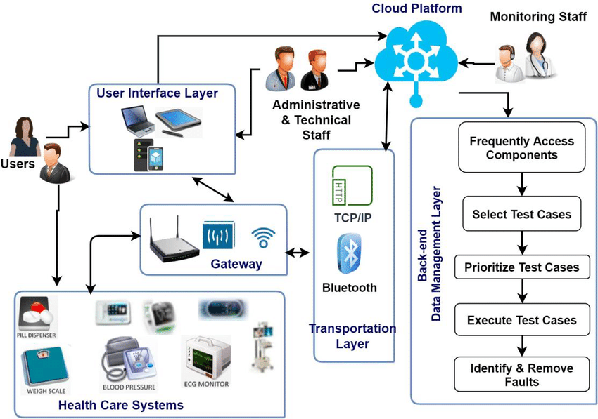
SYSTEM ARCHITECTURE

Slide 8
MODULE 1: DATA PREPROCESSING
Loads the raw healthcare insurance dataset (insurance.csv) containing age, sex, BMI, children, smoker status, region, and charges.
Validates that all required columns are present and standardizes column names before use.
Cleans the dataset by dropping rows with missing values, so the regression model trains only on complete records.
Splits the cleaned data into training and testing sets (80/20) using a fixed random seed for reproducible results.
Separates categorical features (sex, smoker, region) from numerical features (age, BMI, children) ahead of encoding.
Feeds the prepared data into a scikit-learn ColumnTransformer pipeline for downstream modeling.

Slide 9
MODULE 2: EXPLORATORY DATA ANALYSIS
One-hot encodes categorical features (sex, smoker, region) while passing numerical features through unchanged.
Generates an Age vs Healthcare Charges scatter plot, colour-coded by smoking status, to reveal cost trends by age.
Generates a BMI vs Healthcare Charges scatter plot to examine the relationship between body mass index and cost.
Compares average charges for smokers versus non-smokers using a grouped bar chart.
Compares average charges across regions (southwest, southeast, northwest, northeast) using a bar chart.
Surfaces dataset-level KPIs — record count, average, maximum, and minimum charges — alongside every chart.

Slide 10
MODULE 3: REGRESSION MODEL & PREDICTION
Trains a Linear Regression model inside a scikit-learn Pipeline on the preprocessed training split.
Evaluates the trained model on the held-out test set using R² Score, MAE, and RMSE.
Predicts healthcare charges for a new patient from age, sex, BMI, children, smoker status, and region entered by the doctor.
Classifies each prediction into a cost category — Low, Moderate, or High — for quick clinical interpretation.
Logs every prediction to a patient history table that can be searched and exported as CSV.
Plots Actual vs Predicted Charges so the doctor can visually assess model accuracy.

Slide 11
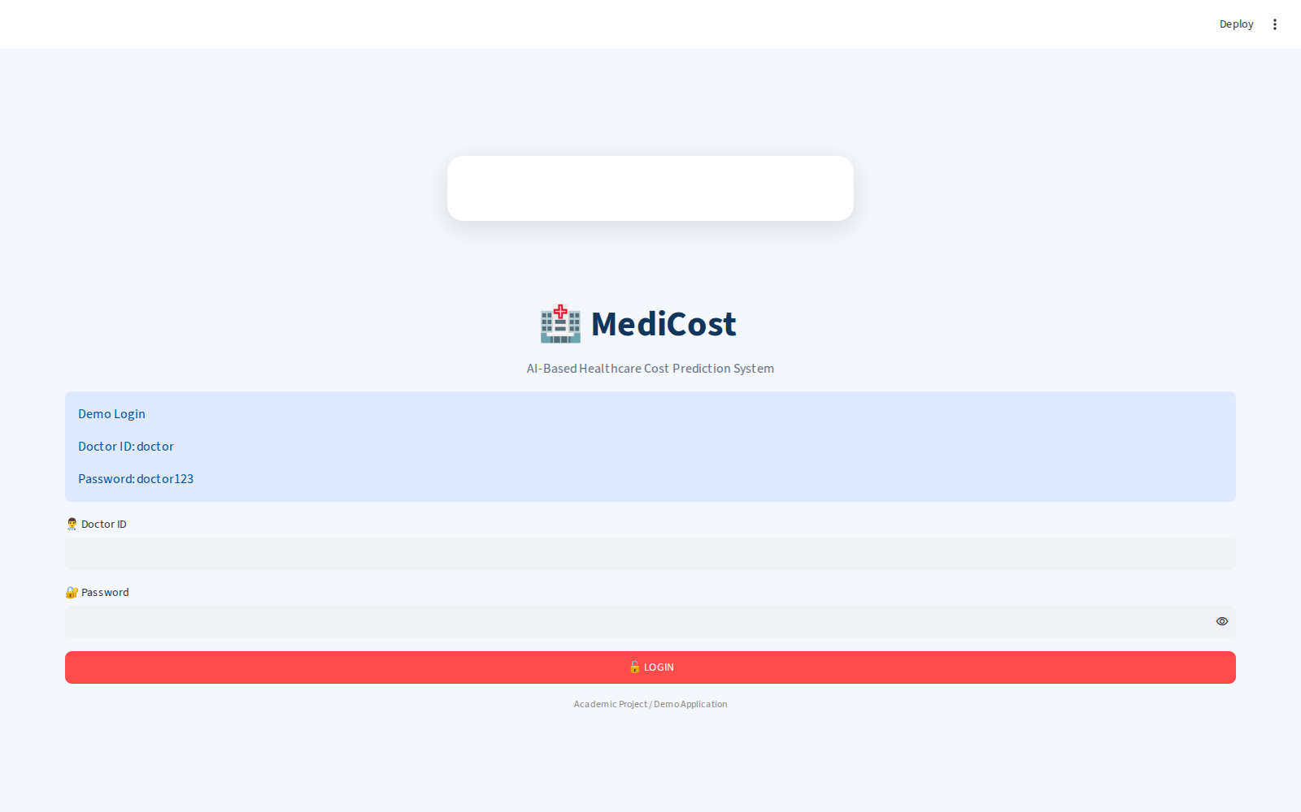
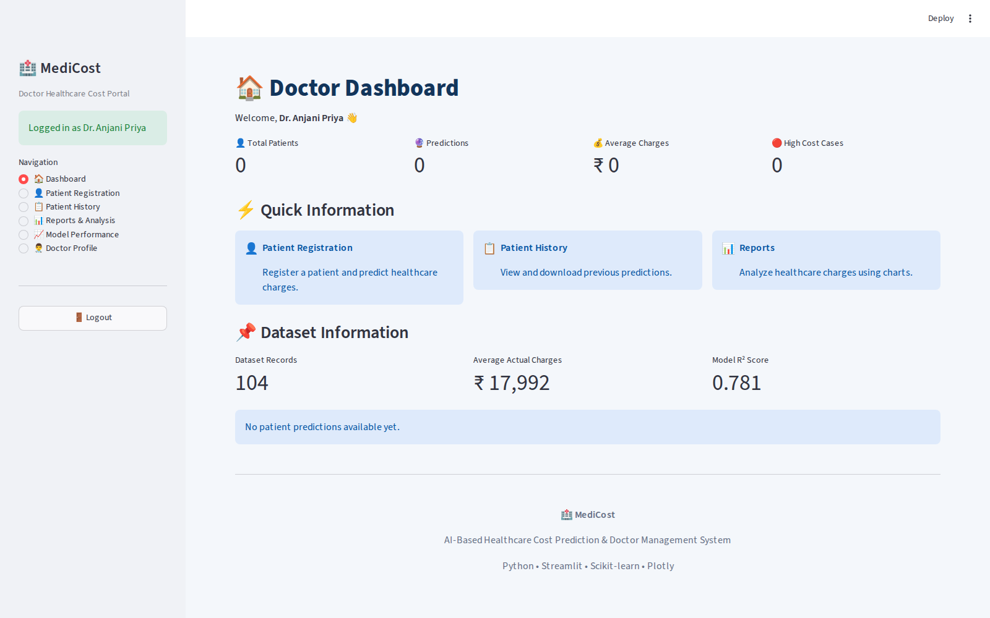
IMPLEMENTATION – LOGIN & DASHBOARD
Doctor login secured with ID/password authentication
Dashboard — live KPIs and dataset summary (R² = 0.781)

Slide 12
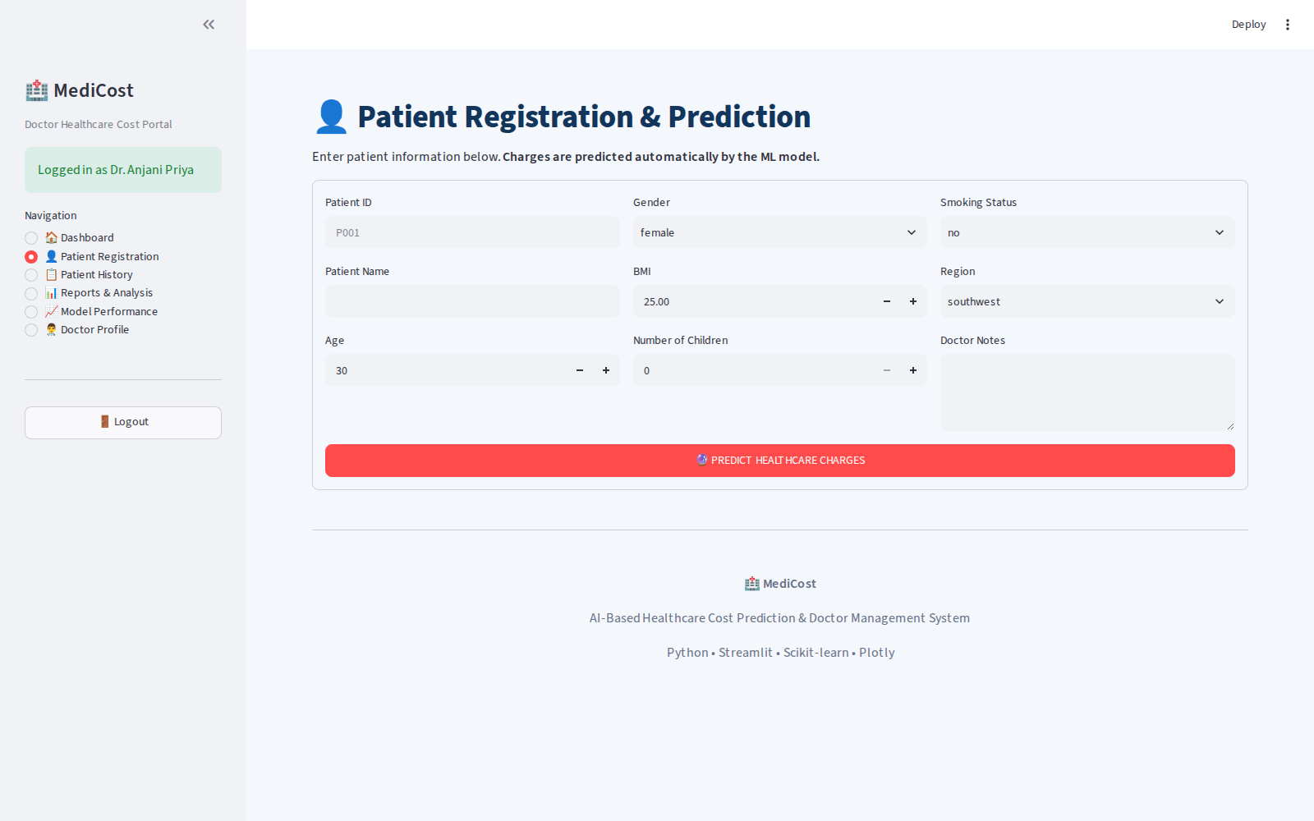
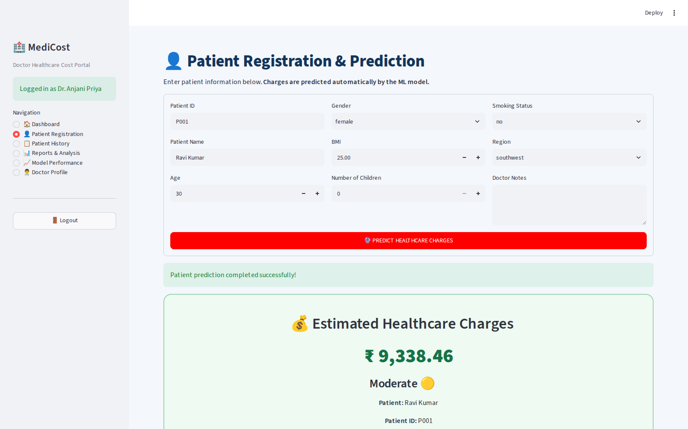
IMPLEMENTATION – REGISTRATION & PREDICTION
Patient Registration form capturing age, BMI, smoker status, region
Predicted charges (₹9,338.46) with Low/Moderate/High category

Slide 13
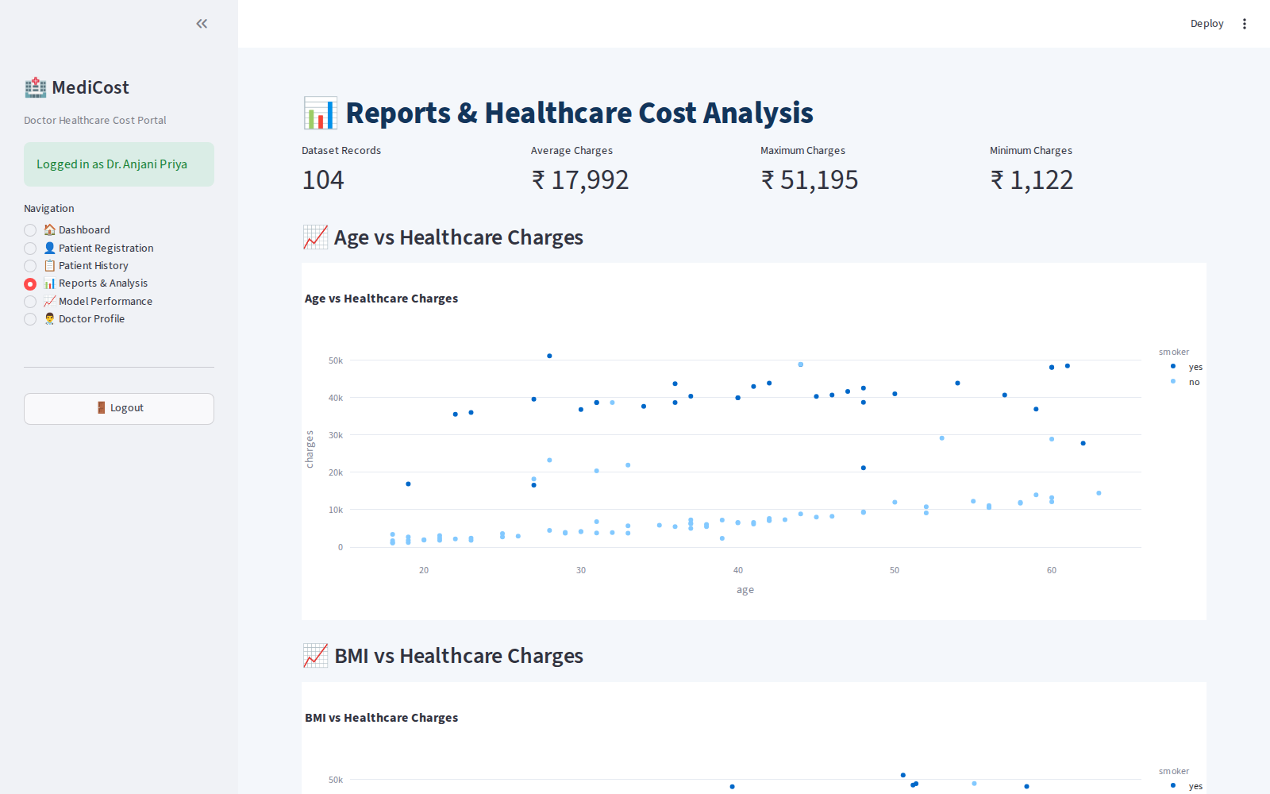
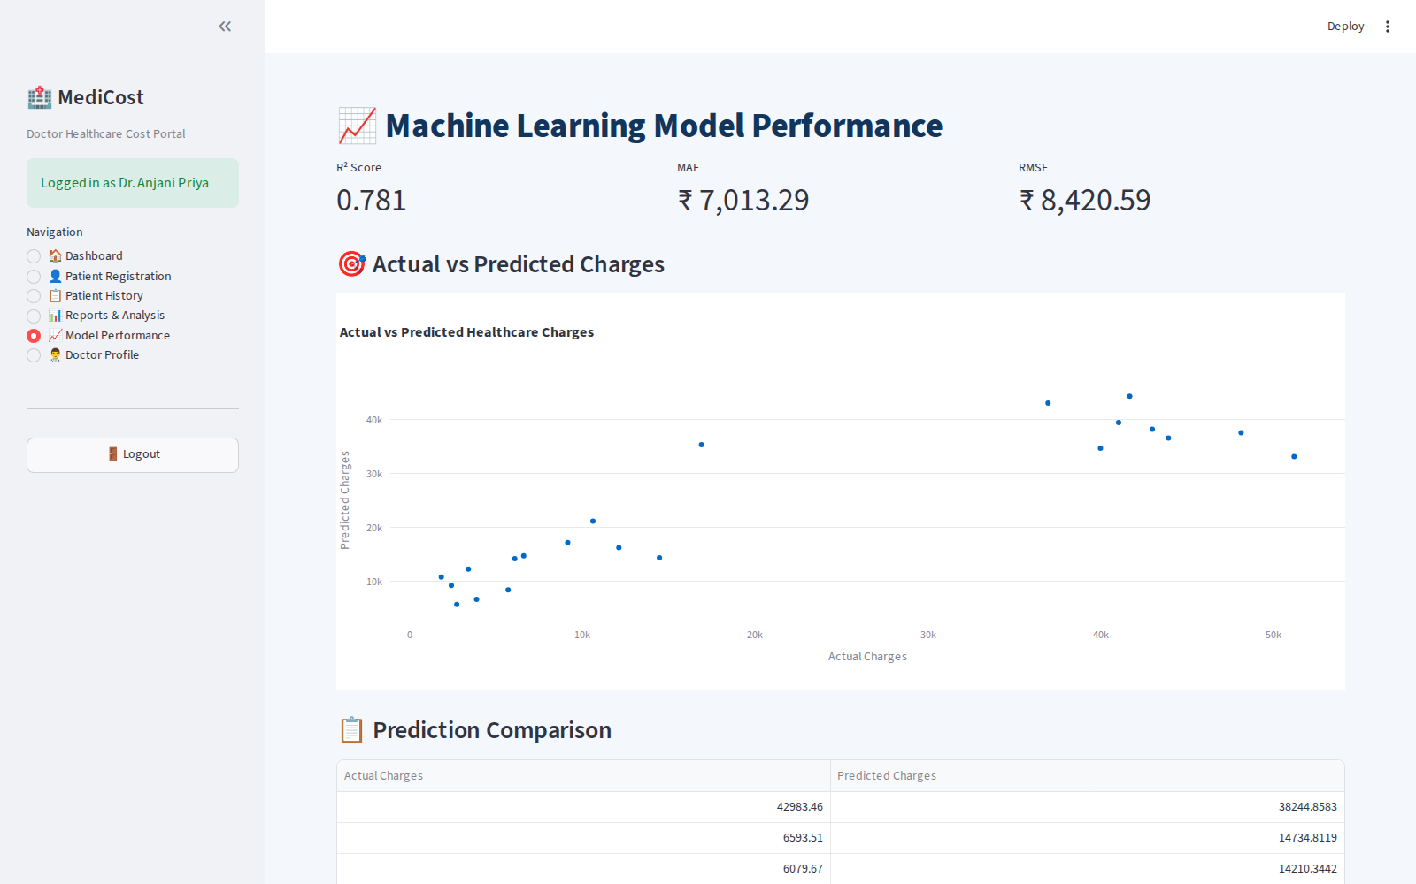
IMPLEMENTATION – REPORTS & MODEL PERFORMANCE
Age vs Charges and dataset KPIs on the Reports & Analysis page
Model Performance — R², MAE, RMSE and Actual vs Predicted plot

Slide 14
CONCLUSION
Healthcare cost prediction helps estimate future medical expenses accurately using patient and lifestyle information.
Exploratory Data Analysis (EDA) was used to understand the dataset, identify patterns, and determine the most influential factors affecting healthcare costs.
A Regression model was developed to predict medical insurance charges based on features such as age, BMI, smoking status, gender, number of children, and region.
The model demonstrated effective prediction performance and can assist insurance companies, healthcare providers, and individuals in making informed financial decisions.
Future improvements can include larger datasets, additional health-related features, and advanced machine learning algorithms to further enhance prediction accuracy.

Slide 15
REFERENCES
Kaggle. Medical Cost Personal Dataset. https://www.kaggle.com/datasets/mirichoi0218/insurance Scikit-learn Documentation.
Machine Learning in Python. https://scikit-learn.org/stable/ Pandas Documentation.
Python Data Analysis Library. https://pandas.pydata.org/ NumPy Documentation.
Fundamental Package for Scientific Computing. https://numpy.org/ Matplotlib Documentation.
Visualization with Python. https://matplotlib.org/ Python Software Foundation.
Python Documentation. https://docs.python.org/3/ James, G., Witten, D., Hastie, T., & Tibshirani, R. (2021).
An Introduction to Statistical Learning (2nd Edition). Springer. Géron, A. (2023).
Hands-On Machine Learning with Scikit-Learn, Keras & TensorFlow (3rd Edition). O'Reilly Media.

