Slide 1

Process mining virtual internship
by
Sania Kowsar
Roll No. 224G1A3396
Department of Computer Science and Engineering
(Artificial Intelligence And Machine Learning)
Srinivasa Ramanujan Institute of Technology
(Affiliated to JNTUA & Approved by AICTE) (Accredited by NAAC with ‘A’ Grade & Accredited by NBA (EEE, ECE & CSE)
Rotarypuram Village, B K Samudram Mandal, Ananthapuramu – 515701.
2023 - 2024

Slide 2

Contents
Course Objective
Introduction
Technology
Modules
Real-World Applications
Learning OutComes
GitHub Link
Queries

Slide 3
Course Objective
Gaining practical experience in process discovery, conformance checking, and process enhancement.
Analyzing real-world datasets to identify inefficiencies and propose process improvement.
Find and fix problems in business processes using data.

Slide 4
Introduction
Introduction to Process Mining
Celonis Process Mining is a powerful tool For analyzing and optimizing business processes.
It helps companies gain real-time visibility into their operations, identify bottlenecks, and uncover hidden opportunities.
This program is not just about learning , it’s about building a solid foundation for a future career in process mining and data analytics.
This internship program is designed to equip you with the essential skills and knowledge to excel in this rapidly growing field.

Slide 5
Technology
Strong Analytical Skills
We should be comfortable working with large datasets and identifying trends.
Data Visualization Skills
Possess skills in data visualization using tools like Power BI, or other relevant software. We should be able to create clear and compelling charts and graphs.
Problem-Solving Skills
We should be resourceful and able to think critically to solve complex process issues.

Slide 6
Modules
Steps in Process Mining
Celonis Process Mining Fundamentals
Rising Star – Technical
  PQL Queries
  Get Data into EMS

Slide 7
Modules
Steps in Process Mining
Step-1:Identify the problem of importance to the business that can realistically be addressed with process mining. Determine the business value of solving the problem and what metrics to use to measure success.
Step-2:Identify the data sources that need to be fully understood to address the business process issues under consideration. Identify the applications and systems that need to provide feeds of event data for continuous visibility into end-to-end processes.
Step-3:Set up a pilot project to prove the potential value of a process mining solution. Ensure that the project can be executed relatively quickly and deliver specific, measurable results that everyone in the organization can understand.
Step-4:Accepting the results of the analysis, as process mining provides, among other things, a clear picture based on facts.

Slide 8
Modules
Celonis Process Mining Fundamentals
Process mining is a set of techniques used for obtaining knowledge and extracting insights from processes.
This training track provides both the theoretical and applied foundations around Process Mining.
Process mining reads this data, converts it into an event log, and then creates visualizations of the end-to-end process, along with insightful analytics.
An event log contains each step performed during the process , the time at which the event occurred , and for which instance of the process.
Using this event log, algorithms generate a process model that shows the process.

Slide 9
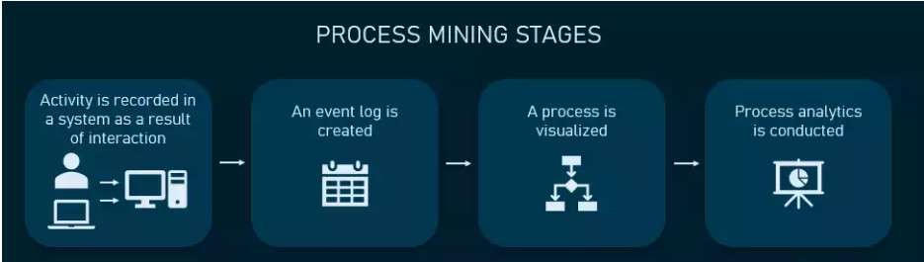
Modules
Main Stages in Process Mining:
  Activity or interaction.
  Event Log.
  Visualized.
  Process Analytics.

Slide 10
Modules
RISING STAR- TECHNICAL
This refers to emerging trends and advancements in process mining, such as new algorithms, techniques, and tools that enhance the capabilities and applications of process mining.
Under this we mainly learn about two topics:
  PQL Queries
  Get Data into Ems

Slide 11
Modules
PQL Queries:
PQL (Process Query Language) is a specialized language used to query process mining tools. It allows users to retrieve specific information from event logs and process models
With PQL, you can ask questions about process performance, identify deviations from expected behavior, or extract patterns and trends from the process data.
Get Data into EMS:
To import data into an EMS, you can collect event logs from various sources, such as system logs, databases, or other applications.
These event logs serve as the input for process mining analysis.
These sources may include transactional systems, databases, application logs, or any other system that generates event data.
Once the event logs are imported into the EMS, they can be used as input for process mining analysis.

Slide 12
Real-World Applications
Finance, speeding up transformation efforts and delivering better quarter-on-quarter results.
Supply Chain , increasing resiliency.
System transformation, minimizing risk and accelerating all phases of migration journeys.
Process excellence, uncovering hidden value opportunities , fast.
Shared services, driving the evolution from cost center to always-on values magnet.
Sustainability and ESG, reducing shipping emission and driving sustainable spend management.

Slide 13
Learning OutComes
The Celonis Internship Program is a fantastic opportunity to gain valuable skills, knowledge, and experience in the rapidly growing field of process mining.
We are committed to providing a challenging and rewarding internship experience that will prepare you for a successful career in process mining.
If you are passionate about data analysis, process optimization, and technology, we encourage you to apply for this internship.
This is your chance to make a real impact, learn from the best, and build a strong foundation for your future in the exciting world of process mining.

Slide 14
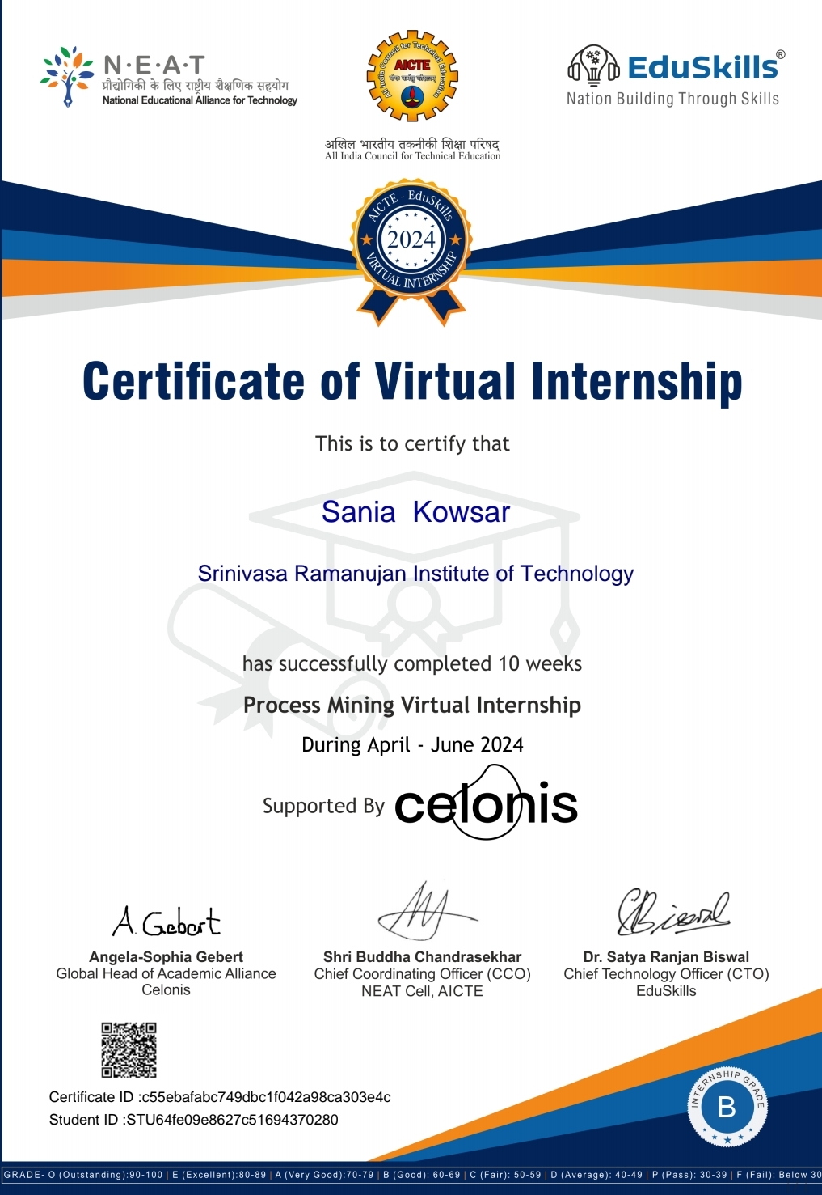
Certificate

Slide 15
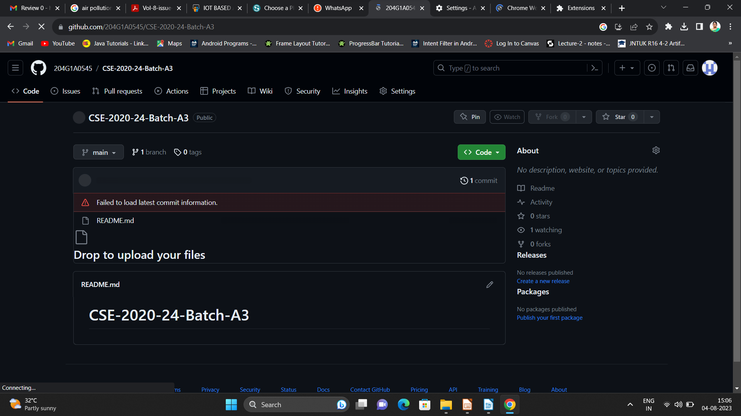

Git Hub Dashboard
Repository Name Like: Summer Internship - I
Under that include document, presentation and Certificate(Pdf).

Slide 16
Any Queries?

Slide 17
Thank You!!!

