Slide 1
Vision-Aided Feedback System for Surgical Assistance
IE 54900 - Final Presentation
April 28, 2026
Team: Vaishnavi Satish, Madhura Kunachi, Sanidhya Shrivastava
Instructor: Prof. Juan Wachs

Slide 2
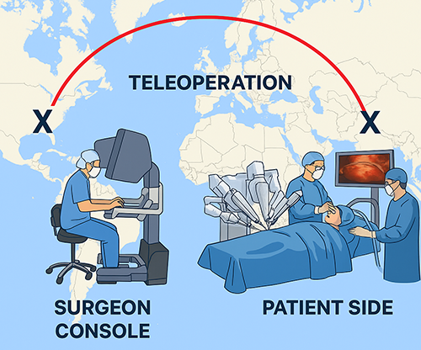
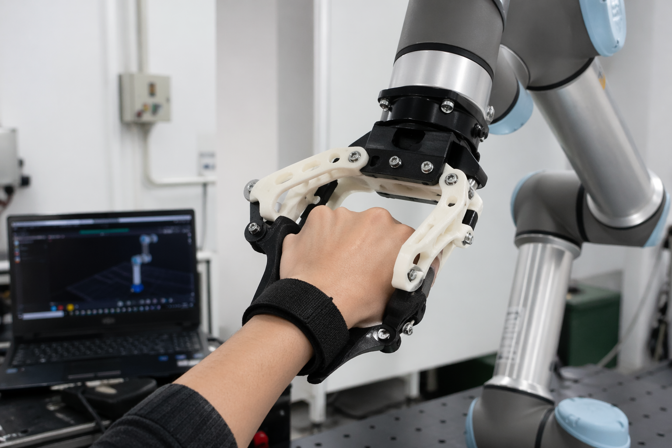
Background and Motivation
Surgical skill requires hands-on guidance.
Expert surgeons are not always accessible.
How do you transfer surgical skill across distance?
Notes:
Vision-based teleoperation system for surgical training.
Map teacher hand pose to robot arm motion via inverse kinematics in simulation and on a real UR robot

Slide 3
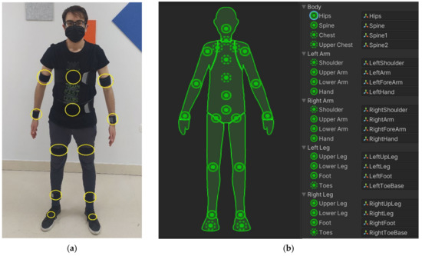
Limitations
Existing teleoperation systems often depend on expensive hardware
Many approaches require wearable markers, gloves, or motion capture setups
Real-time low-cost teleoperation frameworks are unavailable

Slide 4
Methodology
Teacher Side
Video Capture (real time)
Hand Landmark Extraction
Pose & Gripper Estimation
Data Transmission
Student Side
Frame Transformation
Inverse Kinematics
Motion Smoothing
Arm Actuation
Feedback Loop
Visual Feedback to Teacher
Force Feedback to student

Slide 5
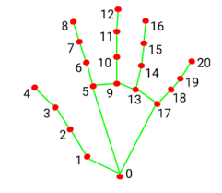
Hand Tracking Pipeline
Landmark Detection: MediaPipe Hands detects 21 landmarks per frame. Five palm landmarks (wrist + 4 MCP joints) are used to compute the palm centroid as the 3D position reference in normalized camera space [0,1].
Palm Orientation: Two vectors are constructed from wrist to index MCP and pinky MCP. Their cross product gives a surface normal vector perpendicular to the palm.
Limitation: MediaPipe's Z-coordinate is a relative depth estimate that degrades with hand rotation and is not calibrated to real-world units, making raw Z unreliable for 6-DoF orientation tracking.
Notes:
methods for experiments, what was the data set, how to material learned in class helped you in the project?

Slide 6
Depth Estimation & Gripper Detection
Palm Area Method: Five palm landmarks are projected to pixel coordinates; their convex hull area is computed via cv2.convexHull. A larger area means the hand is closer. Area is smoothed over 20-frame rolling window and mapped to Z-axis position.
Gripper State: Euclidean pixel distance between thumb tip (landmark 4) and index fingertip (landmark 8) is computed each frame. A threshold of 40 pixels classifies the gesture: below threshold = pinch (gripper closed), above = open.

Slide 7
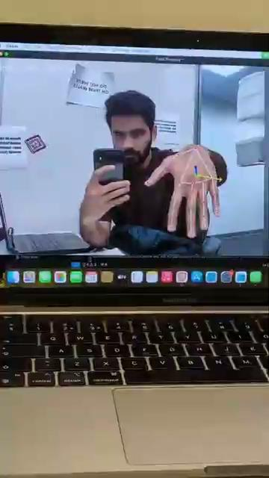
Hand Tracking Pipeline
Notes:
methods for experiments, what was the data set, how to material learned in class helped you in the project?

Slide 8
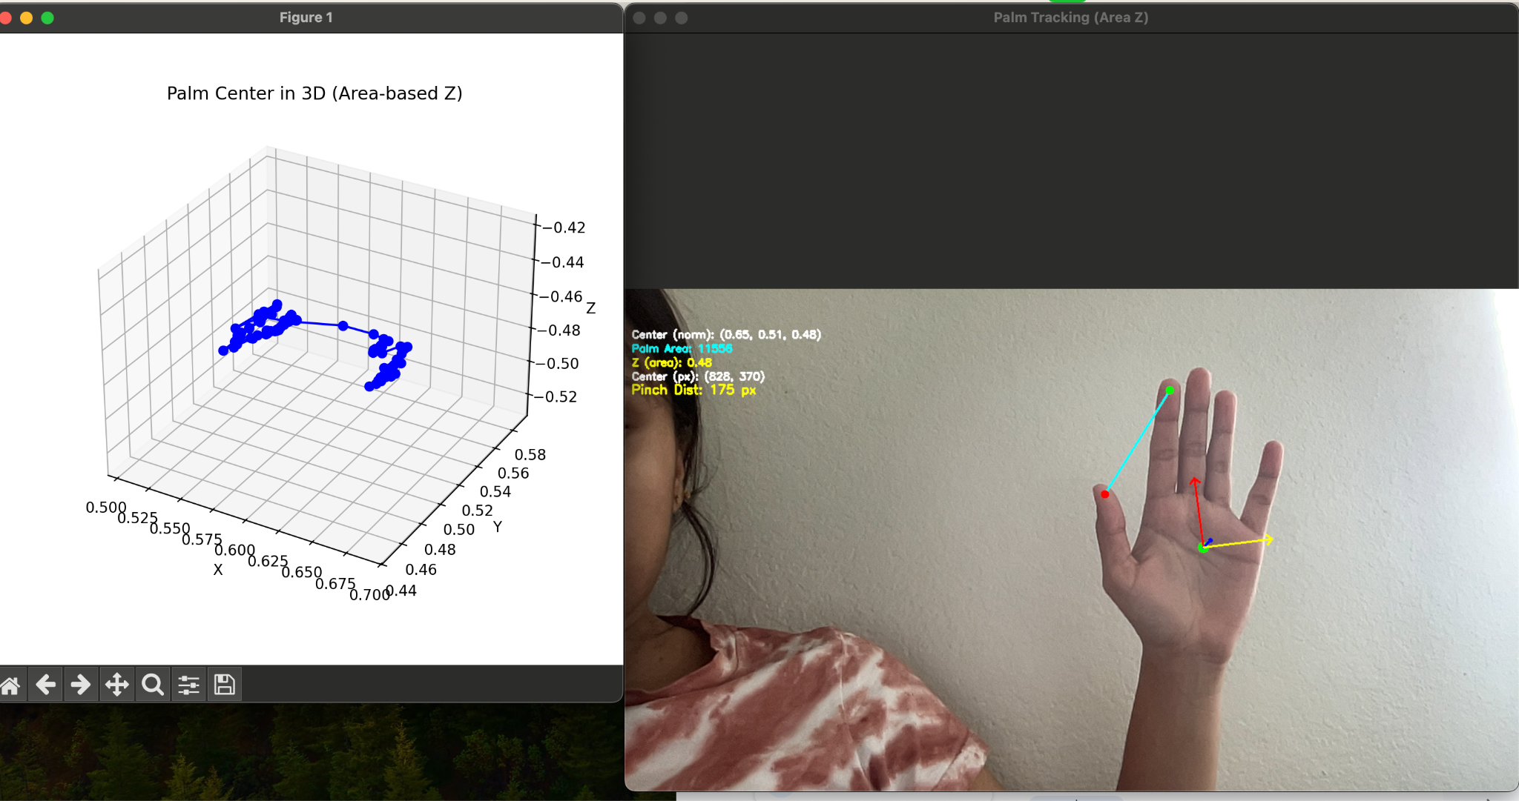
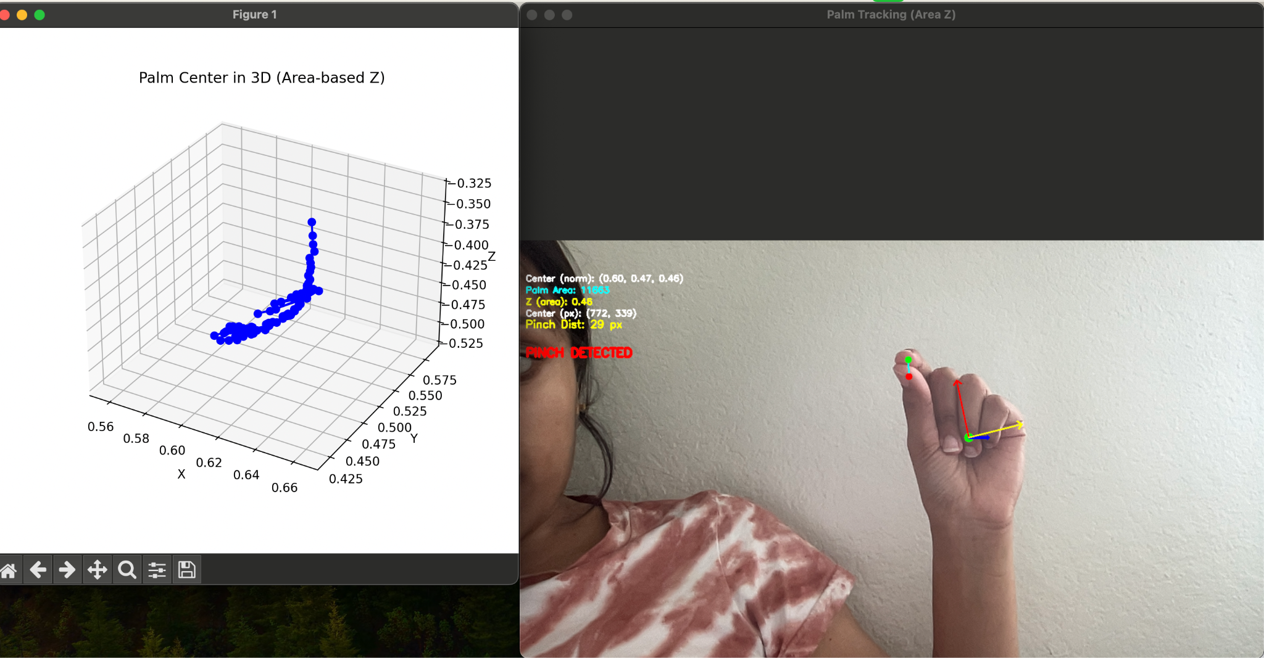
Hand Tracking Pipeline
The teleoperation pipeline continuously captures camera frames, extracts hand landmarks using MediaPipe, maps the palm position to robot workspace coordinates, and sends safe movement commands to the UR robot.
Notes:
methods for experiments, what was the data set, how to material learned in class helped you in the project?

Slide 9
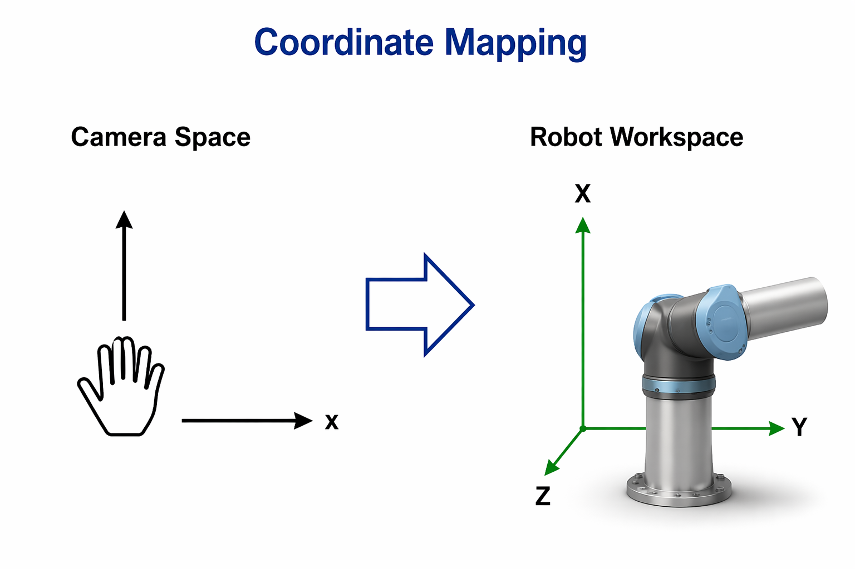
Key Mapping Logic
offset_y = map_range(cx_norm, 0.2, 0.8,
MAX_XY_BOUND, -MAX_XY_BOUND)
offset_x = map_range(cy_norm, 0.2, 0.8,
-MAX_XY_BOUND, MAX_XY_BOUND)
The normalized hand coordinates from MediaPipe are mapped into physical robot workspace coordinates. This creates an intuitive camera-to-robot motion relationship while ensuring the robot never exceeds predefined safety boundaries.

Slide 10

PyBullet Simulation

Slide 11
Real Robot Teleoperation (UR Robot)
Home Position: On startup, the robot's current pose is captured as the fixed home anchor. All subsequent movements are computed as offsets from this anchor, keeping Z, Rx, Ry, Rz locked and only varying X and Y.
Gatekeeper Pattern: Movement commands are only sent when rob.is_program_running() returns False. This prevents command flooding - the camera loop runs continuously for smooth video while the robot processes one pose at a time.
Safety: Velocity and acceleration are set to 0.1 m/s and 0.1 m/s2. Motion is bounded to +-15 cm in X/Y from the home anchor. Camera X/Y coordinates (middle 60% of frame) are linearly mapped to the physical workspace bounds.

Slide 12
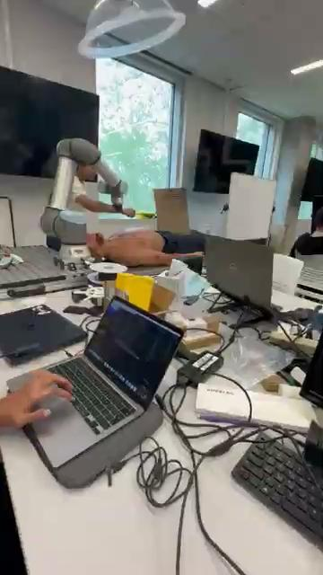
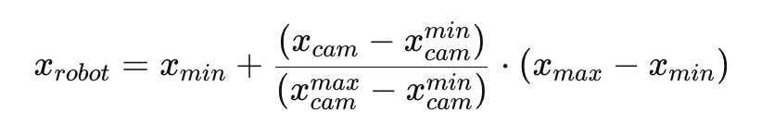
Real Robot Teleoperation (UR Robot)
Linear Mapping Formula

Slide 13

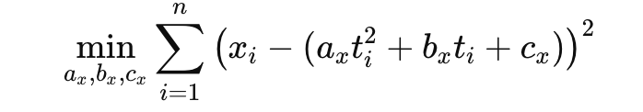
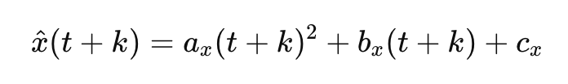
Real Robot Teleoperation (UR Robot)
Polynomial Trajectory Model
Least Squares Curve Fitting
Extrapolation

Slide 14
Typical Failure cases
Z axis flips when the palm is facing flat to camera
Singularity
Latency
Speed and acceleration from robot
Occlusion
Lighting extremitites

Slide 15
Key Takeaways
Our method achieves low position errors
Path smoothing reduces jitter
Safety bounds prevent out-of-range coordinates and improve stability

Slide 16
Future Work
IMU Fusion: Integrate an IMU worn on the hand for robust 6-DoF orientation (roll, pitch, yaw) Get good extimate for Z axis and use Kalman filter for X and Y axis
Deviation Detection: Implement real-time deviation detection loop comparing trainee trajectory to recorded expert path to deliver corrective forces when deviation exceeds threshold
Haptic Glove Integration: Finalize the wearable soft haptic glove attached to the robot end-effector to physically guide the trainee’s hand back toward the expert trajectory without fully constraining dexterity

Slide 17
THANK YOU

Slide 18
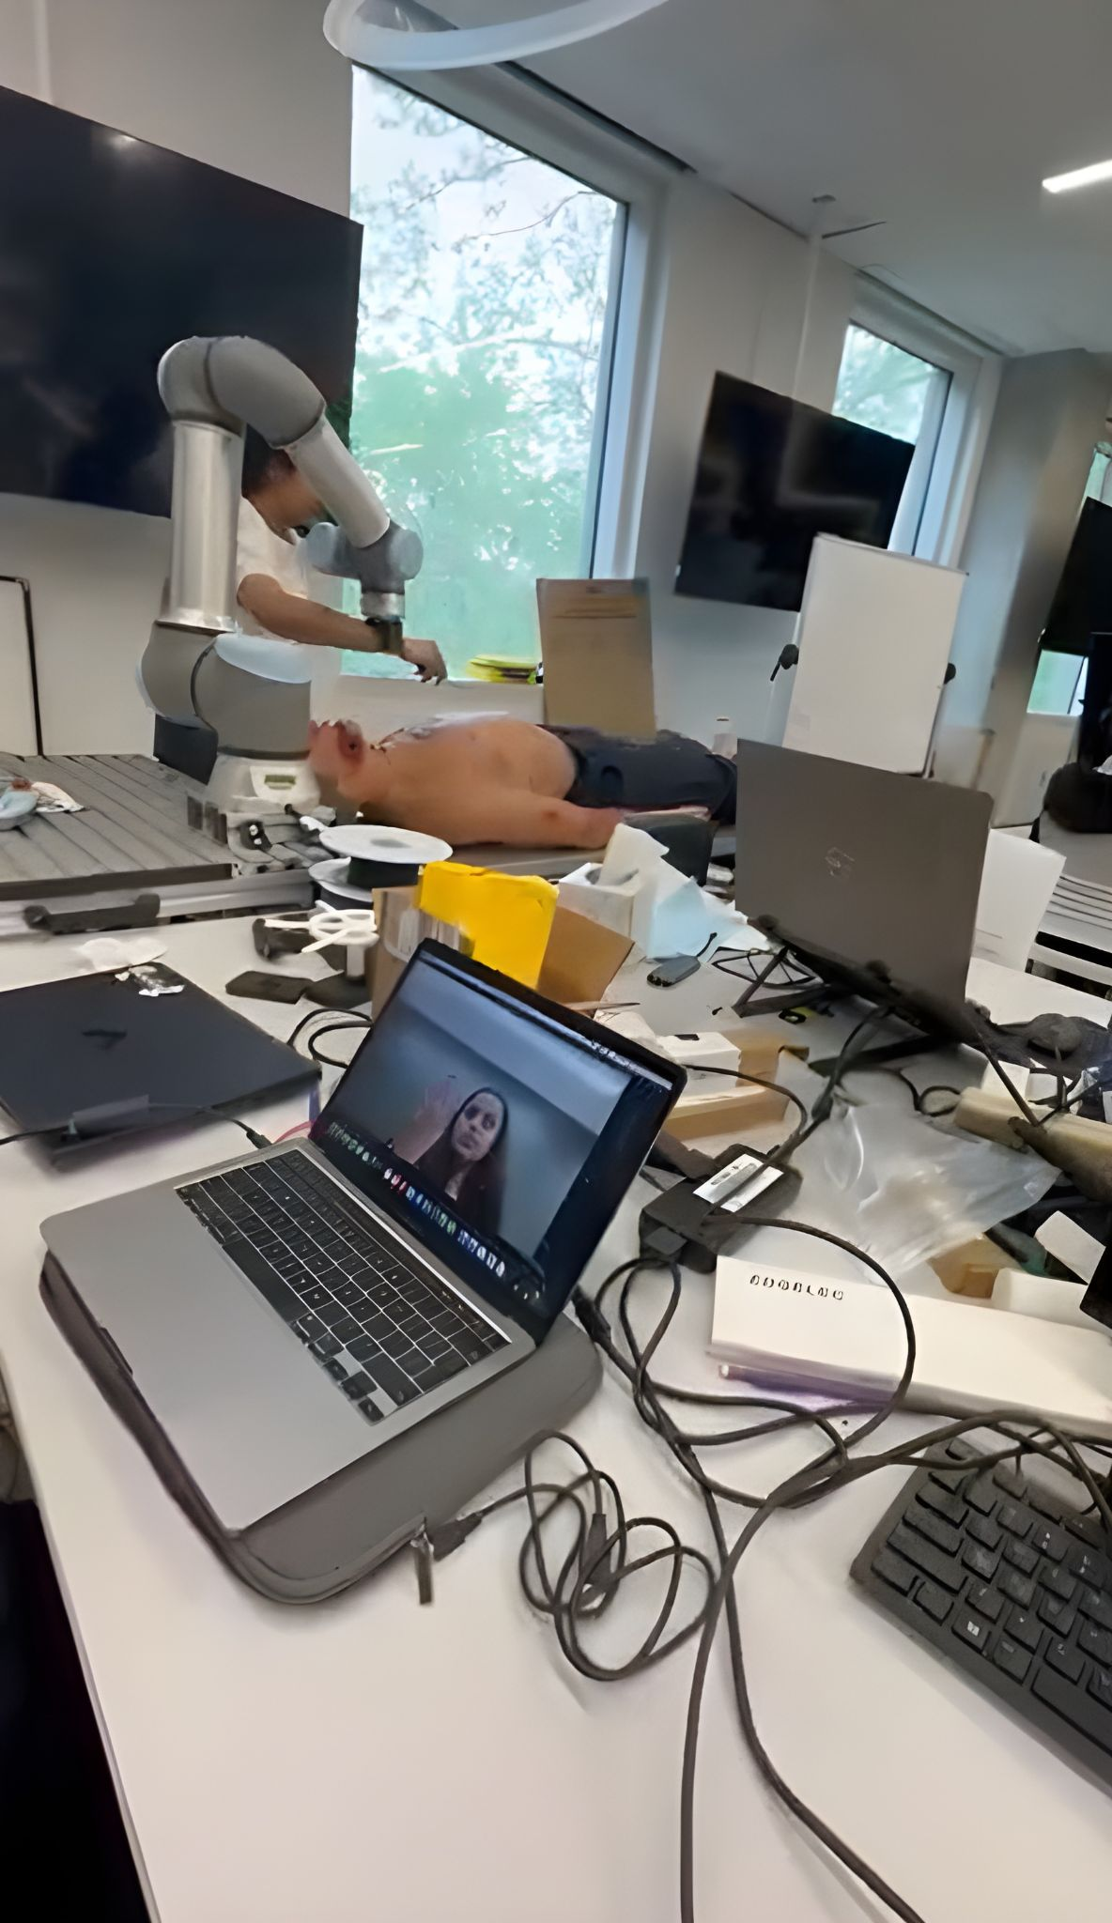
Student getting feedback
Teacher providing
Remote
Assistance

Slide 19
