Slide 1

Descriptive Analysis [BTIBMB402]
Guided By:
Ms. Anmol
Submitted By:
Aryak Tomar (20100BTCSDSI07264)
Parth Shrivastava (20100BTCSDSI07283)
Sanidhya Rajguru (20100BTCSDSI07293)
IBM COGNOS ANALYTICS

Slide 2
IBM Cognos Analytics - Covid-19 Dataset

Slide 3
Table of Content
IBM Cognos Analytics
Report
Crosstab
Visualization
Dashboard
Story
Bibliography

Slide 4
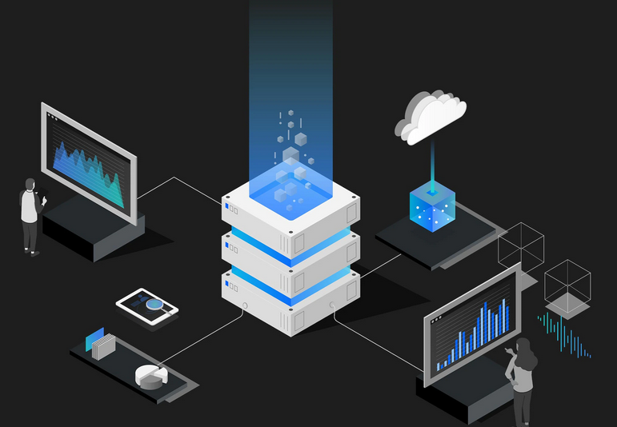
IBM Cognos Analytics
It is a Web-based data modelling used to create Interactive dashboards and enterprise reports having Data exploration and prediction.
Accelerate data prep with AI
Automate data exploration
Visualize and report on data
Scale and integrate
Protect your data
Modernize and maximize your investment

Slide 5
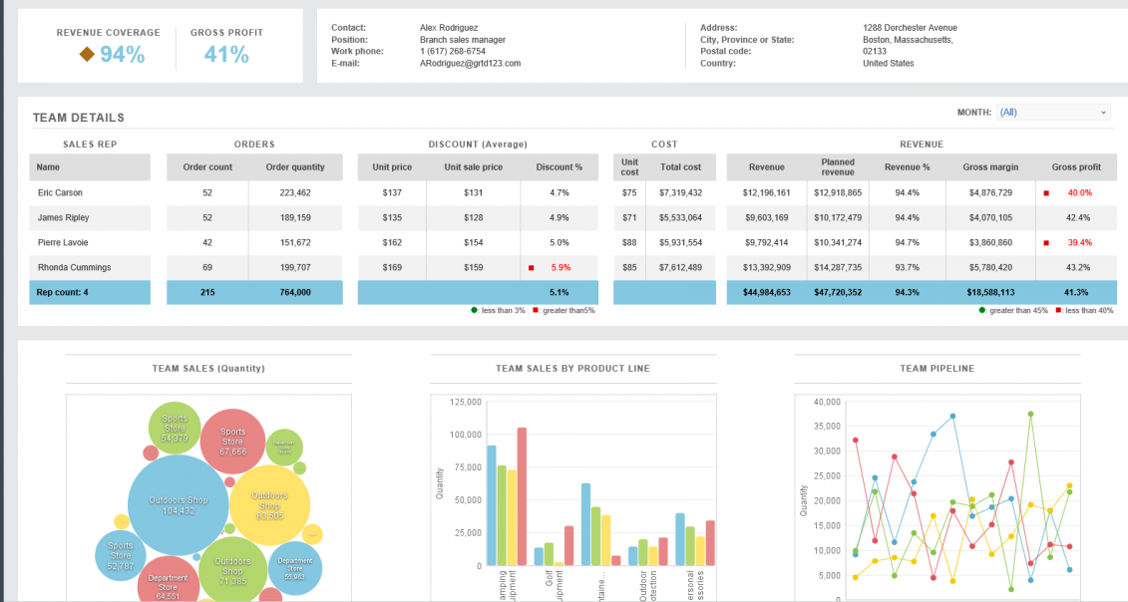
REPORT
It is a web-based report authoring tool that is used to build sophisticated, multiple-page, multiple-query reports against multiple databases. It allows user to include filters to customize and enhance there reports.

Slide 6
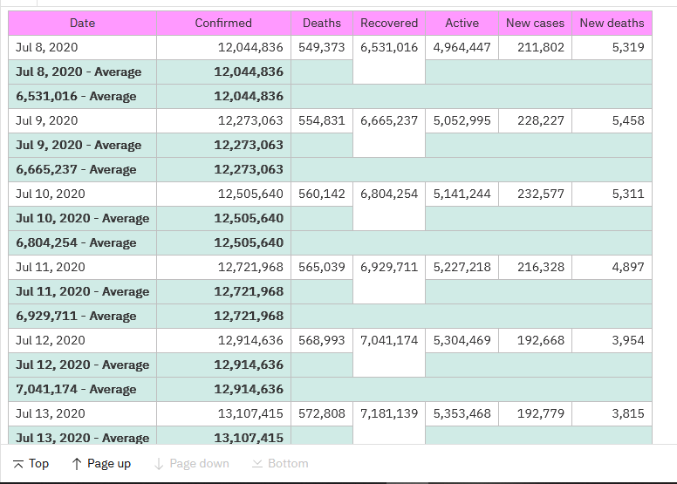
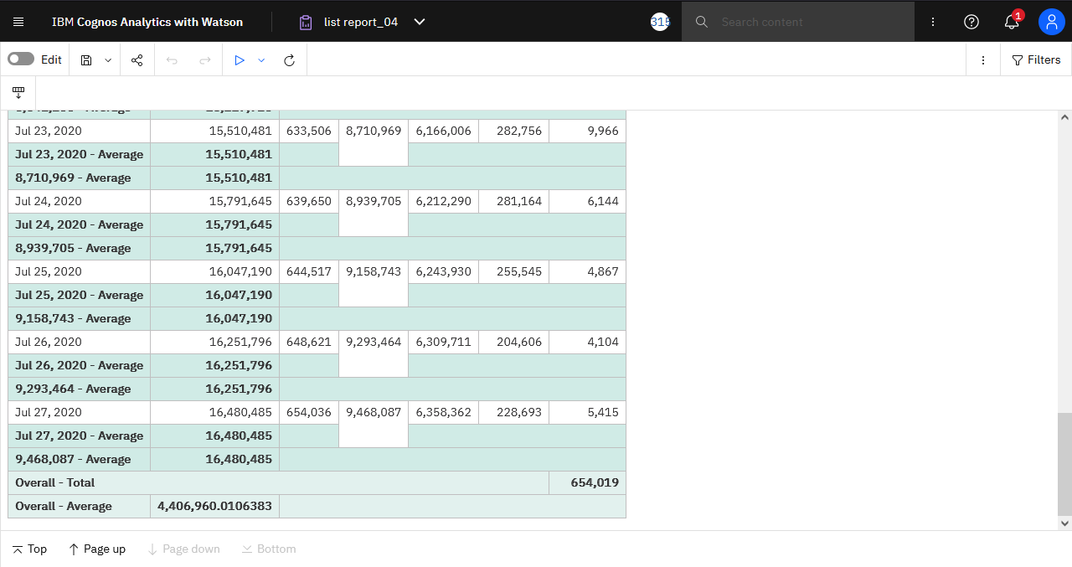
Reports on Covid-19 Dataset
Filters used:
Overall Total
Overall Average
Date wise Ascending order

Slide 7
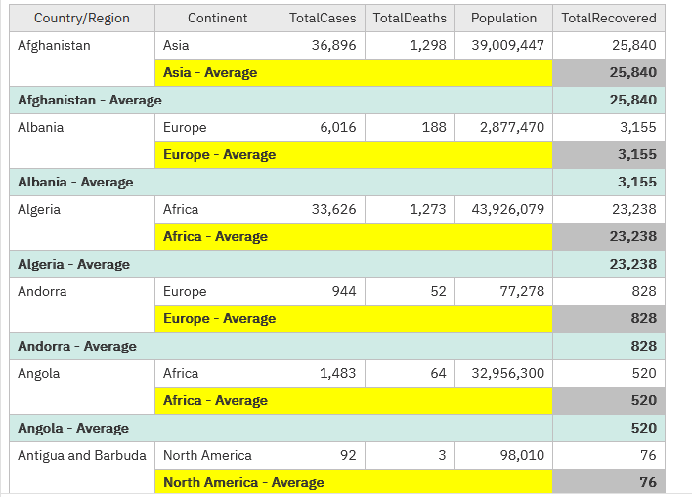
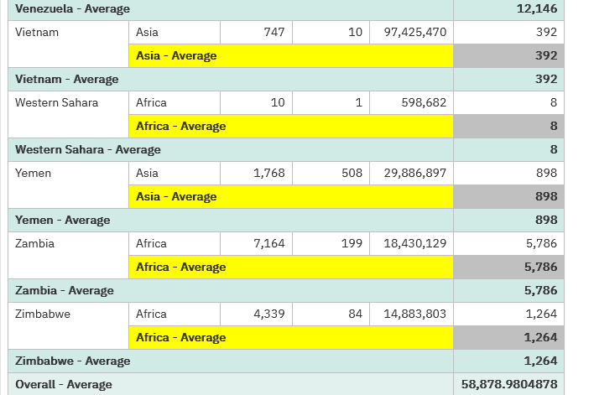
Reports on Covid-19 Dataset (contd)*
Filters used:
Overall Average
Group By
Alphabetically Ascending order

Slide 8
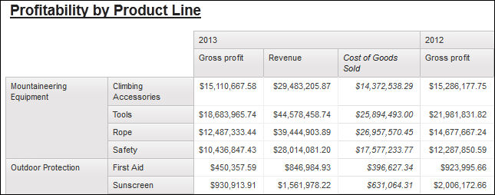
CROSSTAB
Crosstab reports, also known as matrix reports it is used to show the relationships between three or more query items. Crosstab reports show data in rows and columns with information summarized at the intersection points.

Slide 9
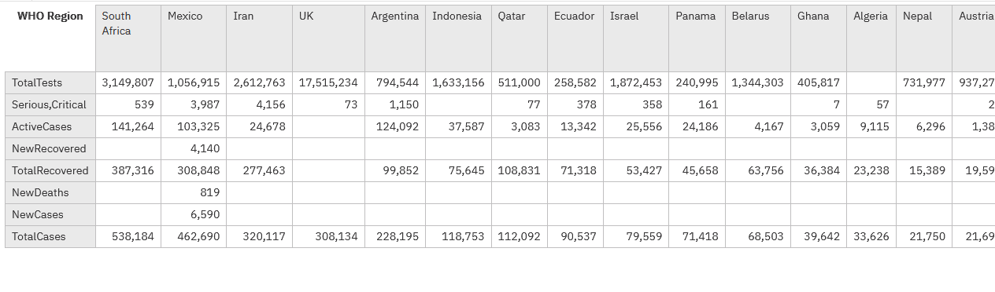
Crosstab reports on Covid-19 Dataset
Crosstab report which is showing Total Cases, Serious, Critical, New Cases, New Deaths etc. in WHO regions

Slide 10
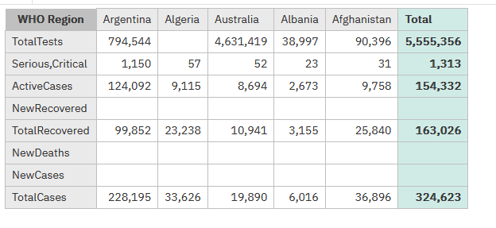
Crosstab reports on Covid-19 Dataset (contd)*
Crosstab report with TOTAL filter which is showing Total Cases, Serious, Critical, New Cases, New Deaths etc. in WHO regions

Slide 11
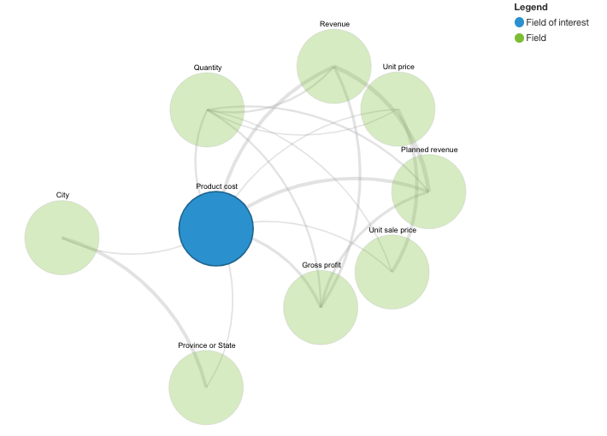
VISUALIZATION
Visualizations help report consumers to spot patterns and outliers and to understand data. We use IBM Cognos Analytics visualization tools to incorporate diverse types of visualizations and greater interactivity into the IBM Cognos reports.

Slide 12
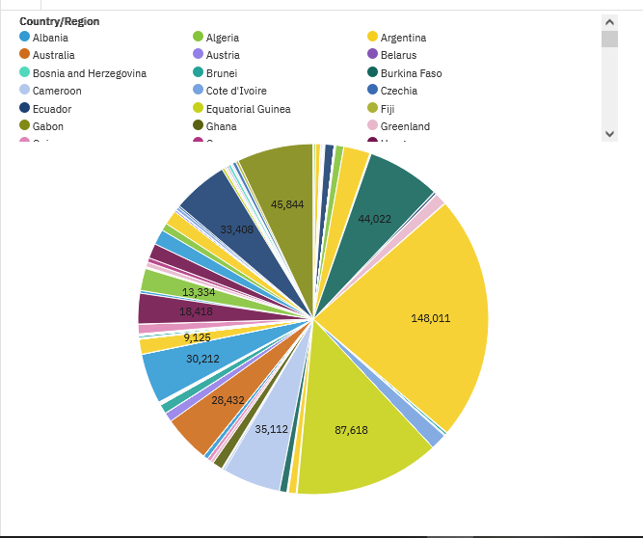
Visualization in Reports on Covid-19 dataset
This PIE-CHART contains data of ‘Death by Country’ record.

Slide 13
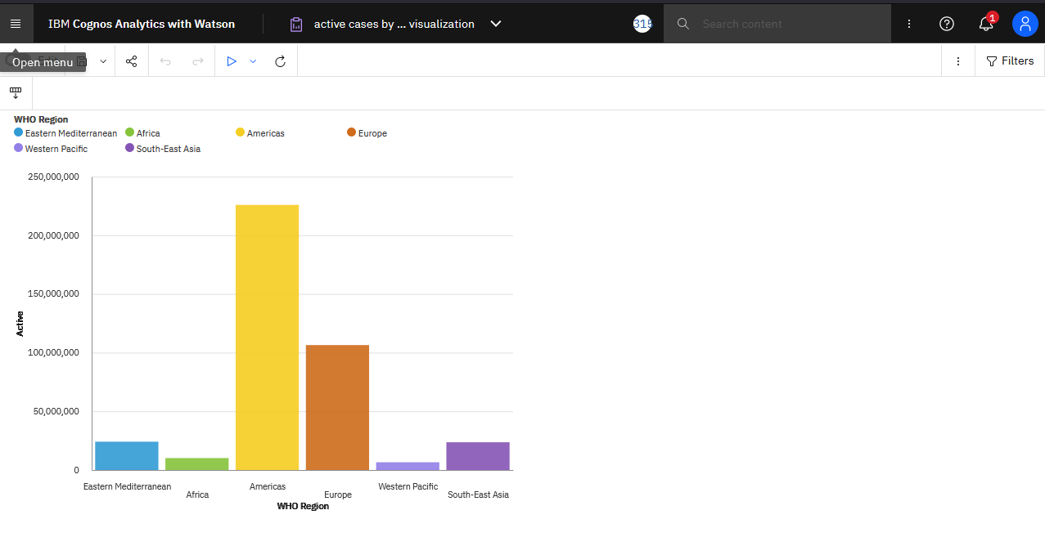
Visualization in Reports on Covid-19 dataset (contd)*
The BAR- GRAPH contains Active Cases in WHO region data.

Slide 14
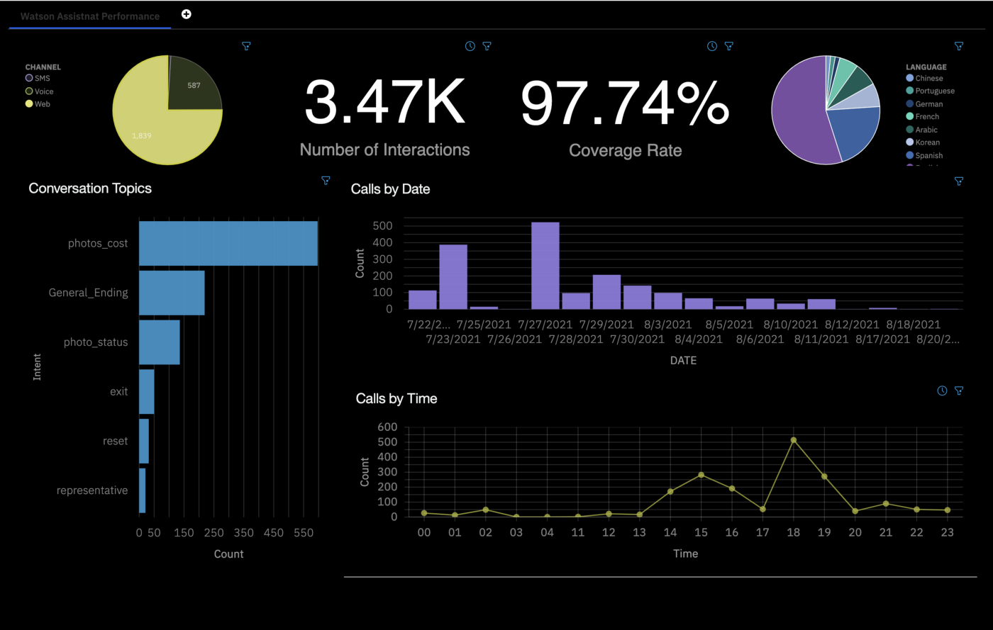
DASHBOARD
Dashboard allows us to explore powerful visualizations of our data in IBM Cognos Analytics and discover patterns and relationships that impact our business. Later we can communicate the insights that has been discovered in a dashboard and share it with others.

Slide 15
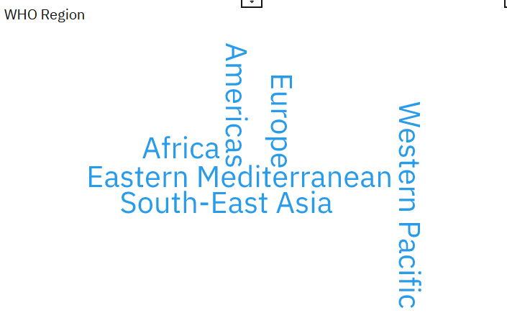
Use Of Dashboard on Covid-19 Dataset
This is WORD CLOUD Feature used in Dashboard of WHO regions.

Slide 16
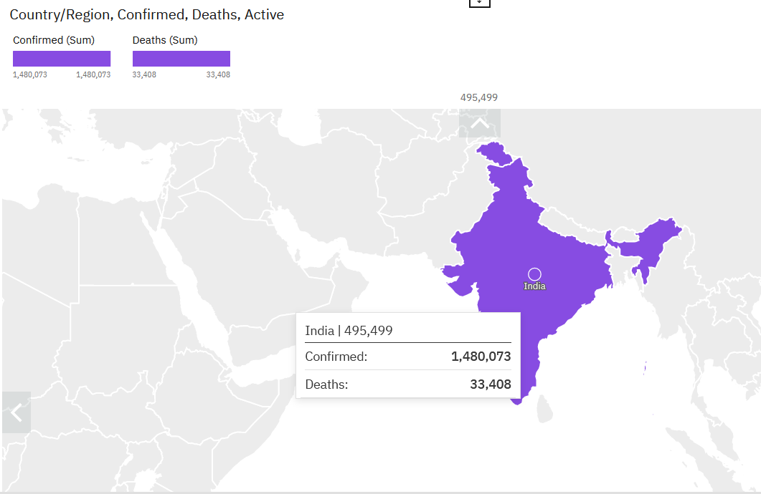
Use Of Dashboard on Covid-19 Dataset (contd)*
This is the LEGACY MAP featuring INDIA.

Slide 17
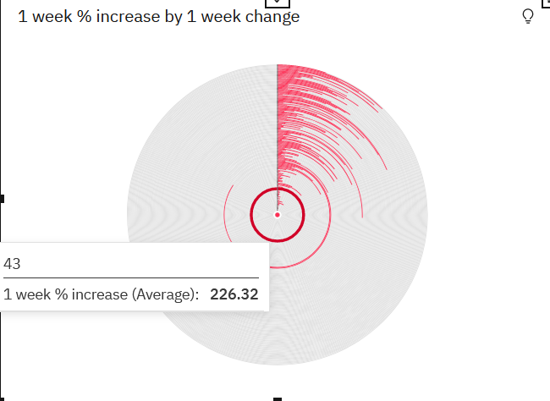
Use Of Dashboard on Covid-19 Dataset (contd)*
This is Radial Feature providing data of 1 week % increase by 1 week change.

Slide 18
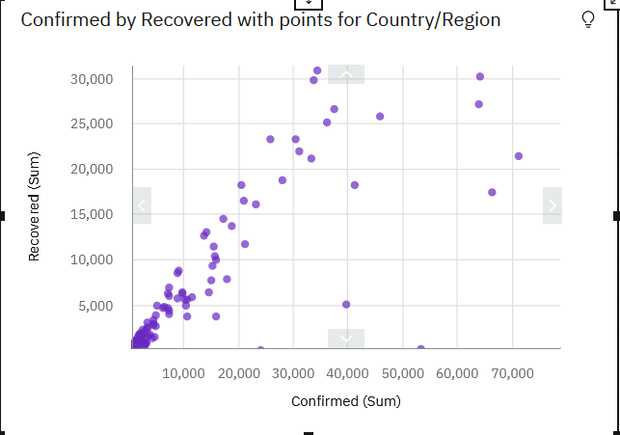
Use Of Dashboard on Covid-19 Dataset (contd)*
This is SCATTER feature showing record of Confirmed by Recovered patients.

Slide 19
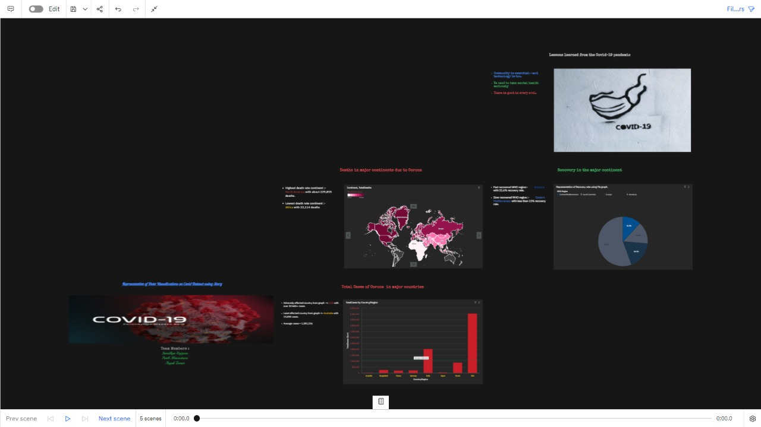
STORY
A story is a type of view. A story is composed of a set of scenes that are displayed in sequence over time. Stories can be used to provide your data with a visual narrative. Stories can help you inform and engage the audience. We can use stories in IBM Cognos Analytics to create scenes that visualize your data and to tell a narrative.
A story is a type of view. A story is composed of a set of scenes that are displayed in sequence over time. Stories can be used to provide your data with a visual narrative. Stories can help you inform and engage the audience. We can use stories in IBM Cognos Analytics to create scenes that visualize your data and to tell a narrative.

Slide 20
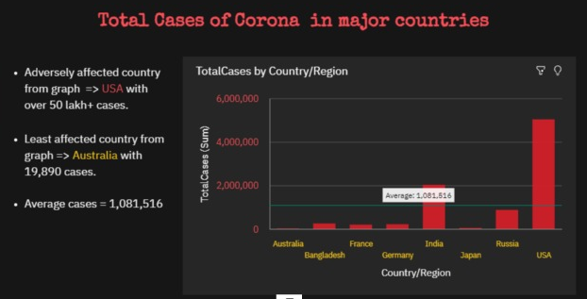
Story Representation

Slide 21
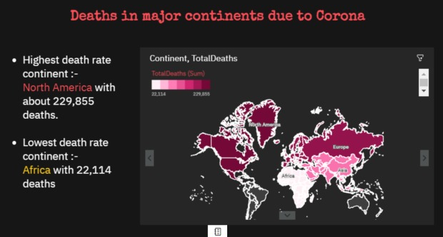
Story Representation (contd)*

Slide 22
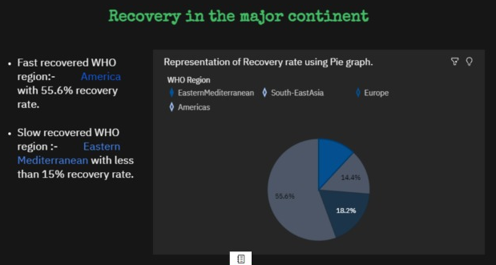
Story Representation (contd)*

Slide 23
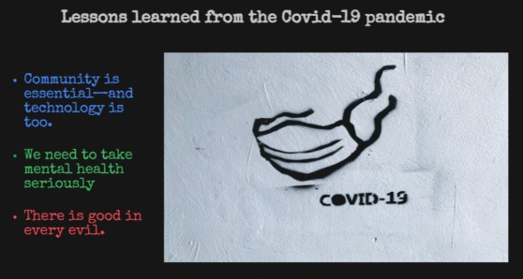
Story Representation (contd)*

Slide 24
Story View

Slide 25
Bibliography
www.google.com/
https://www.kaggle.com/datasets/imdevskp/corona-virus-report
www.ibm.com
https://www.ibm.com/docs/en/cognos-analytics/11.1.0?topic=stories-
https://www.ibm.com/docs/en/cognos-analytics/11.0.0?topic=stories-dashboards
https://www.ibm.com/docs/en/cognos-analytics/11.0.0?topic=library-visualizations
https://www.ibm.com/docs/en/cognos-analytics/11.1.0?topic=reporting-getting-started-in-cognos-analytics

Slide 26
THANK YOU!

