Slide 1
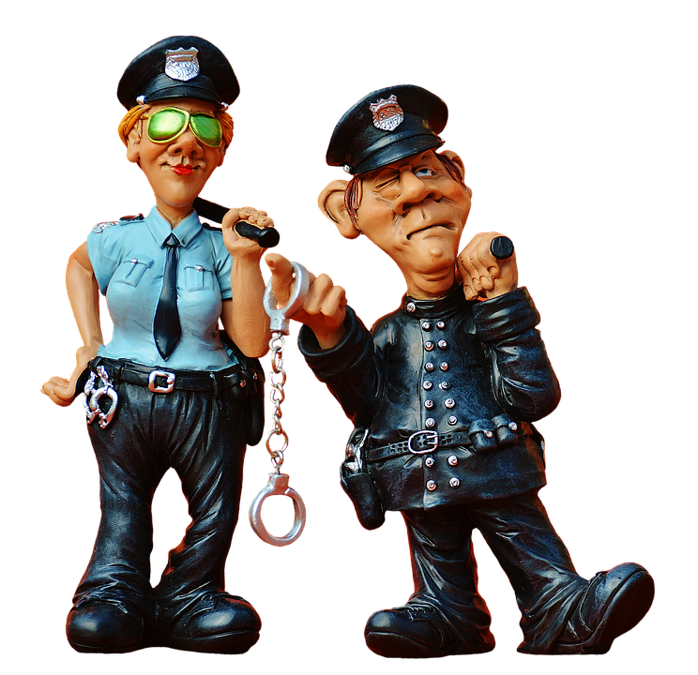
CSRC-Cyber Speed Regulation Cop

Slide 2
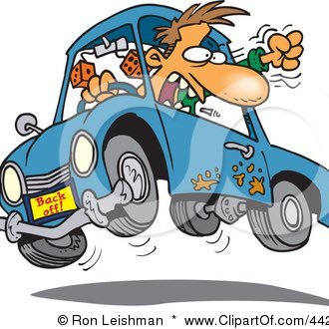

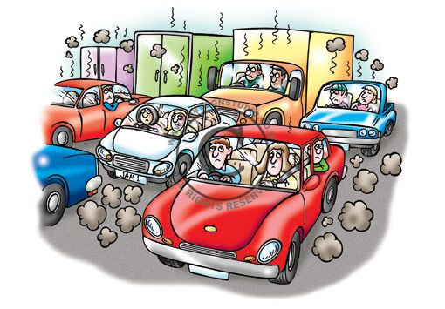
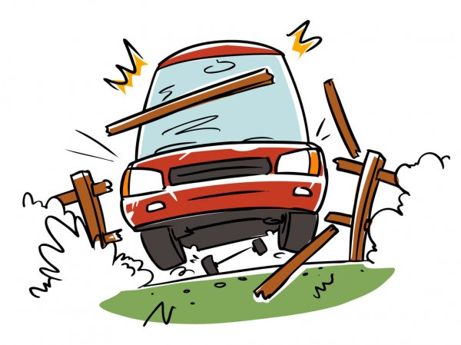
PROBLEM
Driving too fast is the single biggest contributor to death and injury. Speeding consistently contributes to around 41 per
cent of road fatalities and 24 per cent of serious injuries each year.
This means almost 150 lives lost and 1,270 people seriously injured
each year.
High speed impact crashes often leave accident victims with
debilitating injuries and expensive medical bills. Additionally,
high speed car accidents can be fatal.
Rash driving was the root cause behind 92 per cent of the road
accidents reported during 2019. Of the 305 accidents,
282 were caused due to rash driving. Meanwhile, 104 accident deaths
were reported of which a majority were of two-wheeler riders and pedestrians.

Slide 3
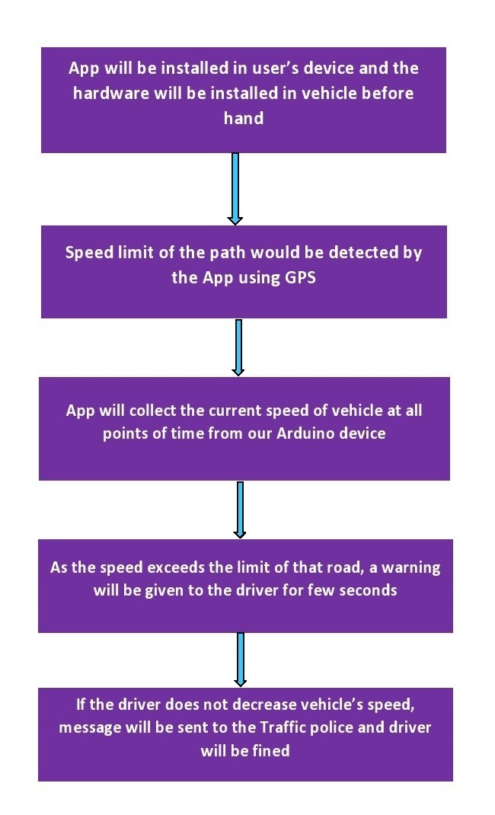
SOLUTION
The solution we proposed to the above discussed problem is that, our Application (CSRC_Tracker) will be installed in the user’s mobile phone. The Arduino Hardware will be pre-installed in the vehicle by the Automobile Company which will get connected to the app via Bluetooth. While driving, the current speed of the vehicle will be checked and if it crosses the speed limit of that road for that vehicle, a warning will be given to the driver on his phone itself, and if he doesn’t take his speed back to normal, a text message will be sent to the Traffic Police, which will tell the Name and Driving License number of Driver, Details of Vehicle Owner, Speed of vehicle and Location of vehicle. With this information, the driver can be fined easily and central authorities can inform the ones on duty on that road.

Slide 4

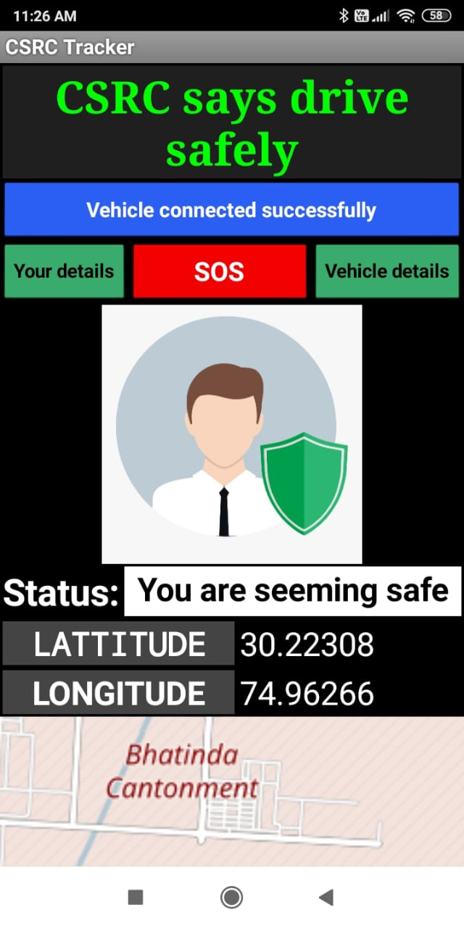
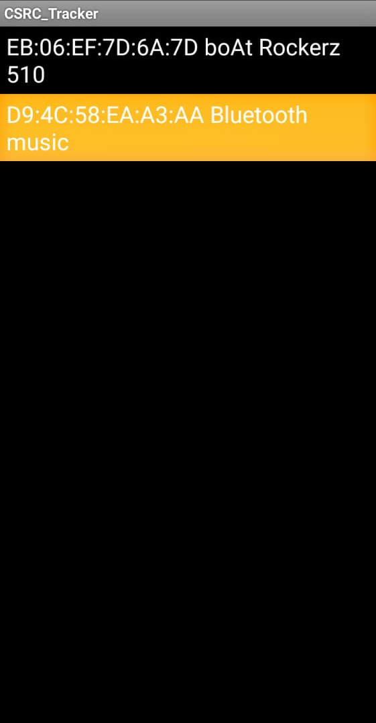
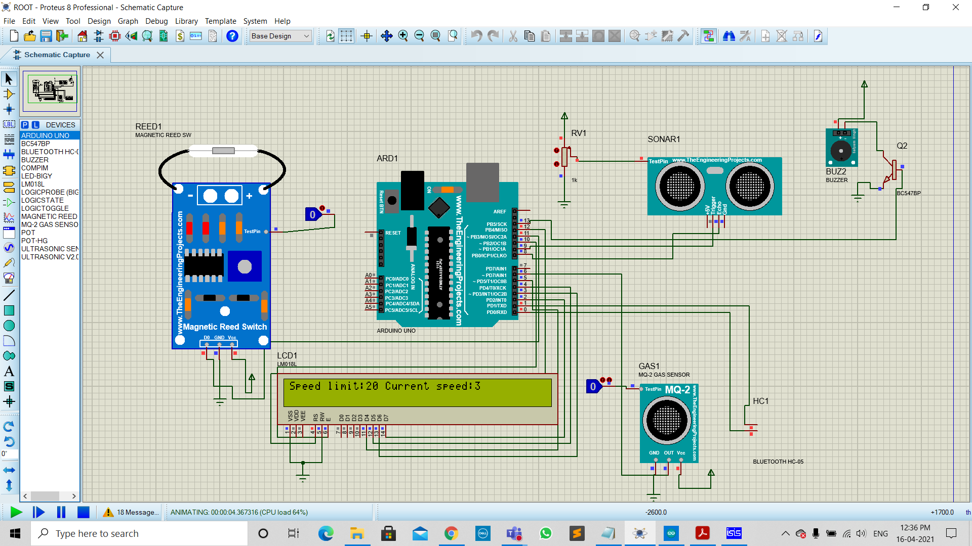
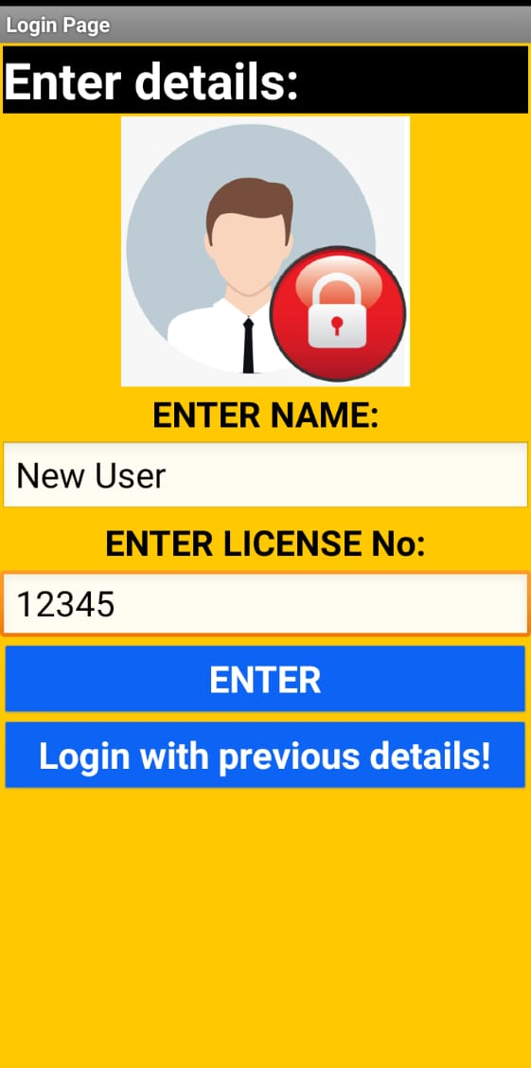
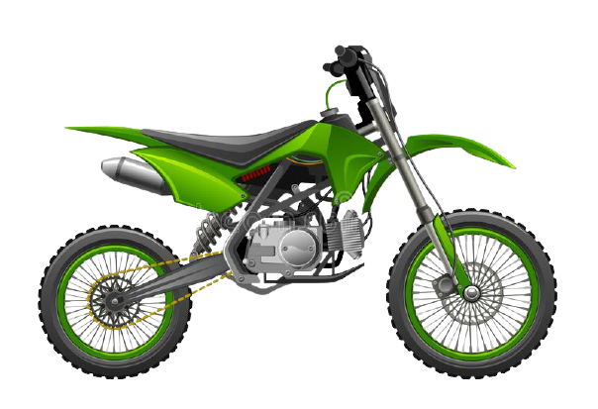

Isn’t that simple?
CSRC

Slide 5
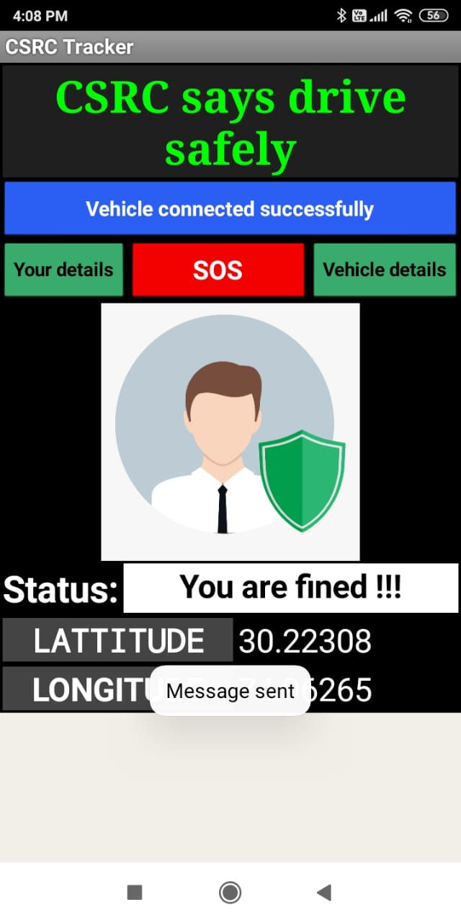
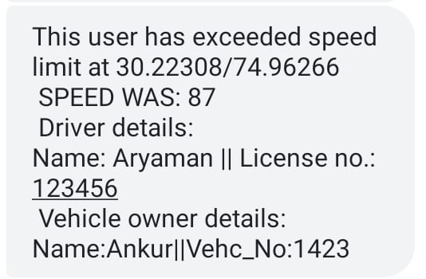

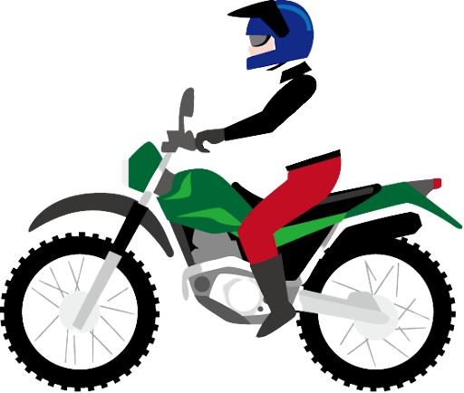

Speed limit was 20 when exceeding message is displayed!
2
1

Slide 6
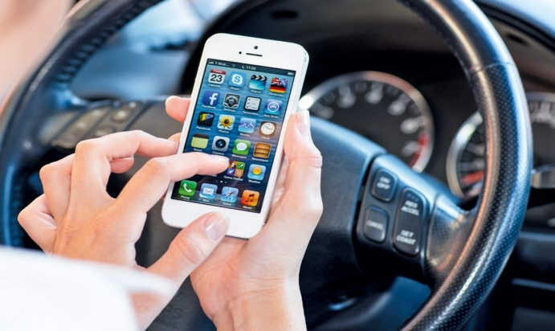
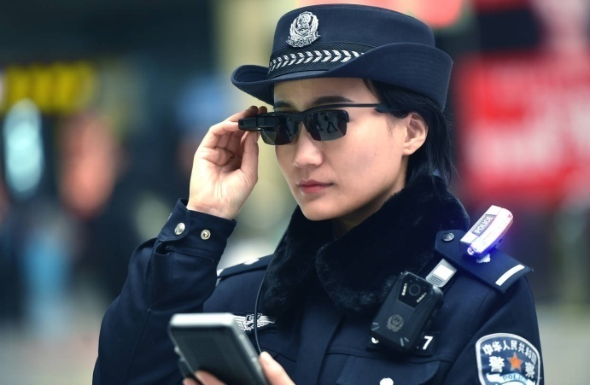
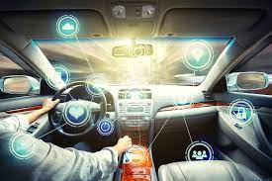
TARGET AUDIENCE
The main Target Audience of this project is the TRAFFIC AUTHORITIES/BODIES ACROSS THE GLOBE since it will be helpful for them to control traffic over highly rushed roads.
More precisely, the Target Audience of this project is EVERY THAT PERSON WHO IS DRIVING ANY MOTOR DRIVEN VEHICLE. The hardware setup of our project will be installed in every sold vehicle by the Automobile Companies and the application involved will be installed in mobile phones of the person driving that vehicle.

Slide 7
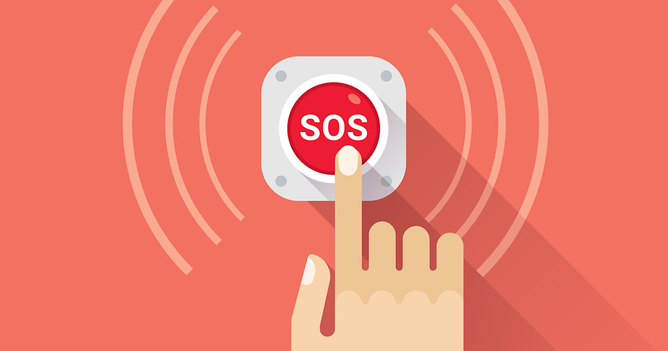
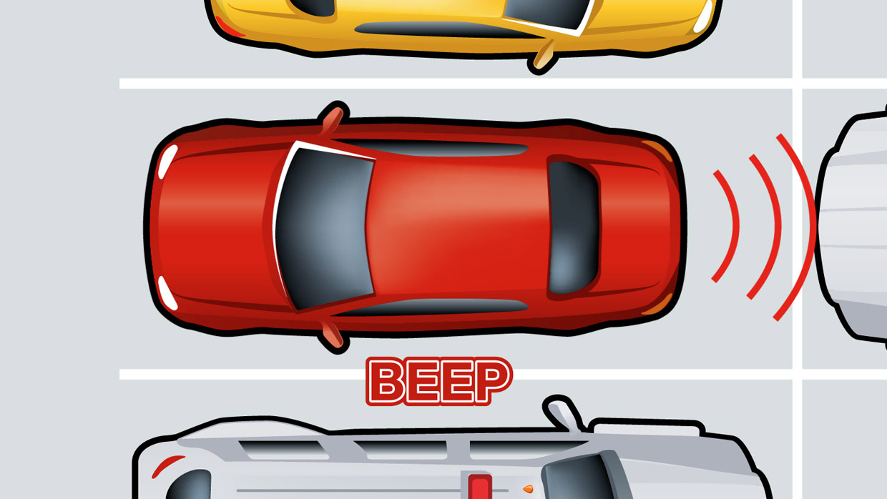

SPECIAL FEATURES
SOS : The Driver can contact the Traffic Police for Help or any kind of Assistance in case of Road Accidents or Emergencies.
Ultrasonic Sensor : When the Vehicle is running on road, and any other vehicle or obstacle comes very close, it will Indicate the Driver by a Loud and High Pitch Alarm.
Use of Google Firebase : When any Vehicle gets Fined, all the Details of Vehicle, Owner and Driver will be stored on Firebase Database for Future Reference and Police Records.

Slide 8
IMPACT ON REAL WORLD
FUTURE SCOPE
With the advanced system, drivers will be cautious enough that they will be directly caught and fined if they cross the limit and there will be no escape to it.
Instead of barricading the roads and manually fine vehicles, everything will be done on its own, and the job of traffic police will also become easier and efficient many folds.
The problem of rash driving will be sorted and traffic jams will also be reduced.
In case of road emergencies, it will be easier to contact police for help.
Presence of Ultrasonic sensors will also play major role in decreasing number of accidents.
With the rapid growth of population and vehicles, our solution can be much more helpful in future.
Also considering the fact that use of smartphones as well as fast and cheap internet is becoming very common from the past one decade, the use of our application will be very easy and handy.
With the day by day advancement in technology, the hardware as well as software implementation will be much more simple and effective.
The hardware possess a minimal cost and can be easily integrated in all types of motor driven vehicles by the automobile companies itself and the usage of our application can become a habitual as well as strict practice among the common public.

Slide 9
PROPOSED BY-
Team NODEzilla
Members:
Ankur Agrawal
Sanidhya Taparia
Aryaman Gupta
THANK YOU

