Slide 1
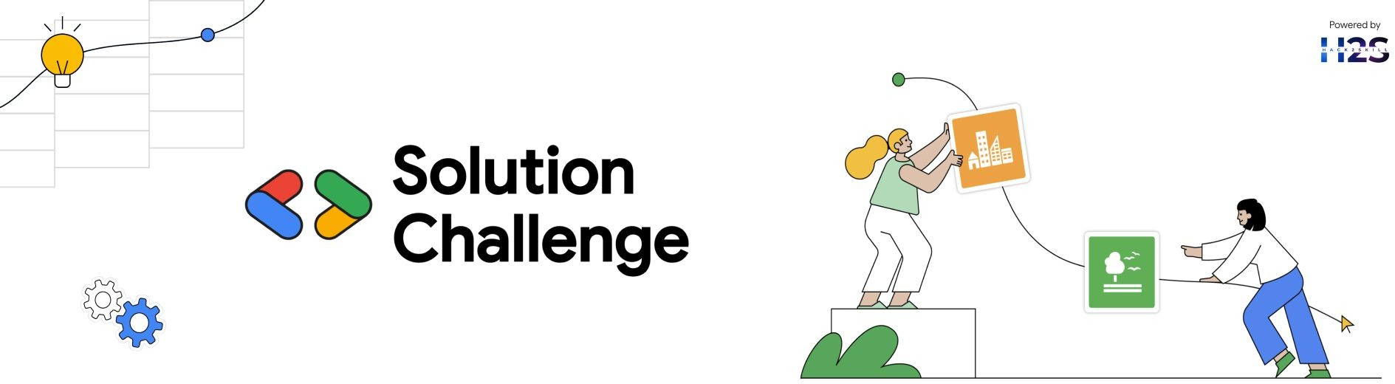
Team Details
Team name: The Think Tank
Team leader name: Saniha Manjunath
Problem Statement: AI-driven Fracture Analysis

Slide 2
Brief about our solution
Our AI-powered X-ray analyzer detects fractures using deep learning and enhances diagnosis with 3D visualization and storytelling. The model classifies fractures from X-ray images, reconstructs a 3D view for better understanding, and provides an interactive narrative explaining the injury. This improves diagnostic accuracy, aids doctor-patient communication, and enhances medical decision-making.

Slide 3
Opportunities
How different is it from any of the other existing ideas?
3D Visualization – Unlike traditional AI models that only classify fractures, your solution provides 3D reconstruction of the affected area, offering a more intuitive and detailed view.
Storytelling Feature – Most AI-based X-ray analyzers focus only on detection, but your app adds narrative insights, making it easier for patients and doctors to understand the severity and implications of the fracture.
Enhanced User Experience – Existing solutions are mainly technical tools for radiologists, while your app integrates interactive and educational elements, improving doctor-patient communication and engagement.

Slide 4
How will it be able to solve the problem?
AI-Powered Detection – Uses deep learning (CNNs) for accurate fracture classification.
3D Visualization – Converts 2D X-ray images into interactive 3D models for better understanding.
Storytelling Insights – Provides easy-to-understand narratives to enhance doctor-patient communication.
Faster & Efficient Diagnosis – Reduces human error and speeds up medical decision-making.
Improved Patient Experience – Makes complex medical insights accessible and engaging.

Slide 5
USP of the proposed solution
AI-Driven Accuracy – Uses deep learning for precise and automated fracture detection.
Interactive 3D Models – Transforms X-rays into detailed 3D visualizations for better diagnosis.
Engaging Storytelling – Provides personalized insights to simplify medical explanations.
Improved Patient Involvement – Helps patients understand their condition beyond just reports.
Enhanced Medical Workflow – Assists doctors in faster decision-making, reducing workload.

Slide 6
List of features offered by the solution
AI-Powered Fracture Detection – Uses deep learning for accurate and automated analysis.
3D Visualization – Converts 2D X-rays into interactive 3D models for better understanding.
Storytelling Insights – Provides easy-to-understand narratives for doctors and patients.
Real-Time Analysis – Delivers instant results to speed up diagnosis and decision-making.
User-Friendly Interface – Ensures seamless interaction for both medical professionals and patients.

Slide 7
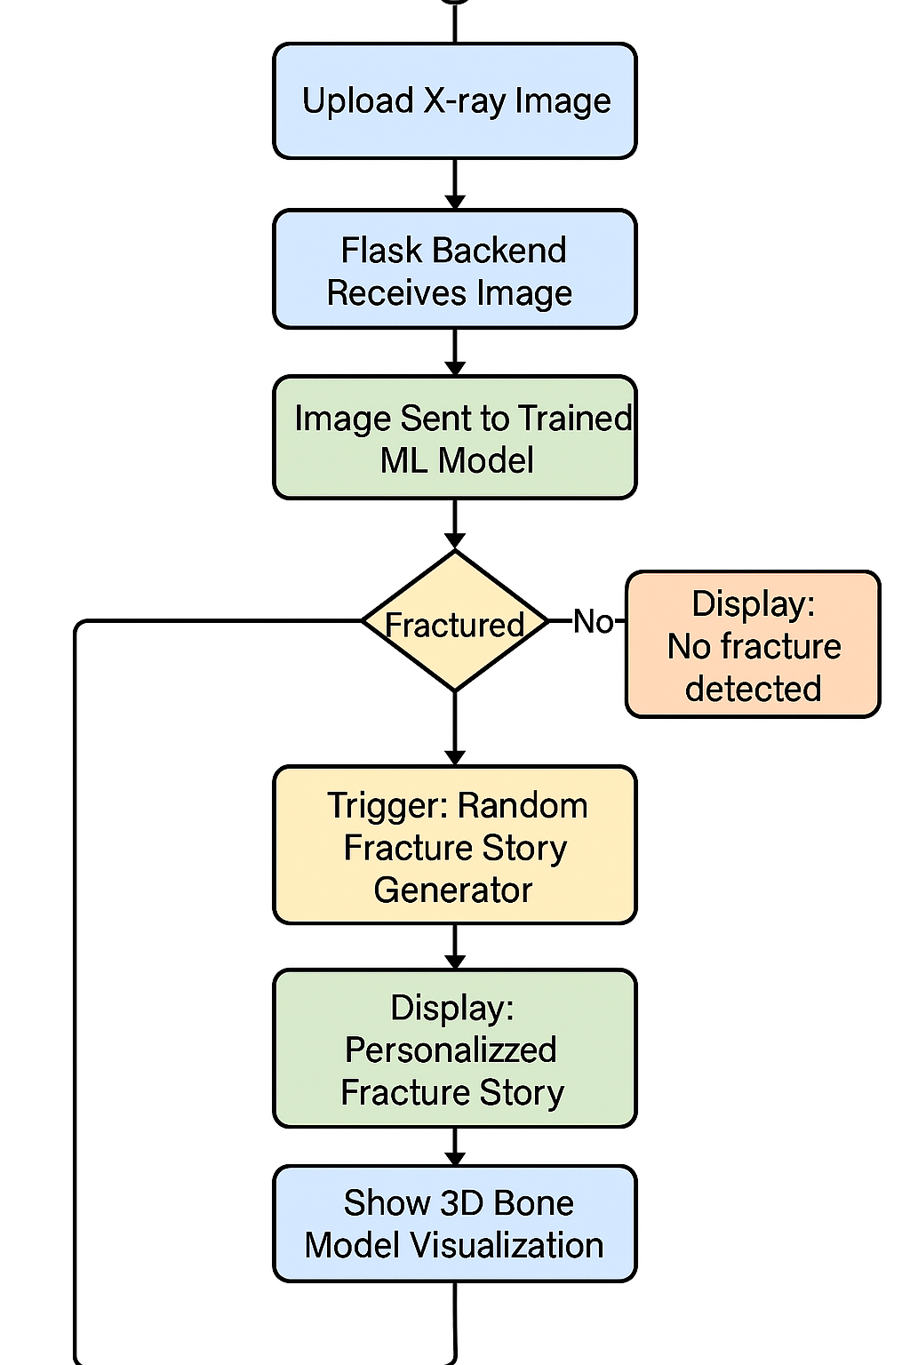
Process flow diagram or Use-case diagram

Slide 8
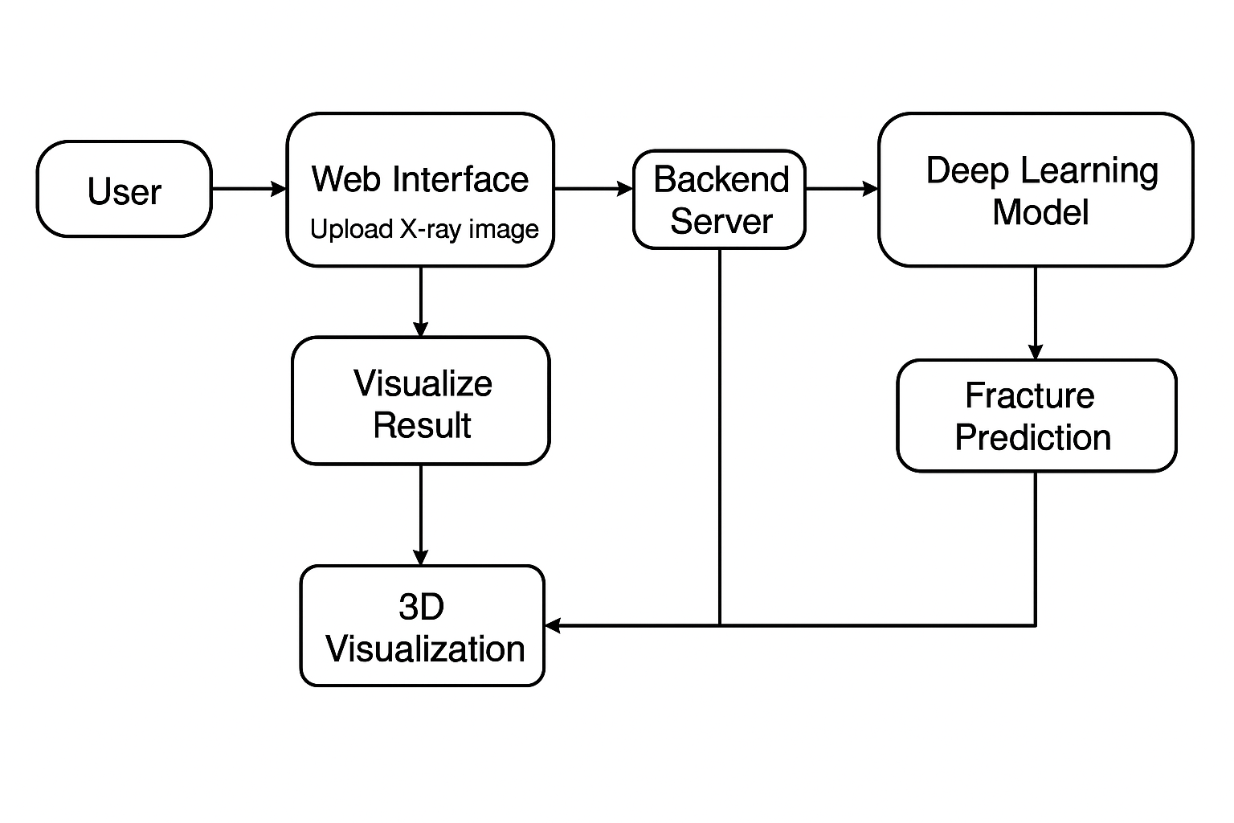
Architecture diagram of the proposed solution

Slide 9
Technologies to be used in the solution
Deep Learning (CNNs, Transformers) – For precise fracture detection from X-ray images.
3D Visualization (Blender API) – To generate interactive 3D fracture models.
Natural Language Processing (GPT) – For storytelling-based medical insights.
Backend & Deployment (Flask) – For model integration and cloud accessibility.
Frontend (React) – To create an intuitive and interactive user interface.

Slide 10
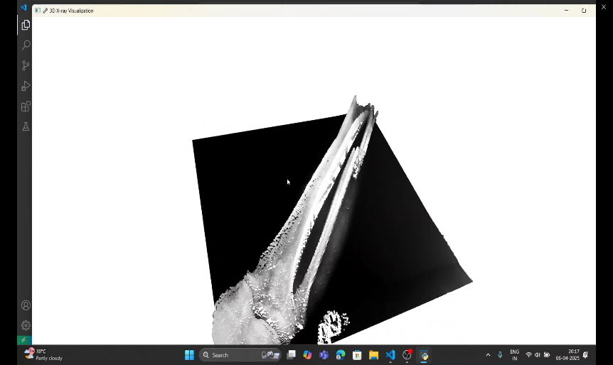
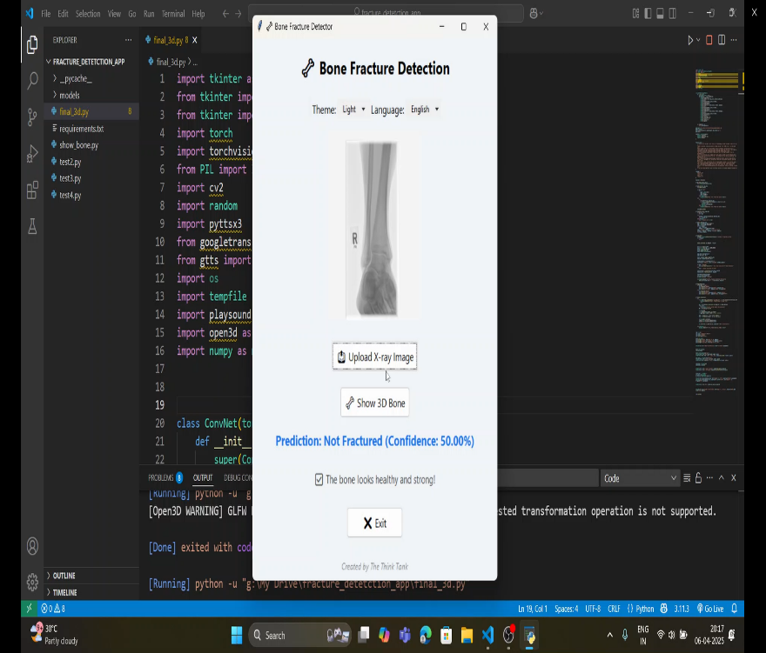
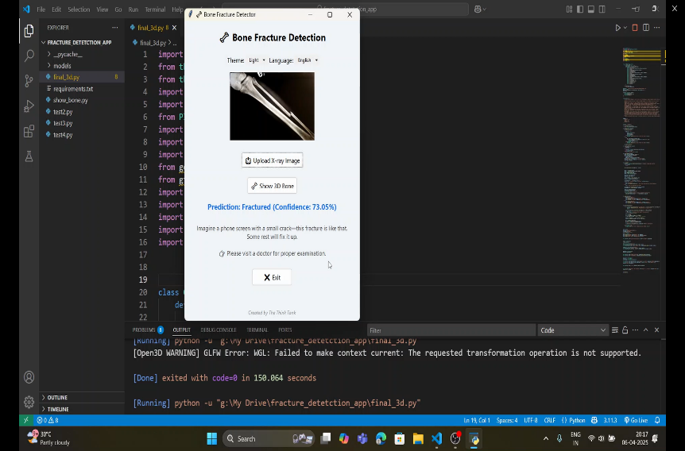
Snapshots of MVP

Slide 11
Additional Details/Future Development
Multi-Class Fracture Detection – Expanding the model to classify different fracture types and severity levels.
Advanced 3D Reconstruction – Improving accuracy with better rendering and real-time interaction.
Augmented Reality (AR) Integration – Enabling doctors and patients to visualize fractures in AR.
Personalized Treatment Recommendations – AI-driven insights for better recovery guidance.
Real-Time Clinical Deployment – Optimizing for hospitals and emergency diagnostics

Slide 12
1. GitHub Public Repository: https://github.com/S-Mayur/AI-driven-Fracture-Analysis
2. Demo Video Link /Explanation Video: https://www.youtube.com/watch?v=fPjgMUB8oTo
3. MVP Link: https://www.youtube.com/watch?v=GJRfrat2RN0

Slide 13
Solution Challenge
Powered by
a

