Slide 1
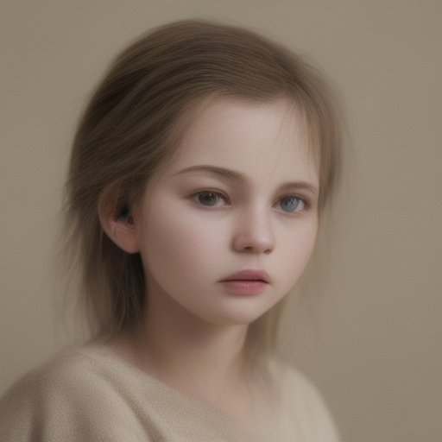
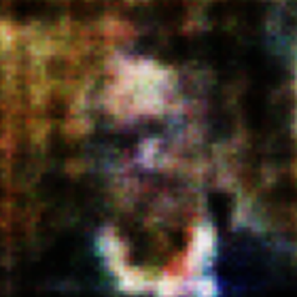
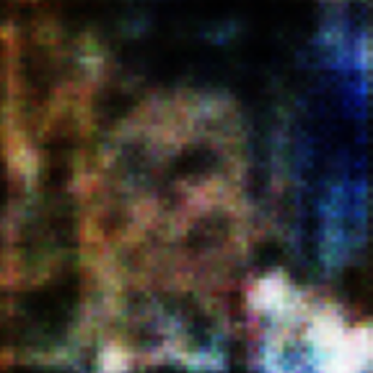
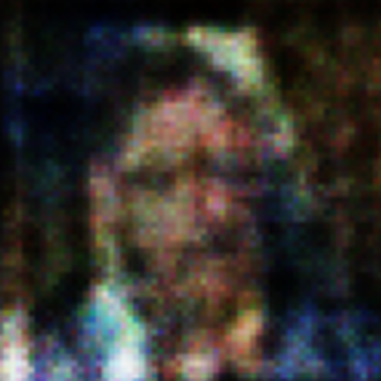
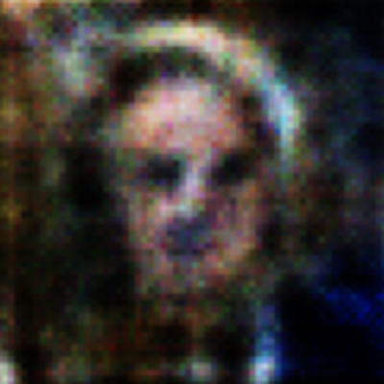
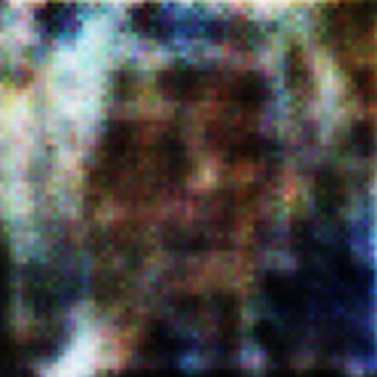
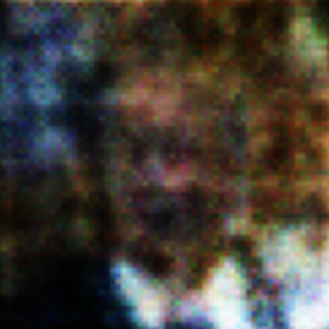
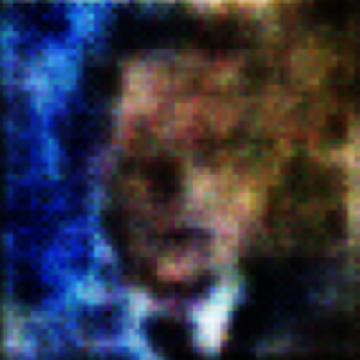
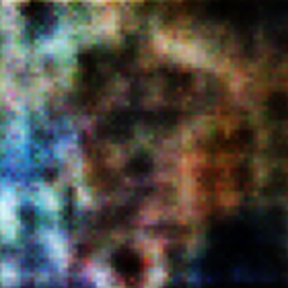
ASSIGNMENT 02 · CO3 + CO4
Reconstruct or Create?
A comparative study of four Generative AI models
Autoencoder · VAE · DCGAN · Diffusion
Generative AI · B.Tech AIML · MIT Academy of Engineering, Pune
SUBMITTED BY
Amruta Kanase 202401110042
Sanika Mane 202401110047
Tanishka Tapkir 202401110071
Open our Colab notebook →
All faces on this slide are AI-generated (diffusion + our DCGAN)
Notes:
Introduce the team. Our question: how do generative models differ when they reconstruct an image versus create a new one? We compared an Autoencoder and VAE for reconstruction (CO3), and DCGAN and a pretrained diffusion model for generation (CO4), using 3,000 LFW face images at 64×64 in Google Colab. Every face on this slide was generated by AI: the large one by the diffusion model, the small ones by our DCGAN.

Slide 2






Four models, two jobs
RECONSTRUCTION · CO3
GENERATION · CO4
Autoencoder
VAE
DCGAN
Diffusion
Squeezes the image into 128 numbers, then rebuilds it (MSE loss)
Learns a distribution (μ, σ), samples z = μ + σ·ε (recon + KL loss)
Generator fakes faces from noise; discriminator judges real vs fake
Removes noise step by step, guided by a text prompt (U-Net)
Simple, fast, stable
Can sample new faces
New, sharper images
Best quality + prompt control
Blurry, loses detail
Even softer outputs
Unstable, artefacts
Heavy compute
Used for Compression, denoising
Used for Representation learning
Used for Face synthesis, augmentation
Used for Text-to-image, design
Notes:
Two models reconstruct and two generate. AE compresses an image to 128 numbers and rebuilds it: stable but blurry. VAE learns a distribution so we can sample new faces, but outputs are softer. DCGAN pits a generator against a discriminator: new, sharper images but unstable training. Diffusion removes noise step by step guided by a prompt: best quality, highest compute.

Slide 3
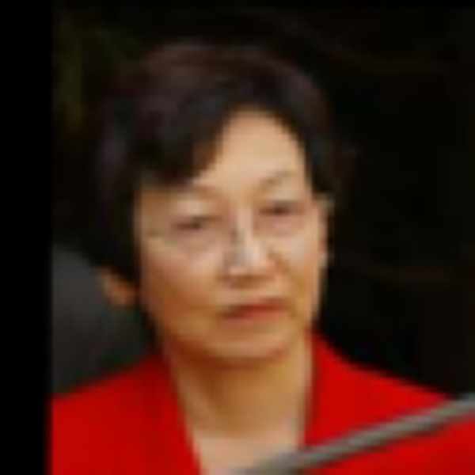
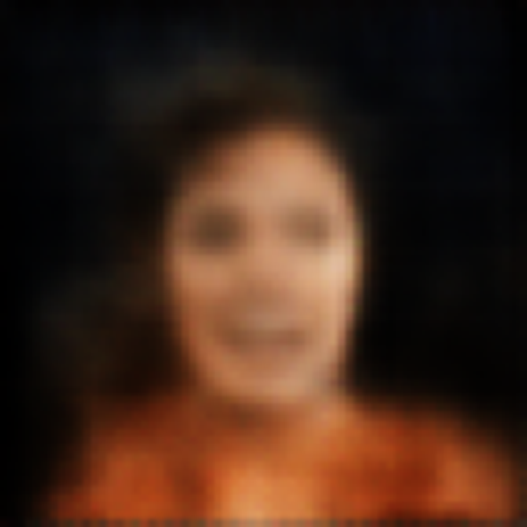



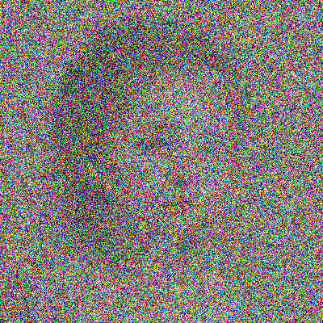
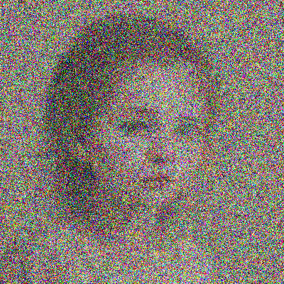
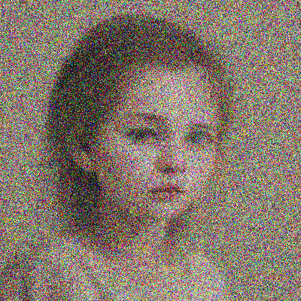
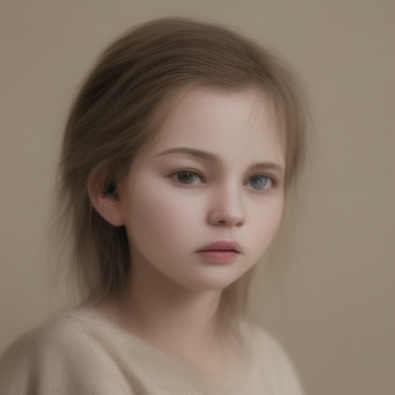
Inside each model
Autoencoder compress → rebuild
VAE learn a distribution, then sample
μ
z
z
σ
128-d
sample
Encoder
Decoder
Encoder
Decoder
DCGAN generator vs discriminator
Diffusion denoise step by step, guided by text
+ real LFW faces
prompt: "realistic portrait…" · guidance 7.0
Real?
Fake?
noise z
Generator
fake
Discriminator
pure noise
U-Net removes noise × 20 steps
image
Faces in the AE/VAE diagrams are a real test image and its actual reconstructions. The diffusion strip illustrates noise levels using our generated output.
Notes:
Inside each model. The Autoencoder funnels the image down to 128 numbers and back up; the output is the actual blurry reconstruction we got. The VAE splits the bottleneck into a mean and a spread, samples z from it, then decodes, which gives the even smoother face. DCGAN turns random noise into a fake face through the generator, and the discriminator compares fakes with real LFW faces. Diffusion starts from pure noise and removes it over 20 U-Net steps, guided by the text prompt.

Slide 4

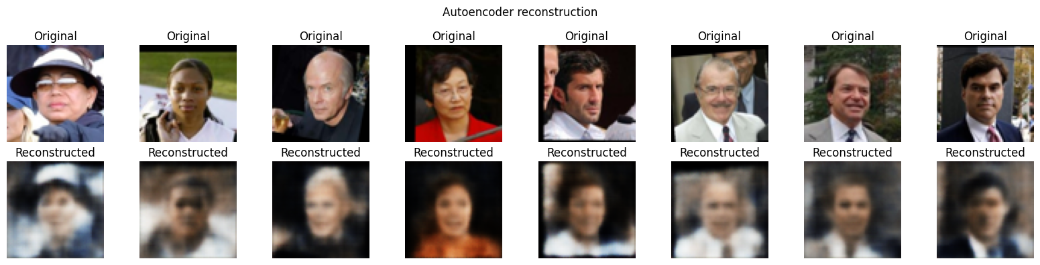
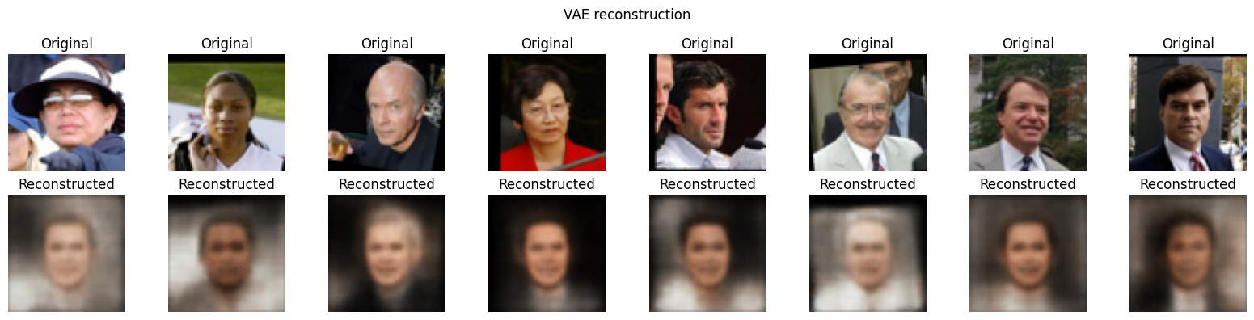
Activity A: AE keeps more detail than VAE
0.0144
−74%
AE validation MSE
MSE drop in 10 epochs
AE keeps face shape, skin tone and lighting
Original (zoomed)
Autoencoder
VAE
Hair, eyes and edges get blurred
VAE faces look smoother and "averaged"
AE: all 8 test faces
VAE: all 8 test faces
Main difference: loss of detail, not distortion
Notebook output · top row original, bottom row reconstructed
Notes:
Activity A. Zooming in on one test face makes the difference obvious: the Autoencoder keeps her pose, hair colour and red jacket, but blurs the face. The VAE output is smoother still and looks like an average face, because the KL term organises the latent space. AE validation MSE dropped 74% to 0.0144 in 10 epochs (31 s); the VAE took 20.5 s. Neither shows heavy distortion; the main difference is loss of detail.

Slide 5
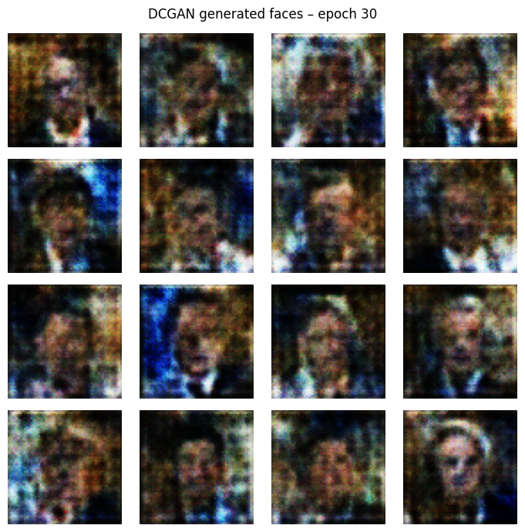
Activity B: Pretrained Diffusion Produces More Realistic Images in Our Experiment
What we saw
Generator creates new faces from random noise.
Some generated images contain colour noise and visual distortions.
Discriminator loss was approximately 1.38, indicating a near-balanced adversarial loss pattern.
Image quality was evaluated by visually inspecting the generated samples.
VS
Prompt: "A realistic portrait photograph of a person, soft natural daylight, neutral background, high detail."
DCGAN · TRAINED BY US
DIFFUSION · PRETRAINED
30 epochs · 64×64 · G 0.79 / D 1.38
segmind/tiny-sd · 20 steps · guidance 7.0
Notes:
Activity B. Our DCGAN trained for 30 epochs and creates new faces, though at 64×64 with colour noise. Its discriminator loss settled near ln 4, meaning the two networks were evenly matched. The pretrained diffusion model produced a realistic portrait in 3.34 seconds from our prompt, but it was pretrained on far more data, so it is not a like-for-like comparison.

Slide 6
DCGAN costs the most; losses are not comparable
10×+
2 nets
DCGAN vs AE/VAE time
trained every step
Model | Loss and scale | Final
AE | MSE, averaged per pixel | 0.0144
VAE | BCE + KL, summed | 6,772.4
DCGAN | Adversarial BCE | G 0.79 / D 1.38
Diffusion | Pretrained | —
Different loss functions, different scales: compare the images, not the numbers.
Notes:
DCGAN took 333.6 seconds, over ten times the AE and VAE, because it trains two networks every step for 30 epochs. The diffusion bar is inference only. The table shows why we did not rank the models by loss: MSE is averaged per pixel, the VAE loss is summed over pixels plus KL, and GAN losses only describe the two networks against each other.

Slide 7



What we learned and how we used AI
AI usage and verification
Key learning
Contributions
Claude for concepts, code explanation, the comparison table and the report
Every number checked against the notebook output
Theory cross-checked with original papers and docs
AE vs VAE: Reconstruction detail vs organised latent space.
GAN: Loss values alone do not indicate image quality.
Diffusion: High-quality, prompt-guided image generation.
Important: Training time and inference time are different.
Sanika ,Tanishka : AE and VAE experiments
Tanishka , Amruta : DCGAN and diffusion experiments
Amruta ,Sanika: comparison, AI documentation, report and PPT
Conclusion AE/VAE for reconstruction · DCGAN for dataset-specific generation · Diffusion for the best quality at the highest cost
Notes:
We used Claude to understand concepts, explain the notebook and structure the report, and verified every number against the notebook output and the original papers. Key learnings: AE keeps detail while VAE organises the latent space; GAN losses do not show image quality; diffusion gives the best results at the highest cost. Each member then states their contribution. Thank you.

