Slide 1



Slide 2
We humans normally use approximately 65% of our celeberal functions. So, there is a huge scope of improvement by increasing the activities for our left and right hemispheres of our brain.
This website has pertained to this need and designed games for both the left(logical) and right(creative) brains.
Go ahead and give your brain some exercise!

Slide 3
HEXTRIS

Slide 4
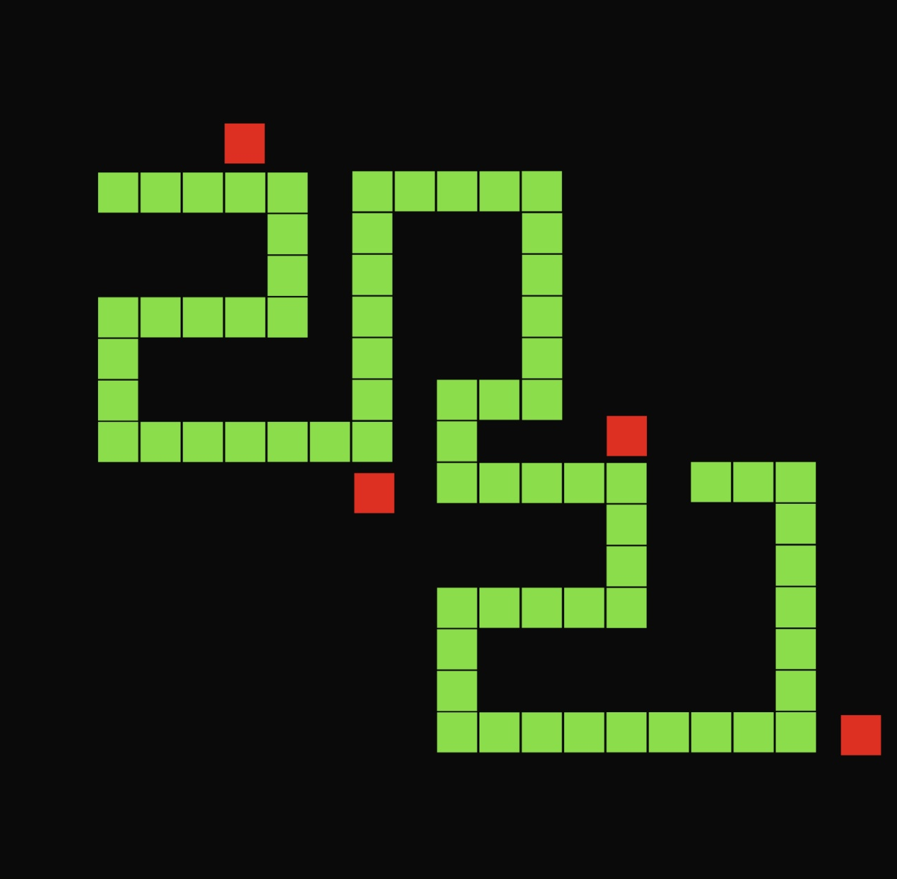

Slide 5


Slide 6
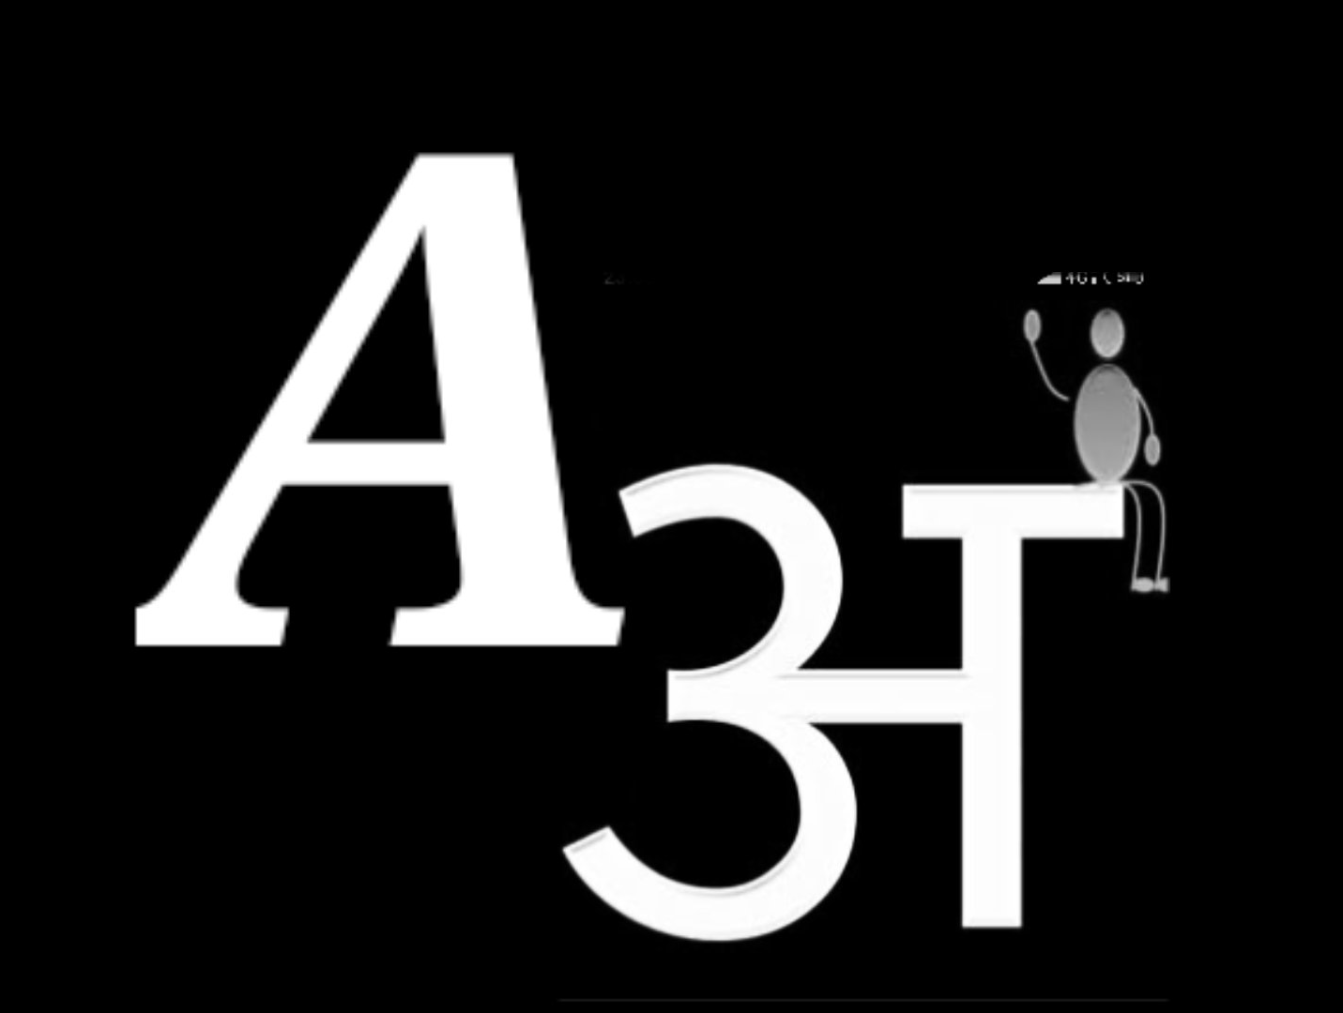

Slide 7
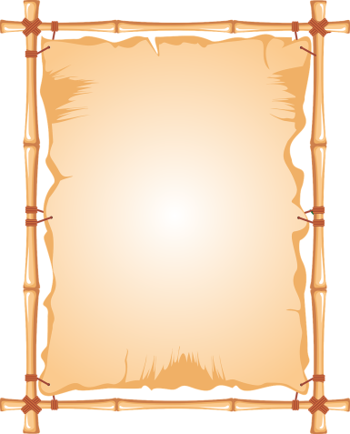
We humans normally use approximately 65% of our cerebral functions. So, there is a huge scope of improvement by increasing the activities for our left and right hemispheres of our brain.
This website has pertained to this need and designed games for both the left(logical) and right(creative) brains.
Go ahead and give your brain some exercise!

