Slide 1
FITNESS BUDDY
Presented By: Sanika Jaind
College Name : MIT Academy of Engineering
Department : CS (AIML)

Slide 2
OUTLINE
Problem Statement
Technology used
Wow factor
End users
Result
Conclusion
Git-hub Link
Future scope
IBM Certifications

Slide 3
Problem Statement
Many individuals struggle with staying consistent in their fitness journey due to lack of guidance, motivation, and structured planning.
Manual tracking of meals, workouts, and wellness habits often fails due to irregular routines and busy schedules.
Proposed Solution:
“Fitness Buddy” – A smart virtual assistant built using IBM Watsonx Assistant that helps users build healthy habits by providing personalized:
– Workout suggestions
– Meal ideas
– Motivational support
The assistant encourages daily consistency through tips and habit-building cues.

Slide 4
Technology used
IBM Watsonx Assistant
Natural Language Understanding (NLU)
Agentic AI Architecture
IBM Cloud Platform
Conditional Dialog Design
Response Variation Logic

Slide 5
IBM cloud services used
IBM Watsonx Assistant
IBM Cloud Dashboard
Object Storage
IBM Granite foundation model

Slide 6
Wow factors
Simple, conversational fitness support agent
Provides workouts, meal suggestions, and motivational quotes
Encourages consistency through habit tips
Friendly design with emoji & natural tone
Randomized motivation quotes for freshness
Easy to integrate into websites or apps

Slide 7
End users
Students & young professionals
Home workout enthusiasts
Anyone starting a fitness journey
People looking for daily fitness support

Slide 8
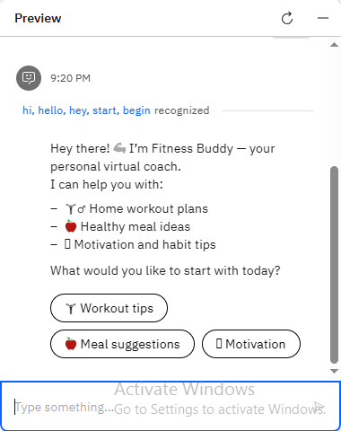
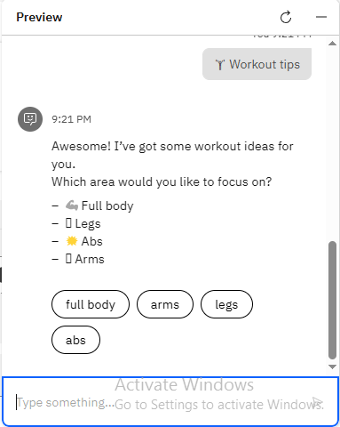
Results

Slide 9
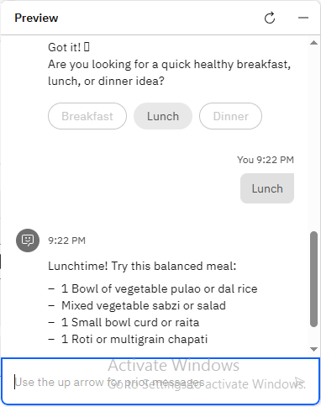
Results
Deployed AI Agent

Slide 10
Conclusion
“Fitness Buddy” proves that an AI agent can provide personalized fitness guidance and motivation with zero human intervention.
The assistant is friendly, reliable, and helps users stay on track with their health goals.
It uses IBM AI tools to create a low-code, intelligent chatbot experience.

Slide 11
Future scope
Add goal-tracking reminders (like streak counters)
Integrate with wearable devices
Enable daily fitness push notifications
Add multilingual support
Expand into mental wellness and habit gamification

Slide 12
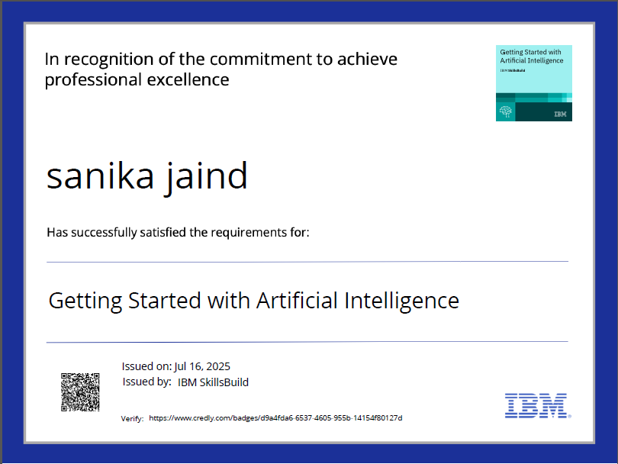
IBM Certifications

Slide 13
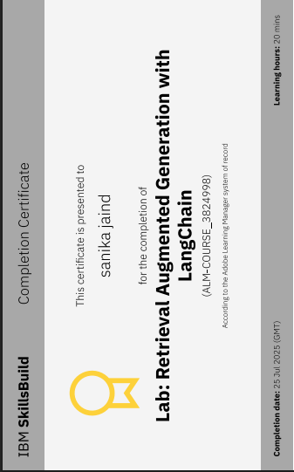

Slide 14
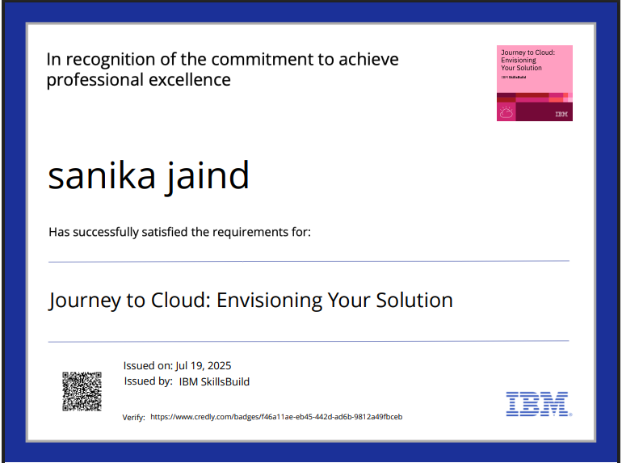

Slide 15
THANK YOU

