Slide 1


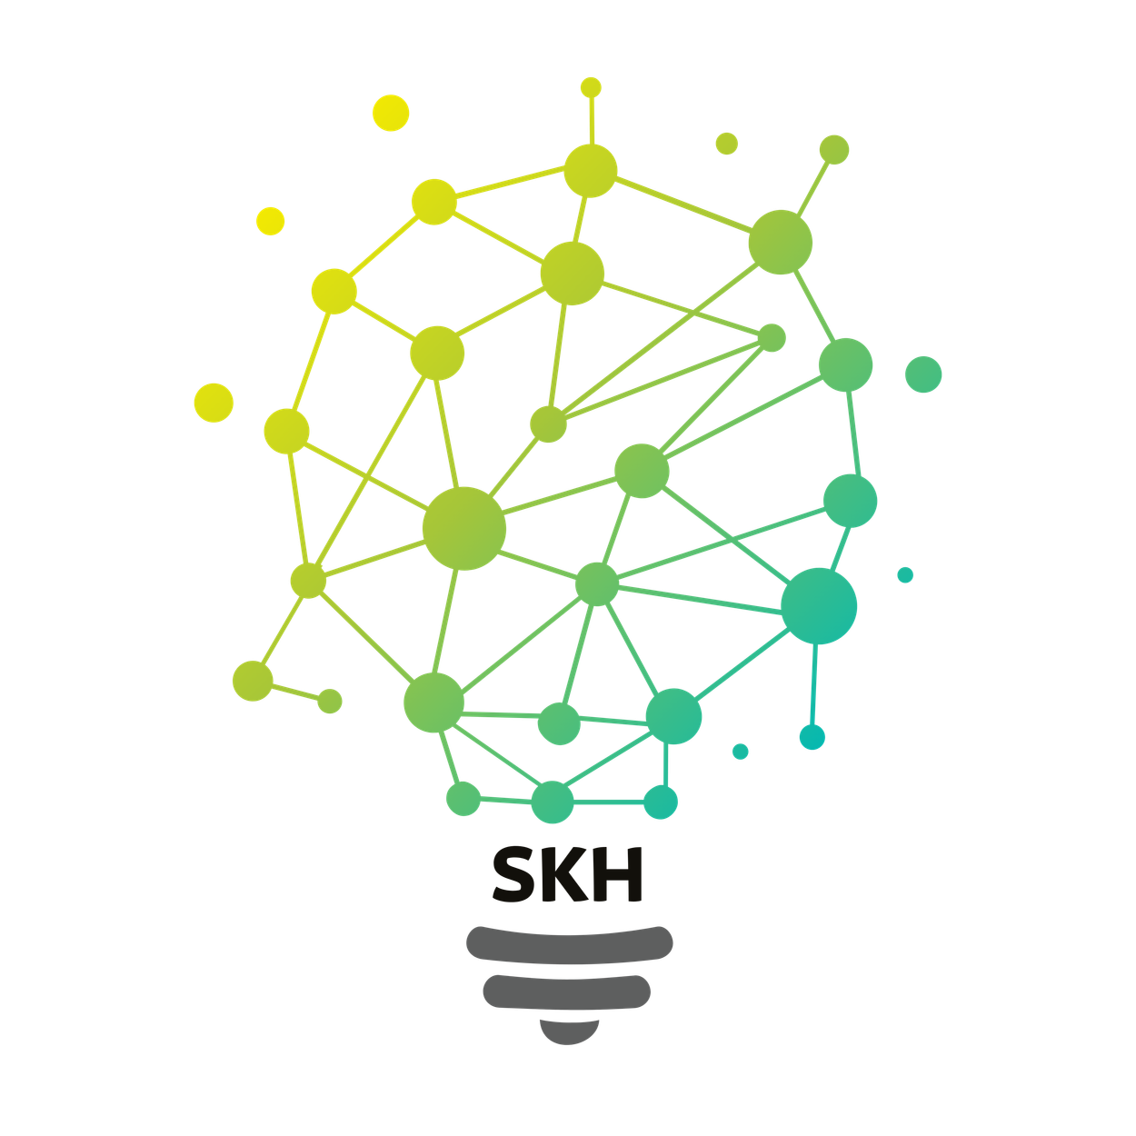

SMART KOPARGOAN HACKATHON
Grand Finale
TITLE PAGE
SMART KOPARGAON HACKATHON 2026
GRAND FINALE — PART A: EXISTING PROJECT
Problem Statement ID: SKH020
Problem Statement Title: Smart Digital Documentation System for Government Offices
Theme: Digital Governance
PS Category: Software
Team ID: 56EGZG
Team Name: PaperTrail
Project: PaperTrail — Cryptographic Chain-of-Custody Audit Protocol
Team Members: Abhidnya H. (BCS) | Sanika Tribhuvan (MCA) | Franklin (BCS)
College: BPHE Society's Ahmednagar College & IMS College, Ahmednagar
sanjivani.edu.in
skh.sanjivaniuniversity.com

Slide 2
IDEA TITLE
Your Team Name
Project Title: PaperTrail — Tamper-Evident Document Custody Protocol
• The Core Problem: Government physical documents (exam papers, 7/12 land mutation records, tender bids) pass through 10+ custodians (printing → transit → strongroom → center). When leaks or alterations occur, there is zero cryptographic proof of who changed it, when, or at which stage.
• Proposed Solution (PaperTrail Protocol):
- Genesis Sealing: Generates an immutable SHA-256 digital fingerprint & QR code at creation (Checkpoint 0).
- Checkpoint Handoff Verification: Re-hashes content at every physical handoff and validates against the previous hash pointer.
- Instant Tamper Localization: Even a 1-character alteration produces an avalanche mismatch, flags the exact custodian & stage, and triggers automated email alerts.
• Innovation & Uniqueness: 100% client-side zero-knowledge architecture using browser-native Web Crypto API. Requires zero server setup, runs completely offline on standard government PCs, and guarantees mathematical non-repudiation.
sanjivani.edu.in
skh.sanjivaniuniversity.com
2

Slide 3
Your Team Name
TECHNICAL APPROACH
Technical Architecture & Implementation Methodology
• Technology Stack:
- Frontend Framework: React 19.2 + Tailwind CSS 4.3 + Vite 8.2 (Sub-second HMR, 258 KB bundle)
- Cryptographic Engine: Web Crypto API (SubtleCrypto.digest SHA-256, native C++ performance <1ms)
- Scanner & QR: html5-qrcode (Camera stream verification) + qrcode.react (Level H 30% error correction)
- Alerting & Persistence: EmailJS automated breach dispatcher + LocalStorage dual-keyed persistence
• End-to-End Execution Pipeline:
1. Registration (Genesis Vault) → Live SHA-256 computation as user types → Sealed Document & QR created.
2. Handoff Verifier → Camera QR Scan or auto-suggest ID → Custodian re-hashes content → Hash pointer check.
3. Audit Timeline & Ledger → Interactive vertical visual chain (Blue=Sealed, Green=Verified, Red=Tampered) with side-by-side hash diff and JSON audit export.
sanjivani.edu.in
skh.sanjivaniuniversity.com
2

Slide 4
Your Team Name
FEASIBILITY AND VIABILITY
Feasibility Analysis, Risk Management & Live Challenge Resilience
• Technical Feasibility & Viability: Zero infrastructure cost, zero server latency, zero database licensing. Operates on standard government desktop/mobile web browsers with native hardware-accelerated hashing.
• Overcoming Hackathon Live Challenges:
- Challenge 1 (Mid-Flight Data Blackout/Wipe): Solved via in-memory shadowing refs + printed QR token re-anchoring. In-flight transactions continue in memory and can be re-synced instantly without data loss.
- Challenge 2 (Misinformation & Fake Submissions): Solved via cryptographic genesis authority binding. Any forged document or fake claim is immediately debunked via instant public QR verification.
• Future Scalability Roadmap: Seamless integration with DigiLocker API, Aadhaar e-Sign custodian authentication, and optional decentralized anchoring on Ethereum/Polygon smart contracts.
sanjivani.edu.in
skh.sanjivaniuniversity.com
2

Slide 5
Your Team Name
IMPACT AND BENEFITS
High-Impact Governance, Economic & Social Benefits
• Educational & Examination Integrity: Eliminates paper leak vulnerabilities in recruitment & entrance exams (MPSC, NEET, TET), safeguarding the futures of millions of students and preventing multi-crore re-examination expenses.
• Land Revenue & Citizen Security: Protects Talathi 7/12 land mutation records from unauthorized alteration, drastically reducing civil court litigation and land grabbing.
• Public Procurement Accountability: Prevents tender bid tampering and post-submission alterations, addressing over ₹1,200 Cr in public sector procurement damages.
• Statutory Compliance & Trust: 100% compliant with RTI Act 2005 Sec 4(1)(b) proactive disclosure and the Public Examinations (Prevention of Unfair Means) Act 2024.
sanjivani.edu.in
skh.sanjivaniuniversity.com
2

Slide 6
Your Team Name
RESEARCH AND REFERENCES
Research Grounding, Cryptographic Standards & Statutory Citations
• Cryptographic & Web Standards:
- NIST FIPS 180-4: Secure Hash Standard (SHA-256 Specification & Collision Resistance)
- W3C Web Cryptography API Recommendation (SubtleCrypto Digest Architecture)
• Legal & Statutory Governance Frameworks:
- Public Examinations (Prevention of Unfair Means) Act, 2024 (Section 3 & 4: Chain-of-Custody Security)
- Right to Information Act, 2005 (Section 4(1)(b): Proactive Cryptographic Public Disclosure)
- Maharashtra Land Revenue Code, 1966 (Sec 148: Record of Rights & Mutation Verification)
• Empirical Incident Studies: 2024 UGC-NET unauthorized digital transit vector; 2024 Maharashtra TET audit.
sanjivani.edu.in
skh.sanjivaniuniversity.com
2

Slide 7
Your Team Name
IMPORTANT INSTRUCTIONS
The presentation must not exceed 6 slides, including the Title Slide.
Present your solution using bullet points, diagrams, infographics, flowcharts, or relevant visuals instead of lengthy paragraphs.
Keep the content clear, concise, and easy to understand.
Ensure your proposed solution is innovative, original, and demonstrates novelty.
Use only the official presentation template provided. Do not modify the template structure, slide sequence, or the required sections.
sanjivani.edu.in
skh.sanjivaniuniversity.com
2

