Slide 1
Perceptron

Slide 2
Perceptron Model (1957)
Perceptron was conceptualized by Frank Rosenblatt in the year 1957 and it is the most primitive form of artificial neural networks.
McCulloch-Pitts neuron had very limiting capabilities and was not a true machine learning model either.
Limitation of McCulloch-Pitts Neuron:
McCulloch-Pitts neuron could only take boolean values as inputs. But the real world problems are not limited to only boolean values. For e.g. you cannot give real number like age, price, area etc. as inputs.
It does not considers weights to the inputs. Weights are very important to indicate which of the input features plays more important role in output and which features plays very little role. So without weights it cannot determine the importance of input data.
The only parameter which is there in this model is Threshold Θ and that too we are computing it on our own. There is no learning taking place to determine the optimum value of Threshold based on past data. So this is not a true machine learning model.

Slide 3
Perceptron Model
It’s various parts:
Inputs: The inputs to perceptron is no longer limited to boolean. The input attributes can represent any real number.
Weights: Each input has a weight associated with it in perceptron model. These weights are initially unknown but are learned by Perceptron during training phase.
Neuron: Neuron is a computational unit which has incoming input signals. The input signals are computed and an output is fired.
Output: This is simply the output of the neuron which produces only binary values of 0 or 1. The value of 0 indicates that the neuron does not fire, the value of 1 indicates the neuron does fire.

Slide 4
Activation Function
Here the activation function used is the step function.
It sees if the summation is more than equal to calculated Threshold value , if yes then neuron should fire (i.e. output =1 ) if not the neuron should not fire (i.e. output =0).
Neuron fires: Output =1 , if Summation(Inputs*Weights) >= Threshold
Neuron does not fire: Output =0 , if Summation(Inputs*Weights) < Threshold

Slide 5
How Perceptron Model works
The input data is enabled into the Perceptron.
Apply dot product between input & it’s respective weights and sum them up.
Apply step function on above summation –
If output of step function >= 0 then perceptron is fired, output = 1
If output of step function < 0 then perceptron does not fire, output = 0

Slide 6
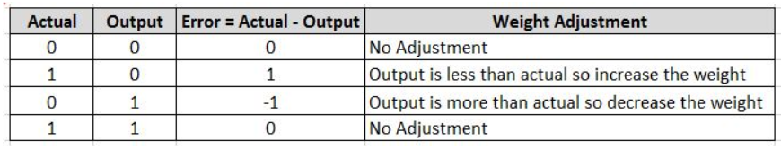
Training a Perceptron
Learning Parameters:
Machine learning models have parameters whose optimal value it learns during the training phase.
In a Perceptron the parameters that are learned during training phase are –
Weights of input parameters
bias
Threshold value
Errors and Weight adjustment:
During training phase, the weights are initialized randomly and with each data, the error is calculated and weights are adjusted accordingly so as to reduce the error.
As you have seen above, the possible output of perceptron is only binary i.e 0 or 1. So there are only four possible combination of actual value and output value.
Below chart shows this combination and will help you to get intuition how weights should be adjusted in case of error.

Slide 7
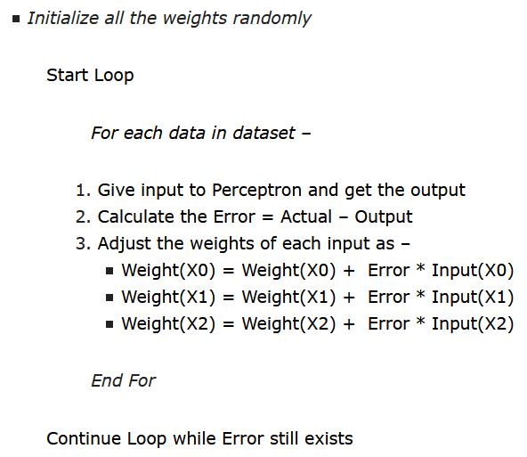
Perceptron Learning Algorithm
Let us first see the pseudo code of this algorithm with respect to our example in above animation.

Slide 8
Intuition behind Perceptron Learning Algorithm
For most part of the pseduo code, things should be self explanatory.
We are doing multiple loops over dataset and in each loop we are passing data one by one through perceptron, calculating error and adjusting weights.
The loop is continued till there are no errors.
Example 1:
Actual =1 , Output =0, Error =1
In this case, since Output is less than actual, we would like to increase the weight to push the output towards actual. It requires a positive weight adjustment
Weight = Weight + Error*Input = Weight + 1*Input (weight adjustment is positive)
Example 2:
Actual =0 , Output =1, Error = -1
In this case, since Output is more than actual, we would like to decrease the weight to pull back the output towards actual. It requires a negative weight adjustment
Weight = Weight + Error*Input = Weight – 1*Input (weight adjustment is negative)
Example 3:
Actual =0 , Output =0, Error =0
In this case since Output and Actual is same, there is no error so zero weight adjustment is required.
Weight = Weight + Error*Input = Weight – 0*Input = Weight (no weight adjustment)

Slide 9
Numerical: AND function using Perceptron
Training Data:
Number of weights: 3
Suppose initial weights are equal to 1.
i.e. w0=w1=w2=1
Consider threshold =0
Epochs = 3
X1 | X2 | Actual
0 | 0 | 0
0 | 1 | 0
1 | 0 | 0
1 | 1 | 1
X0=1
x1
w1
w0
Output
x2
w2

Slide 10
Epoch 1: Error Calculation
Weights: w0=1, w1=1, w2= 1
Ynet=x0*w0+x1*w1+x2*w2
Input (0,0):
Ynet=1*1+0*1+0*1=1
Ynet>=0: neuron fires
Output=1
Error=Actual-Output=0-1=-1 (Error non zero, change weights)
W0=1+(-1)*1=0
W1=1+(-1)*0=1
W2=1+(-1)*0=1
Updated weights: w0=0, w1=1, w2=1

Slide 11
Epoch 1: Error Calculation
weights: w0=0, w1=1, w2=1
Ynet=x0*w0+x1*w1+x2*w2
Input (0,1):
Ynet=1*0+0*1+1*1=1
Ynet>=0: neuron fires
Output=1
Error=Actual-Output=0-1=-1 (Error non zero, change weights)
W0=0+(-1)*1=-1
W1=1+(-1)*0=1
W2=1+(-1)*1=0
Updated weights: w0=-1, w1=1, w2=0

Slide 12
Epoch 1: Error Calculation
weights: w0=-1, w1=1, w2=0
Ynet=x0*w0+x1*w1+x2*w2
Input (1,0):
Ynet=1*-1+1*1+0*0=0
Ynet>=0: neuron fires
Output=1
Error=Actual-Output=0-1=-1 (Error non zero, change weights)
W0=-1+(-1)*1=-2
W1=1+(-1)*1=0
W2=0+(-1)*0=0
Updated weights: w0=-2, w1=0, w2=0

Slide 13
Epoch 1: Error Calculation
weights: w0=-2, w1=0, w2=0
Ynet=x0*w0+x1*w1+x2*w2
Input (1,1):
Ynet=1*-2+1*0+1*0=-2
Ynet>=0: neuron does not fire
Output=0
Error=Actual-Output=1-0=1 (Error non zero, change weights)
W0=-2+(1)*1=-1
W1=0+(1)*1=1
W2=0+(1)*1=1
Updated weights: w0=-1, w1=1, w2=1
Final Weights after 1st iteration:
w0=-1, w1=1, w2=1

Slide 14
Epoch 2: Error Calculation
Weights: w0=-1, w1=1, w2= 1
Ynet=x0*w0+x1*w1+x2*w2
Input (0,0):
Ynet=1*(-1)+0*1+0*1=-1
Ynet>=0: neuron does not fire
Output=0
Error=Actual-Output=0-0=0 (Zero Error, No change in weights)

Slide 15
Epoch 2: Error Calculation
weights: w0=-1, w1=1, w2=1
Ynet=x0*w0+x1*w1+x2*w2
Input (0,1):
Ynet=1*(-1)+0*1+1*1=0
Ynet>=0: neuron fires
Output=1
Error=Actual-Output=0-1=-1 (Error non zero, change weights)
W0=(-1)+(-1)*1=-2
W1=1+(-1)*0=1
W2=1+(-1)*1=0
Updated weights: w0=-2, w1=1, w2=0

Slide 16
Epoch 2: Error Calculation
weights: w0=-2, w1=1, w2=0
Ynet=x0*w0+x1*w1+x2*w2
Input (1,0):
Ynet=1*-2+1*1+0*0=-1
Ynet>=0: neuron does not fire
Output=0
Error=Actual-Output=0-0=0 (Error zero, No change in weights)

Slide 17
Epoch 2: Error Calculation
weights: w0=-2, w1=1, w2=0
Ynet=x0*w0+x1*w1+x2*w2
Input (1,1):
Ynet=1*-2+1*1+1*0=-1
Ynet>=0: neuron does not fire
Output=0
Error=Actual-Output=1-0=1 (Error non zero, change weights)
W0=-2+(1)*1=-1
W1=1+(1)*1=2
W2=0+(1)*1=1
Updated weights: w0=-1, w1=2, w2=1
Final Weights after 2nd iteration:
w0=-1, w1=2, w2=1

Slide 18
Epoch 3: Error Calculation
Weights: w0=-1, w1=2, w2= 1
Ynet=x0*w0+x1*w1+x2*w2
Input (0,0):
Ynet=1*(-1)+0*2+0*1=-1
Ynet>=0: neuron does not fire
Output=0
Error=Actual-Output=0-0=0 (Zero Error, No change in weights)

Slide 19
Epoch 3: Error Calculation
weights: w0=-1, w1=2, w2= 1
Ynet=x0*w0+x1*w1+x2*w2
Input (0,1):
Ynet=1*(-1)+0*2+1*1=0
Ynet>=0: neuron fires
Output=1
Error=Actual-Output=0-1=-1 (Error non zero, change weights)
W0=(-1)+(-1)*1=-2
W1=2+(-1)*0=2
W2=1+(-1)*1=0
Updated weights: w0=-2, w1=2, w2=0

Slide 20
Epoch 3: Error Calculation
weights: w0=-2, w=2, w2=0
Ynet=x0*w0+x1*w1+x2*w2
Input (1,0):
Ynet=1*-2+1*2+0*0=0
Ynet>=0: neuron fires
Output=1
Error=Actual-Output=0-1=-1 (Error non zero, change weights)
W0=(-2)+(-1)*1=-3
W1=2+(-1)*1=1
W2=0+(-1)*0=0
Updated weights: w0=-3, w1=1, w2=0

Slide 21
Epoch 3: Error Calculation
weights: w0=-3, w1=1, w2=0
Ynet=x0*w0+x1*w1+x2*w2
Input (1,1):
Ynet=1*-3+1*1+1*0=-2
Ynet>=0: neuron does not fire
Output=0
Error=Actual-Output=1-0=1 (Error non zero, change weights)
W0=-3+(1)*1=-2
W1=1+(1)*1=2
W2=0+(1)*1=1
Updated weights: w0=-2, w1=2, w2=1
Final Weights after 3rd iteration:
w0=-2, w1=2, w2=1

Slide 22
So, Even after 3rd iteration, error is non-zero.
We have to train the model for more iterations.
Implement the Perceptron Algorithm in Python for AND function, and find the final weights.

Slide 23
Some points to consider
Perceptron addresses the three drawbacks that we discussed about McCulloch-Pitts neuron above. It can take real number as inputs and weights are also associated with inputs. This is also a true machine learning model which can be trained using past data.
It still, however can produce only binary output. So perceptron can be used in case of binary classification problems only.
Perceptron can classify only those data which are linearly separable. So it cannot solve a XOR problem.
If the data is linearly separable, perceptron learning algorithm will always converge in finite number of loops.

Slide 24
Thanks

