Slide 1

MINI PROJECT
EXPENSE TRACKER
A behaviour-first, goal-linked budgeting app built for India
Obaid Shaikh (2631) | Omkar Bordekar (2633) | Sanish Kalagutkar (2644)
Notes:
1

Slide 2
Introduction
A smarter way to understand everyday spending - built around real behaviour, not just raw numbers
Behaviour-first
Goal-linked
India-aware
Insight over data-entry. The app tells you why money leaks, not just where it went.
Every rupee is tied to a goal, so each purchase shows its impact on a trip, gadget or emergency fund.
Built for UPI, cash, festival and irregular spends that Western apps ignore.
Notes:
2

Slide 3
Problem Statement & Objectives
Problem
Objectives
  Most people know their balance but not their habits
  Small daily UPI spends add up unnoticed
  Impulse purchases derail savings goals
  Festival and seasonal spikes are never planned for
  Existing apps just log data - little motivation to change
  Detect impulse purchases and hidden small expenses
  Show how each spend affects a savings goal
  Keep users engaged with streaks
  Plan festival / seasonal expenses in advance
  Track emergency savings
  Turn spending into a simple monthly story
Notes:
3

Slide 4
Competitive Analysis
How Expense Tracker compares with apps Indians use every day
Feature | PhonePe | Paytm | Google Pay | Amazon Pay | Expense Tracker
Impulse purchase detector | ✗ | ✗ | ✗ | ✗ | ✓
Hidden small-expense finder | ✗ | ✗ | ✗ | ✗ | ✓
Goal impact calculator | ✗ | ✗ | ✗ | ✗ | ✓
Streak-based engagement | ✗ | ✗ | ✗ | ✗ | ✓
Festival / seasonal planner | ✗ | ✗ | ✗ | ✗ | ✓
Emergency savings tracker | ✗ | ✗ | ✗ | ✗ | ✓
Narrative expense story | ✗ | ✗ | ✗ | ✗ | ✓
Auto-tracking (UPI / SMS) | ~ | ~ | ~ | ~ | ✓
Notes:
4

Slide 5
Product Overview
The apps most people already use to pay and check spends
App | Origin | Pricing model | Primary focus | Key gap
PhonePe | India | Free | UPI payments + spend history | Tracks only in-app payments; no budgets or goals
Paytm | India | Free | Payments, wallet, bills | Basic spend summary; no behavioural nudges
Google Pay | Global (Google) | Free | UPI payments, rewards, bill pay | Shows spend history only; no budgets or goals
Amazon Pay | Global (Amazon) | Free | Payments tied to Amazon shopping and bills | Limited to own transactions; no goals or nudges
Notes:
5

Slide 6
Market Analysis
Payments in India are mature; behavioural spend-tracking is still thin
24.07B
1.7B
UPI transactions in Sept 2026
Finance app downloads, 2024
worth Rs 29.37 lakh crore, +23% YoY (NPCI)
India is the world's largest market (Sensor Tower)
$44.1B
$42.5M
India fintech market, 2025
India personal finance software, 2024
projected ~$95.3B by 2030, ~16.7% CAGR (Mordor)
projected $63.6M by 2033 (IMARC)
Notes:
6

Slide 7
Market Trends & Target Audience
Market Trends
Target Audience
  UPI generates rich, granular spending data
  Top apps (PhonePe, Google Pay, Paytm) dominate usage
  Existing apps lean to investing, credit and loans
  Festival and wedding spikes are poorly served
  Cash is still common, so manual entry matters
  Privacy concerns around SMS reading are rising
Young earners (18-30)
Students and early-career professionals
Urban & semi-urban India
UPI-first, smartphone users
Goal-driven savers
Saving for a trip, gadget or emergency fund
Festival-season households
Planning ahead for high-variance spends
Notes:
7

Slide 8
Key Features
Impulse Detector
Hidden Expense Finder
Goal Impact
Streaks
Flags unplanned, unusual buys
Shows what a spend delays
Rewards daily tracking habit
Totals small daily leaks
Custom Categories
Festival Planner
Emergency Fund
Expense Story
Your own spend buckets
Budget for Diwali, weddings
Tracks savings safety net
Monthly spending narrative
Notes:
8

Slide 9
System Design & Technology Stack
High-level flow (diagrams in the project report)
User
→
App UI
→
Logic Engine
→
Database
Logic Engine modules
Tech stack
  Impulse purchase detection
  Small-expense aggregation
  Goal impact calculation
  Streak and festival planning
  Frontend: Html,CSS (Thymeleaf for pages)
  Backend: JAVA 17 with Springboot
  Database: H2
  Tools:
Notes:
9

Slide 10
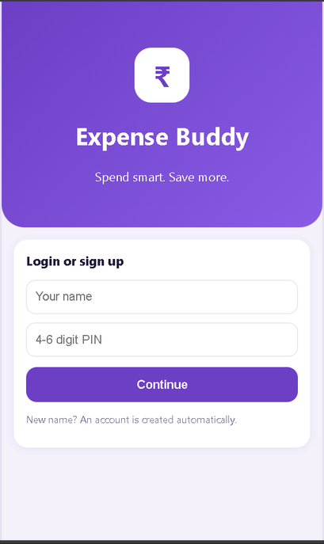
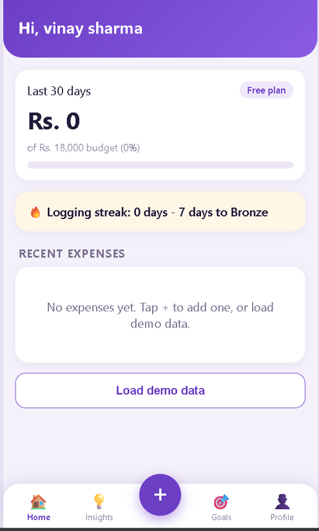
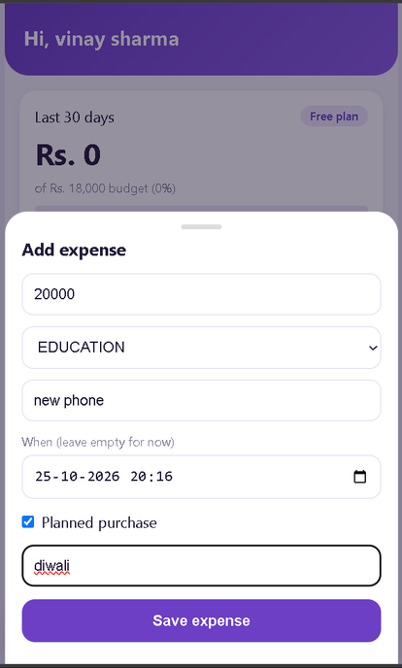
Working Product (5-min demo)
1
2
3
4
5
Add expense
Dashboard
Impulse & small-spend alerts
Goal impact
Festival planner & story
Notes:
10

Slide 11
Limitations & Future Scope
Current limitations
Future scope
  Manual entry only, no automatic bank sync.
  Demo payments only.
  PINs are hashed with plain SHA-256. A real product would use bcrypt with salting.
  The service worker and full PWA install need HTTPS. Over plain http on a phone it's a shortcut.
  Impulse streaks are limited to the 30-day window.
  No edit or delete of expenses yet.
  Auto-import via SMS / Account Aggregator (with consent)
  ML-based impulse prediction
  Regional language support
  Family and shared budgets
  Bill reminders and UPI deep links
Notes:
11

Slide 12
Revenue Model
Plan | Price | Expenses\Month | What you get
Free | Rs.0 | 30 | Category tracking,streaks
Student | Rs.49/month | 150 | Adds impulse detector,hidden expenses,goal impact,emergency savings(student ID needed)
Basic | Rs.149/month | Unlimited | Everything,including festival planner and expense story
Notes:
11

Slide 13
Conclusion
Expense Tracker moves from logging numbers to changing habits - linking every rupee to a goal, with India's festivals, UPI and cash in mind.
THANK YOU!
Notes:
12

