Slide 1
Setters, getters and constructors

Slide 2
Encapsulation & Data Hiding
Encapsulation involves bundling the data (attributes or properties) and methods (functions) that operate on that data into a single unit, called a class. This allows for better organization of code and improves the security and integrity of the data.
Data hiding is a key aspect of encapsulation, where the internal representation of an object is hidden from the outside world. This prevents external code from directly accessing or modifying the internal state of an object, thus ensuring data integrity and security.

Slide 3
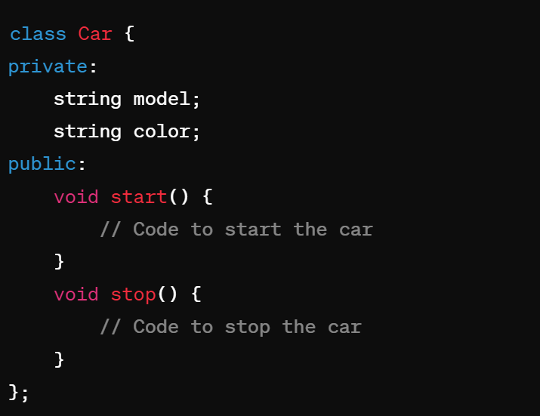
In this example, the model and color member variables are private,(data hiding) meaning they can only be accessed within the Car class. The start() and stop() methods are public, allowing external code to interact with the Car object. They all are encapsulated.

Slide 4
Constructors & Destructors
Constructors are special member functions of a class that are automatically called when an object of that class is created. They are used to initialize the object's state. They have the same name as the class itself. They don’t have a return type.
Destructors are special member functions that are automatically called when an object is destroyed. They are used to clean up resources allocated by the object

Slide 5
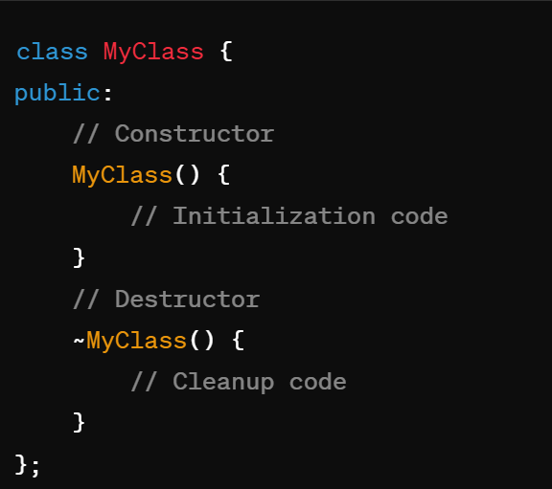

Slide 6
Copy Constructor
A copy constructor is a special constructor used to create a new object as a copy of an existing object. It is invoked when an object is passed by value or when an object is explicitly copied.
A copy constructor is like a photocopy machine for objects. It creates a duplicate of an existing object, so we have two identical copies.
Imagine you have a car, and you want another car that's exactly the same. A copy constructor helps you make that duplicate, saving you time and effort.

Slide 7
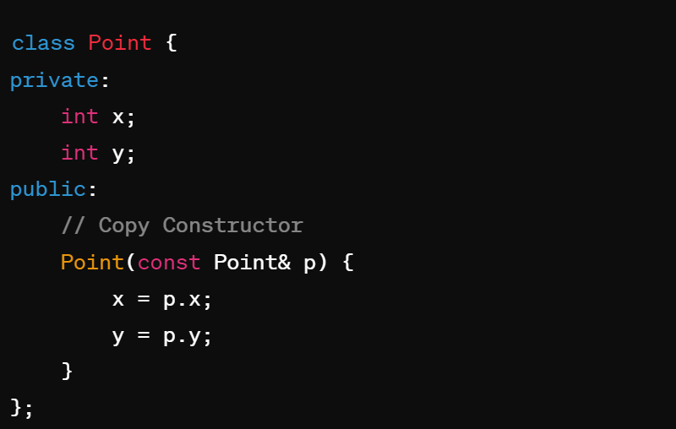

Slide 8
Default and No-Argument Constructors
A default constructor is a constructor with no parameters. It is automatically invoked when an object is created without any arguments.
A no-argument constructor is a constructor with parameters but with default values. It is used to provide default initialization for objects.
Default constructors are like pre-made templates for objects. They allow us to create objects without specifying any initial values. It's like ordering a standard pizza without any extra toppings.
No-argument constructors are similar, but they let us provide default values for object initialization. It's like ordering a pizza and specifying that you want cheese and tomato sauce by default.

Slide 9
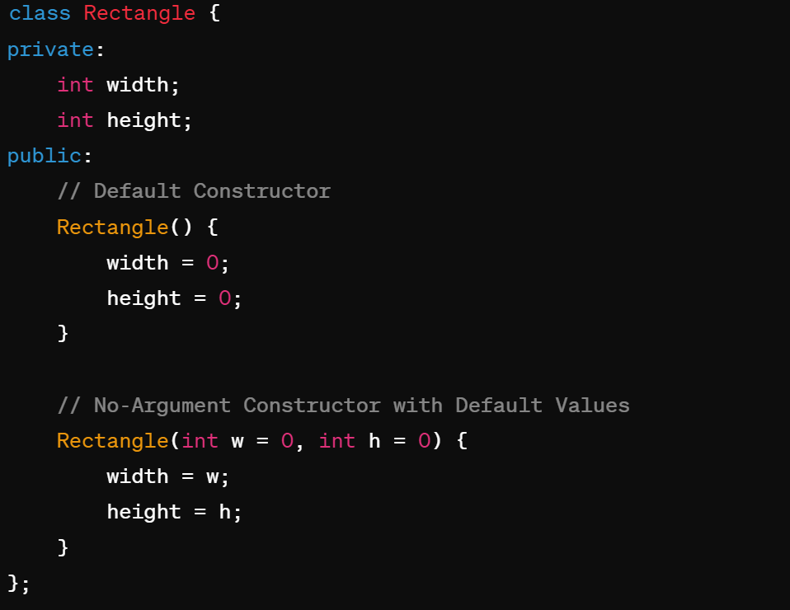

Slide 10
Setters & Getters
Setters and getters are methods used to set and get the values of private member variables, respectively. They provide controlled access to the private data of a class.
Setters and getters are like the caretakers of our data. They help us control how others interact with our class's variables.
Setters let us change the values of private variables safely. It's like giving someone permission to update the details on a form.
Getters allow us to retrieve the values of private variables without directly accessing them. It's like asking for information from a trusted source.
By using setters and getters, we can maintain control over our data and prevent accidental changes or misuse.

Slide 11
