Slide 1
ONLINE RETAIL DATA ANALYSIS
By
Saniya Jain

Slide 2
ABOUT THE DATASET
INTRODUCTION
Attribute Description:
Invoice No - Invoice ID, encoded as Label
StockCode - Unique code per stock, encoded as Label
Description - The Description, encoded as Label
Quantity - Quantity purchased
InvoiceDate - Date of purchase
UnitPrice - The target value, price of every product
CustomerID - Unique Identifier for every Customer
Country - Country of sales, encoded as Label
I have worked with python for the analysis of this dataset.
The analysis is divided into three parts: Data cleaning, Exploratory Data Analysis and Model Building
The initial stage before data cleaning is nothing but just importing some packages and reading the data.

Slide 3
DATA CLEANING
Most of the data given to us was already cleaned so a lot of data cleaning was not required. Most of it is done as and when it is required for the EDA and feature scaling.
In this part I have just converted the InvoiceDate column to date time and added a few columns in the dataset.
One significant column added is TotalAmount which is used a lot for EDA and model building.

Slide 4
RESULTS FROM EXPLORATORY DATA ANALYSIS
More products were sold in 2011.
2. The customer with the highest number of sales comes from the country 35.
3. Customers purchased most products on a Wednesday.
The company receives the highest number of orders between 11:00 AM to 2:00 PM
. Possibly most customers made purchases during lunch hour.
The top 3 customers are from countries: 23,35 and 10. Among these, customers from
country 23 spent the highest amount of money and most of the customers are from
country 35.
The count of new customers is remarkably low. The retailer should focus more on
the regular customers and improve on marketing strategies to attract more new
customers.
The company tends to give some offers for purchases occasionally. However, it is
not clear what factors contribute to giving out the offers on particular products.

Slide 5
EXPLORATORY DATA ANALYSIS
I have visualised various graphs such as bar plots, pie charts, scatter plots and count plots using matplotlib and seaborn for the Exploratory Data Analysis.
The purpose of Exploratory Data Analysis is to visualise your data and gather valid conclusions. That is what I have done with my EDA.
Here is a list of all the graphs that I have plotted:
Bar plot to check the quantity of products sold in 2010 and 2011.
Bar plot to check the highest number of customers on a particular day.
Another bar plot to analyse what time of the day were the most products purchased.
Distplot for hours
Pie chart and bar plot for countries
Box Plot
Count Plot to check new and regular customers.
Bar Chart for stockcode
Scatter plots to deal with outliers
Dist plots for Quantity

Slide 6
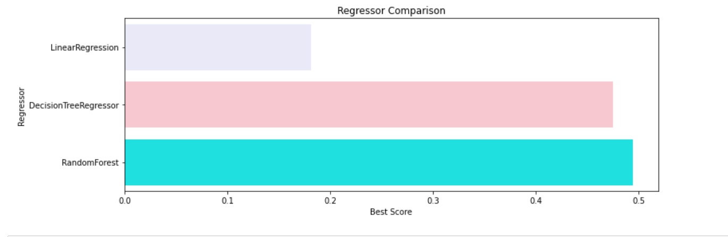
MODEL BUILDING
Before the model building a lot of data preprocessing is done which is explained in the code itself.
I have applied three different models for training purposes:
Linear Regression, Decision Tree and Random Forest Classifier
Visualizing the results gives us this graph. We can say that Random Forest works best for us

Slide 7
THANK YOU

