Slide 1
CareSlot
Clinic appointment booking, shipped end-to-end with DevOps
FastAPI
React
PostgreSQL
Docker
GitHub Actions
Trivy
GHCR
Terraform
EKS
Helm
Saniya Sanjiv Patil
Roll No. 24bcs10246 · Session 21 Final DevOps Project

Slide 2
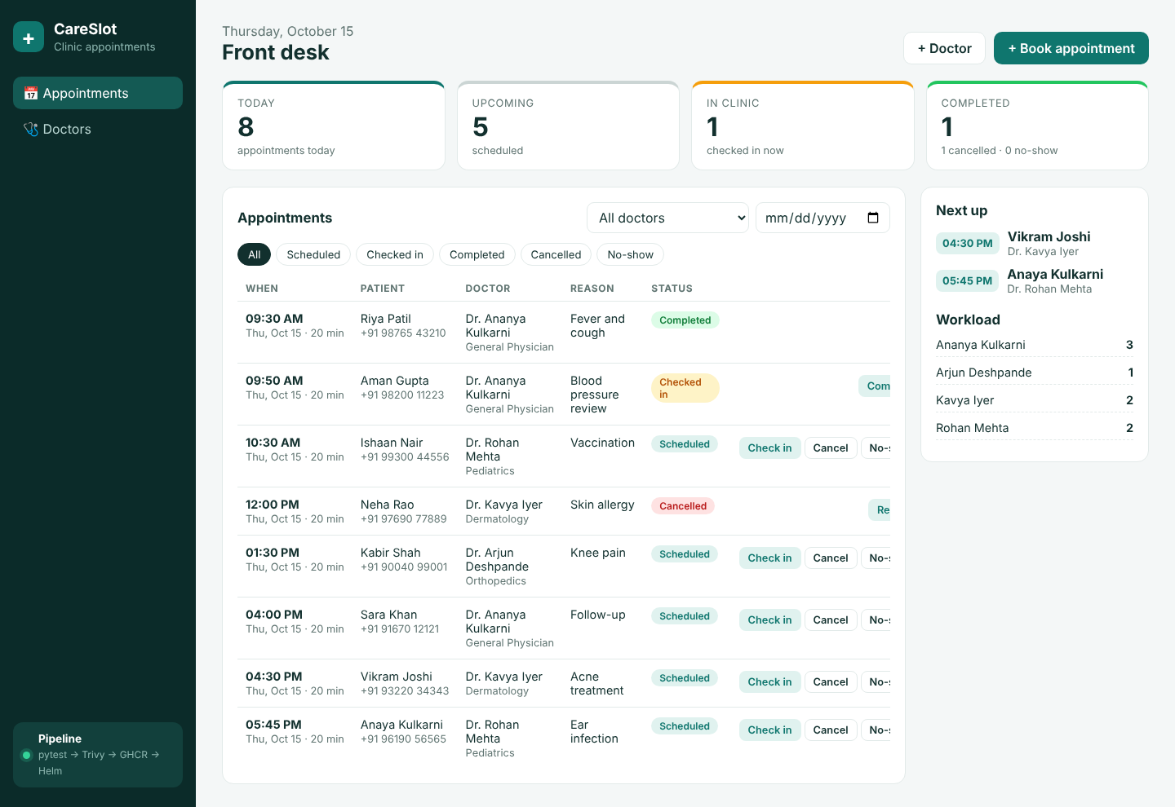
What CareSlot does
1
Book appointments
Patient, doctor, time and reason; a slot can never be double-booked (API returns 409)
2
Run the front desk
Today, upcoming, in-clinic and completed counts; check-in, complete, cancel, no-show
3
Manage doctors
Specialities, active status and each doctor's workload for the day

Slide 3
The delivery chain I built
1
2
3
4
Code
FastAPI + React
Git
commit + push
CI tests
pytest, 15 cases
Security
SAST · SCA · IaC · secrets
5
6
7
8
Docker
non-root images
Trivy
image CVE gate
GHCR
tag = commit SHA
Terraform
VPC + EKS on AWS
9
10
11
12
Kubernetes
EKS, 2 nodes
Helm
one chart, all objects
Ingress + HPA
AWS LB, autoscaling
Monitoring
Prometheus + Grafana
Every push to main runs the whole chain automatically: test → scan → build → push → deploy → verify.

Slide 4
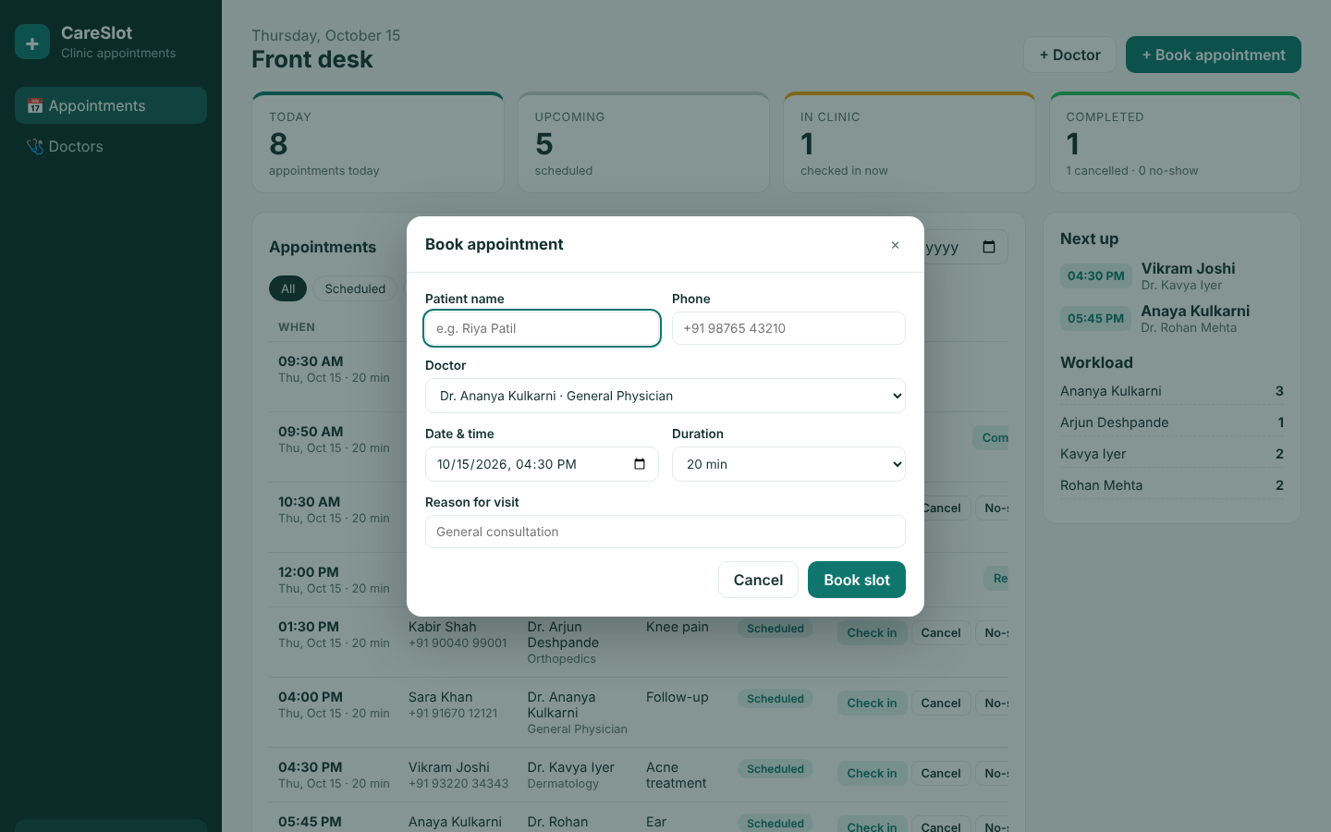
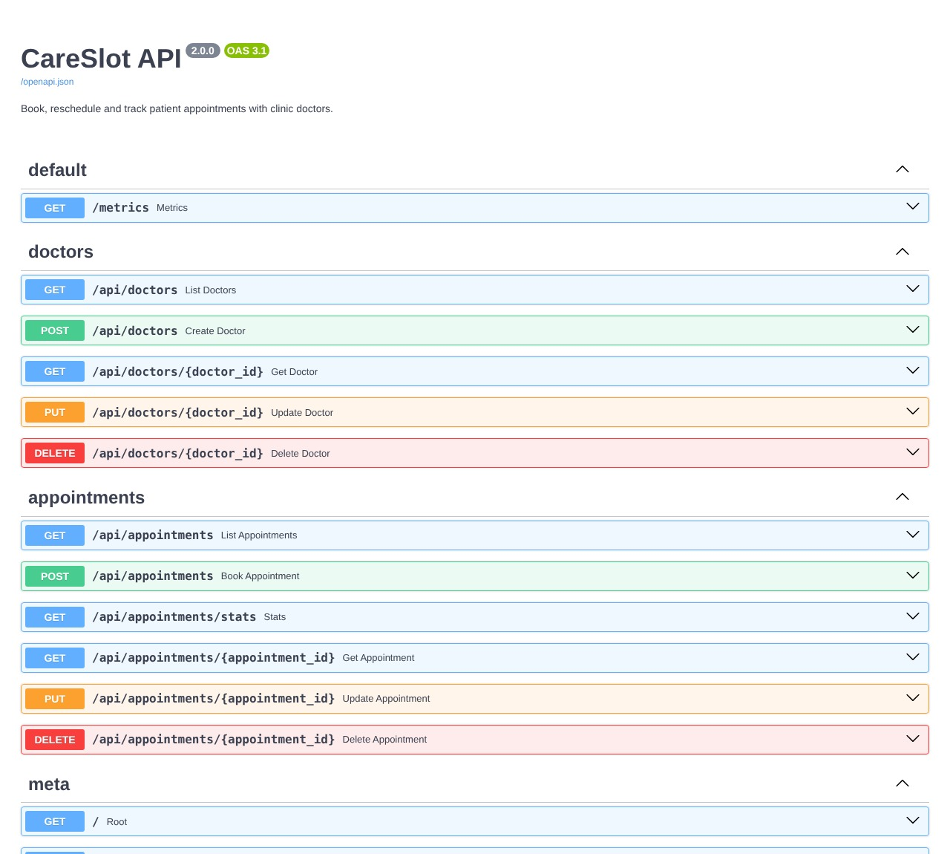
Application and API
React + Vite front desk, served by nginx
FastAPI Swagger at /docs: doctors and appointments CRUD
FastAPI · SQLAlchemy 2 · Alembic migrations · PostgreSQL 16 · /health, /ready, /metrics

Slide 5
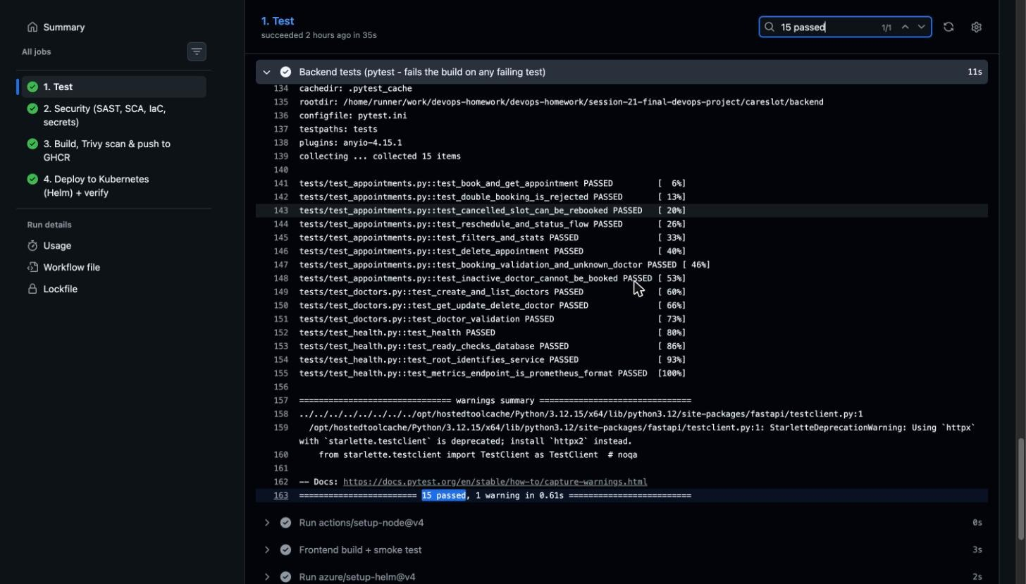
Tests gate everything
15
pytest cases, all passing
Health and readiness, doctors CRUD, booking, double-booking 409, reschedule, status flow and stats. They run on an isolated SQLite database, so CI needs no Postgres. A failing test stops the pipeline before any image is built.

Slide 6
Containers: small, patched, non-root
1
Backend image
2
Frontend image
3
docker compose
python:3.12-slim, OS packages upgraded
Runs as uid 10001, not root
Runs Alembic migrations, then uvicorn
Multi-stage: node:22 builds, nginx serves
nginx-unprivileged, uid 101
Proxies /api to the backend
postgres + backend + frontend
Health checks and depends_on
One command for the full local stack
Tagging rule: every image is tagged with the full git commit SHA, never "latest". So any running pod can be traced back to the exact commit that built it.

Slide 7
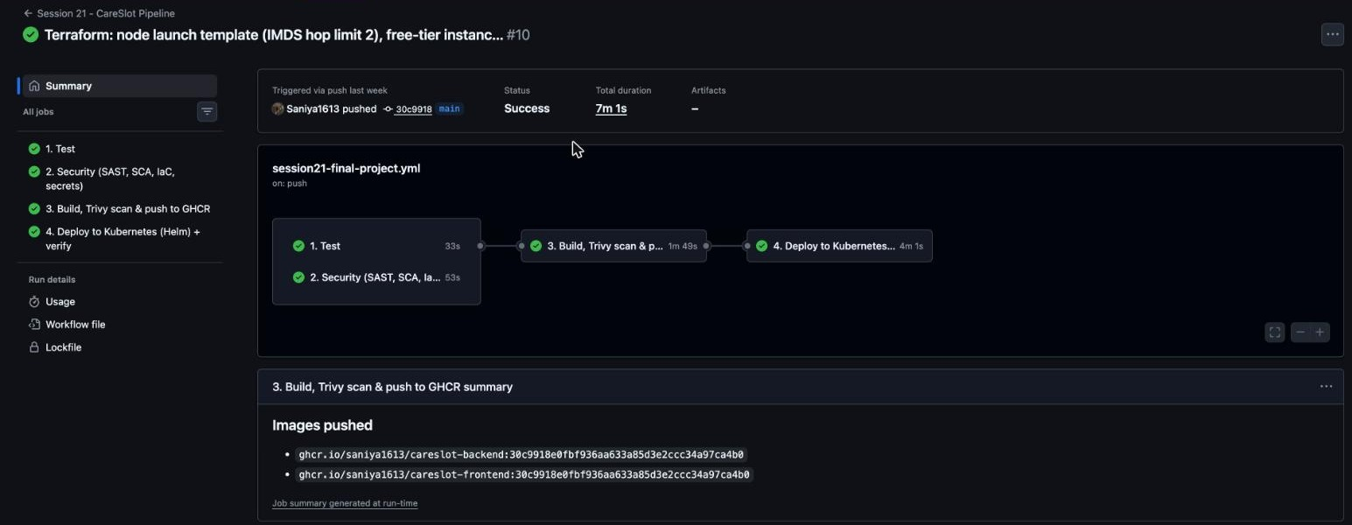
CI/CD: four jobs on every push
1
Test
pytest + frontend build
2
Security
Semgrep, pip-audit, Trivy config, gitleaks
3
Build, scan, push
Docker build → Trivy gate → GHCR
4
Deploy + verify
kind cluster, Helm, Ingress smoke test, HPA, Prometheus
Run #10 on main: all four jobs green in 7 min

Slide 8
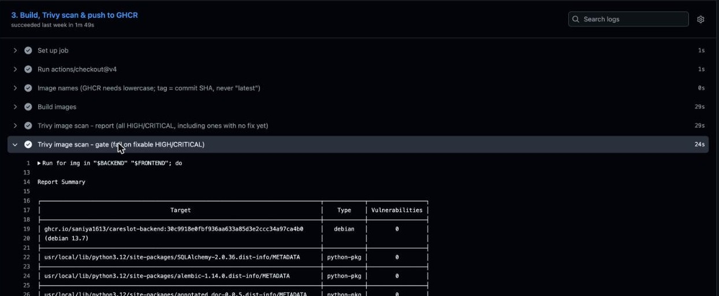
Security is a gate, not a report
1
SAST
Semgrep on the Python and JS code
2
SCA
pip-audit on Python dependencies
3
IaC + secrets
Trivy config on Terraform, Helm, Dockerfiles; gitleaks
4
Image gate
Trivy fails the build on fixable HIGH / CRITICAL CVEs

Slide 9
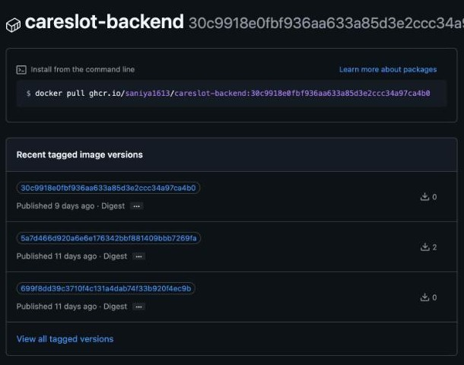
Registry: GHCR, tagged by commit SHA
1
Two packages
careslot-backend and careslot-frontend, both public
2
One tag per commit
30c9918…, 5a7d466…: the same SHA as the git commit
3
Easy rollback
helm upgrade --set backend.tag=<old SHA> goes back to any build

Slide 10
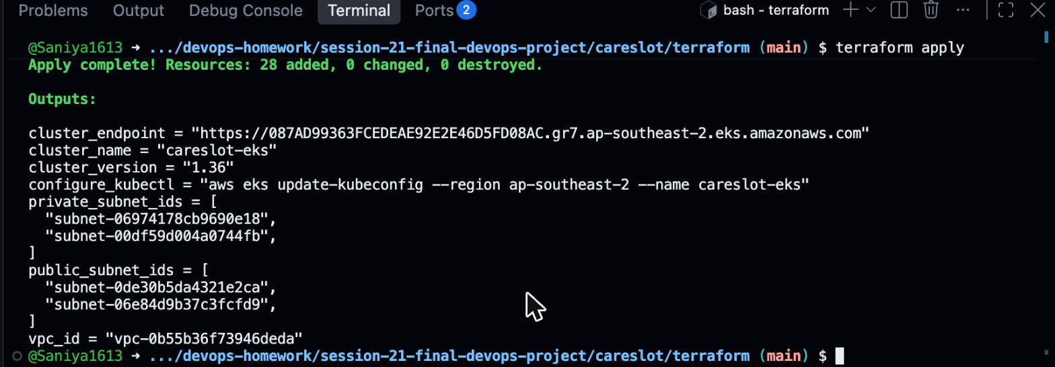
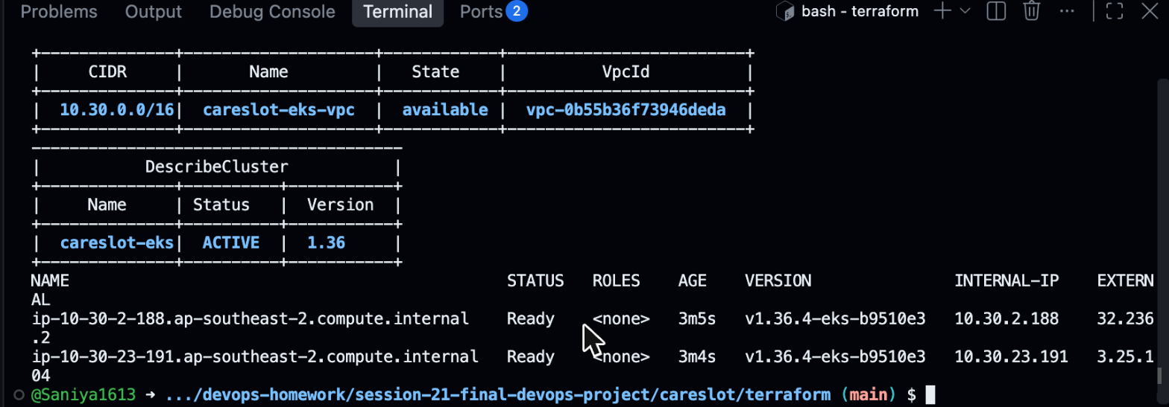
Infrastructure as code on AWS
1
VPC
10.30.0.0/16, 2 public + 2 private subnets, Sydney region
2
EKS 1.36
Secrets encrypted with KMS, add-ons incl. EBS CSI
3
Node group
2 × m7i-flex.large, launch template, IMDS hop limit 2
4
28 resources
Created with terraform apply, removed with destroy

Slide 11
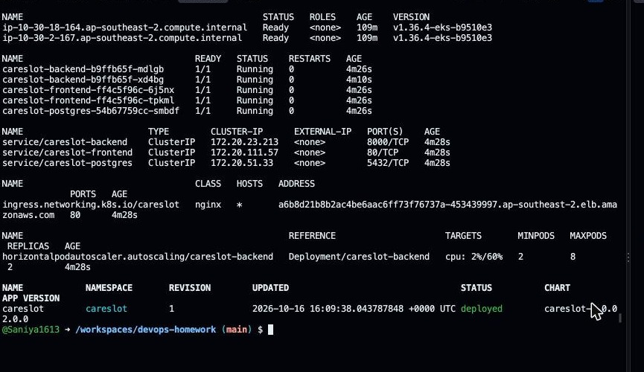
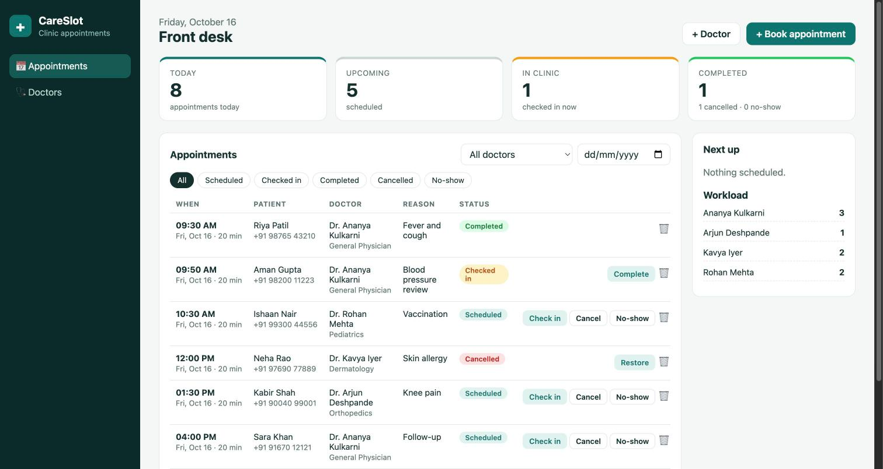
Kubernetes deployment with Helm
The app served through the Ingress (AWS load balancer)
kubectl get pods,svc,ingress,hpa · helm list on EKS
One chart: Deployments, Services, Ingress, HPA, PDBs, ServiceMonitor, ConfigMap, generated DB Secret, probes and resource limits.

Slide 12
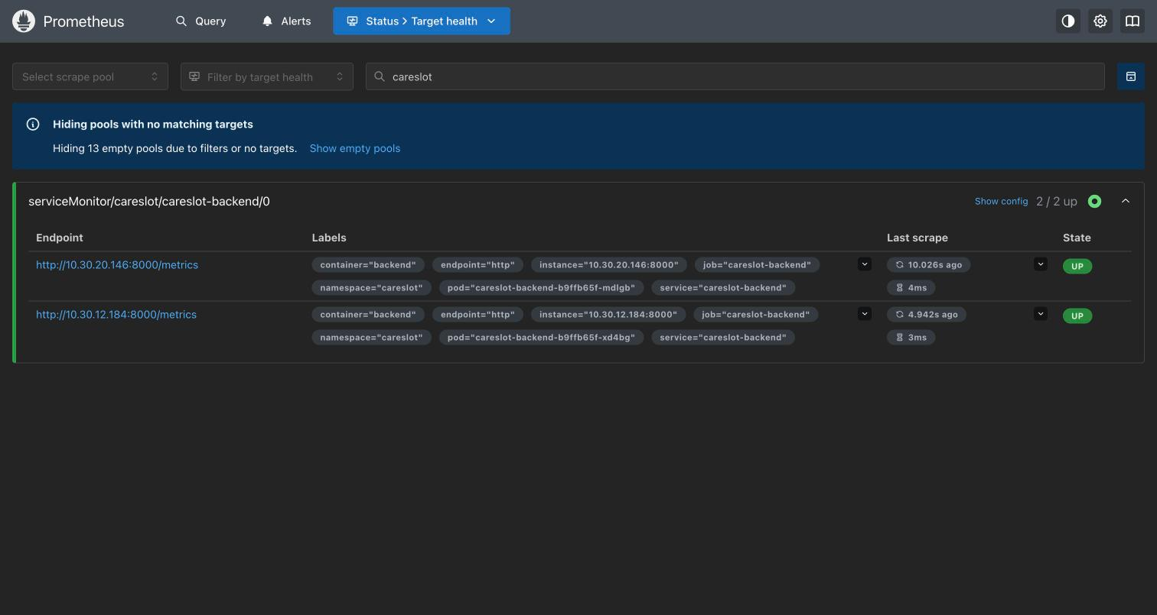
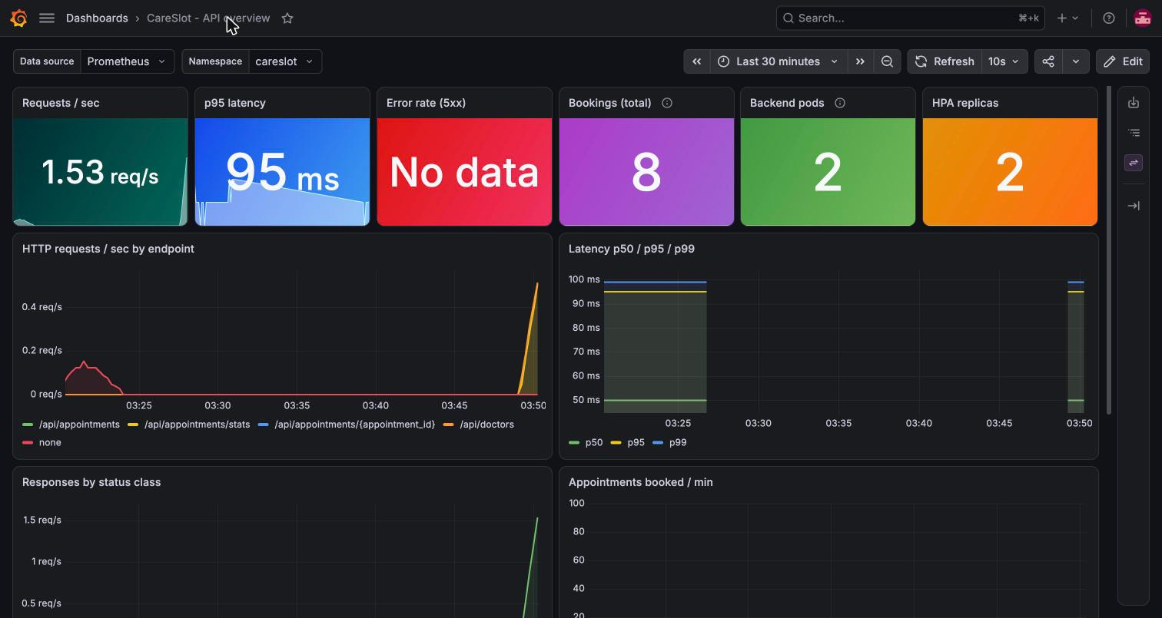
Observability: Prometheus and Grafana
ServiceMonitor: both backend pods scraped, state UP
CareSlot dashboard: req/s, p95 latency, errors, bookings, pods, HPA

Slide 13
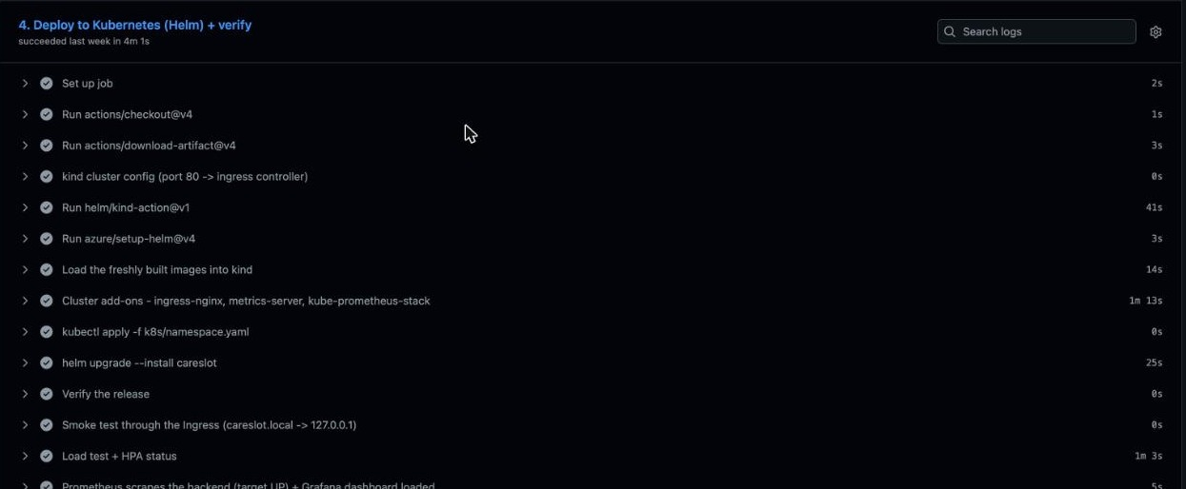
From commit to running deployment
1
Commit and push
git push to main triggers the workflow
2
Test and scan
Any failure stops the pipeline here
3
Build and push
New images tagged with the new SHA
4
helm upgrade
--set backend.tag=<SHA>: rolling update, zero downtime
5
Verify
Rollout status, Ingress smoke test, Prometheus target UP
Deploy job of run #10: every step green

Slide 14
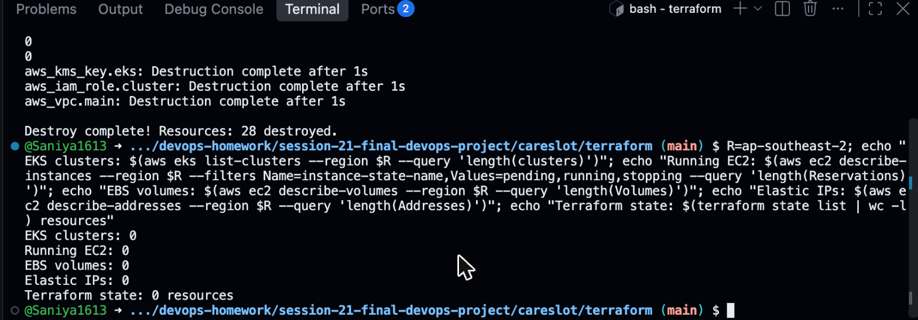
Cleanup and lessons
1
Tests first
The cheapest place to catch a bug is before an image exists.
2
Readiness ≠ liveness
/ready checks the database, so a bad DB pulls pods out of traffic instead of restart-looping them.
terraform destroy: 28 resources removed, nothing left running
3
Infrastructure costs money
No NAT gateway, small node group, and always terraform destroy.
github.com/Saniya1613/devops-homework · session-21-final-devops-project

