Slide 1
Heart analysis
Saniya Nilesh Deshpande

Slide 2
Introduction
This Python script conducts a thorough exploration of a heart disease dataset using Pandas, Matplotlib, and Seaborn. It begins by loading the dataset, providing an initial overview through descriptive statistics. The distribution of the target variable, indicating the prevalence of heart disease, is then visualized using a count plot.

Slide 3
Details of data
The details of the heart disease dataset used in the provided Python script are as follows:
Size:
The dataset contains an unspecified number of rows and columns (not explicitly mentioned in the script).
Columns:
The script mentions the presence of a 'target' variable, but specific details about other columns are not provided.
Data Exploration:
Descriptive statistics (mean, standard deviation, quartiles) are computed for numerical features, but the names and characteristics of these features are not explicitly outlined in the script.
Visualizations:
Distribution of the 'target' variable is visualized using a count plot.
Numerical features (age, trestbps, chol, thalach, oldpeak) are explored through histograms.
Scatterplots depict the relationships between individual numerical features and the 'target' variable.
Box plots illustrate the distribution of categorical features (sex, cp, fbs, restecg, exang, slope, ca, thal) colored by the 'target' variable.
A correlation heatmap is generated to visualize relationships between numerical features.
Missing Information:
The script does not explicitly mention the presence or handling of missing values in the dataset.
Context:
The script lacks details about the origin, source, or context of the heart disease dataset.

Slide 4
Main kpi
Target Variable ('target'):
Represents the presence or absence of heart disease.
Binary classification (0: No heart disease, 1: Heart disease).
Numerical Features:
Age: Patient's age.
Resting Blood Pressure ('trestbps'): Resting blood pressure.
Cholesterol ('chol'): Serum cholesterol levels.
Maximum Heart Rate ('thalach'): Maximum heart rate achieved.
ST Depression ('oldpeak'): Exercise-induced ST depression.
Categorical Features:
Sex ('sex'): Gender of the patient (0: Female, 1: Male).
Chest Pain Type ('cp'): Type of chest pain experienced.
Fasting Blood Sugar ('fbs'): Fasting blood sugar > 120 mg/dl (1: True, 0: False).
Resting Electrocardiographic Results ('restecg'): Resting electrocardiographic results.
Exercise-Induced Angina ('exang'): Exercise-induced angina (1: Yes, 0: No).
Slope of the Peak Exercise ST Segment ('slope'): Slope of the peak exercise ST segment.
Number of Major Vessels Colored by Fluoroscopy ('ca'): Number of major vessels colored by fluoroscopy.
Thalassemia Type ('thal'): Thalassemia type.

Slide 5
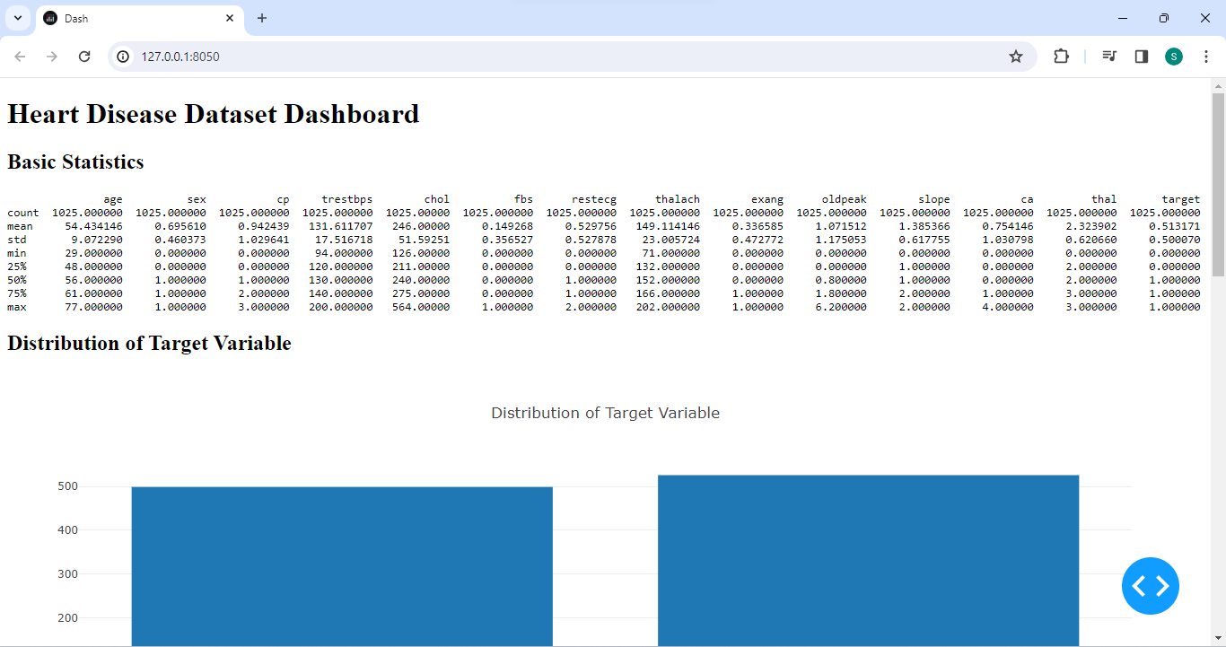
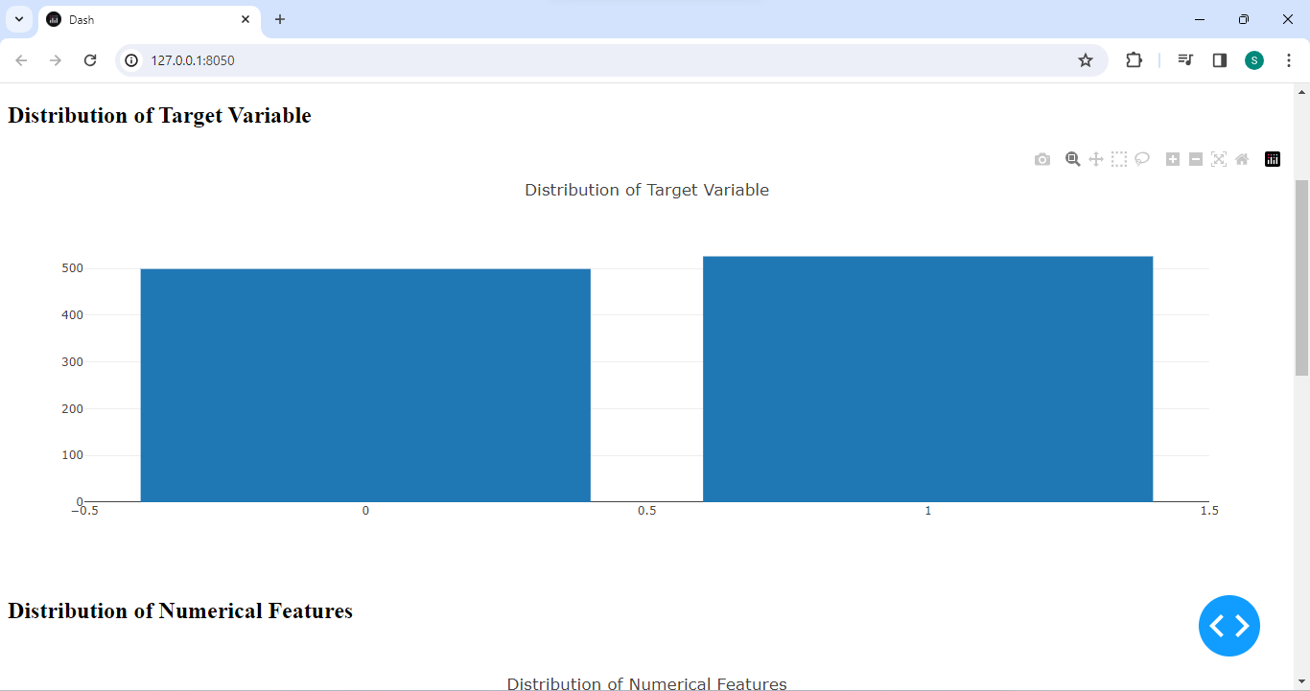
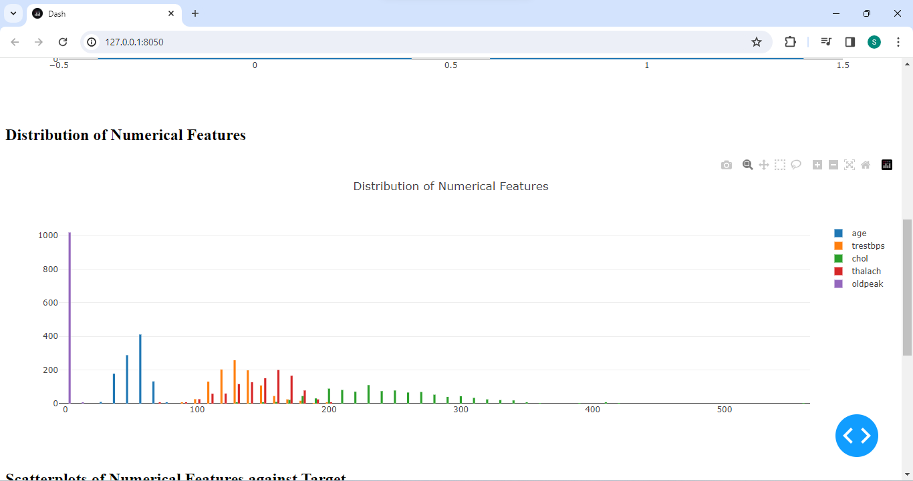
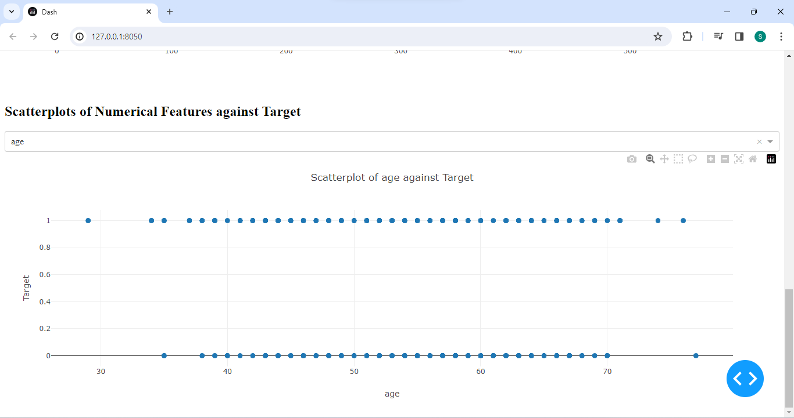
My Design

Slide 6
THANK YOU

