Slide 1

21ECSC210
Exploratory Data Analysis Course Project: Final Review
A Comprehensive Analysis on
Influenza(flu) Virus
Department of Computer Science and Engineering,
KLE Technological University’s Dr. M. S. Sheshgiri College of Engineering and Technology, Belagavi

Slide 2
Details of the Team-14
Div:
Sl. No. | Name |  | SRN.
1 | Anuj Kanamadi |  | 02FE22BCS020
2 | Regina Fernandes |  | 02FE22BCS081
3 | Saniya Kadarbhai |  | 02FE22BCS106
4 | Shreya Miskin |  | 02FE22BCS125
Department of Computer Science and Engineering,
KLE Technological University’s Dr. M. S. Sheshgiri College of Engineering and Technology, Belagavi

Slide 3
SDG Target:
In line with SDG 3:
Good Health and Well-being, our influenza project targets several key objectives: understanding the epidemiology of influenza, identifying at-risk demographics, and evaluating the effectiveness of vaccination programs.
Target 3.3 of SDG 3 :
Aims to end epidemics and combat various communicable diseases, including the influenza virus. By focusing on the influenza virus, we can reduce its prevalence and mitigate its impact on public health.
This involves improving vaccination coverage, enhancing surveillance, and developing targeted interventions. Efforts in these areas can help prevent outbreaks, protect vulnerable populations, and contribute to overall global health security.
Department of Computer Science and Engineering,
KLE Technological University’s Dr. M. S. Sheshgiri College of Engineering and Technology, Belagavi

Slide 4
Motivation :
1. Public Health : The flu causes many illnesses and deaths each year. Understanding it better can help reduce its impact.
2. Resource Allocation : Knowing when and where the flu hits hardest can help distribute vaccines and treatments more effectively.
3. Prediction : Predicting flu outbreaks can help in taking early actions to prevent widespread illness.
4. Targeted Interventions : By understanding who is most affected, we can tailor health measures to protect those groups.
Department of Computer Science and Engineering,
KLE Technological University’s Dr. M. S. Sheshgiri College of Engineering and Technology, Belagavi

Slide 5




Empathy:
Department of Computer Science and Engineering,
KLE Technological University’s Dr. M. S. Sheshgiri College of Engineering and Technology, Belagavi

Slide 6
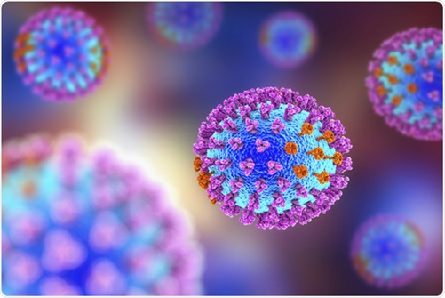
Course Project Problem Statement
The objective of this project is to forecast the frequency and severity of influenza cases by analyzing and modeling the Influenza dataset taken from Kaggle.
-The dataset includes a wealth of data regarding influenza cases, including demographics of the patients, symptoms, diagnosis, status of vaccination, and outcomes. It contains 19577 instances(rows) and 19 attributes(columns).
Department of Computer Science and Engineering,
KLE Technological University’s Dr. M. S. Sheshgiri College of Engineering and Technology, Belagavi

Slide 7
Dataset Details
Description of the dataset:
The dataset provides comprehensive information on influenza cases, including patient demographics, medical history, test results, treatment regimens, and outcomes which appeared on Kaggle.
With almost 19,000 entries, it offers valuable insights into the characteristics and management of influenza cases across different regions and years.
Source URL:
https://www.kaggle.com/datasets/sajalmaheshwari/influenzadatasetagemod/suggestions?status=pending&yourSuggestions=true
Department of Computer Science and Engineering,
KLE Technological University’s Dr. M. S. Sheshgiri College of Engineering and Technology, Belagavi

Slide 8
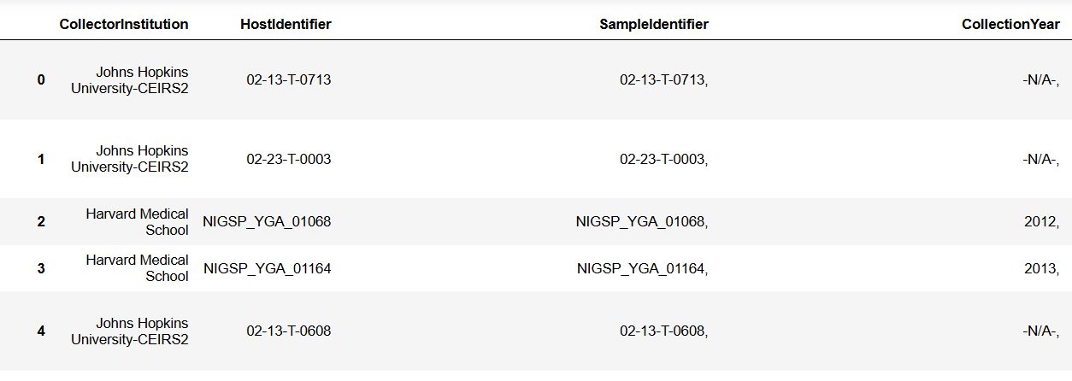
Department of Computer Science and Engineering,
KLE Technological University’s Dr. M. S. Sheshgiri College of Engineering and Technology, Belagavi

Slide 9
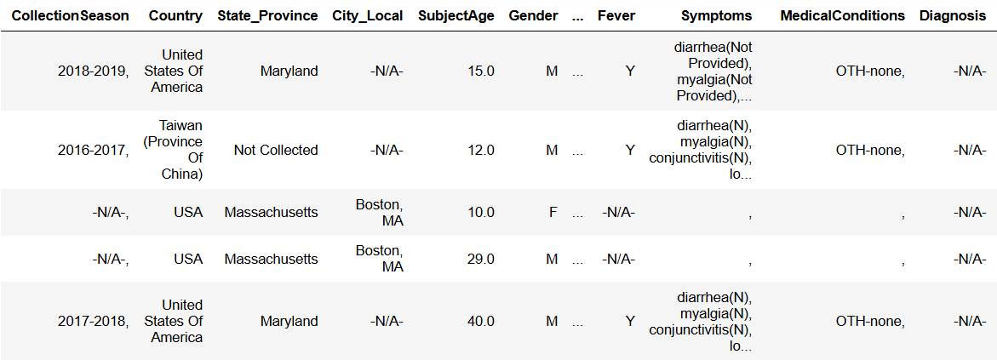
Department of Computer Science and Engineering,
KLE Technological University’s Dr. M. S. Sheshgiri College of Engineering and Technology, Belagavi

Slide 10
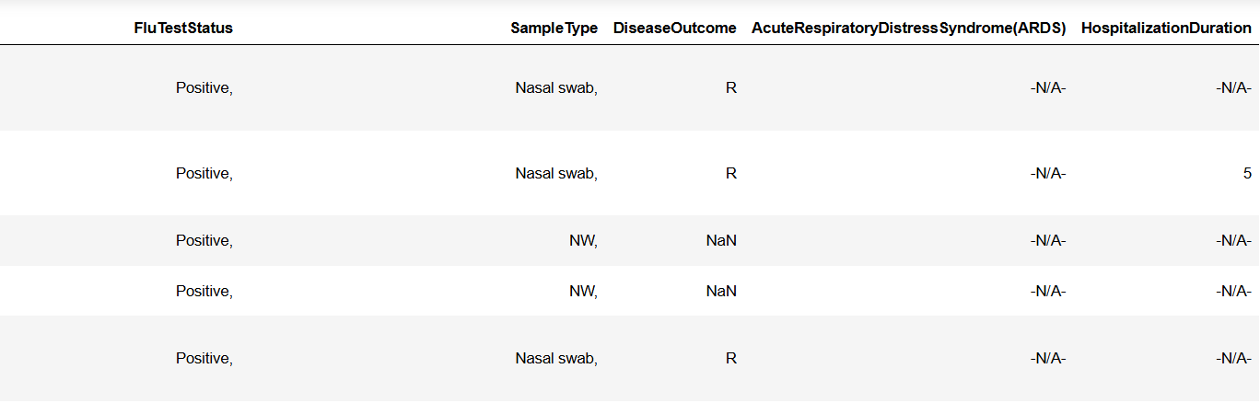
Department of Computer Science and Engineering,
KLE Technological University’s Dr. M. S. Sheshgiri College of Engineering and Technology, Belagavi

Slide 11
Knowing the Dataset
Collector Institution: Identifies the institution or organization collecting the data. It provides insight into the entities involved in influenza research and surveillance.
Host Identifier: An identifier for the host (e.g., patient) from which the sample was collected. It helps in tracking individual cases and possibly linking them to specific demographics or medical histories.
Sample Identifier: An identifier for the specific sample collected. It distinguishes individual samples and may provide information about the collection method or location.
Collection Year: Indicates the year in which the sample or data related to the influenza case was collected. It allows analysis of temporal trends in influenza prevalence.
Collection Season: Specifies the season during which the sample was collected. It helps understand seasonal patterns of influenza activity.
Country: Indicates the country where the sample was collected. It provides geographical context and allows for comparisons between different regions.
Department of Computer Science and Engineering,
KLE Technological University’s Dr. M. S. Sheshgiri College of Engineering and Technology, Belagavi

Slide 12
Knowing the Dataset
State_Province: Provides additional geographical detail, specifying the state or province within the country where the sample was collected.
City_Local: Specifies the local city or area where the sample was collected. It offers further granularity in geographical information.
Subject Age: Indicates the age of the subject (e.g., patient) from whom the sample was collected. It provides demographic information about the affected population.
Gender: Specifies the gender (or sex) of the subject from whom the sample was collected. It offers demographic information about the affected population.
Medical Conditions: Specifies any pre-existing medical conditions or comorbidities the patient may have had. It offers insight into the health status of the affected individuals.
Department of Computer Science and Engineering,
KLE Technological University’s Dr. M. S. Sheshgiri College of Engineering and Technology, Belagavi

Slide 13
Knowing the Dataset
Diagnosis: Indicates the state of diseases that affect the influenza. It provides crucial information about the outcome of diagnostic tests.
Flu Test Status: Specifies the result of the influenza test conducted on the patient. It provides crucial diagnostic information about the presence or absence of influenza infection.
Sample Type: Indicates the type of sample collected for testing. It provides information about the specimen used for diagnostic purposes.
Disease Outcome: Specifies the outcome of the influenza case. It provides information about the severity and prognosis of influenza infections.
Hospitalization Duration: Specifies the duration of hospitalization for the patient, if applicable. It provides information about the length of medical care required.
Department of Computer Science and Engineering,
KLE Technological University’s Dr. M. S. Sheshgiri College of Engineering and Technology, Belagavi

Slide 14
Knowing the Dataset
VaccinationStatus : Indicates whether an individual has been vaccinated, often categorized as 'Yes' or 'No'.
Fever : Reflects whether the individual has a fever.
Symptoms : Lists additional symptoms experienced by the individual, which can be a detailed text description or a categorical variable indicating the presence of symptoms.
Department of Computer Science and Engineering,
KLE Technological University’s Dr. M. S. Sheshgiri College of Engineering and Technology, Belagavi

Slide 15
Feature Set Description
Attributes | Distinct values/Missing values | Types
1.CollectorInstitution | 19577/ 0 | Categorical (Nominal)
2. HostIdentifier | 19577/ 0 | Categorical (Nominal)
3. SampleIdentifier | 19577/ 0 | Categorical (Nominal)
4. Collection Year | 22/ 0 | Categorical (Nominal)
5. Collection Season | 13/ 0 | Categorical (Nominal)
6.Country | 20/ 0 | Categorical (Nominal)
7. State_Province | 19347/ 230 | Categorical (Nominal)
8. City_Local | 19542/ 35 | Categorical (Nominal)
9.Subject Age | 0 | Numerical (Discrete)
10.Gender | 0 | Categorical (Nominal)
Department of Computer Science and Engineering,
KLE Technological University’s Dr. M. S. Sheshgiri College of Engineering and Technology, Belagavi

Slide 16
Attributes | Distinct values/Missing values | Types
11.VaccinationStatus | 0 | Categorical (Nominal)
12. Fever | 0 | Categorical (Nominal)
13. Symptoms | 0 | Categorical (Nominal)
14. MedicalConditions | 3580 | Categorical (Nominal)
15. Diagnosis | 0 | Categorical (Nominal)
16. FluTestStatus | 0 | Categorical (Nominal)
17. SampleType | 0 | Categorical (Nominal)
18. DiseaseOutcome | 0 | Categorical (Nominal)
19. HospitalizationDuration | 4535 | Numerical (Discrete)
Department of Computer Science and Engineering,
KLE Technological University’s Dr. M. S. Sheshgiri College of Engineering and Technology, Belagavi

Slide 17
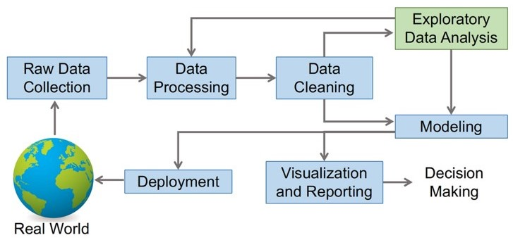
Implement Framework
Department of Computer Science and Engineering,
KLE Technological University’s Dr. M. S. Sheshgiri College of Engineering and Technology, Belagavi

Slide 18
Implement Framework
1. Data Collection - Gather the dataset from relevant sources. This could involve downloading data from online repositories, accessing databases, using APIs, or collecting data through surveys and experiments. Ensuring that the data is relevant, reliable, and up-to-date is crucial for the quality of the analysis.
2. Data Loading - Load the dataset into a Data Frame for analysis using appropriate tools and libraries such as pandas in Python. This step ensures that the data is structured in a format suitable for analysis. It involves reading data from files (e.g., CSV, Excel) and handling any initial issues such as file encoding or delimiters.
3. Data Preprocessing - Inspect the dataset to understand its structure and contents. This includes viewing the first few rows, checking the data types of each column, and summarizing statistical properties. The goal is to get a sense of the data’s layout and identify any obvious issues such as missing values, duplicate entries, or anomalies.
Department of Computer Science and Engineering,
KLE Technological University’s Dr. M. S. Sheshgiri College of Engineering and Technology, Belagavi

Slide 19
Implement Framework
4. Data Cleaning - Handle missing values by filling them with appropriate values, using statistical methods, or removing incomplete records. Ensure all columns have appropriate data types, converting them if necessary (e.g., strings to dates). This step also includes removing duplicates, correcting inconsistencies , and addressing any errors in the data to ensure accuracy and reliability.
5. Data Transformation - Convert categorical data into numerical data using techniques like One Hot Encoding or label encoding. This is essential for enabling statistical analysis and machine learning models to process the data effectively. Framework Transformation may also include scaling numerical features, creating new features, and normalizing or standardizing data.
6. Data Visualization - Use visualization techniques to understand data distributions and relationships. Creating plots such as histograms, bar charts , scatter plots, and box plots helps to identify patterns, trends, and outliers in the data. Visualization is a powerful tool for gaining insights and communicating findings effectively.
Department of Computer Science and Engineering,
KLE Technological University’s Dr. M. S. Sheshgiri College of Engineering and Technology, Belagavi

Slide 20
Implement Framework
7. Documenting the Process - Document each step taken during data preprocessing for future reference and reproducibility. This includes recording methods used for handling missing values, transformations applied, and any assumptions made. Proper documentation ensures that the analysis can be replicated, understood by others, and serves as a reference for future projects. It also provides transparency and accountability in the data analysis process.
Department of Computer Science and Engineering,
KLE Technological University’s Dr. M. S. Sheshgiri College of Engineering and Technology, Belagavi

Slide 21
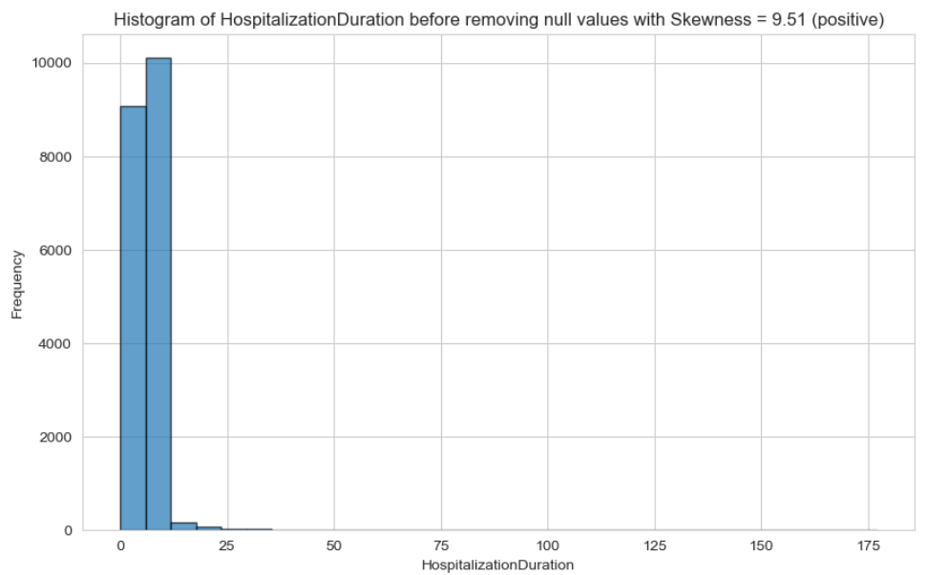
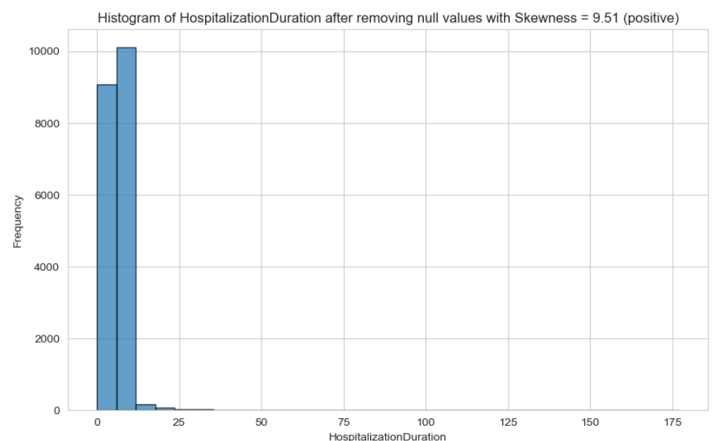
Data Preprocessing
1. Handling Missing Values: We checked for missing values in the dataset and decided how to handle them. Depending on the extent of missingness and the nature of the data, we have removed missing values in HospitalisationDuration attribute and imputed them with appropriate method simple imputation such as mean.
2. Dealing with Duplicates: Duplicate records can skew analysis results and model performance. We checked the skewness of the HospitalisationDuration attribute before and after removing missing values. It was same.
Department of Computer Science and Engineering,
KLE Technological University’s Dr. M. S. Sheshgiri College of Engineering and Technology, Belagavi

Slide 22
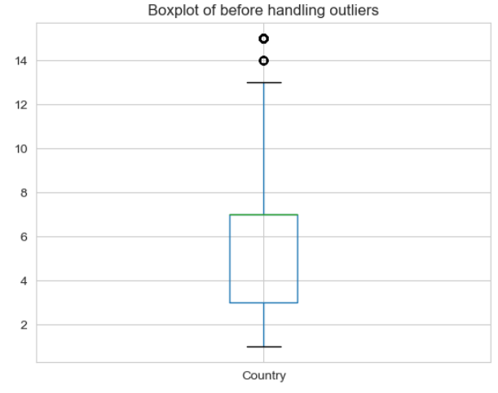
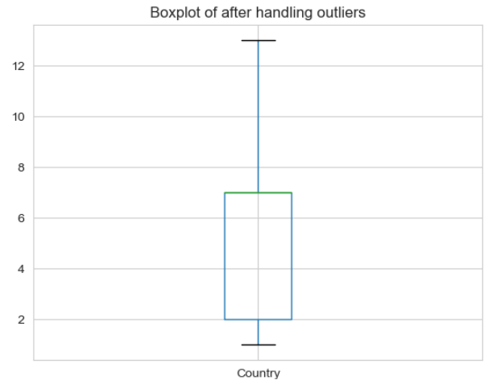
Data Preprocessing steps
3. Outlier Detection and Handling: We identified and handled outliers in the data. We chose to remove outliers and handle them by finding lower and upper boundary and then filtering the data in the following attributes :-
Collection Year, CollectionSeason, Country, City_Local, SubjectAge, Gender, VaccinationStatus, Fever, Diagnosis, FluTestStatus, DiseaseOutcome and Hospitalization Duration.
For Example:
Department of Computer Science and Engineering,
KLE Technological University’s Dr. M. S. Sheshgiri College of Engineering and Technology, Belagavi

Slide 23
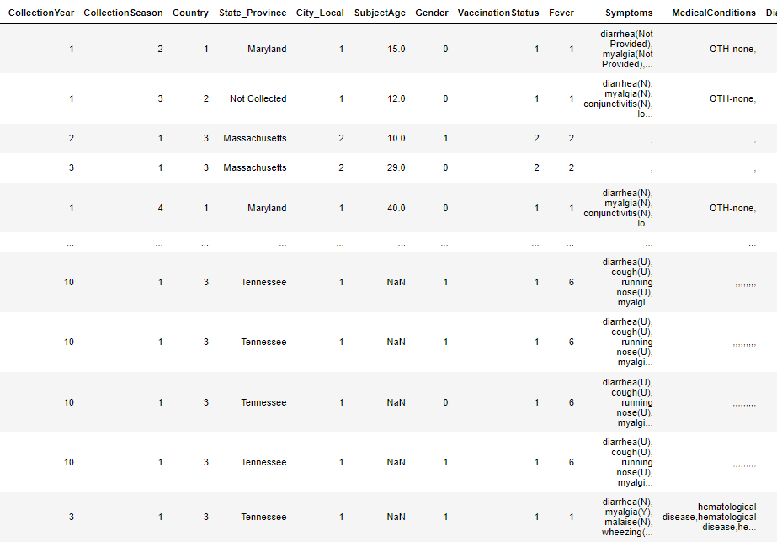
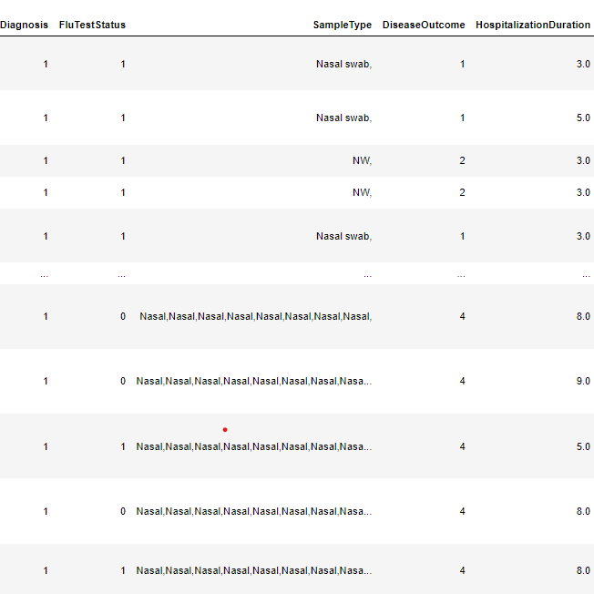
Data Preprocessing steps
4. Encoding Categorical Variables: Their are categorical variables in the dataset, we converted them into numerical format using technique label encoding. The following attributes are- Gender, CollectionYear, City_local, CollectionSeason, Country, DiseaseOutcome, Diagnosis, Fever, VaccinationStatus,FluTestStatus
The updated snapshot of dataset-
Department of Computer Science and Engineering,
KLE Technological University’s Dr. M. S. Sheshgiri College of Engineering and Technology, Belagavi

Slide 24
Data Preprocessing steps
5. Feature Selection: We analyzed the relevance of each feature and selected the target attribute as FluTestStatus . We identified irrelevant and highly correlated features to improve model efficiency and reduce overfitting.
Department of Computer Science and Engineering,
KLE Technological University’s Dr. M. S. Sheshgiri College of Engineering and Technology, Belagavi

Slide 25
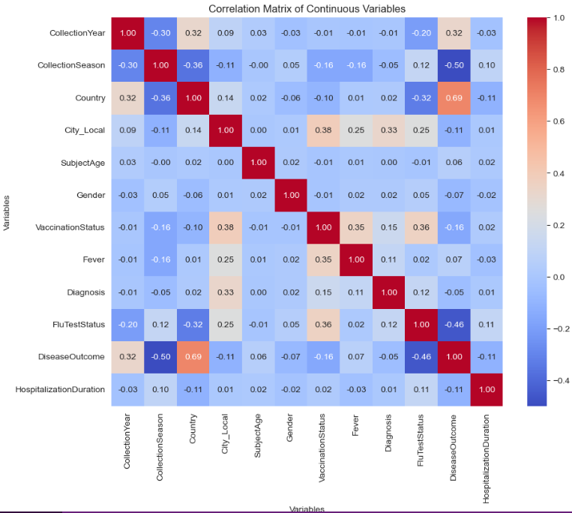
Data Preprocessing steps
Department of Computer Science and Engineering,
KLE Technological University’s Dr. M. S. Sheshgiri College of Engineering and Technology, Belagavi

Slide 26
Proposed Hypothesis
1. There is a difference in disease outcome based on country.
2. There is a significant difference in hospitalization duration based on Flu Test Status.
3. The duration of hospitalization is correlated with the patient's age.
4. Patients with certain pre-existing medical conditions have a higher risk of severe disease outcomes.
5. The presence of diagnosed outcomes is associated with a longer hospitalization duration.
6. Vaccination status influences the likelihood of different symptoms.
7. Patients with fever are most likely to get positive flu test status.
Department of Computer Science and Engineering,
KLE Technological University’s Dr. M. S. Sheshgiri College of Engineering and Technology, Belagavi

Slide 27
Proposed Hypothesis
8. Vaccination Status and Country Affect Flu Test Status.
9. The distribution of Diagnosis outcomes differs between vaccinated and unvaccinated patients.
10. The distribution of Flu test outcomes varies between different Genders.
11. The severity of diagnosis outcomes based on age.
12. Collection Year and Subject Age affect Flu Test Status.
13. Analysis of Flu Test Status Over Different Years.
Department of Computer Science and Engineering,
KLE Technological University’s Dr. M. S. Sheshgiri College of Engineering and Technology, Belagavi

Slide 28
Proposed Hypothesis
14. The time of year (season) affects the likelihood of hospitalization due to positive flu tested .
15. Interaction between vaccination status and disease outcome across different states.
16. Distribution of Flu Test Status by Vaccination Status.
Department of Computer Science and Engineering,
KLE Technological University’s Dr. M. S. Sheshgiri College of Engineering and Technology, Belagavi

Slide 29
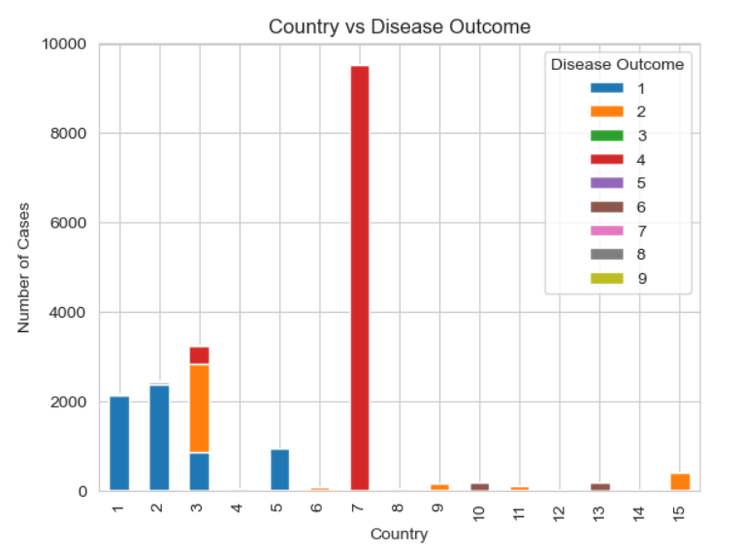
Proposed Hypothesis
Hypothesis1: There is a difference in disease outcome based on country.
Department of Computer Science and Engineering,
KLE Technological University’s Dr. M. S. Sheshgiri College of Engineering and Technology, Belagavi

Slide 30
Proposed Hypothesis
Hypothesis1: There is a difference in disease outcome based on country.
The journey begins by investigating how disease outcomes vary significantly between different countries. This sets the stage for understanding the broader geographical context of flu-related health issues.
Inference:
According the hypothesis the country no. 1 i.e. China has the highest number of unknown Disease outcomes.
Further we can see that in the country no. 3 i.e. USA has 3 different disease outcomes they are: recovered, unrecovered and unknown.
The correlation between DiseaseOutcome and Country is positive and strong with 0.69.
Department of Computer Science and Engineering,
KLE Technological University’s Dr. M. S. Sheshgiri College of Engineering and Technology, Belagavi

Slide 31
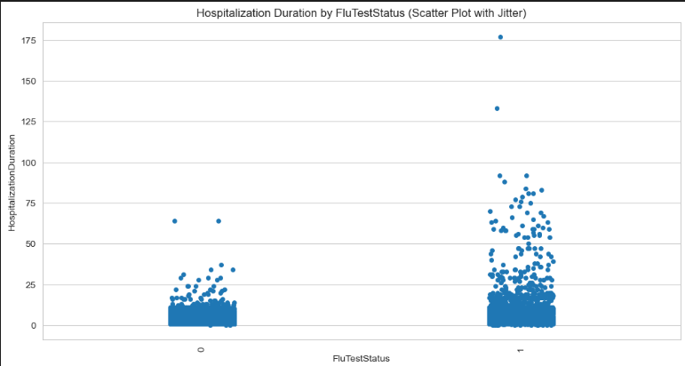
Proposed Hypothesis
Hypothesis2: There is a significant difference in hospitalization duration based on Flu Test Status.
Department of Computer Science and Engineering,
KLE Technological University’s Dr. M. S. Sheshgiri College of Engineering and Technology, Belagavi

Slide 32
Proposed Hypothesis
Hypothesis 2: There is a significant difference in hospitalization duration based on Flu Test Status.
Next, we examine whether there is a significant difference in hospitalization duration based on Flu Test Status testing positive or negative.
Inference:
We can see that the people tested positive for Flu have longer hospitalization duration.
The correlation between HospitalizationDuration and FluTestStatus is positive with 0.11.
Department of Computer Science and Engineering,
KLE Technological University’s Dr. M. S. Sheshgiri College of Engineering and Technology, Belagavi

Slide 33
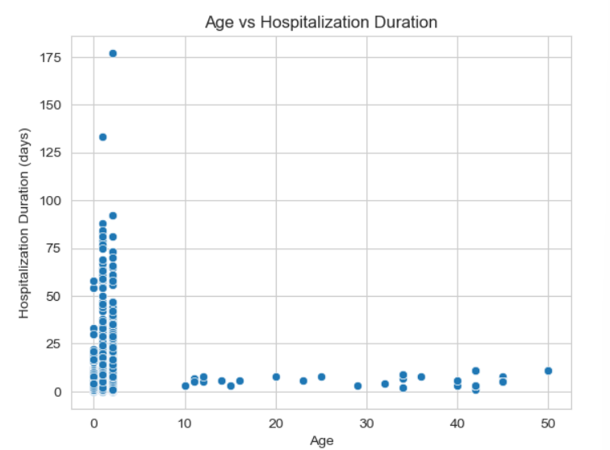
Proposed Hypothesis
Hypothesis3 : The duration of hospitalization is correlated with the patient's age.
Department of Computer Science and Engineering,
KLE Technological University’s Dr. M. S. Sheshgiri College of Engineering and Technology, Belagavi

Slide 34
Proposed Hypothesis
Hypothesis 3 : The duration of hospitalization is correlated with the patient's age.
We then explore how the duration of hospitalization correlates with the patient's age, revealing important insights into how different age groups are affected by flu-related complications.
Inference :
We have analyzed that younger age group people have higher hospitalization duration as compared to elder age group.
The correlation between SubjectAge and HospitalizationDuration is positive with 0.02.
Department of Computer Science and Engineering,
KLE Technological University’s Dr. M. S. Sheshgiri College of Engineering and Technology, Belagavi

Slide 35
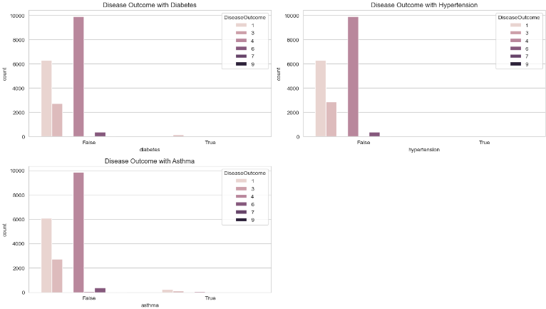
Proposed Hypothesis
Hypothesis 4 : Patients with certain pre-existing medical conditions have a higher risk of severe disease outcomes.
Department of Computer Science and Engineering,
KLE Technological University’s Dr. M. S. Sheshgiri College of Engineering and Technology, Belagavi

Slide 36
Proposed Hypothesis
Hypothesis 4 : Patients with certain pre-existing medical conditions have a higher risk of severe disease outcomes.
Moving to individual health factors, we assess whether patients with certain pre-existing medical conditions have a higher risk of severe disease outcomes, highlighting the role of comorbidities in flu severity.
Inference:
By this hypothesis we can say that there is no direct relationship between pre-existing medical conditions and disease outcomes.
The correlation between Diagnosis and DiseaseOutcome is negative with -0.05.
Department of Computer Science and Engineering,
KLE Technological University’s Dr. M. S. Sheshgiri College of Engineering and Technology, Belagavi

Slide 37
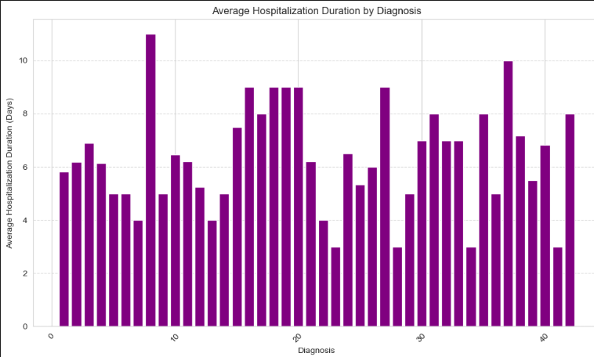
Proposed Hypothesis
Hypothesis 5 : The presence of diagnosed outcomes is associated with a longer hospitalization duration.
Department of Computer Science and Engineering,
KLE Technological University’s Dr. M. S. Sheshgiri College of Engineering and Technology, Belagavi

Slide 38
Proposed Hypothesis
Hypothesis 5 : The presence of diagnosed outcomes is associated with a longer hospitalization duration.
We investigate how the presence of diagnosed outcomes is associated with longer hospitalization durations, providing a closer look at the severity and complexity of cases.
Inference
By this Hypothesis we have analyzed that people diagnosed with no. 7 disease i.e. Flu, Common cold have longer hospitalization duration.
The correlation between Diagnosis and HospitalizationDuration is positive with 0.01.
Department of Computer Science and Engineering,
KLE Technological University’s Dr. M. S. Sheshgiri College of Engineering and Technology, Belagavi

Slide 39
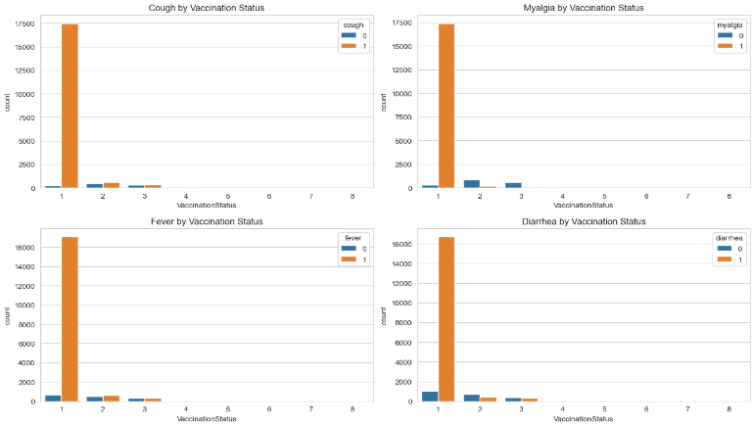
Proposed Hypothesis
Hypothesis 6 : Vaccination status influences the likelihood of different symptoms.
Department of Computer Science and Engineering,
KLE Technological University’s Dr. M. S. Sheshgiri College of Engineering and Technology, Belagavi

Slide 40
Proposed Hypothesis
Hypothesis 6 : Vaccination status influences the likelihood of different symptoms.
The narrative then shifts to the influence of vaccination status, analyzing how being vaccinated affects the likelihood of experiencing different flu symptoms.
Inference :
People who are not vaccinated are more likely to get symptoms like cough, malaria, fever and diarrhea.
Department of Computer Science and Engineering,
KLE Technological University’s Dr. M. S. Sheshgiri College of Engineering and Technology, Belagavi

Slide 41
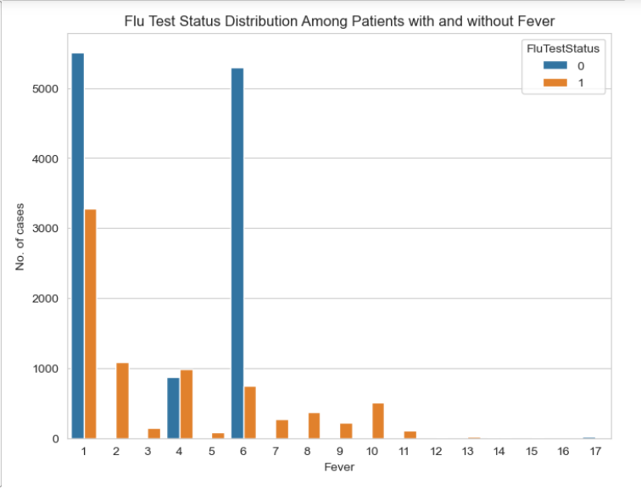
Proposed Hypothesis
Hypothesis 7 : Patients with fever are most likely to get positive flu test status.
Department of Computer Science and Engineering,
KLE Technological University’s Dr. M. S. Sheshgiri College of Engineering and Technology, Belagavi

Slide 42
Proposed Hypothesis
Hypothesis 7 :Patients with fever are most likely to get positive flu test status.
We identify that patients with fever are most likely to test positive for flu, focusing on a common symptom that plays a key role in diagnosis.
Inference
The correlation between FluTestStatus and Fever is positive with 0.02.
Hence we can observe that FluTestStatus and Fever have very weak positive correlation.
Department of Computer Science and Engineering,
KLE Technological University’s Dr. M. S. Sheshgiri College of Engineering and Technology, Belagavi

Slide 43
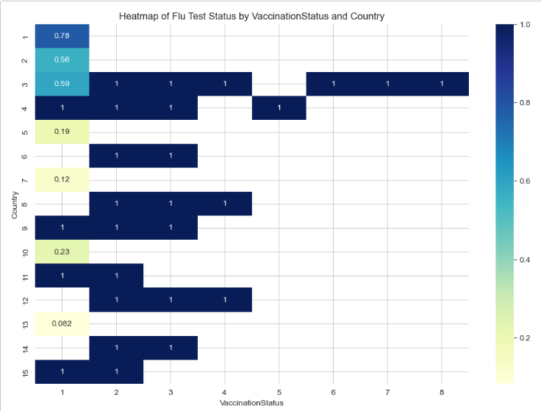
Proposed Hypothesis
Hypothesis 8 : Vaccination Status and Country Affect Flu Test Status.
Department of Computer Science and Engineering,
KLE Technological University’s Dr. M. S. Sheshgiri College of Engineering and Technology, Belagavi

Slide 44
Proposed Hypothesis
Hypothesis 8 : Vaccination Status and Country Affect Flu Test Status.
Combining vaccination and geographic factors, we explore how vaccination status and country jointly affect flu test outcomes.
Inference:
Country no. 4, 9, 11 and 15 (Mexico, Chile, Nicaragua and Brazil ) have high changes of getting Flu test as positive who are not vaccinated .
Department of Computer Science and Engineering,
KLE Technological University’s Dr. M. S. Sheshgiri College of Engineering and Technology, Belagavi

Slide 45
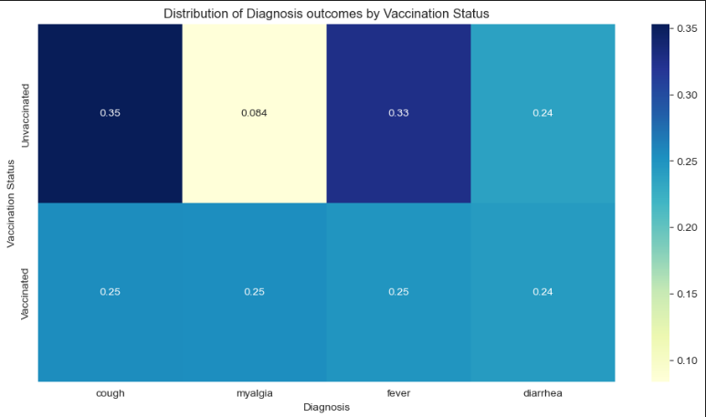
Proposed Hypothesis
Hypothesis 9 : The distribution of Diagnosis outcomes differs between vaccinated and unvaccinated patients.
Department of Computer Science and Engineering,
KLE Technological University’s Dr. M. S. Sheshgiri College of Engineering and Technology, Belagavi

Slide 46
Proposed Hypothesis
Hypothesis 9 : The distribution of Diagnosis outcomes differs between vaccinated and unvaccinated patients.
We compare the distribution of diagnosis outcomes between vaccinated and unvaccinated patients, shedding light on the protective effects of vaccination.
Inference :
People who are unvaccinated and have cough have high severity of getting Flu Test as positive.
Department of Computer Science and Engineering,
KLE Technological University’s Dr. M. S. Sheshgiri College of Engineering and Technology, Belagavi

Slide 47
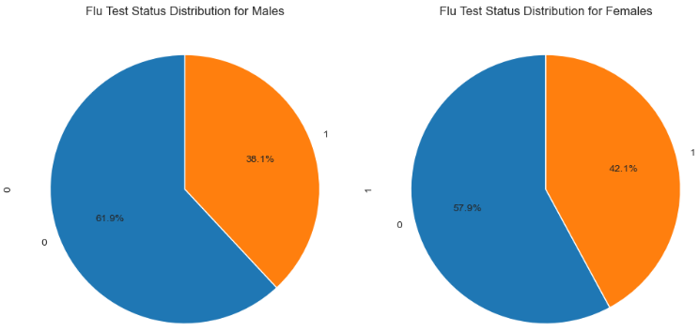
Proposed Hypothesis
Hypothesis 10 : The distribution of Flu test outcomes varies between different Genders.
Department of Computer Science and Engineering,
KLE Technological University’s Dr. M. S. Sheshgiri College of Engineering and Technology, Belagavi

Slide 48
Proposed Hypothesis
Hypothesis 10 : The distribution of Flu test outcomes varies between different Genders.
We examine how flu test outcomes vary between different genders, adding another demographic dimension to our understanding.
Inference:
We can observe that Females are more likely to be tested positive for Flu.
The correlation between FluTestStatus and Gender is positive and strong with 0.05.
Department of Computer Science and Engineering,
KLE Technological University’s Dr. M. S. Sheshgiri College of Engineering and Technology, Belagavi

Slide 49
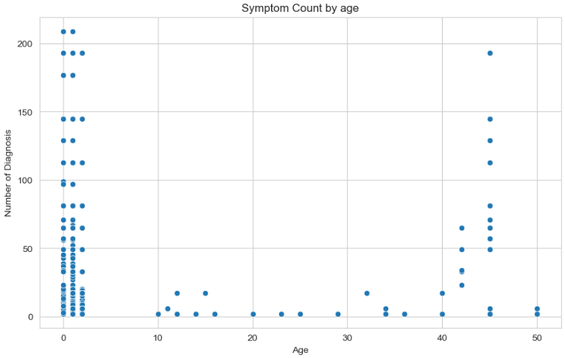
Proposed Hypothesis
Hypothesis 11 : The severity of diagnosis outcomes based on age.
Department of Computer Science and Engineering,
KLE Technological University’s Dr. M. S. Sheshgiri College of Engineering and Technology, Belagavi

Slide 50
Proposed Hypothesis
Hypothesis 11 : The severity of diagnosis outcomes based on age.
The severity of diagnosis outcomes based on age is then analyzed, highlighting age-specific vulnerabilities and risks
Inference :
We can observe that younger age group have highest no of diagnosis outcomes.
The correlation between FluTestStatus and Country is Positive with 0.01
Department of Computer Science and Engineering,
KLE Technological University’s Dr. M. S. Sheshgiri College of Engineering and Technology, Belagavi

Slide 51
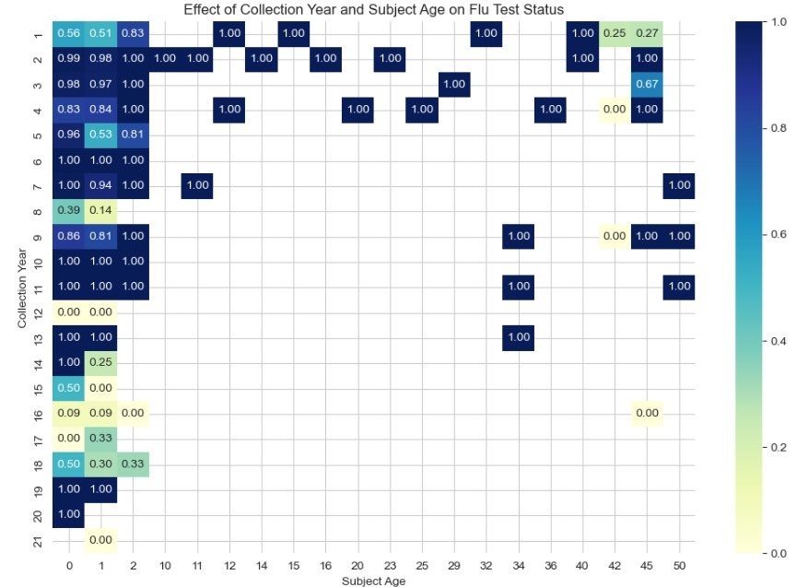
Proposed Hypothesis
Hypothesis 12 : Collection Year and Subject Age affect Flu Test Status.
Department of Computer Science and Engineering,
KLE Technological University’s Dr. M. S. Sheshgiri College of Engineering and Technology, Belagavi

Slide 52
Proposed Hypothesis
Hypothesis 12 : Collection Year and Subject Age affect Flu Test Status.
We investigate how the collection year and subject age affect flu test status, bringing in a temporal aspect to the analysis.
Inference :
Younger people have tested more severity in Flu in the following years :
2014-2015(6), 2010(7), 2014(10), 2007(11), 2006(13), 2008(14), 2015-2017(19), 2008-2009(20) .
Department of Computer Science and Engineering,
KLE Technological University’s Dr. M. S. Sheshgiri College of Engineering and Technology, Belagavi

Slide 53
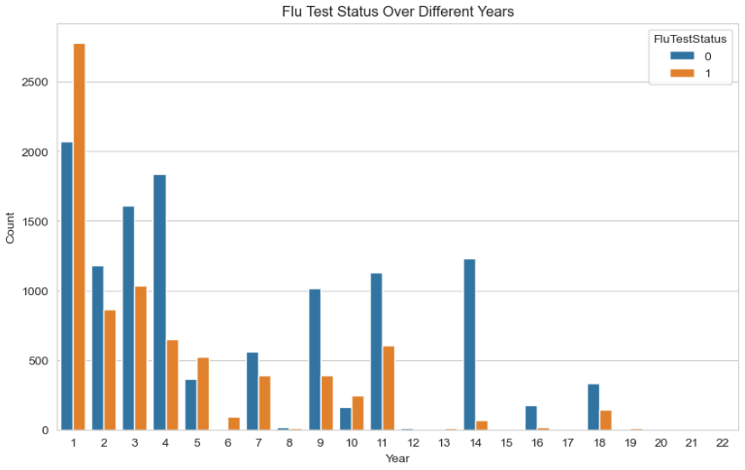
Proposed Hypothesis
Hypothesis 13 : Analysis of Flu Test Status Over Different Years.
Department of Computer Science and Engineering,
KLE Technological University’s Dr. M. S. Sheshgiri College of Engineering and Technology, Belagavi

Slide 54
Proposed Hypothesis
Hypothesis 13 : Analysis of Flu Test Status Over Different Years.
Building on the previous point, we analyze trends in flu test status over different years, identifying patterns and shifts over time
Inference :
The correlation between FluTestStatus and CollectionYear is negative with
-0.20.
Hence they are not correlated.
Department of Computer Science and Engineering,
KLE Technological University’s Dr. M. S. Sheshgiri College of Engineering and Technology, Belagavi

Slide 55
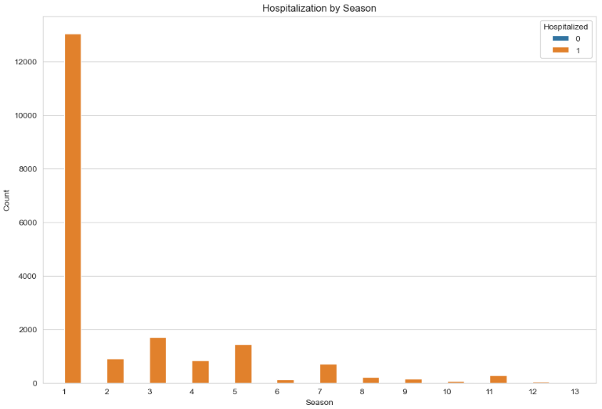
Proposed Hypothesis
Hypothesis 14 : The time of year (season) affects the likelihood of hospitalization due to positive flu tested .
Department of Computer Science and Engineering,
KLE Technological University’s Dr. M. S. Sheshgiri College of Engineering and Technology, Belagavi

Slide 56
Proposed Hypothesis
Hypothesis 14 : The time of year (season) affects the likelihood of hospitalization due to positive flu tested .
We explore how the time of year (season) affects the likelihood of hospitalization due to flu, emphasizing the seasonal nature of flu outbreaks.
Inference:
In the year 2017 more people were tested positive for Flu and were Hospitalized for longer period of time .
The correlation between Collectionseason and HospitalizationDuration is positive with 0.10.
Department of Computer Science and Engineering,
KLE Technological University’s Dr. M. S. Sheshgiri College of Engineering and Technology, Belagavi

Slide 57
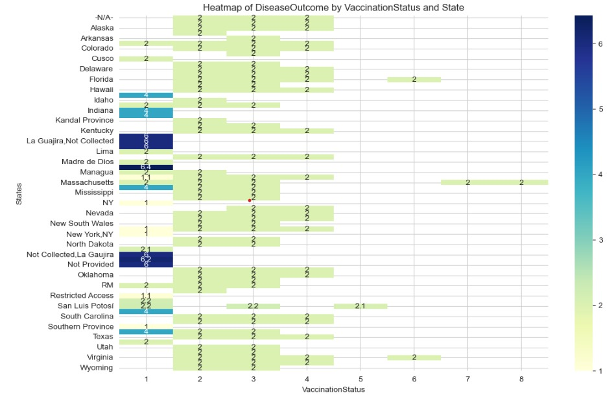
Proposed Hypothesis
Hypothesis 15 : Interaction between vaccination status and disease outcome across different states.
Department of Computer Science and Engineering,
KLE Technological University’s Dr. M. S. Sheshgiri College of Engineering and Technology, Belagavi

Slide 58
Proposed Hypothesis
Hypothesis 15 : Interaction between vaccination status and disease outcome across different states.
The narrative examines how the prevalence of specific disease outcomes varies significantly between countries, underscoring the importance of local factors.
Inference :
State La Guajira and Managua has higher chances of getting disease outcomes as they were not vaccinated.
Department of Computer Science and Engineering,
KLE Technological University’s Dr. M. S. Sheshgiri College of Engineering and Technology, Belagavi

Slide 59
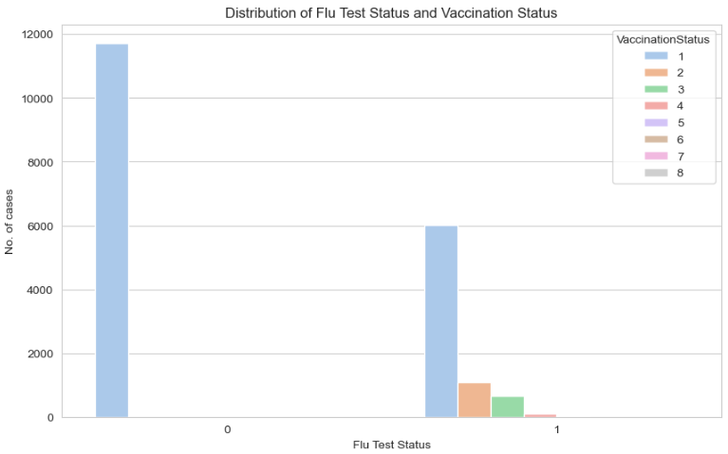
Proposed Hypothesis
Hypothesis 16 : Distribution of Flu Test Status by Vaccination Status.
1 0
Department of Computer Science and Engineering,
KLE Technological University’s Dr. M. S. Sheshgiri College of Engineering and Technology, Belagavi

Slide 60
Proposed Hypothesis
Hypothesis 16 : Distribution of Flu Test Status by Vaccination Status.
Finally, we conclude by analyzing the distribution of flu test status by vaccination status, reinforcing the critical role of vaccination in flu prevention and control.
Inference:
The people who are not vaccinated have high changes of tested positive for Flu.
The correlation between FluTestStatus and VaccinationStatus is positive and strong with 0.36.
Department of Computer Science and Engineering,
KLE Technological University’s Dr. M. S. Sheshgiri College of Engineering and Technology, Belagavi

Slide 61
MOOC Course Details
Team No. : EDA-14
Div: B
Sl. No. | Name | SRN. | Course Name | Course Link | Status
1 | Anuj Kanamadi | 02FE22BCS020 | Python for Data Science | https://www.udemy.com/course/python-data-science-master-course/ | Completed
2 | Regina Fernandes | 02FE22BCS081 | Python for Data Science | https://www.udemy.com/course/python-data-science-master-course/ | Completed
3 | Saniya Kadarbhai | 02FE22BCS106 | Python for Data Science | https://www.udemy.com/course/python-data-science-master-course/ | Completed
4 | Shreya Miskin | 02FE22BCS125 | Python for Data Science | https://www.udemy.com/course/python-data-science-master-course/ | Completed
Department of Computer Science and Engineering,
KLE Technological University’s Dr. M. S. Sheshgiri College of Engineering and Technology, Belagavi

Slide 62
Thank you !
Department of Computer Science and Engineering,
KLE Technological University’s Dr. M. S. Sheshgiri College of Engineering and Technology, Belagavi

