Slide 1



Analyzing Agriculture Productivity Across Indian States

Slide 2

Learning Objectives
To understand the agricultural productivity trends across different Indian states.
To analyze the impact of rainfall, fertilizer, and pesticide usage on crop production.
To identify which crops and states contribute most to total agricultural output.
To derive insights that help improve agricultural efficiency and resource allocation.
GOAL
Source :
www.freepik.com/

Slide 3
Tools and Technology used
Power BI:
For data visualization and dashboard development
Excel/CSV:
For data preparation and cleaning
Power BI Filters & Slicers:
For dynamic state and seasonal analysis

Slide 4
Methodology
Data Collection:
Gathered data on rainfall, fertilizer use, pesticide application, crop production, and state-wise contributions.
Data Cleaning:
Removed inconsistencies and handled missing values.
Dashboard Development:
Created interactive visuals like pie charts, bar graphs, and trend lines.
Analysis:
Performed multi-level filtering by state, season, and crop to derive insights.

Slide 5
Problem Statement:
How can Indian states improve agricultural productivity while optimizing the use of fertilizers, pesticides, and natural resources like rainfall?

Slide 6
Solution:
Developed an interactive Power BI dashboard to:
Track average and total production by crop and state
Compare fertilizer and pesticide usage
Analyze seasonal crop trends
Identify crops with high input vs. output efficiency
Highlight production contributions by key states and crops

Slide 7
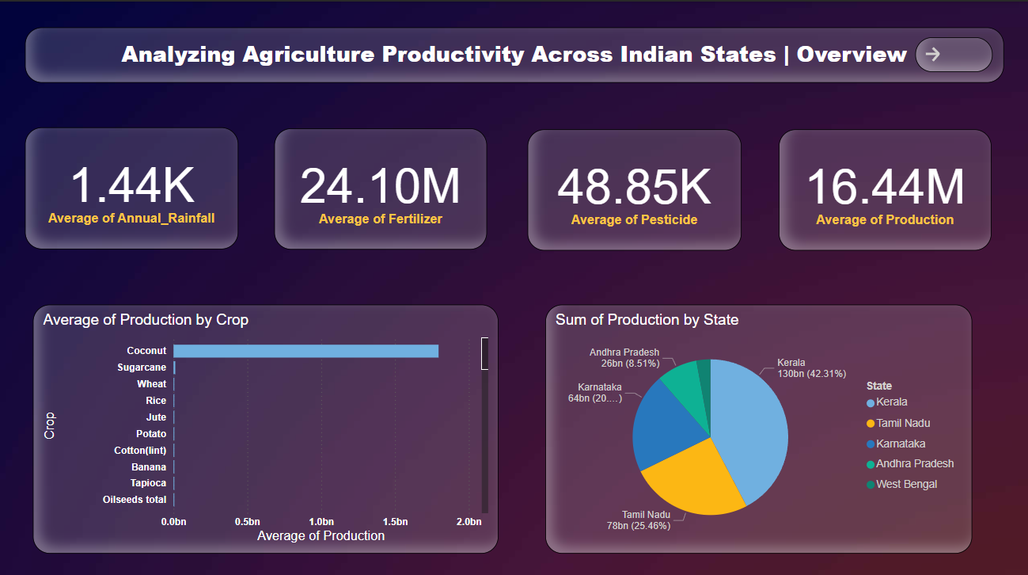
Screenshot of Output:
Overview of Agricultural Productivity

Slide 8
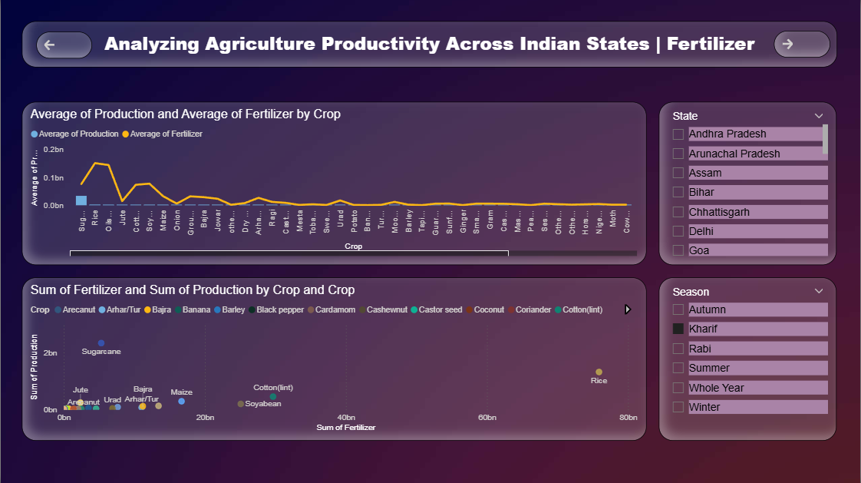
Screenshot of Output:
Fertilizer and Crop-Wise Analysis

Slide 9
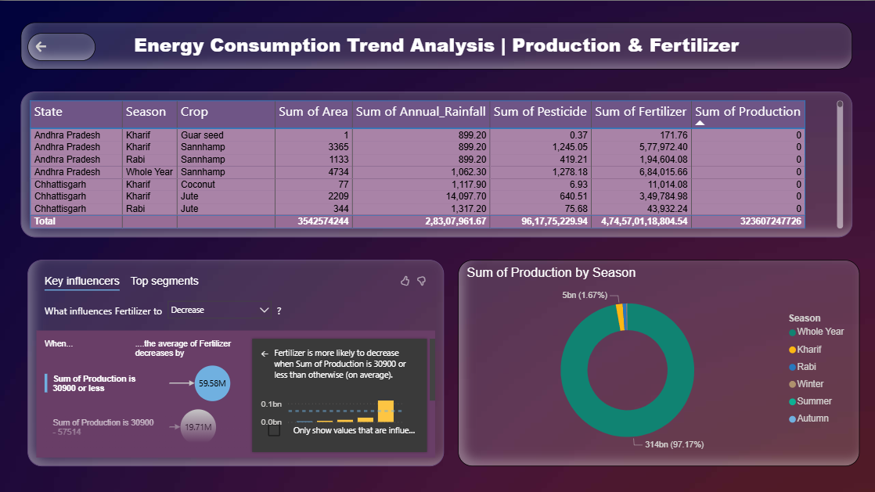
Screenshot of Output:
Energy Consumption and Seasonal Production Trends

Slide 10
Conclusion:
Kerala is the highest contributor to total crop production (~42%)
Coconut is the most productive crop by volume
Higher fertilizer usage doesn't always result in higher yield
Whole Year season dominates overall production (~97%)
Insights can help optimize input usage and focus on high-yield states and crops for better planning and sustainability

