Slide 1
HyperCasual Crowd Runner Game

Slide 2

Hello!
I AM SANJA GIGOVA
Passionate Fortnite player

Slide 3
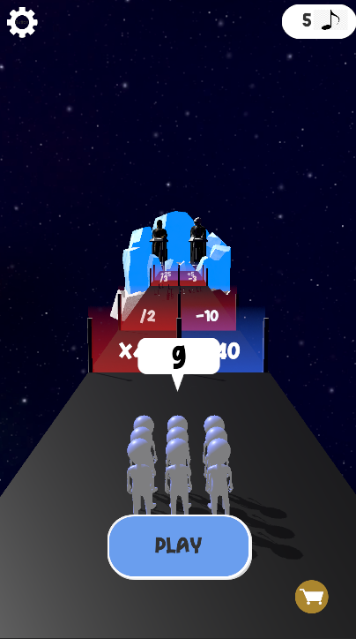
Game instructions
Galaxy Game
The lack of games played in the Galaxy, inspired me to develop this game. With its stunning visuals, immersive gameplay, living universe to explore, The Galaxy Game offers an unparalleled gaming experience for space enthusiasts and adventure seekers alike.

Slide 4
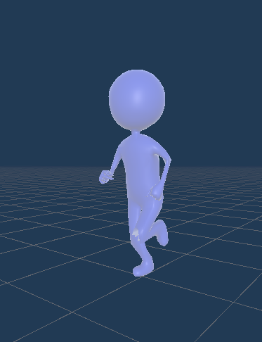
1.Runner
3D Hyper casual character in Unity with a collider, material and two animations
The character has two animations(Idle, Running)
The player movement is made with a Script(PlayerController) and Animator.
"ManageControl" function handles player controls in Unity. When the player presses and holds the left mouse button, the function calculates the player's movement based on the mouse positions. During the movement, the player is constrained within predefined boundaries of the road.

Slide 5
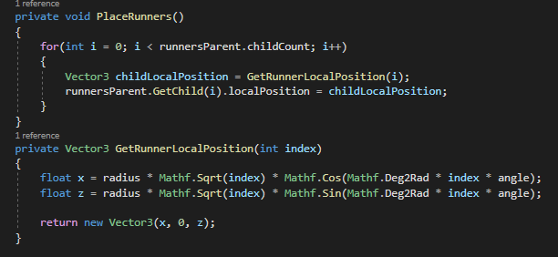
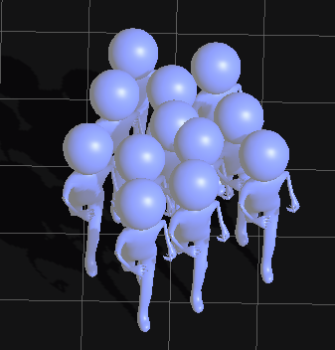

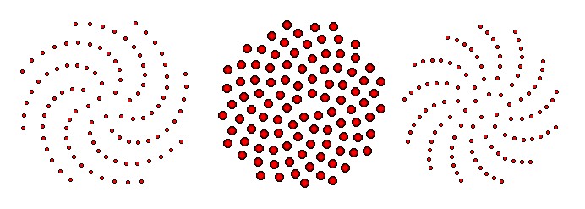

2.Crowd
The crowd was created with the Fermat spiral using the golden angle.
This patter can be seen in nature, in the sunflower

Slide 6
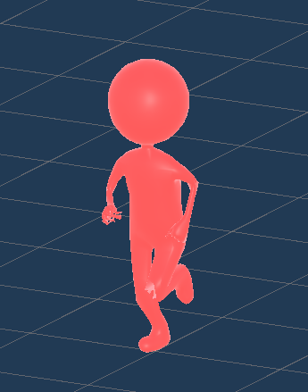
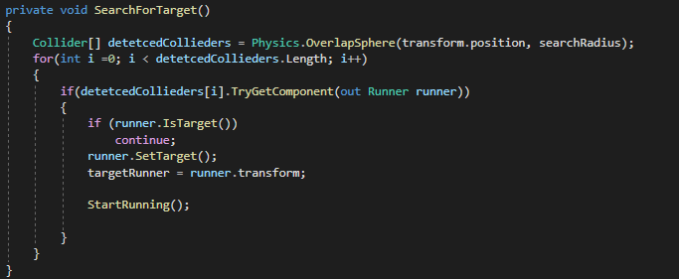
3.Enemies
The enemy unit is designed to engage the player in combat. It follows a specific behavior pattern where it will continuously check the distance between itself and the player.
If the player is within the attack range of the enemy, the enemy will initiate an attack.
The attack range determines the maximum distance at which the enemy considers the player close enough to launch an attack.

Slide 7
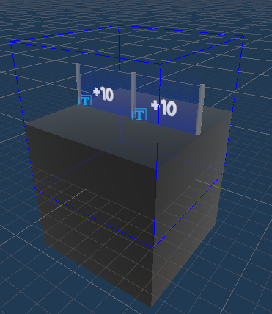
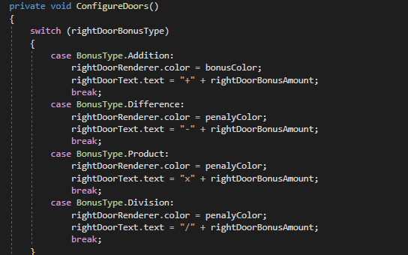
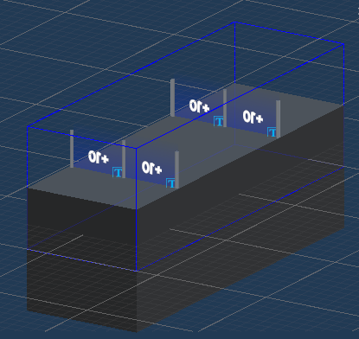
4.Doors and Chunks
Using two gates on the pathway, each capable of collecting, subtracting, multiplying, or dividing the total number of players
2 colors -blue for addition and product
-red for difference and division

Slide 8

5.Mysic Coins
Music symbols are prominently featured throughout various levels, enticing players to collect and save them as valuable currency. By accumulating these symbols, players can unlock and purchase an array of captivating skins and customization options for their characters, enhancing their overall gaming experience.

Slide 9
6.Levels
This game offers a dynamic gameplay experience with multiple levels, each featuring unique doors, varying numbers of enemies, and a collection of music coins. It utilizes a scriptable object array to define the levels, allowing for seamless progression as one level ends and another begins. Notably, the coins collected in the previous level persist and carry over to the next level, ensuring the player's progress is maintained.
Within the script, diverse chunks are generated to construct the levels, providing a sense of variety and unpredictability in each playthrough. Furthermore, the inclusion of music coins adds an extra layer of engagement, incentivizing players to explore and collect them throughout the game.

Slide 10
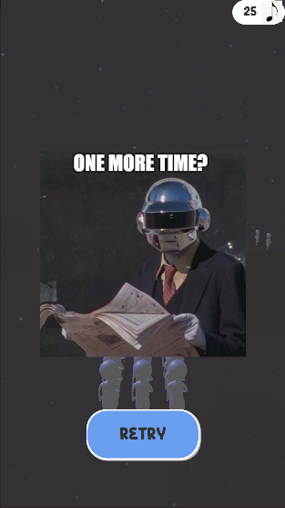
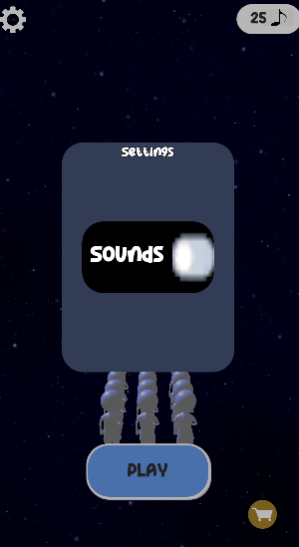
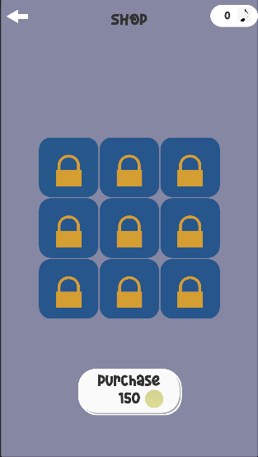
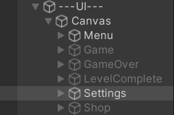
8.UI
On the Canvas, a visually appealing layout awaits you with six distinct panels, each accompanied by a button that beckons to be pressed. But these panels offer more than just visual appeal. They proudly display the fruits of your in-game efforts – the coveted music coins you have amassed throughout your gaming journey.

Slide 11
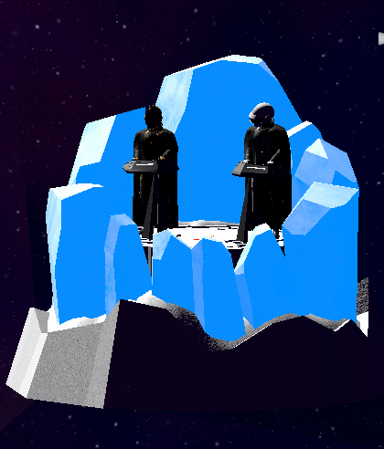

9.Daft Punk Models
I've chosen my favorite band to be the constant background melody, infusing each moment with their captivating tunes.
Also I have animated models of them playing the music.

Slide 12

I HOPE YOU LIKED IT!!!

