Slide 1
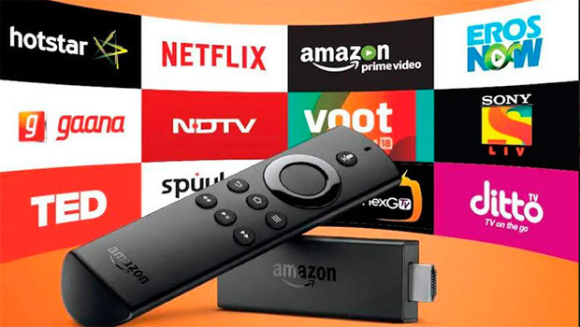
Customer Categorization
Sanjana Panda

Slide 2
The Problem
The boom of internet has given OTT Platforms accessibility to a large audience.
Created potential in the market but the conversion rate is not as high.
Websites have their customer activity data that can be used to improve customer improvement.
Aim is to investigate customer category based on activity.

Slide 3
Data
Data was collected from HackerEarth Amazon Hackathon.
Train Data: 10738
Test Data: 7160
Customers are scored based on their online activities. And these scores can help in predicting Customer Category.

Slide 4
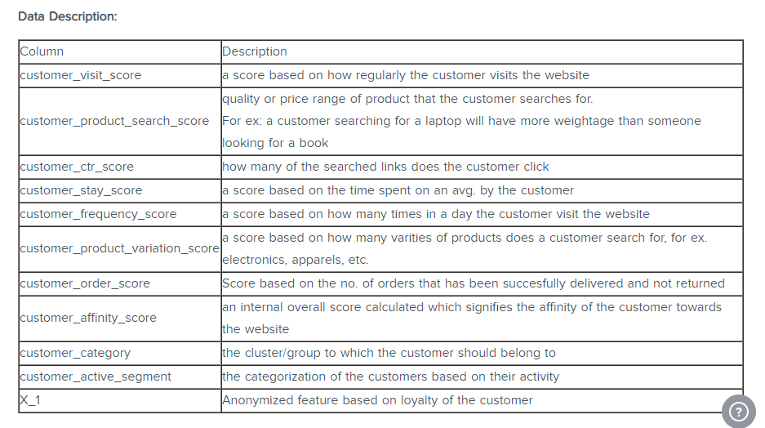
Data

Slide 5
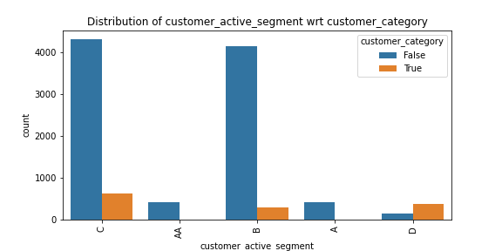
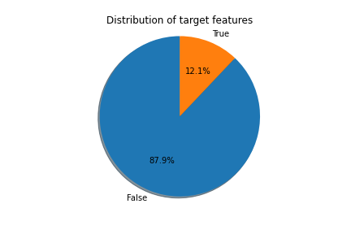
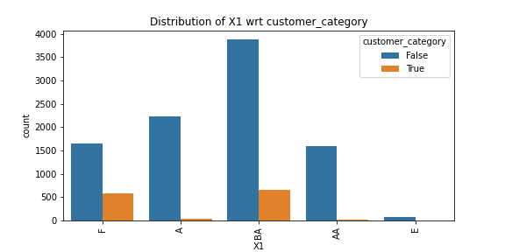
Exploratory Data Analysis
Imbalance Data with a ration of 3:22

Slide 6
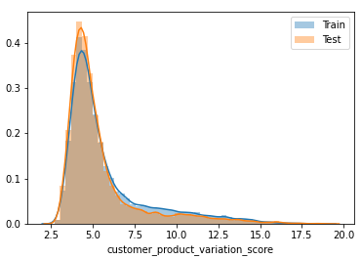
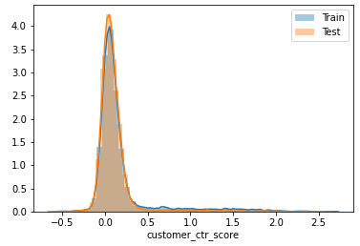
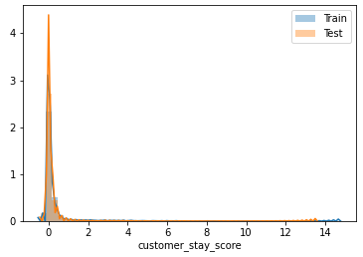
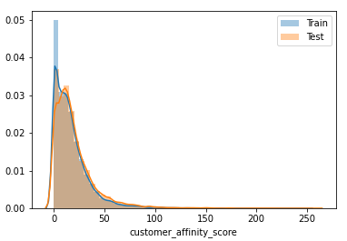
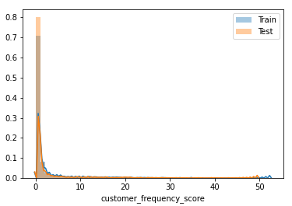
Exploratory Data Analysis
Most of the Continuous Variables are highly skewed.

Slide 7
Machine Learning Modelling (Overview)
Type: Supervised Learning and Binary Classification
Most of the continuous values are skewed.
Highly Imbalance Data: 12% True and 88% is False.
Tools: Python’s Scikit Learn and Imblearn

Slide 8
Machine Learning Modelling (Modelling step)
Data Preprocessing
Splitting Data
Modelling
Used Yeo Jonson technique to deal with skewed variables.
One Hot Encoding for Categorical Variables.
Split Data to Train and Validation set in 70:30 ratio
Apply model with Cross Validation using Train dataset
Pick Final Model
Standardization of Numeric Variable
Use Class Weight, Near Miss or SMOTE to deal with imbalance.
Use macro Precision Score as metric for comparing models.
Use Validation Set to select final model.

Slide 9
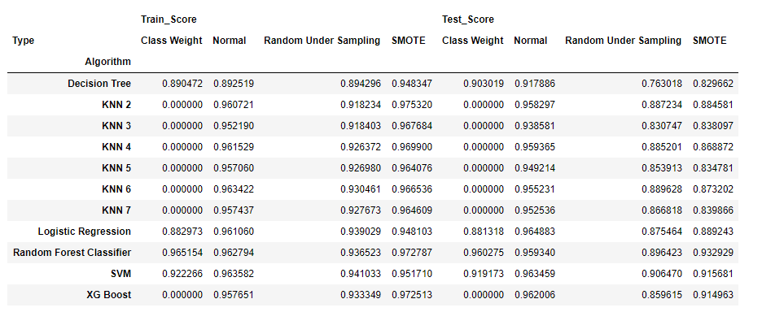
Logistic Regression and SVM performs well on both train and test data.
As expected as most of the features are continuous variables hence algorithms LR and SVM performs well.
A simple algorithm performs well because we are considering macro precision scores.

Slide 10
Statistical Test
Null Hypothesis: All columns are significant for prediction of target variables.
All columns have a p_value less than 0.05.
Hence we have failed to disprove Null Hypothesis.
Correlation Matrix:
‘customer_affinity_score’ is highly correlated to ‘customer_frequency_score’ .
Hence ‘customer_affinity_score’ is dropped while using Logistic Regression.

Slide 11
Future Improvement
Observations
‘customer_ctr_score’ has highest importance. If customer finds the content they are looking for, it will influence engagement.
Using a better metric than macro precision metric score like F1 .
Can perform customer segmentation and analyze customer demography.
Creating Recommendation system.

