Slide 1

Online Shopper Intention
Sanjana Panda

Slide 2
The Problem
The boom of internet has given e-commerce websites accessibility to a large audience.
Created potential in the market but the conversion rate is not as high.
Websites have their customer activity data that can be used to improve customer improvement.
Aim is to investigate the conversion rates and understand what is happening.

Slide 3
Data
Data was collected from Kaggle.
The dataset consists of feature vectors belonging to 12,330 sessions.
Each session belongs to a different user in a 1-year period to avoid any tendency to a specific campaign, special day, user profile, or period.

Slide 4
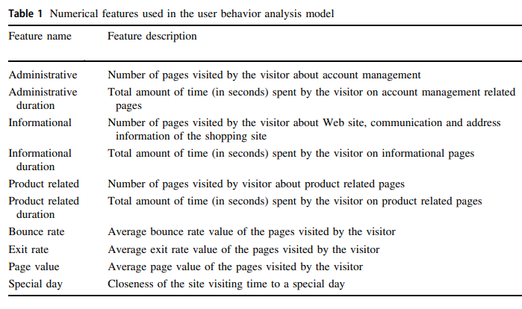
Data

Slide 5
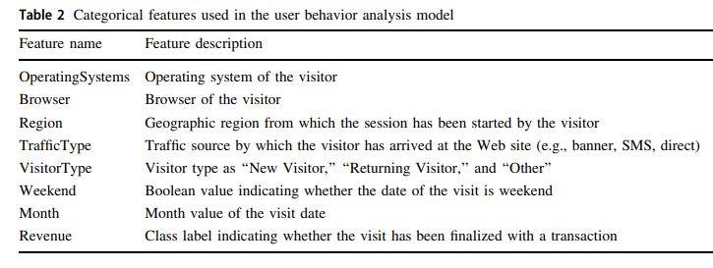

Slide 6
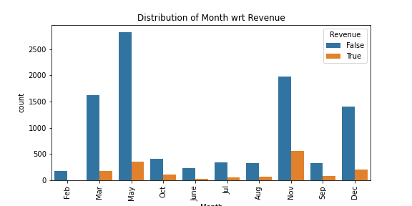
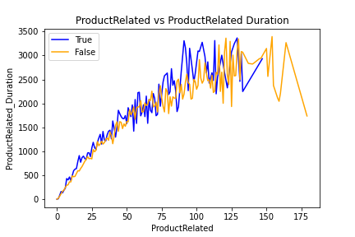
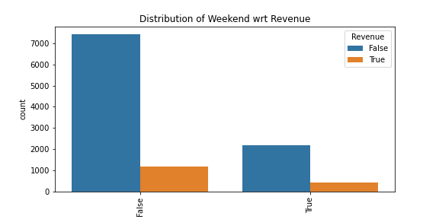
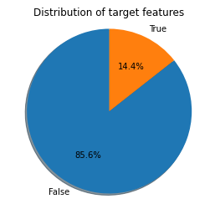
Exploratory Data Analysis

Slide 7
Machine Learning Modelling (Overview)
Type: Supervised Learning
Classification: True for Revenue generated, False for not.
Highly Imbalance Data: 14% True and 85% is False.
Tools: Python’s Scikit Learn and Imblearn

Slide 8
Machine Learning Modelling (Modelling step)
Data Preprocessing
Splitting Data
Modelling
One Hot Encoding for Categorical Variables.
Split Data to Train and Validation set in 90:10 ratio
Apply model with Cross Validation using Train dataset
Pick Final Model
Standardization of Numeric Variable
Use Class Weight, Near Miss or SMOTE to deal with imbalance.
Use F1 score as metric for comparing models.
Use Validation Set to select final model.
Use hyper parameter tuning and feature selection to tune well performing model.

Slide 9
Machine Learning Modelling (Model Comparison)
 | Class Weight | Class Weight FS | Under Sample | Under Sample FS | Over Sample | Over Sample FS
Logistic Regression | 0.63372093 | 0.642507346 | 0.627973359 | 0.640155189 | 0.595135908 | 0.638633377
Decision Tree | 0.559038698 | 0.560550389 | 0.532808209 | 0.536235 | 0.586149146 | 0.567097454
Random Forest | 0.632481316 | 0.644842344 | 0.656502732 | 0.652125218 | 0.692403333 | 0.688472191
XG Boost | 0.653234358 | 0.662460568 | 0.63176575 | 0.621172353 | 0.650366748 | 0.678403756
SVM | 0.653444676 | 0.652892562 | 0.635014837 | 0.628683694 | 0.659062104 | 0.671361502
Random Forest performs better in general.

Slide 10
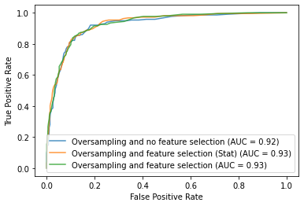
Machine Learning Modelling (Model Comparison)
Random Forest with over sampling (SMOTE) and Feature Binning performs the best.
F1 Score of 72

Slide 11
Assumption, Limitation and Disclaimers
We have data for only a year.
Each data point is for a unique customer, so can’t get more details on customer visit.
No data on customer demography, eg. Gender, Age etc.

Slide 12
Future Improvement
Can perform customer segmentation and analyze customer demography.
Analytics on Product cost optimization.
Creating Recommendation system.

